Slide 1
Sign Language Translator Using Machine Learning
R.M.D ENGINEERING COLLEGE
DEPARTMENT OF ELECTRONICS AND COMMUINICATION
Presented By
Mavuluru Viswajith Reddy (111515106083)
Kollipara Hemanth Gupta (111515106064)
Malepati kalyan Kumar Chowdary (111515106076)
Madana Naren Guru Sai (111515106070)
Under The Guidance Of
Dr. Helenprabha

Slide 2
ABSTRACT
The communication between normal person and deaf/dumb person is always challenging task.
Sign language is the main communication medium of the impaired people. It contain gestures instead of sound to elaborate the meaning.
Our project aims to bridge this gap by enabling communication between dumb/deaf people on one side and common people on other.

Slide 3
WORKING PROCESS
The Samples of the gesture are collected and stored in the form of records
When the Actions are been performed the system will collect the data.
Prediction will be done depending on the collected samples and the collected data

Slide 4
MACHINE LEARNING
Machine learning (ML) is the scientific study of algorithms and statistical models that computer systems use to effectively perform a specific task without using explicit instructions, relying on models and inference instead. It is seen as a subset of artificial intelligence.
Machine learning algorithms build a mathematical model of sample data, known as "training data", in order to make predictions or decisions without being explicitly programmed to perform the task. Machine learning is closely related to computational statistics, which focuses on making predictions using computers. Machine learning is also referred to as predictive analytics.

Slide 5
Arduino Nano
The Arduino Nano is a small, complete, and breadboard-friendly board based on the ATmega328P (Arduino Nano 3.x). It has more or less the same functionality of the Arduino Duemilanove, but in a different package. It lacks only a DC power jack, and works with a Mini-B USB cable instead of a standard one.
Flex Sensor
This flex sensor is a variable resistor like no other. The resistance of the flex sensor increases as the body of the component bends.
MPU6050
The MPU-6050 Motion Tracking devices designed for the low power, low cost, and high-performance requirements of smartphones, tablets and wearable sensors.

Slide 6
FEATURES
It can store the Samples in the form of records and can predict the outcome in fast and accurate way
Teaching new instructions is much simpler and doesn’t need any coding or technical skill.
Prediction rate can be increases by the load store of the records.
The Records can be easily shared with the devices with any cables.

Slide 7
REQUIREMENTS
Arduino Nano
Flex Sensors
Gyroscope
Accelerometer
Bluetooth Module
5V Battery Supply
Gloves

Slide 8
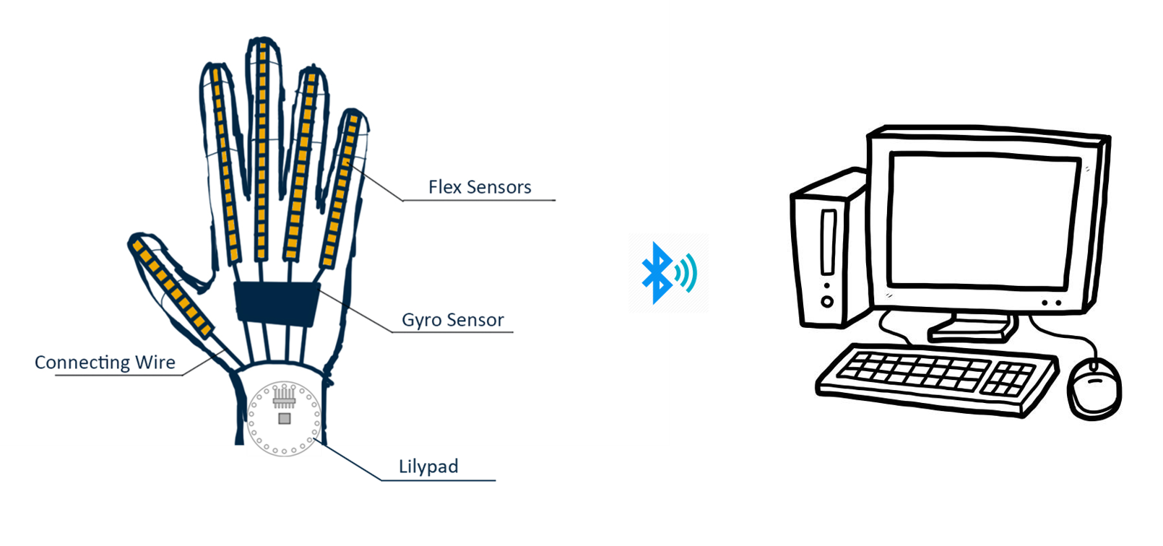
DESIGN PLAN

Slide 9
THANK YOU

