Slide 1
Introduction to Cloud Computing Unit 1- Day3 Enterprise computing
Prashant Kaushal

Slide 2
Recap
For scale / availability => Distributed Computing
For High Performance Computing => Cluster Computing
Grid Computing => similar to power grid, where the user does not have to worry about the source of the computing power
For Metering and Billing => Utility Computing

Slide 3
Enterprise Computing
Mainframe architecture
Client-Server architecture
3-tier architecture

Slide 4
Introduction
Enterprise computing been around for ~50 years
Use of computers for data processing..aka IS or IT
First users
Telecom domain
Finance domain .. Banks, insurance companies
Now , can’t imagine life w/o it
Get Scale, ubiquity of access
At a very high cost and complexity

Slide 5
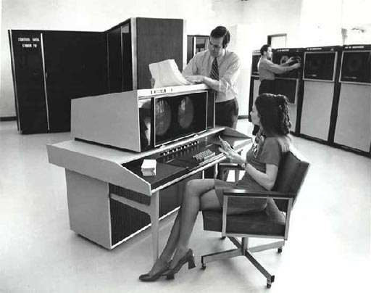
Mainframe Architecture

Slide 6
Mainframe Architecture
Enterprise computing picked up ~’60s
3rd gen computers
Used ICs instead of vacuum tubes
IBM System/360 ‘mainframe’ computer
Currently used IBM z-series
Until 80’s
Input -> punched cards
Output -> teleprinter
Later , CRT

Slide 7
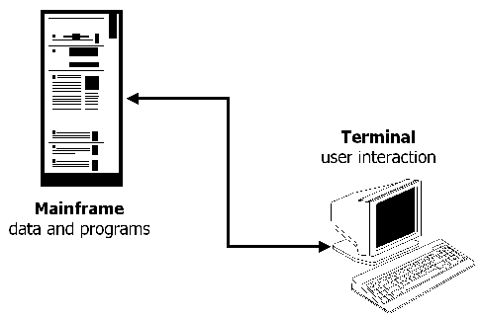
Mainframe Architecture
Terminal based UI
Screens controlled by mainframe server
Virtual Telecommunications Access Method (VTAM) for entering data and viewing information.
Terminals communicated using ‘Systems Network Architecture’ (SNA) instead of TCP/IP
Limited CPU power but great I/O

Slide 8
Mainframe Architecture
Batch architecture
minimize CPU utilization during data entry or retrieval
Data written to disk and processed by scheduled background tasks
Deposit money in bank a/c, reflected
Next day in ‘Batch-processing’
Now, almost instantaneous because of ‘Online’ transaction processing
Incorrect data entry, lots of corrective measure
As opposed to immediate data validations

Slide 9
Mainframe Architecture
Data storage
Structured files
Hierarchical or networked data model
RDBM came during 70s and became popular in 80s
Storage subsystem -> Virtual Storage Access Mechanism (VSAM)
Support for variety of file access
Indexing mechanisms
Concurrent data access using record level locking

Slide 10
Mainframe Architecture
Transaction Processing Monitors (TP-monitors)
Commit and roll back protocols to support atomic transactions in multi-user environment
TPF system used by the airlines industry has a very fast application embedded TP-monitor
Pioneered the concept of ‘Virtual Machines’
Could run multiple ‘guest’ OS
High level of automation
Fault tolerance
Hardware/Software
Fine-grained resource measurement, monitoring and error diagnostic capabilities

Slide 11
Client-Server Architecture
’80s -> microprocessor revolution
Mini computers running UNIX and C
Move some data processing tasks from expensive mainframes to inexpensive desktops
Desktops used for word processing and spreadsheets
Same desktop used for data processing as well
Terminals used on ‘data processing rooms’
RDBMS implementations like Oracle became popular

Slide 12
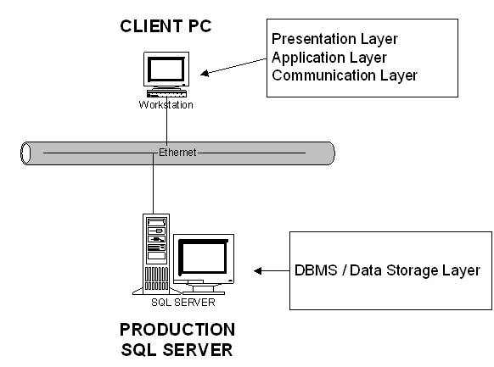
Client-Server Architecture

Slide 13
Client-Server Architecture
‘Forms’ architecture
Initially, use of terminals to access server side logic in C
Similar to mainframe architecture
CUI
Later, PC based forms application with GUI
Significant logic on client side
‘Fat-client’ architecture
Direct db calls using SQL/Net
Business logic on client

Slide 14
Client-Server Architecture
Provided ‘online’ systems, break away from mainframes / batch processing
GUI
Spawned various application software products like SAP-R/3
Siebel (CRM)

Slide 15
Client-Server Architecture
Limitations
Performance issues when the group grew
Many requests to the server to ‘paint’ the screen
Terminal based; only input and then final result
CICS, IMS -> ‘changed-data’ only
Global terminals connected to central mainframe
Issues with WAN deployment
Software upgrades
Application maintenance costlier with intermixed UI and business logic

Slide 16
3-tier Architecture
Limitations of client-server model
Not CPU power but lack of virtual machines or job control system
Not scale to many clients
10k connections
+
10k processes
+
5GB RAM
+
100k open files
10k clients

Slide 17
3-tier Architecture
Transaction-processing Monitors
Middleware
Sits between client and db server
Queuing client requests
TP Monitor
50 connections
+
50 processes
+
1GB RAM
+
500 open files
10k clients

Slide 18
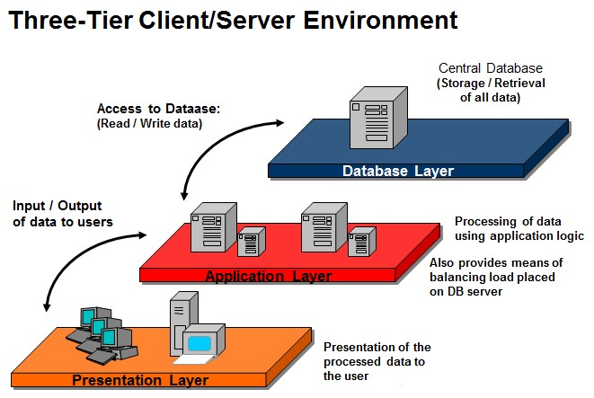
3-tier Architecture

Slide 19
3-tier Architecture
Various technologies
RPC
CORBA
DCOM
Separation of presentation and Business Logic
Load balancing using request queuing

Slide 20
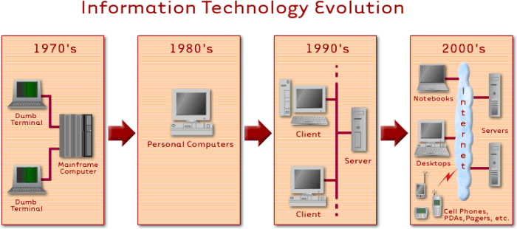
Enterprise Architecture

Slide 21
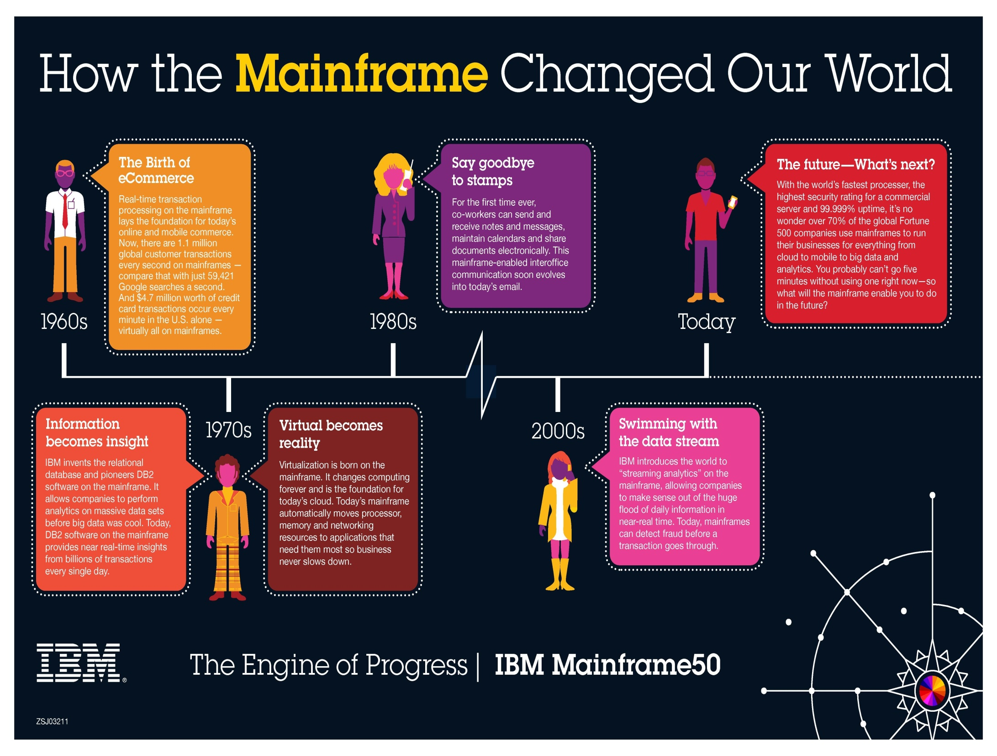

Slide 22
Thanks
Cloud computing is revolutionizing enterprise computing
Whatsapp -> 55 employees -> $19B valuation -> $350M per employee

