Slide 1
Introduction to Cloud Computing Unit 1- Day4 The Internet as a Platform
Prashant Kaushal

Slide 2
Recap
Mainframe architecture
Client-Server architecture
3-tier architecture

Slide 3
The Internet as a platform
Internet technology and web-enabled applications
Web application Servers
Web services, AJAX and mashups
Internet of Services

Slide 4
Internet Technology
Born as comms infra for data sharing between large gov research labs in US
Grew to cover acad institutes across the world
1993 -> NCSA Mosaic Web Browser => rapid expansion of Internet
Sharing documents
HTTP protocol
HTML developed by Tim Bernes Lee at CERN, Geneva, 1990
Using browser, information ‘published’ over the internet, can be accessed anonymously by public => WWW
Commercialization of web; dotCom boom

Slide 5
Web Applications
Rely fundamentally on HTTP and HTML
Standards defined by W3C
IE, Chrome, Mozilla ; servers viz IIS, httpd implement these standards
XML, SOAP etc -> other related technologies

Slide 6
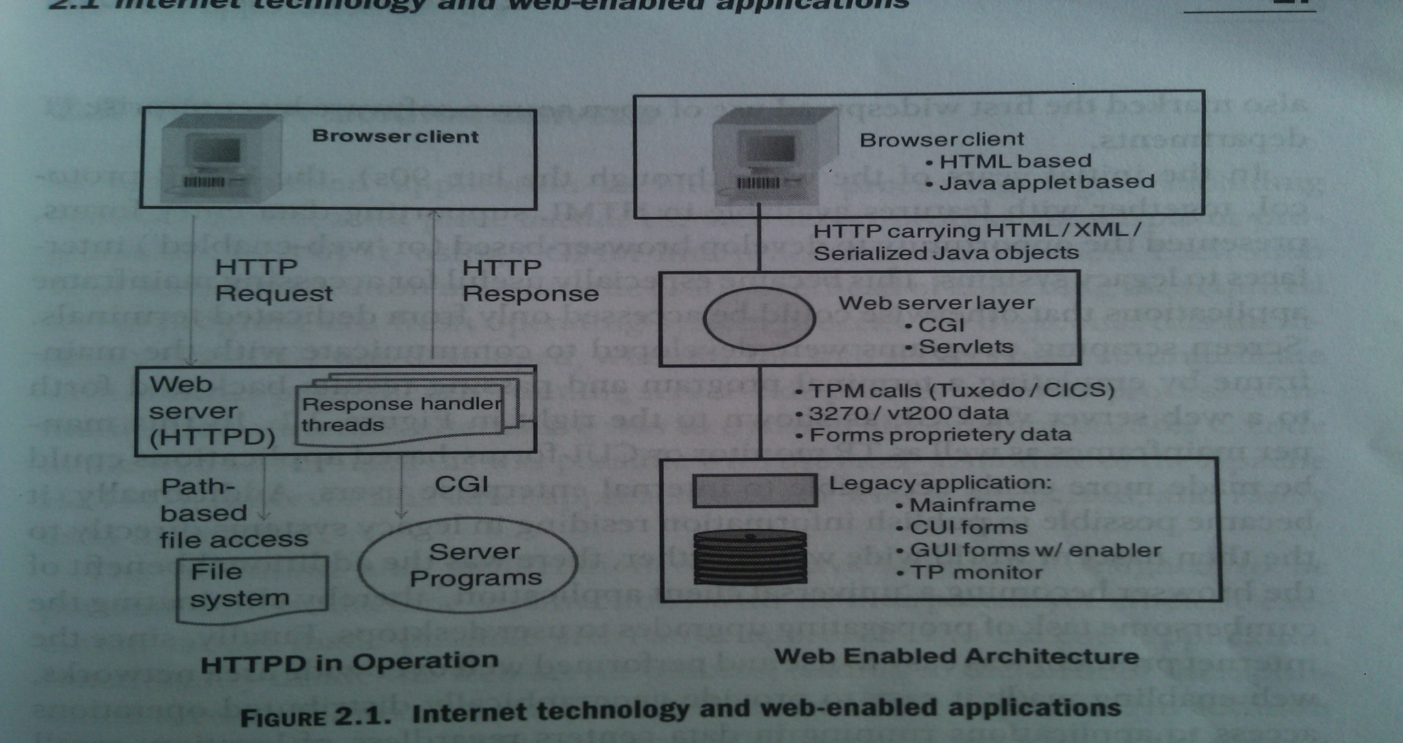
Web Applications

Slide 7
Web Applications
Wide-spread adoption encouraged by open source httpd
Apache community; feared that http protocol would become corrupted with proprietary extensions
http 1.0; http1.1; http2.0
SPDY

Slide 8
Web Applications
~90s
HTML -> data entry form support
Browser based i/f to legacy systems
Specially useful in accessing Mainframe applications
Replace dedicated terminals by ‘screen scraping’ programs emulating a terminal
Result to/fro a web server via CGI
Easy access to internal enterprise users
Also, publish some info to www
Browser -> universal client application
Eliminate upgrades to users
Location independence vis-à-vis client-server application
Client-server apps were difficult to ‘web-enable’

Slide 9
Web Applications
Key disadvantage
Limited UI behaviour
Security model
Hardware resources
Connection to legacy systems through variety of mechanisms
Newer set of problems

Slide 10
Web Application Server
Processing logic, db access o/s of web server
‘CGI-script’ overhead
Process creation
FastCGI
Another permanent process; IPC
Dynamic link application C code (mod_c module of Apache httpd)

Slide 11
Web Application Server
Java
Portable across machine architecture
Interpreted yet efficient execution model
Alternate approaches to execute application in web server
Birth of ‘Application Server’ architecture
Bring in advantage of 3-tier architeture

Slide 12
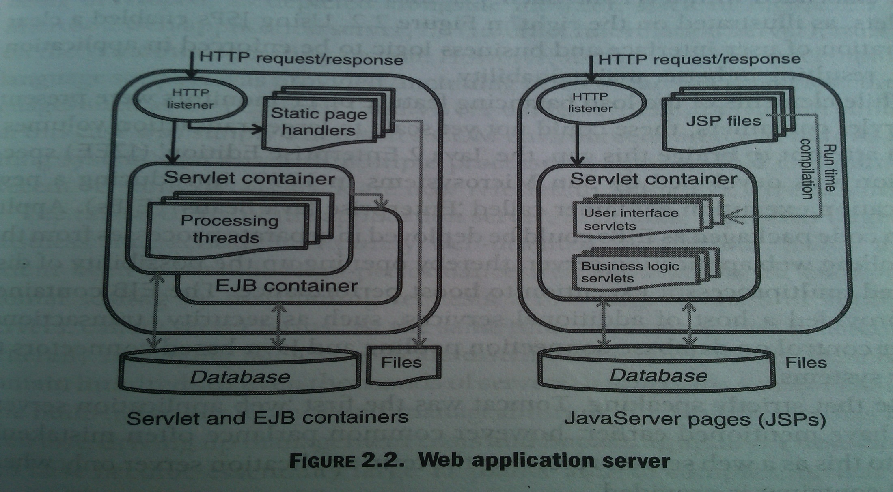
Web Application Server

Slide 13
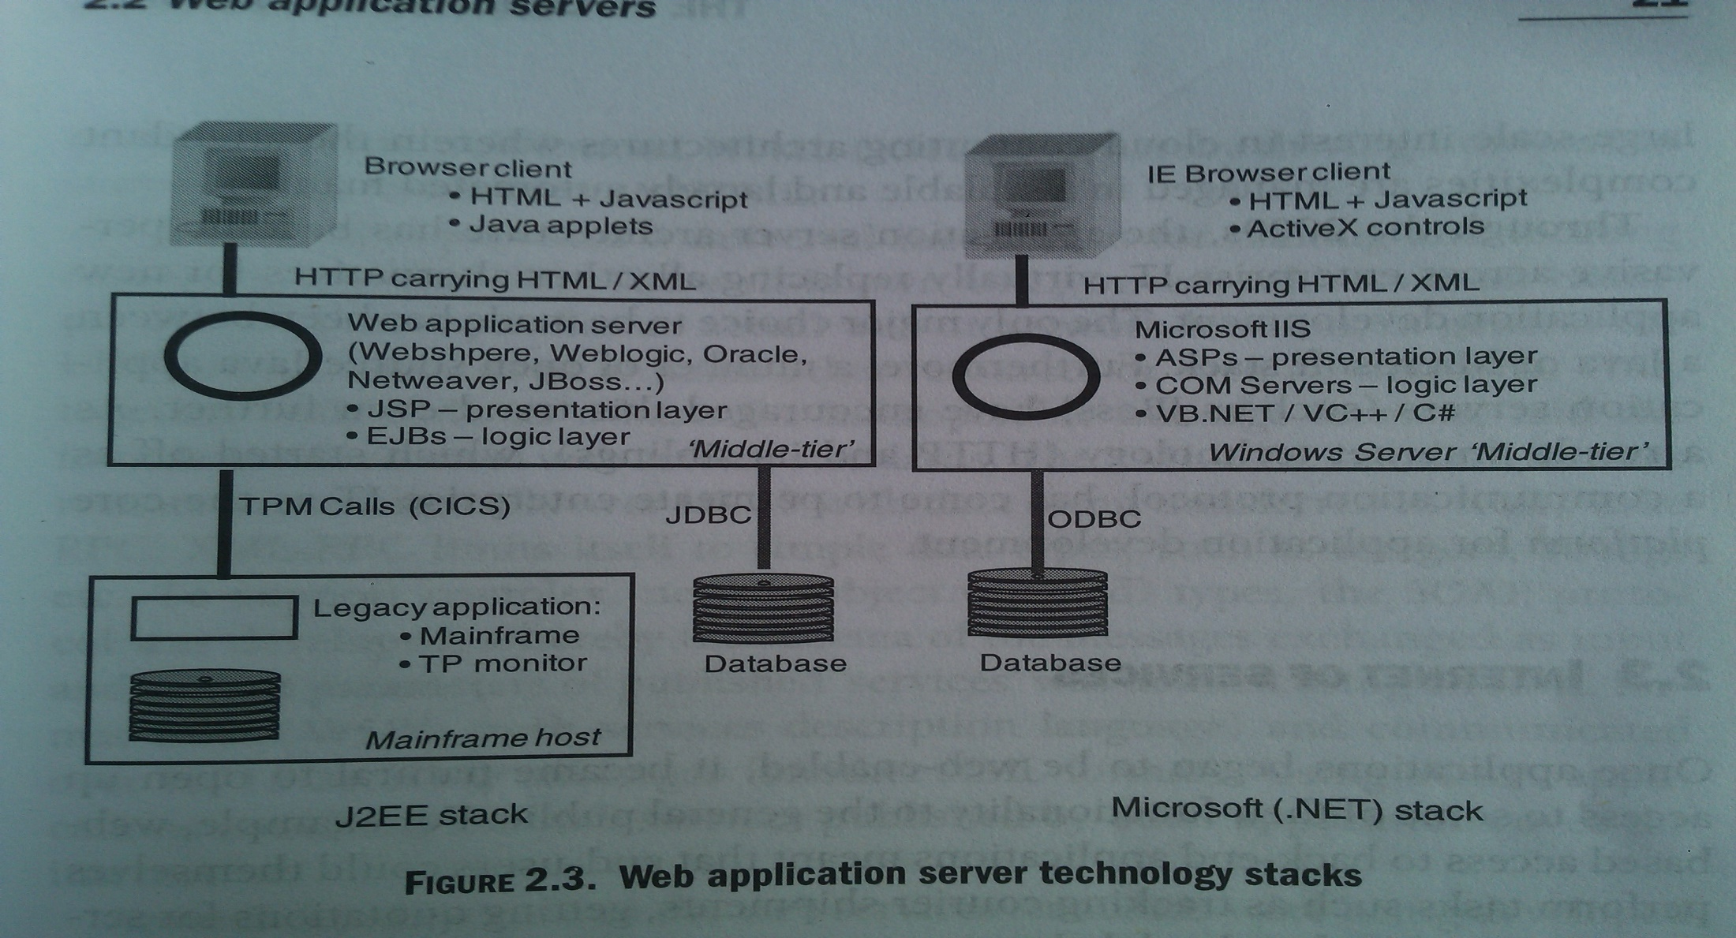
Web Application Server–TechStacks

Slide 14
Web Application Servers
Web-oriented 3-tier architecture; large scale business processing
Load balancing
Horizontal scaling; server farms; 100s – 1000s severs
Challenge
Huge volume
Downtime?
In-built fault tolerance and manageability of mainframes?
Increased management cost and lower agility
DataCenters ~ ‘IT Plants’ ~ Nuclear Power plants

Slide 15
Critical Web Technologies
Web Services
Request/Response across systems; no human tocuhpoint
AJAX
User-friendly web
Mashups
Single UI using multiple underlying i/f

Slide 16
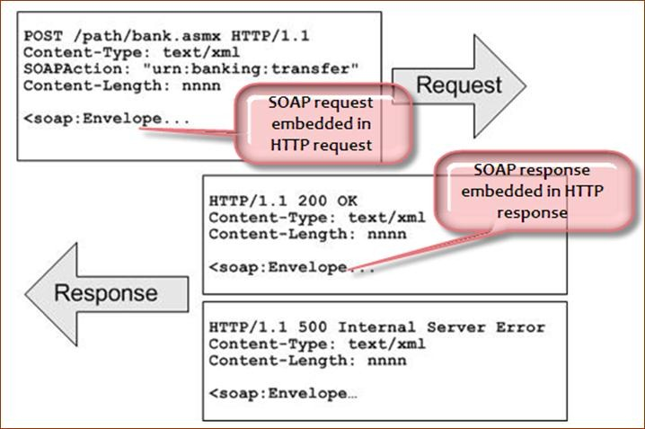
SOAP

Slide 17
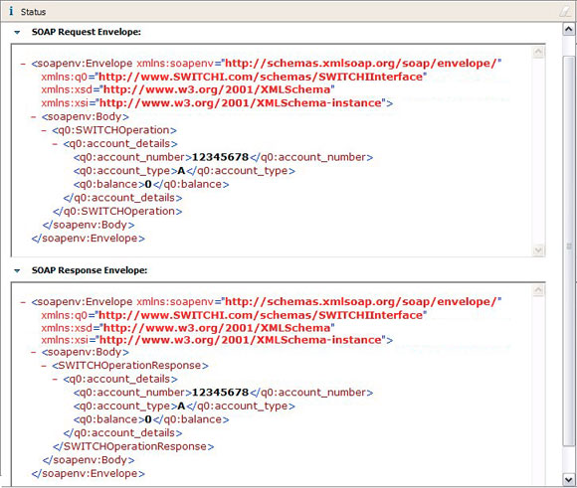
SOAP

Slide 18
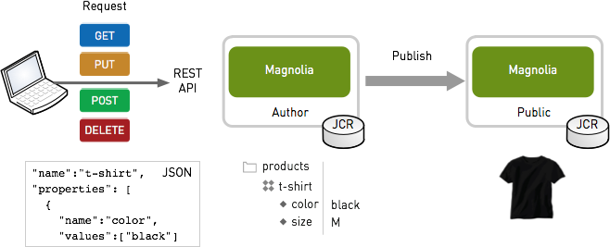
REST

Slide 19
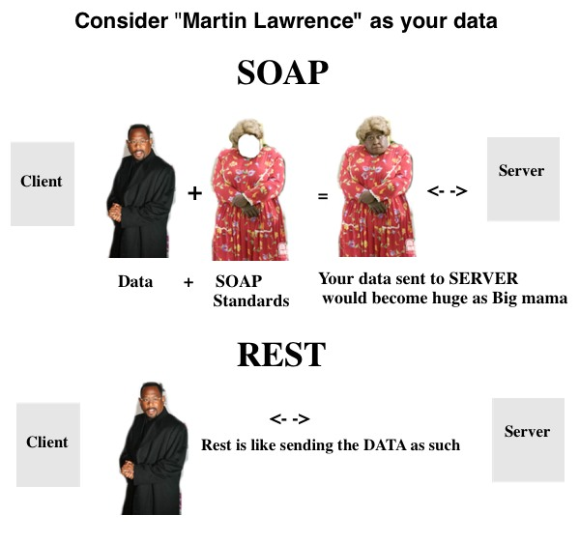
Web Services: SOAP v/s REST

Slide 20
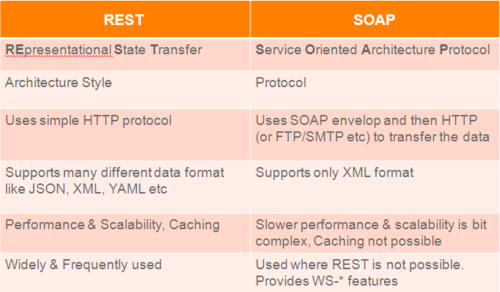
Web Services: SOAP v/s REST

Slide 21
AJAX
Traditionally
HTTP GET , POST
Page refresh upon each request/response
JavaScript
Mainly for client side validation, minor animation (hide/show)
Brower idle until response is received
User stuck
AJAX
Asynchronous Javascript and XML
Rich Internet Applications

Slide 22
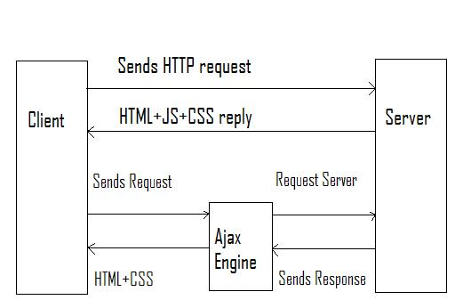
AJAX

Slide 23
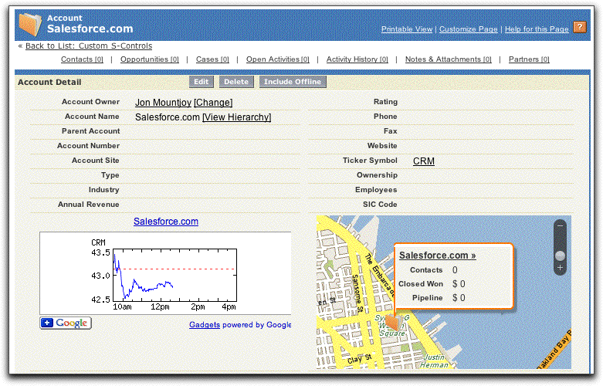
Mashups
Using AJAX, multiple webservices call simultaneously
UI left to JavaScript on the client
Mashup -> one level further
Presentation along with service

Slide 24
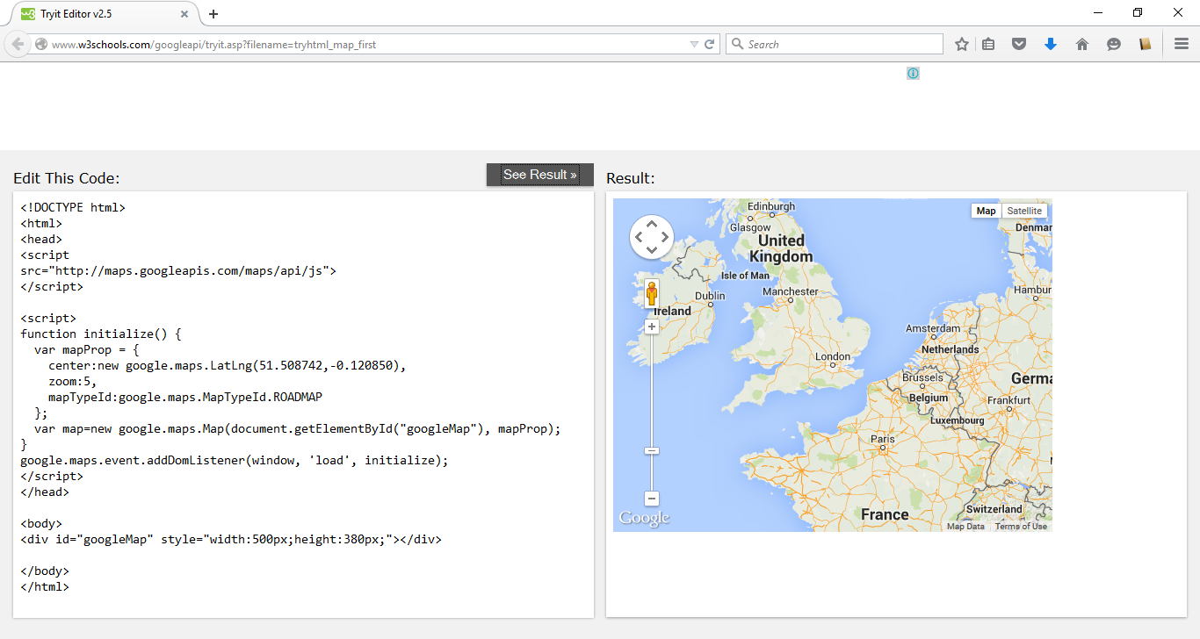
Mashups

Slide 25
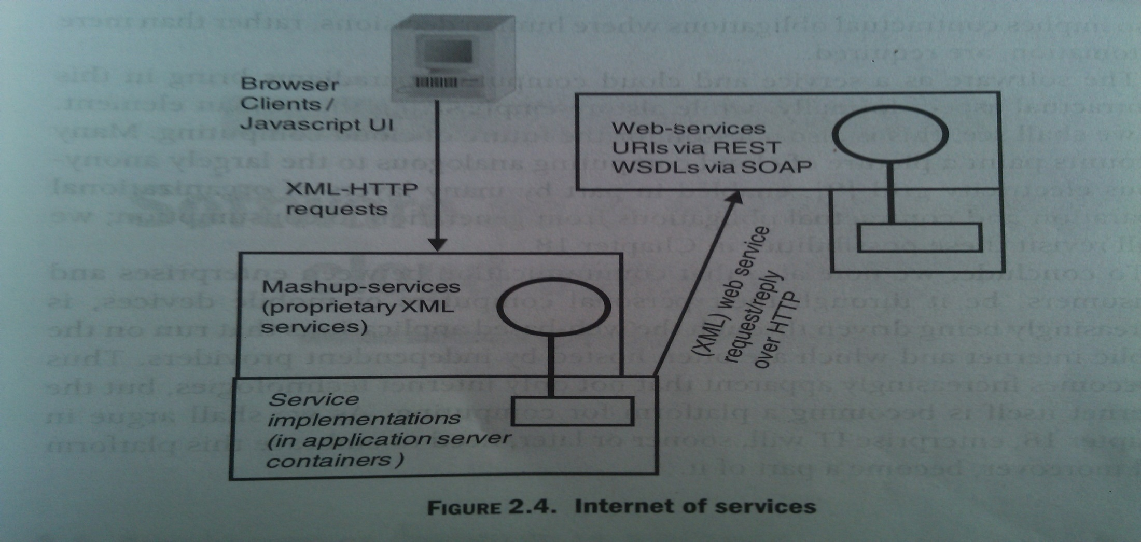
Internet of Services
Online shopping, payments … countless more

Slide 26

Internet of Things

Slide 27
Thanks

