Slide 1
Introduction to Cloud Computing Unit 1- Day5 Enterprise Architecture
Prashant Kaushal

Slide 2
Recap
Internet technology and web-enabled applications
Web application Servers
Web services, AJAX and mashups
Internet of Services

Slide 3
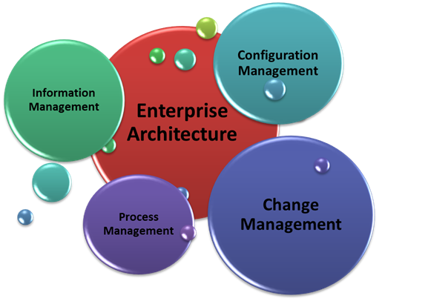
Enterprise Architecture
Enterprise data and processes
Enterprise components
Application integration and SOA
Enterprise technical architecture
Data centre infrastructure

Slide 4
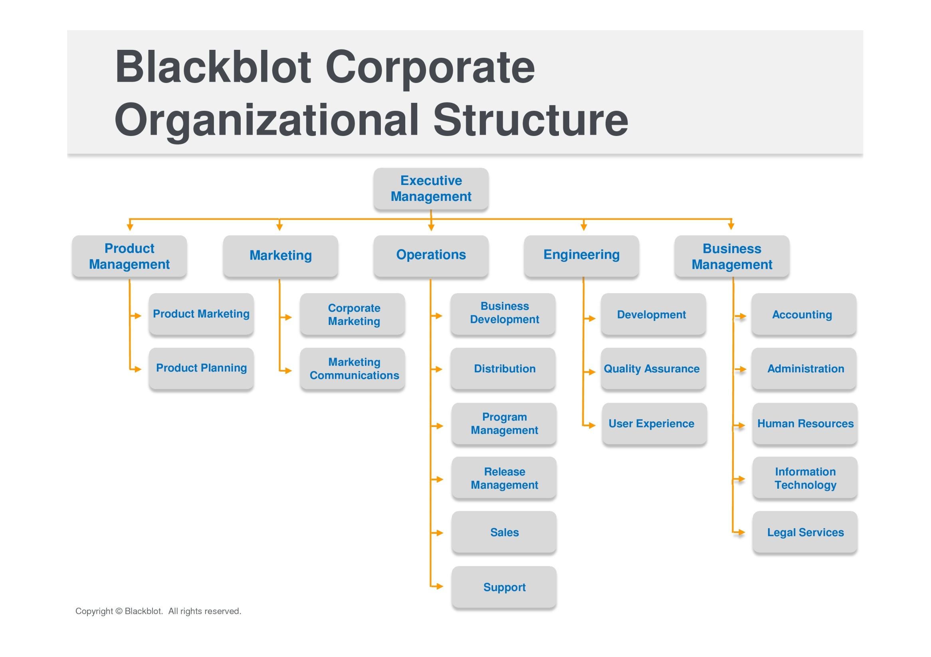

Slide 5
Enterprise Architecture
Continuously evaluate emerging architectures
Mainframes, Client-Server, 3-tier, cloud computing
Plan evolution of IT systems
‘Keep the lights on’
‘Balancing act’
Mixture of technology
Stability of systems and processes
New business requirements

Slide 6
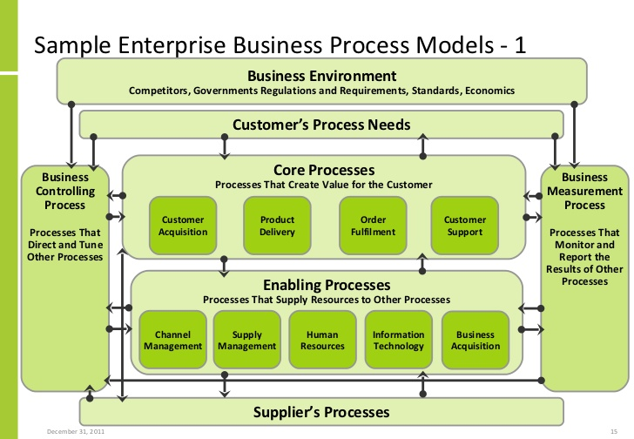

Slide 7
Enterprise Architecture
Conceptual blueprint that defines the structure and operation of an organization
High level holistic view
Created by mixture of business leaders, technical leaders and data custodians

Slide 8
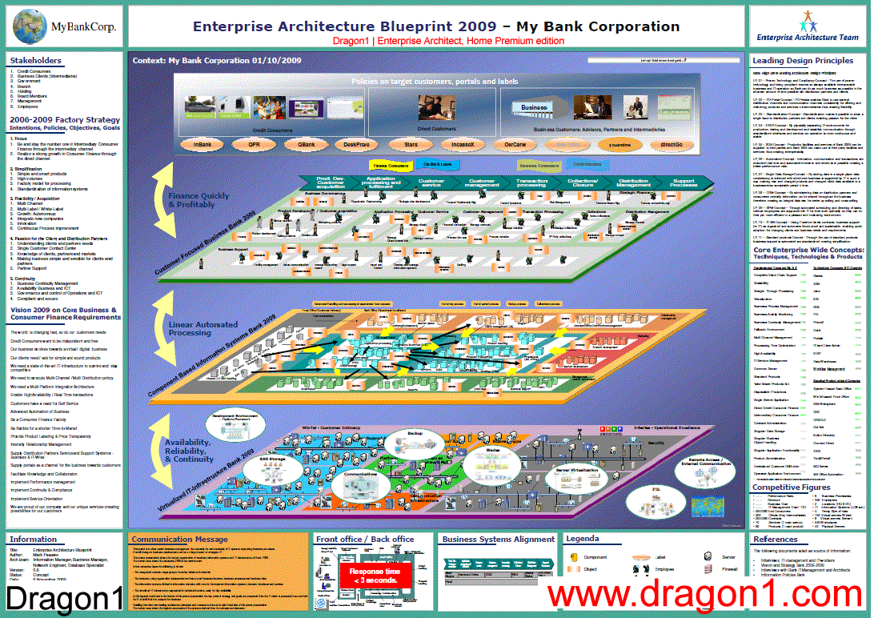

Slide 9
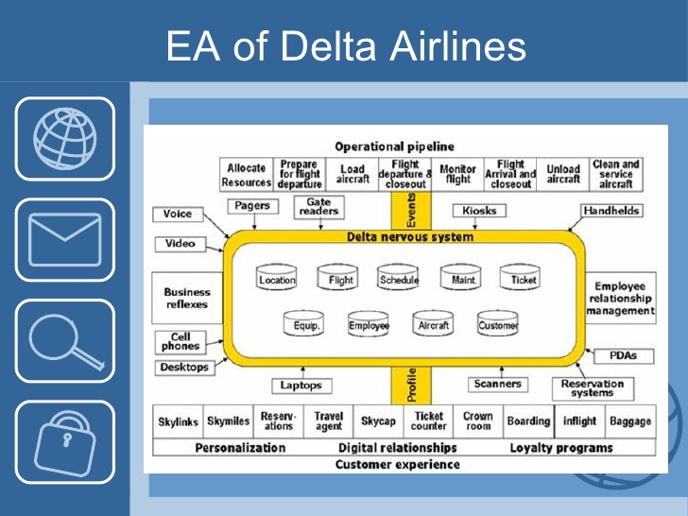

Slide 10
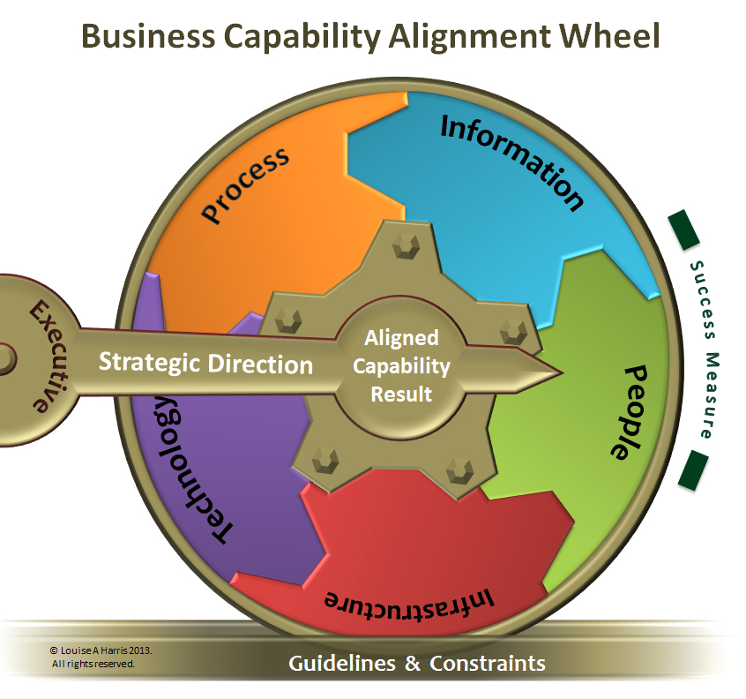
Enterprise Architecture
Description of all s/w
How they fulfil biz functions
Technical implementation
Communication with other systems
Defining and enforcing technical standards

Slide 11
Enterprise architecture
‘Operational-excellence’: emphasis on combination of supplier-facing (left-side) and self (centre) in Enterprise Canvas
‘Product-leadership’: emphasis on self (centre) in Enterprise Canvas
‘Customer-intimacy’: emphasis on customer-facing (‘right-side) in Enterprise Canvas

Slide 12
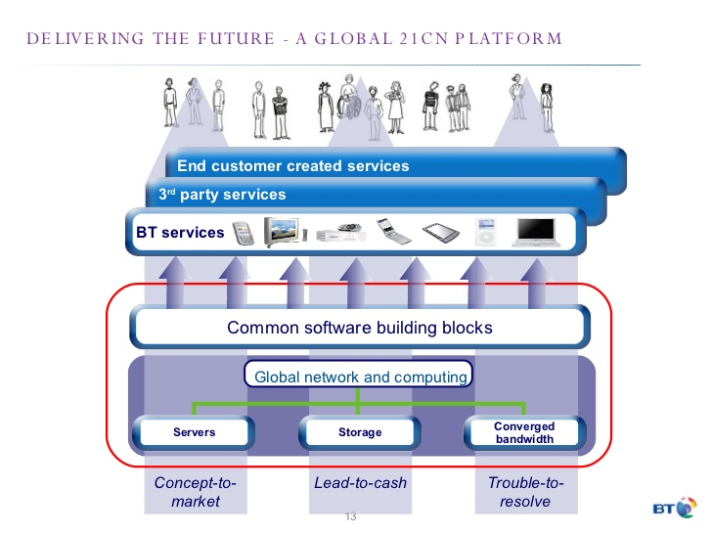

Slide 13
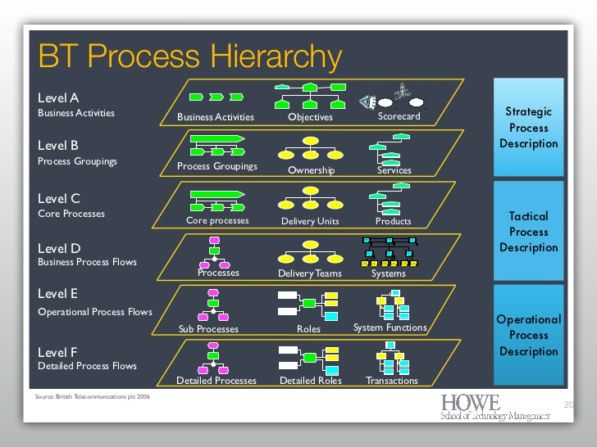

Slide 14
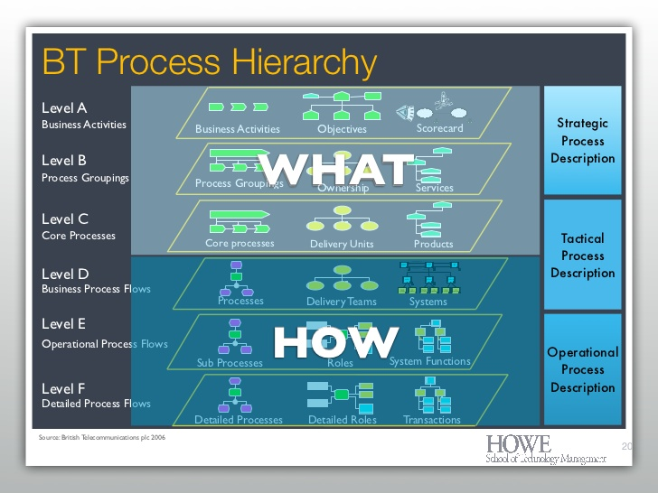

Slide 15
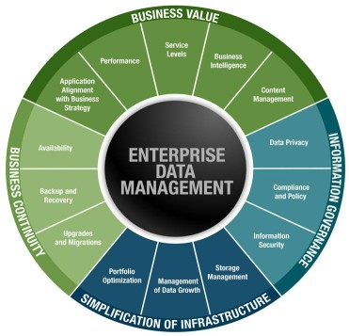
Enterprise data
Information systems -> keep track of core information
Customers
Inventory
Master data
Transactional data
Data retention
Data archival and purging

Slide 16
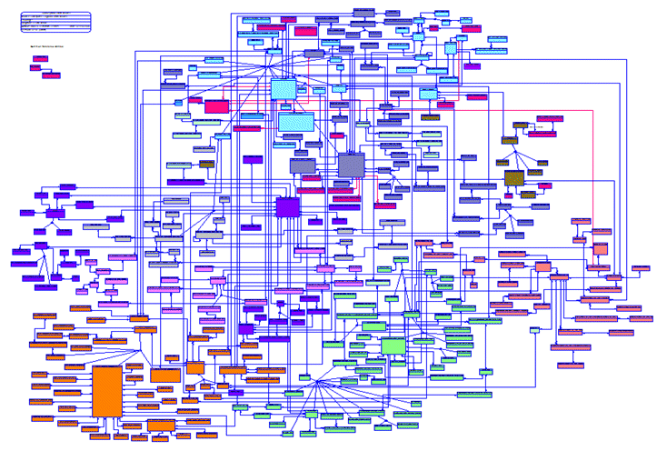
Enterprise data

Slide 17
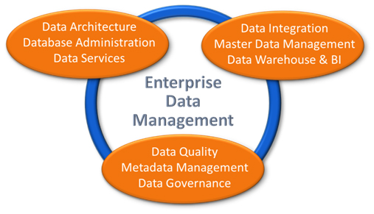
Enterprise Data Management

Slide 18
Enterprise process
Vertical
Operate within single organization function for eg sales or accounting
‘Lead to Order’ -> vertical process in Sales department
Horizontal
Cut across functional units
‘Order to Cash’ -> Spans sales, production and finance

Slide 19
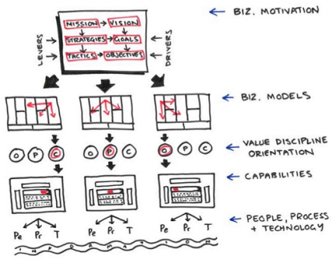
Enterprise process

Slide 20
Enterprise components
Component -> s/w subsystem that has well defined interfaces which can be used independently of its internal implementation
Leads to modularity
Makes it easier to evolve a large system by incrementally replacing its components

Slide 21
Enterprise components
Business Components
High level business processes ; vertical or horizontal
Application Components
Set of smaller processes
Information needs restricted to cohesive set of data for eg ‘customer data’ or ‘payment data’
Software components
‘Entity Component’
Deal with one enterprise entity
‘Process Component’
Business logic and workflow

Slide 22
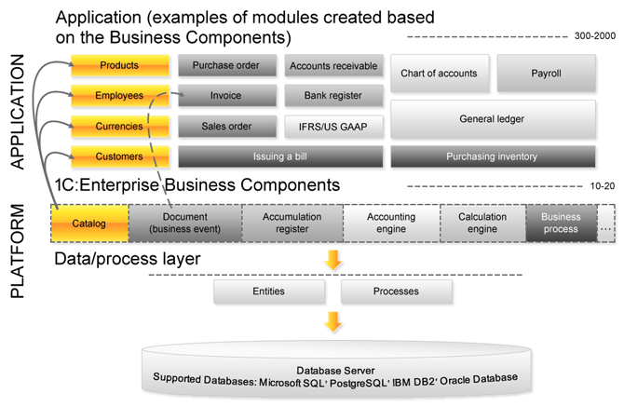
Enterprise components

Slide 23
Enterprise components
Set of application components -> Application System
Not each application system need to be custom built
Use COTS or OpenSource packages
Leads to overlap of functionality

Slide 24
Enterprise Application Integration
Multiple components / applications -> need to communicate
Never an exact break down … some data resides with other component
Overlapping processes / data
Present a unified view of data
E2e process monitoring
Real-time decision support
Data warehousing / BI

Slide 25
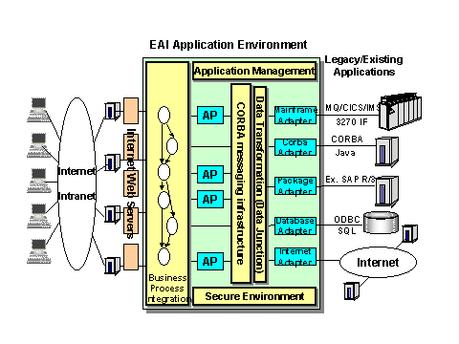
EAI

Slide 26
Enterprise Application Integration
Data level integration
Batch programs or online triggers
API level integration
REST
Service method level integration
SOAP
UI level integration
Mashups
Workflow level integration

Slide 27
Service Oriented Architecture
Enables better EAI
Wrap legacy systems with web services
Enterprise service model with well defined schema for data exchange
New components publish and use service interfaces
Common UI using enterprise mashup
Replace legacy while retaining service interface

Slide 28
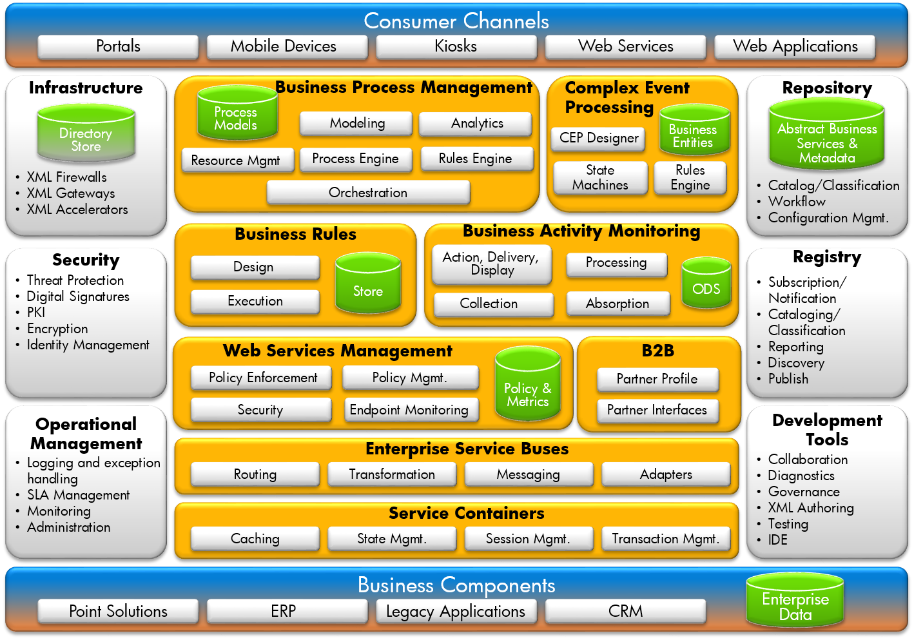

Slide 29
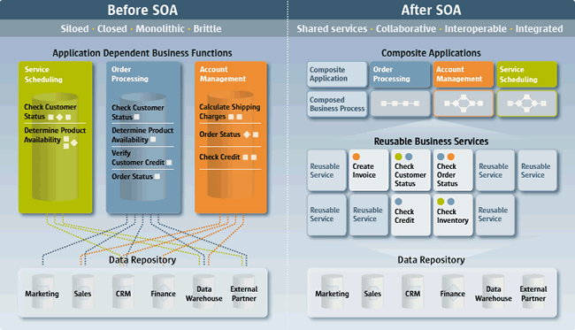
Service Oriented Architecture

Slide 30
Enterprise Technical Architecture
Location of technical stuff i.e. hardware and COTS
Application servers, databases and integration tools
In premise or in cloud
Uniformity or ‘best of breed’
Cost / Simplicity
Java stack or Microsoft stack
COTS or OpenSource
Network and data security

Slide 31
Enterprise Technical Architecture
Implementation architecture and quick-wins
People skill required
Development, testing and deployment tools
Business continuity
Disaster recovery
Minimize Total Cost of Ownership (TCO)

Slide 32
Data Centre Architecture
Data Center infrastructure
# server
# data storage
# bandwidth
Space requirement
Power / cooling requirement
Many similar applications running on dedicated h/w

Slide 33
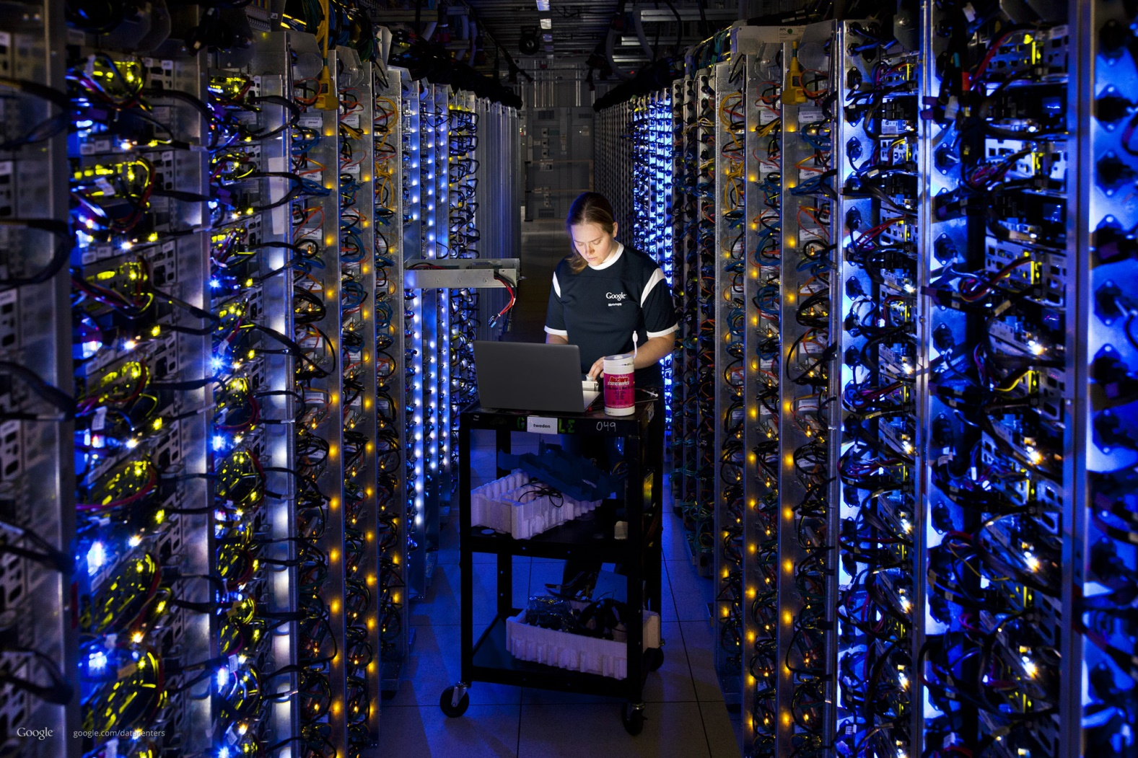
Data Center

Slide 34
Data Centre Architecture
Complexity because of ‘natural / continuous evolution’
New business requirement not supported by legacy stack
‘Server sprawl’
one system one server
Difficult to manage
Wasteful
Huge support and maintenance cost

Slide 35
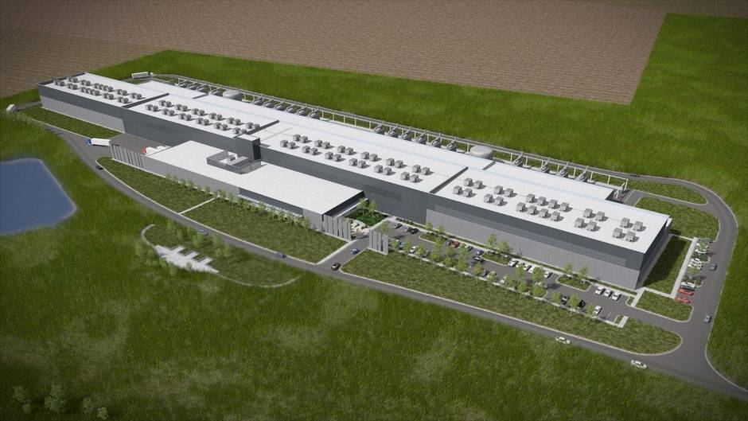
Data Center

Slide 36
Thanks

