Slide 1
Introduction to Cloud Computing Unit 1- Day6 Software As a Service
Prashant Kaushal

Slide 2
Recap
Enterprise data and processes
Enterprise components
Application integration and SOA
Enterprise technical architecture
Data centre infrastructure

Slide 3
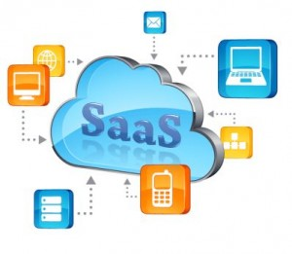
SaaS
Emergence of SaaS
SaaS architecture

Slide 4
Emergence of SaaS
Early days of Internet led to
‘packaged software’ -> Application Service Providers
Hosted remotely
Rather than enterprise’s data center, the s/w ran on ASP’s data center
First wave of ASPs -> not much success
Limited internet bandwidth
Most popular applications viz ERP and CRM were client-server based
Used inefficient ‘screen scraping’ -> Citrix MetaFrame
Not structured properly enough to give sufficient cost advantage

Slide 5
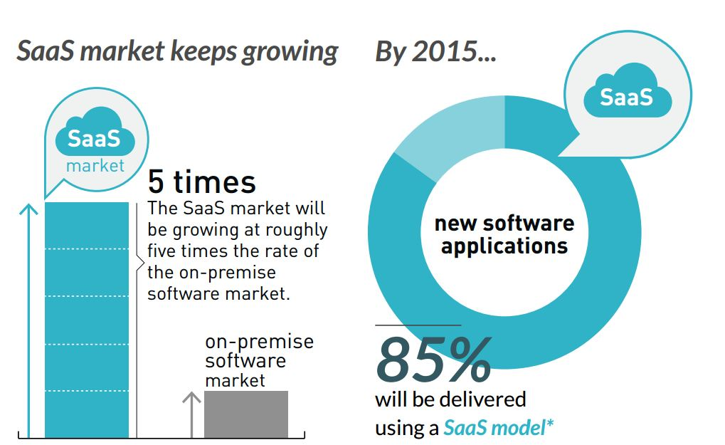
Emergence of SaaS

Slide 6
Emergence of SaaS
Key winners from ASP days
QuickBooks, Salesforce.com
Completely web-based
Designed for sharing across multiple customers
Spawned the new wave of hosted applications -> Software as a Service (SaaS)
Subscription based
Minor customization
Free from product upgrades

Slide 7
SaaS Architecture
Completely web-based
Multi-tenancy
Configurable
Significant economic advantage
High cost of managing s/w in a traditional manner
Dev/test
Hosting
Configuration / version management
Agility

Slide 8
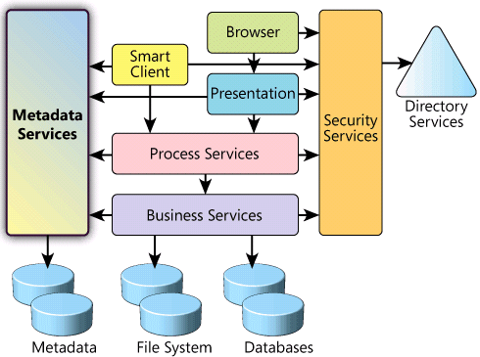
SaaS Architecture

Slide 9
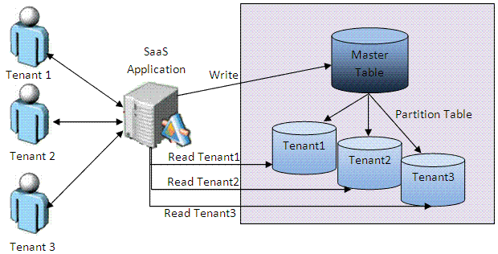
SaaS Architecture

Slide 10
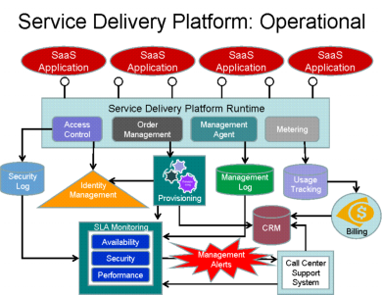
SaaS Architecture

Slide 11
SaaS Architecture: SalesForce

Slide 12
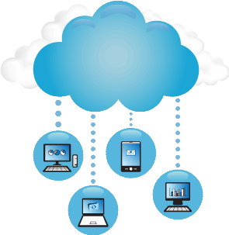


Slide 13
Thanks

