Slide 1
Introduction to Cloud Computing Unit2 - Day5 Software As a Service Prashant Kaushal

Slide 2
Recap
Service Models
IaaS
PaaS
SaaS

Slide 3
The 60’s: Batch Processing
In the 1960’s batch processing arrived
You’d submit your work on a deck of cards
Come back later & pick up your listing…
Lots of concurrent batch jobs
Offline User interaction – still had the white coats

Slide 4
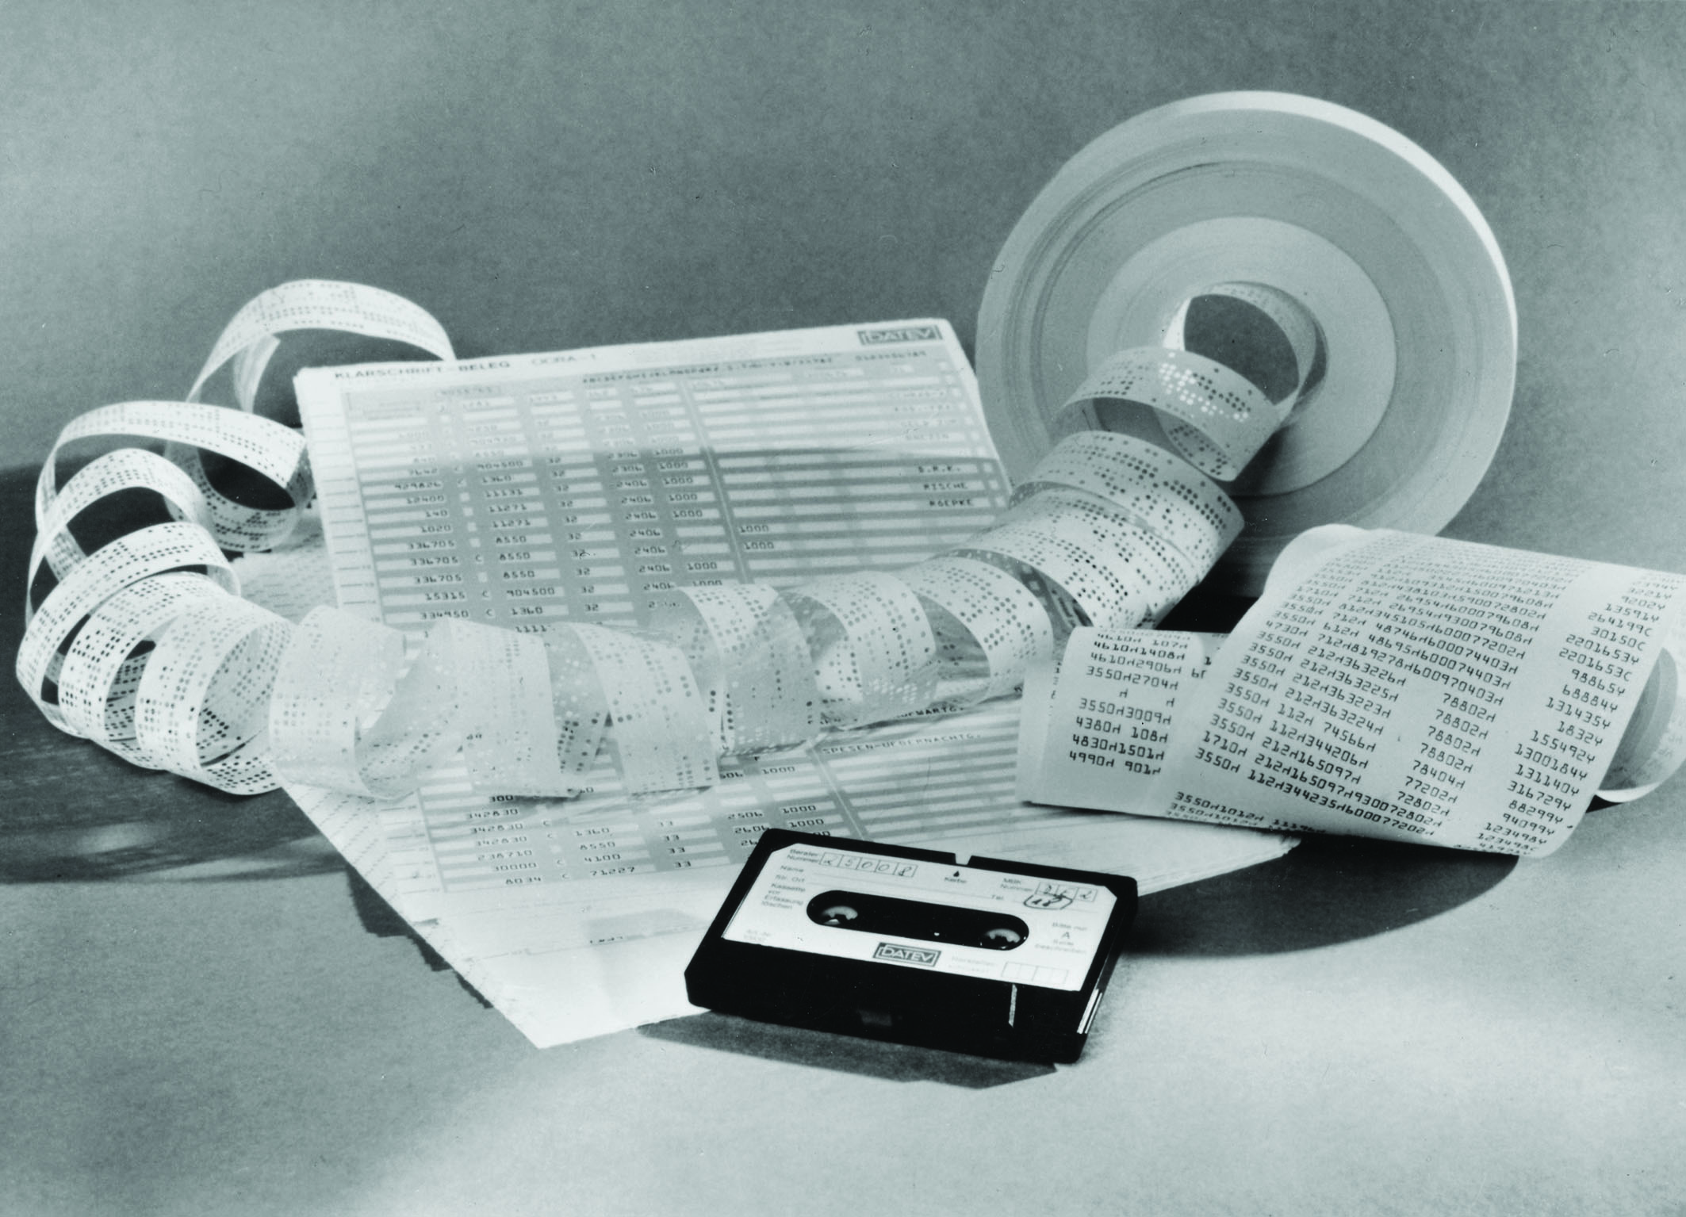
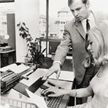

Late 60‘s, 70‘s: Accounting as Service
Snail Mail
Snail Mail
Many Customers

Slide 5
Late 60‘s, 70‘s: Accounting as Service
Decoupled Input
From
Process
Multi Tenancy (Business)
Hosted
Transport
Decoupled Output
From
Process
Transport
Many Customers

Slide 6
Some Observations
Decoupled I/O devices and transport were typically process specific.
The exchange of documents and the level of service is essentially a business contract.
Large numbers of SMBs as customers (hundreds of thousands)
These customers would have never used IT
Too expensive
No or little competency
But they have a fundamental need for the service

Slide 7
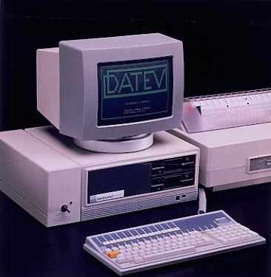
Innovation happens...
In the 80‘s the dedicated devices were replaced by PCs
Often still dedicated PCs for the purpose of the service provider
Exchange still by snail mail and diskettes
Late 80‘s, early 90‘s : Data exchange via dedicated dial-in
Still tied to the service provider
PCs often still dedicated to the service

Slide 8
Innovation never stops...
Mid 90‘s : PC is universal business device
The Internet get‘s discovered by the economy
Late 90‘s: The connected device revolution takes the market
Situation: We can connect people, devices, systems and processes
Decoupling of devices from processes and systems becomes „universal“

Slide 9
What is Software as a Service (SaaS)?

Slide 10
A working definition of SaaS
A hosted IT capability
Owned, located, operated and managed externally
Not just application software!
Also operating environments, integration platforms etc
But… only technology, not people
Optimised for delivery as a service
Not just a hosted instance of an off-the-shelf packaged application
Designed to be offered to multiple customers (multi-tenant)
Optimised for subscription-based licensing
Customer configuration, not customisation
Transparent upgrades
Service level monitoring/management
Over the Internet
But… not necessarily to a browser client

Slide 11
Something old…
Hosted IT capability delivery is nothing new!
In the 1960s the bulk of the software & services industry consisted of “processing bureaux”
In the late 1990s the buzz was around Application Service Provision (ASP)
Consumer-oriented capabilities
Hotmail, ICQ, AIM etc
How is SaaS different?

Slide 12
…something new!
The web is evolving to become a much more natural medium for IT capability delivery
Service providers and their business models are maturing to take advantage of technology possibilities
Wave 3: “Web as place”
Adapting platform
Nature of the Web
Wave 2: “Web as sales channel”
Wave 1: “Web as library”
Static publishing medium
Proprietary transactions
Open communities
Applications of the Web

Slide 13
…something new!
IT capabilities delivered in the “web as place” context aren’t applications in the traditional sense
“Applications as platforms”
New online application services provide open interfaces that make them easy to integrate, extend and enhance
Offer a multitude of ways to get access to functionality and information – not just pre-canned user interfaces
RSS, web services APIs, etc etc
The expectations and appetite of customers has grown
Influenced by their experience as consumers
Sourcing strategies are maturing

Slide 14
SaaS: an optimization
Software
Off-the-shelf functionality
Access to best practice
Time-to-market
Lower risk
Hosted software
No capital expenditure
No infrastructure
SaaS
Simpler customisation
Quicker upgrades
More sophisticated identity management
Service level management
These benefits are all about addressing issues with hosting

Slide 15
SaaS and SOA: two sides of the same coin
SaaS
SOA
(Service networks)
SaaS is to ASP what SOA is to monolithic enterprise applications!
Monolithic on-premise applications
ASP

Slide 16
Two sides of the same coin, creating one service network
SaaS
SOA
(Service networks)
Monolithic on-premise applications
ASP

Slide 17
Why should you care?

Slide 18
Situation
Infrastructure costs
Personnel costs
Rising/uncertain data centre costs
Upgrades, customisations
Legacy platforms
Cost of entry into a solution / upfront cost loading
Pace of change
Access to best practice

Slide 19
SaaS benefits
TCO – predictability of investment
Link of investment to value
You pay as you go and grow
Risk minimization
Upgrade availability
Constraints – limits your options!
This is often a good thing

Slide 20
How does SaaS fit in the IT landscape?

Slide 21
The SaaS value proposition
SaaS has value here but the benefits aren’t unique to SaaS. They also apply to generic hosted remotely managed applications or packaged off-the-shelf applications
Emerging possibility but not well-established
Still constrained by scope and vision of the service provider
Strong
Capability/maturity of process automation
SaaS provides a low-risk, quick on-ramp to managed automated capabilities in support of processes
Limited temptation to customise
Access to best practice
Weak
Non-differentiating
Differentiating
Business process “target”

Slide 22
SaaS value isn’t just about “green fields”
Capability can be reduced in the context of requirements by external factors
Mergers & acquisitions
Legacy issues and forced upgrades
Strong
Capability/maturity of execution
The SaaS “sweet spot”
Weak
Non-differentiating
Differentiating
Business process “target”

Slide 23
Software as a Service
Employease
Salesforce
Google
Consumer SaaS
LOB SaaS
WebEx
Zimbra
Coghead
NetSuite
CRM Live
RightNow
Basecamp
Presents challenging multi-tenancy issues
Amazon S3 + EC2
Axentis
Windows Live
On Premise
SaaS
The continuum of hosted software services
Licensing | Perpetual | Subscription | Transaction | Ad-Funded
Location | On-Premise | Appliance | Third-Party Hosted
Life Cycle Management | Corporate IT | ASP | SLA

Slide 24



Software as a Service Taxonomy
Software, services & support offerings specifically designed for one-to-many delivery over the Internet
Software as a Service
Packaged software customized, deployed & managed by provider
Hosted Outsourced IT
Software Delivery
How is the end-to-end experience delivered?
Today’s packaged software deployed on-premise
Traditional Software
Customer Managed
Co-Managed
Provider Managed
Application Management
Who manages the app software experience, SLA?
Notes:
SITO Summit 2005
9/8/2015 10:44 AM
© 2005 Microsoft Corporation. All rights reserved.
This presentation is for informational purposes only. Microsoft makes no warranties, express or implied, in this summary.
24

Slide 25
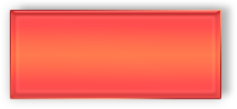
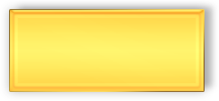
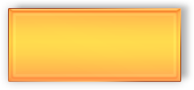
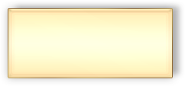
Software as a Service Taxonomy
“Services Building Blocks”
Microsoft Exchange Hosted Services
SalesForce, Microsoft OfficeLive
Software as a Service
Amazon EC2, S3, Win+IIS+.NET
“Attached Services”
“Finished Services”
Hosted Outsourced IT
Co-Location Services
Hosted Infra & Applications
Software Delivery
How is the end-to-end experience delivered?
Today’s
In-House IT
Outsourced IT,
On-site Contractors,
Asset Transfer, etc
Traditional Software
Customer Managed
Co-Managed
Provider Managed
Application Management
Who manages the app software experience, SLA?
Notes:
25

Slide 26


Software as a Service Taxonomy
“Services Building Blocks”
(e.g. Amazon EC2, S3, WinServer+IIS+.NET)
“Attached Services”
(e.g. MEHS, FSS)
“Finished Services”
(e.g. SalesForce, MMS)
Software as a Service
Provider delivers development & hosting infrastructure. Customer delivers the application.
Provider delivers service that augments existing on-premise IT function
Provider delivers software application service end-to-end
Hosted Outsourced IT
Software Delivery
How is the end-to-end experience delivered?
software moves to
software + service
Traditional Software
Customer Managed
Co-Managed
Provider Managed
Application Management
Who manages the app software experience, SLA?

Slide 27
challenges

Slide 28
Challenges aren’t unique to SaaS
But there is a trust/control domain boundary to be navigated that makes challenges clearer

Slide 29
Challenges to discuss
Identity management / security
Functional integration
Management integration
Quality of service / remediation
Rigorous understanding of SLAs, contracts required
Skills
Change, customisation
Cultural resistance
NIH, job protection
Regulatory, legal issues
Particularly for non-differentiating SaaS sweet spot
DPA, SOx, etc – auditing / logging / controls provability
Managing implications of automated upgrades
Training, integration testing, etc

Slide 30
Business opportunities

Slide 31
Looking at some numbers...
500000
Number of licensed seats of a certain large CRM SaaS ISV as of July/Aug 2006
24800
Number of unique customer accounts
500000 / 24800 ≈ 20
Who purchases a traditional CRM package for this many (or better: this few) users?

Slide 32
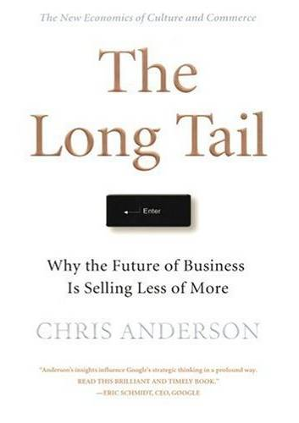
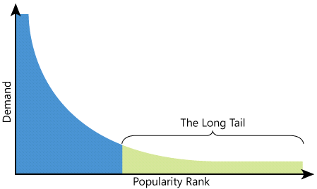
…products that have a low sales volume can collectively make up a market share that rivals or exceeds the relatively few current bestsellers - if the distribution channel is large enough…
(paraphrased from wikipedia)

Slide 33

The Long Tail and Software
$ / Customer
Your Large Customers
What if you could lower your costs, and thus lower the sale price of your software?
Your Typical Customers
New addressable market >> current market
(Currently) “non addressable” Customers
# of Customers
Notes:
9/8/2015 10:44 AM
33

Slide 34
Why the „Long Tail“?
It addresses mostly SMB and Consumer space
Lesser challenges for adoption
It reaches out to new customers
and potentially a lot of them

Slide 35
Who are the players?

Slide 36
The components of a SaaS proposition
Service composition/aggregation
Service functions
Commercial enablers (billing, provisioning etc)
Development and integration tools
Hosting infrastructure

Slide 37
Who can play a role in SaaS delivery?
Systems integrator
SaaS Hoster
Aggregator
Enterprise
Hoster
ISV
Service composition/aggregation
✓
✓
✓
Service functions
✓
✓
Commercial enablers (billing, provisioning etc)
✓
✓
Development and integration tools
✓
✓
Hosting infrastructure
✓
✓
As the SaaS market plays out, today’s incumbents will focus on their specialities

Slide 38
Three models for SaaS propositions
Service composition/aggregation
Composition platform delivery model
- Natural focus for aggregators
Service functions
Commercial enablers
Component services delivery model
- Natural focus for ISVs, SIs
Development and integration tools
Hosting infrastructure
Complete solution delivery model
Natural focus for largest providers (Google, Microsoft, etc)

Slide 39
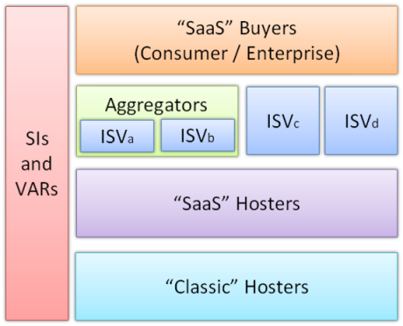
SaaS Ecosystem
Consumption Architecture
Aggregation Architecture??
Application Architecture
Delivery Architecture
SaaS Enablement

Slide 40
Application Architecture
Application Architecture
Notes:
Application Architecture – how to offer SaaS – 3 headed monsters
Consumption Architecture – how do enterprises integrate SaaS into their IT strategy and infrastructure?
Delivery Architecture – how do I get my services hosted and delivered
Aggregator Architecture – architecture, issues are verification of quality of services,
fred

Slide 41
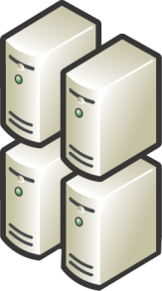

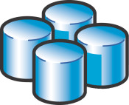

The SaaS Architecture Shift Single Instance – Multi-tenant
Scaleable
Configurable
Multi-tenant efficient

Slide 42
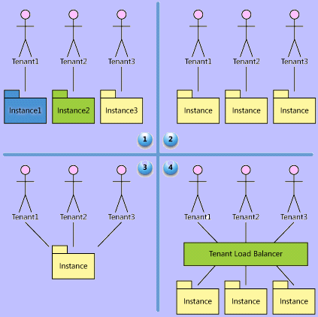
“Basic” SaaS Maturity Model
1 Ad-hoc / Custom
2 Configurable (single tenant)
4 Configurable Multi tenant Scalable
3 Configurable Multi tenant
Notes:
gp

Slide 43
Consumption Architecture
Consumption Architecture
Notes:
Application Architecture – how to offer SaaS – 3 headed monsters
Consumption Architecture – how do enterprises integrate SaaS into their IT strategy and infrastructure?
Delivery Architecture – how do I get my services hosted and delivered
Aggregator Architecture – architecture, issues are verification of quality of services,
fred

Slide 44
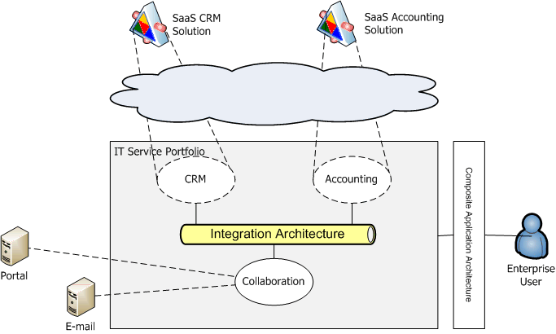
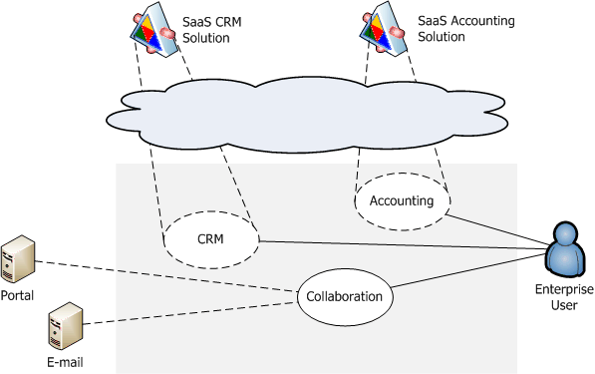
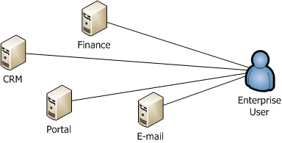
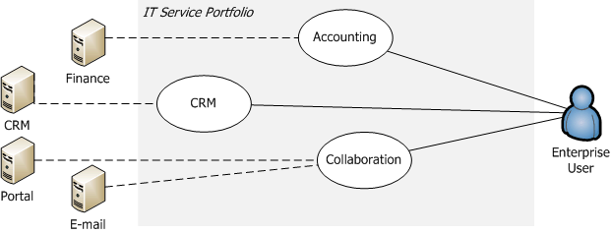
Software + Services
3 key take away:
“on premise” + “in the cloud”
Integration
Composition
Composition Architecture
The application-centric view of IT.
IT as a portfolio of services
Consumption Architecture
Software + Services

Slide 45
Delivery Architecture
Delivery Architecture
Notes:
Application Architecture – how to offer SaaS – 3 headed monsters
Consumption Architecture – how do enterprises integrate SaaS into their IT strategy and infrastructure?
Delivery Architecture – how do I get my services hosted and delivered
Aggregator Architecture – architecture, issues are verification of quality of services,
fred

Slide 46
SaaS Hosting Platform
SaaS Application
SaaS Application
SaaS Application
SaaS Application
SaaS Hosting Platform Runtime
Access Control
Order Management
Management Agent
Metering
Security Log
Provisioning
Management Log
Usage Tracking
Identity Management
Provisioning
CRM
SLA Monitoring
Billing
Availability
Management Alerts
Security
Call Center Support System
Performance

Slide 47
SaaS Enablement
SaaS Enablement

Slide 48
SaaS Enablement
ISV
Moving from on-premise model to SaaS
Enterprise
Integration with existing systems
Hosting
Operation best practices: design for operation
SaaS Hosting

Slide 49
Thank You

