Slide 1



VIrtual Twins as tools for personalised clinicAL care
What Complexity of Cardiovascular System Models is Optimal? You choose!
Dr Beatrice Ghitti [beatrice.ghitti@auckland.ac.nz]
Dr Finbar Argus [finbar.argus@auckland.ac.nz]
Postgraduate Training School
Delft University of Technology, March 18-21, 2025

Slide 2
Outline
PART I
Physiological vs personalized CVS models
An exclusive choice?
Specifying CVS model complexity …you choose!
Anatomical complexity
Anatomical personalisation
Hetero-dimensional models
A modular framework for 0D CVS modelling
Modules and their coupling
…in Circulatory Autogen is easier!
PART II
Circulatory Autogen overview
Model generation from modules
Circulatory Autogen software structure
Circulatory Autogen example uses

Slide 3
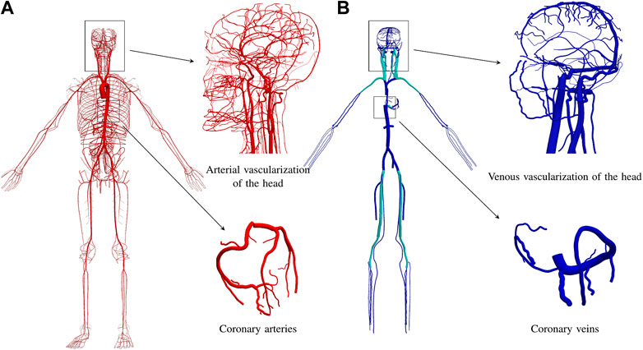
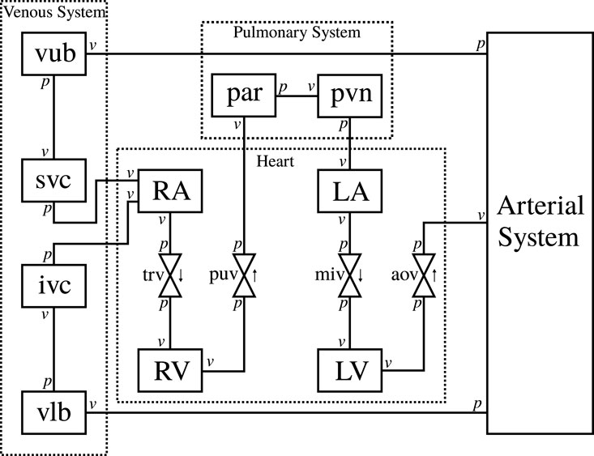
Physiological vs personalized: an exclusive choice?
ADAVN model¹
A simplified circulatory system model²
Find the differences!

Slide 4
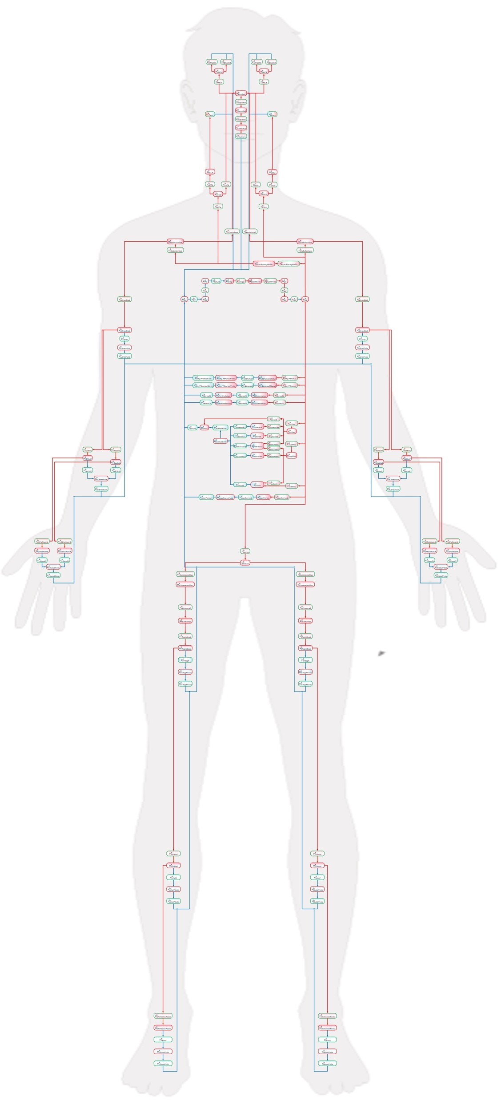
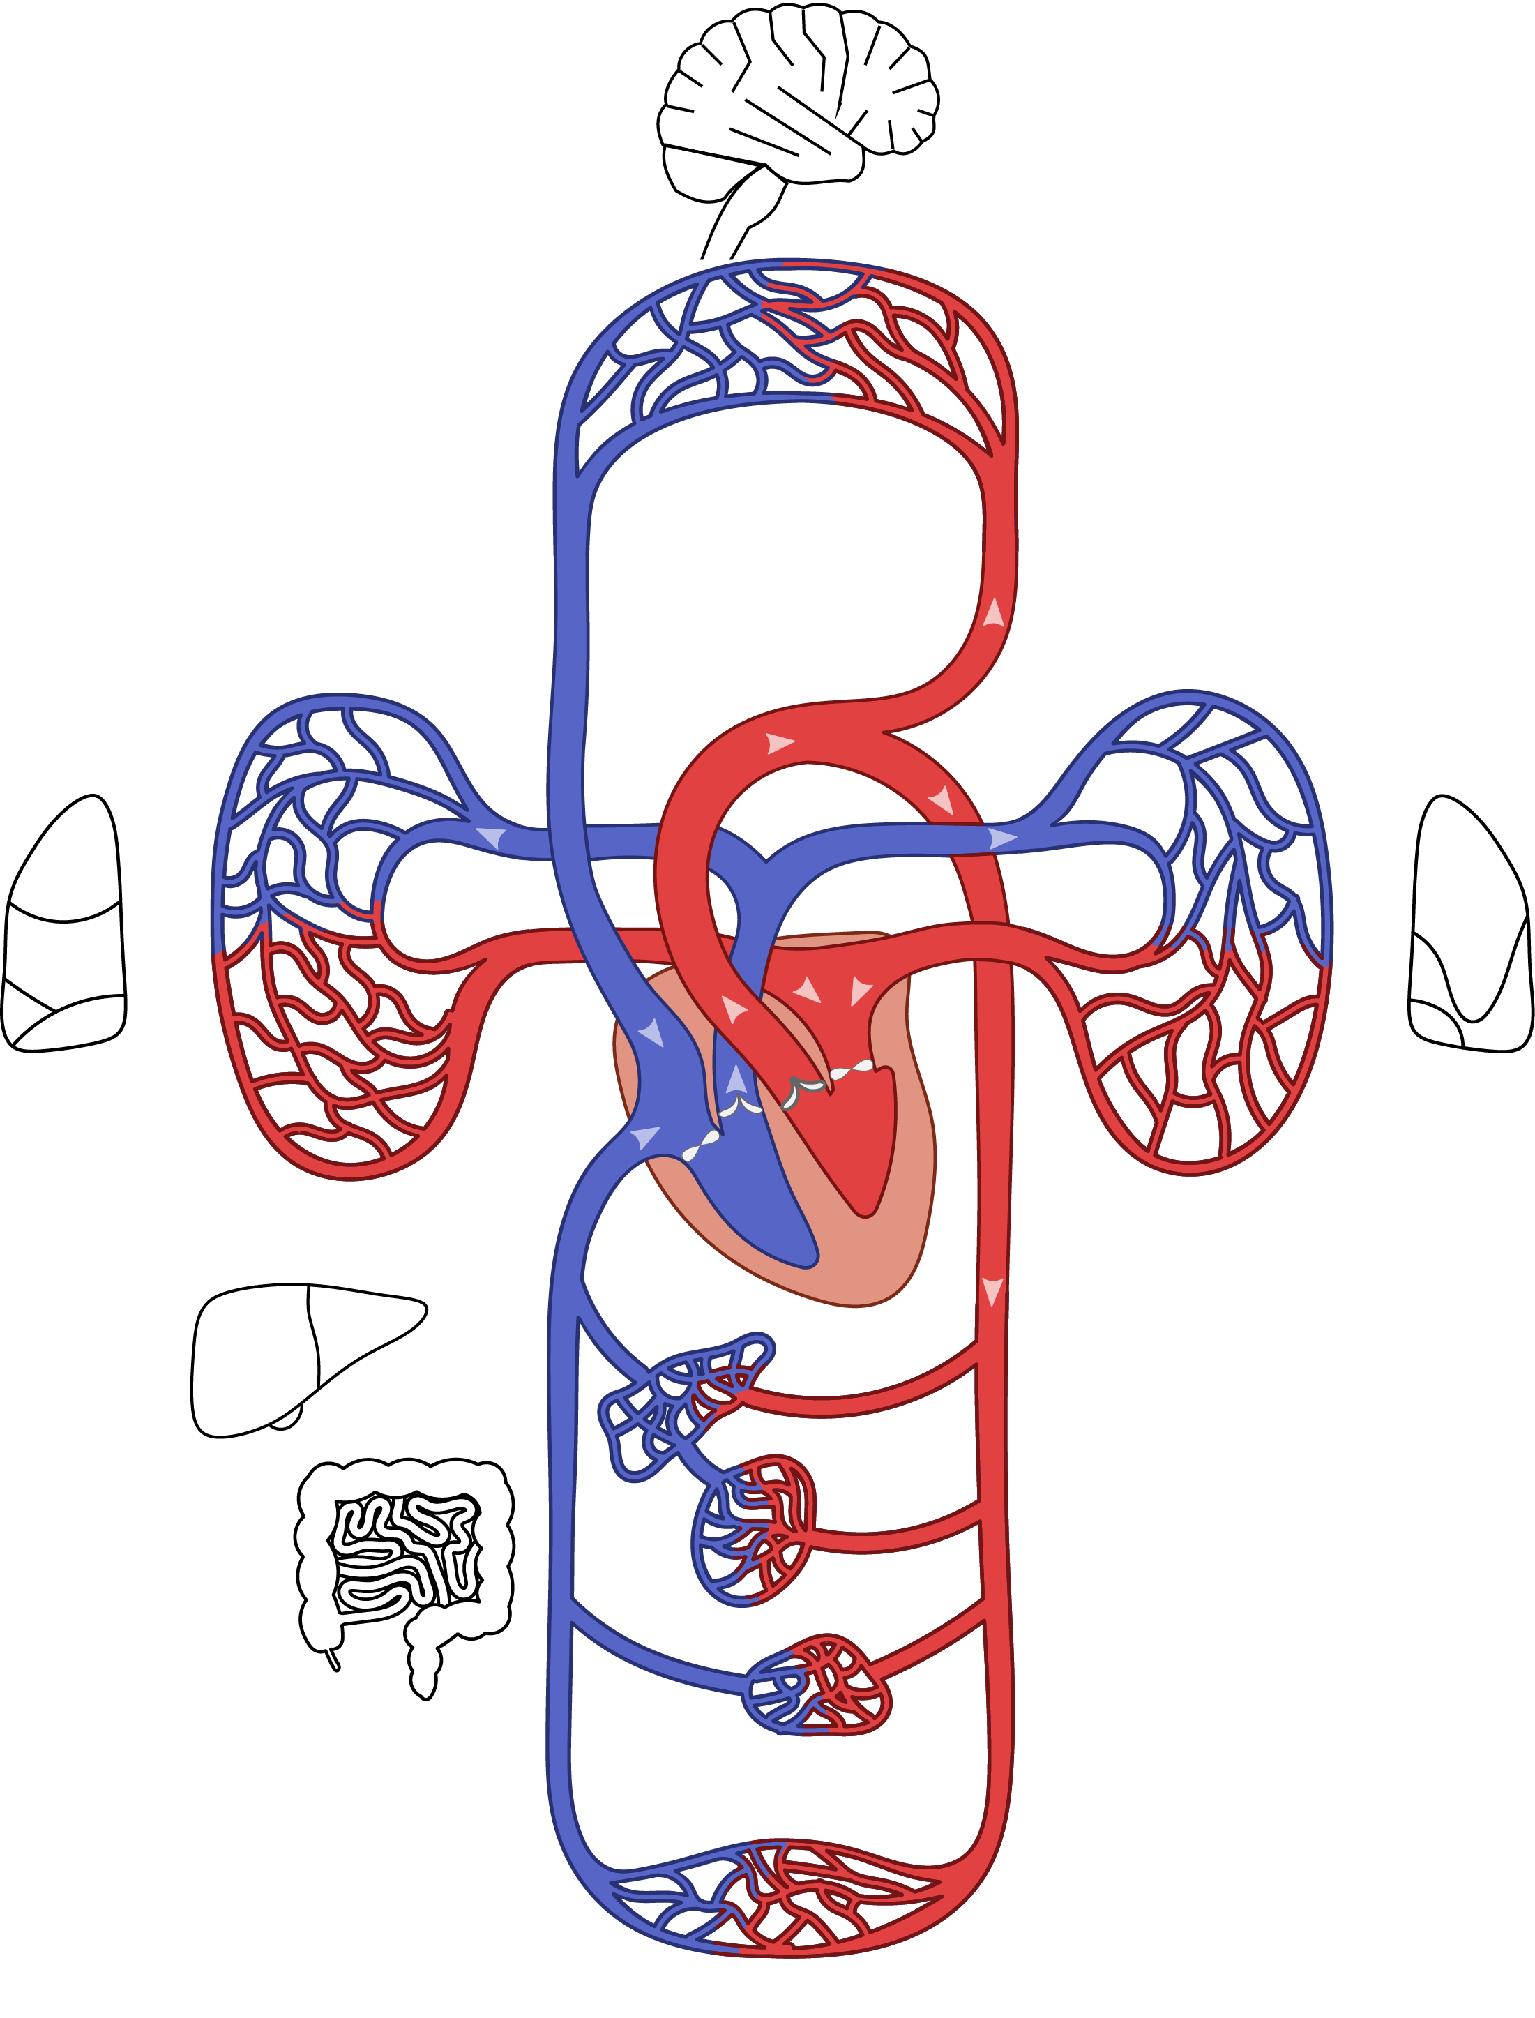
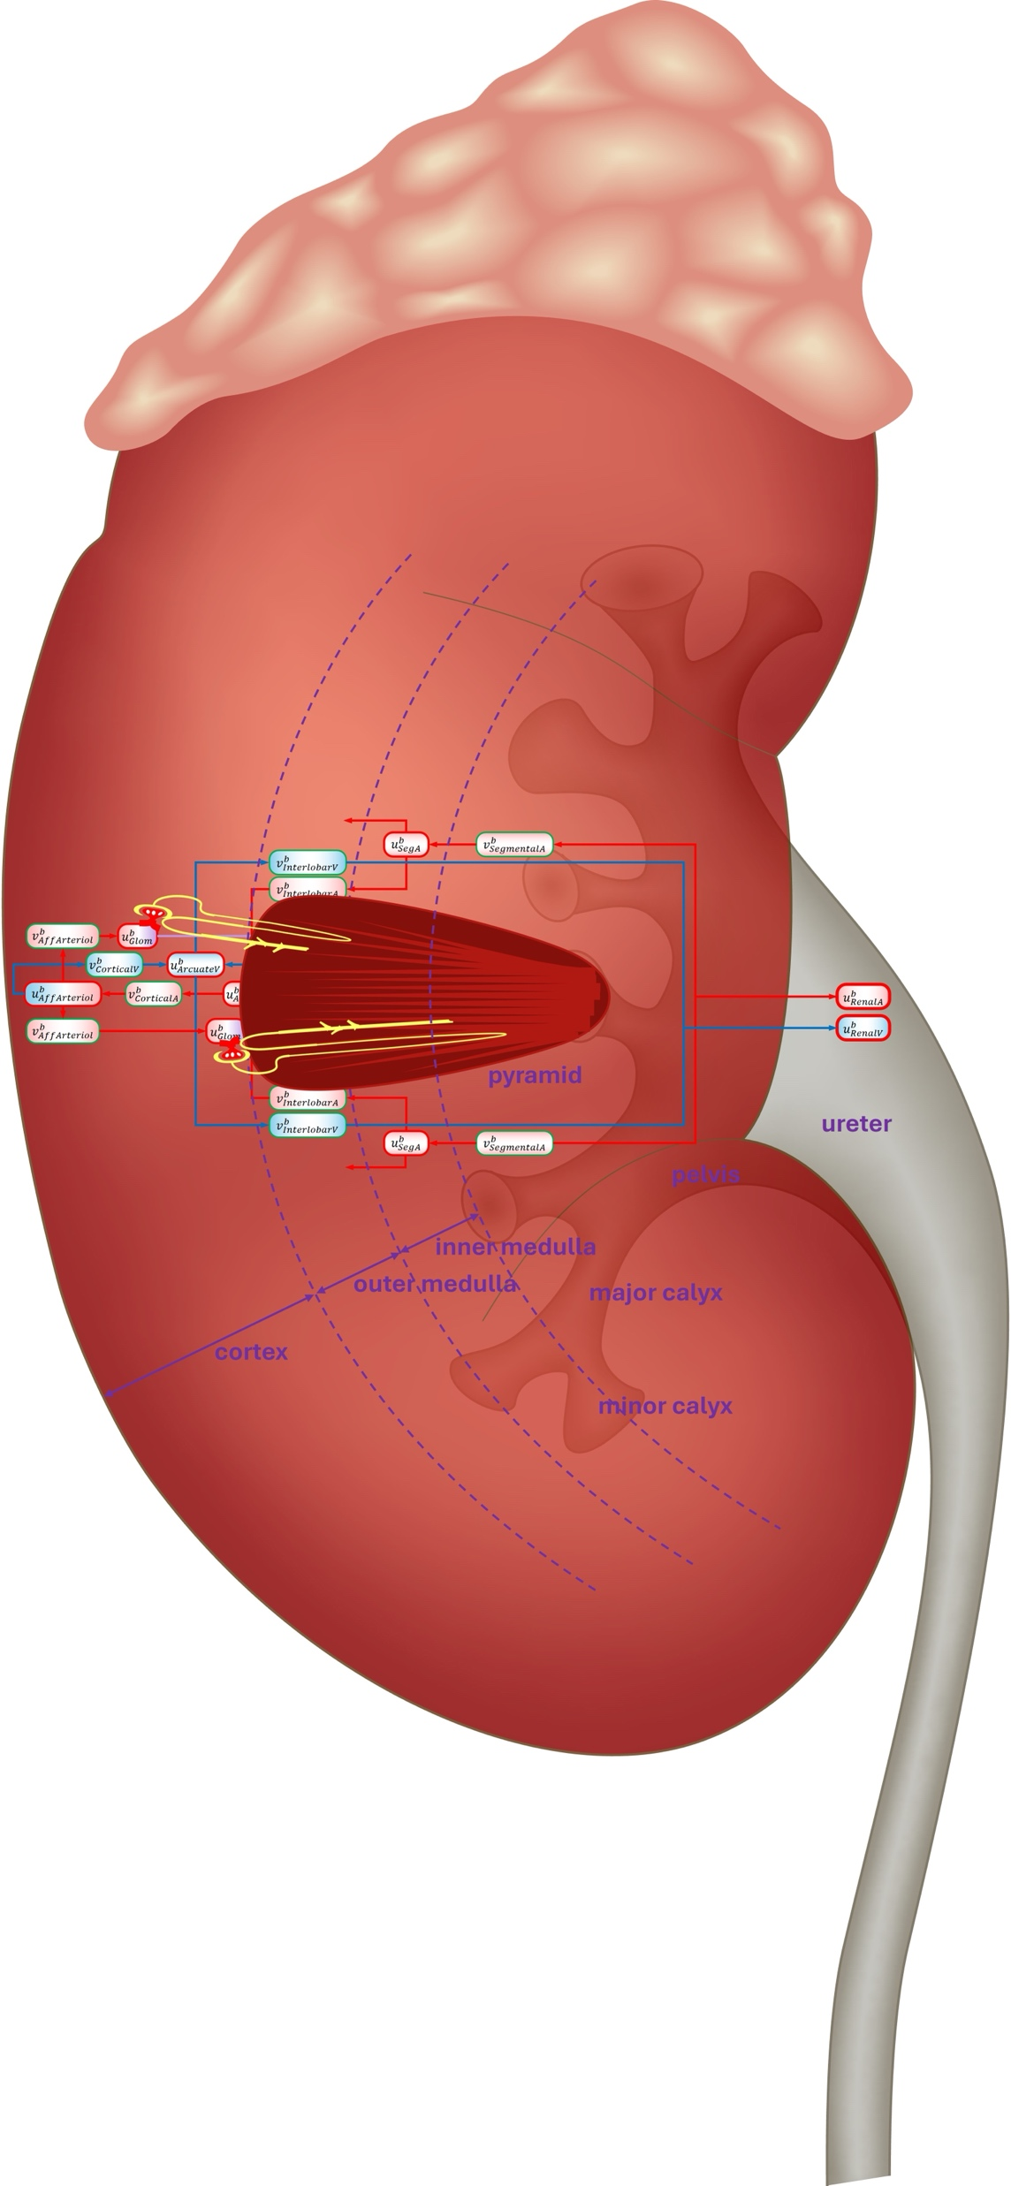
Specifying CVS model complexity…
Anatomical complexity & personalization
Interactions with other systems
CVS model
Hetero-dimensional models
Model sophistication for
biological mechanisms
mechanical characteristics
…you choose!
Picture courtesy of Peter Hunter
Human circulation system³
Notes:
Biological mechanisms – examples: baroreflex control, cerebral autoregulation.
Mechanical characteristics – examples: viscoelastic properties of vessel walls.

Slide 5
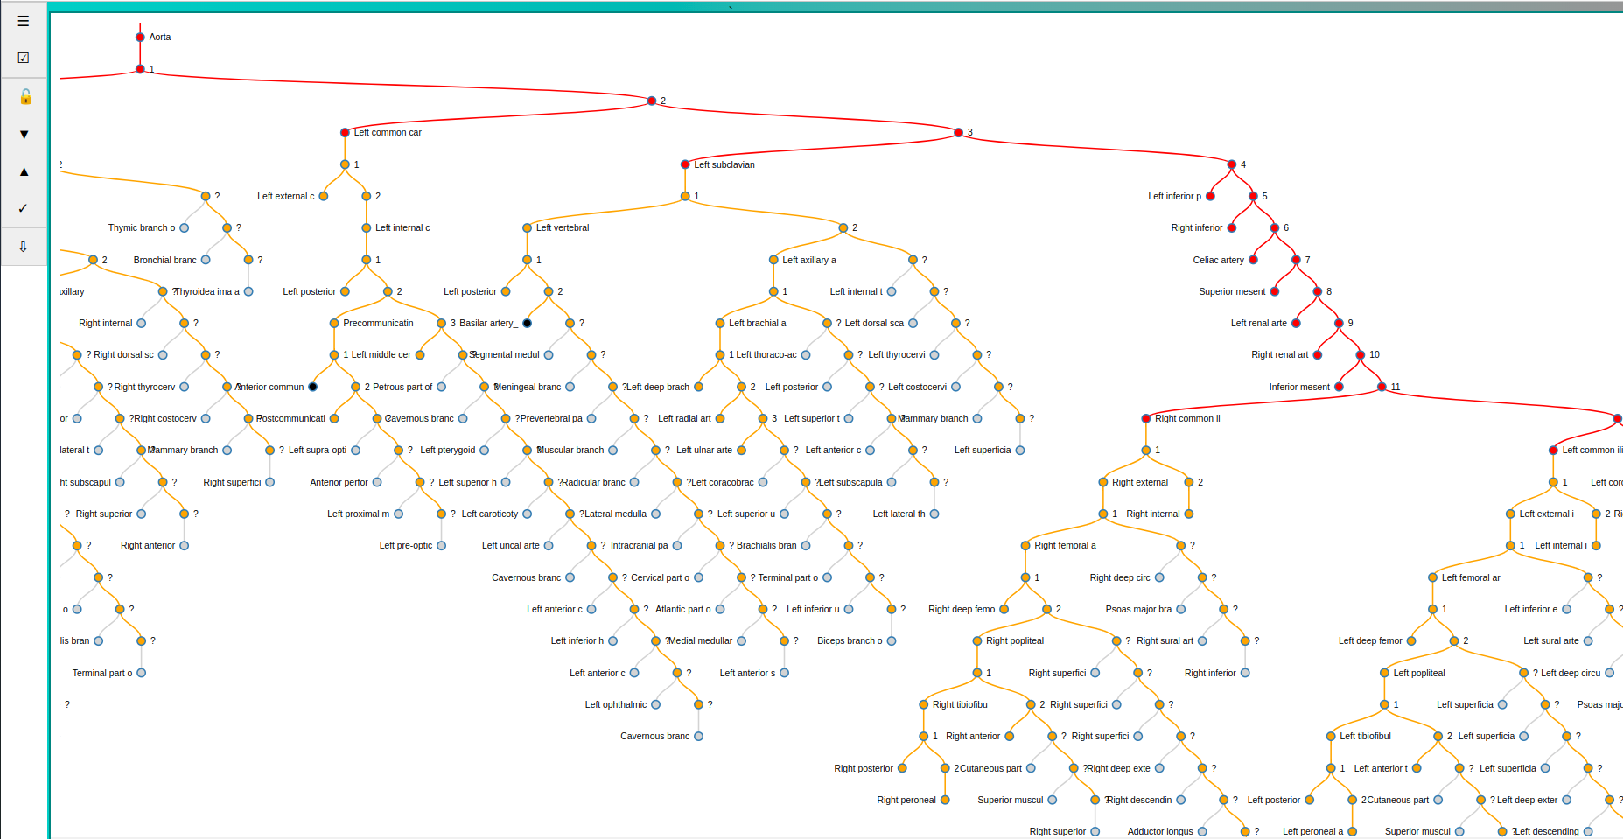
An anatomically accurate model: pros and cons
Regional blood flow distribution and tissue composition
Anatomy/topology definition based on FMA Ontology
Anatomical variations
Different stages of increasing anatomical complexity
Male and female models
Vessel metadata
(diameter, length,…)
Advantages:
Hypothesis testing
Re-scale to body volume/surface area
…
Issues/challenges:
Computationally expensive
How to make it subject-specific?
…

Slide 6
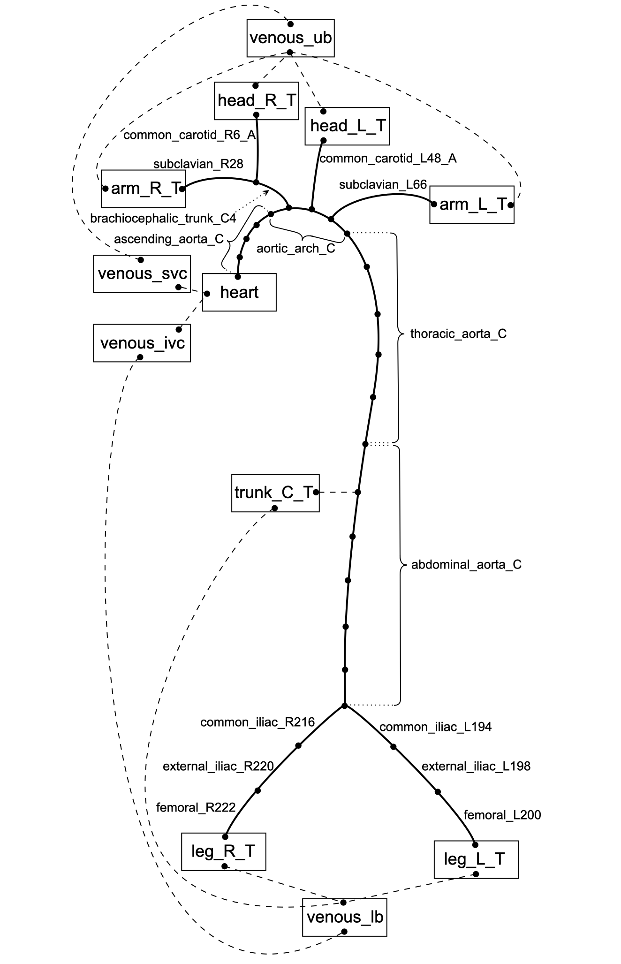
Anatomical complexity
A simple adaptable closed-loop CVS model:
arterial system network,
terminal compartments,
venous compartments,
heart (heart chambers and valves).
Decrease in complexity to ensure models can be calibrated to clinically available, subject-specific data.
Example: Argus et al. (2022), doi: 10.3389/fphys.2022.1018134

Slide 7
Anatomical (& physiological) personalization
A semi-automated workflow for generating cerebrovascular anatomical digital twins (picture courtesy of Jiantao Shen)
+ Flow personalisation (Sharifzadeh-Kermani et al. (2024), doi: 10.1007/s10237-024-01908-5)

Slide 8
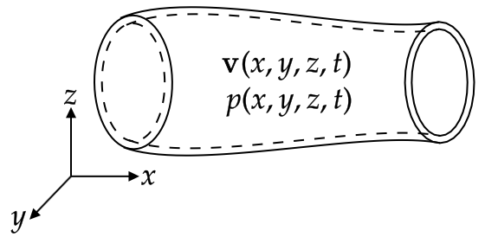
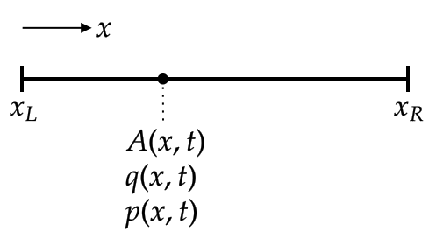
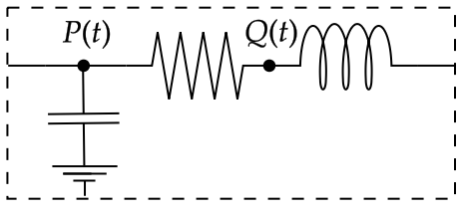
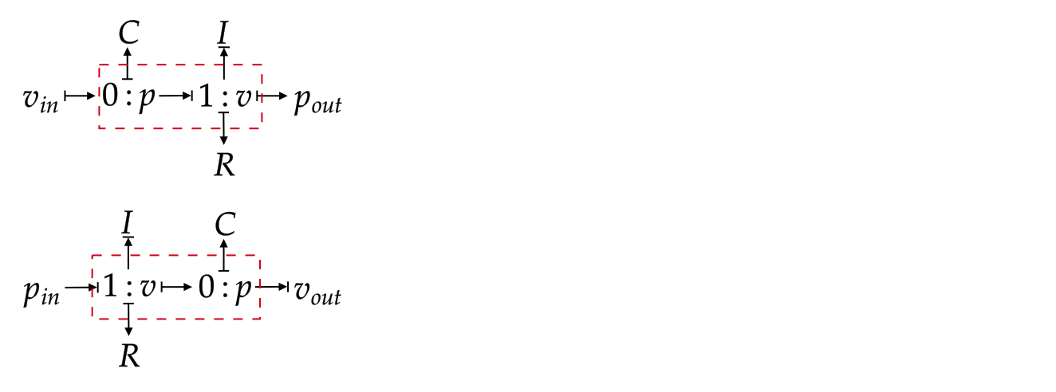
Hetero-dimensional CVS models
Accuracy
3D models
surrogates
1D models
0D models
Computational cost

Slide 9


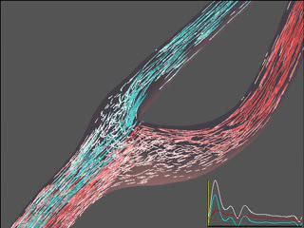
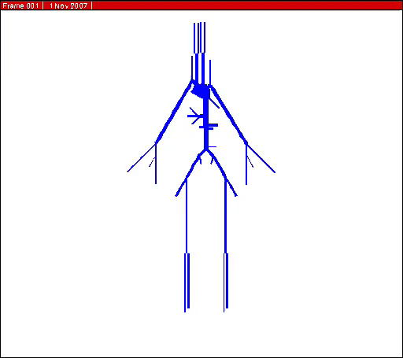

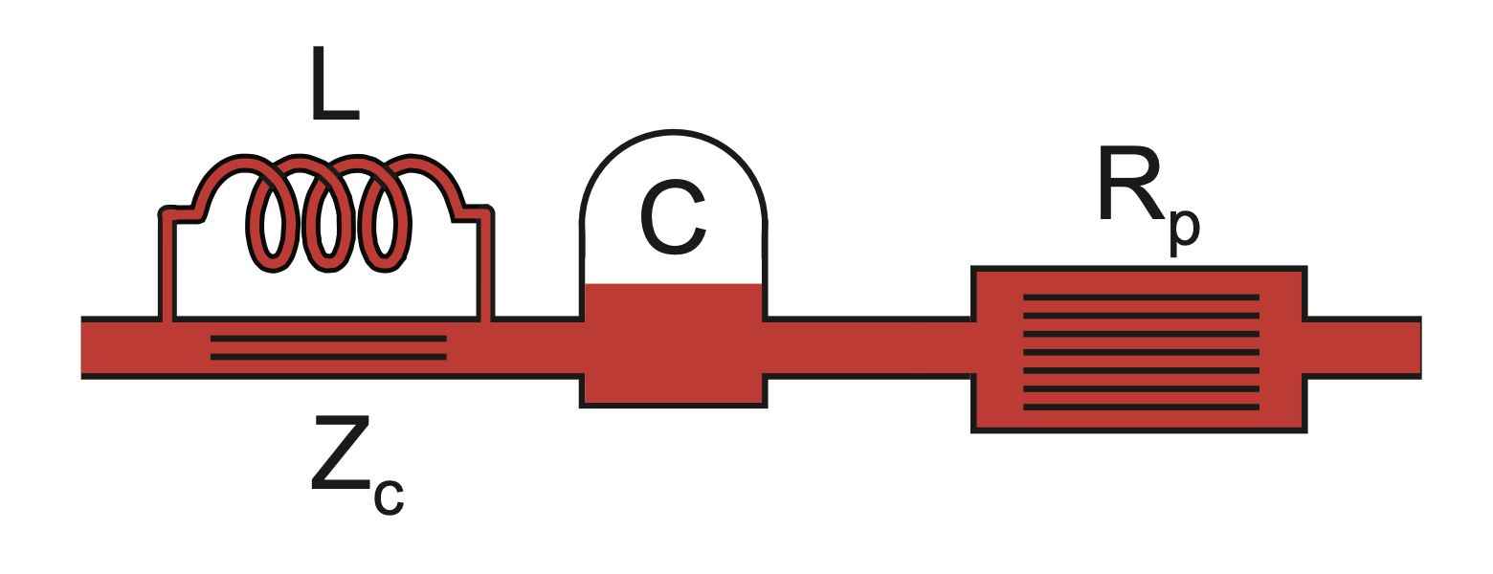
Arterial Blood Flow Modelling
(hours)
3-D Models
Computational cost
Courtesy of Steinman’s lab
Good for pulse wave signals
Lecture tomorrow 8h45-12h30
on 0D/1D circulation modelling!
1-D Models
(seconds)
0-D Models
Global Features
Accuracy
Local Features
Alastruey, et al., Am J Physiol Heart Circ Physiol 325:H1–H29, 2023

Slide 10
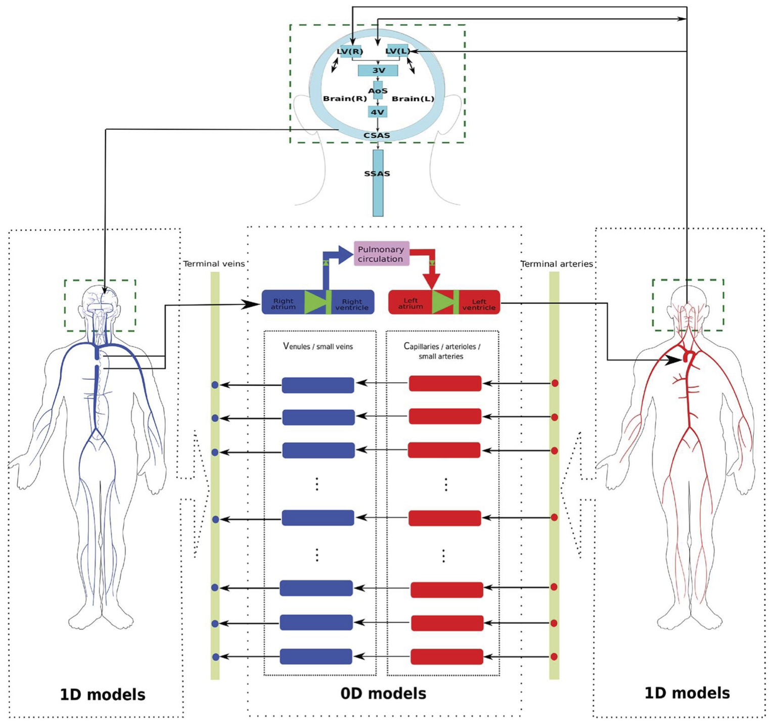
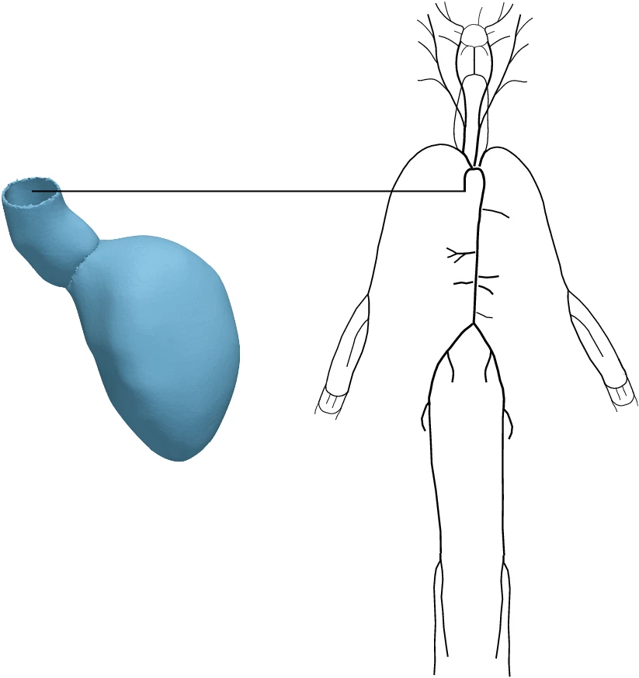
Hetero-dimensional CVS models
A 1D-0D closed-loop global circulation model⁵
A 3D-1D model of left ventricle and arterial system⁶

Slide 11
0D CVS modelling
0D models
3D models
1D models
A modular framework for 0D CVS modelling:
modules based on lumped-parameter BG models;
modularisation to create arbitrary topology circulation system models for specific subjects/clinical applications;
computational efficiency.

Slide 12
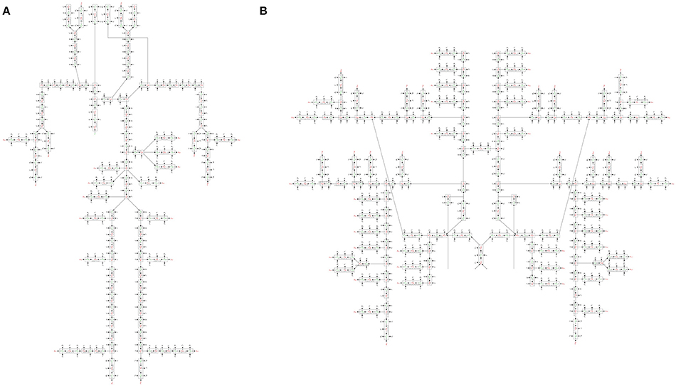
Modules, heaps of modules (!), and their coupling
Modules for different CVS components
BG modular framework for CVS modelling
BG modules coupled via each module port variables (BCs)
Different modules for a CVS component
Coupling must preserve
mass
energy
[…]
vessels (art/ven)
heart
capillary beds
vessel properties
control mechanisms
…
Integrated whole-body physiology models from cellular to organ and system levels

Slide 13
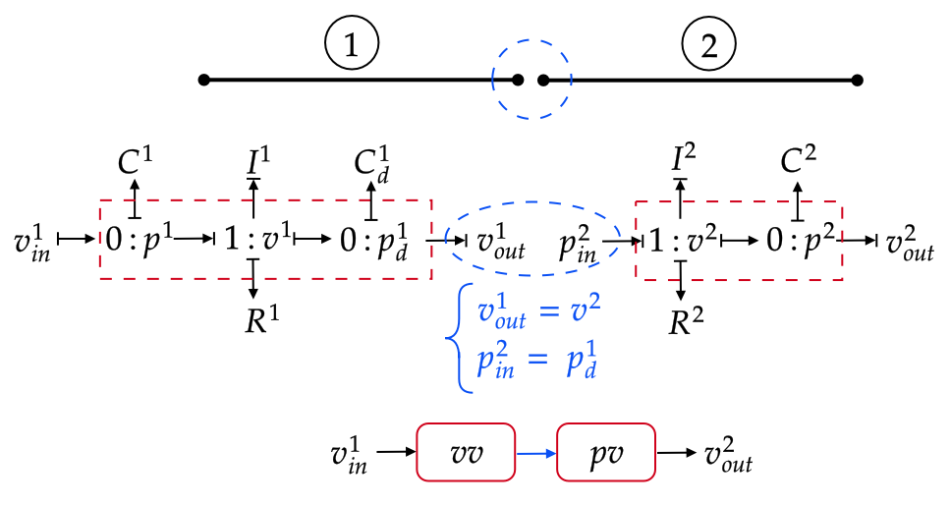
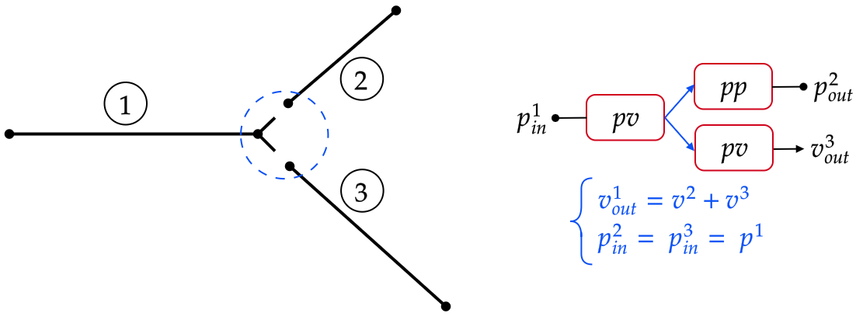
Modules, heaps of modules (!), and their coupling
1) Define each module’s port variables (BCs) for connectivity/coupling

Slide 14
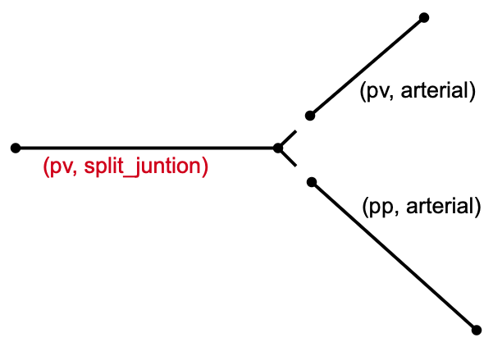
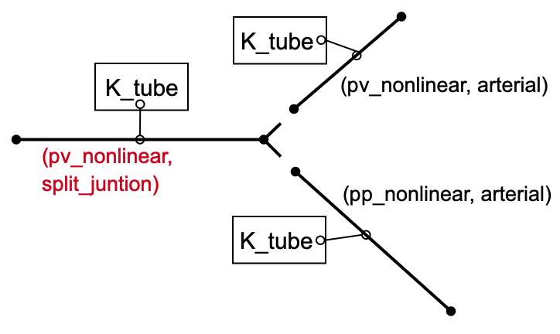
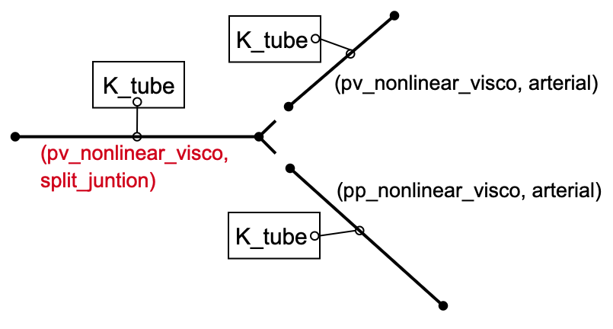
Modules, heaps of modules (!), and their coupling
2) Define each module’s type

Slide 15
…any questions?!?
Time for Circulatory Autogen!!!

