Slide 1


Session on Surrogate Modelling
VITAL Training School 01
Speaker: Gonzalo Maso Talou Auckland Bioengineering Institute

Slide 2
Agenda
Introduction to Surrogate models
AI-surrogate models
Architecture
Loss function
Encoding inputs
Use case: a ventricular model

Slide 3
Surrogate models

Slide 4



What is a surrogate model?
Given a high-fidelity model , we define a surrogate model as an approximation with lower computational cost.
Particularly, we define a general notation for our biomechanical models as
Coordinates
Parameters
Geometry
parameters
Boundary
conditions

Slide 5
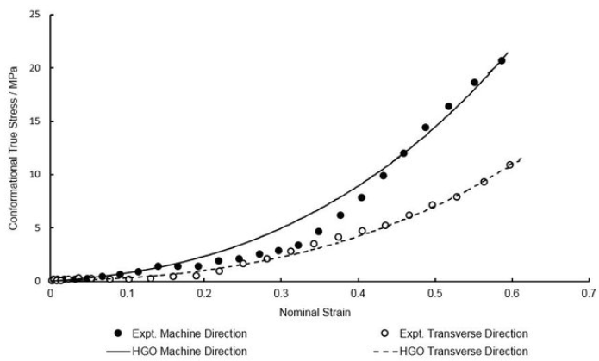
What is a surrogate model?
Given a high-fidelity model , we define a surrogate model as an approximation with lower computational cost.
Particularly, we define a general notation for our biomechanical models as
Coordinates
Parameters
Geometry
parameters
Boundary
conditions
Note
Empirical constitutive laws derived from experiments normally use a surrogate-like model (e.g. function fitting). Its associated high-fidelity model would be a microscale model fitted to the experimental data.

Slide 6
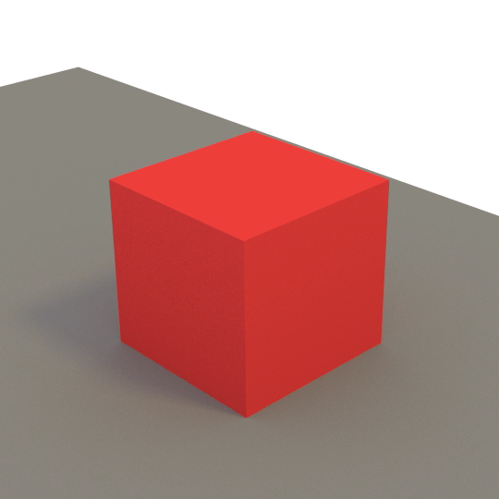
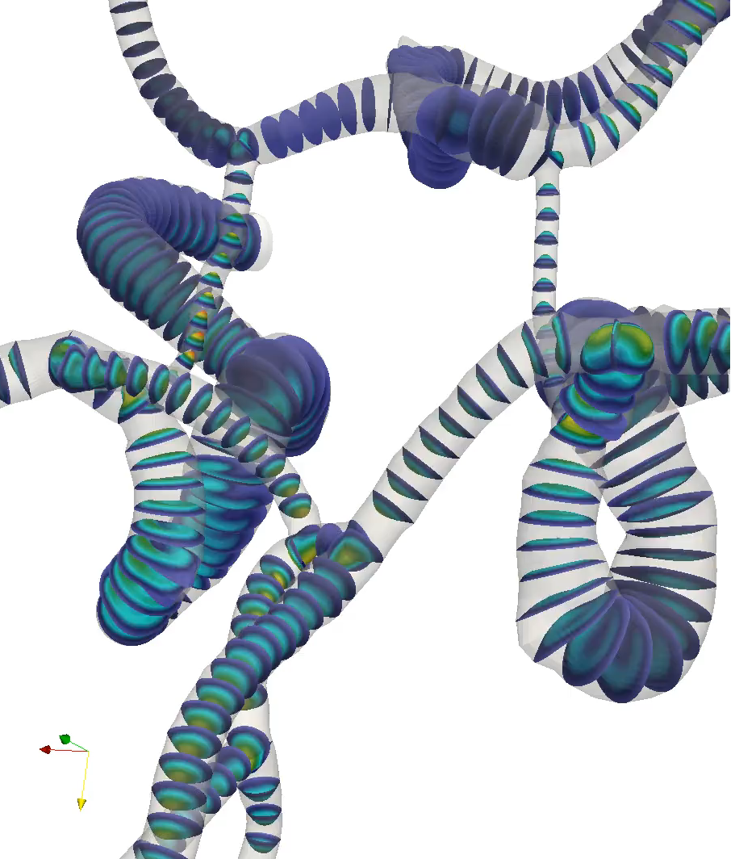
What can we do with surrogate model?
True physics for computer graphics
Online simulations from medical imaging
Translate complex models to clinical practice
+ model calibration, uncertainty quantification, parameter identifiability…

Slide 7
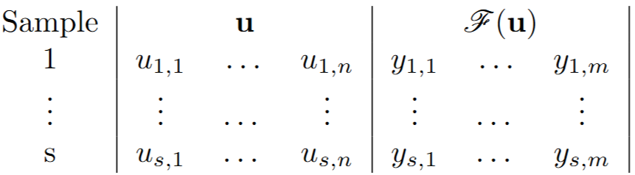
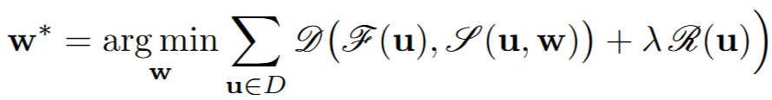
How to generate ?
Full dataset (Trivial case)
A full parametric sweep of inputs provide a comprehensive and densely sampled input-output dataset for the construction of an interpolant.
But given the cost of evaluating , this is prohibitive for most high-fidelity models.
Sparse dataset
The most general scenario is to define an operator based on a sparse input-output dataset of . Based on the choice of the surrogate model method chosen, the optimal sampling strategy and level of sparseness change. For most advanced surrogates, optimal experimental design methods are employed for sampling.
Table 1. Input-output dataset ( ) of with s samples.

Slide 8
How to choose a surrogate model?
Surrogate model methods use a different approximators, providing different complexity, smoothness and continuity.
Most of the approximators are defined from machine learning techniques due to their computational efficiency and parallelisation capabilities:
Gaussian process regression Good for continuous “smooth” operators
Polynomial regression Good for operators with polynomial-like behaviour
Support vector regression Good for high-dimensional problems
Deep neural networks Good for high-dimensional “non-smooth” operators – but highly data hungry!
And many more…

Slide 9
How to choose a surrogate model?
Surrogate model methods use a different approximators, providing different complexity, smoothness and continuity.
Most of the approximators are defined from machine learning techniques due to their computational efficiency and parallelisation capabilities:
Gaussian process regression Good for continuous “smooth” operators
Polynomial regression Good for operators with polynomial-like behaviour
Support vector regression Good for high-dimensional problems
Deep neural networks Good for high-dimensional “non-smooth” operators – but highly data hungry!
And many more…
Today’s focus is AI-surrogate models.

Slide 10
AI-surrogate models

Slide 11
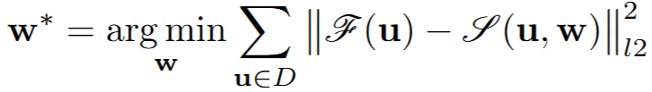
AI-surrogate model
Find the parameters such that
Or, in a general form,
where is the input-output dataset, is a similarity function and is a regulariser.
Table 1. Input-output dataset ( ) of with s samples.

Slide 12
AI-surrogate model
Find the parameters such that
Or, in a general form,
where is the input-output dataset, is a similarity function and is a regulariser.
Loss function
Table 1. Input-output dataset ( ) of with s samples.

Slide 13
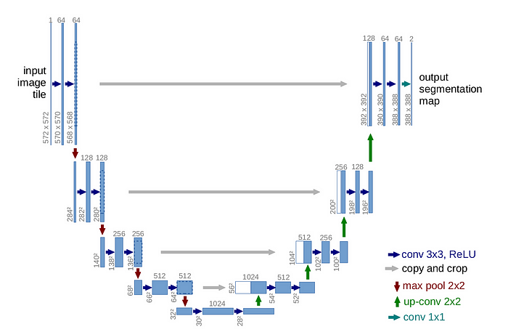
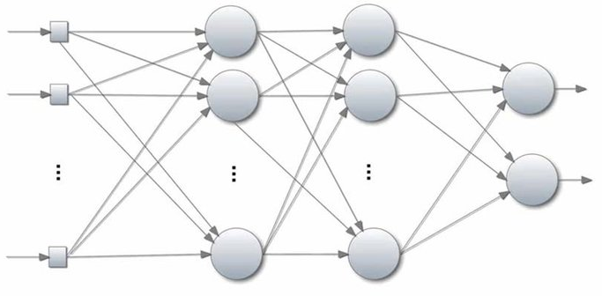
AI-surrogate model
The AI-surrogate model can be implemented using different architectures.
…
…
…
Example of an AI surrogate model
with MLP architecture
Example of an AI surrogate model
with UNet architecture

Slide 14
AI-surrogate model
Two main components shape the operator: architecture and loss function.
Architecture
Defines the operator capacity (level of complexity that can be learnt) and internal representation.
The more complex relationship between inputs and outputs of , the higher the capacity required.
The higher the capacity, the larger the dataset required for training.
Types of architectures:
Multi-layer perceptron (MLP) Scalar input/output
Convolutional neural network (CNN) Structured input/output
Recursive neural network (RNN) Sequential input/output
Encoder-Decoder (e.g. U-Net, autoencoder-like) Scalar or Structured input/output
Ensembles (e.g. DeepONet) Many variations
All types of architectures can increase their capacity by programmatically adding more layers, although each architectural type lead to different properties.

Slide 15
AI-surrogate model
Loss function
Defines the learning objective of the operator. Permits to models:
Contribution of different samples (e.g. WLS for similarity function);
Sample uncertainty;
Smoothness and constraints of the operator (e.g. adding regularisation or penalisation terms);
Similarity criteria between high-fidelity and surrogate model (e.g. using LS, MLE,etc. for similarity function).
Well-constrained and regularised surrogate models require a smaller dataset than their unconstrained/unregularised counterpart.

Slide 16
AI-surrogate model
Loss function
Defines the learning objective of the operator. Permits to models:
Contribution of different samples (e.g. WLS for similarity function);
Sample uncertainty;
Smoothness and constraints of the operator (e.g. adding regularisation or penalisation terms);
Similarity criteria between high-fidelity and surrogate model (e.g. using LS, MLE,etc. for similarity function).
Well-constrained and regularised surrogate models require a smaller dataset than their unconstrained/unregularised counterpart.
PINN
=0
Note
An extreme case of well-constrained and regularised models are the Physics-informed neural networks (PINNs), which does not require any dataset to be trained! (Unsupervised method)
Domain space
Residuals of the governing equations

Slide 17

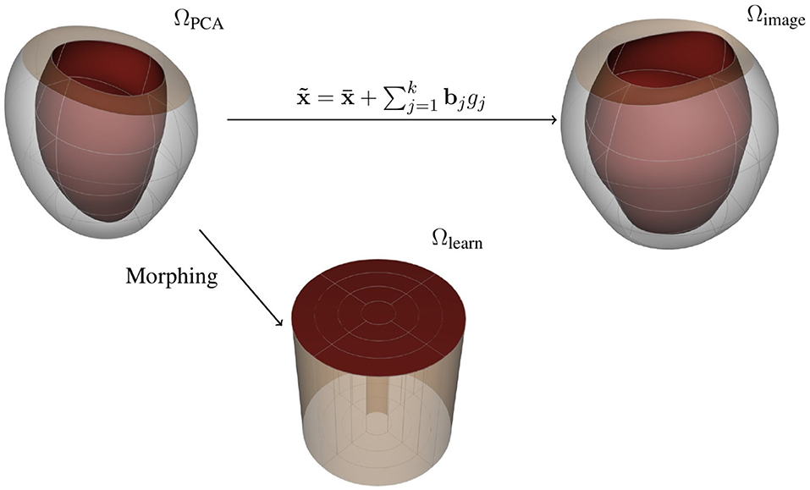
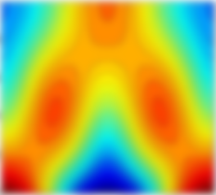

Simplifying the operator
Encoding inputs/outputs
The input parameters and model outputs can be dimensionally reduced to reduce the number of input/output dimensions of the surrogate model. This improves the efficiency of training (metaheuristic) and quality of the solution due to the consequential denser sampled dataset.
Any dimensionality reduction technique can be used for this end.
Example of a lower spectral encoding of boundary conditions , same can be applied to spatially heterogeneous material parameter
Example of a dimensionality reduction of parameter from ~150 DoF to just 3 PCA modes for a ventricular geometry

Slide 18

Use case: ventricular mechanical model

Slide 19
High-fidelity model
Governing equations: Finite elasticity with a Guccione constitutive model.
Boundary conditions: Neumann BC in the endocardium, homogenous Dirichlet BC in the
normal direction to the base and in all the epicardial nodes of the base.
Spatial discretisation: FEM mixed formulation with linear Lagrange basis functions for the hydrostatic pressure.
Dataset
Geometries: 81 subject-specific meshes constructed with Cubic Lagrange basis functions (1108 nodes).
Simulations: 10 different endocardial pressures * 7 different material properties * 81 different geometries (~6M nodal samples).
6M
Table 1. Input-output dataset ( ) of with s samples.

Slide 20
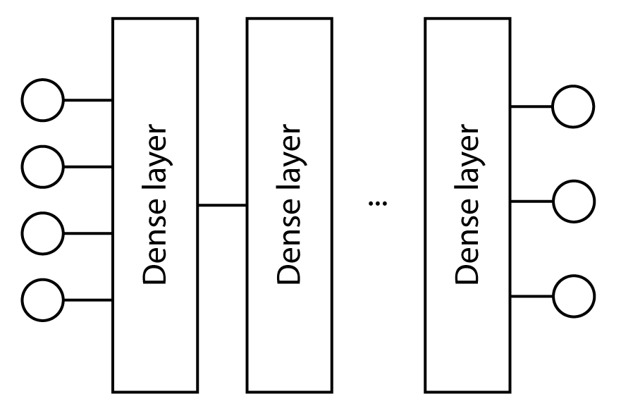

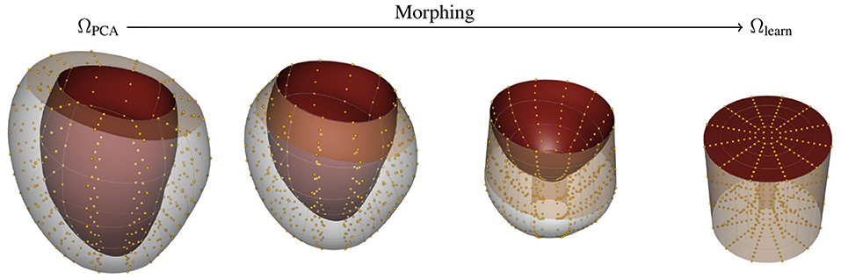
AI-surrogate model
Architecture: Multi-layer perceptron
Loss function:
Encoding of inputs: PCA and domain morphing (learning domain)¹.
¹Maso Talou, G.D., Babarenda Gamage, T.P., Sagar, M. and Nash, M.P., 2020. Deep learning over reduced intrinsic domains for efficient mechanics of the left ventricle. Frontiers in Physics, 8, p.30.

Slide 21
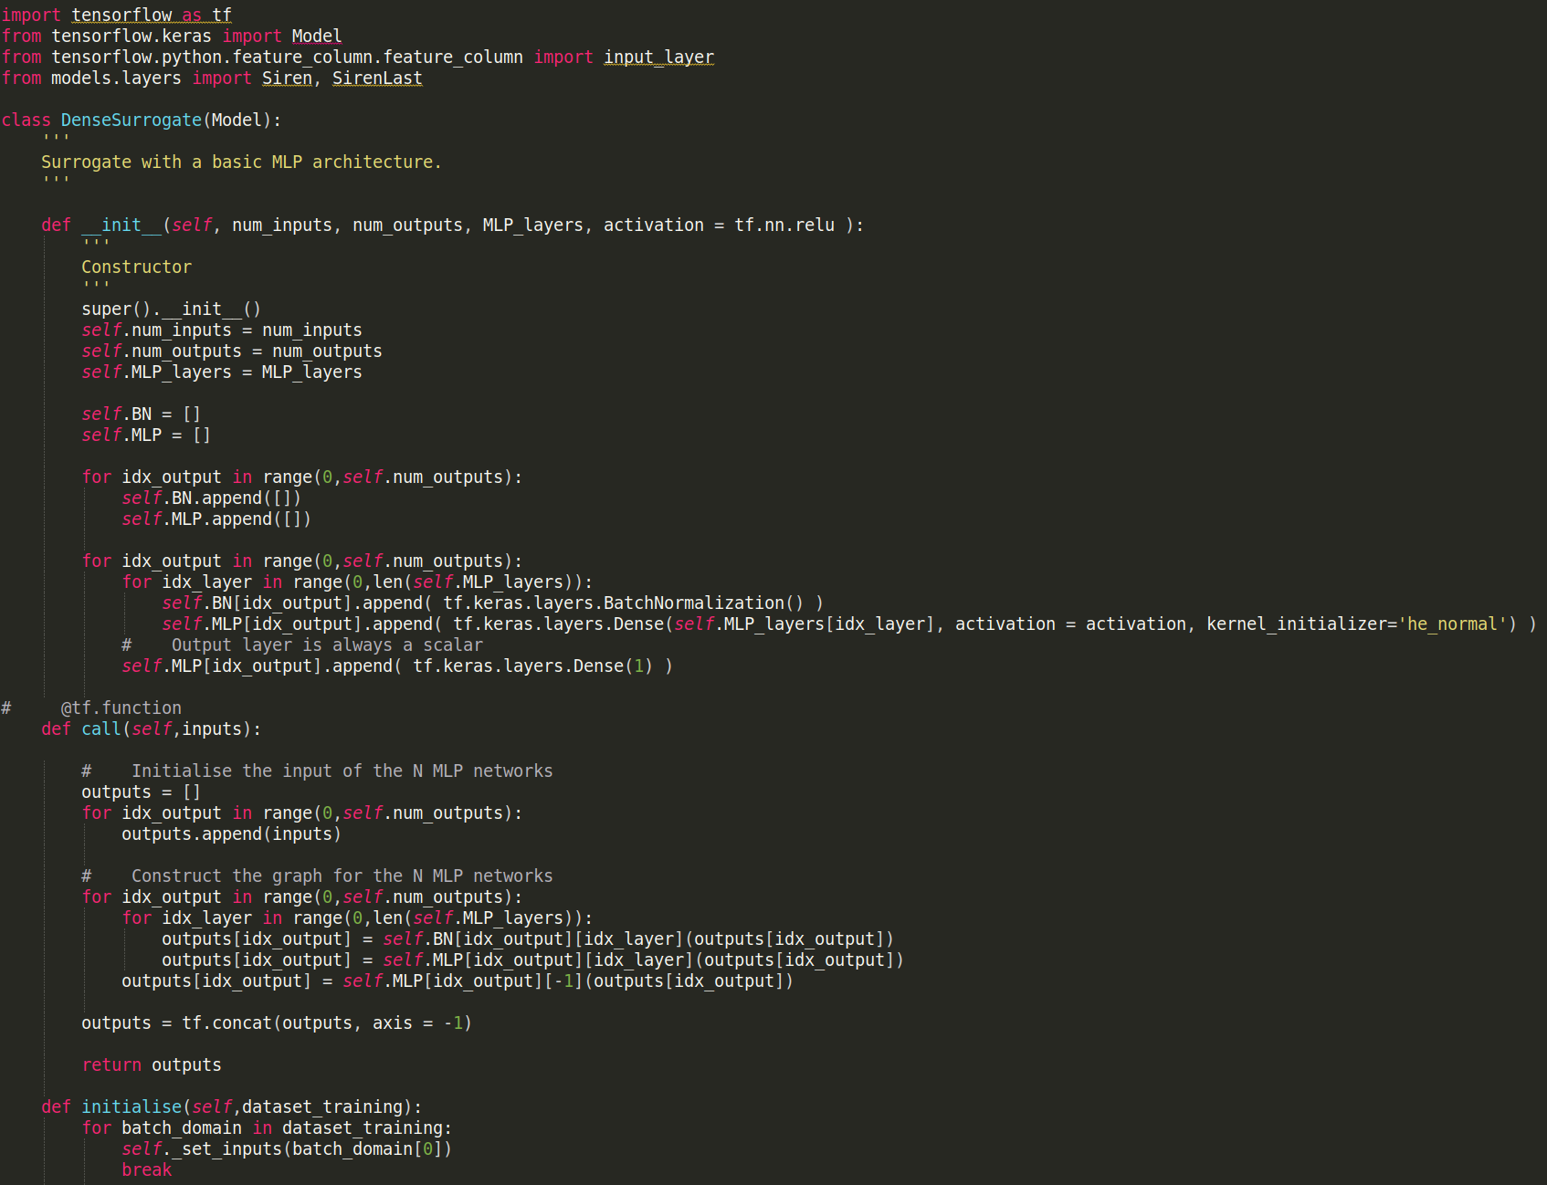
AI-surrogate model – How does it look on code?
Architecture:
MLP with batch normalisation.
One MLP per output.

Slide 22
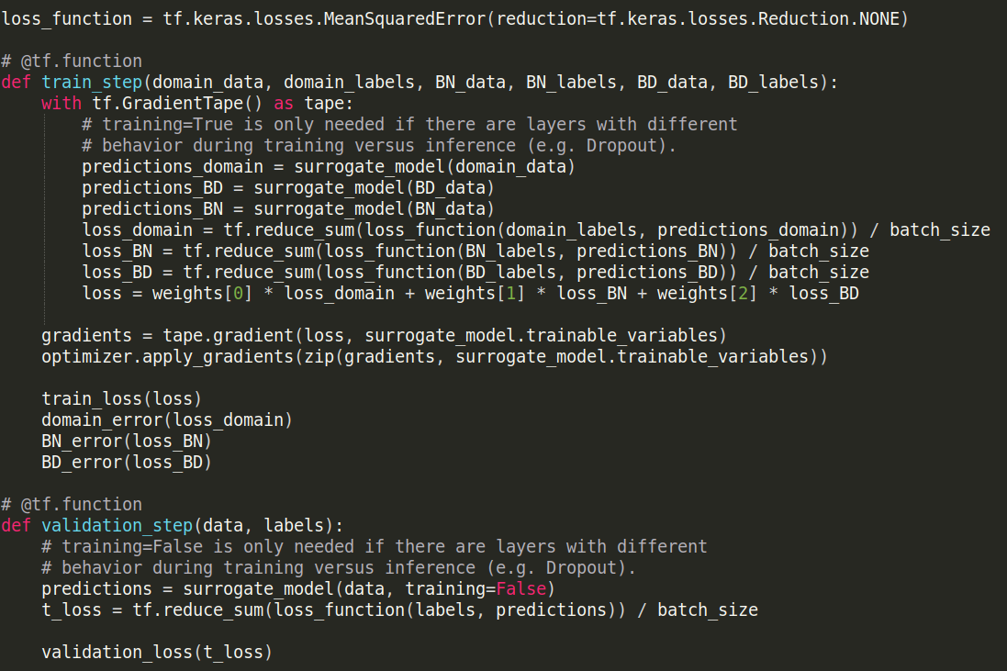
AI-surrogate model – How does it look on code?
Loss function:
BD_data and BD_labels are randomly
generated points in the base of the
ventricle, enforcing the boundary
condition more homogeneously.

Slide 23
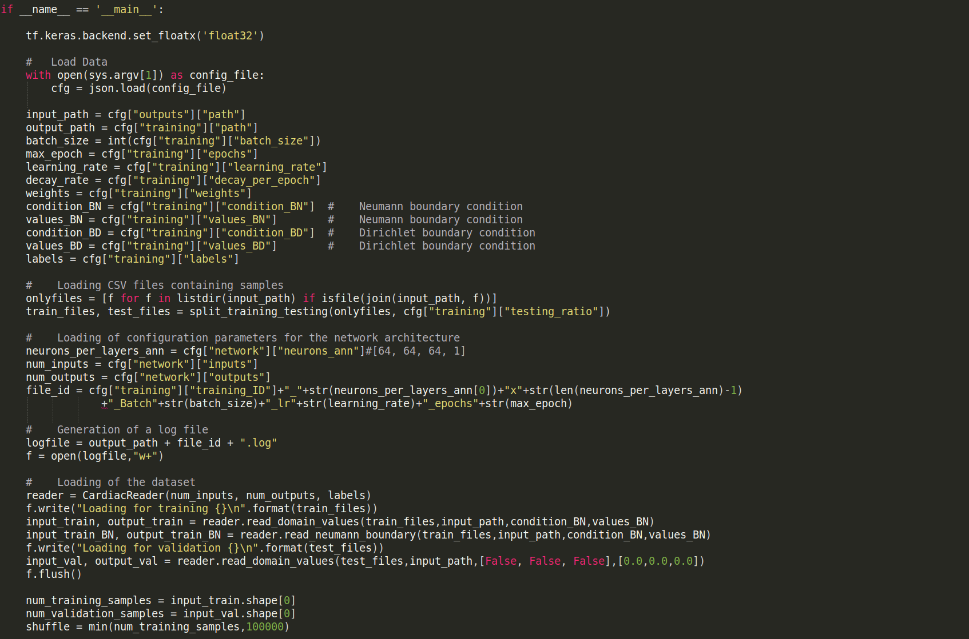
AI-surrogate model – How does it look on code?
Main script:
Configuration files parsing

Slide 24
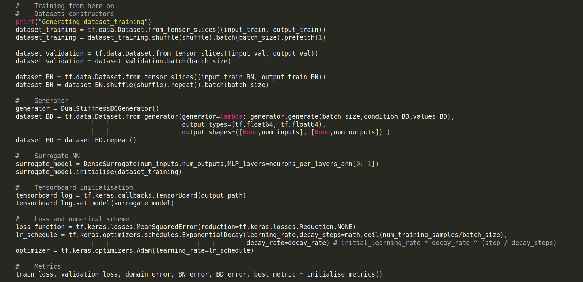
AI-surrogate model – How does it look on code?
Main script:
Training setup

Slide 25
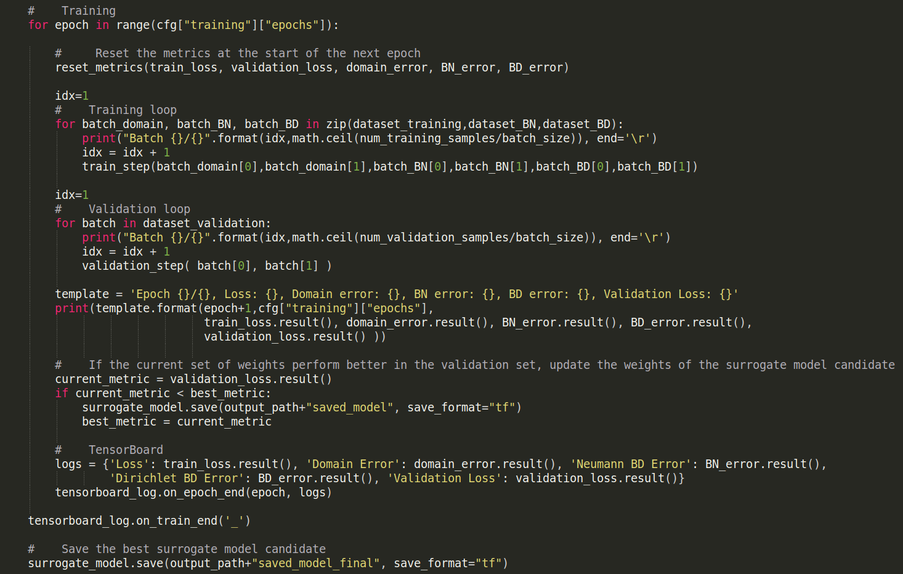
AI-surrogate model – How does it look on code?
Main script:
Training loop

Slide 26
AI-surrogate model – Results

Slide 27
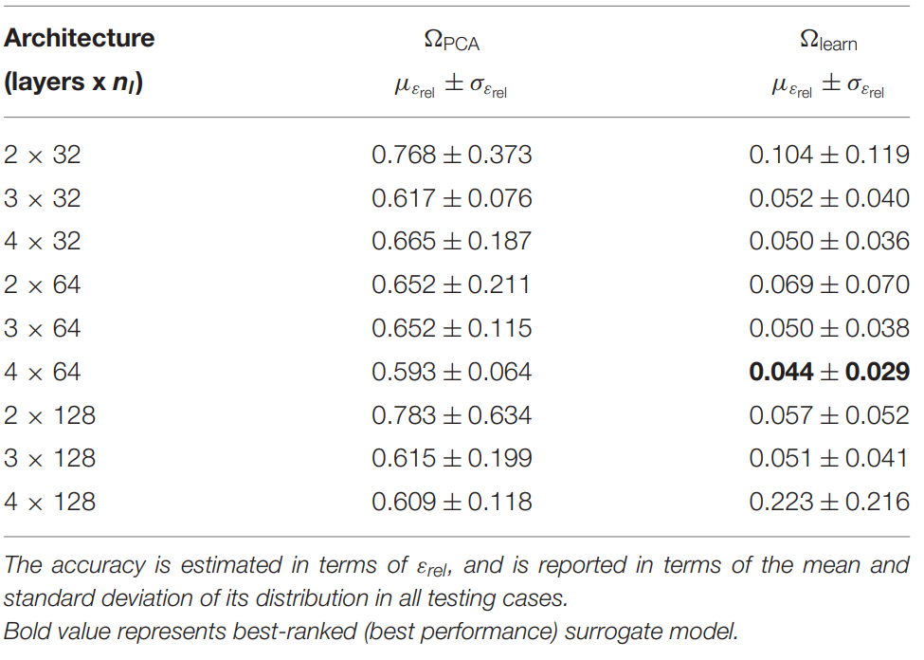
AI-surrogate model – Results
Execution time: Hardware
High-fidelity model 44.515 +/- 0.484 sec Intel Xeon Gold 6136 CPU at 3.00 GHz
AI-surrogate model 0.704 +/- 0.056 sec (acceleration x62.23) TitanXP GPU (3840 cores) at 1400 MHz (379.7 GF)
Training time: 324 sec/epoch * ~500 epochs = ~45 hours

Slide 28
Tutorial: parameter estimation with an AI-surrogate model

Slide 29
AI-surrogate model tutorial
An advantage of using deep learning frameworks (PyTorch, TensorFlow, etc.) is their capability to perform automatic differentiation of the operators (aka neural networks). We compute n-order derivatives of outputs or intermediate layers with respect to:
Network weights (intensively used during training)
Network inputs
This allows computing model sensitivity with respect to inputs and model parameters.
Task 1: Familiarise with the “run_learn_model.py” script, and execute it with the “data_generation_test.gen” configuration file.
Task 2: Execute the inference script “run_execute_prediction.py” script with the pre-trained model from “data_generation_DS_HPC.gen” and visualise errors. Notice that the predictions are in the learning space.
Task 3: Modify the “run_learn_model.py” for parameter estimation, i.e., instead of training the network weights, train two of the inputs, specifically E_1 and E_2. For this, use the pre-trained model used for inference (“data_generation_DS_HPC.gen”), where the weights are already trained. Notice that the network inputs are ordered as [x,y,z,E1,E2,P1,PCA1,PCA2]. As observations, use any of the files in “resources/train_0” folder, which correspond to simulation outputs of the high-fidelity model with different material properties E_1 and E_2. Thus, the result of your parameter estimation when using the data from “training_data_E1_3.0_E2_10.0_PCA1_0.0_PCA2_0.0.csv” should be E_1=3.0 and E_2=10.0.

Slide 30
AI-surrogate model tutorial
Task 3: Modify the “run_learn_model.py” for parameter estimation, i.e., instead of training the network weights, train two of the inputs, specifically E_1 and E_2. For this, use the pre-trained model used for inference (“data_generation_DS_HPC.gen”), where the weights are already trained. Notice that the network inputs are ordered as [x,y,z,E1,E2,P1,PCA1,PCA2].
HINTS: Look at the script “run_parameter_estimation_P.py” for an example of how to train inputs for a given observation.

