Slide 1



VIrtual Twins as tools for personalised clinicAL care
Cardiovascular System Modelling
& Context of Use:
When, Why, and How Complex?
Dr Beatrice Ghitti [beatrice.ghitti@auckland.ac.nz]
Dr Finbar Argus [finbar.argus@auckland.ac.nz]
Postgraduate Training School #2
University of Auckland, Feb 9-12, 2026

Slide 2

Outline
PART I: CVS modelling & Context of use
Why do we need modelling “simplifications”?
Context of use
PART II: What options do we have?
From 3D to 1D models
Hetero-dimensional models & Geometric multiscale
PART III: Does one size fit all?
Sensitivity analysis
Identifiability analysis
& Model calibration in a nutshell

Slide 3
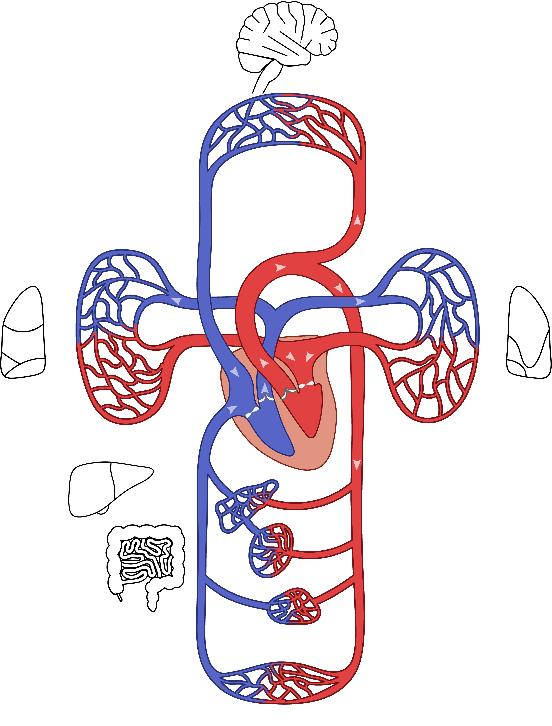
PART I: CVS modelling & Context of use
“From experimental and clinical data acquisition to the personalisation of physiological models, […] to build a complete workflow for constructing cardiovascular digital twins, with applications to in-silico clinical trials, hypotheses testing, biomarker discovery, and more.”
What are the challenges of constructing and personalising complex and comprehensive physiological and computational models, and of using them, for instance, in clinical settings?
WHY do we need “simplifications”?

Slide 4
CVS modelling & Context of use
What are the challenges of constructing and personalising complex and comprehensive physiological and computational models, and of using them, for instance, in clinical settings?
WHY do we need “simplifications”?
Limited data or with noise
Computational complexity (vs clinical timeframes)
Parameter identifiability
?
??
???

Slide 5
CVS modelling & Context of use
WHERE do we need to simplify?
What districts of the system?
What spatial scales?
WHAT do we need to simplify?
Function/physiology
Anatomy
WHEN do we need to simplify?
These choices are guided by the specific applications / scientific questions to answer / physiological hypotheses to test
…the context of use of the model!
HOW can we simplify in a mathematically and biologically/physiologically valid way?
WHO?
Modellers and clinicians!

Slide 6
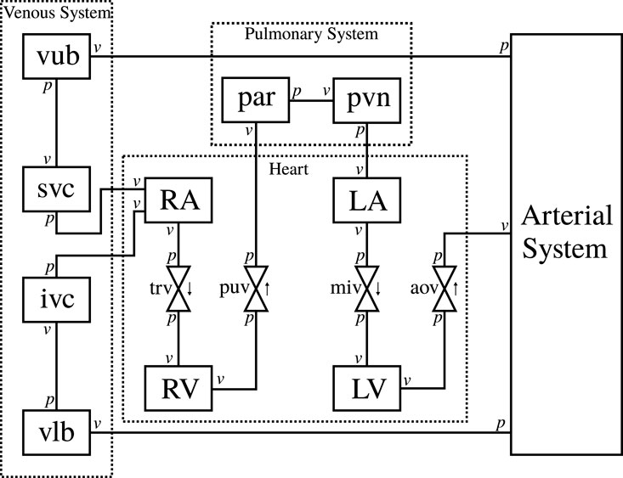
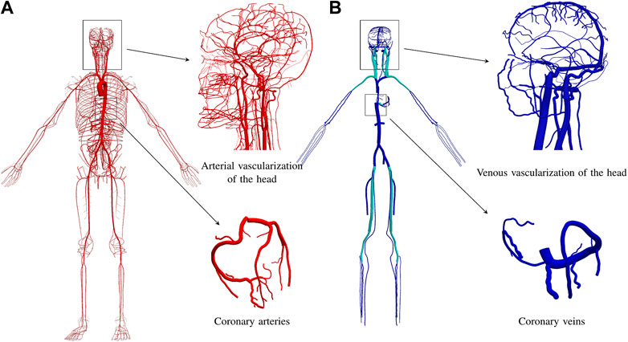

CVS modelling & Context of use
💡 a context of use $⇄$ a CVS model
Anatomical complexity/simplification & Personalisation
Interactions with other systems
Model reduction and Hetero-dimensional models
Physiological personalization
Accuracy vs Computational cost (time-sensitive clinical applications)
Model sophistication for
biological mechanisms
mechanical characteristics
A simplified circulatory system model²
ADAVN model¹

Slide 7
CVS modelling & Context of use
💡🤔 Now, think of your context of use and keep it in mind…

Slide 8

CVS modelling & Context of use
💡 a context of use $⇄$ a CVS model
Model reduction and Hetero-dimensional models

Slide 9
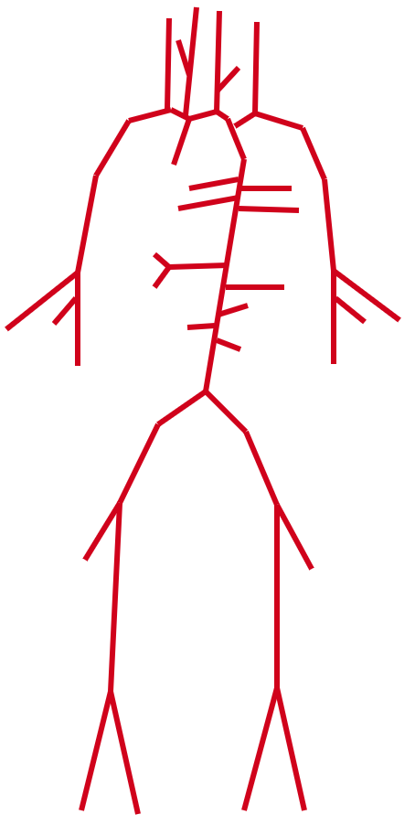
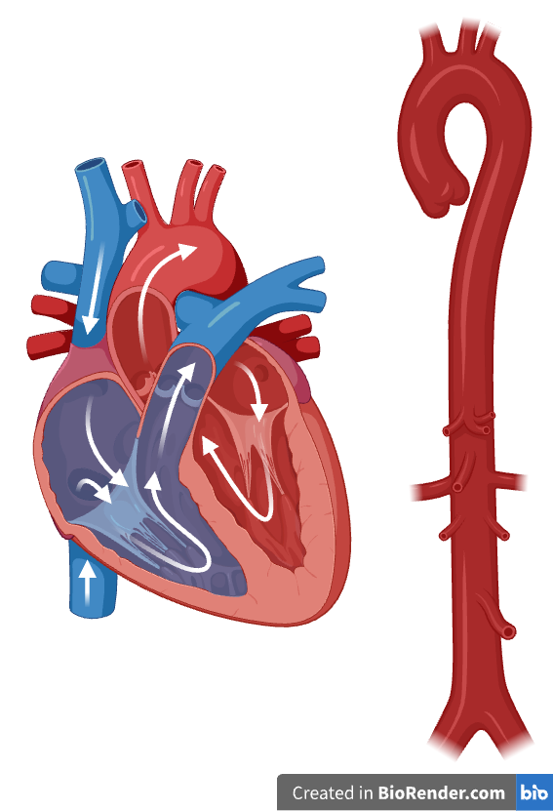
CVS modelling & Context of use
💡 a context of use $⇄$ a CVS model
Accuracy
3D models
Model reduction and Hetero-dimensional models
1D models
Geometric multi-scale modelling approach
0D models
Computational cost

Slide 10
PART II: Geometric multiscale – what options do we have?
Accuracy
3D models
1D models
0D models
Computational cost

Slide 11
PART II: Geometric multiscale – what options do we have?
Accuracy
3D models
surrogates
High-fidelity models
1D models
Low-fidelity models
0D models
Computational cost

Slide 12
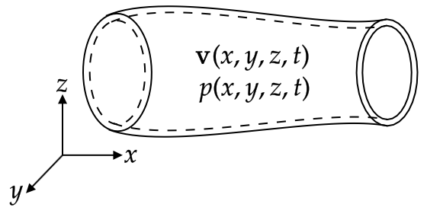
Geometric multiscale – what options do we have?
3D models:
Resolve local details;
Account for blood flow features (blood rheology, velocity vectors, wall shear stresses, interaction between blood flow and vessel wall deformation);
Investigate the eﬀects of geometry.
Plaque formation, aneurysm formation, valve dysfunction, testing of medical devices (e.g., stents),…
Accuracy
3D models
1D models
0D models
Computational cost

Slide 13
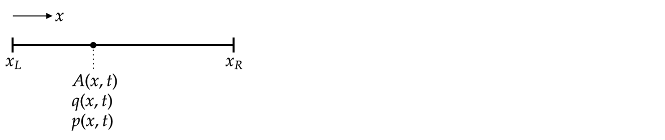
Geometric multiscale – what options do we have?
1D models:
Describe and analyse flow patterns, pressure wave propagation and reflection, average velocities in networks of vessels;
Compute local and global pulse wave velocity (PWV);
Offer good trade-off between accuracy and computational cost in simulating systemic hemodynamics.
Accuracy
3D models
1D models
0D models
Computational cost

Slide 14
Geometric multiscale – what options do we have?
0D models:
Simulate global hemodynamics in the whole system, via spatially-homogeneous fields within any 0D compartment;
Provide BCs to 1D/3D models;
Have physical parameters usually quantifiable from clinical measurements.
Accuracy
3D models
1D models
0D models
Computational cost

Slide 15
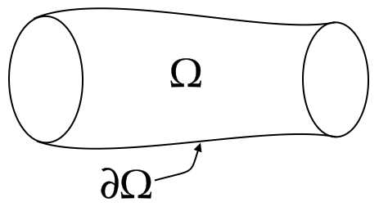
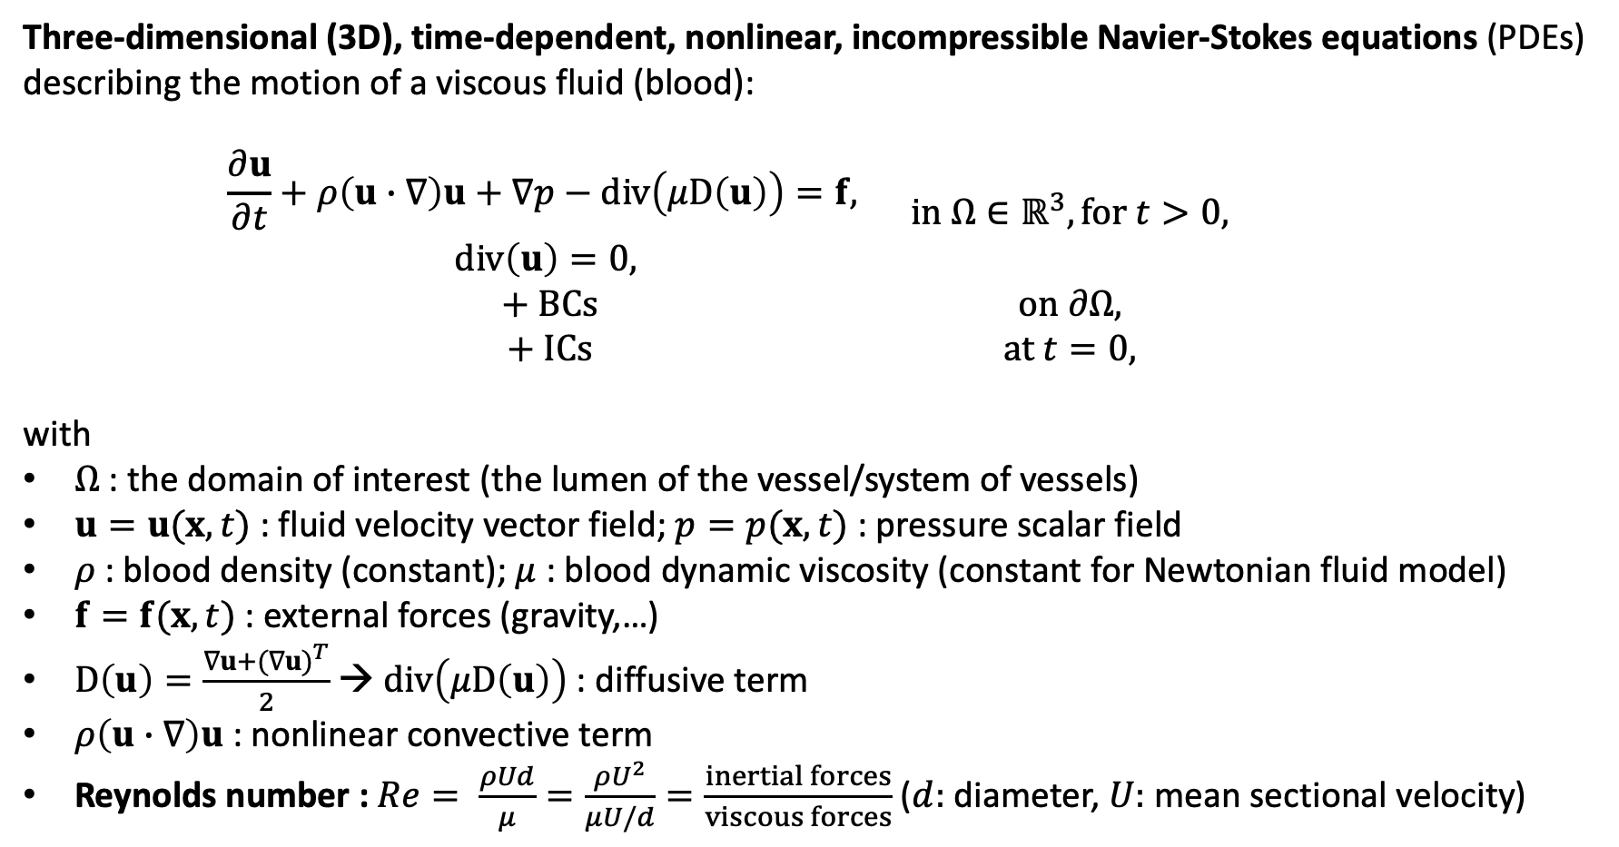
3D Navier-Stokes equations of fluid dynamics
Three-dimensional (3D), time-dependent, nonlinear, incompressible Navier-Stokes equations (PDEs) describing the motion of a viscous fluid (blood):
$$\begin{matrix}\begin{matrix}\frac{∂u}{∂t}+ρ\left(u∙∇\right)u+∇p−div\left(μD\left(u\right)\right)=f, \\ div\left(u\right)=0\text{,} \end{matrix} & in Ω∈ℝ^{3}, for t>0, \\ + BCs & on ∂Ω, \\ + ICs & at t=0,\end{matrix}$$
with
$Ω$ : the domain of interest (the lumen of the vessel/system of vessels)
$u=u(x,t)$ : fluid velocity vector field; $p=p(x,t)$ : pressure scalar field
$ρ$ : blood density (constant); $μ$ : blood dynamic viscosity (constant for Newtonian fluid model)
$f=f(x,t)$ : external forces (gravity,…)
$D\left(u\right)=\frac{∇u+{(∇u)}^{T}}{2}$ → $div\left(μD\left(u\right)\right)$ : diffusive term
$ρ\left(u∙∇\right)u$ : nonlinear convective term
Reynolds number : $Re= \frac{ρUd}{μ}=\frac{ρU^{2}}{μU/d}=\frac{inertial forces}{viscous forces}$ ($d:$ diameter, $U:$ mean sectional velocity)
Notes:
Navier-Stokes eqs: balance of momentum = inertial forces + pressure forces + viscous forces
Conservation of mass / continuity eq (under incompressibility assumption)

Slide 16
3D Navier-Stokes equations of fluid dynamics
Three-dimensional (3D), time-dependent, nonlinear, incompressible Navier-Stokes equations (PDEs) describing the motion of a viscous fluid (blood):
$$\begin{matrix}\begin{matrix}\frac{∂u}{∂t}+ρ\left(u∙∇\right)u+∇p−div\left(μD\left(u\right)\right)=f, \\ div\left(u\right)=0\text{,} \end{matrix} & in Ω∈ℝ^{3}, for t>0, \\ + BCs & on ∂Ω, \\ + ICs & at t=0,\end{matrix}$$
with
$Ω$ : the domain of interest (the lumen of the vessel/system of vessels)
$u=u(x,t)$ : fluid velocity vector field; $p=p(x,t)$ : pressure scalar field
$ρ$ : blood density (constant); $μ$ : blood dynamic viscosity (constant for Newtonian fluid model)
$f=f(x,t)$ : external forces (gravity,…)
$D\left(u\right)=\frac{∇u+{(∇u)}^{T}}{2}$ → $div\left(μD\left(u\right)\right)$ : diffusive term
$ρ\left(u∙∇\right)u$ : nonlinear convective term
Reynolds number : $Re= \frac{ρUd}{μ}=\frac{ρU^{2}}{μU/d}=\frac{inertial forces}{viscous forces}$ ($d:$ diameter, $U:$ mean sectional velocity)
Fluid-Structure Interaction (FSI) approach
Navier-Stokes equations of fluid dynamics (blood), coupled with
Equations of solid mechanics for the 3D structure (deformable vessel wall), via BCs.
Computational Fluid Dynamics (CFD)
Notes:
Navier-Stokes eqs: balance of momentum = inertial forces + pressure forces + viscous forces
Conservation of mass / continuity eq (under incompressibility assumption)

Slide 17
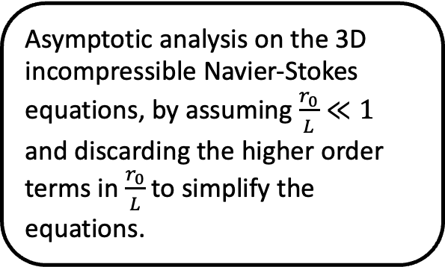
1D averaged blood flow model
Several ways of deriving a one-dimensional (1D) model of an incompressible fluid flowing in a compliant pipe.
[see Formaggia, Quarteroni & Veneziani, Eds, (2009), doi: 10.1007/978-88-470-1152-6]
Asymptotic analysis on the 3D incompressible Navier-Stokes equations, by assuming $\frac{r_{0}}{L}≪1$ and discarding the higher order terms in $\frac{r_{0}}{L}$ to simplify the equations.
Integrating the Navier-Stokes equations on a generic section, by assuming cylindrical symmetry.
Making use of the Reynolds’ transport theorem, to derive the 1D mass conservation and momentum balance equations.
→ More general approach, no simplifying assumptions on the vessel section geometry.

Slide 18
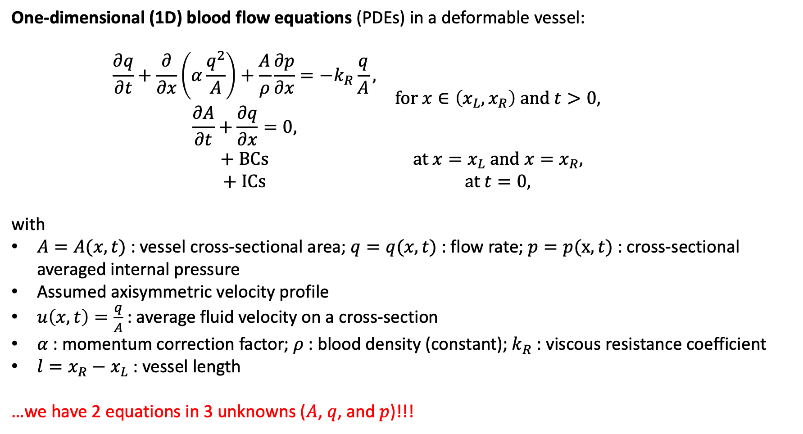
1D averaged blood flow model
One-dimensional (1D) blood flow equations (PDEs) in a deformable vessel:
$$\begin{matrix}\begin{matrix}\frac{∂q}{∂t}+\frac{∂}{∂x}\left(α\frac{q^{2}}{A}\right)+\frac{A}{ρ}\frac{∂p}{∂x}=−k_{R}\frac{q}{A}\text{,} \\ \frac{∂A}{∂t}+\frac{∂q}{∂x}=0,\end{matrix} & for x∈\left(x_{L},x_{R}\right) and t>0, \\ + BCs & at x=x_{L} and x=x_{R}, \\ + ICs & at t=0,\end{matrix}$$
with
$A=A(x,t)$ : vessel cross-sectional area; $q=q(x,t)$ : flow rate; $p=p(x,t)$ : cross-sectional averaged internal pressure
Assumed axisymmetric velocity profile
$u\left(x,t\right)=\frac{q}{A}$ : average fluid velocity on a cross-section
$α$ : momentum correction factor; $ρ$ : blood density (constant); $k_{R}$ : viscous resistance coefficient
$l=x_{R}−x_{L}$ : vessel length
…we have 2 equations in 3 unknowns ($A$, $q$, and $p$)!!!
Notes:
Balance of momentum eq = convective term + pressure gradient + friction force per unit length
Mass conservation eq / continuity eq

Slide 19
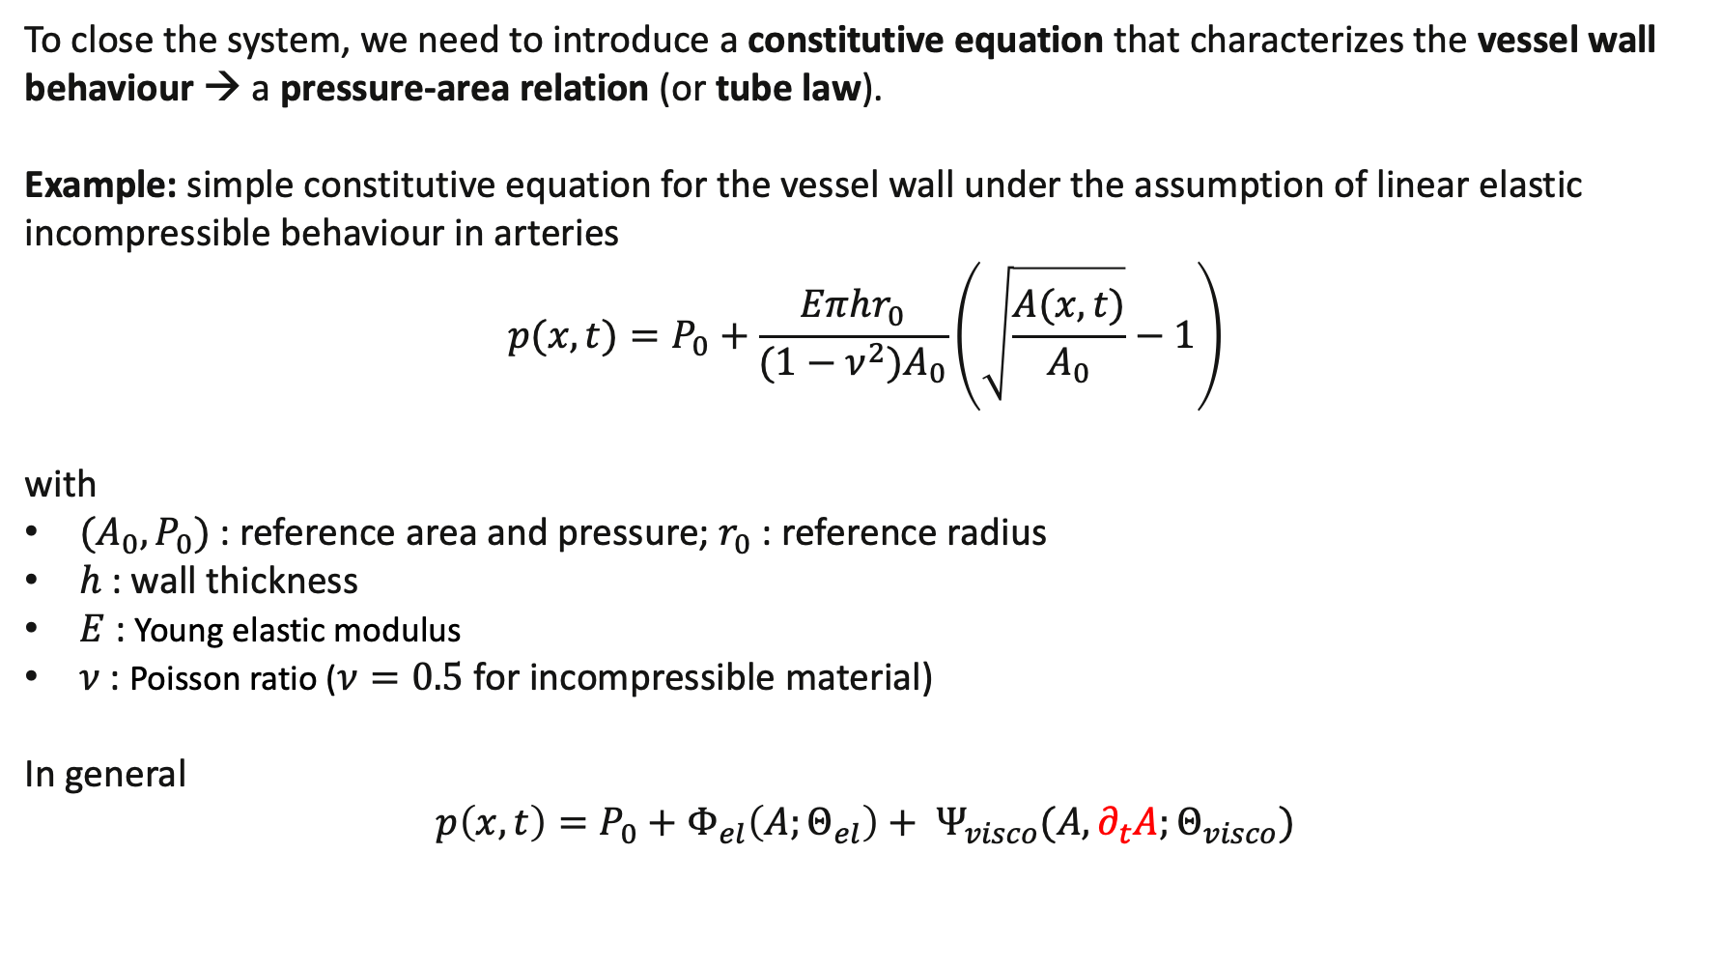

1D averaged blood flow model
To close the system, we need to introduce a constitutive equation that characterizes the vessel wall behaviour → a pressure-area relation (or tube law).
Example: simple constitutive equation for the vessel wall under the assumption of linear elastic incompressible behaviour in arteries
$$p(x,t)=P_{0}+\frac{Eπhr_{0}}{(1−ν^{2})A_{0}}\left(\sqrt{\frac{A(x,t)}{A_{0}}}−1\right)$$
with
$(A_{0},P_{0})$ : reference area and pressure; $r_{0}$ : reference radius
$h$ : wall thickness
$E$ : Young elastic modulus
$ν$ : Poisson ratio ($ν=0.5$ for incompressible material)
In general
$$p\left(x,t\right)=P_{0}+Φ_{el}\left(A;Θ_{el}\right)+ Ψ_{visco}(A,∂_{t}A;Θ_{visco})$$
More details in tomorrow’s lecture on constitutive modelling by A. Giudici!!!
$K$ : vessel wall stiffness parameter
elastic component
viscoelastic component (Voigt-type)

Slide 20
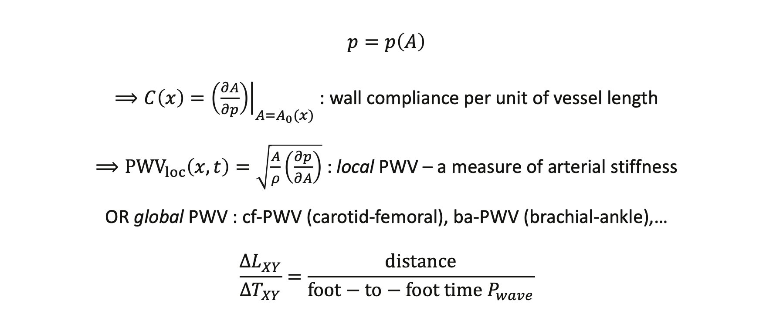
Pulse wave velocity (PWV)
$$p=p\left(A\right)$$
$⟹C\left(x\right)={\left.\left(\frac{∂A}{∂p}\right)\right|}_{A=A_{0}(x)}$ : wall compliance per unit of vessel length
$⟹{PWV}_{loc}\left(x,t\right)=\sqrt{\frac{A}{ρ}\left(\frac{∂p}{∂A}\right)}$ : local PWV – a measure of arterial stiffness
OR global PWV : cf-PWV (carotid-femoral), ba-PWV (brachial-ankle),…
$$\frac{∆L_{XY}}{∆T_{XY}}=\frac{distance}{foot−to−foot time P_{wave}}$$

Slide 21
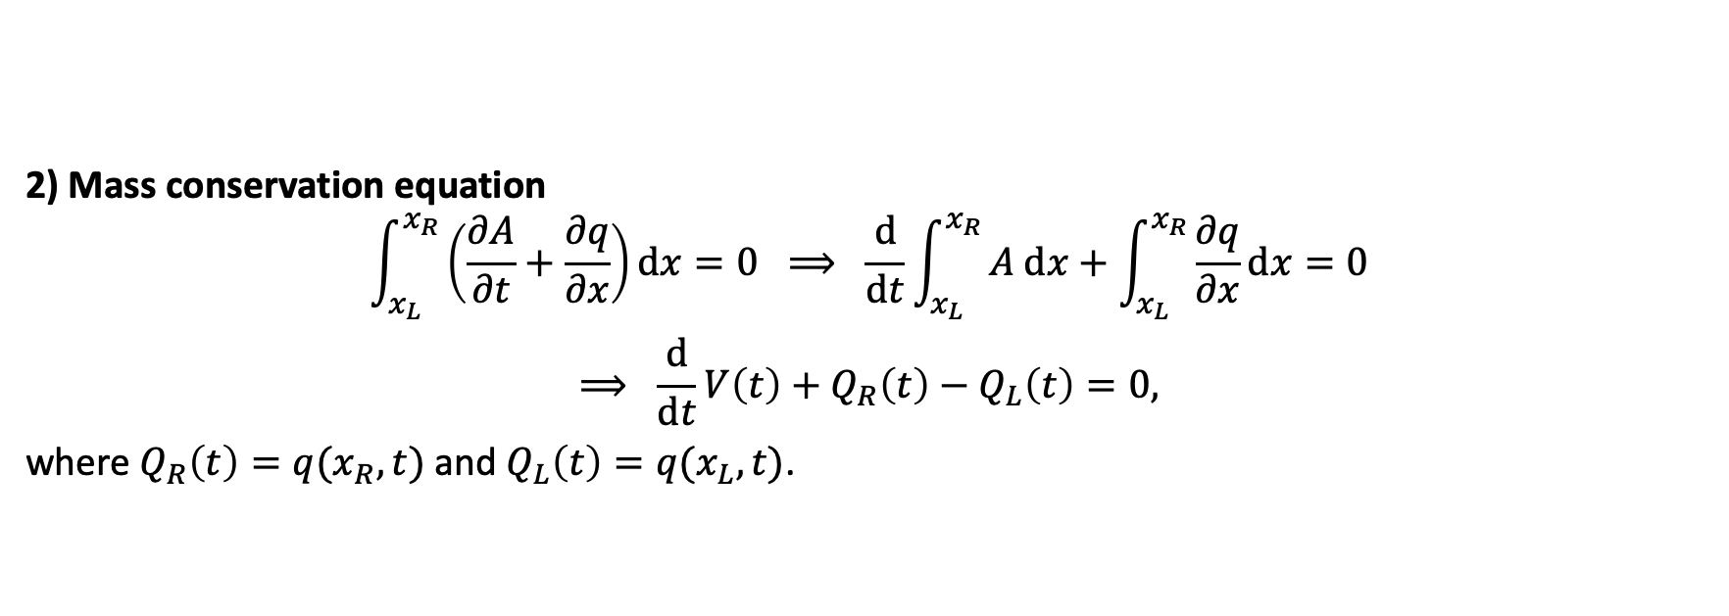
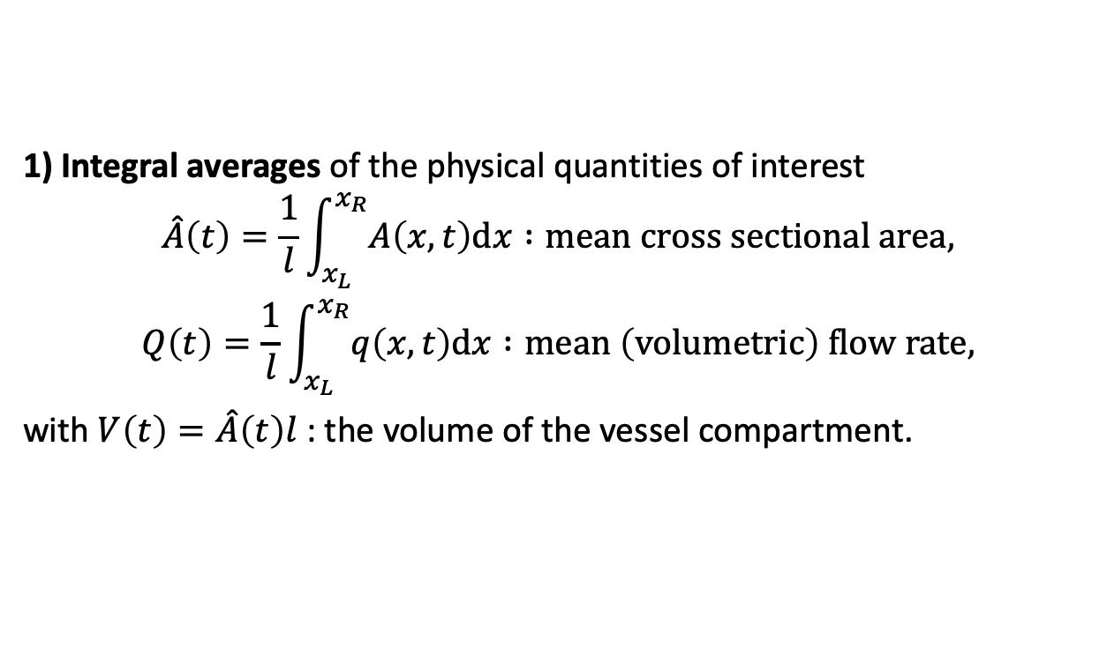
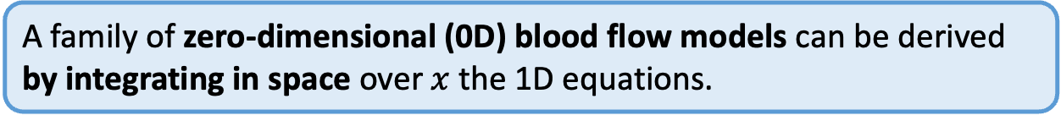
Derivation of 0D blood flow models
A family of zero-dimensional (0D) blood flow models can be derived by integrating in space over $x$ the 1D equations.
1) Integral averages of the physical quantities of interest
$$\begin{matrix}\hat{A}\left(t\right)=\frac{1}{l}\int_{x_{L}}^{x_{R}}{A\left(x,t\right)dx} :mean cross sectional area, \\ Q\left(t\right)=\frac{1}{l}\int_{x_{L}}^{x_{R}}{q\left(x,t\right)dx :mean \left(volumetric\right) flow rate,}\end{matrix}$$
with $V\left(t\right)=\hat{A}\left(t\right)l$ : the volume of the vessel compartment.
2) Mass conservation equation
$$\int_{x_{L}}^{x_{R}}{\left(\frac{∂A}{∂t}+\frac{∂q}{∂x}\right)dx=0} ⟹ \frac{d}{dt}\int_{x_{L}}^{x_{R}}{A dx+\int_{x_{L}}^{x_{R}}{\frac{∂q}{∂x}dx=0}}$$
$$⟹ \frac{d}{dt}V\left(t\right)+Q_{R}\left(t\right)−Q_{L}\left(t\right)=0,$$
where $Q_{R}\left(t\right)=q(x_{R},t)$ and $Q_{L}\left(t\right)=q(x_{L},t)$.

Slide 22
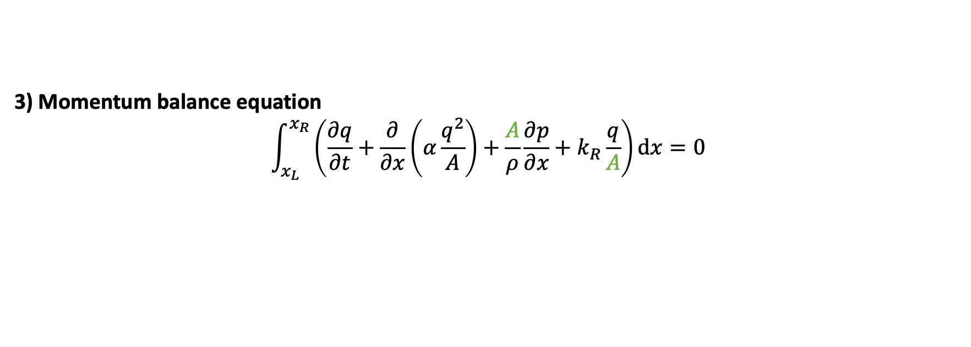
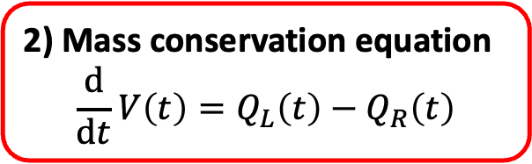
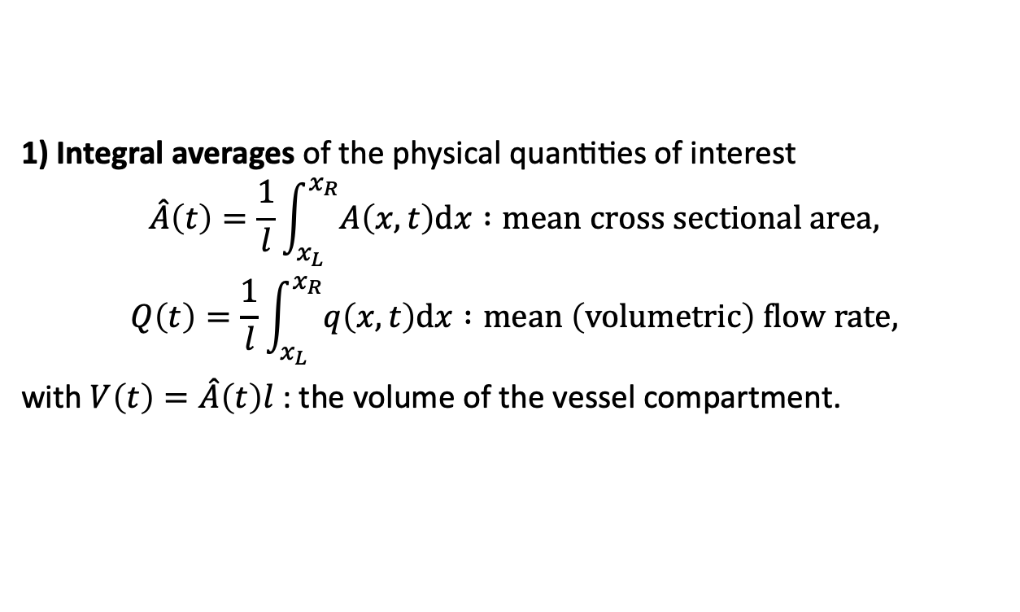
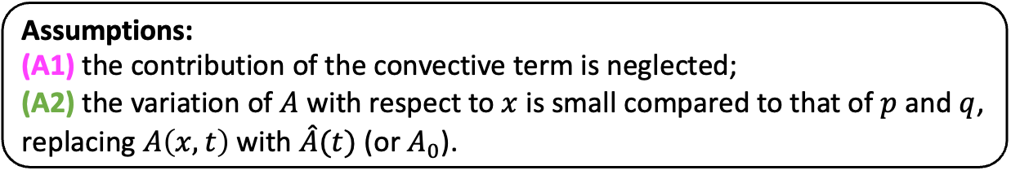
Derivation of 0D blood flow models
A family of zero-dimensional (0D) blood flow models can be derived by integrating in space over $x$ the 1D equations.
1) Integral averages of the physical quantities of interest
$$\begin{matrix}\hat{A}\left(t\right)=\frac{1}{l}\int_{x_{L}}^{x_{R}}{A\left(x,t\right)dx} :mean cross sectional area, \\ Q\left(t\right)=\frac{1}{l}\int_{x_{L}}^{x_{R}}{q\left(x,t\right)dx :mean \left(volumetric\right) flow rate,}\end{matrix}$$
with $V\left(t\right)=\hat{A}\left(t\right)l$ : the volume of the vessel compartment.
2) Mass conservation equation
$$\frac{d}{dt}V\left(t\right)=Q_{L}\left(t\right)−Q_{R}\left(t\right)$$
3) Momentum balance equation
$$\int_{x_{L}}^{x_{R}}{\left(\frac{∂q}{∂t}+\frac{∂}{∂x}\left(α\frac{q^{2}}{A}\right)+\frac{A}{ρ}\frac{∂p}{∂x}+k_{R}\frac{q}{A}\right)dx=0}$$
Assumptions:
(A1) the contribution of the convective term is neglected;
(A2) the variation of $A$ with respect to $x$ is small compared to that of $p$ and $q$, replacing $A\left(x,t\right)$ with $\hat{A}(t)$ (or $A_{0}$).

Slide 23
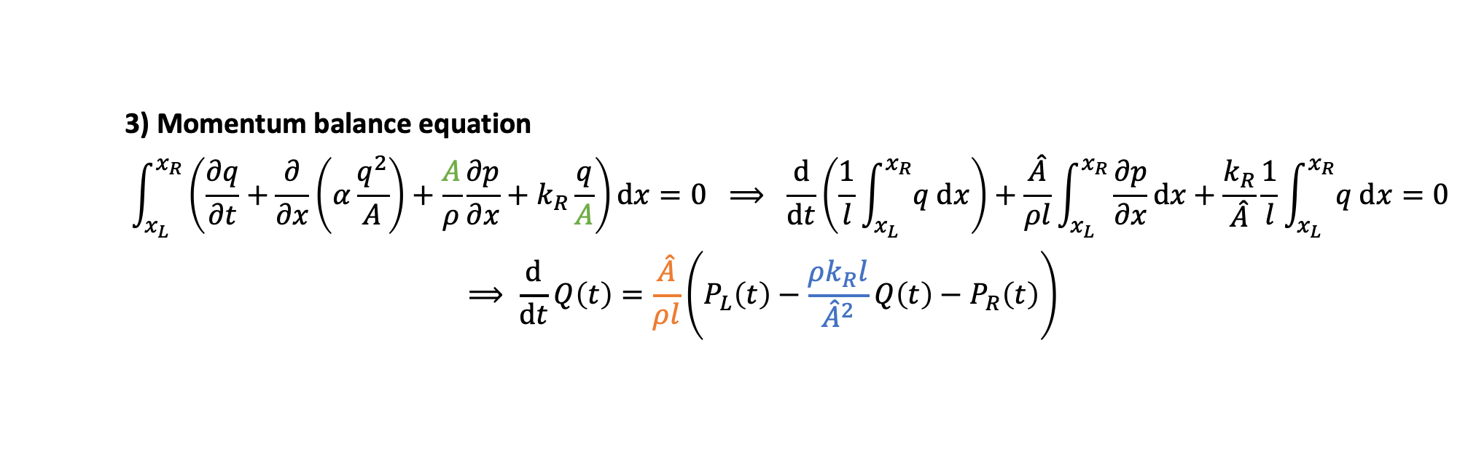


Derivation of 0D blood flow models
A family of zero-dimensional (0D) blood flow models can be derived by integrating in space over $x$ the 1D equations.
1) Integral averages of the physical quantities of interest
$$\begin{matrix}\hat{A}\left(t\right)=\frac{1}{l}\int_{x_{L}}^{x_{R}}{A\left(x,t\right)dx} :mean cross sectional area, \\ Q\left(t\right)=\frac{1}{l}\int_{x_{L}}^{x_{R}}{q\left(x,t\right)dx :mean \left(volumetric\right) flow rate,}\end{matrix}$$
with $V\left(t\right)=\hat{A}\left(t\right)l$ : the volume of the vessel compartment.
2) Mass conservation equation
$$\frac{d}{dt}V\left(t\right)=Q_{L}\left(t\right)−Q_{R}\left(t\right)$$
3) Momentum balance equation
$$\int_{x_{L}}^{x_{R}}{\left(\frac{∂q}{∂t}+\frac{∂}{∂x}\left(α\frac{q^{2}}{A}\right)+\frac{A}{ρ}\frac{∂p}{∂x}+k_{R}\frac{q}{A}\right)dx=0 ⟹ \frac{d}{dt}\left(\frac{1}{l}\int_{x_{L}}^{x_{R}}{q dx}\right)+\frac{\hat{A}}{ρl}\int_{x_{L}}^{x_{R}}{\frac{∂p}{∂x}dx}+\frac{k_{R}}{\hat{A}}\frac{1}{l}\int_{x_{L}}^{x_{R}}{q dx=0}}$$
$$⟹ \frac{d}{dt}Q\left(t\right)=\frac{\hat{A}}{ρl}\left(P_{L}\left(t\right)−\frac{ρk_{R}l}{{\hat{A}}^{2}}Q\left(t\right)−P_{R}\left(t\right)\right)$$
inverse of inductance $I$
resistance $R$

Slide 24
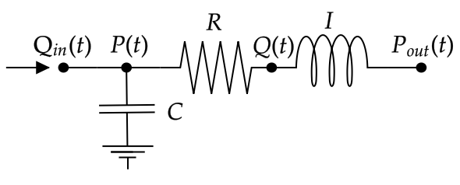
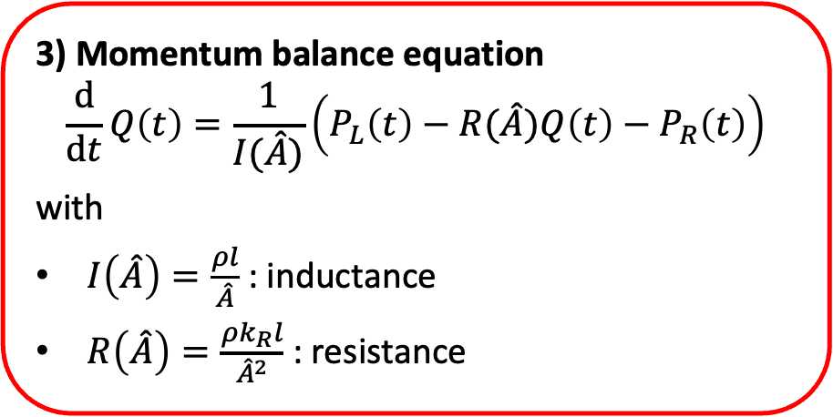
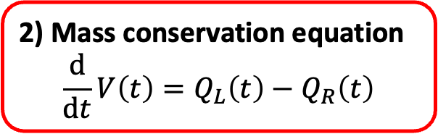
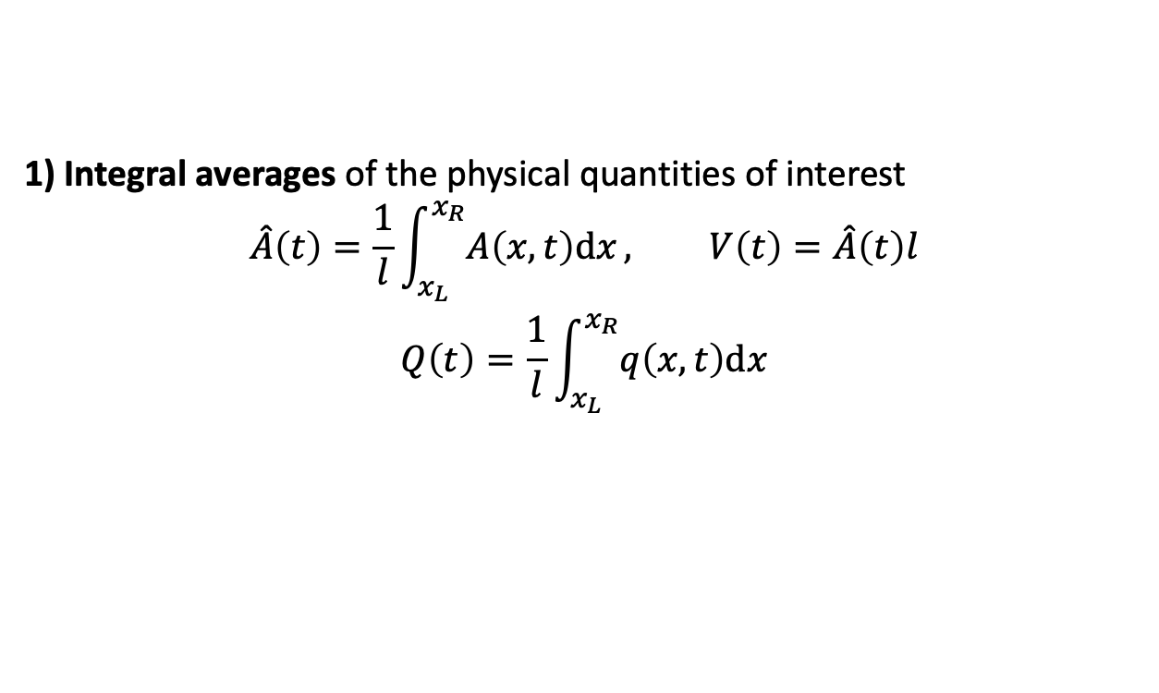
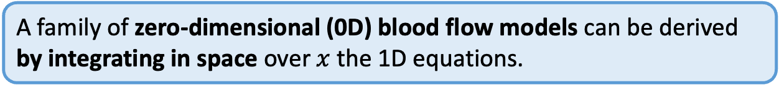
Derivation of 0D blood flow models
A family of zero-dimensional (0D) blood flow models can be derived by integrating in space over $x$ the 1D equations.
1) Integral averages of the physical quantities of interest
$$\begin{matrix}\hat{A}\left(t\right)=\frac{1}{l}\int_{x_{L}}^{x_{R}}{A\left(x,t\right)dx}, V\left(t\right)=\hat{A}\left(t\right)l \\ Q\left(t\right)=\frac{1}{l}\int_{x_{L}}^{x_{R}}{q\left(x,t\right)dx}\end{matrix}$$
2) Mass conservation equation
$$\frac{d}{dt}V\left(t\right)=Q_{L}\left(t\right)−Q_{R}\left(t\right)$$
3) Momentum balance equation
$$\frac{d}{dt}Q\left(t\right)=\frac{1}{I(\hat{A})}\left(P_{L}\left(t\right)−R(\hat{A})Q\left(t\right)−P_{R}\left(t\right)\right)$$
with
$I\left(\hat{A}\right)=\frac{ρl}{\hat{A}}$ : inductance
$R\left(\hat{A}\right)=\frac{ρk_{R}l}{{\hat{A}}^{2}}$ : resistance
???

Slide 25
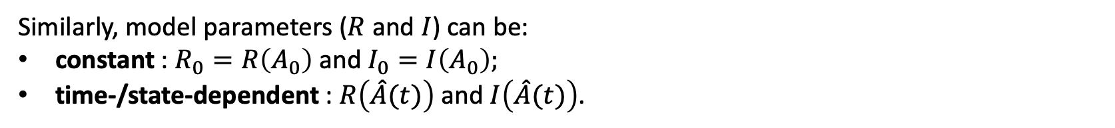
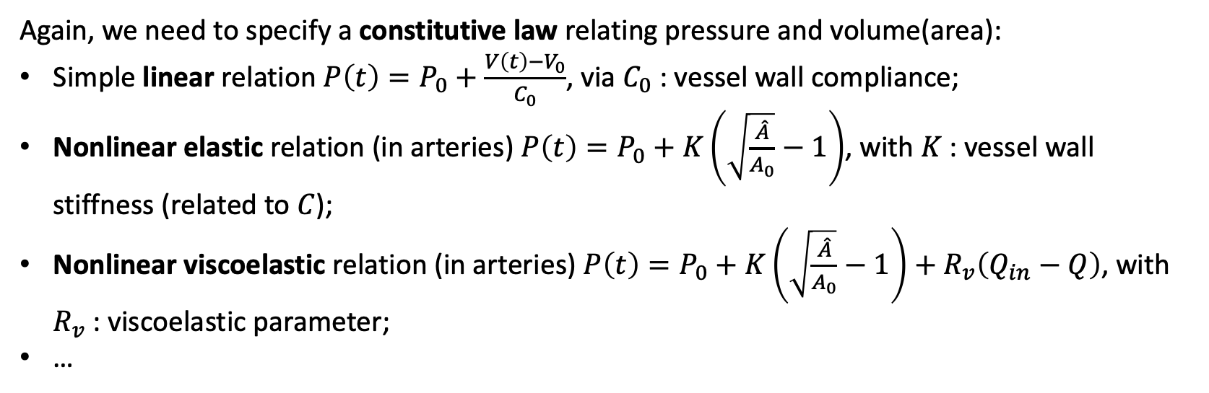
0D blood flow models
Again, we need to specify a constitutive law relating pressure and volume(area):
Simple linear relation $P\left(t\right)=P_{0}+\frac{V\left(t\right)−V_{0}}{C_{0}}$, via $C_{0}$ : vessel wall compliance;
Nonlinear elastic relation (in arteries) $P\left(t\right)=P_{0}+K\left(\sqrt{\frac{\hat{A}}{A_{0}}}−1\right)$, with $K$ : vessel wall stiffness (related to $C$);
Nonlinear viscoelastic relation (in arteries) $P\left(t\right)=P_{0}+K\left(\sqrt{\frac{\hat{A}}{A_{0}}}−1\right)+R_{v}\left(Q_{in}−Q\right)$, with $R_{v}$ : viscoelastic parameter;
…
Nonlinear vs linear dynamics,
Time-/space-/state-dependent vs constant parameters,
…
→ Model sophistication for biological mechanisms and mechanical characteristics.
Similarly, model parameters ($R$ and $I$) can be:
constant : $R_{0}=R\left(A_{0}\right)$ and $I_{0}=I\left(A_{0}\right);$
time-/state-dependent : $R\left(\hat{A}(t)\right)$ and $I\left(\hat{A}(t)\right)$.

Slide 26
How to use 0D models
Model reduction
1D → 0D
From micro- to macro-scale
One 0D lumped compartment with equivalent hemodynamic function
More details in tomorrow’s lecture on multiscale modelling by G. Maso Talou!!!

Slide 27
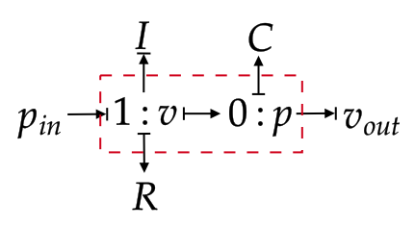
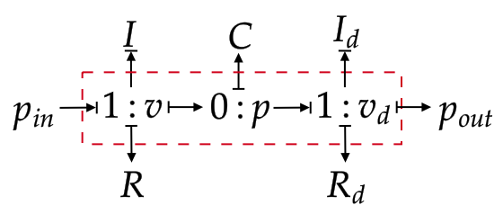
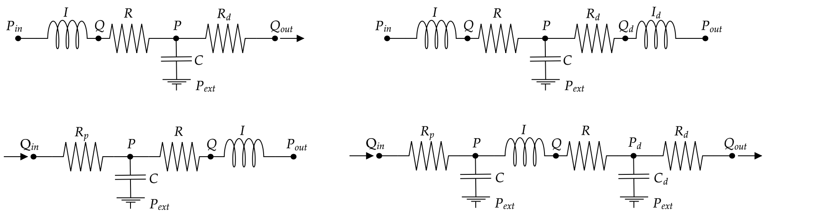
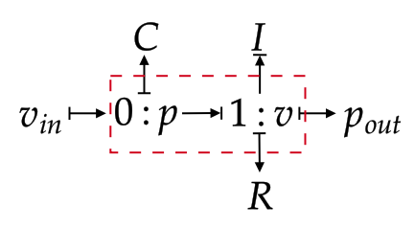
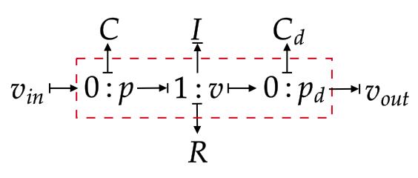
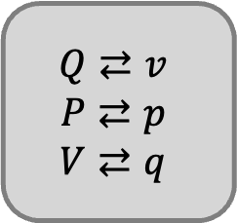
Comparing 0D & BG-0D models
Refreshing what we’ve learnt from P. Hunter’s lecture…
$$Q⇄v$$
$$P⇄p$$
$$V⇄q$$

Slide 28
Comparing 0D & BG-0D models
Refreshing what we’ve learnt from P. Hunter’s lecture…
$$Q⇄v$$
$$P⇄p$$
$$V⇄q$$
A modular framework for CVS modelling
Integrated whole-body physiology models from cellular to organ and system levels

Slide 29
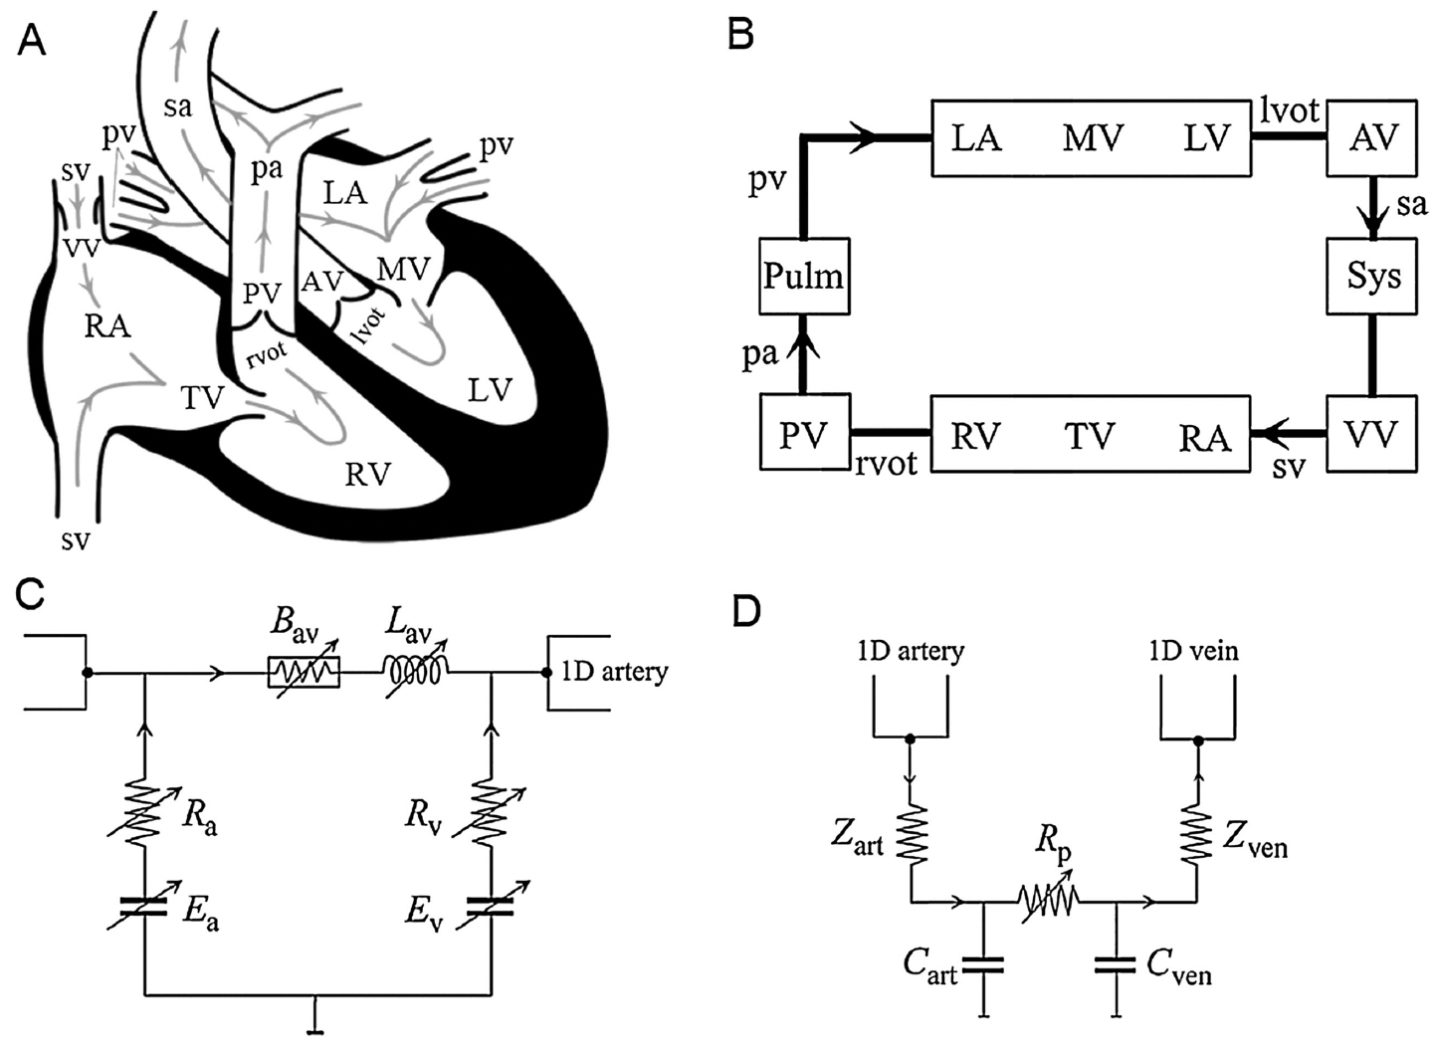

0D heart and valve models
Valve model $∆p=B_{av}q\left|q\right|+L_{av}\frac{dq}{dt}$
Pressure-dependent source resistance
Time-varying elastance

Slide 30

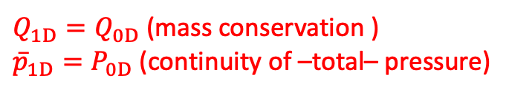


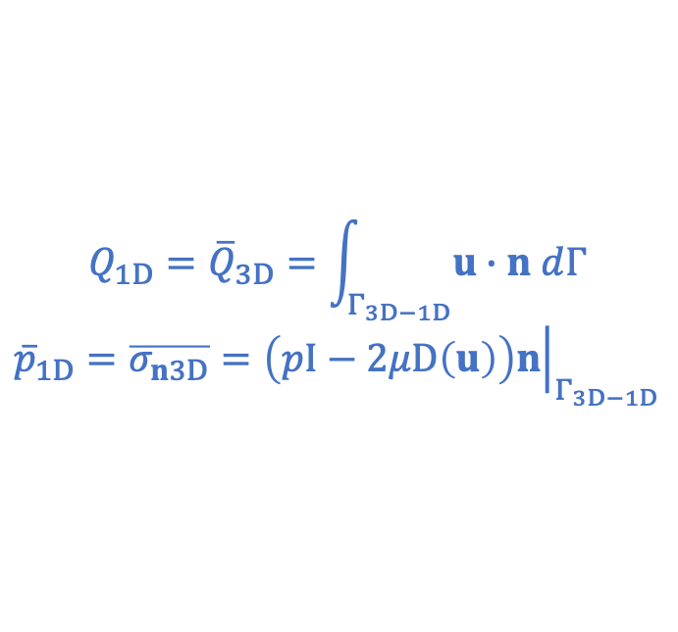
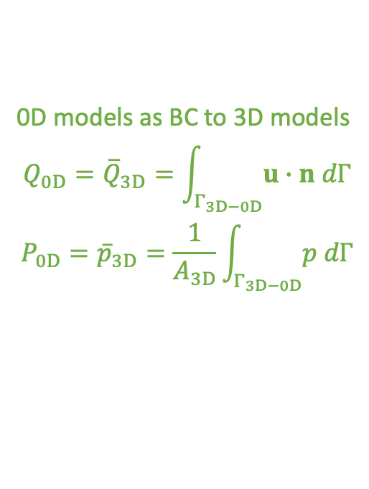
Geometric multiscale
Coupling 0D, 1D and 3D models to construct hetero-dimensional CVS models.
$$Γ_{3D−0D}$$
$$Γ_{3D−1D}$$
$$n_{1D−0D}$$
0D models as BC to 3D models
$$Q_{0D}={\overline{Q}}_{3D}=\int_{Γ_{3D−0D}}{u∙n dΓ}$$
$$P_{0D}={\overline{p}}_{3D}=\frac{1}{A_{3D}}\int_{Γ_{3D−0D}}{p dΓ}$$
$$Q_{1D}={\overline{Q}}_{3D}=\int_{Γ_{3D−1D}}{u∙n dΓ}$$
$${\overline{p}}_{1D}=\overline{σ_{n3D}}={\left.\left(pI−2μD\left(u\right)\right)n\right|}_{Γ_{3D−1D}}$$
$Q_{1D}=Q_{0D}$ (mass conservation )
${\overline{p}}_{1D}=P_{0D}$ (continuity of –total– pressure)

Slide 31
Numerical schemes
99% of cases, we need numerical schemes to discretise and numerically solve our models, to predict the behaviour of the system.
1D & 3D models → PDEs
space + time discretization
Finite Difference (FD) schemes,
Finite Volume (FV) methods (e.g., 1D),
Finite Element (FE) methods (e.g., 3D FSI),
…
0D models → ODEs
→ time integration schemes
⚠️ Some numerical challenges ⚠️
stability of the numerical methods and couplings;
convergence;
stiffness;
accuracy of the predicted numerical solution;
computational cost of simulations;
…

Slide 32
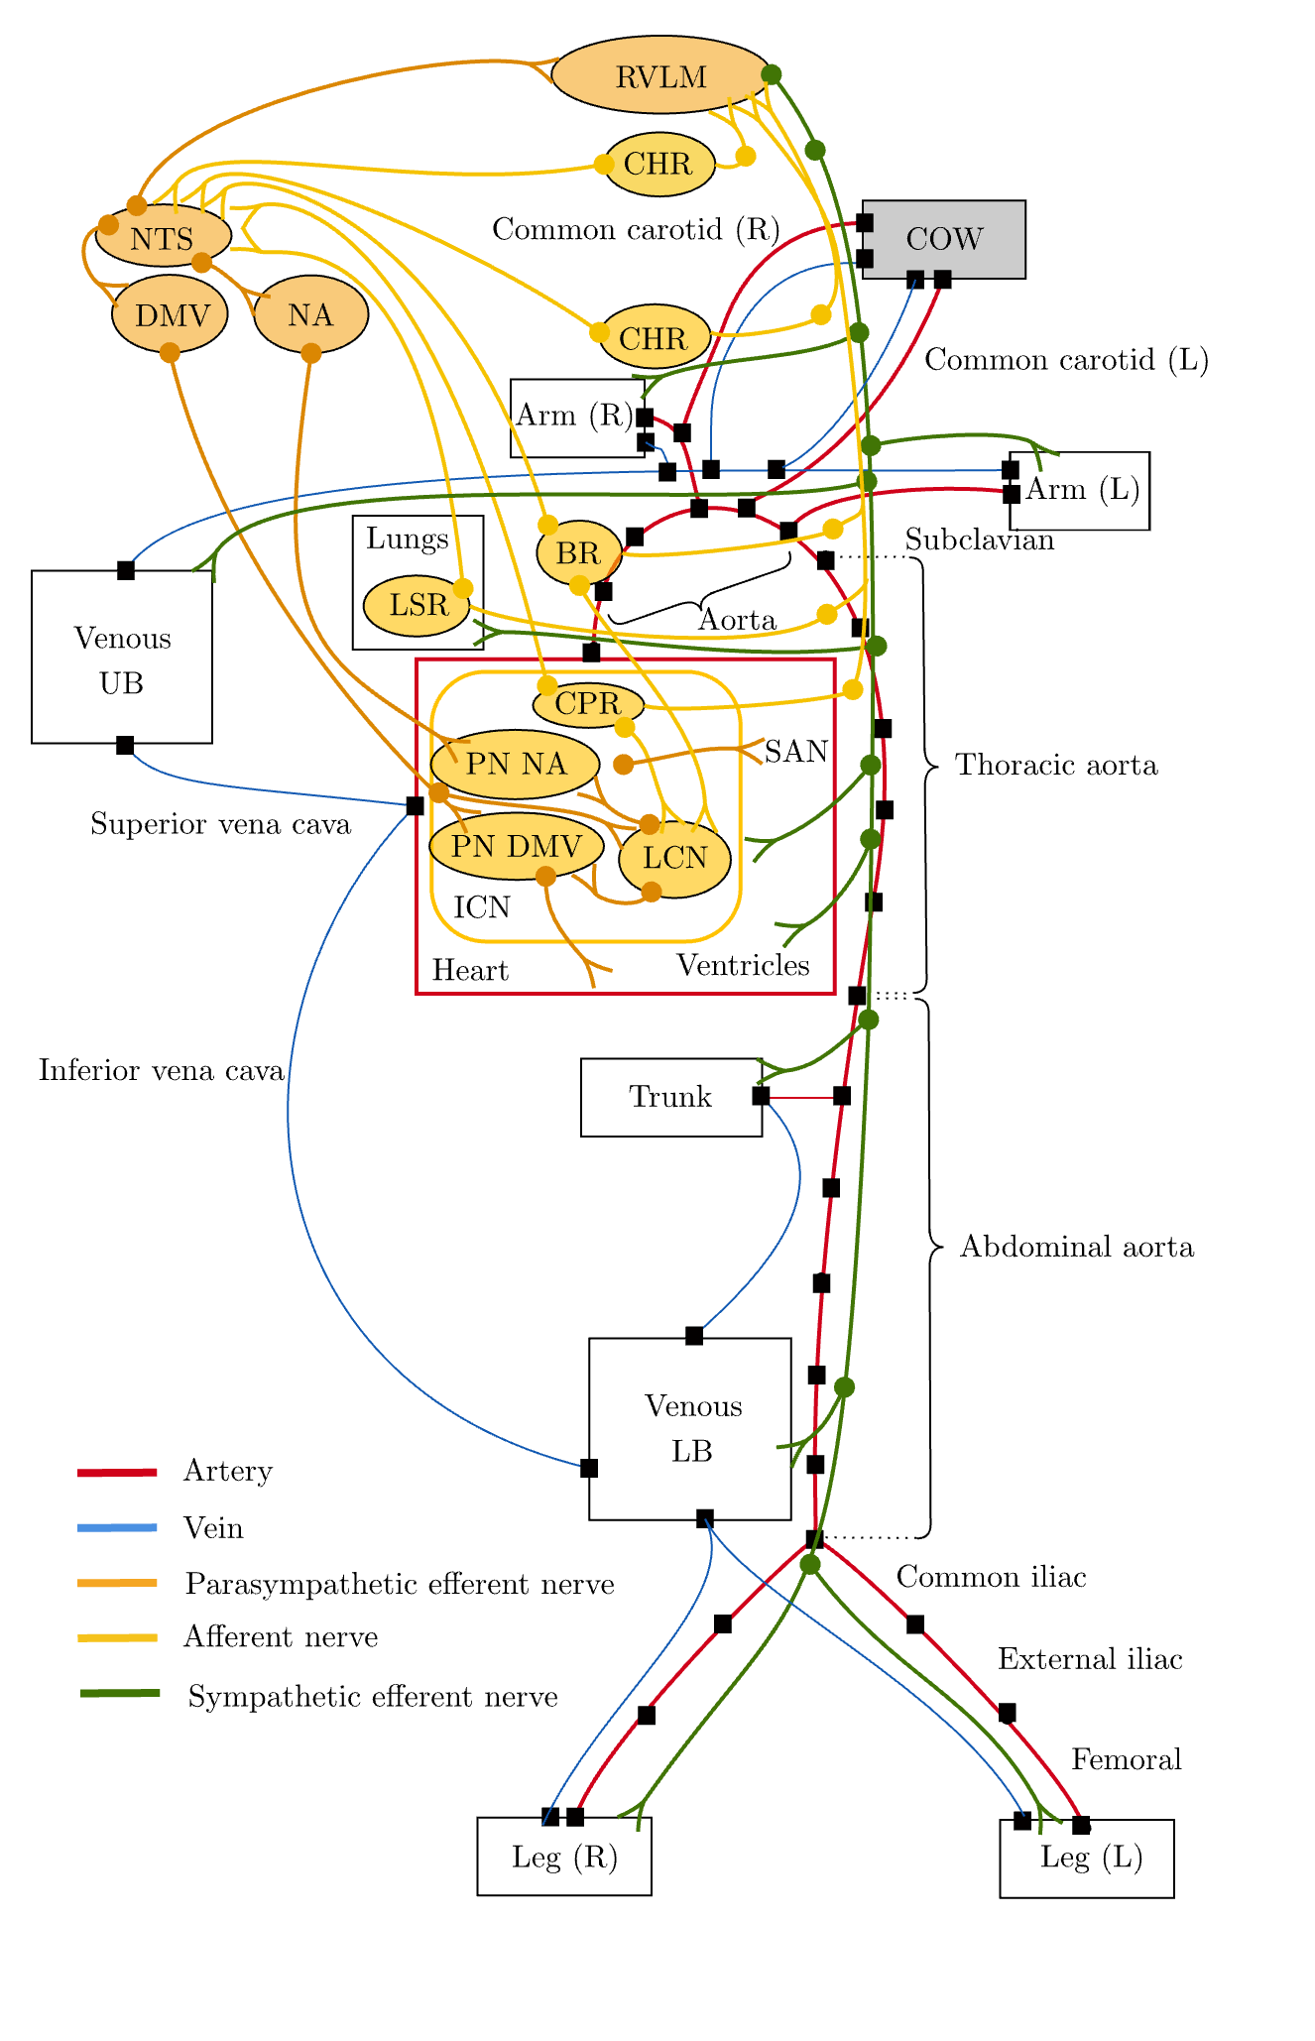
What else?
Autonomic nervous system [rapid/short-term]
Baroreceptors – ”top-down” systemic controller
Chemoreceptors (O2, CO2, pH)
Sympathetic activity (vasoconstriction)
Humoral/endocrine regulation [intermediate/long-term]
Local/autoregulatory mechanisms
Cerebral autoregulation – local protective mechanism
Metabolic control and myogenic response
Respiration
…
Notes:
Control mechanisms to maintain BP, flow and tissue perfusion

Slide 33
Context of Use – Brainstorm!
💡🤔 …what is your context of use then, and what CVS model do you need?

Slide 34
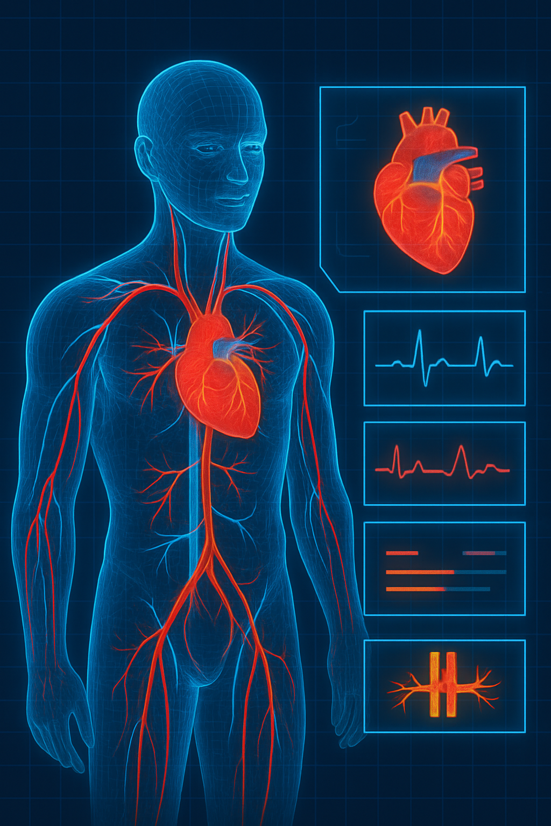
PART III
Does one size fit all?
Filtering non-influential parameters
Refining parameters or data?
1.
Sensitivity Analysis Which parameters matter and drive model output?
2. Identifiability Analysis Can we determine them uniquely using the available data?
3.
Model Calibration Finding subject-specific parameter values
Subject-specific Digital Twin

Slide 35
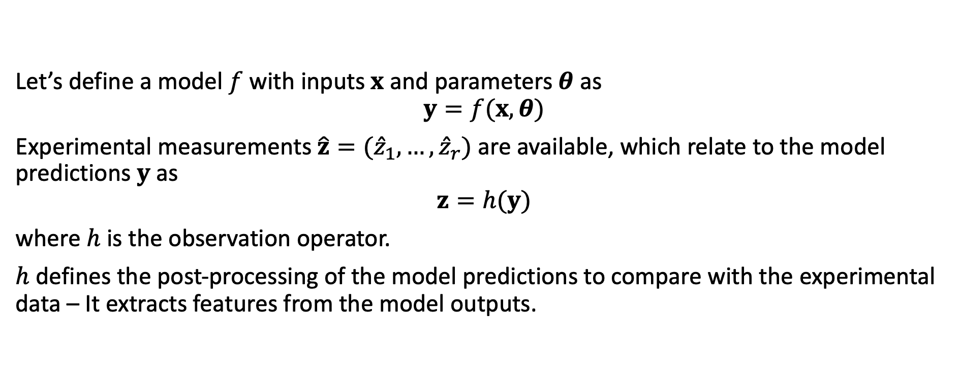
Model Calibration
Let’s define a model $f$ with inputs $x$ and parameters $θ$ as
$$y=f(x,θ)$$
Experimental measurements $\hat{z}=({\hat{z}}_{1},…,{\hat{z}}_{r})$ are available, which relate to the model predictions $y$ as
$$z=h(y)$$
where $h$ is the observation operator.
$h$ defines the post-processing of the model predictions to compare with the experimental data – It extracts features from the model outputs.

Slide 36
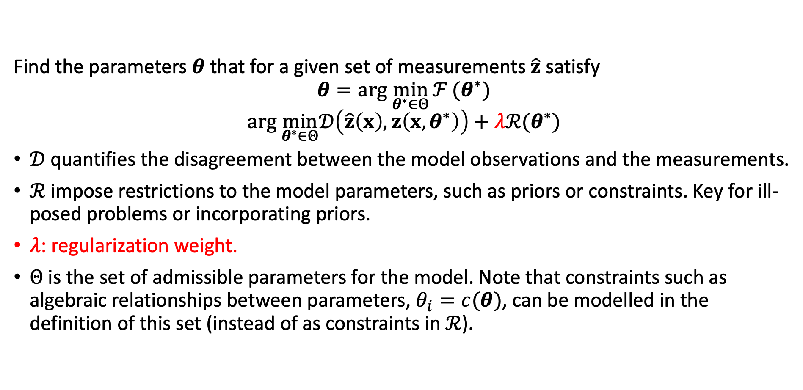
Model Calibration
Find the parameters $θ$ that for a given set of measurements $\hat{z}$ satisfy
$$θ=arg \min_{θ^{∗}∈Θ}{ℱ}(θ^{∗})$$
$$arg \min_{θ^{∗}∈Θ}𝒟\left(\hat{z}\left(x\right),z\left(x,θ^{∗}\right)\right)+λℛ(θ^{∗})$$
$𝒟$ quantifies the disagreement between the model observations and the measurements.
$ℛ$ impose restrictions to the model parameters, such as priors or constraints. Key for ill-posed problems or incorporating priors.
$λ$: regularization weight.
$Θ$ is the set of admissible parameters for the model. Note that constraints such as algebraic relationships between parameters, $θ_{i}=c(θ)$, can be modelled in the definition of this set (instead of as constraints in $ℛ$).

Slide 37
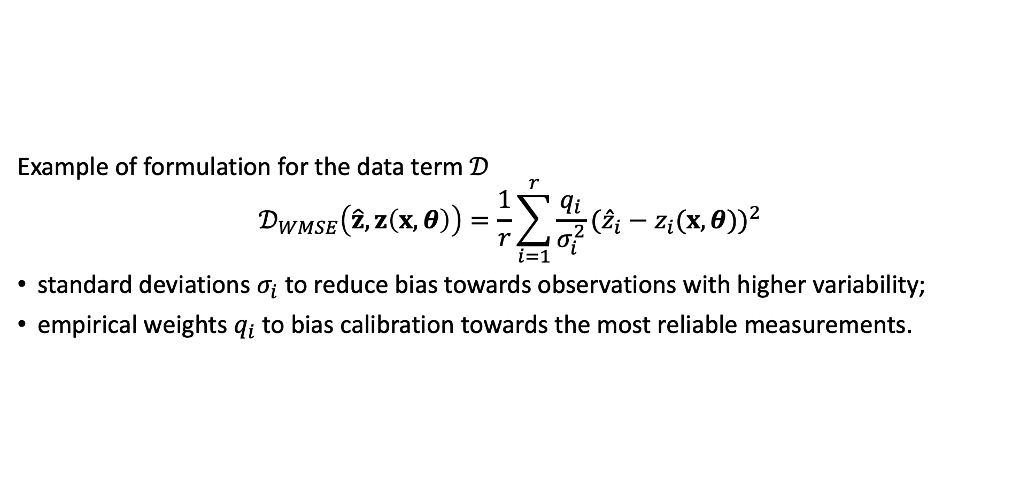
Model Calibration
Example of formulation for the data term $𝒟$
$$𝒟_{WMSE}\left(\hat{z},z\left(x,θ\right)\right)=\frac{1}{r}\sum_{i=1}^{r}{\frac{q_{i}}{σ_{i}^{2}}}({\hat{z}}_{i}−z_{i}(x,θ))^{2}$$
standard deviations $σ_{i}$ to reduce bias towards observations with higher variability;
empirical weights $q_{i}$ to bias calibration towards the most reliable measurements.

Slide 38
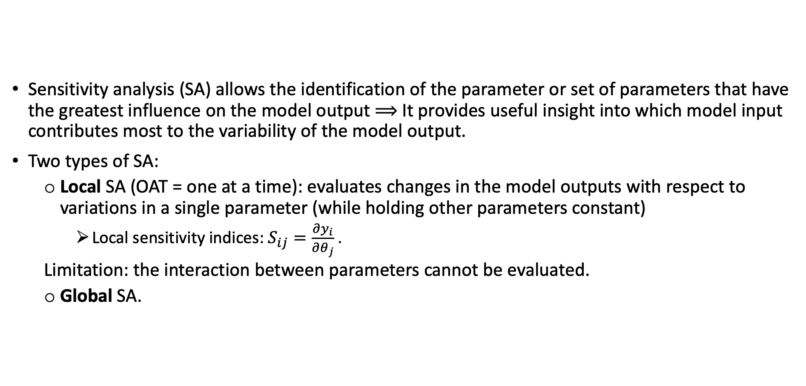
Sensitivity Analysis
Sensitivity analysis (SA) allows the identification of the parameter or set of parameters that have the greatest influence on the model output $⟹$ It provides useful insight into which model input contributes most to the variability of the model output.
Two types of SA:
Local SA (OAT = one at a time): evaluates changes in the model outputs with respect to variations in a single parameter (while holding other parameters constant)
Local sensitivity indices: $S_{ij}=\frac{∂y_{i}}{∂θ_{j}}$ .
Limitation: the interaction between parameters cannot be evaluated.
Global SA.

Slide 39
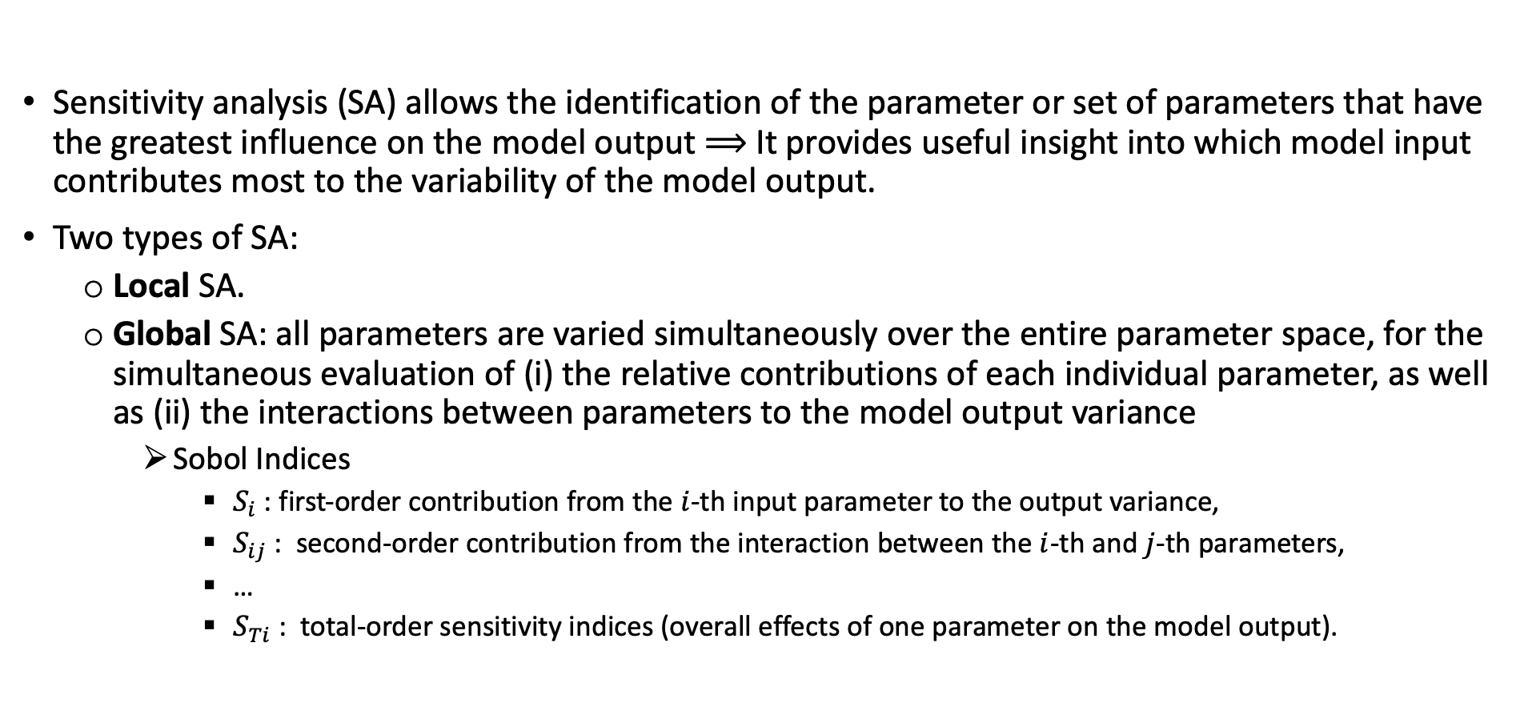
Sensitivity Analysis
Sensitivity analysis (SA) allows the identification of the parameter or set of parameters that have the greatest influence on the model output $⟹$ It provides useful insight into which model input contributes most to the variability of the model output.
Two types of SA:
Local SA.
Global SA: all parameters are varied simultaneously over the entire parameter space, for the simultaneous evaluation of (i) the relative contributions of each individual parameter, as well as (ii) the interactions between parameters to the model output variance
Sobol Indices
$S_{i}$ : first‐order contribution from the $i$-th input parameter to the output variance,
$S_{ij}$ : second‐order contribution from the interaction between the $i$-th and $j$-th parameters,
…
$S_{Ti}$ : total‐order sensitivity indices (overall effects of one parameter on the model output).

Slide 40
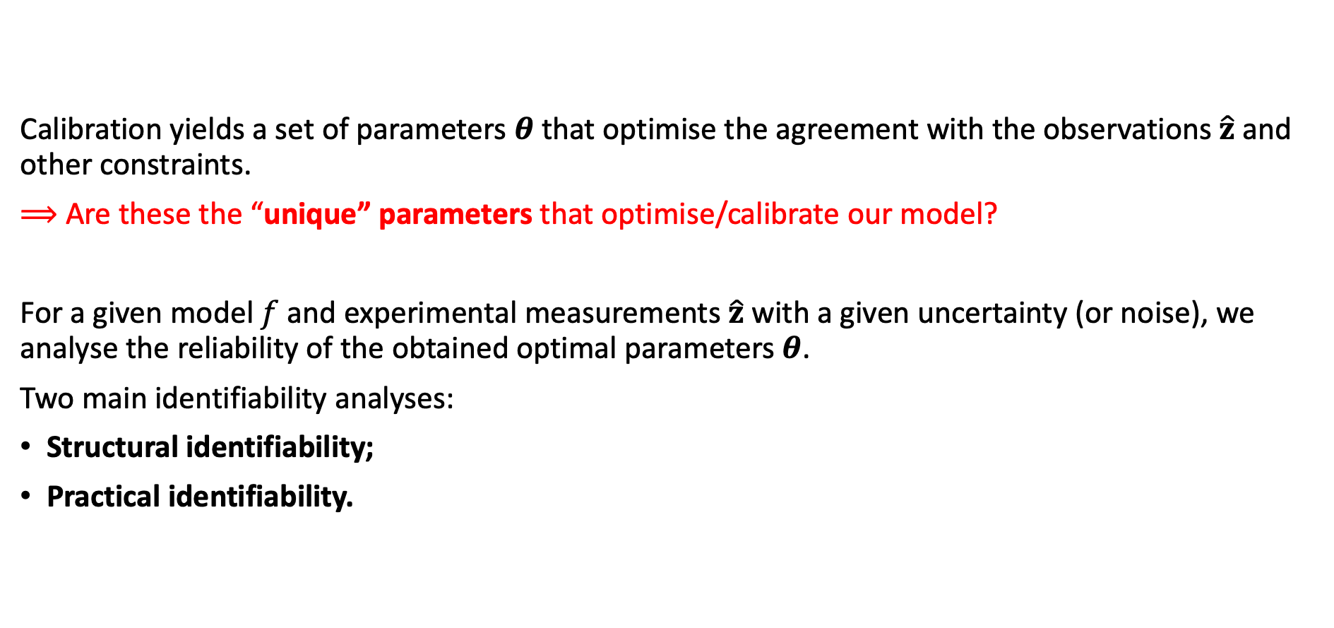
(Local) Identifiability Analysis
Calibration yields a set of parameters $θ$ that optimise the agreement with the observations $\hat{z}$ and other constraints.
$⟹$ Are these the “unique” parameters that optimise/calibrate our model?
For a given model $f$ and experimental measurements $\hat{z}$ with a given uncertainty (or noise), we analyse the reliability of the obtained optimal parameters $θ$.
Two main identifiability analyses:
Structural identifiability;
Practical identifiability.
Notes:
*To a reasonable level of precision. Notice that highly noisy measurements will define a family of plausible parameters for the model, such that all predictions are within the bounds of the noise around the ground truth.

Slide 41
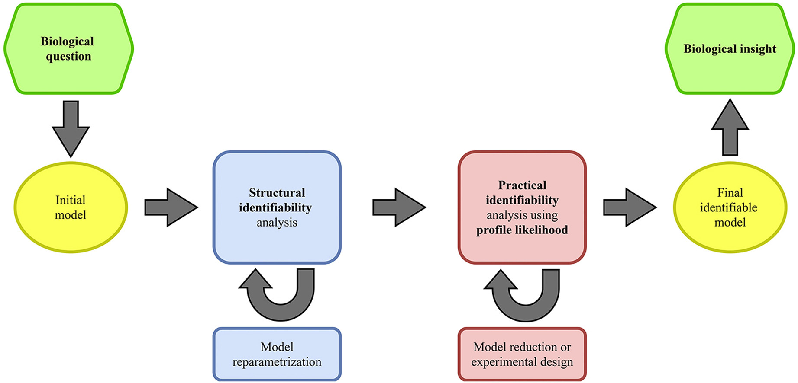

(Local) Identifiability Analysis
Two main identifiability analyses:
Structural identifiability: analysis of the structure of the model $f$, assuming infinite, continuous and noise free measurements $\hat{z}$.
Practical identifiability: analysis of the impact of the practical constraints related to $\hat{z}$ (noise/uncertainty) and their impact on the uncertainty of the estimated $θ$
Bayesian approaches (MCMC);
Profile likelihood.
Notes:
*To a reasonable level of precision. Notice that highly noisy measurements will define a family of plausible parmeters for the model, such that all predictions are within the bounds of the noise around the ground truth.
Practical identifiability: analysis of the impact of the practical constraints related to $\hat{z}$ (noise/uncertainty) and their impact on the uncertainty of the estimated $θ$ – the effect of the noise (uncertainty) in the measurements $\hat{z}$ for the estimates of $θ$.

Slide 42
(Local) Identifiability Analysis
Decrease in complexity to ensure models can be calibrated to clinically available, subject-specific data.
Notes:
*To a reasonable level of precision. Notice that highly noisy measurements will define a family of plausible parmeters for the model, such that all predictions are within the bounds of the noise around the ground truth.
Practical identifiability: analysis of the impact of the practical constraints related to $\hat{z}$ (noise/uncertainty) and their impact on the uncertainty of the estimated $θ$ – the effect of the noise (uncertainty) in the measurements $\hat{z}$ for the estimates of $θ$.

Slide 43
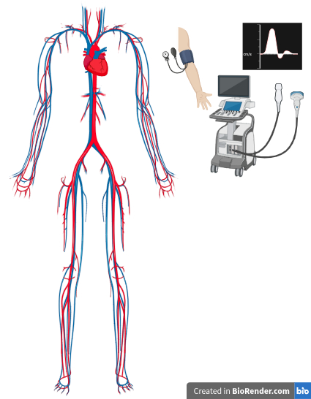

Model Calibration
And now we can calibrate!
In our case:
$f$ :
$x$ :
$θ$ :
$y$ :
$z$ :
$\hat{z}$ :

Slide 44

Model Calibration
And now we can calibrate!
In our case:
$f$ : CVS model;
$x$ : pressure, volume, flow rate in each model compartment at the current time step;
$θ$ : elastic modulus of arterial walls, capacitance of venous compartments, resistance of arterial compartment, elastances of heart ventricles, total stressed blood volume, etc.;
$y$ : pressure, volume, flow rate in each model compartment at the next time step, i.e., $y=f(x)$;
$z$ : systolic and diastolic pressure in the brachial artery, mean and max flow in the aortic root, predicted by the model;
$\hat{z}$ : systolic and diastolic cuff pressure at the brachial artery level, and aortic root mean and max flow measured with Doppler ultrasound.

Slide 45
Thank you!
Time for Q&As!
And our tutorial!

Slide 46
Some useful references
L. Formaggia, A. Quarteroni, and A. Veneziani, Eds. “Cardiovascular Mathematics: Modeling and Simulation of the Circulatory System.” Vol. 1. MS&A: Modeling, Simulation & Applications. Milano: Springer, 2009. https://doi.org/10.1007/978-88-470-1152-6.
P. J. Blanco, and L. O. Müller. “One‐Dimensional Blood Flow Modeling in the Cardiovascular System. From the Conventional Physiological Setting to Real‐Life Hemodynamics.” Int J Numer Meth Biomed Engng, 41:e70020, 2025. https://doi.org/10.1002/cnm.70020.
B. Ghitti. “Numerical methods for computationally efficient and accurate blood flow simulations in complex vascular networks: Application to cerebral blood flow.” PhD Thesis. University of Trento, 2023.
B. Ghitti, E. F. Toro, and L. O. Müller. “Nonlinear lumped-parameter models for blood flow simulations in networks of vessels.” ESAIM: Mathematical Modelling and Numerical Analysis, 56(5):1579–1627, 2022. https://doi.org/10.1051/m2an/2022052.
A. Sharifzadeh-Kermani, J. Shen, F. Argus, et al. “Semi-automated pipeline for generating personalised cerebrovascular models.” Biomech Model Mechanobiol, 24:251–264, 2025. https://doi.org/10.1007/s10237-024-01908-5.
E.F. Toro. “Riemann Solvers and Numerical Methods for Fluid Dynamics: A Practical Introduction.” 3rd edn. Springer-Verlag Berlin Heidelberg, 2009.

