Slide 1

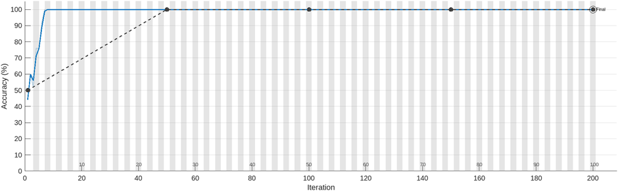
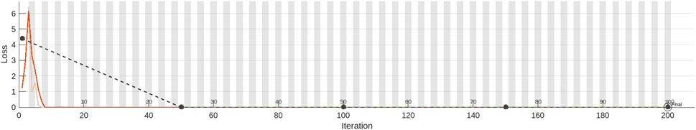
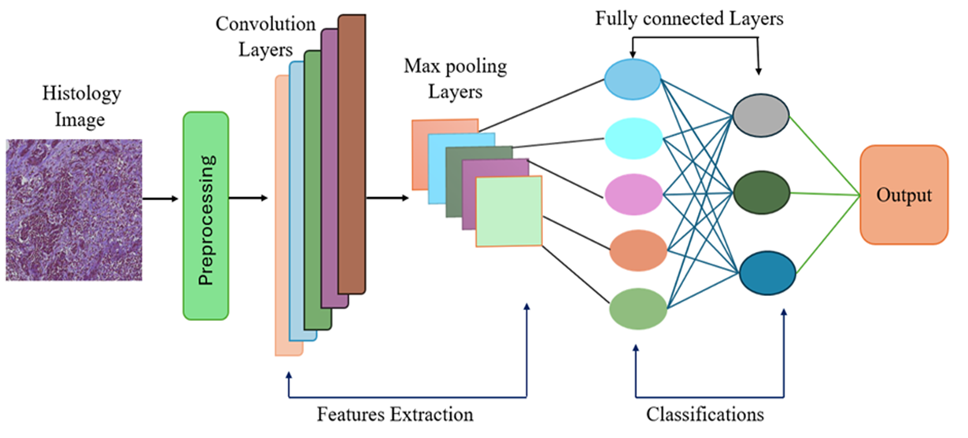
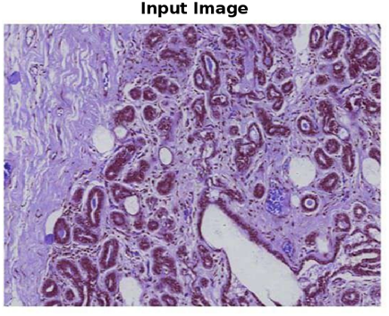
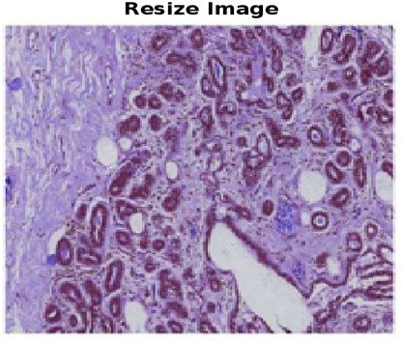

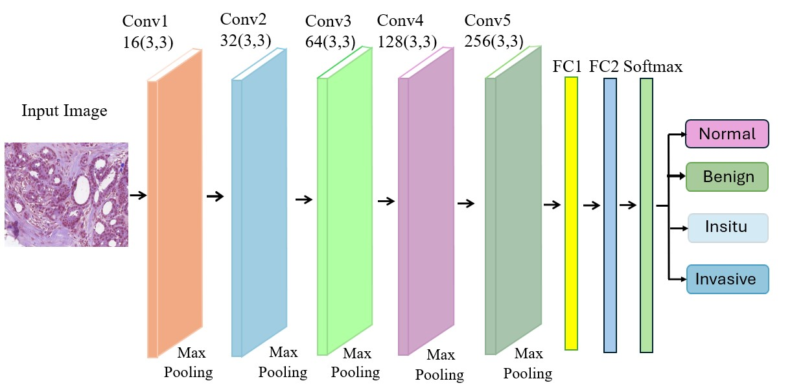
MULTICLASS BREAST CANCER CLASSIFICATION USING BC-CCN
Vivek Reddy(RA2011004010331), Siva Sankar(RA2011004010153)
Under the guidance of Dr. A.Jaba Deva Krupa (Assistant Professor)
Department of Electronics and Communication Engineering, SRM Institute of Science and Technology, Kattankulathur
g
When cancer starts in the breast tissue, it becomes breast cancer Breast cancer is the most common cancer worldwide, with 7.8 million people surviving as of the end of 2020 who received a diagnosis during the previous five years. Convolutional neural networks (CNNs) are artificial neural networks designed primarily to understand pixel input. For image classification, deep learning (DL) with convolutional neural networks (DCNN) has shown to be one of the most successful machine learning (ML) techniques. The Convolutional mapping preserves the most important differential properties of the input data while reducing its dimension. It is well known that convolutional neural networks (CNN) are a type of regular neural networks. This technique provides a unique network that prioritizes ultimately linked hidden layers above convolution and pooling layers . CNN can be used for two purposes: classifier and feature extraction. The findings of patches are pooled for the whole picture to get the final result .
The critical need for early detection of breast cancer to improve survival rates and reduce disease burden. However, traditional detection methods like mammography and ultrasound have limitations such as low sensitivity and high false-positive rates.
The objectives include improving diagnostic accuracy and enhancing our overall comprehension of the diverse nature. It involve refining architecture for better performance, and diverse datasets optimizing computational efficiency.
In the breast cancer classification project, realistic constraints encompass various aspects
crucial for effective implementation in real-world
Our research concludes that using a Convolutional Neural Network (CNN) to improve breast cancer categorization is helpful We trained the CNN using an optimal datasets. Compared to the Capsule Network’s 85.6 percent accuracy, our designed BC-CCN achieved the maximum accuracy of 98.7 percent in summary, our research highlights the potential of deep learning methodologies in the conjunction with sophisticated signal processing techniques to enhance the categorization of breast cancer. This can ultimately facilitate early detection and treatment planning, leading to better patient outcomes.
Swapna G, Soman, K. P., and Vinayakumar R., “Automated detection of diabetes using CNN and CNN-LSTM network and heart ratesignals”, Procedia Computer Science, vol. 132, pp. 1253-1262, 2018.
W. Gómez-Flores et al.A comparative study of pre-trained convolutional neural networks for semantic segmentation of breast tumors in ultrasound Comput. Biol. Med.(Nov. 2020)
J. Bai, R. Posner, T. Wang, C. Yang, S. Nabavi. Applying deep learning in digital breast tomosynthesis for automatic breast cancer detection: a review, Med. Image Anal. 71 (2021), 102049
A.B. Nassif, M.A. Talib, Q. Nasir, Y. Afadar, O. Elgendy, Breast cancer detection using artificial intelligence techniques: a systematic literature review, Artif. Intell. Med. 127 (2022), 102276.
G. Olgun, C. Sokmensuer, C. Gunduz-Demir, Local object patterns for the representation and classification of colon tissue images, IEEE J. Biomed. Health Inf. 18 (4)
Dr. A. Jaba Deva Krupa, L. Vivek Reddy, B. Sivasankar Reddy, Multiclass Breast Cancer classification using BC-CNN Submitted to 12th International Conference ICRTC 2024.
Introduction
healthcare settings. This involves addressing dataset limitations, optimizing computational resources, ensuring model generalization, integrating into clinical workflows, balancing feature extraction and interpretability, complying with regulations, designing for image quality robustness, and conducting realistic clinical validation studies.
For processing and recognizing images, convolutional neural networks (CNNs) are a particular type of artificial neural network that are designed to handle pixel input. The layers of neurons are designed to encompass the whole visual field. With its reduced processing requirements in mind, a CNN uses a system that is like a multilayer perceptron. The input layer, output layer, and hidden layer which consists of several convolutional layers, Maxpooling layers, and fully connected layers are the layers that make up a CNN.
After a number of convolution and pooling layers, the output of the final layer is transformed into a linear array and sent as an input to the nodes of a fully connected layer. When utilizing a SoftMax layer, an input is assigned a SoftMax function. After using the SoftMax Layer, create a new one. For the weighted classification tasks pertaining to mutually classes, a classification layer calculates the cross-entropy loss.
Empirical Results
Conclusion
Methodology
Accuracy curve during training process
References
Loss curve during training process
Results
Problem Statement
S.no | Training Cycle | Size
1 | Epoch | 100
2 | Iteration | 200
3 | Iterations Per Epoch | 2
Objective
Training process
Conference publications`
Realistic Constraints
Accuracy difference between Capsule Network and BC-CCN

