Slide 1
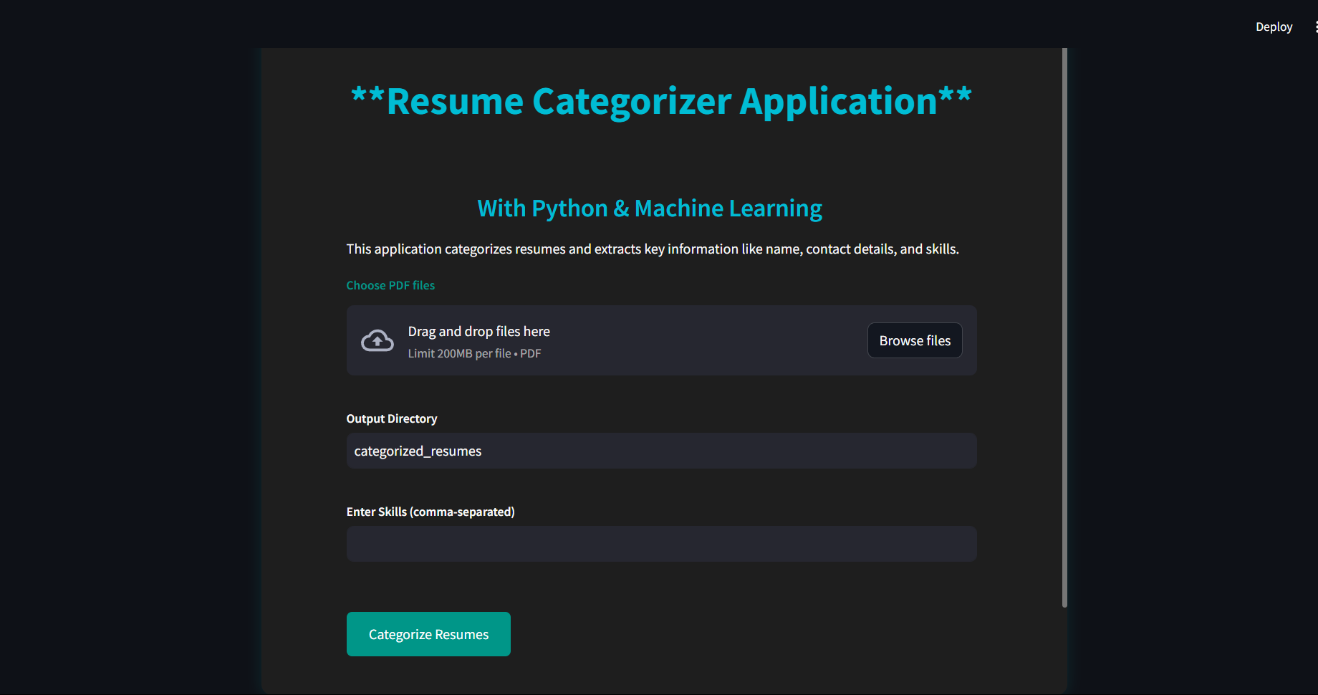
JobFit : Resume Categorizer and ATS
Using Machine learning and NLP
Vivek R
AI/ML
PG Diploma 2

Slide 2
OBJECTIVE
To develop an automated system for categorizing resumes and extracting key information such as names, contact details, and skills using machine learning and natural language processing techniques.
This project aims to streamline the resume screening process, making it more efficient and less time-consuming for HR departments and recruiters.
PROBLEM STATEMENT
Manual resume screening:
Time-consuming and labor-intensive manual resume screening.
Difficulty identifying relevant skills and qualifications from diverse resumes.
Inconsistent and error-prone manual categorization.
Inefficient handling of large volumes of resumes.

Slide 3
Need for Automation:
Streamlines the resume screening process.
Ensures consistent and accurate categorization.
Speeds up identification of relevant candidates.
Frees up HR resources for strategic tasks.
Dataset Description:
Link: https://www.kaggle.com/datasets/jillanisofttech/updated-resume-dataset
The dataset is designed to train a resume classifier and consists of entries for various job positions within the realm of software development and data science. Each entry represents a resume and is labeled with 25 distinct categories.
Each resume entry in the dataset includes relevant information such as educational background, skills, work experience, projects, certifications, and any other pertinent details typically found in resumes. The dataset aims to cover a diverse range of roles within the tech industry, providing a comprehensive training set for the classifier to accurately categorize resumes based on the job roles specified.

Slide 4
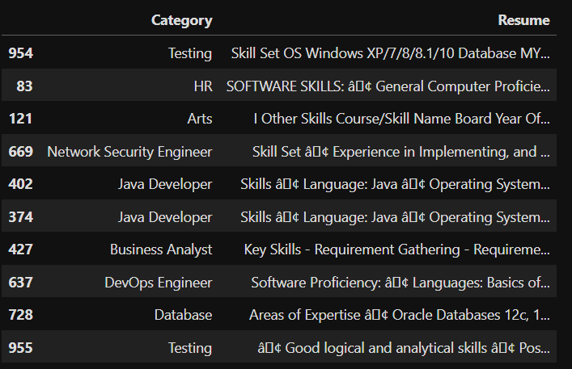
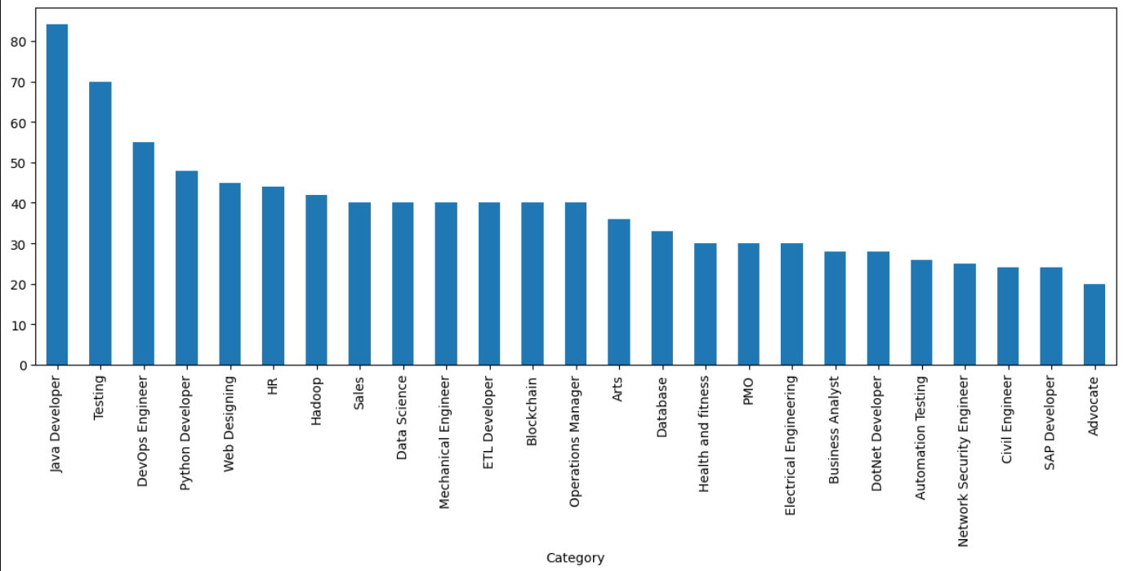
Contains two columns: Category and Resume.
Category: Represents 25 different job categories.
Resume: Contains skills and expertise related to each job category.
No null values in the dataset.
Each Category is paired with a detailed Resume that outlines the required skills and expertise for the job.

Slide 5
PROJECT ARCHITECTURE
8.Download & Display
Pdf format
1.Resume Upload
CSV format.
2.Text Extraction
7. Categorization
PdfReader
3.Text Cleaning
6. Information Extraction
Named Entity Recognition (NER)
cleanResume()
4.Feature Extraction
5.Model Prediction (Categorization)
TF-IDF (Term Frequency-Inverse Document Frequency).
Random Forest classifier

Slide 6
Data Preprocessing
Text Extraction:
The first step in preprocessing involves extracting text from the uploaded PDF resumes.
Tool Used: PdfReader from the pypdf library is used to extract text from each page of the resume.
The raw extracted text is then stored in a string format.
Text Cleaning (cleanResume function):
Remove URLs
Remove Social Media Mentions
Remove Special Characters
Remove Non-ASCII Characters
Remove Extra Whitespace
Text Normalization:
Lowercase Conversion: To maintain consistency, all text is converted to lowercase.
Whitespace Reduction: Extra spaces between words or at the beginning/end of the text are replaced with a single space.
Final Cleaned Text:
After applying the cleaning steps, the final cleaned text is ready for further processing (e.g., feature extraction).

Slide 7
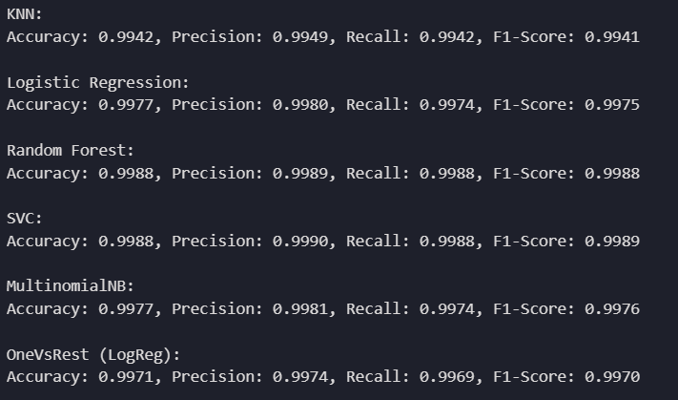
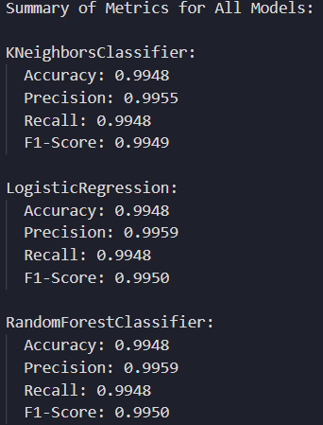
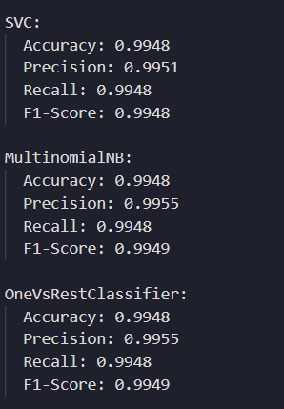
Feature Extraction
TF-IDF is a statistical measure used to evaluate the importance of a word in a document relative to a collection of documents (corpus).
TF (Term Frequency) measures how frequently a term appears in a document.
IDF (Inverse Document Frequency) measures how important a term is across the corpus.
TF-IDF helps to downscale the weight of common words (e.g., "the", "and") while highlighting the importance of rare, meaningful words.
Machine Learning Model
Cross validation
Based on these results RandomForestClassifier
Algorithm is used to build the model

Slide 8
Named Entity Recognition (NER)
Named Entity Recognition (NER) is a Natural Language Processing (NLP) task that identifies and classifies named entities in text, such as names, dates, locations, and more.
NER helps to extract valuable information from resumes like candidate name, contact details, and skills.
The spaCy library is used for NER in this project, specifically the en_core_web_sm model, which is pre-trained to recognize a wide range of entities like persons, organizations, and products.
For example, the name of the candidate is often found in the first line of the resume, and spaCy can help identify it.
Other entities such as phone numbers and emails are extracted through regular expressions.
Web Interface
The web interface is developed using Streamlit.
Streamlit was chosen because of its simplicity, speed in creating web applications, and the ability to integrate Python code seamlessly.
Interface Flow:
Users upload resumes (PDF format).
Specify the directory for storing categorized resumes.
Optionally, enter a list of desired skills to filter the resumes.
Click "Categorize Resumes" to process and display categorized results.
Download the filtered CSV file with resume information.

Slide 9
Web Application Interface

Slide 10
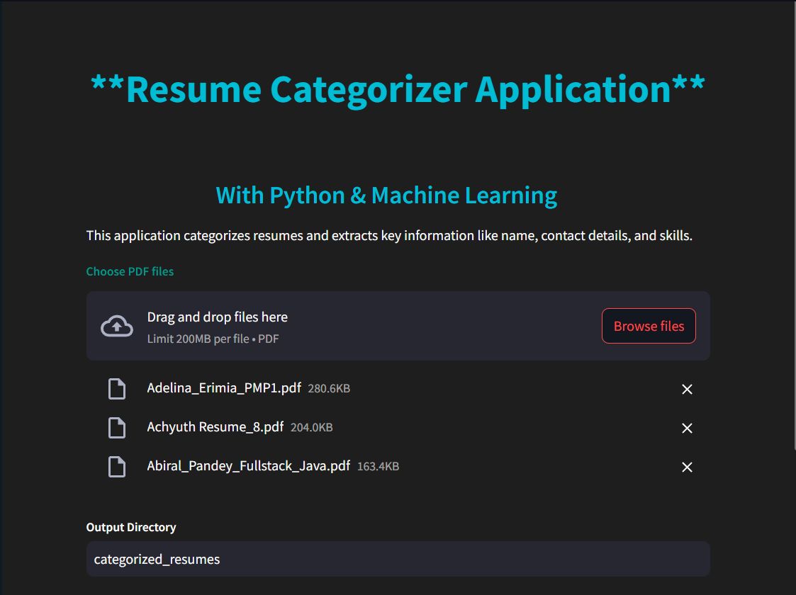
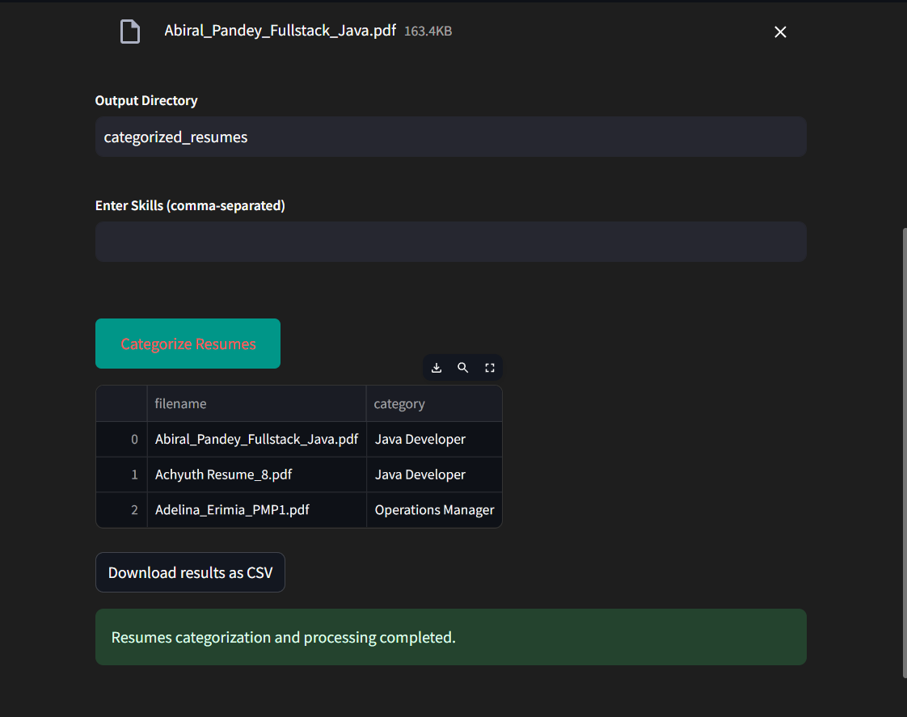
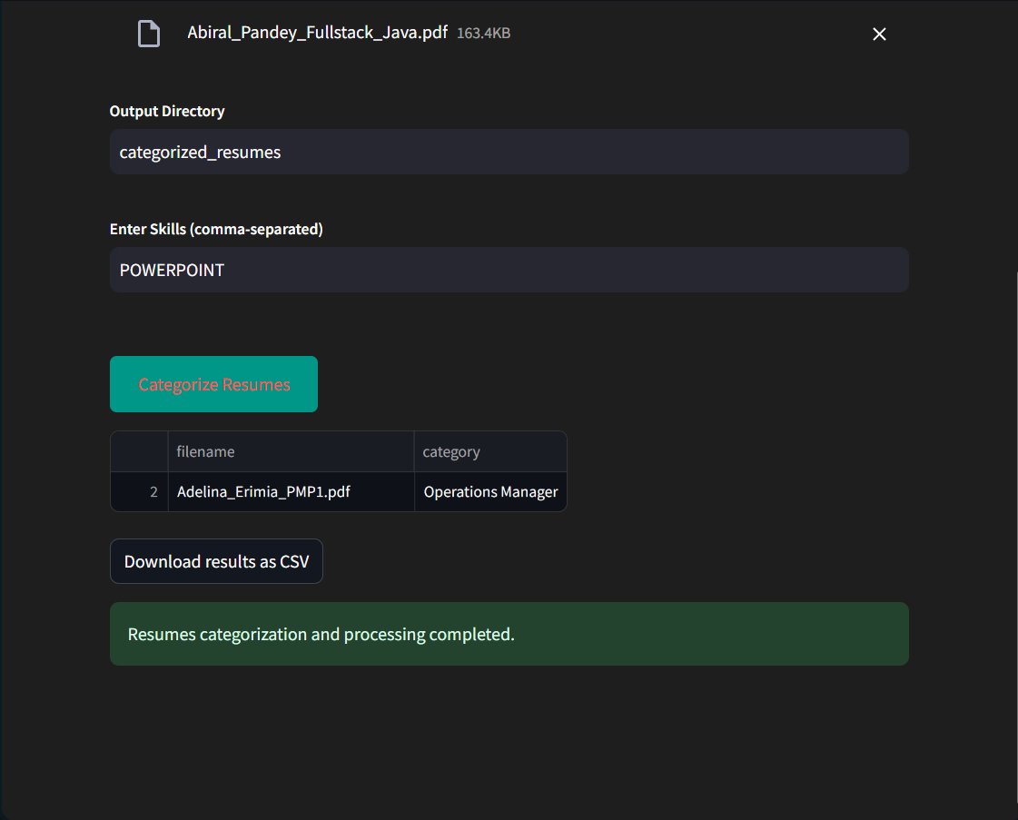
RESULT
Uploading multiple resumes
Categorizing the uploaded Resumes
Filtering Resumes with required skills

Slide 11
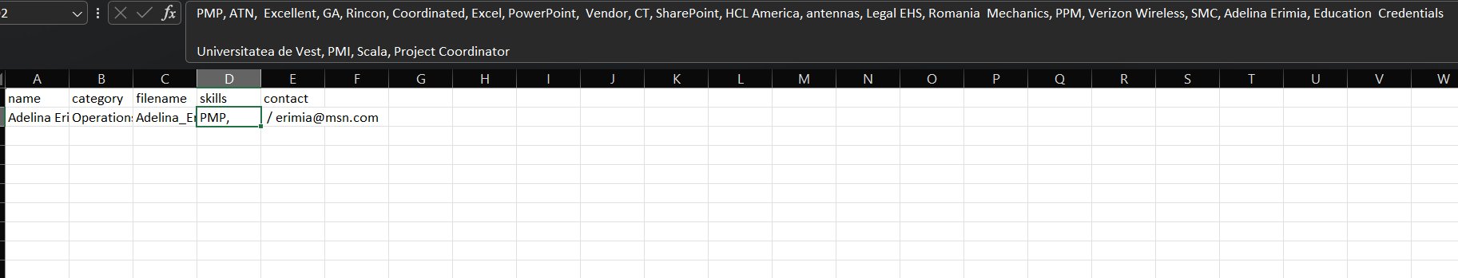
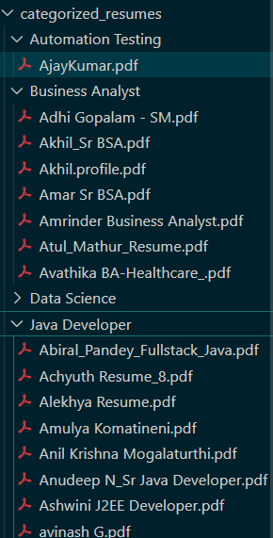
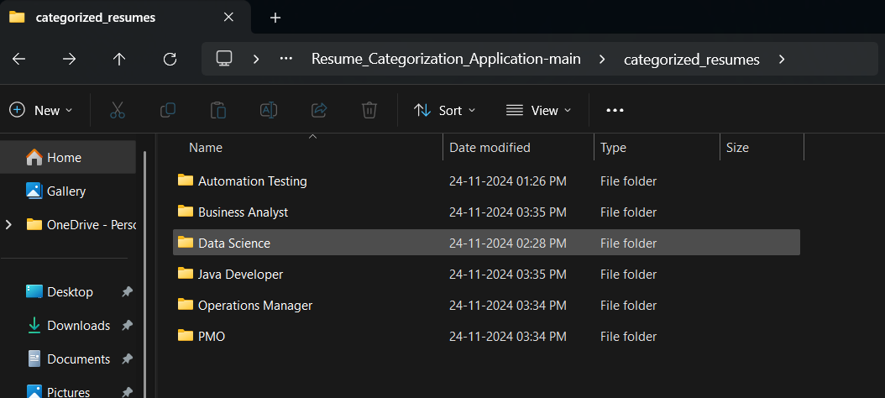
Final downloaded CSV file
Output Directory

Slide 12
FUTURE ENHANCEMENTS
Support for Additional File Formats:
Currently, the application only supports PDF files. Future versions could include support for other resume formats like DOCX, TXT, or HTML to cater to a wider range of files.
Improved Skill Extraction:
Enhance the skill extraction process using more advanced NLP models like BERT or GPT-based models, which can understand context better and extract a wider range of skills from resumes.
Multilingual Support:
Extend the categorization and extraction features to support resumes in multiple languages, making the application more versatile for global users.
Real-Time Categorization:
Implement real-time resume categorization, where resumes can be categorized instantly as they are uploaded, improving efficiency in high-volume recruitment scenarios.
AI-Based Resume Scoring:
Introduce an AI model that can score resumes based on relevance to a specific job description, helping recruiters prioritize candidates more effectively.

Slide 13
CONCLUSION
The Resume Categorizer application effectively uses machine learning and natural language processing (NLP) to automate the process of resume categorization.
The project involves text extraction from PDFs, cleaning the text, and applying TF-IDF for feature extraction.
A machine learning model is trained to classify resumes into predefined categories, while spaCy's Named Entity Recognition (NER) extracts key information like name, contact details, and skills.
The web interface developed with Streamlit allows users to easily upload resumes and obtain categorized results, making the application user-friendly and accessible.
This tool significantly reduces the time and effort involved in sorting and analyzing resumes manually, especially for HR departments and recruiters.
It provides an automated way to categorize and extract essential information from resumes, improving workflow efficiency and accuracy.

Slide 14
THANK YOU

