Slide 1
Nuera-AI: The Cognitive Agent
An Interactive Research Assistant for Knowledge Management and Retrieval
VIVEK R
AI/ML
PG DIPLOMA 2

Slide 2
To create an interactive research assistant for efficient knowledge management and retrieval.
To combine semantic search (FAISS) and keyword search (TF-IDF) for accurate context retrieval.
To generate detailed, context-aware answers using FLAN-T5-large.
To provide a user-friendly interface for adding, managing, and querying research material.
To design a modular system that is scalable and adaptable for future enhancements.
OBJECTIVE

Slide 3
PROBLEM STATEMENT
Inefficient Knowledge Retrieval : Traditional search methods struggle to retrieve semantically relevant information, especially in large datasets.
Ambiguity in Queries : Users often face challenges when queries are paraphrased or lack exact keyword matches.
Lack of Personalization : Generic AI models (e.g., GPT-3) cannot incorporate user-specific knowledge bases, limiting their effectiveness for personalized queries.
Fragmented Tools : Existing solutions either focus on structured databases or AI-powered models but rarely combine both for hybrid search and retrieval.
Scalability Issues : As datasets grow, traditional databases and search methods become inefficient, requiring advanced indexing and retrieval techniques.
Irrelevant Results : Many systems fail to prioritize contextually relevant results, leading to inaccurate or unrelated answers.
Time-Consuming Workflows : Researchers and professionals waste significant time manually sifting through data to find relevant information.

Slide 4
SYSTEM ARCHITECTURE
Data Ingestion Layer Manual Entry (Text Area) Wikipedia Integration (API Call) File Upload (PDF/TXT Parsing)
Data Storage Layer SQLite Database (Persistent Storage: Titles, Content, Tags) FAISS Index (Semantic Search: Vector Embeddings) TF-IDF Matrix
Embedding Generation Layer SentenceTransformer (`all-MiniLM-L6-v2`) Normalization (Cosine Similarity for FAISS)
Search & Retrieval Layer Hybrid Search (FAISS + TF-IDF) FAISS: Semantic Similarity Search TF-IDF: Exact Keyword Matching Cross-Encoder Re-Ranking (`cross-encoder/ms-marco-MiniLM-L-6-v2`) Scores Query-Context Pairs Prioritizes Most Relevant Contexts
Answer Generation Layer FLAN-T5-Large (Generative Model) Combines Retrieved Contexts Generates Detailed Answers
Output Layer Display Answer to User (Streamlit Interface)
User input

Slide 5
User Interaction Layer
Manual Entry: Add text directly.
Wikipedia Integration: Fetch summaries via API.
File Upload: Parse PDF/TXT files for bulk data.
Query Interface : Chat-based input for natural language queries.
Real-time feedback on contexts and answers.
2. Data Storage Layer
SQLite Database : Persistent storage for titles, content, tags, and metadata.
FAISS Index : Semantic search using SentenceTransformer embeddings.
TF-IDF Matrix : Keyword search for exact term matching.
3. Embedding Generation Layer
SentenceTransformer : Model: all-MiniLM-L6-v2 for dense embeddings.
Normalization : Cosine similarity for FAISS compatibility.
4. Search & Retrieval Layer
Hybrid Search : Combines FAISS (semantic) + TF-IDF (keyword) for top-k results.
Cross-Encoder Re-Ranking : Model: cross-encoder/ms-marco-MiniLM-L-6-v2.
Prioritizes most relevant contexts.

Slide 6
5. Answer Generation Layer
FLAN-T5-Large : Generates detailed, context-aware answers.
Prompt Engineering : Custom prompts ensure concise, query-aligned responses.
6. Feedback & Debugging Layer
Debug Logs : Logs retrieved contexts and scores for transparency.
Error Handling : Graceful fallbacks (e.g., "I don't have enough information to answer this.").
ADVANTAGES OF THE ARCHITECTURE
Modularity : Each component is independent, allowing easy upgrades or replacements.
Scalability : FAISS and SQLite support large datasets, and the design allows future cloud deployment.
Accuracy : Hybrid search and re-ranking ensure high-quality results.
Flexibility : Supports diverse input methods and query types.

Slide 7
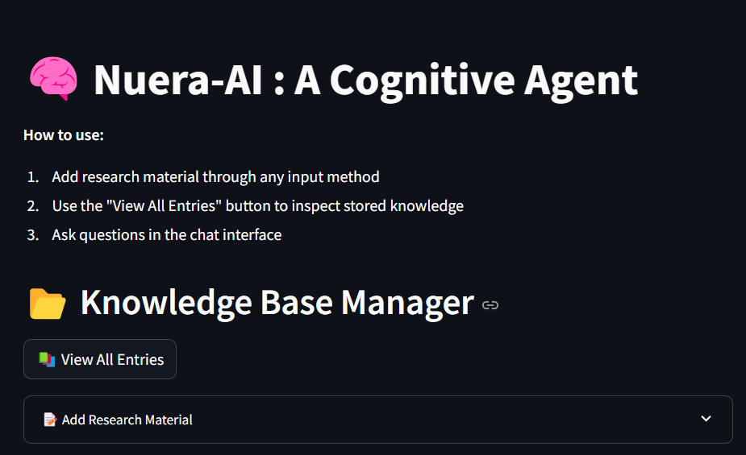
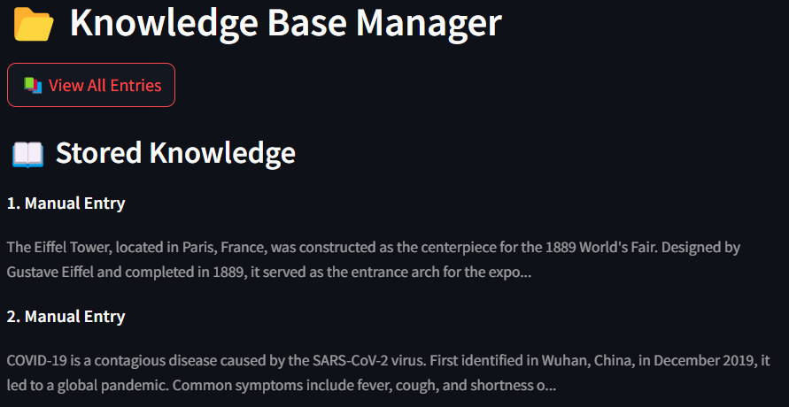
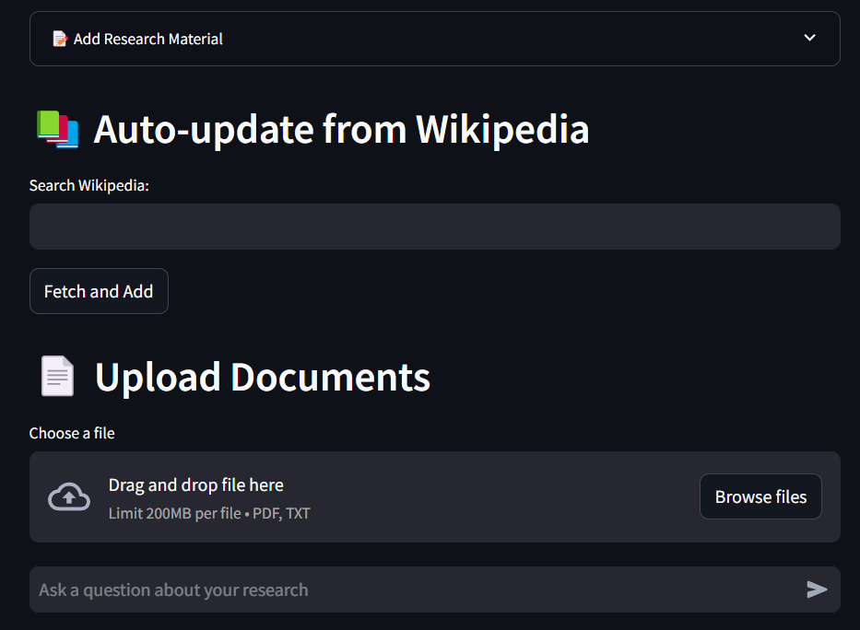
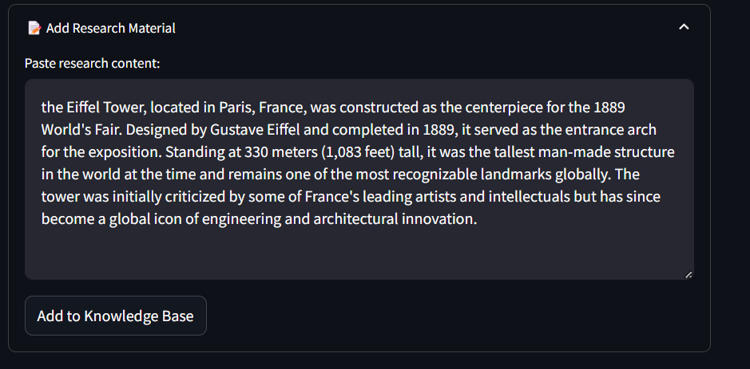
WEB APPLICATION INTERFACE

Slide 8
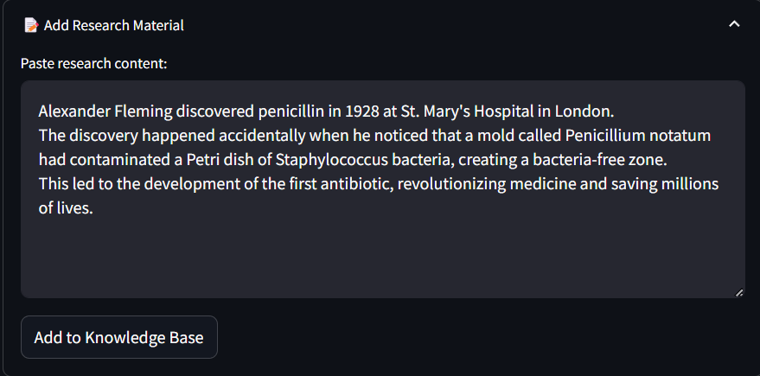
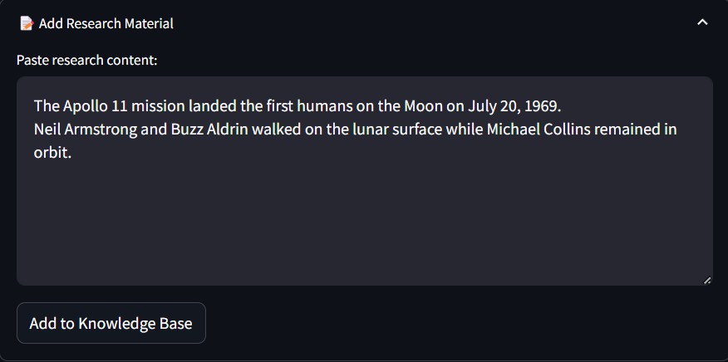
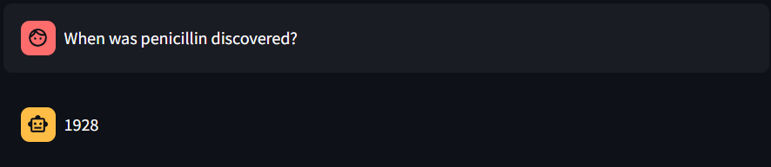
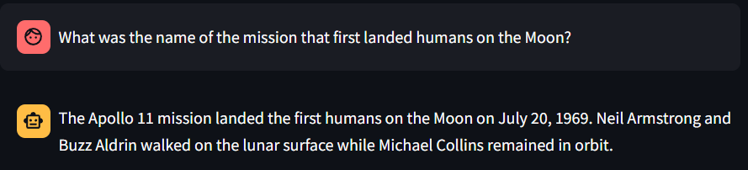
RESULT

Slide 9
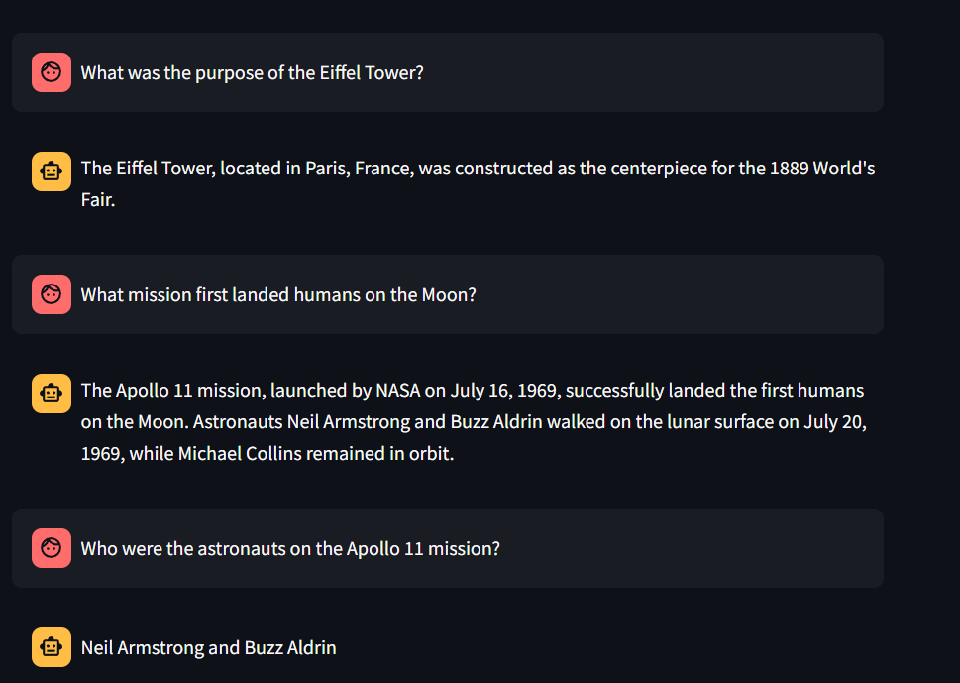
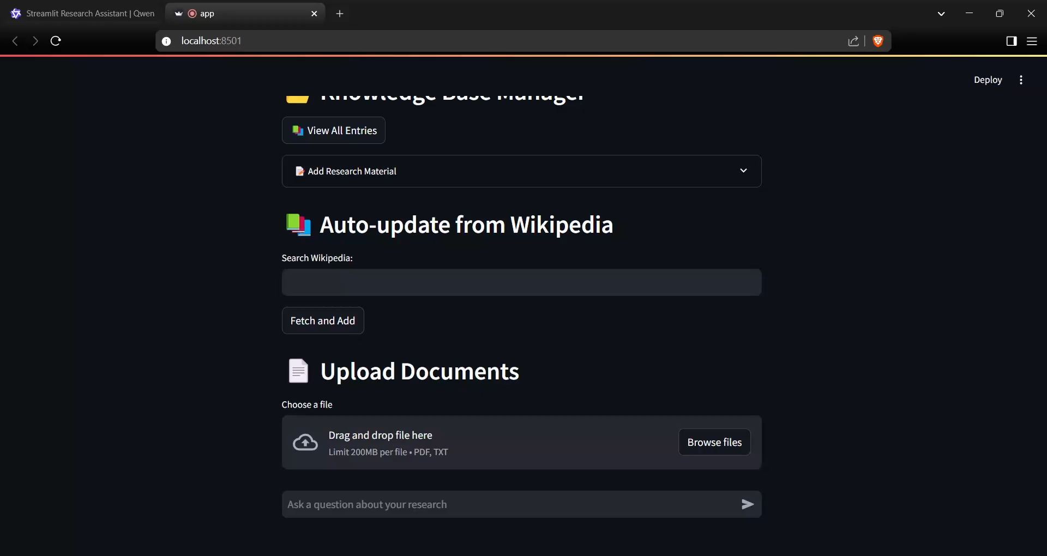

Slide 10
FUTURE ENCHANCEMENTS
Multi-Language Support : Add multilingual embeddings (e.g., paraphrase-multilingual-MiniLM-L12-v2) to support queries in multiple languages, making the system globally accessible.
Cloud Deployment : Migrate to cloud platforms like AWS or Google Cloud for better scalability, enabling real-time access and handling larger datasets efficiently.
Domain-Specific Embeddings : Fine-tune embeddings for specialized fields like math, physics, chemistry, and medicine to improve accuracy for niche use cases.
Metadata Filtering : Introduce advanced filtering by tags, date, or domain, allowing users to narrow down searches for more precise and relevant results.
Enhanced Security : Add authentication, role-based access control (RBAC), and data encryption to secure sensitive information and ensure privacy compliance.
Reasoning and Problem Solving : Enable the system to solve math, physics, and chemistry problems with step-by-step explanations. Handle reasoning questions using advanced AI models like GPT-4 or PaLM.

Slide 11
CONCLUSION
Nuera-AI successfully addresses the inefficiencies of traditional knowledge management systems by combining advanced AI technologies like semantic search (FAISS), keyword search (TF-IDF), and generative models (FLAN-T5-large).
The system retrieves accurate, context-aware answers through hybrid search and Cross-Encoder re-ranking, solving challenges like ambiguous queries and irrelevant results.
By enabling efficient storage, retrieval, and query of research material, Nuera-AI overcomes the limitations of fragmented tools and traditional databases.
It bridges the gap between generic AI models and personalized knowledge bases, empowering users to manage their own datasets effectively.
The intuitive Streamlit interface simplifies workflows for academics, professionals, and individuals, saving time and effort in research tasks.
A modular architecture ensures scalability, allowing the system to grow with user needs and handle larger datasets efficiently.
Planned enhancements like multi-language support, domain-specific embeddings, and reasoning capabilities will expand Nuera-AI’s usability in education, research, and professional domains.

Slide 12
Cloud deployment and real-time updates will further improve accessibility and keep the knowledge base current.
Nuera-AI demonstrates the power of combining modern AI techniques with a user-centric design to create a versatile, scalable, and impactful solution for knowledge management and retrieval.
By addressing the challenges outlined in the problem statement, it offers a robust foundation for future advancements in AI-powered research assistance.

Slide 13
THANK YOU

