Slide 1
Total Upgrades
Rating Upgrades: 1,1Z3

Slide 2
999

Slide 3
Net Rating Change
124

Slide 4
Average Precision Score
39.21^A

Slide 5
Vendor Rating Changes
Vendor Name
300
Vendor Name
Kroll
DBRS
Moody's
m ritch SBP ICRA CARE
Morningstar
280
260
240
220
200
180
1G0
140
120
100
80
60
40
20
0
Ratlng Chenge Count
Kroll
DDRS Moody.. Fitch SBP ICPA
CASE fviorni

Slide 6
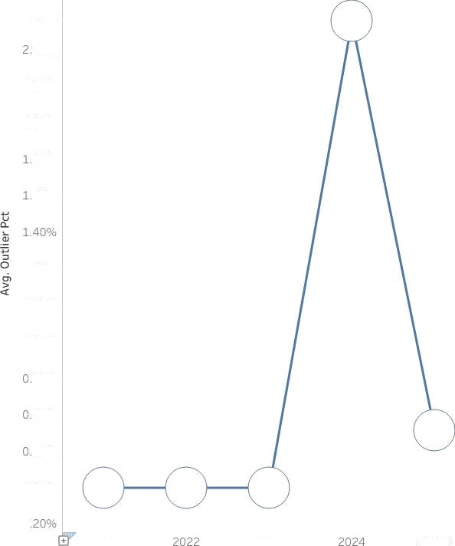
Outlier % Trend
Rating Date
2.609
40K
2.205£
2.005£
805£
60%
120%
1.00Œ
080Œ
60Œ
40}
209s
000}
-0
2021
2023
2025

Slide 7
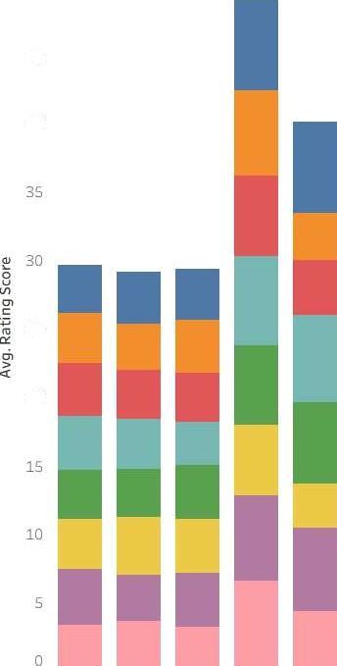
Rating Trend by Vendor
Effective Start Date
50
Vendor Name CARE
DBRS
m ritch
ICRA
4S
Moody's Morningstar SBP
40
25
20
2021 2022 2023 2024 2025

Slide 8
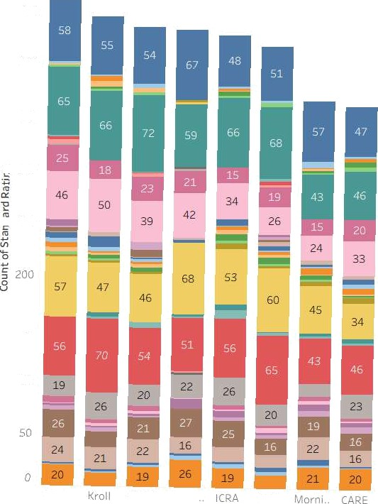
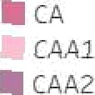
Vendor Rating Distribution
Standard Rating
flA ##A1
Vendox Name
450
R A2 ##A2+
flA- ##A+ ##AA ##AA1
pgqg
##AA3 ##AA-
AA+
AAAA
+• B B1 B2 B3
%B-
%B+
BA1 BA2 MBA3
8AAI BAA2 BAA3
ABB
BB- BB+ BBB BBB- BBB+
350
_ 300
250
150
100
Fitch
O9RS Moody
SBP

Slide 9
Outlier Severity
SUM(Outlier Pet)
Rating Type
0.00
13.00
120
110
100
90
80
70
G0
50
40
30
20
10
0
Bond R.. Ccrpor.. Issuer .. Long T.. SüGrt
Score Diff

Slide 10
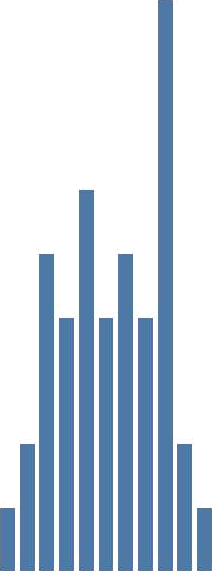
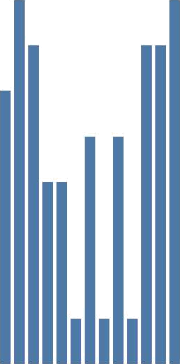





Top Outliers
Security Name

Slide 11
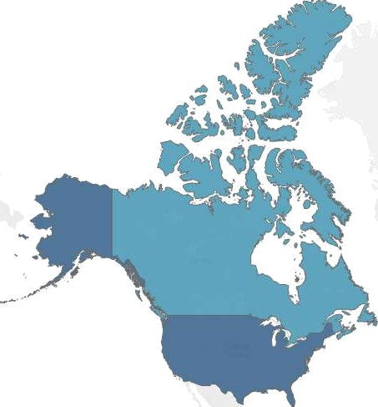


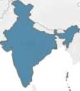
Country Comparison
A\/G(Rating Score)
3.4515
3 9244
' ' 2025 I\1apbox * OperiStree\Map

Slide 12
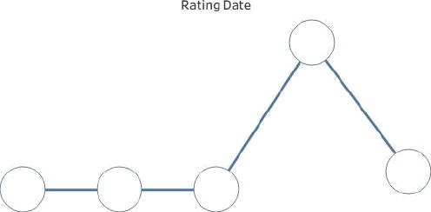















Credit Rating KPI Dashboard (2021—2025)
Consolidated summary of credit rating movements across vendors and rating types.
Total Upgrades
1,123
Total Downgrades
999
Net Rating Change
124
Average Precision Score
39.2196
Rating Trend by Vendor
Vandor Name
CARE M DBRS
hitch
Outller &o Trend
I Elective Start Date
M Moody's
M Morningstar
2021
?02?
2C23
2024
2025
2021
2022
2023
2024
Vendor Rating Changes
Vandor Nama
0
D9RS
Fitch
Morningstar
Kroll
k*OOfi\ ' E
SbP
ICPA

Slide 13

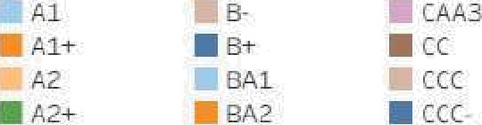
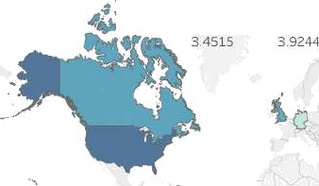
















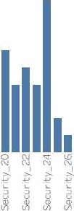

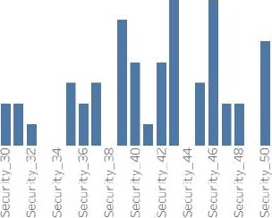
Vendor & Country Performance Insights
Comparative analysis of vendor behavior, rating distribution, and regional trends.
Country Comparison
Vendor Rating Distribution
Vendor Name
Standard Ratlng
g
Avg. Rating Score
•
100
M A-
A+ M AA M AA1 M AAZ B AA3 M AA- M AA+ M AAA
M BAA1
BAA2 M BAA3 M BB
M BB- M BB+ M BBB M BBB- M BBB+
M D
o 200
20Q
100
a z02s t'aapbox ID OpenSoeetMap
Outlier Severity
Rating Type
Top Outliers
Security Name
O
lg
120
IC'
100
00
60
Recur ltd 6
Recur i / a0

