Slide 1
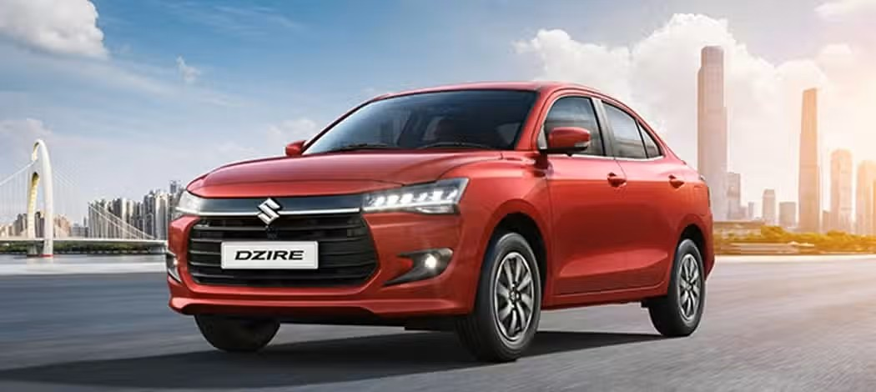
Car Rental System
VIVEK DUBEY
PRIYANSHU SINGH
YUVRAJ SINGH
KARTIKEY VARSHNEY

Slide 2
Introduction
RoyalRide is a modern online car rental platform designed for convenience and reliability.
Allows users to book verified cars safely and quickly from anywhere.
Provides a seamless rental experience with secure payments and easy navigation.
Aims to replace traditional rental hassles with a digital, user-friendly solution

Slide 3
What is Car Rental System
A platform that allows users to rent cars for a specific period
.Provides verified vehicles with secure booking option
.Reduces dependency on traditional rental methods

Slide 4
Objective / Aim
Simplify car rental process for users
Offer online booking and secure payments
Ensure verified cars and seamless admin management

Slide 5
System Architecture / Flow
Flow: Frontend → Backend → Database
Users interact via frontend → Backend handles requests → MongoDB stores data
“
”

Slide 6
Tech Stack Used
Frontend: HTML, CSS, JavaScript
Backend: Node.js, Express
Database: MongoDB

Slide 7
Modules / Features user Sigunup/login complete …. car search& booking
Admin panel (Add/Delete cars)
Secure payment with verified cars
n

Slide 8
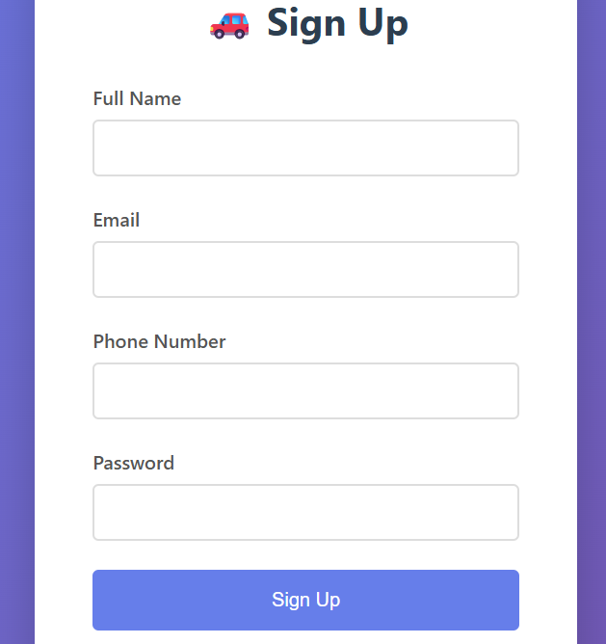
Working / Output
Signup

Slide 9
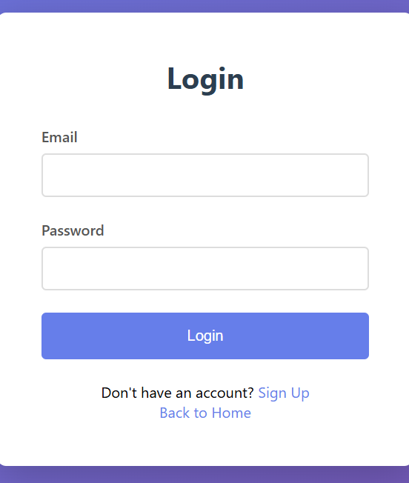
Working / Output
Login page

Slide 10
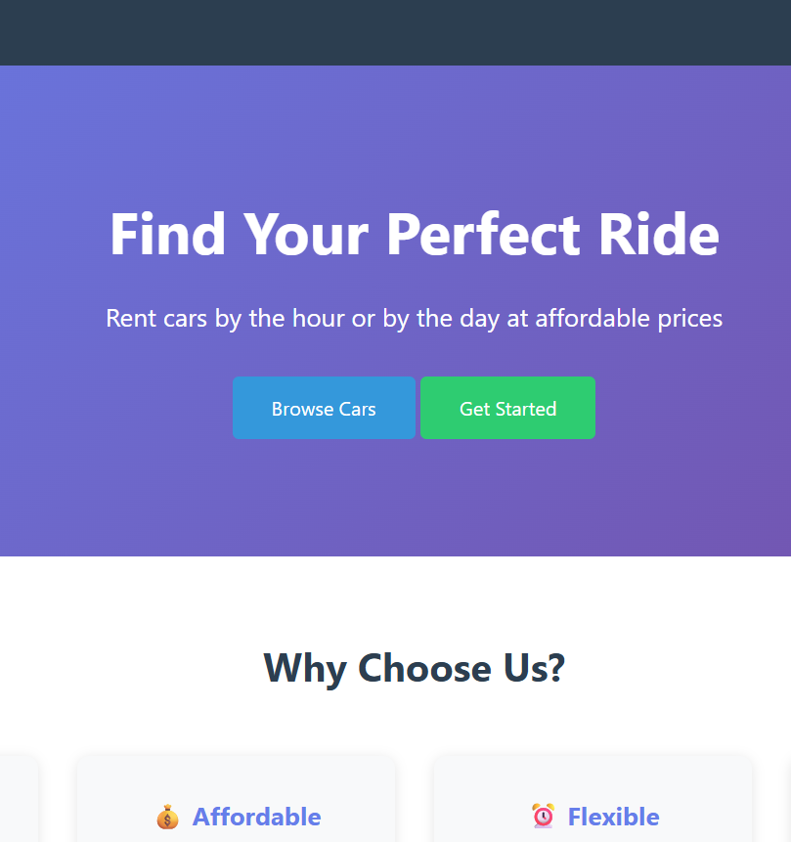
Working / Output
Homepage (get Started)

Slide 11
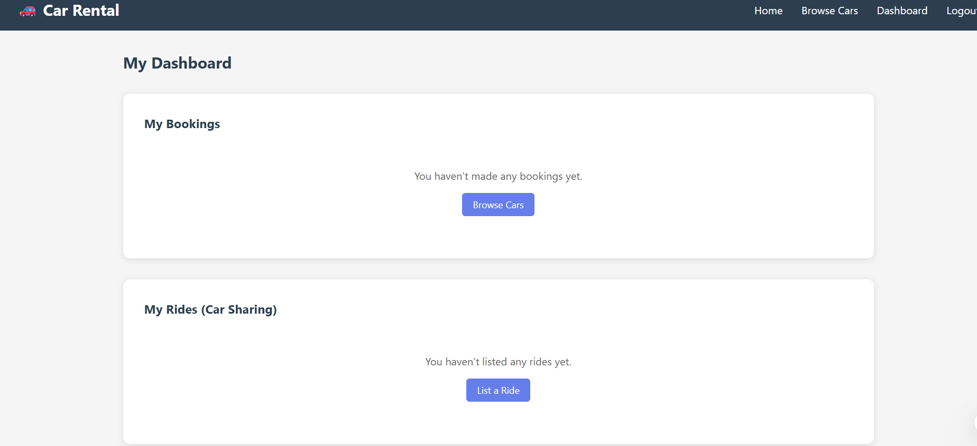
Users Dashboard

Slide 12
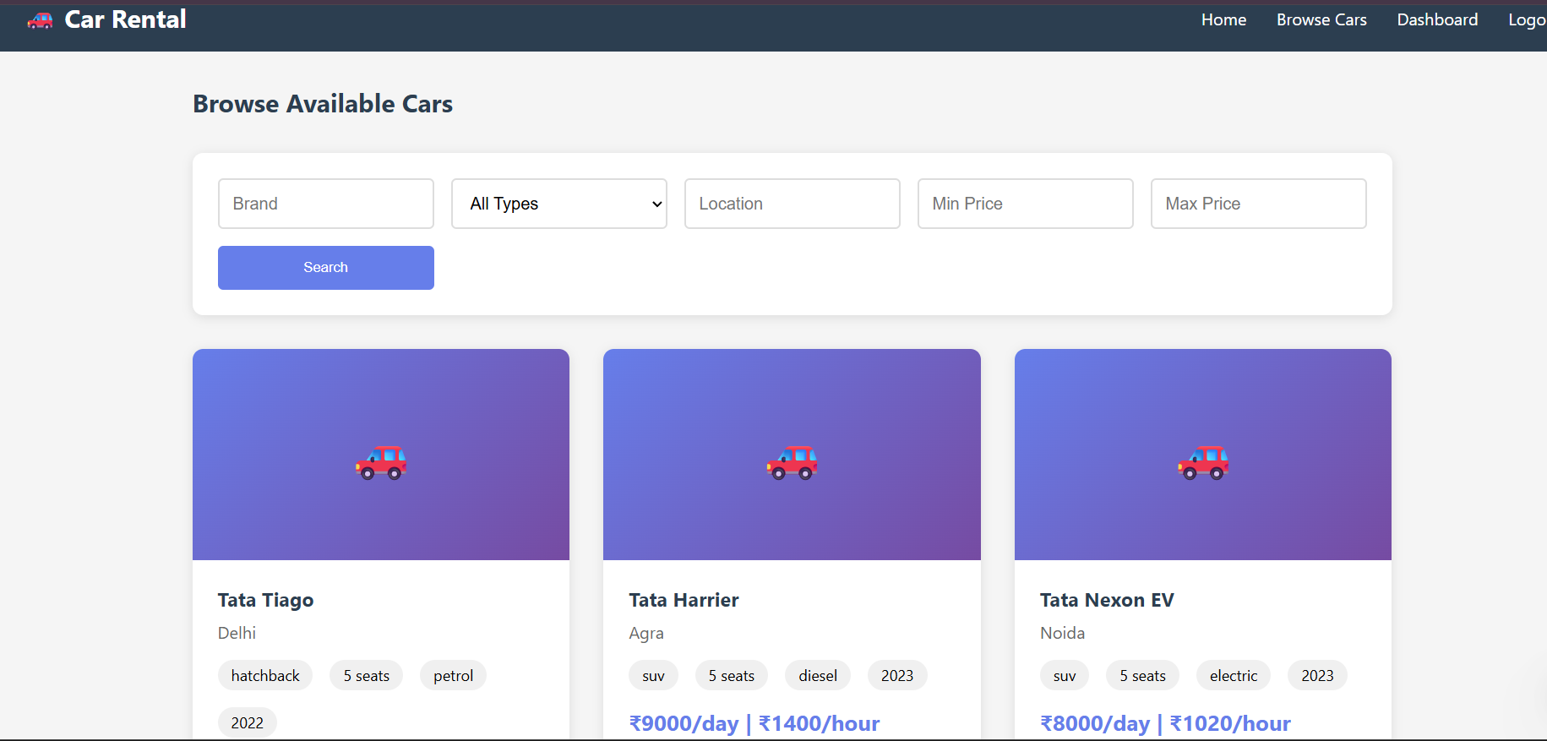
Browse Cars Page

Slide 13
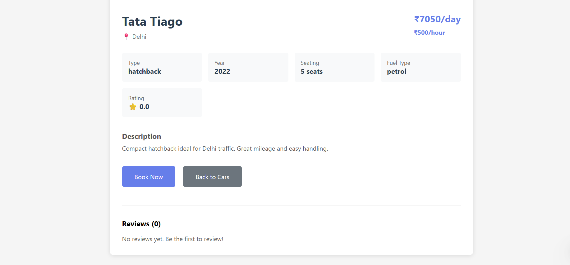
Car Details + Booking Screen

Slide 14
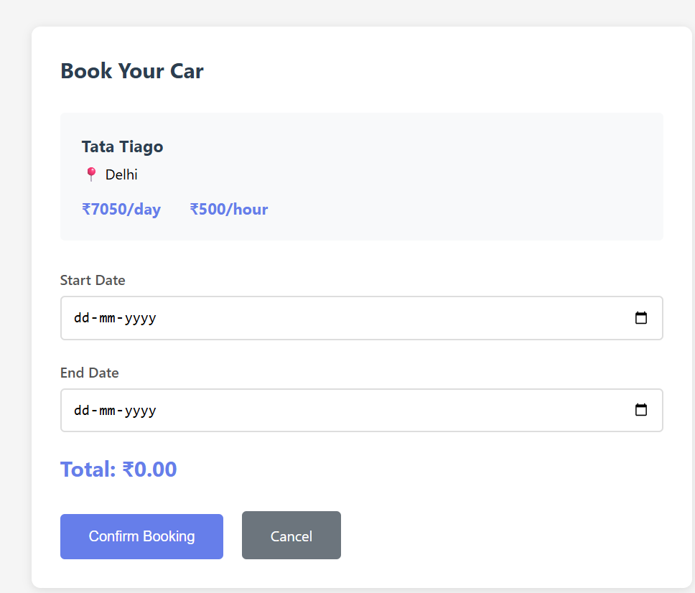
Bookings Table

Slide 15
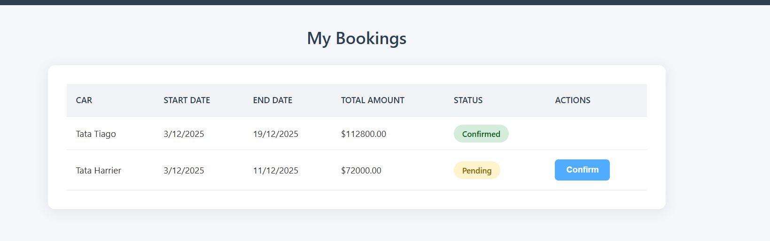
Booking Confirmation / Action

Slide 16
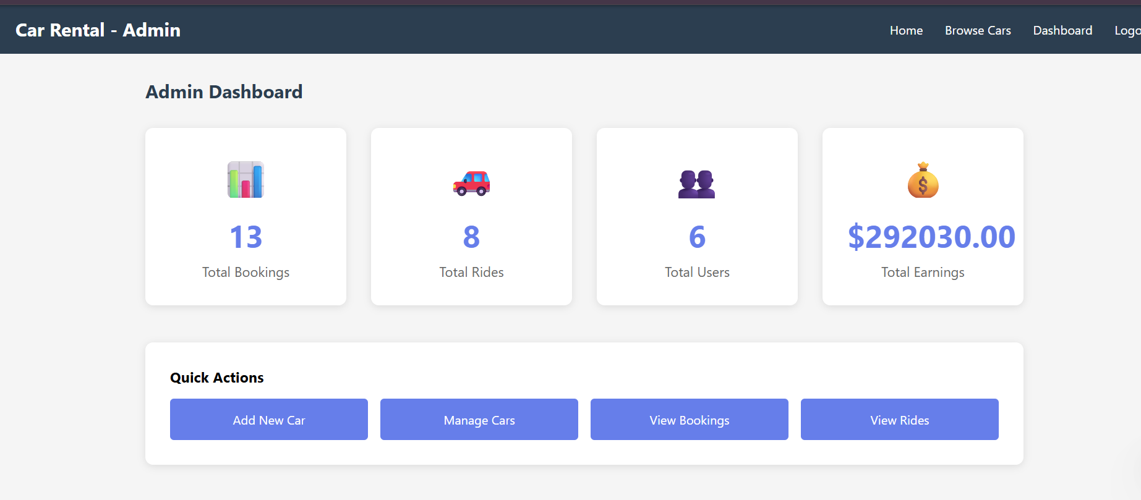
Admin Dashboard

Slide 17

Summary
RoyalRide is an innovative online car rental system designed to provide users with a safe, convenient, and hassle-free way to rent cars. The platform allows users to signup/login, search for cars, and make secure bookings with verified vehicles. Built using HTML, CSS, JavaScript, , Node.js and Express for backend, and MongoDB for database, the system ensures smooth operation and reliable data management. Its modular features include an admin panel, secure payments, and easy-to-use frontend forms. The working output demonstrates a fully functional website with responsive pages, car listings, and signup/login modals, offering a complete digital car rental experience.”

Slide 18
Thank you

