Slide 1
Node.js
Deepak H G

Slide 2
Introduction to NOde.js
For a long time, JavaScript was limited to use within the browsers.
Node.js allows JavaScript to be executed outside the browser.
Node.js uses the same JavaScript engine as Google Chrome i.e., V8 engine.
Node.js is an open-source project.
Node.js was originally developed by Ryan Dahl, a PhD student in mathematics.
In January 2009, Ryan Dahl began working on the implementation for server-side JavaScript.
In September 2009, Isaac Schlueter started working on a package manager for Node.js, the Node Package Manager (npm).

Slide 3
Set Up Development Environment
Installation
Node.js can be installed on Unix-based systems like Linux or macOS and Windows.
Node.js version number consists of three parts: major release, minor release and patch level.
Major release as even number indicates Long Term support and odd versions have a shorter life span.
Download Node.js from Node.js — Download Node.js®
The installation of Node.js can be verified using the command:
node --version

Slide 4
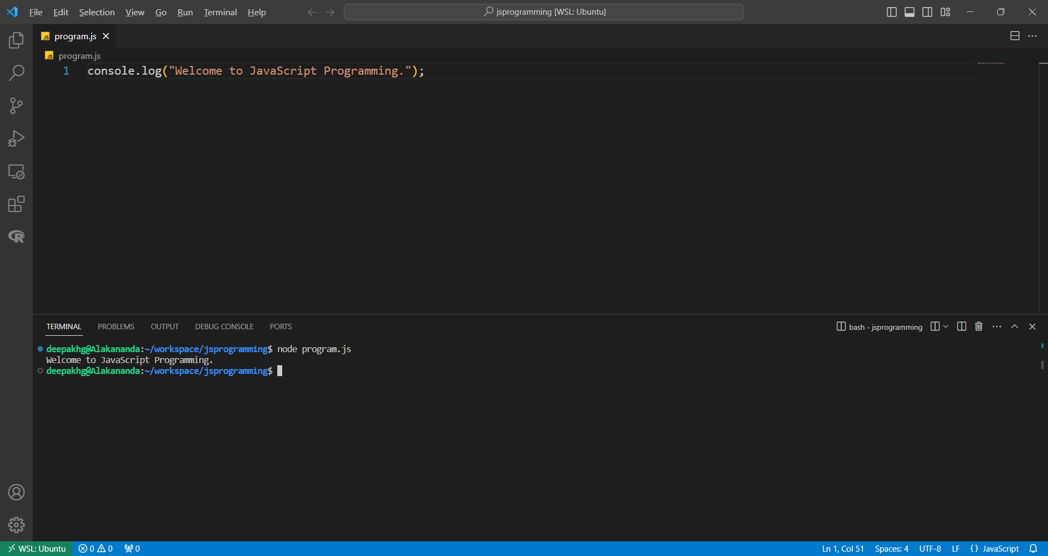
Executing JAVASCRIPT CODE on Node.js
Create a file with extension .js
Execute the code using the command node <fileName>.js

Slide 5
Node.js Package Manager
Different modules are available for Node.js.
The Node.js modules can be installed via Node.js Package Manager (NPM).
NPM is included in the installation of Node.js.
The installation of NPM can be verified using the command:
npm –version

Slide 6
Node.js Package Manager
With NPM, packages can be installed either locally or globally.
Local installation – Useful when the package is required by one of the application.
Command for installation: npm install <package>
Global installation – Useful when the package is required to be available to all the applications.
Command for installation: npm install –g <package>
NPM creates a new directory node_modules in the current directory and installs the package along with its dependencies.

Slide 7
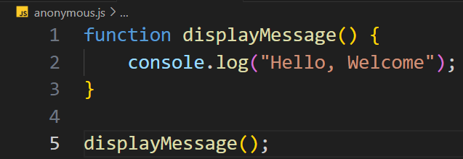
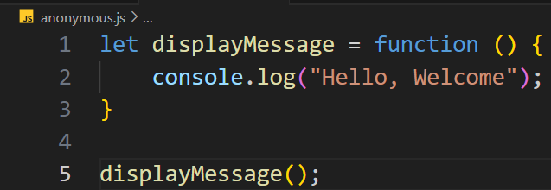
Anonymous Functions
Functions without names and stored inside variables.

Slide 8
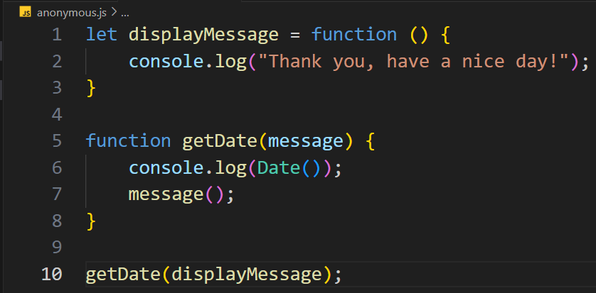
Function Callbacks
A callback is a function passed as an argument to another function.
Callback allows a function to call another function.
A callback function runs after the execution of another function.

Slide 9
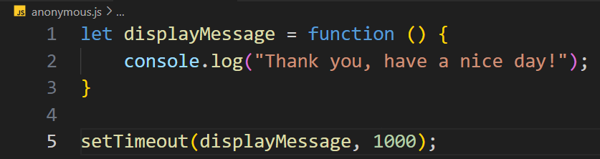
Function Callbacks
setTimeout() is going to wait for 1000 ms and then execute the displayMessage() function.
Function executing the function after been called is useful for managing asynchronous program execution.

Slide 10
Node.JS Modules
A module is a JavaScript library, containing a block of code that can be reused throughout the application.
Modules enable to divide the code into multiple files making easier to maintain a code-base.
Modules can be :
Built-in Modules
Custom Modules

Slide 11
Node.JS Modules
Built-in Modules
Used without any installation.
Example
HTTP Module
Allows Node.js to transfer data over the Hyper Text Transfer Protocol (HTTP).
File System Module
Allows to work with the file system on the computer.
URL Module
Splits up a web address into readable parts.
OS Module
Provides information about the computer’s operating system.
Path Module
Provides a way of working with the directories and file paths.

Slide 12
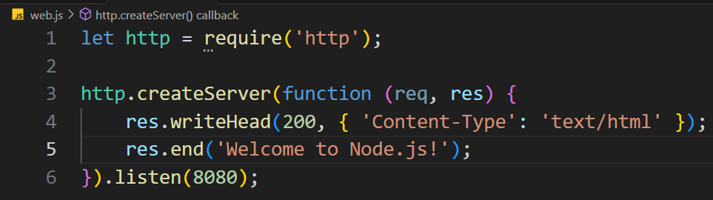
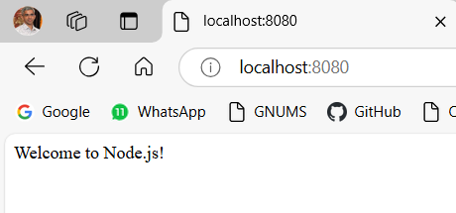
Node.JS Modules
HTTP Module
Include Modules
To include a module, use require() function with the name of the module.
Create the Server

Slide 13
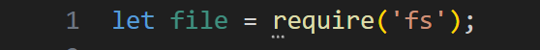
Node.JS Modules
File System Module
The file system module allows to work with the file system on the computer.
To include the File System module, use:
Common use of File System module:
Create files
Read files
Update files
Delete files
Rename files

Slide 14
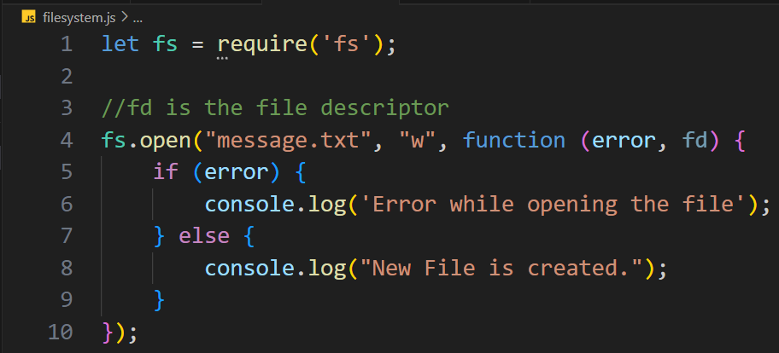
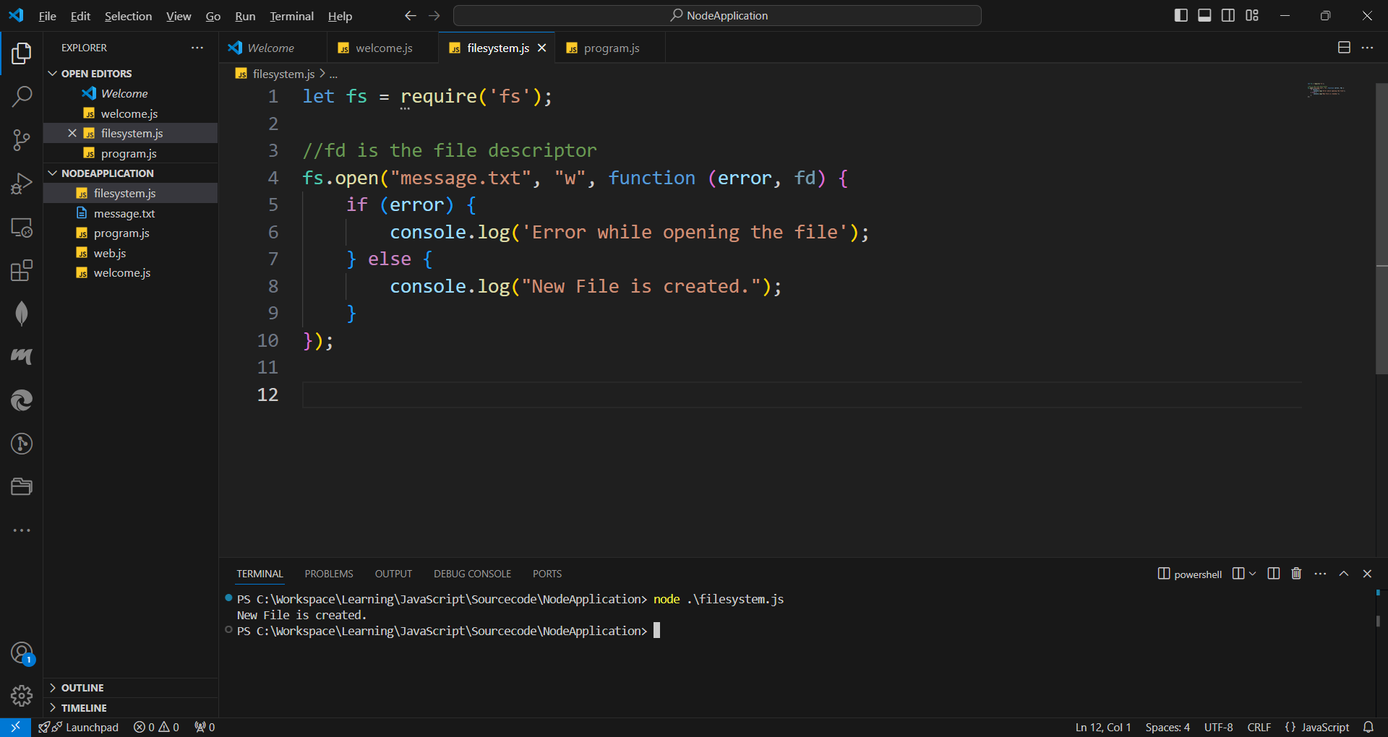
File System
Create File:
Use open() method
The first parameter is the file to be opened. If file doesn’t exists, new file is created.
The second parameter is the flag indicating the mode of opening.

Slide 15
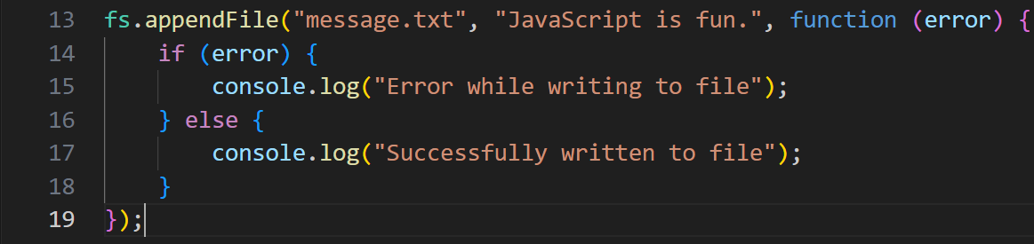
File System
Create/Append File:
Use fs.appendFile() method
Appends the specified content to the file. If the specified file doesn’t exists, it will be created.
The first parameter is the file name and second is the text.

Slide 16
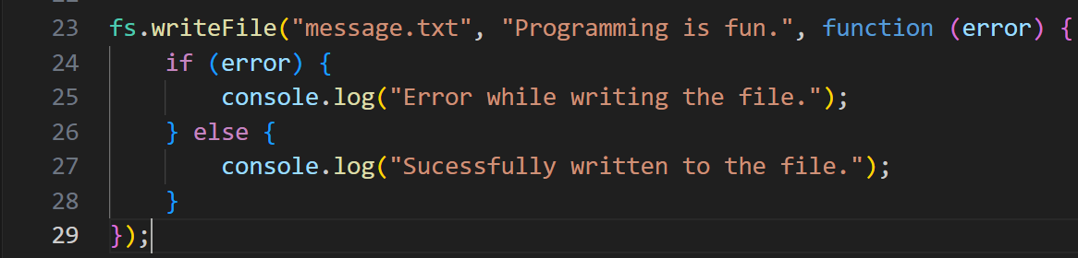
File System
Create/Write to file:
Use fs.writeFile() method
Replaces the specified file and content, if exists.
If file doesn’t exists, a new file with the specified content will be created.
The first parameter is the file name and second is the text.

Slide 17
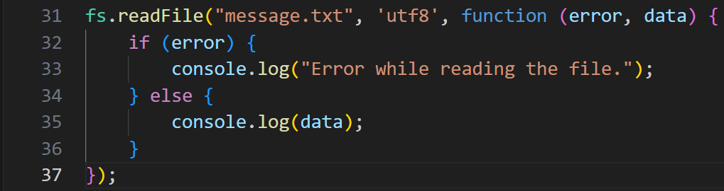
File System
Read File
Use fs.readFile() method to read the file content.
The first parameter is the file name and second is the encoding.

Slide 18
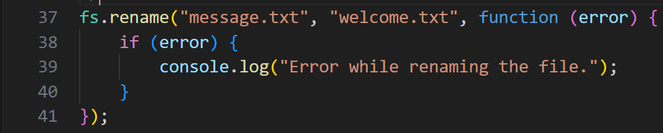
File System
Rename File
Use fs.rename() method to rename the specified file.

Slide 19
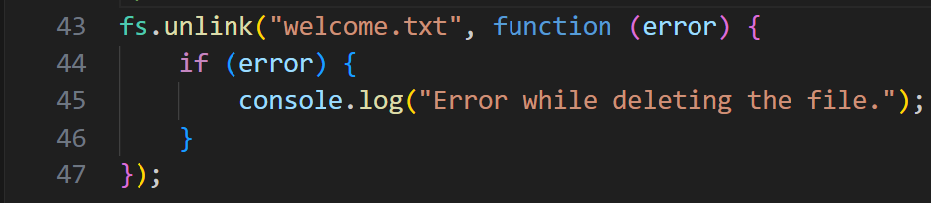
File System
Delete File
Use fs.unlink() method to delete a file.

Slide 20
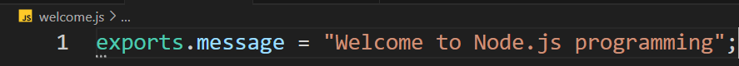
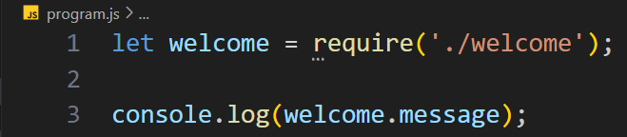
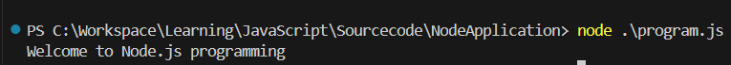
Node.JS Custom Modules
Create own modules and include in the application.
Use the keyword exports to make properties and functions available outside the module.
Note: ./ indicates the module is located in the same folder.

Slide 21
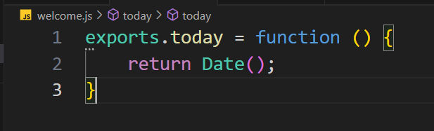
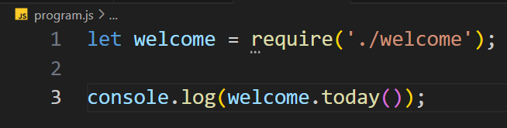
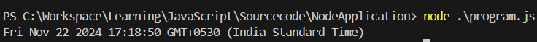
Node.JS Custom Modules

Slide 22
Events
Every action on a computer is an event.
Node.js has a built-in module, called “events” to create, fire, or listen for events.
All event properties and methods are an instance of an EventEmitter object.
EventEmitter class has 2 methods to subscribe and fire events:
on() method: To subscribe to the event.
emit() method: To fire an event.

Slide 23
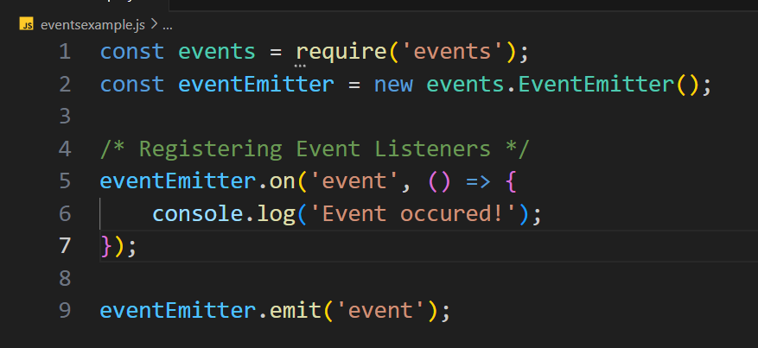
Events

Slide 24
MongoDb
A database is an organized collection of data stored in a computer system.
MongoDB is a document database that stores data in a JSON format.
MongoDB is one of the most popular NoSQL database.
SQL Vs NoSQL Database
SQL Database | NoSQL Database
Relational database. | Document or non-relational database.
Stores data in tables. | Stores data in flexible documents.

Slide 25
MongoDB
MongoDB is available in two editions:
Community
Enterprise
MongoDB installation: Install MongoDB - MongoDB Manual v8.0
MongoDB Compass
A powerful GUI for querying, aggregating, and analyzing MongoDB data in a visual environment.
Free to use and runs on macOS, Windows, and Linux.

Slide 26
MongoDb
Database
Contain one or more collections of documents.
Collection
A collection is same as a table in SQL.
Document
A document is same as a record in SQL.

Slide 27
MongoDb
Open MongoDB Compass:
Create New Connection.
Create New Database.
Create New Collection.
Working with MongoDB using Node.js
Installing MongoDB Driver: npm install mongodb
JavaScript code

