Slide 1

OldAndBald
Historical ChatBot

Slide 2


About our project
What is the idea?
How does it work?

Slide 3


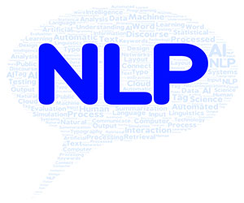
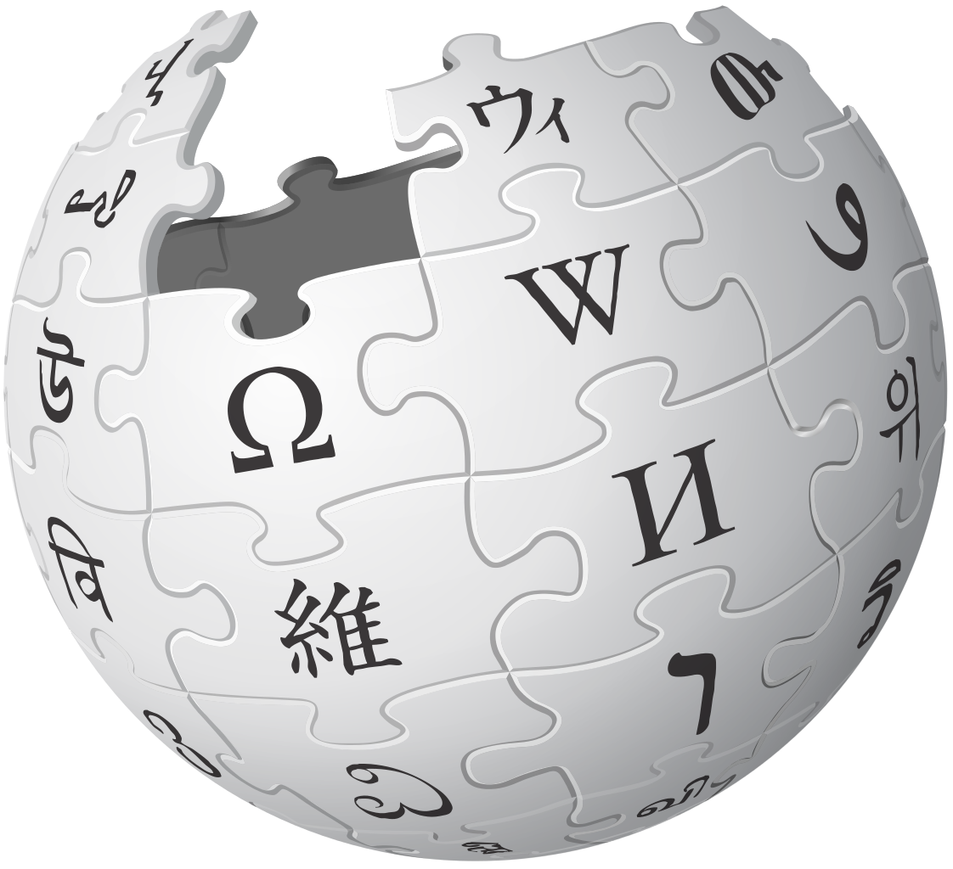
Technologies

Slide 4
Natural Language Processing
Standartization
"luv" -> "love"
Removing "Noise"
words like
"is", "was", "a" …
punctuation
Stemming
"playing" -> "play"
"player" -> "play"

Slide 5
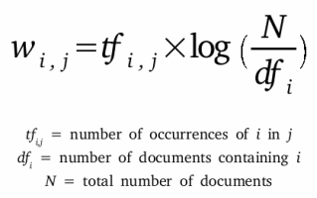
Text to features?
TF-IDF

Slide 6
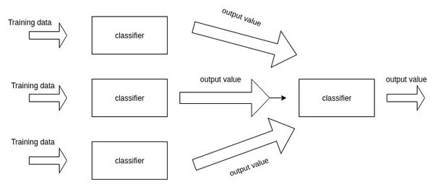
1. ML Algorithms
Classifying users response with 93% accuracy
Naive Bayes x 2
Logistic Regression
Decision Tree

Slide 7
2. ML Algorithms
Topic recognition
Named Entity Recognition (NLTK)
Ensemble models (eg. RandomForest)
Text summarization algorithm
Elasticsearch service for recommendation engine

Slide 8
DEMO

Slide 9
About us
Victor Velev – ML
Anton Yanchev – ML and UI
Samuil Georgiev – UI and functionality
Georgi Lubenov – UI and functionality

Slide 10
Future Plans
Add other sources (not only Wikipedia)
Finalize the other features of the app apart from the chat
History
Bookmarks
and others...
Publish it so it is accessible for everyone :)

Slide 11
?

