Slide 1
HINTS-5 DATA ANALYSYS
Vigneshwaran Giri Velumani

Slide 2
Objective
Who are actively using/not using Online portal to access their health records?
Why/Why not they are using? (or) What are the characteristics of the users who are using/not using?

Slide 3
Variable Selection
Looking for health Info & Internet Usage
Variable Label | Screening Variable
A1,A2,B1,B5,B10,B12 | A1,B1
Patient's Health Care
Variable Label | Screening Variable
C3,C5,C7 | -
Medical Records
Variable Label | Screening Variable
D1,D2,D4,D6,D7,D8,D9,D11 | D1, D4
Target Variable – D6
0 - NON USER - 1 - ONE/TWO TIMER – 1 to 2times 2 -FREQUENT USER - 3 & Above
Patient's Health & Physical Activity
Variable Label | Calculated Variables
G1,G2,G3,G4,G5,I1,I2 | Height, BMI
Demographics
Variable Label | Screening Variable
O1,O2,O5,O6,O7,O9,O11,O17,018 | -

Slide 4
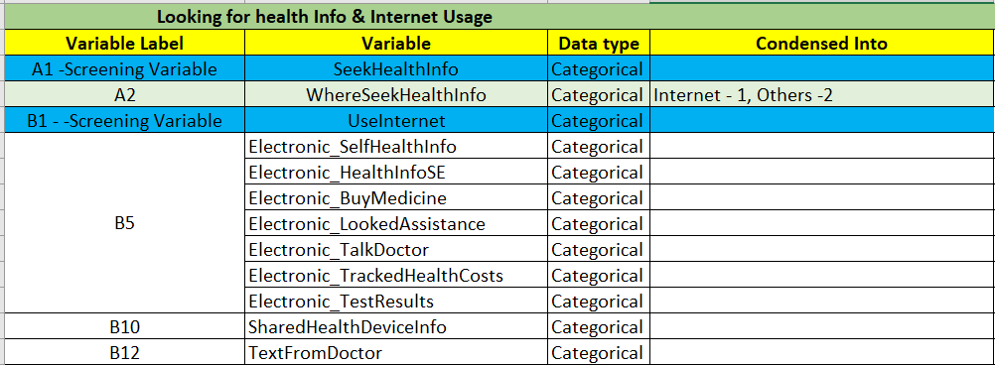
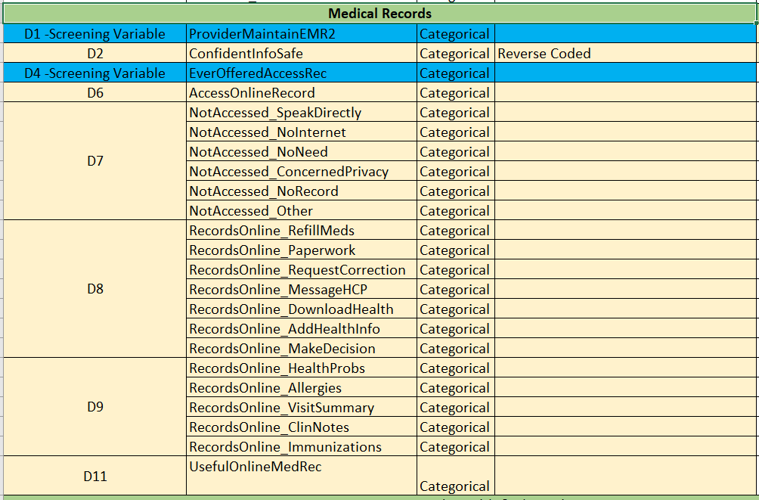
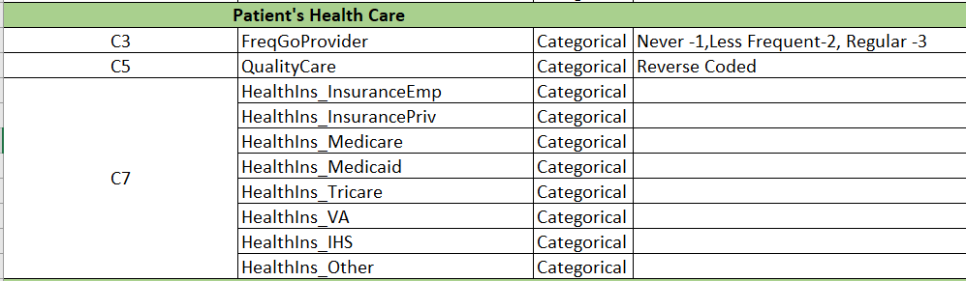
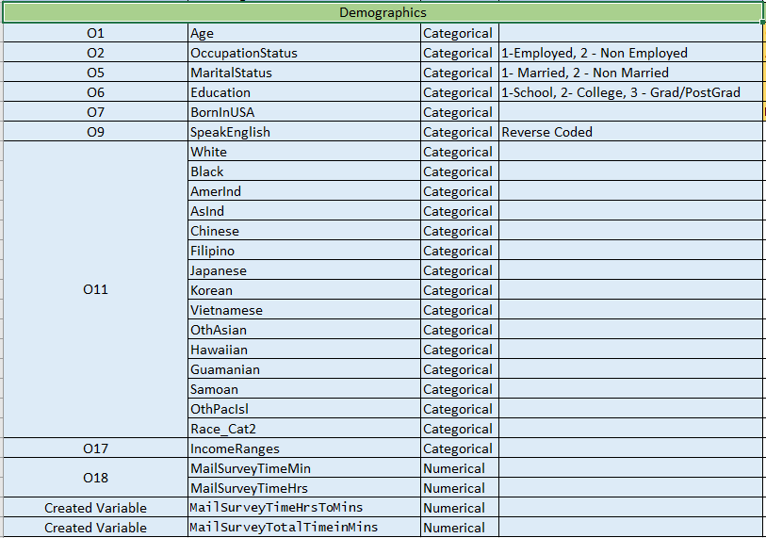
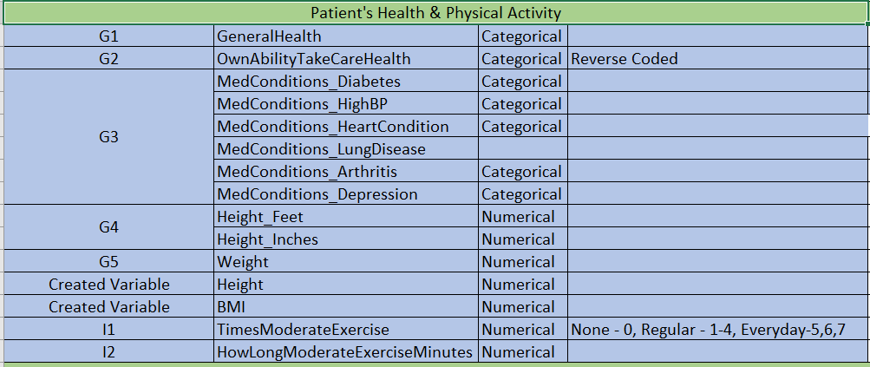
Variable Characteristics

Slide 5
Model Selection
Model | Accuracy (%)
Classification and Regression Tree (CART) | 75.74
Neural Net | 76.82
Random Forest | 77.36

Slide 6
Random Forest
Block | Variable Importance | Accuracy(%)
Looking for health Info & Internet Usage | Electronic_TalkDoctor Electronic_TestResults | 60.11
Patient's Health Care | FreqGoProvider QualityCare | 41.24
Medical Records | RecordsOnline_MessageHCP UsefulOnlineMedRec | 74.66
Patient's Health & Physical Activity | BMI HowLongModerateExerciseMinutes MedConditions_Arthritis MedConditions_Diabetes | 33.96
Demographics | OccupationStatus Age Education IncomeRanges MailSurveyTotalTimeinMins | 40.16

Slide 7
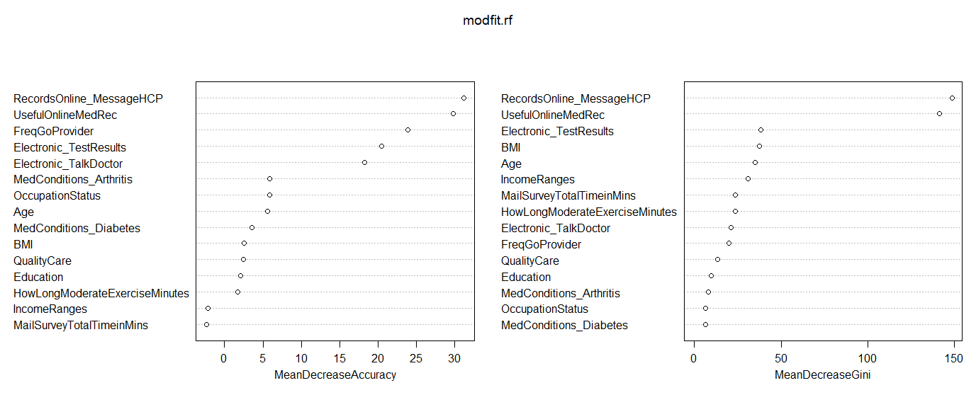
Random Forest
Block | Variable Importance | Accuracy(%)
Including all Important Variables in Each Block | FreqGoProvider RecordsOnline_MessageHCP UsefulOnlineMedRec Electronic_TalkDoctor Electronic_TestResults | 76.82
Including the 5 Most Important Variables | - | 76.01

Slide 8
Characteristics of Users & Non Users
Label | Variable | Non Users | Frequent Users | One/Two Timers
B5 | Electronic_TalkDoctor | 75% don't | 25% do | 95% do | 70% don’t 30% do
C3 | FreqGoProvider | 65 % visit Less frequent 35% visit Regular | 50 % visit Less frequent 50% visit Regular | 60 % visit Less frequent 40% visit Regular
D2 | ConfidentInfoSafe | Most are somewhat Confident | Even Distribution | 55% somewhat & 40% Very Confident
D7 | NotAccessed_SpeakDir | Most prefer to Speak Directly | Insignificant | Insignificant
D7 | NotAccessed_NoNeed | Most think they don’t need Online access | Insignificant | Insignificant
D8 | Online Medical Record Usages | Most of them do not Prefer to do all these Online | 90% don’t use online for Correction 50% of them prefer to sms 30% don’t | Most of them do not Prefer to do all these Online
D9 | Awareness of Availability of OMR | Most of them are aware but not using | Active usage | Active Usage
D11 | UsefulOnlineMedRec | somewhat useful or not very useful | 70% of them find either Very useful or Somewhat useful | 65% of them find either Very useful or Somewhat useful
G3 | High BP | Insignificant | 45% have 55% don’t | Insignificant
O17 | Income Ranges | 45% earn between 20-75K & only 25% earn between 50-200K | 75% of them earn between 50-200K or More | 65% of them earn between 50-200K

Slide 9
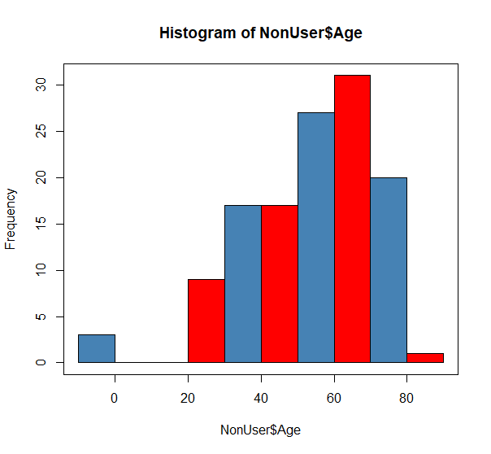
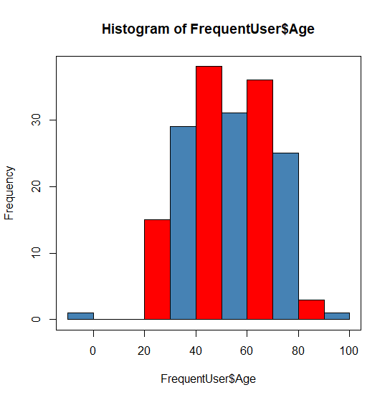
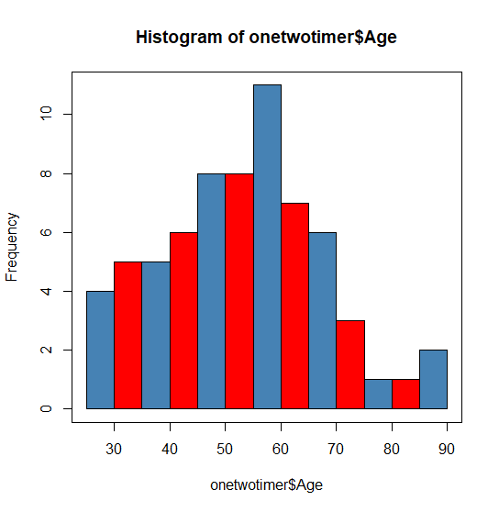
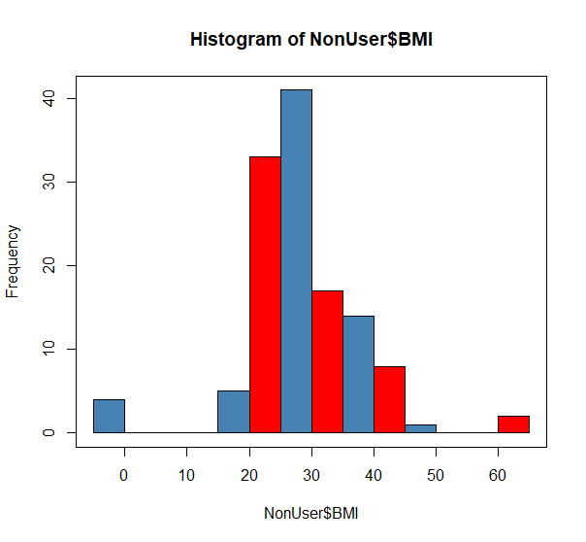
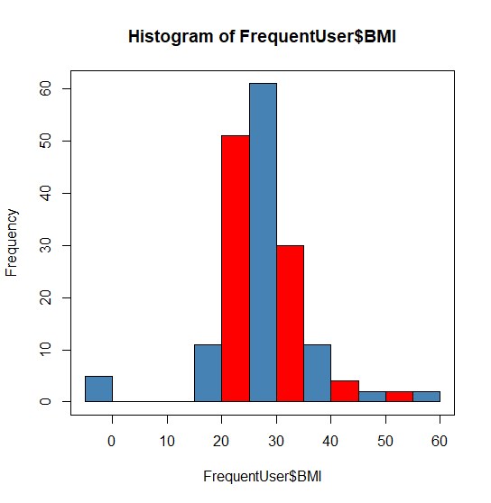
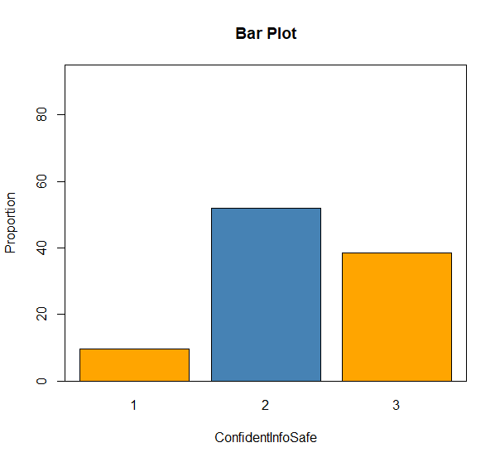
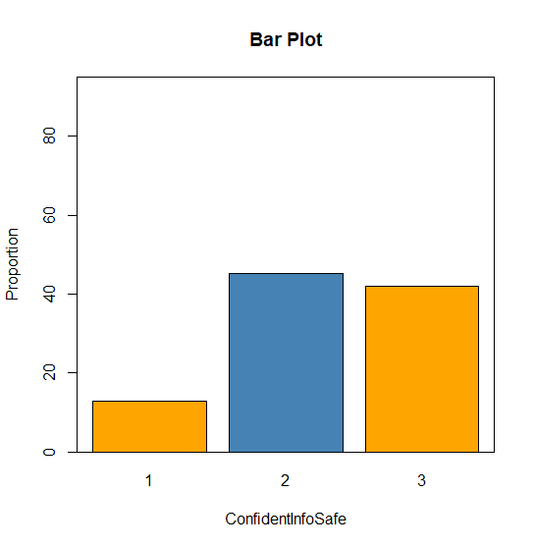
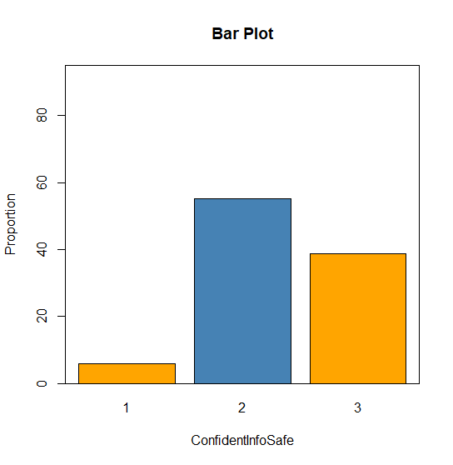
Bivariate Analysis Plots
Non User
Frequent User
One/Two Timer
Age
BMI
ConfidentInfoSafe

Slide 10
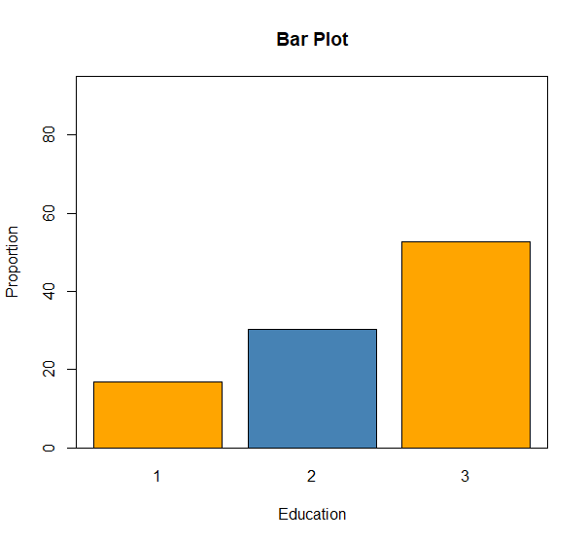
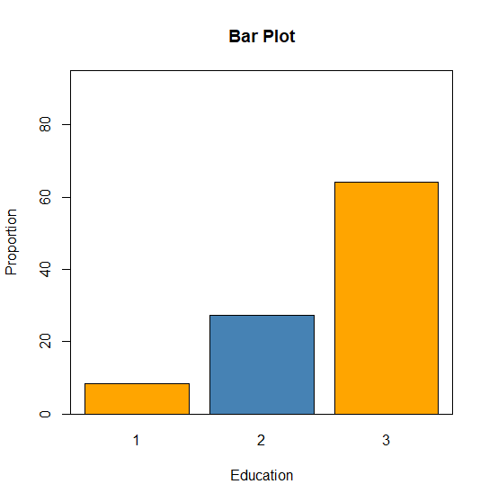
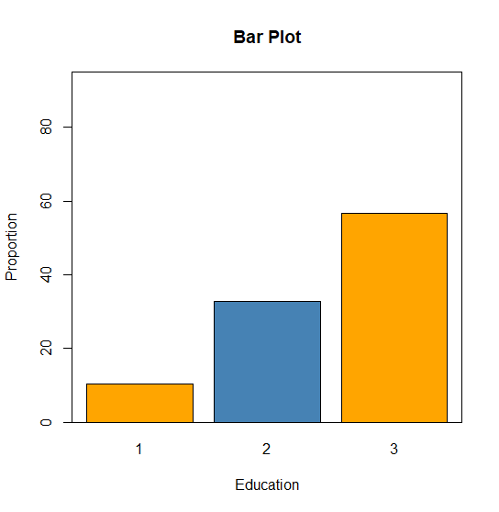
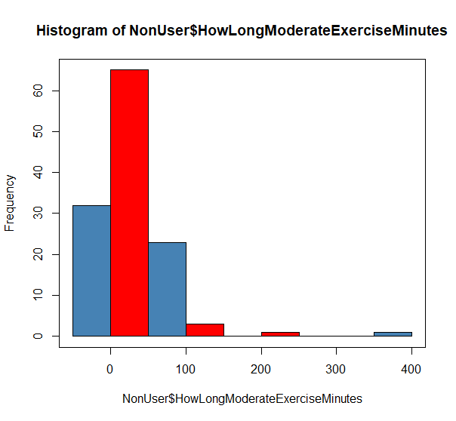
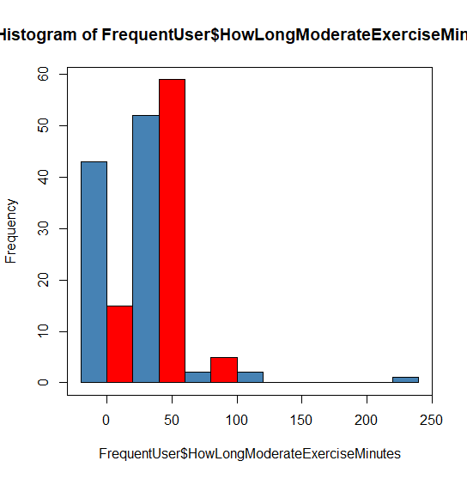
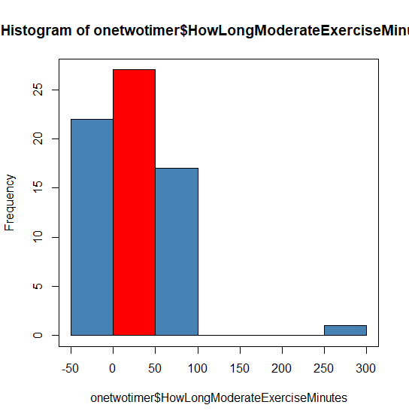
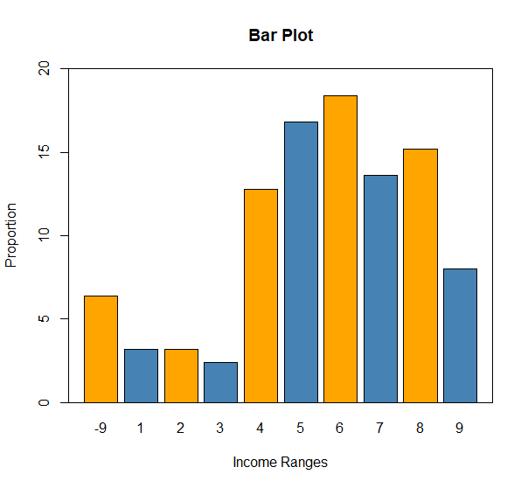
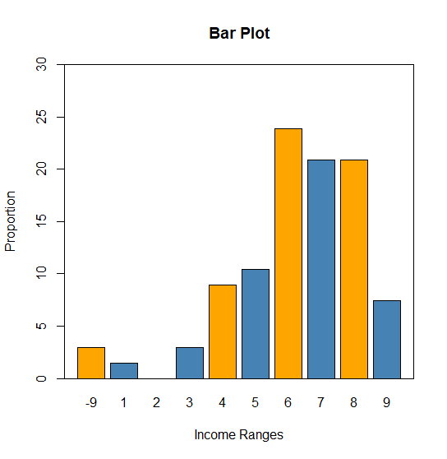
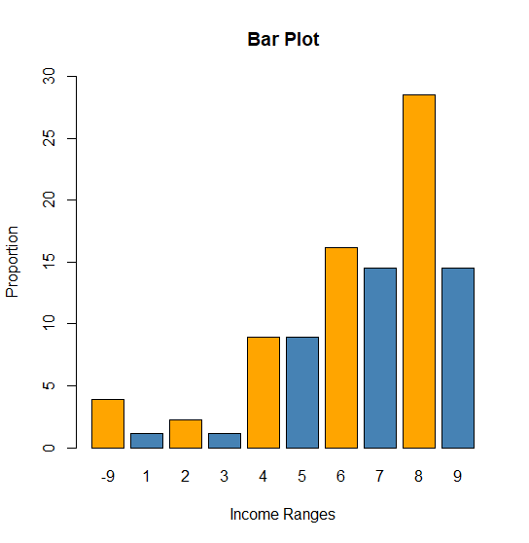
Bivariate Analysis Plots
Non User
Frequent User
One/Two Timer
Education
Exercise Mins
Income Range

Slide 11
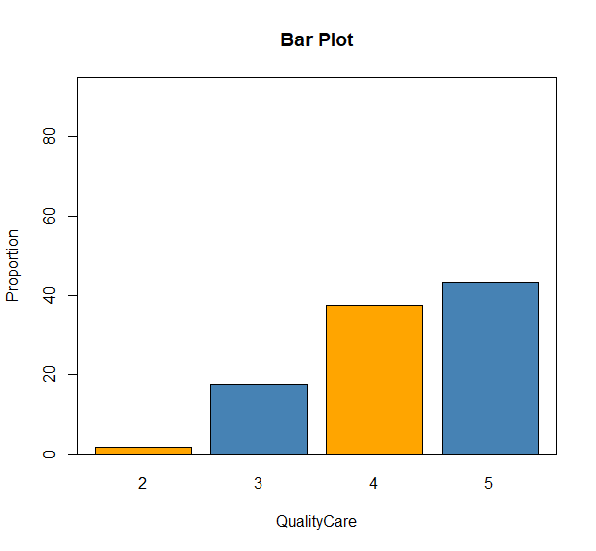
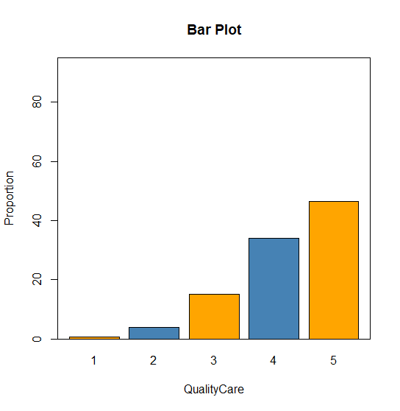
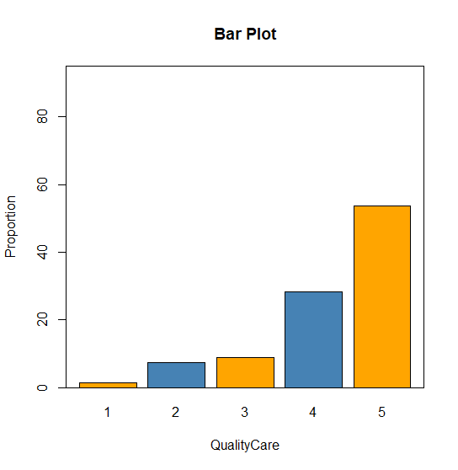
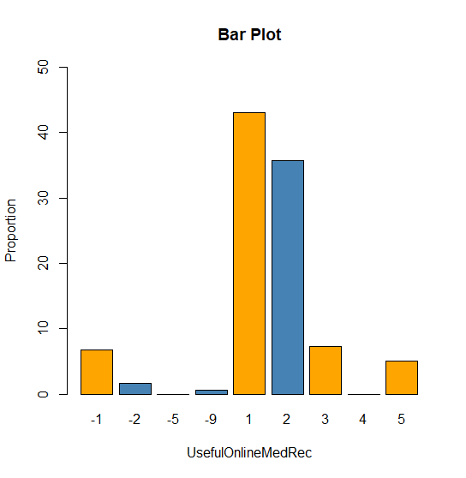
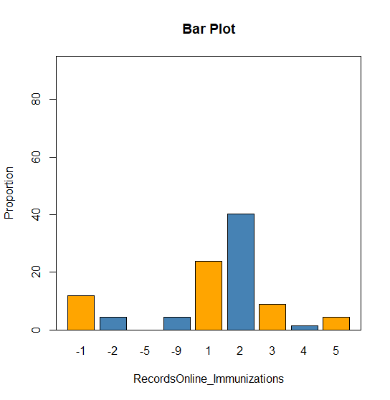
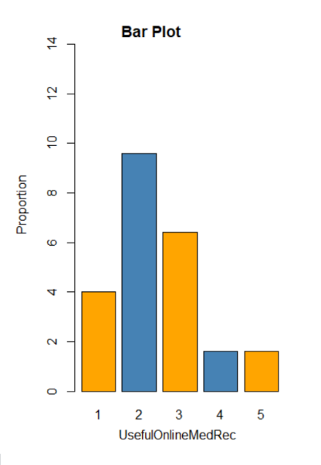
Bivariate Analysis Plots
Non User
Frequent User
One/Two Timer
Quality Care
Useful Online Med Rec

Slide 12
Findings
Non Users prefer conventional approach despite being aware of the Availability of Features in the Online Portal
Non Users most of them are only somewhat confident about the safety of their info online
Non Users don't think they need online access
Significant Non users are in the low income ranges compared to other two types of users

