Slide 1
01
PRODUCT & ENGINEERING CASE STUDY
CAREERMATCH
Product Designer
Job search that
explains itself.
Northwind Labs · Remote
Frontend Engineer
Octopus Energy · London
Senior Full Stack Engineer
73% fit
Northwind Labs · Bengaluru
A full-stack job board with real listings, transparent match scores, and a workspace for candidates, recruiters, and admins.
TypeScript
React
Node.js
Recommendations with matched and missing skills
React 18
Fastify 5
PostgreSQL
Prisma
2026 · One repository · Two entry points
Notes:
CareerMatch is a full-stack job-matching product: React SPA, Fastify API, PostgreSQL, real job feeds, local resume parsing, and explainable recommendations. The deck walks problem, product, engineering, and operations.

Slide 2
01 — THE PROBLEM
Hiring tools hide the reasoning.
Candidates are asked to trust a number they cannot inspect, against listings that were never local to begin with.
01
02
03
Opaque scoring
Off-target feeds
No feedback loop
Applicant tracking systems collapse skills, experience, and preferences into one unexplained score.
Global remote boards dominate results, pushing India-focused roles to page three or out entirely.
Applications vanish without a trace, so nobody learns which skill would have changed the outcome.
CareerMatch makes every ranking inspectable: the inputs, the weights, the matched skills, and the gaps.
CareerMatch — product case study
02 / 14
Notes:
Three failures of mainstream job search: opaque scoring, feeds that ignore the candidate's market, and zero feedback. The product is a direct answer to each.

Slide 3
02 — THE PRODUCT
One board. Three workspaces.
The same job model and ranking engine, shaped for whoever is looking.
01
02
03
Candidate
Recruiter
Admin
Find and track the right role
Hire with context
Keep the marketplace honest
— Build a profile and upload a resume
— Publish and manage company listings
— Marketplace counters and moderation
— Ranked roles with reasons, not just scores
— Ranked applicants with match evidence
— Role grants, revokes, account disabling
— Saved jobs, applications, notifications
— Pipeline stages and resume download
— Audit log for privileged actions
— Career paths from curated transitions
— Access limited to your own listings
— Manual feed refresh when needed
SHARED CORE — one Job model · one ranking engine · one auth model
CareerMatch — product case study
03 / 14
Notes:
Three experiences over one core. Candidate, recruiter, and admin all read the same Job rows and the same scoring function, which is why the product stays consistent.

Slide 4
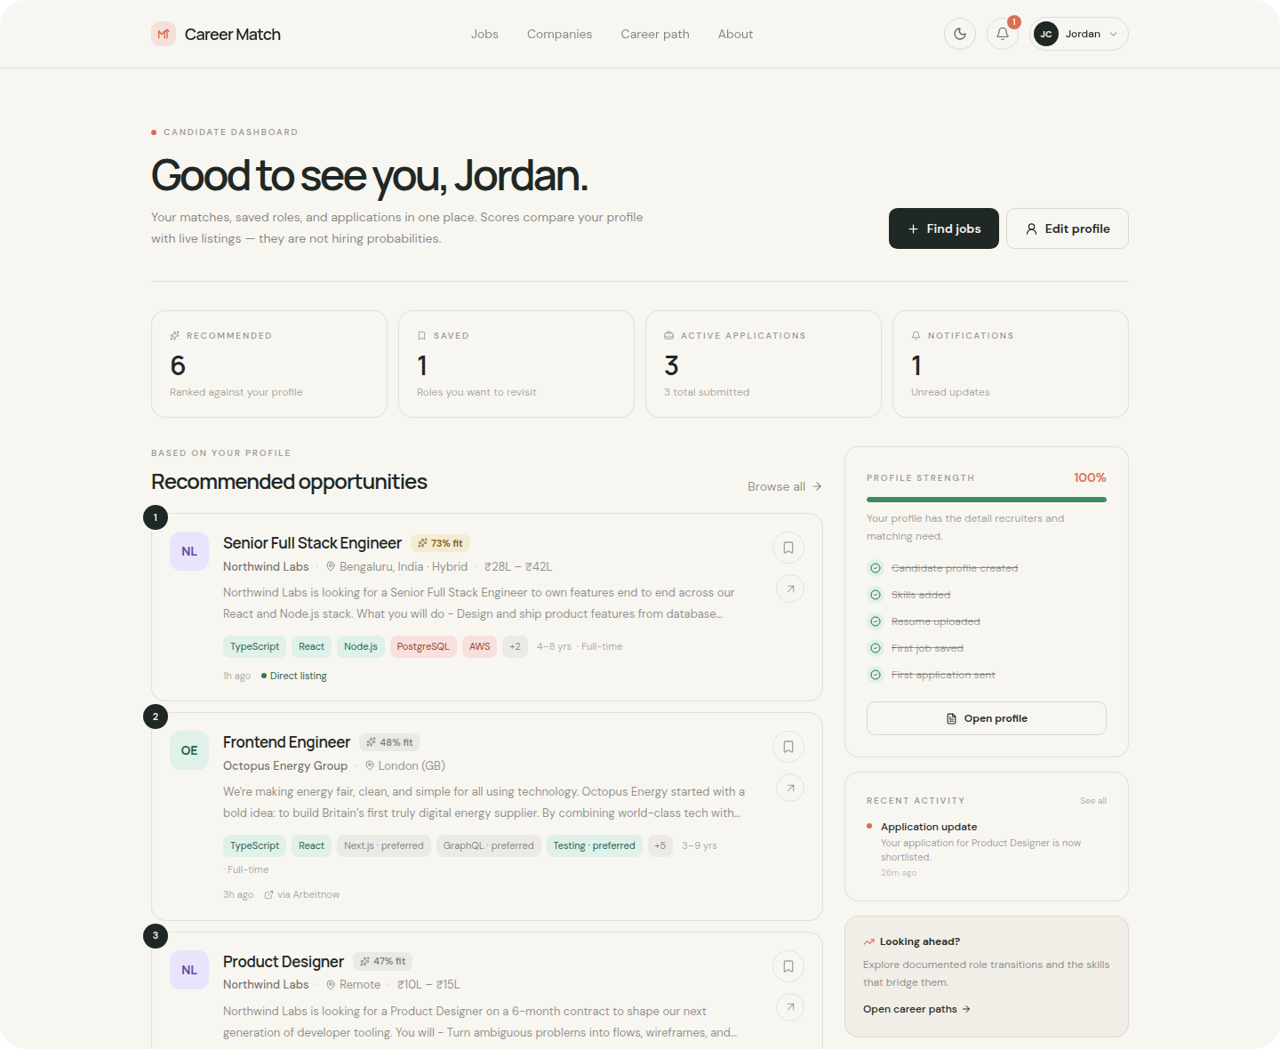
03 — CANDIDATE
A workspace,
not a search box.
Everything a candidate needs sits on one page: fit, gaps, saved roles, and the state of every application.
— Profile strength shows exactly what is missing
— Recommendations ranked against your own profile
— Application tracker with stages and withdrawal
— Notifications the moment a status changes
Candidate dashboard · recommendations, profile strength, applications
CareerMatch — product case study
04 / 14
Notes:
The dashboard leads with recommendations and profile strength rather than an empty search box. Scores are framed as relative fit, not probability.

Slide 5
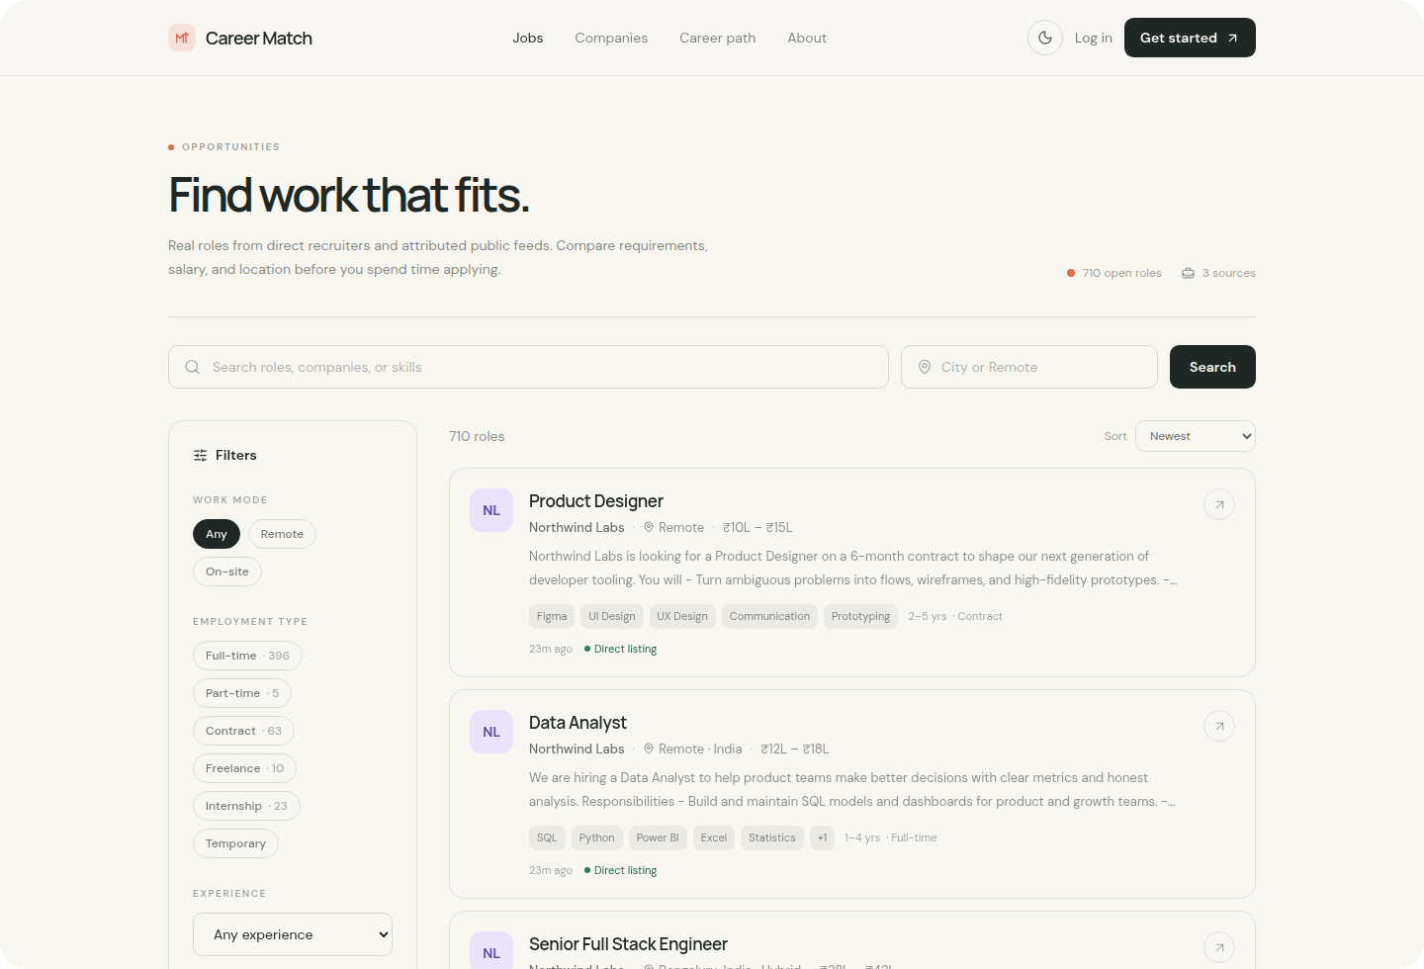
04 — DISCOVERY
Find work that fits.
Every filter is server-side and composable, so a search narrows instead of guessing.
Keyword, city, or remote
01
One query across title, description, and skills.
Work mode and type
02
Remote, on-site, full-time, contract, internship.
Experience and salary
03
Ranges, not exact matches.
Source and recency
04
Direct listings or attributed public feeds.
Results show why each role matched, the salary when the source provides one, and a link back to the original post.
CareerMatch — product case study
05 / 14
Notes:
Search combines keyword, location, work mode, employment type, experience, salary, and source. All of it is server-side, so results stay consistent across pages.

Slide 6
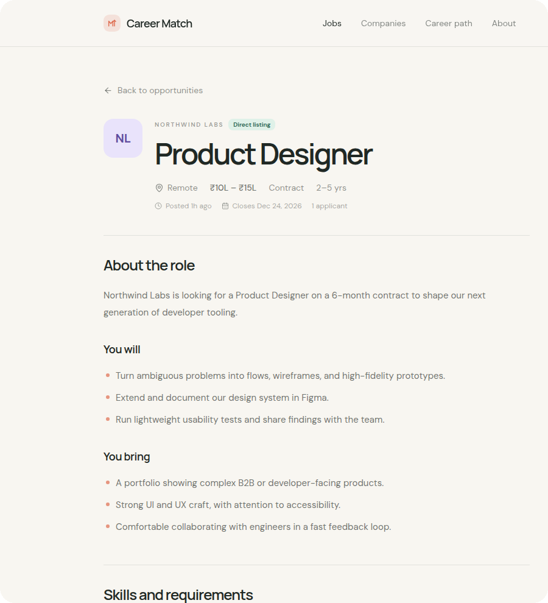
05 — EXPLAINABILITY
Scores you can argue with.
44
%
PROFILE FIT
A relative comparison with your saved profile — not a hiring probability.
Skills
20%
Experience
100%
Description match
30%
Matched · Figma
Missing · UI Design, UX Design, Communication
Missing required skills are listed by name — never hidden inside a percentage.
CareerMatch — product case study
06 / 14
Notes:
The job detail page shows the score, the factor breakdown, matched skills, and missing required skills. This is the core differentiator against a black-box ATS score.

Slide 7
06 — MATCHING ENGINE
Weights you can tune.
Reasons you can read.
A weighted blend of skills, experience, preferences, and in-process text similarity — no external model call.
Semantic similarity
35%
Text signals
Profile summary, roles, skills, and a resume excerpt are compared with each job's text.
Skills overlap
25%
Experience fit
15%
TF-IDF cosine
Preferences
15%
Computed in-process, so ranking behaves identically in development and production.
Education
5%
Evidence returned
Collaborative signal
5%
Matched skills, missing required skills, and per-factor scores ship with every recommendation.
MATCH_WEIGHT_* environment variables · normalized when a signal is unavailable
CareerMatch — product case study
07 / 14
Notes:
Weights are configurable through MATCH_WEIGHT_* and normalized at request time. TF-IDF keeps the ranking local and deterministic; the explanation is generated from the same signals.

Slide 8
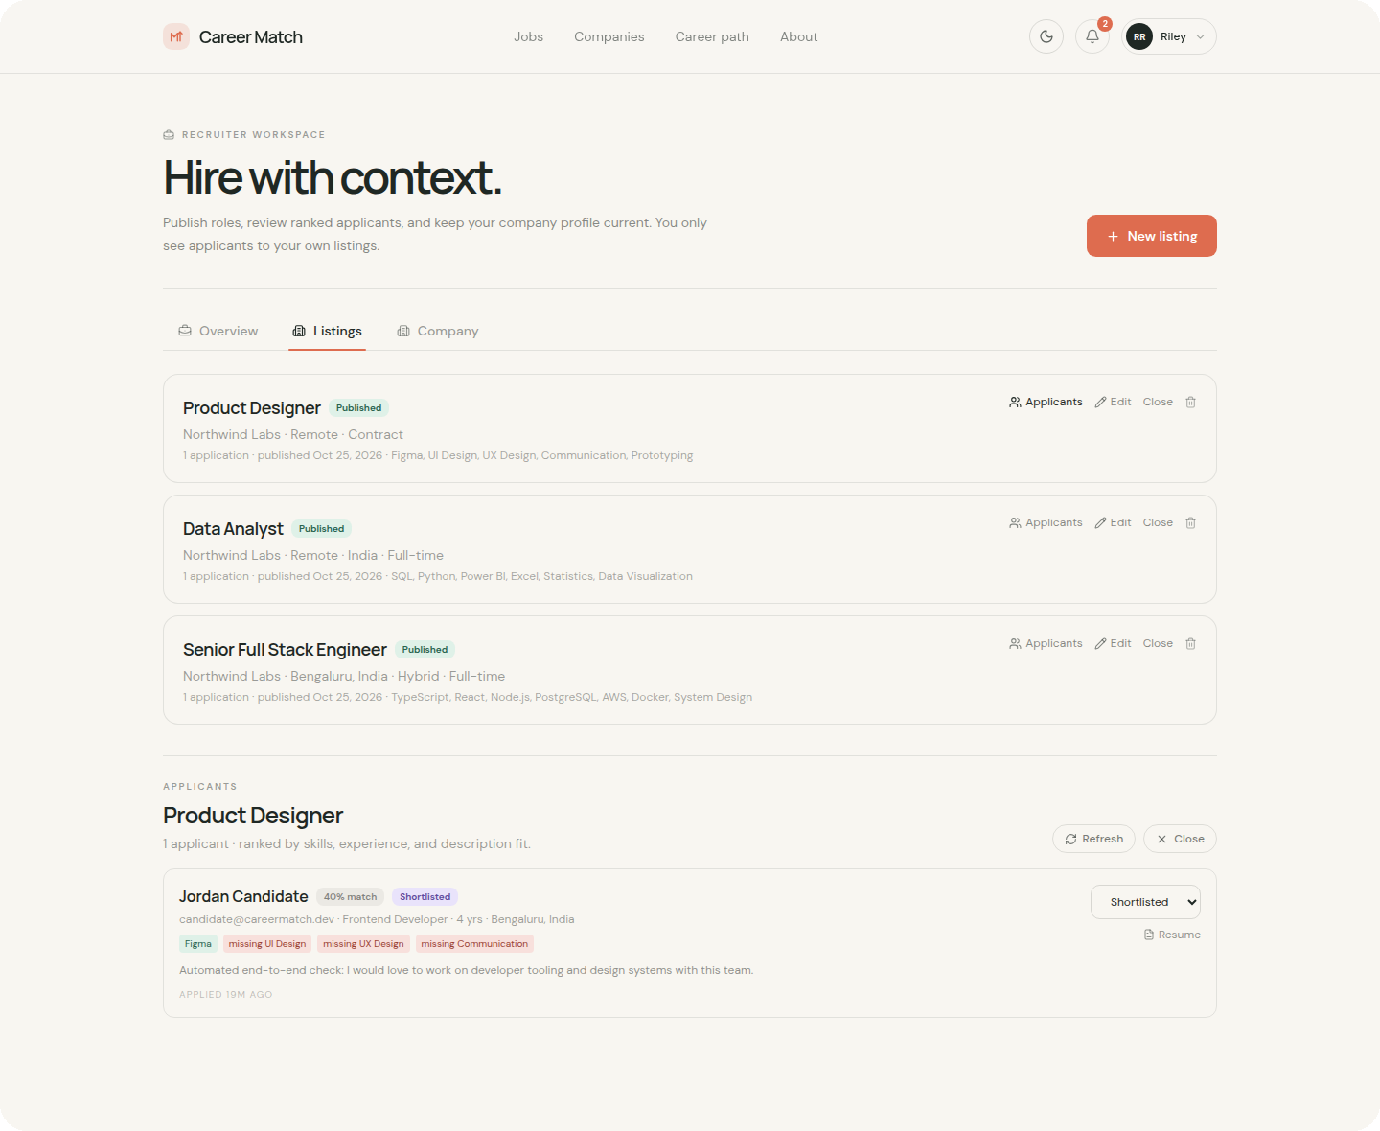
07 — RECRUITER
Ranked applicants,
not a pile.
Recruiters see the same explainable signal candidates do, scoped strictly to their own listings.
— Listing ownership enforced on every request
— Applicant ranking reuses the same explainable score
— Pipeline stages: submitted → review → shortlisted
— Resume download and candidate context in one place
Recruiter workspace · listings, ranked applicants, pipeline
CareerMatch — product case study
08 / 14
Notes:
Recruiters get ranked applicants with the same evidence. Ownership checks prevent cross-company access, and pipeline updates are auditable.

Slide 9
08 — RESUME INTELLIGENCE
Parsing that works without a key.
PDF and DOCX are read in-process, so an upload never depends on a third-party AI service.
01
02
03
04
Upload
Extract
Parse
Review
PDF or DOCX up to 5 MB, stored privately — PostgreSQL in production, local disk in development.
unpdf for PDF and mammoth for DOCX; HTML stripped and whitespace normalised before parsing.
Rule-based fields plus a curated skill vocabulary. The optional Python service enriches when present.
Extracted fields are editable, and corrected values update the candidate profile.
FIELDS EXTRACTED
Skills
Job titles
Experience years
Education
Certifications
Projects
If the optional ML service is unreachable, the local parser still completes the upload — no silent failures.
CareerMatch — product case study
09 / 14
Notes:
Resume parsing is deliberately dependency-light: local PDF/DOCX extraction, rule-based fields, curated skills. The Python service is an enhancement, never a requirement.

Slide 10
09 — JOB INGESTION
Real listings, attributed to the source.
Six documented feeds. India is the default country, not an afterthought.
Adzuna
INDIA
Jooble
INDIA
Remotive
REMOTE
Free key · city-level
Free key · aggregator
Keyless
Jobicy
REMOTE
RemoteOK
REMOTE
Arbeitnow
GERMANY
Keyless
Keyless
Keyless
— Refresh every six hours; listings expire after 60 days.
— Every card keeps sourceName, sourceJobId, and a link to the original post.
— Descriptions are stored as text; search text is capped at 3,000 characters.
— Providers can be disabled individually with one environment variable.
CareerMatch — product case study
10 / 14
Notes:
India-focused sources are first-class: Adzuna and Jooble activate with free keys, while keyless remote feeds fill in. Attribution and backlinks are preserved on every listing.

Slide 11
10 — ARCHITECTURE
One deployable, two entry points.
A single TypeScript repository builds the SPA and the API, with Prisma as the only database access layer.
React 18 SPA
Fastify 5 API
Prisma 6
PostgreSQL
Vite · React Router · Tailwind · Radix
HTTPS
/api/v1 · Zod · JWT · rate limits
SQL
typed queries · migrations
users · jobs · applications · tokens
SIDE SERVICES
Resume parsing
Email
Resume storage
Observability
unpdf · mammoth · optional ML
Brevo or Resend · dev fallback
PostgreSQL or S3-compatible
Fastify logs · OpenAPI docs
Deploy: Vercel serves the static SPA and routes /api/* to one Fastify function. Run prisma migrate deploy before the first request.
CareerMatch — product case study
11 / 14
Notes:
One repository, one deploy. Vercel handles the SPA and the catch-all API function; Prisma is the only path to PostgreSQL. Side services are optional and fail soft.

Slide 12
11 — SECURITY
Recoverable by design.
01
Request
Rate-limited to five attempts per 15 minutes. The response never reveals whether the email exists.
02
Issue
15 min
access JWT · HttpOnly cookie
A 48-byte token is stored only as a SHA-256 hash, with a 30-minute expiry.
03
Consume
7 days
rotating refresh · one per device
Single use: the token is marked used inside the same transaction that rotates the password.
04
Revoke
Refresh tokens are revoked, so other sessions drop immediately.
Argon2id hashing · role-scoped guards · ownership checks · 120 requests/min global limit
Development shows the reset link inline; production never exposes it.
CareerMatch — product case study
12 / 14
Notes:
The reset flow is hashed, expiring, and single-use, and it revokes sessions. Password changes keep the current device while dropping others. Production never returns the token.

Slide 13
12 — QUALITY & OPERATIONS
Built to be checked, not just demoed.
A production-shaped setup: typed end to end, tested where it matters, documented at the API layer.
25
3
6
0
automated tests
role-scoped workspaces
job feeds
keys for the core product
RUN IT LOCALLY
— Typecheck runs inside the production build
pnpm install
— Vitest covers matching, feed normalisation, and email transports
pnpm db:migrate
— OpenAPI documentation at /api/docs
pnpm dev
pnpm test
— Demo seed with three accounts and real listings
pnpm build
— SPA and API built from one repository
CareerMatch — product case study
13 / 14
Notes:
Quality is verifiable: tests, typecheck in build, API docs, and seeds. The core product runs with no third-party keys; India feeds and email are optional additions.

Slide 14
13 — WHAT'S NEXT
What ships next.
Each item compounds on the same explainable core rather than adding a parallel system.
CAREERMATCH
Job search that
explains itself.
01
Saved searches & alerts
Notify candidates when a matching role lands, not only when they remember to visit.
02
Employer verification
React · Fastify · PostgreSQL · Prisma
Real feeds · local parsing · explainable ranking
Domain and document checks before a company can publish a listing.
03
Skill-gap learning paths
Thank you
Turn missing required skills into an ordered, realistic plan.
04
Ranking evaluation harness
Offline metrics before any change to weights or signals ships.
CareerMatch — product case study
14 / 14
Notes:
Close on the roadmap: alerts, employer verification, learning paths, and an evaluation harness. All four build on the same job model and explainable ranking.

