Slide 1
Predicting the next FIFA World Cup Champion
Joshua Gray
Vaijayanti Shrikant Deshmukh
Lasya Raghavendra

Slide 2
Scope of Project
This project aims to design and deploy a scalable AWS-based machine learning environment capable of predicting the next FIFA World Cup champion using historical and contemporary football data. The system integrates data engineering, analytics, and machine learning pipelines across three separate AWS accounts, each managed by a different team member to ensure balanced collaboration and modular responsibility.

Slide 3
Data Sources
External Data Sources: We will source data from public repositories, including Kaggle Datasets (historical matches, player stats) and FIFA.com (official team rankings)
Automated Ingestion (Account 1): An AWS Lambda function is responsible for fetching this data and landing it in its raw format
Central Storage (Account 1): All incoming data is stored in the "Raw Data" folder within the Shared S3 Bucket, making it accessible to other accounts
Metadata Tracking (Account 1): Amazon DynamoDB is used to track the ingestion process, storing information like data source, update timestamps, and job statuses

Slide 4
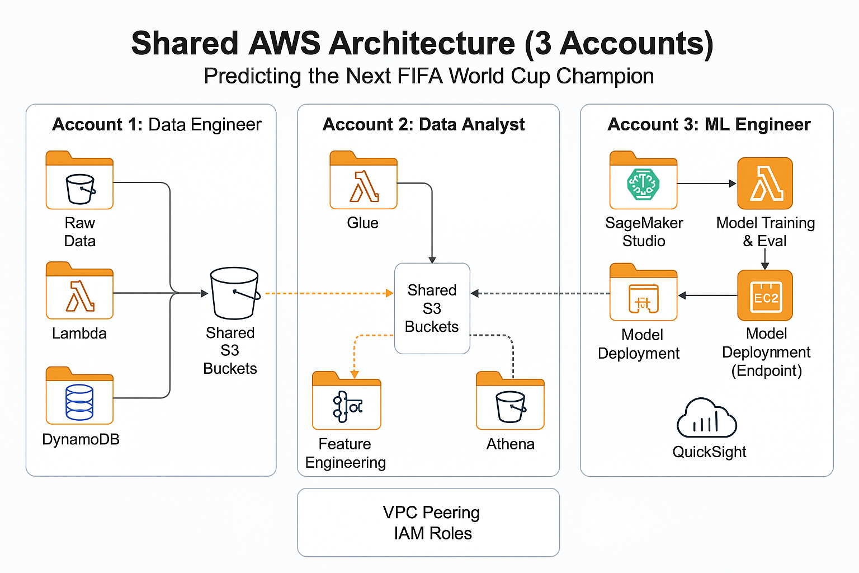
Cloud Architecture/Data Flow
Ingestion (Account 1: Data Engineer): Raw data is ingested by AWS Lambda and stored in a Shared S3 Bucket, with metadata managed by DynamoDB
Feature Engineering (Account 2: Data Analyst): AWS Glue jobs run on the raw data in S3 to transform it and create our predictive features. This processed data is saved back to the Shared S3 Bucket.
Key Engineered Features: The Glue jobs create features like Team Performance (Recent Form, H2H Record), Player Strength (Star Player Factor, Squad vs. Squad), and Match Context (Host Advantage, Knockout Stage)
Feature Consumption (Account 3: ML Engineer): The final, clean features are read from the Shared S3 Bucket into Amazon SageMaker Studio, where they are used to train and evaluate the prediction model.

Slide 5
Features
Ingestion (Account 1: Data Engineer): Raw data is ingested by AWS Lambda and stored in a Shared S3 Bucket, with metadata managed by DynamoDB
Feature Engineering (Account 2: Data Analyst): AWS Glue jobs run on the raw data in S3 to transform it and create our predictive features. This processed data is saved back to the Shared S3 Bucket.
Key Engineered Features: The Glue jobs create features like Team Performance (Recent Form, H2H Record), Player Strength (Star Player Factor, Squad vs. Squad), and Match Context (Host Advantage, Knockout Stage)
Feature Consumption (Account 3: ML Engineer): The final, clean features are read from the Shared S3 Bucket into Amazon SageMaker Studio, where they are used to train and evaluate the prediction model.

Slide 6
Expected Outcomes
A Trained & Deployed Prediction Model: Our primary outcome is a model trained in SageMaker Studio (Account 3) and deployed as a live EC2 Endpoint to serve real-time match predictions
An Interactive "Insights" Dashboard: A "World Cup Insights" dashboard, built in QuickSight (Account 3), to visualize model predictions and allow users to analyze team and player statistics
A Clean & Queryable Feature Set: A production-ready, clean dataset of engineered features, processed by AWS Glue (Account 2), and made queryable for analysts via Amazon Athena
A Secure, Multi-Account Pipeline: A governed and secure data pipeline using VPC Peering and IAM Roles that separates the duties of Data Engineering (Account 1), Data Analysis (Account 2), and ML Engineering (Account 3).

