Slide 1
Overview
Python Data Structures:
Lists
Dictionary
Tuples
Sets

Slide 2
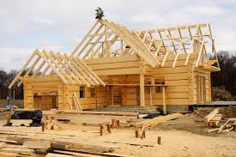

Data Structures:
Building block of a program
Data structures + logic = program
What types of data structures to use?
Depends on business need
Space and time complexity
Performance requirements
Neglecting Data structures leads to:

Slide 3
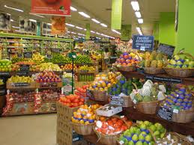
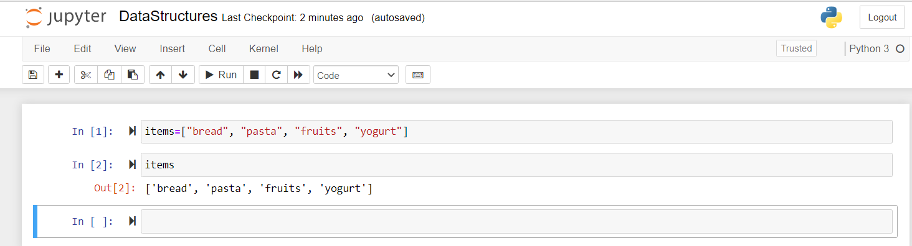
List
What is List?
Example: A trip to grocery store
Traditional way of storing items in a variable:
Item1 = pasta, item2= bread, item3=fruits…
Instead
We can create a variable that stores the list
Items = [“bread”, “pasta”, “fruits”, “yogurt”]

Slide 4

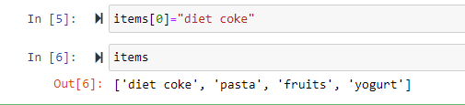

List
0 | bread
1 | pasta
2 | fruits
3 | yogurt
Data storage in Memory:
Through index
Can access a specific data through index
items[3]
Modify the list through index
items[0]=“diet coke”
Last element:
items[-1]

Slide 5
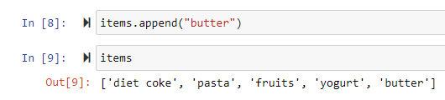
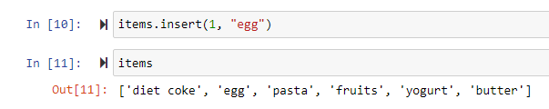

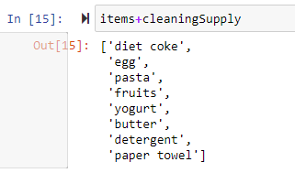

List
Append items
items.append(“butter”)
Can also use “insert”
items.insert(1.”egg”)
Join two list: Grocery (items) + Cleaning Supply
Items+cleaningSupply
Length of list
Len(items)

Slide 6
Dictionary and Tuples
What is Dictionary?
Adding and removing values in a dictionary
Iterating through dictionary
Tuples

Slide 7

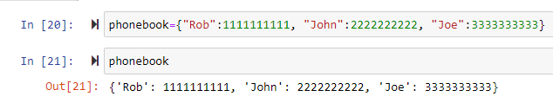

Dictionary
Dictionary
Allows you to store key value pairs
It’s also known as Maps, Hash tables and Associate Arrays
Example: Telephone directory
Syntax:
phonebook = {“Rob”: 1111111111, “John”: 2222222222, “Joe”: 3333333333}
Access:
phonebook [“Rob”]
Rob | 1111111111
John | 2222222222
Joe | 3333333333

Slide 8
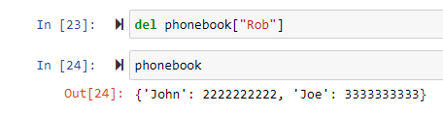
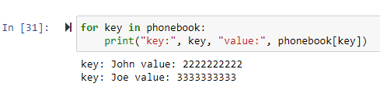
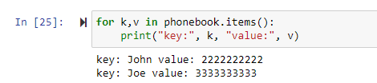
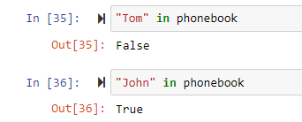
Dictionary
Delete
del phonebook[“Rob”]
Iterate through a Dictionary
for key in phonebook:
Print(“key:”, key, “values:”, phonebook[key])
Know if Tom is in the dictionary
“tom” in phonebook
“john” in phonebook
Clear entries in a dictionary
phonebook.clear()

Slide 9
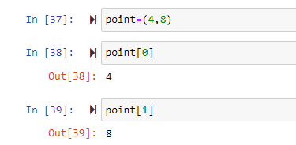
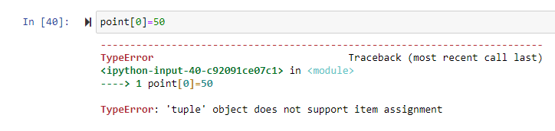
Tuples
Tuples
List of values grouped together
Example – point in geometry
point = (4,8)
point[0] = 4
point[1] = 8
List vs Tuples
List
Values are of same type
E.g. name , expense etc.
Tuples
Values can be of different types
E.g. point in geometry, address [1000, FedEx Dr, Moon Twp, PA 15108] etc.
Tuples are immutable
Notes:
Similar to a list; can access using index you can have homo/hetro dt then it ma

Slide 10
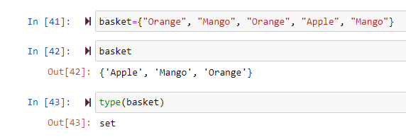
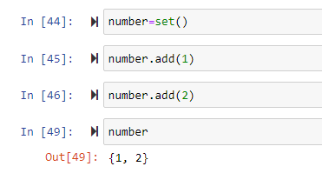
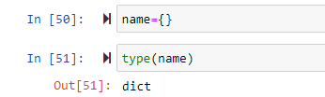
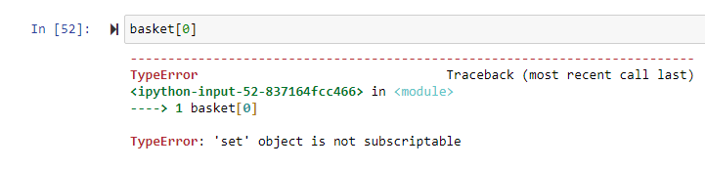
Sets
Sets
Unordered collection of unique elements
Example – Fruit basket
basket = {“orange”, “apple”, “mango”, “apple”, “orange”}
Useful when you want to have unique elements
Another way to initialize set
number=set()
number.add(1)
number.add(2)
Remember – No empty {}
It will get initialized as dictionary
Sets are unordered
Does not allow index operation
Does not allow duplicates
Notes:
Unique values

Slide 11
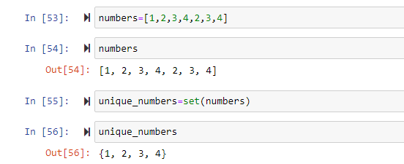
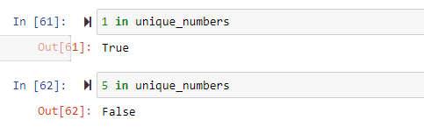
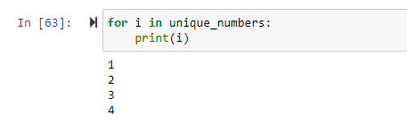
Sets
Sets
Sets supports taking list as in input in the constructor
numbers =[1,2,3,4,2,3,4] #List
unique_number=set(numbers)
Basic operations:
In operator
Iteration
Notes:
Unique values

Slide 12
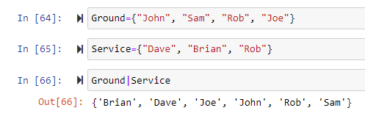



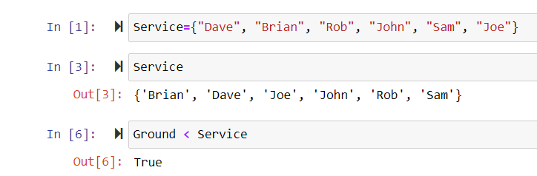
Sets
Sets
Basic operations:
Union
Interaction
Difference
Subset
Notes:
Unique values

Slide 13
Helpful Resources
Python Documentation:
https://docs.python.org/3/tutorial/index.html
Notes:
Unique values

Slide 14
Thank you!
Notes:
Unique values

