Slide 1
Grocify – Fast. Fresh. Affordable.
Presented by: Shreya Ulegaddi
Karthik Shetty
Vijay Khanai

Slide 2
Overview
What is Grocify?
- A desktop application to manage grocery shopping.
- Developed using Python with Tkinter for GUI and ReportLab for billing.
Purpose:
- Simplify the shopping and billing process.
- Provide digital receipts.
- Enhance customer experience.

Slide 3
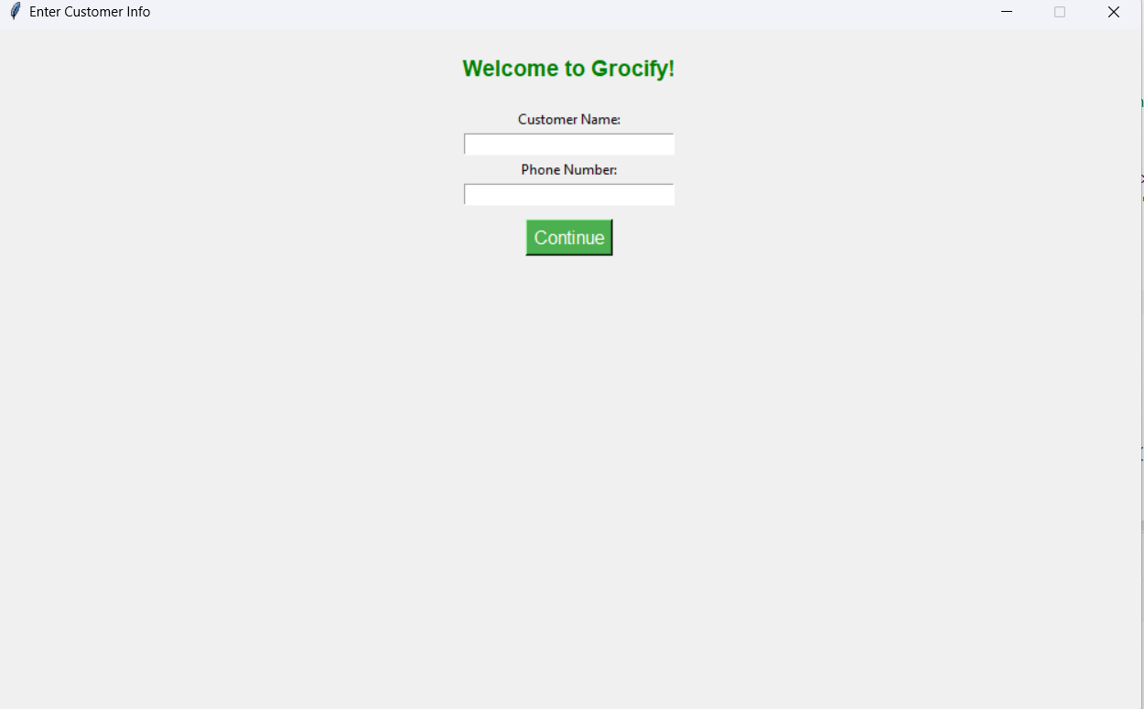
User Onboarding
- Customer Info Entry:
- Name and 10-digit phone validation.
- User-friendly interface to proceed to shopping.

Slide 4
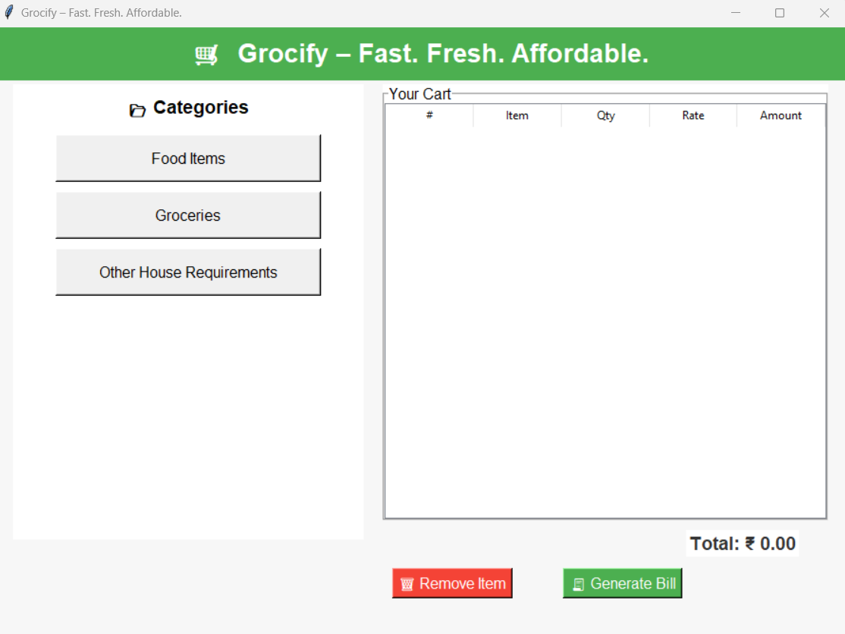
Categorized Product Selection
- Categories:
• Food Items
• Groceries
• House Requirements

Slide 5
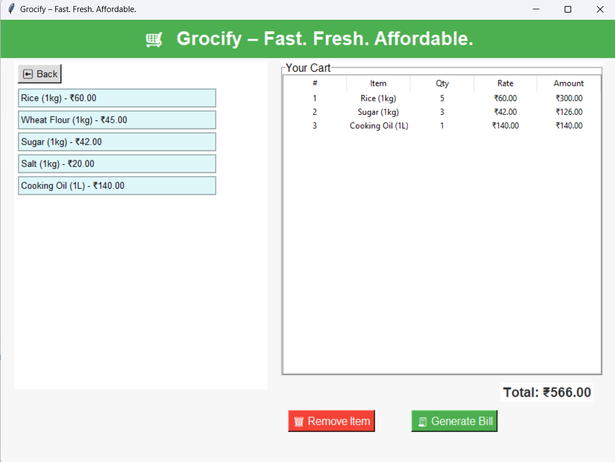
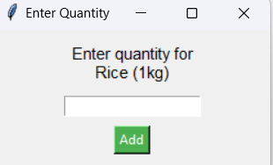
Cart Management
- Add to Cart: Quantity popup for each item.
- Real-time cart update.
- Remove Item: Button to delete selected product.
- Cart Display: Item, Qty, Rate, Amount (with auto-calculation).

Slide 6
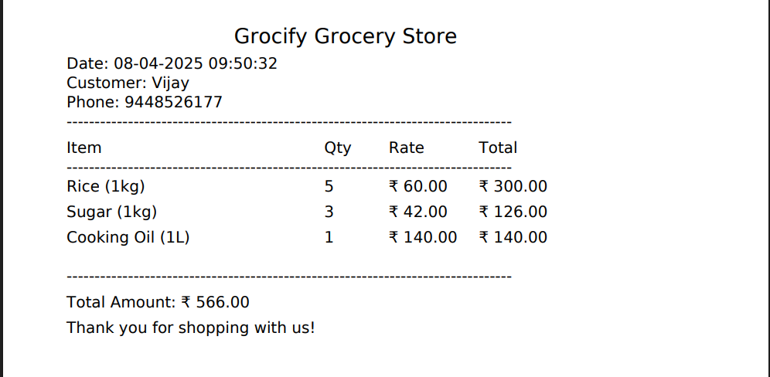
Billing & Receipt
- PDF Receipt Generation using ReportLab.
- Includes customer info, date/time, and detailed bill.
- DejaVuSans font used to support ₹ symbol.

Slide 7
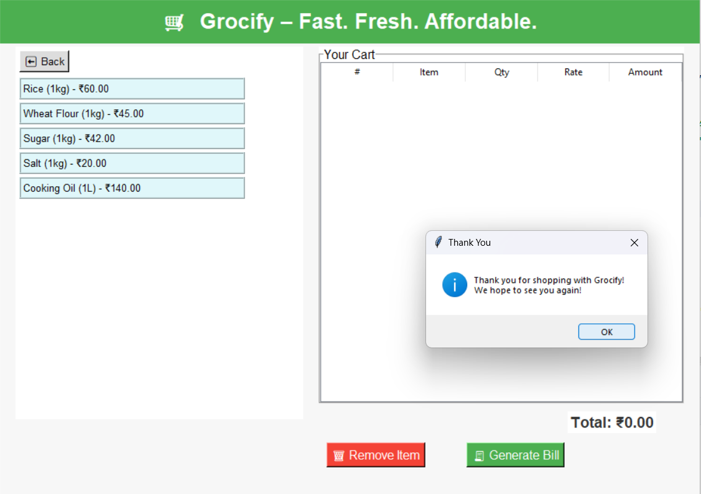
User Experience
- Attractive UI: Clean, modern design.
- Easy Navigation: Back buttons, scroll-friendly interfaces.
- Thank You Prompt after billing.

Slide 8
Final Thoughts
Why Grocify Stands Out:
- Simple, fast, and functional.
- Tailored for local retail/grocery shops.
Technologies Used:
- Python, Tkinter, ReportLab.
Future Scope:
- Integrate with database for inventory.
- Add barcode scanning.
- Implement online payment gateway.

Slide 9
Thank You

