Slide 1
Weekly update
Current results
Dissertation
Discussion
Feedback

Slide 2
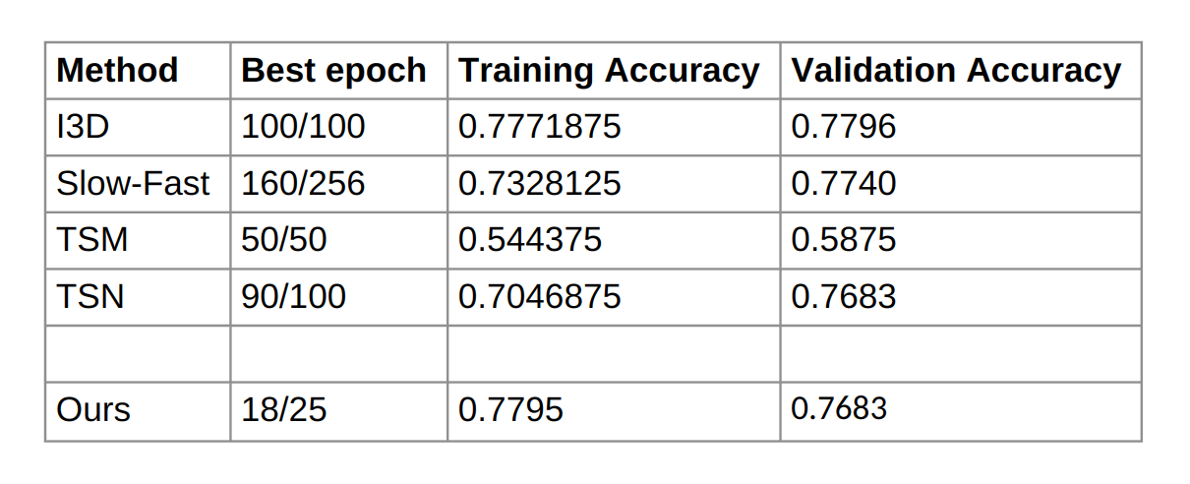
Typing training / validation accuracies

Slide 3
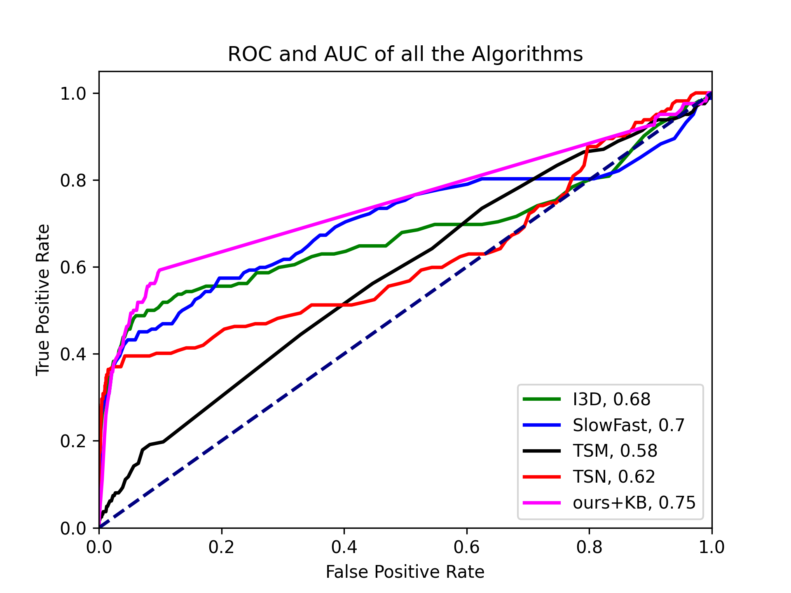
Typing, C3L1P-D, Feb 21
SOTA running times will be similar to writing with our method being fastest.
I have not calculated it yet, I will present in next meting.

Slide 4
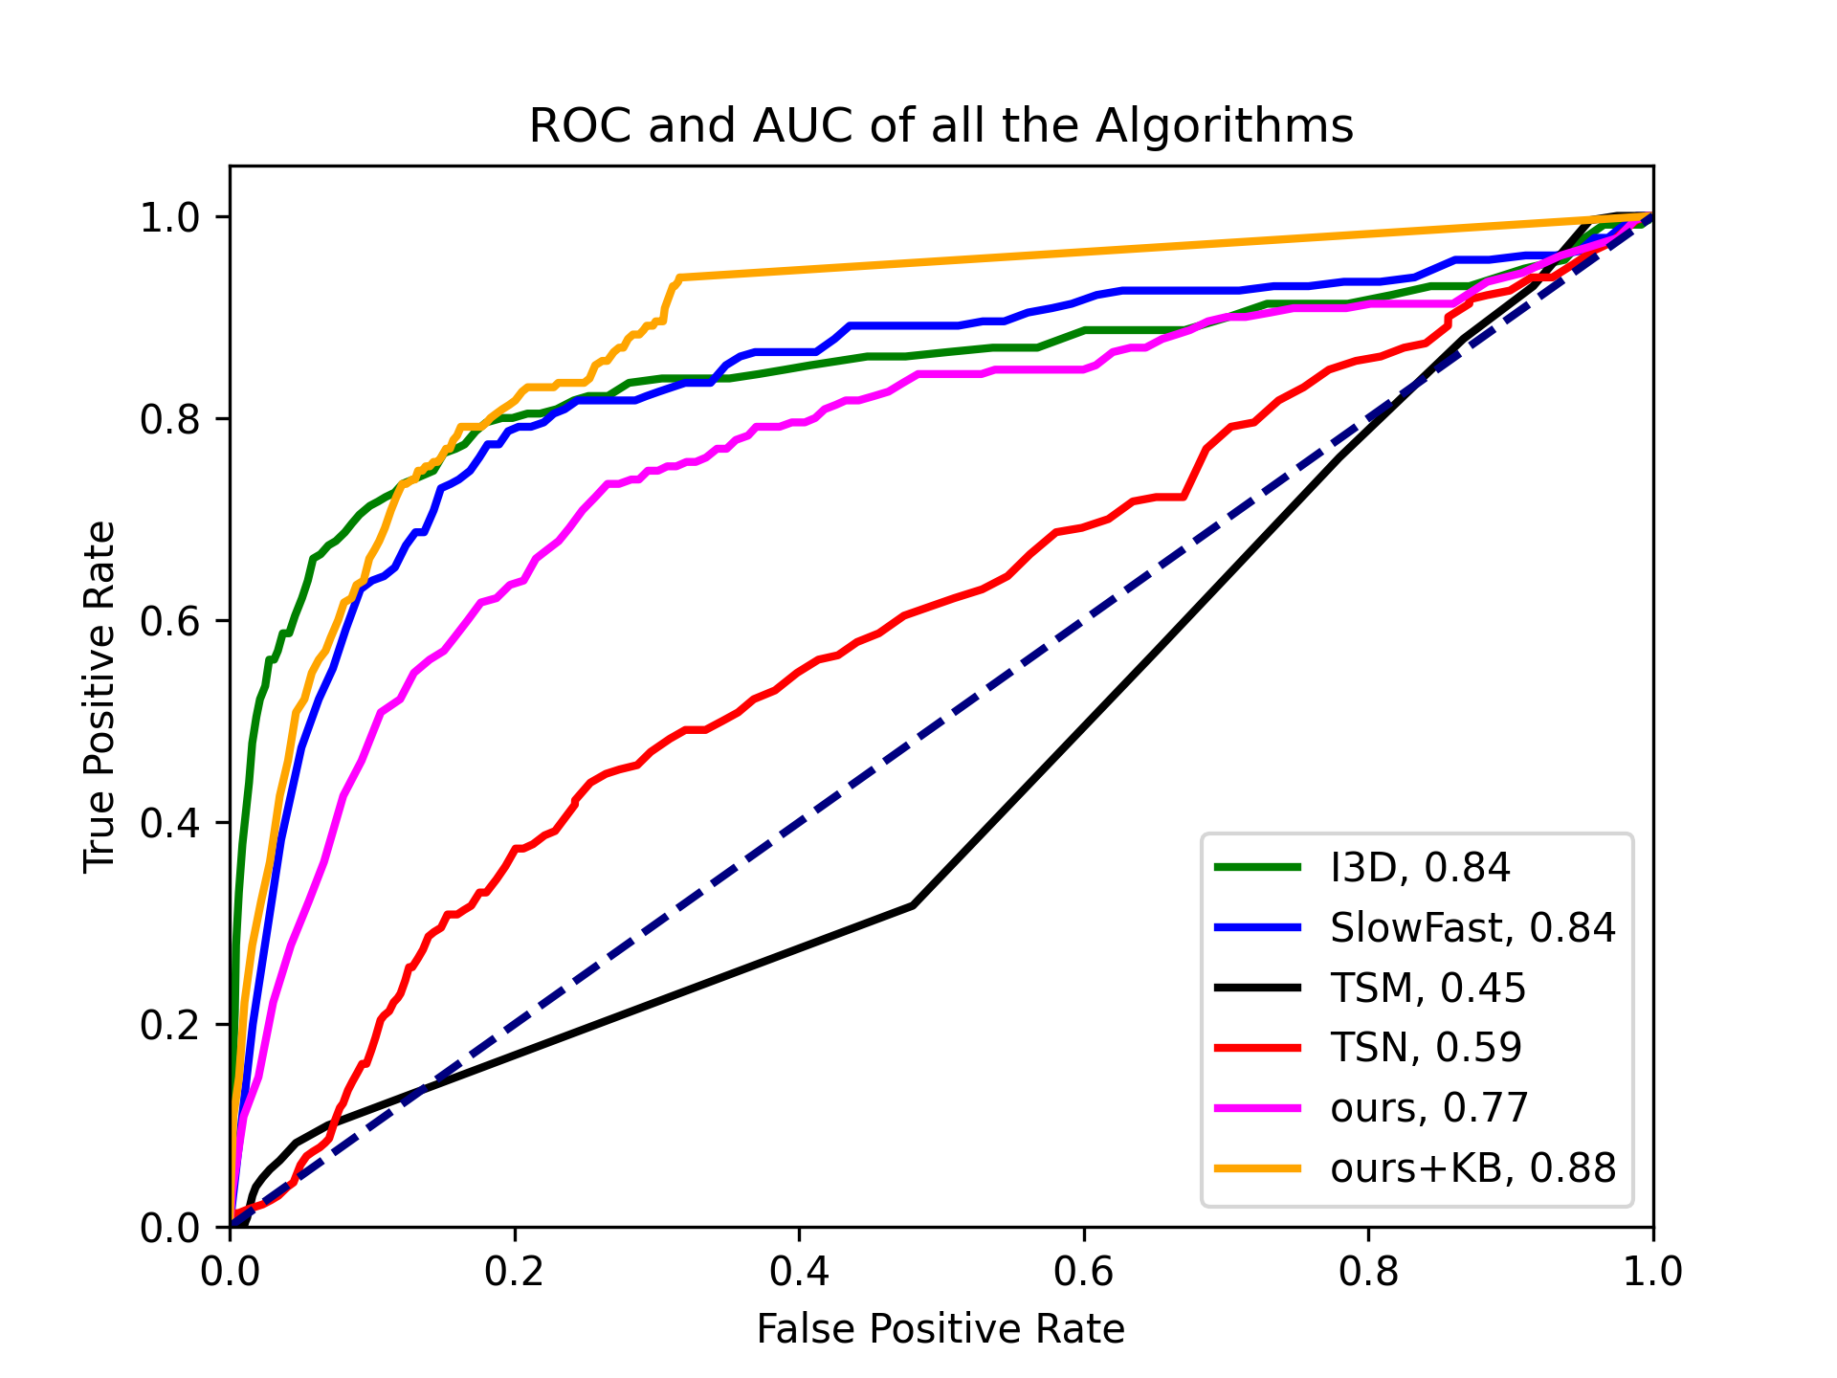
Typing, C2L1P-B, Feb 23
SOTA running times will be similar to writing with our method being fastest.
I have not calculated it yet, I will present in next meting.

Slide 5
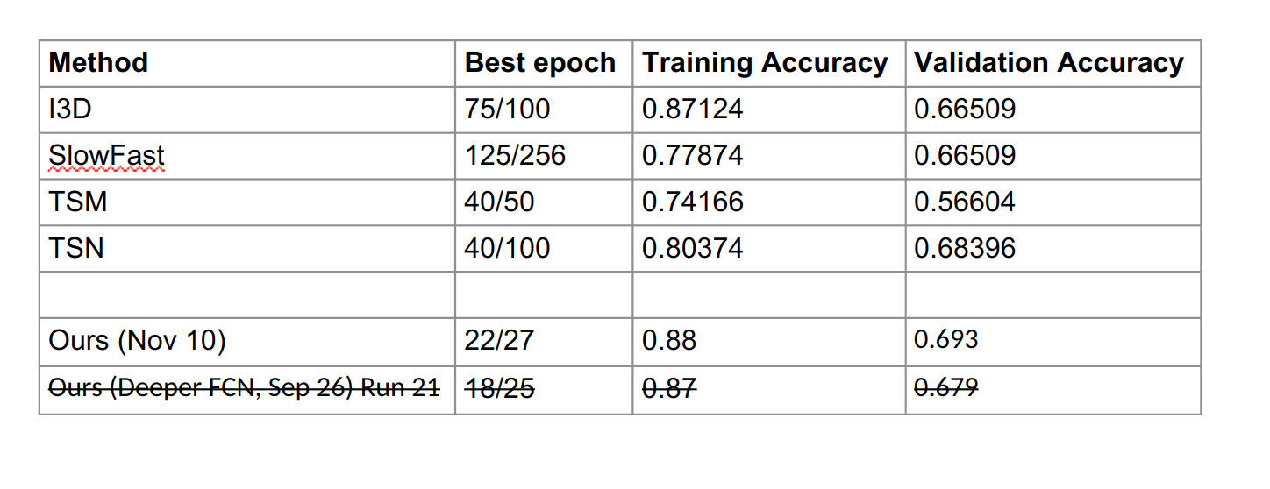
Writing training / Validation accuracies

Slide 6
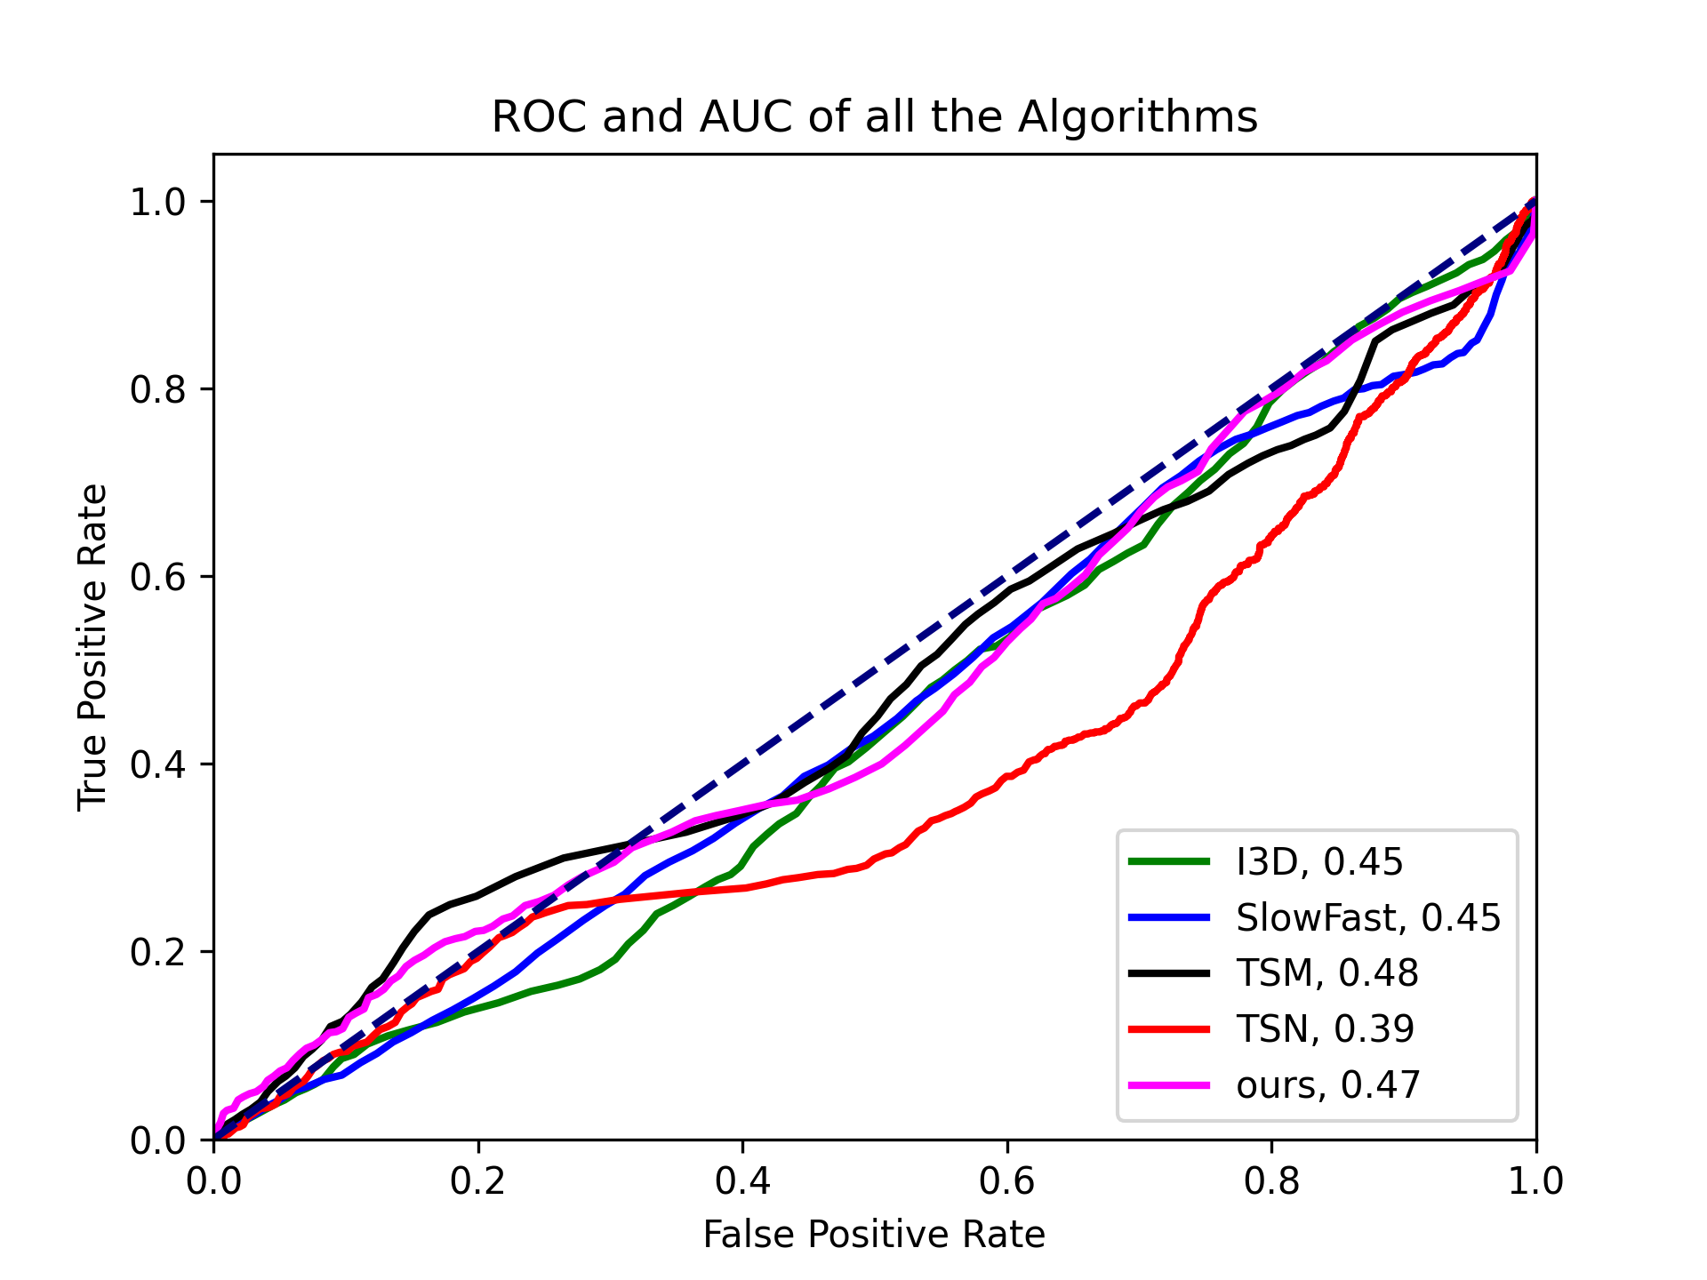
Writing C3L1P-C, Apr 11
Method | hours
I3D | 31
Slowfast | 31
TSM | 2
TSN | 5.8
ours | 2.5

Slide 7
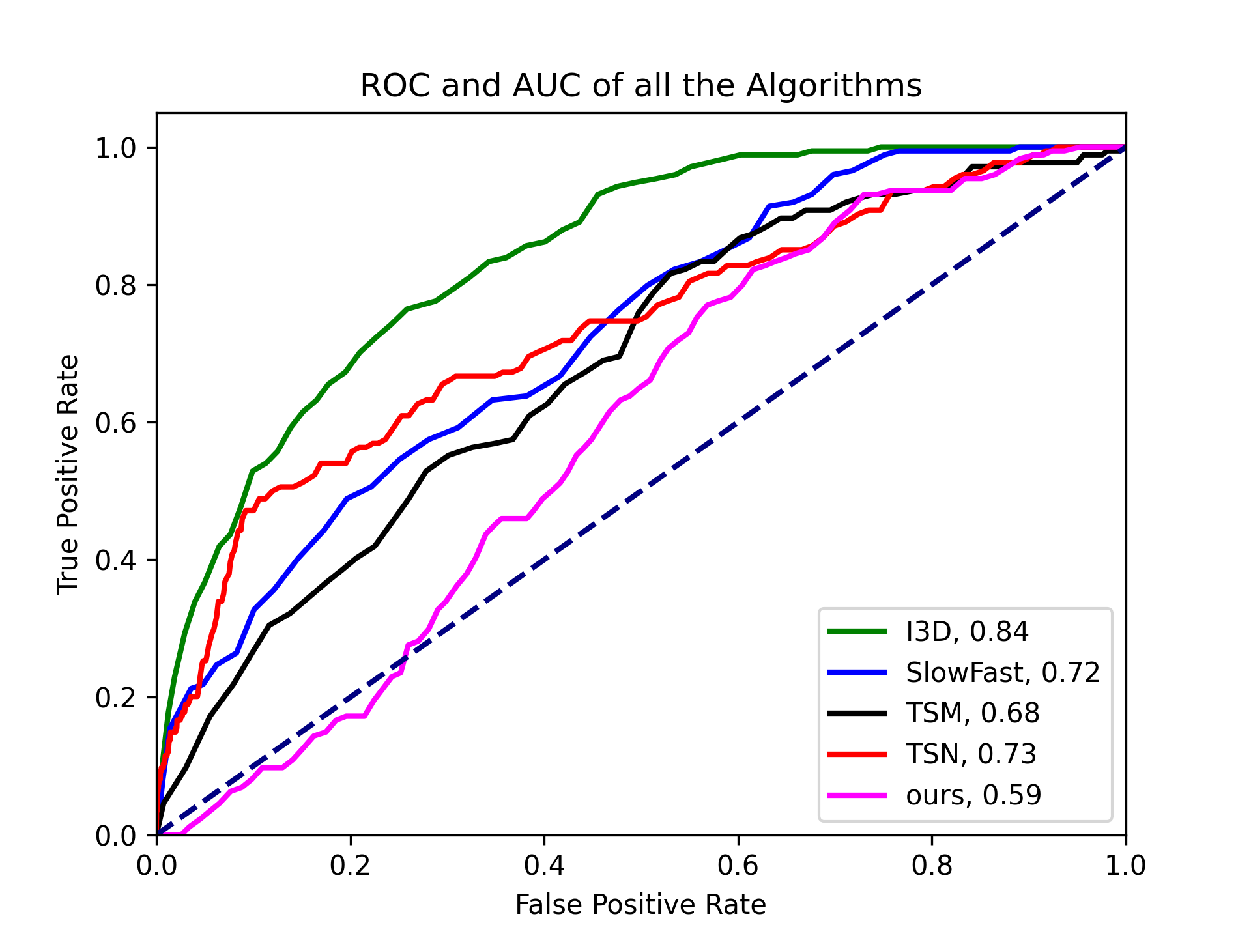
Writing C1L1P-C, Apr 13
Method | hours
I3D | 23
Slowfast | 23
TSM | 1.5
TSN | 4
ours | 1.95

Slide 8
Dissertation
Working on Background chapter.
Grammarly is being used as to correct errors.
Manager agreed to give me a weeks leave in January 2023 to work on writing.

Slide 9
Discussion
What do I do with the writing testing session? I believe it is an isolated incident.
Advisement hold worksheet.
There is work to be done on creating and inferring from Activity Maps.

Slide 10
Feedback

