Slide 1
GLOBAL AI HACKATHON · AI AGENTS & INTELLIGENT SYSTEMS
SignalFlow
SYNTHETIC CASES
One workspace for the evidence, the context, and the next review step.
The analyst makes the decision.
HUMAN DECISION GATE
WORKING PROTOTYPE
Earlier AML interface from Azentio Build Labs; the bounded agent was added after the Global prompt opened.

Slide 2
The signal is only the start
An alert tells you something moved. It does not tell you what it means.
TODAY: SEPARATE LOOKUPS
TRANSACTION MONITORING
What triggered the alert
Who the customer is
How the money usually moves
What screening and history show
Which rules and policies apply
KYC PROFILE
SCREENING RESULTS
PRIOR CASES
POLICY LIBRARY
Until that context sits in one place, every case takes longer to understand.
Five systems, five searches, one case.
Illustrative workflow, not a measured outcome.

Slide 3
One case. One evidence-led workspace.
01
02
03
04
Case context
Evidence
Open questions
Next step
Alert reason, customer profile, and prior history.
Transactions and patterns that support or contradict the alert.
What is missing, conflicting, or needs verification.
A reviewable recommendation with its reasoning attached.
The analyst reviews the evidence and chooses the disposition.
Recommendations are prompts for review, never decisions.
Prototype with fictional data.

Slide 4
A bounded local agent, not a black box
01 · INPUT
02 · SERVER
03 · ORCHESTRATOR
04 · LOCAL TOOLS
05 · OUTPUT
Fictional case
Loopback Node
Bounded loop
Four functions
Validated draft
One of five fixed synthetic IDs.
Rejects free text and caller facts.
Max 4 turns, max 6 tool calls.
Signals, baseline, gaps, checklist.
Analyst decides the disposition.
PUBLIC GITHUB PAGES · STATIC
LOCAL MODEL MODE · OPT-IN
Deterministic rules; no model backend
Fictional sample data stays in browser
Editable examples persist locally
Labels itself as a non-AI demo result
OpenAI-compatible provider; tool-call model
Only fixed synthetic IDs reach the model
No search, bank-system, or case-write tools
Schema-checked output; labelled fallback
Verified run: GPT-6.1 Sol via the current Manus gateway · 3 real local tool calls · human gate retained.

Slide 5
AI assists. The analyst decides.
What the agent helps with
What stays with the analyst
Reading the alert's synthetic signals
Comparing them with a demo baseline
Naming the context that is missing
Drafting one next step to review
Reading the underlying evidence
Judging what actually matters
Choosing the disposition
Owning the record
The public site uses deterministic rules. The local mode uses a bounded, tool-using model agent. Either way the reasoning is visible and the decision is human.
Not an automated decision system.

Slide 6
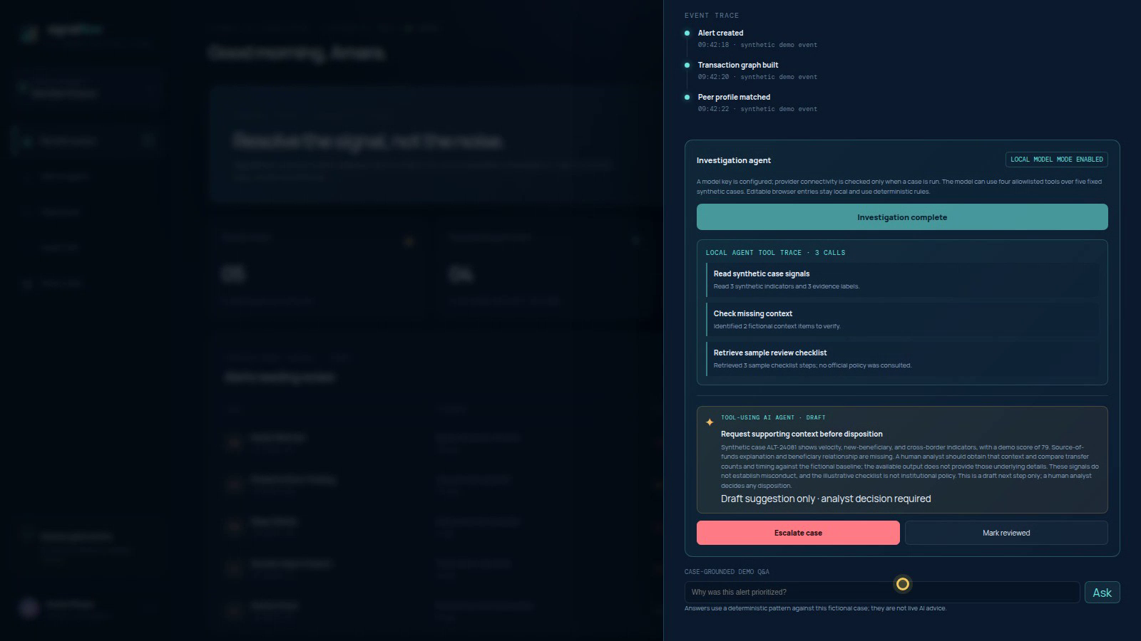
A working prototype you can explore
Open a fictional case and see why it was prioritized
Run the local agent and read its three tool calls
Add, edit, or remove sample cases in the browser
Works on desktop, tablet, and phone
Every case is fictional, and the interface says so on screen. The public build makes no model call.
Actual local agent run: 3 tool calls and a human-gated draft.
Live at vjoycelyn.github.io/signalflow

Slide 7
SIGNALFLOW
From alert to accountable review.
Evidence, context, and the decision kept in one place.
DEMO vjoycelyn.github.io/signalflow
CODE github.com/VJoycelyn/signalflow
Prototype with fictional data · not a production AML system.
Thank you.

