Slide 1

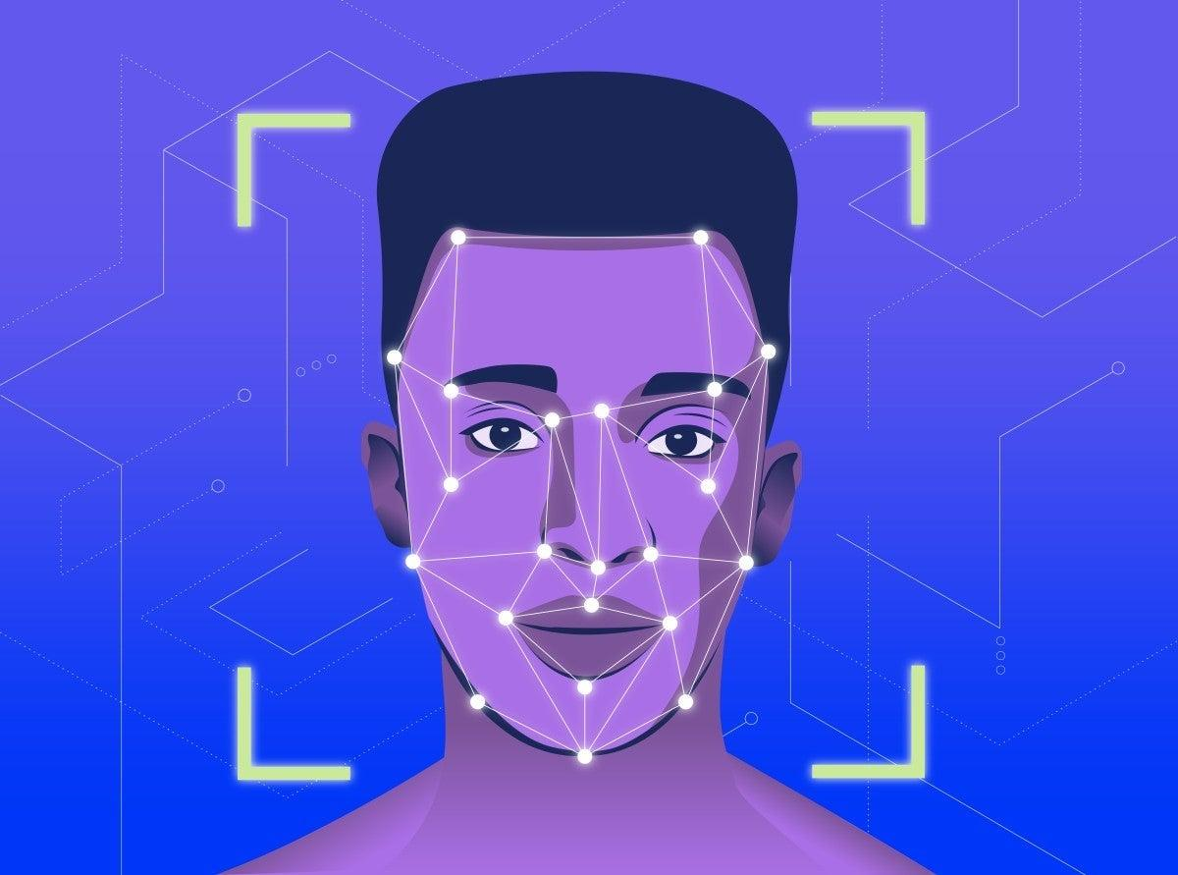
FACE BASED ATTENDANCE SYSTEM USING NVIDIA JETSON AGX XAVIER DEVICE
BY,
VENKATKUMAR R

Slide 2
CONTENT :
Introduction
Objective
Prerequisite knowledge
Proposed work
Tools
Project implementation
Demo
Application
Advantage and disadvantage
Application
Reference

Slide 3
1. INTRODUCTION:
A face based attendance system incorporates facial recognition technology to recognize and verify an employee’s or student facial features and to record attendance automatically.
A facial recognition attendance system is a non-contact approach to managing employees in a business significantly when they are out on the field.

Slide 4
1.1. PROBLEM STATEMENT
Unlike other forms of biometric technology, such as fingerprint recognition, which captures identity by touching, a facial identification system manages employees without the approach of direct contact.

Slide 5
2. OBJECTIVE
The objective of this project is to implement Face based Attendance system using Nvidia jetson AGX Xavier device
Developing stage :
Face Recognition using Dlib
And identify face and stored data in database or represent folder
Finally deploy Nvidia jetson AGX Xavier devices

Slide 6
3. PREREQUISITE KNOWLEDGE OF FACE ATTENDANCE SYSTEM PROCESS
Face Recognition using Dlib
Basic knowledge of Jetson nano or AGX Xavier

Slide 7
3.1. FACE RECOGNITION USING DLIB
Face recognition is generally divided into 4 steps, which are as follows:
Face Detection: The first step in the face recognition pipeline is to detect all the faces in the image. This can be done using a face detector such as Haar cascades, Histogram of Oriented Gradients (HOG), or deep learning-based face detectors.

Slide 8
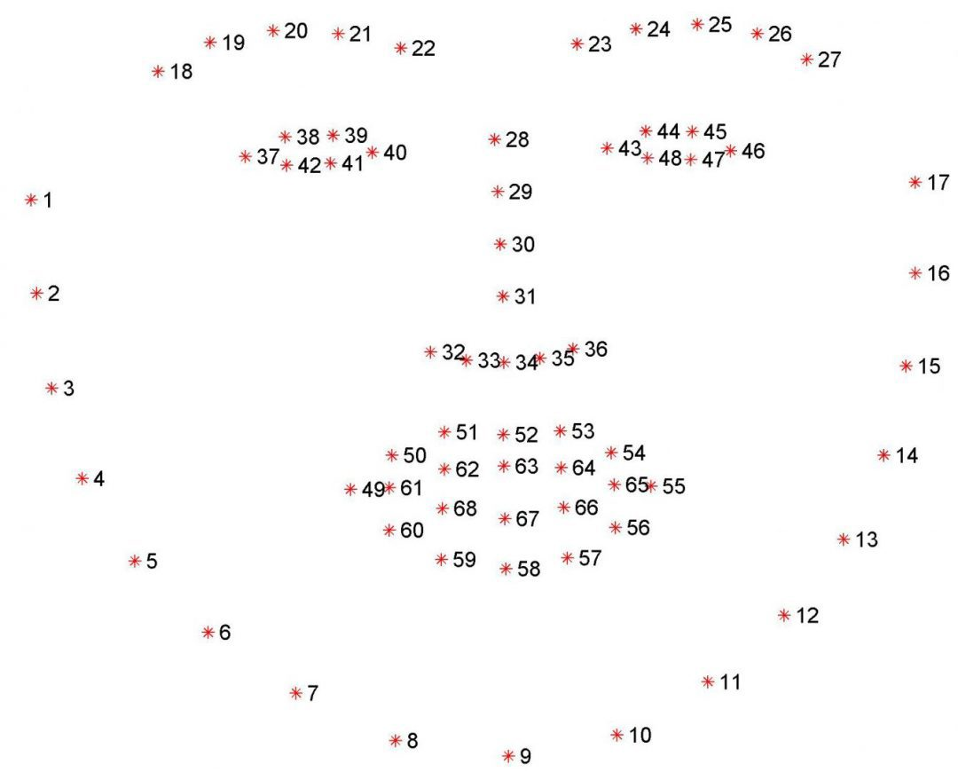
3.1. FACE RECOGNITION USING DLIB
2. Face Alignment using facial landmarks :
The second step in the pipeline is to align or normalize the face using facial landmarks. This step is optional but it can improve the accuracy of the face recognition.

Slide 9
3.1. FACE RECOGNITION USING DLIB
3. Face Encoding:
In this step, we pass the face image to the model and extract the facial features.
4. Face Recognition:
This is the last step in the pipeline where we compare the extracted face features with a database of known face features and try to find a match. This can be done using a variety of different algorithms, including K-Nearest Neighbors (KNN), Support Vector Machine (SVM), Random Forest, etc.

Slide 10
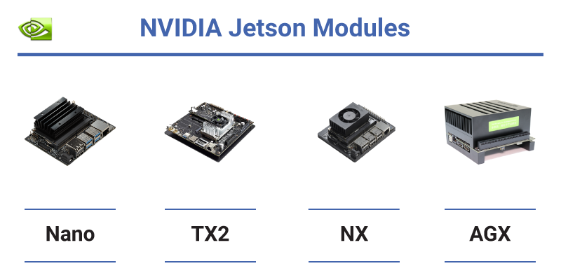
3.2. PREREQUISITE KNOWLEDGE OF JETSON NANO OR AGX XAVIER
NVIDIA® Jetson AGX Xavier sets a new bar for compute density, energy efficiency, and AI inferencing capabilities on edge devices. It’s the next evolution in next-generation intelligent machines with end-to-end autonomous capabilities.

Slide 11
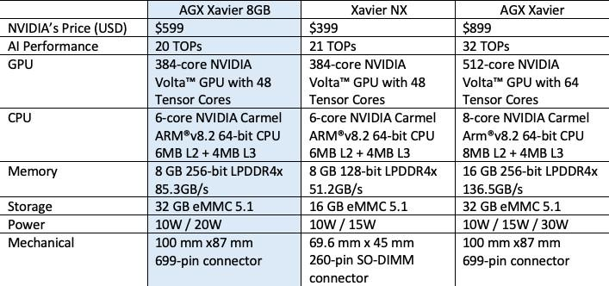
Jetson nano Introduction Course: link
Jetson AGX Xavier : link

Slide 12
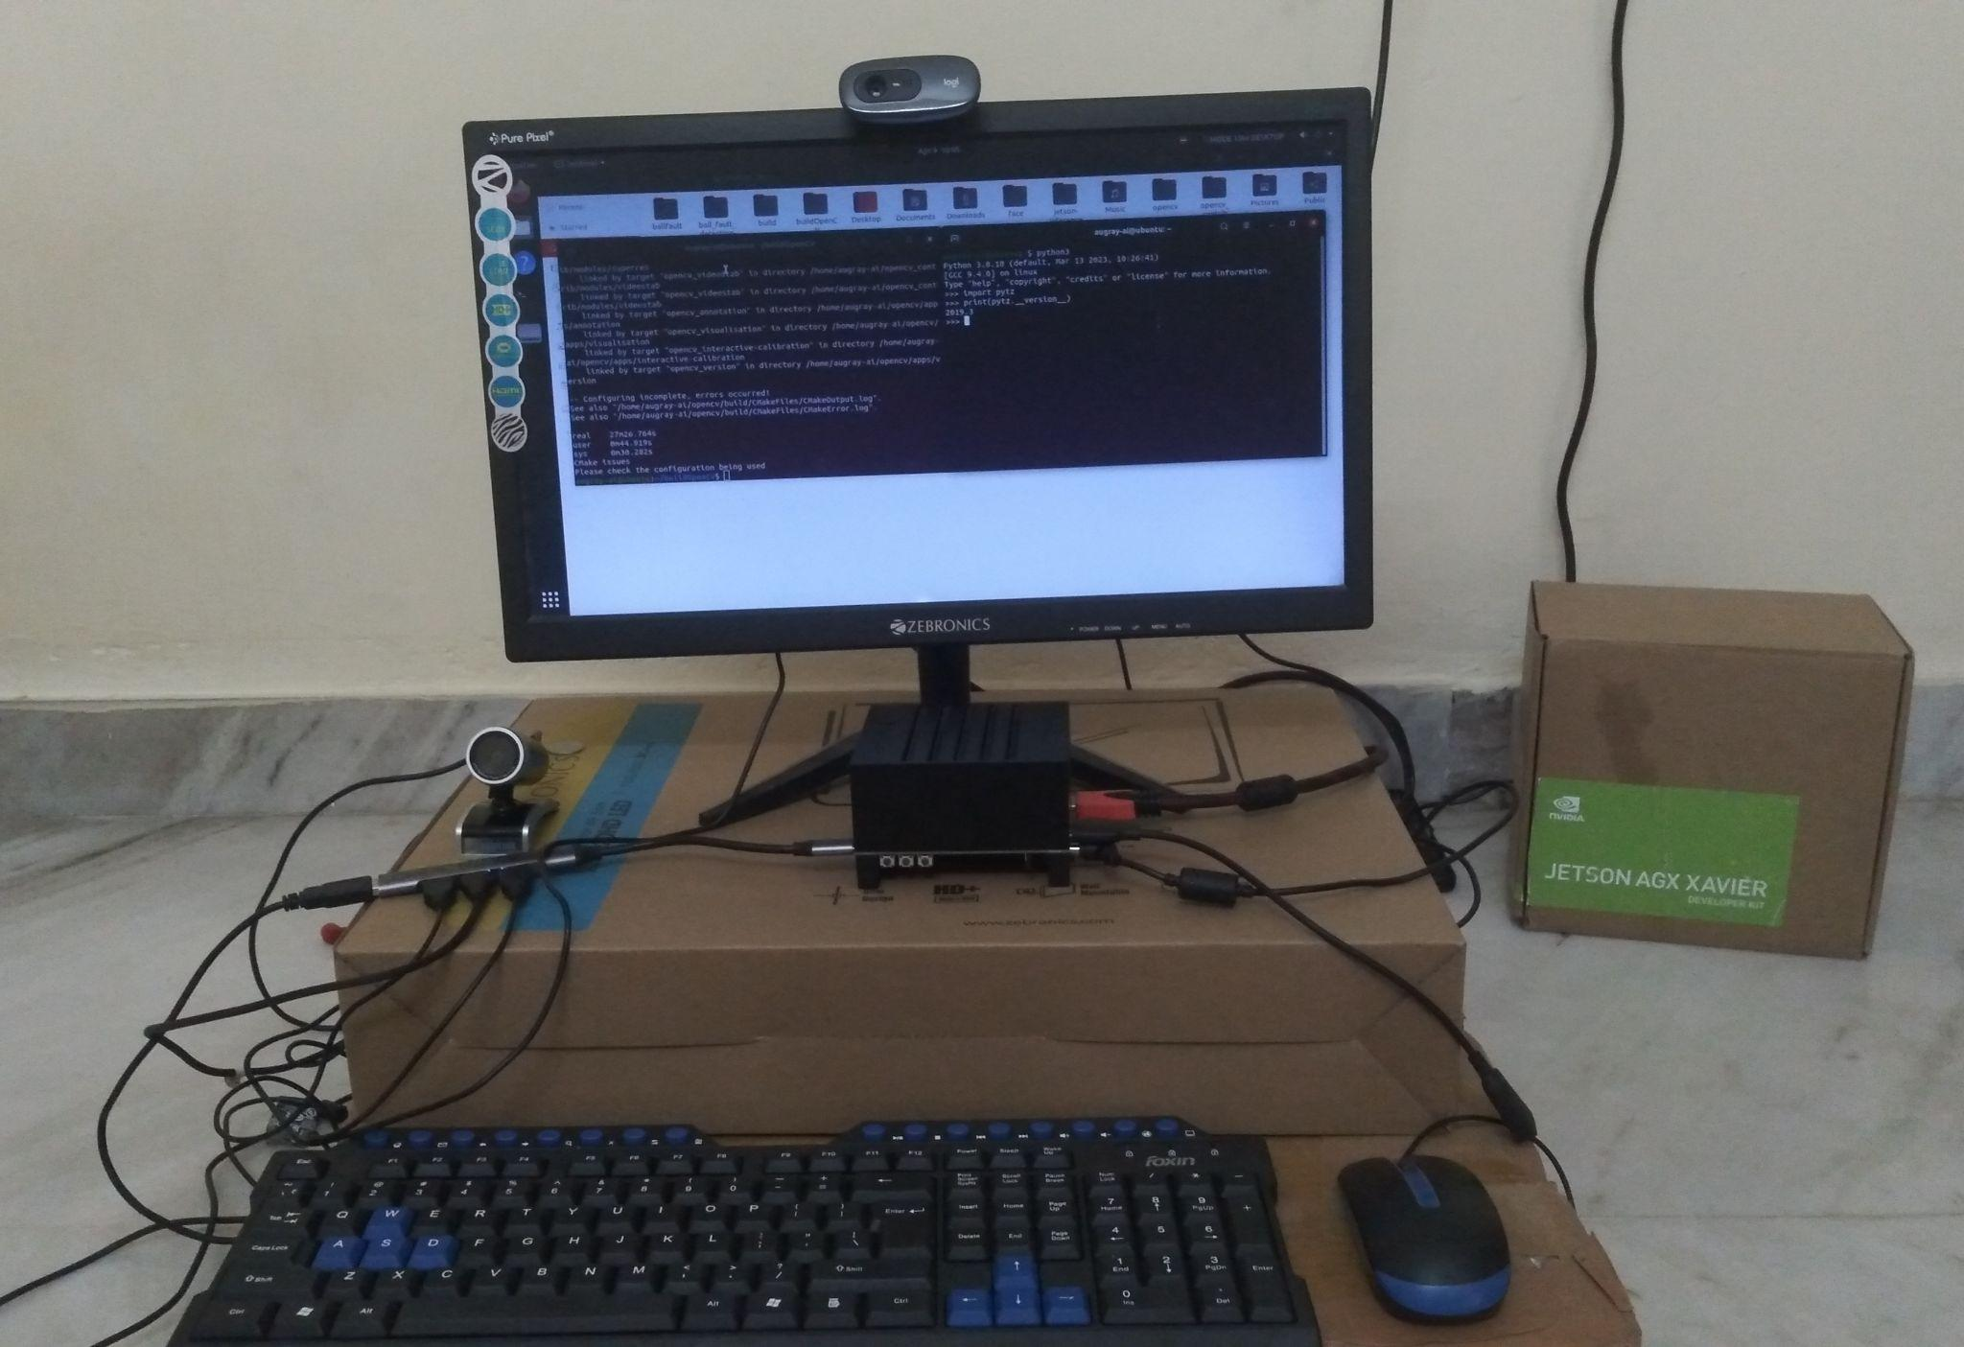
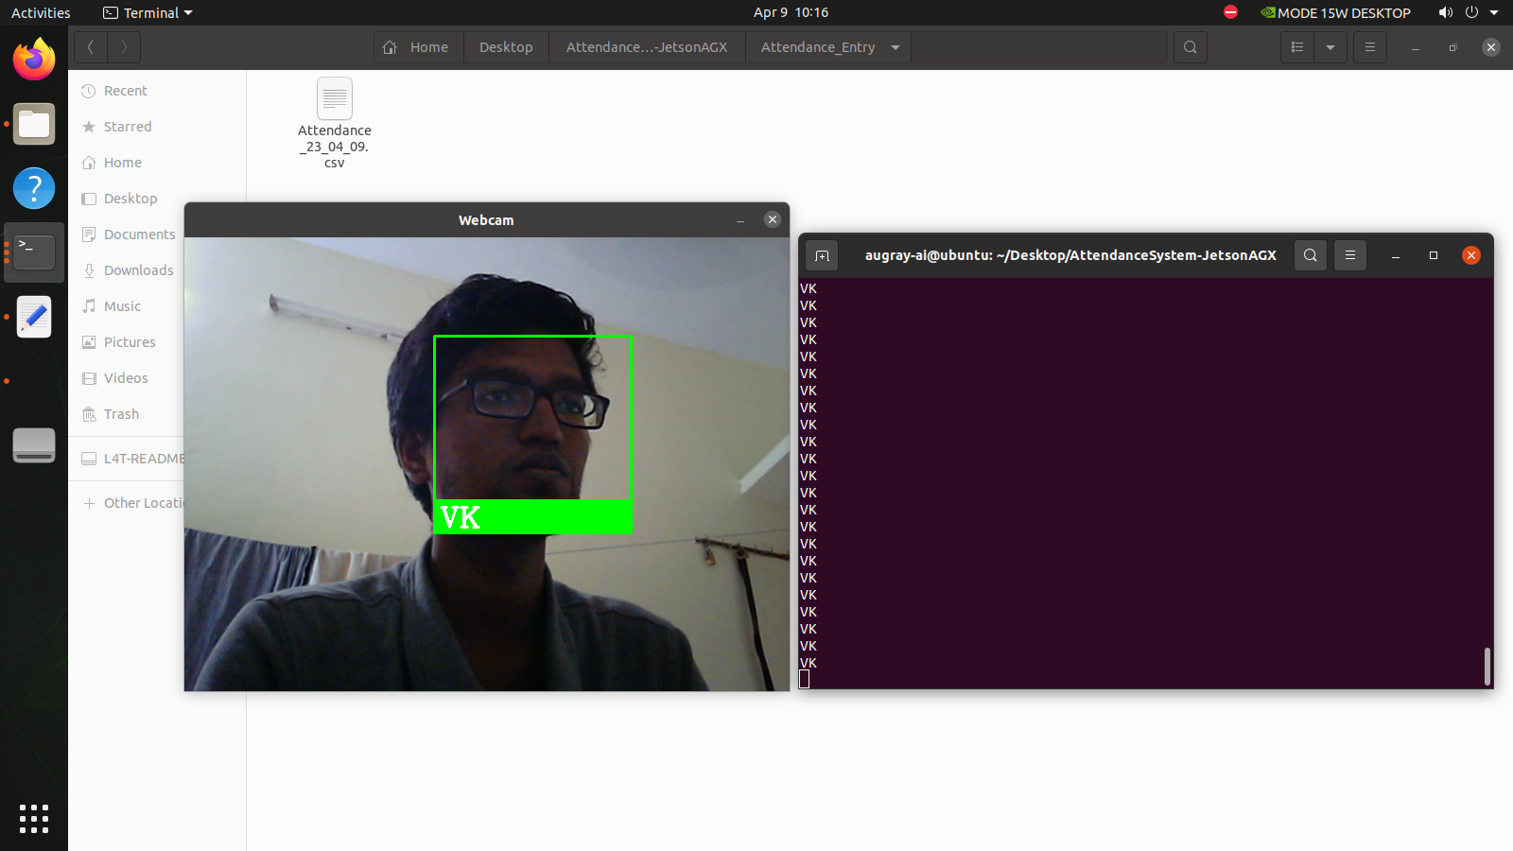
4. PROPOSED WORK
This project is based on Face recognition based Attendance system using Nvidia jetson Xavier
Uncontact for biometric devices and also easily identify the geo location based on your images

Slide 13
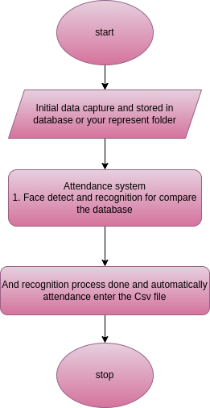
4.1. FLOW CHART

Slide 14
5. TOOLS
Hardware :
Monitor
Keyboard, Mouse
HDMI cable
Nvidia jetson AGX Xavier
Software:
OS booting in AGX Xavier (SDK manager)
vim or any ide

Slide 15
IMPLEMENTATION OF ATTENDANCE SYSTEM USING AGX XAVIER
Install requirement file
first identify the face using face recognition library
store the data for Attendance_data folder
Then identify the face store the name for database or attendance_data folder
And finally automatically attendance stored in excel sheet(Name, Data, Time)
If you want remove the person data in database or data throught folder

Slide 16
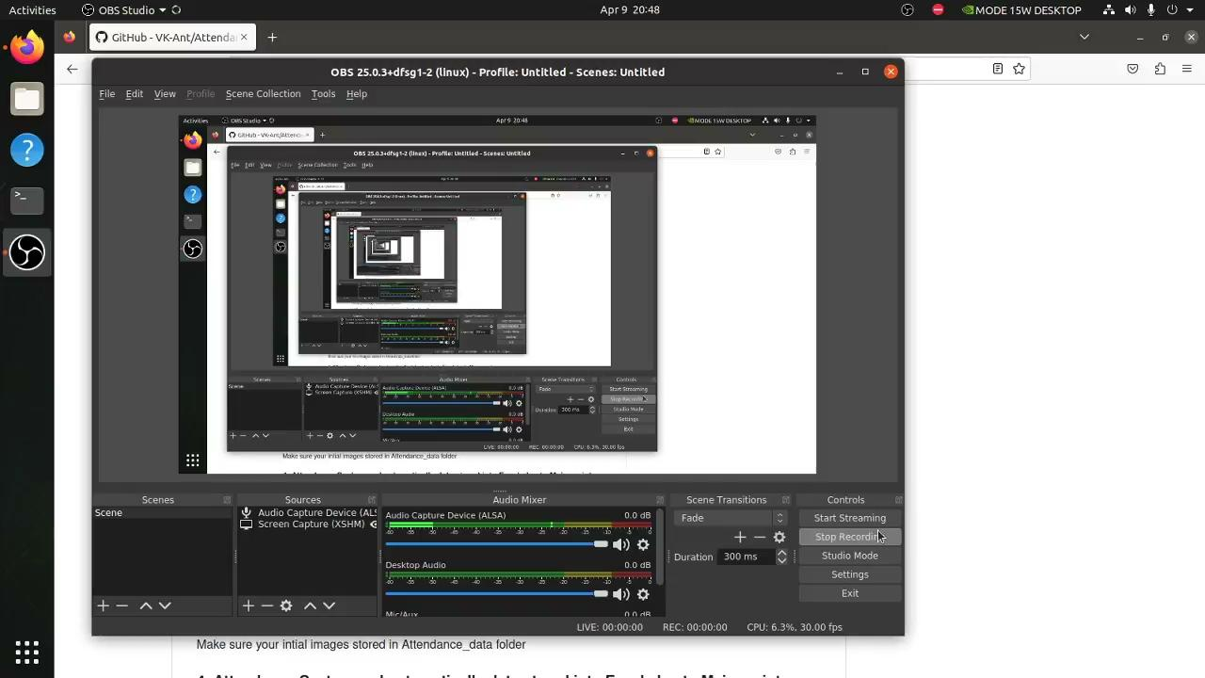
DEMO

Slide 17
6. Benefit of the project
Time-Saving For Your Workforce
Increased Efficiency and Capability
Enhances Workplace Security
Improved Employee Wellness And Productivity
Automated Time Tracking
Easy Integration With Other Systems
Easy to manage the record

Slide 18
7. REFERENCE AND CREDIT
https://pyimagesearch.com/2017/04/03/facial-landmarks-dlib-opencv-python/
https://courses.nvidia.com/courses/course-v1:DLI+S-RX-02+V2/
Thankyou,
1. My friends Venkatesan and balagopal
2. BSS. Narayan (Providing the development kit)

Slide 19
THANKYOU

