Slide 1
Healthcare and Disease Trends Analysis

Slide 2


Introduction
Objective
Problem Statement
Data Overview
Data Preparation
EDA
Model Building
Evaluations for Model
Conclusions
Importance

Slide 3
Problem Statement
The healthcare industry faces significant challenges in managing vast amounts of patient data, optimizing resource allocation, and improving patient outcomes. Analyzing patient demographics, medical conditions, treatment plans, and associated costs can provide valuable insights to address these challenges. However, the large volume and complexity of healthcare data make it difficult to extract actionable information.
Analyze patient demographics
Examine medical conditions
Predict healthcare costs
Identify high-risk
patients
Understand the age, gender, and blood type distribution of patients to identify any correlations with medical conditions and treatment outcomes
Develop predictive models to estimate billing amounts based on patient characteristics, medical conditions. This can help healthcare providers and insurance companies manage costs more effectively.
Detect patterns and risk factors that contribute to poor health outcomes, enabling early intervention and preventive care strategies
Identify the most prevalent medical conditions, their severity, and associated treatment plans to optimize resource allocation and develop targeted interventions

Slide 4


Technologies Used
Programming Language:
Python: Primary language for data analysis, machine learning, and visualization
Development Environment:
Jupyter Notebook: Interactive web-based environment for writing and executing Python code.
Google Colab: Cloud-based Jupyter notebook environment provided by Google.
Data Analysis and Machine Learning Libraries
Pandas: For data manipulation and analysis
NumPy: For numerical computations
Scikit-Learn: For machine learning algorithms and model evaluation
Matplotlib and Seaborn: For data visualization

Slide 5
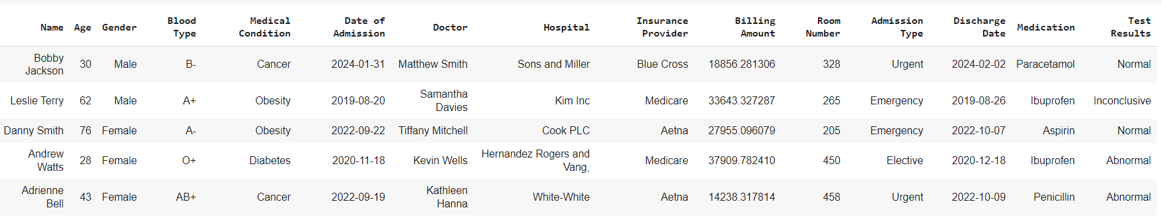
Data Overview
The healthcare dataset contains information about patient demographics, medical conditions, treatment details, and billing amounts. Key features include:
Patient Demographics: Name, Age, Gender, Blood Type
Medical Information: Medical Condition, Date of Admission, Doctor, Hospital
Insurance and Billing: Insurance Provider, Billing Amount, Room Number, Admission Type, Discharge Date
Treatment Details: Medication, Test Results
The dataset has 55000 records with 15 attributes related to patient and billing. The dataset was collected from Kaggle and the data was collected from various healthcare insurance firms.

Slide 6
Data Preparation
Preparing for Analysis

Slide 7

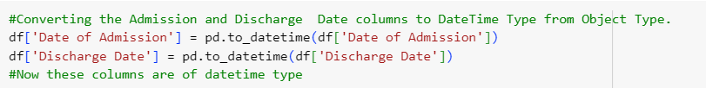
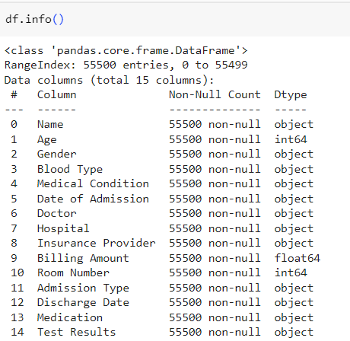
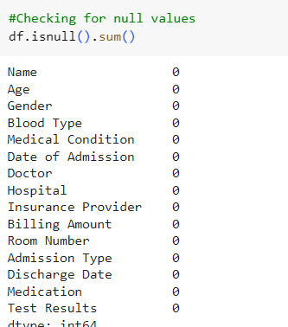
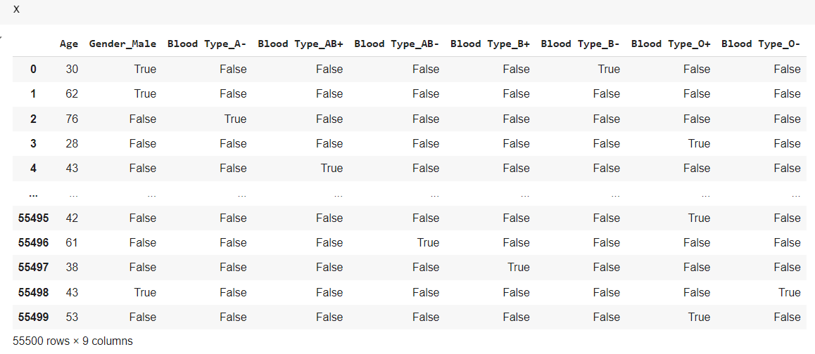
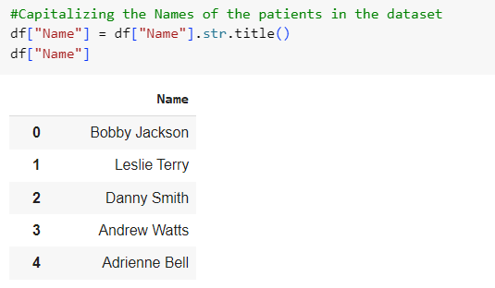
Steps Taken For Preparation
Data Collection and Data Cleaning
Identifying Missing Values: Detected missing data in critical field (e.g., Billing Amount has negative values) and decided on strategies to handle them, such as filling with mean/median values or removing incomplete rows.
Detecting Outliers: Identified and addressed outliers that could skew the analysis and model performance.
Data Transformation
Converting the Name column of the Dataset to Capitalizing the names.
Converted raw data into a suitable format for analysis, including:
Date Formatting: Ensured that the Date of Admission and Discharge Date fields are in the correct date format.
Categorical Encoding: Converted categorical variables (e.g., Gender, Blood Type, Medical Condition) into numerical formats using techniques like one-hot encoding.

Slide 8
Exploratory Data Analysis
Exploratory Data Analysis (EDA) is a crucial step in understanding the dataset's structure, patterns, and relationships. It helps in identifying trends, anomalies, and insights that inform further analysis and model development.

Slide 9
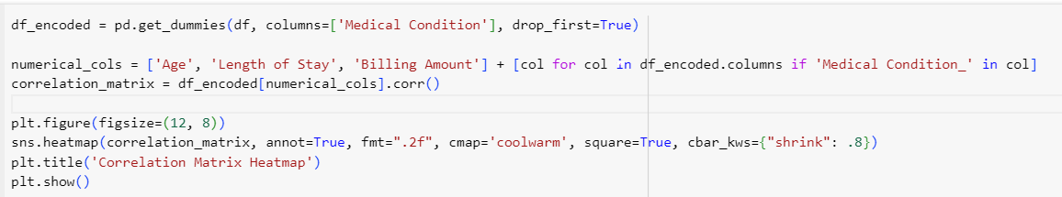
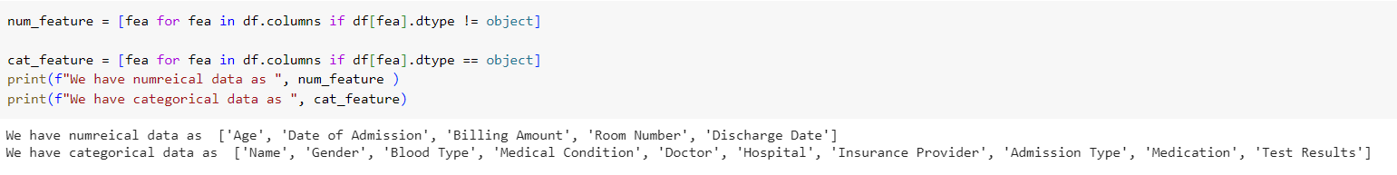
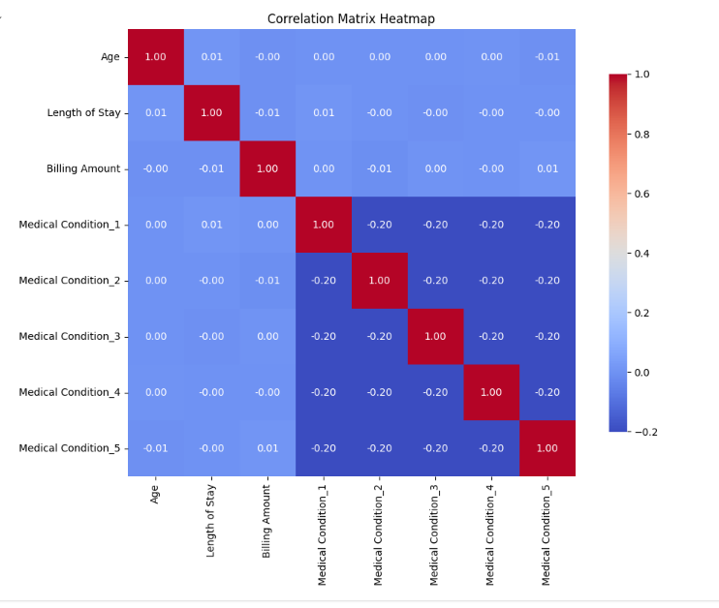
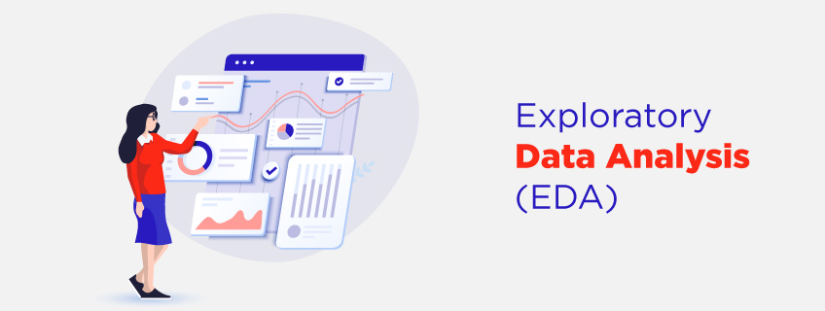
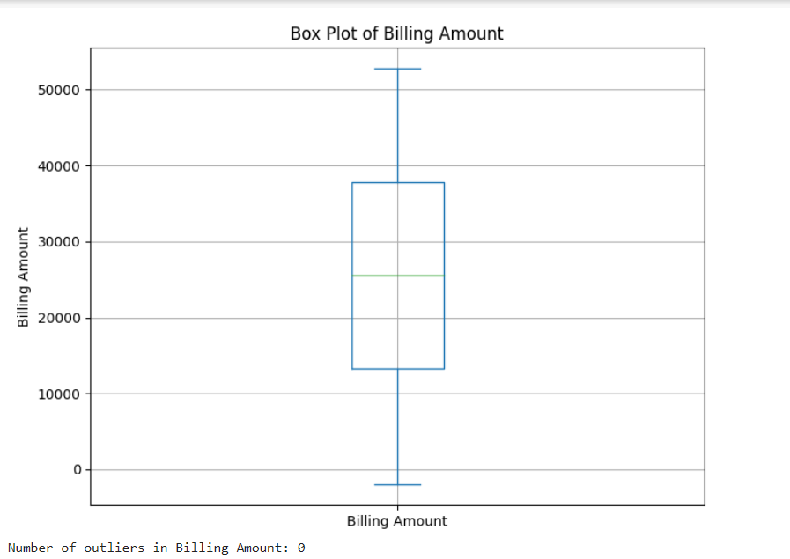
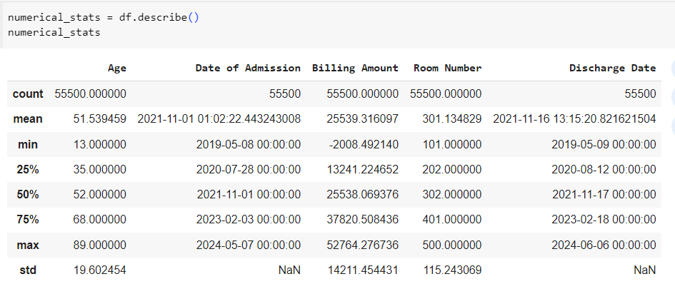
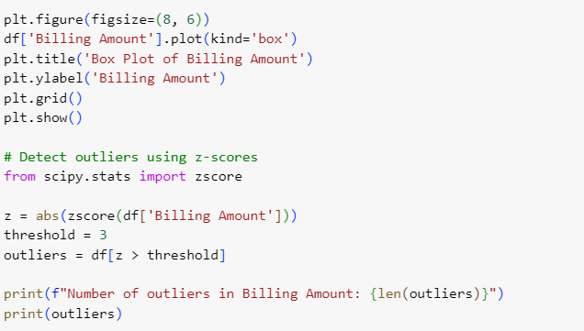
EDA
Correlation Matrix and Heatmap
The correlation matrix helps identify which variables are related to each other, which can inform feature selection for predictive modeling. For example, if Age and Billing Amount have a strong positive correlation, it suggests that older patients tend to have higher billing amounts.
The heatmap provides an intuitive way to visualize the correlation matrix, making it easier to spot patterns and relationships at a glance. It allows for quick identification of strong or weak correlations through color intensity.
Interpretation
High positive correlations (e.g., above 0.5) suggest that as one variable increases, the other variable tends to increase as well.
High negative correlations (e.g., below -0.5) suggest that as one variable increases, the other variable tends to decrease.
Values close to 0 suggest little to no linear relationship between the variables.
Darker shades (red) indicate strong positive correlations.
Darker shades (blue) indicate strong negative correlations.
Lighter shades indicate weaker correlations.
Descriptive Statistics
Age: Ranges from 13 to 89 years with a mean of approximately 51.5 years.
Billing Amount: Has a mean of about 25,539.32 with a standard deviation of 14,211.45.
(Note: That there are negative values in the billing amount, which may need further investigation.)
Room Number: Ranges from 101 to 500.
Descriptive Statistics
Summary Statistics: Calculated mean, median, and standard deviation for numerical variables such as Age and Billing Amount.
Distribution Analysis: Visualized distributions using histograms and box plots to identify the spread and central tendency of the data.
Checking for Outliers

Slide 10
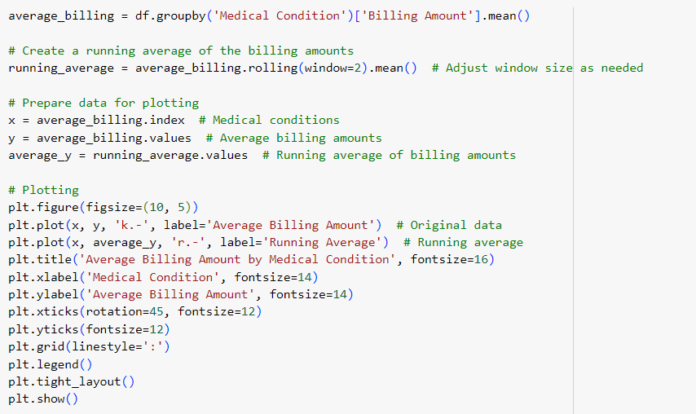
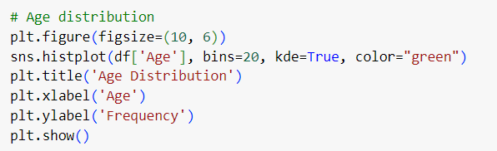
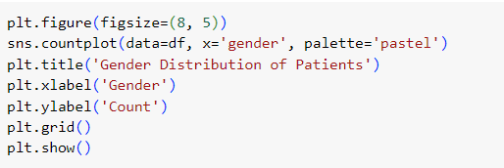
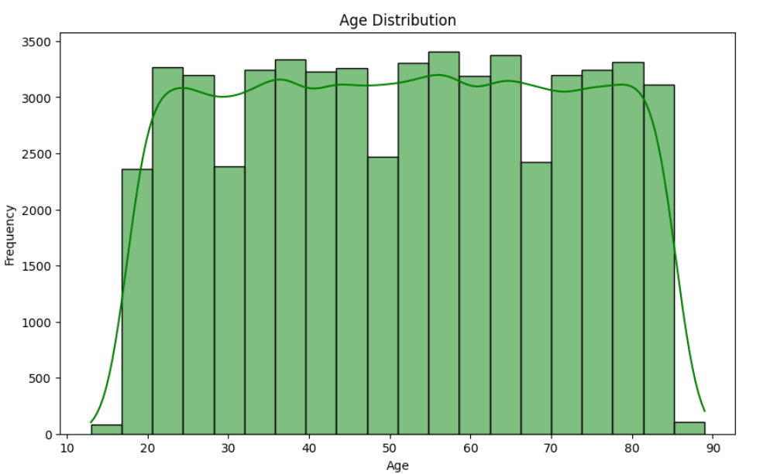
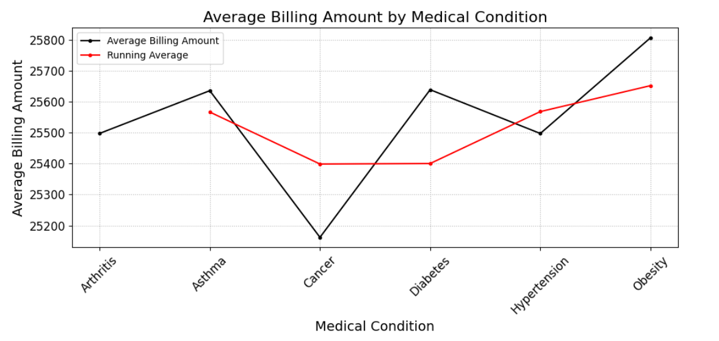
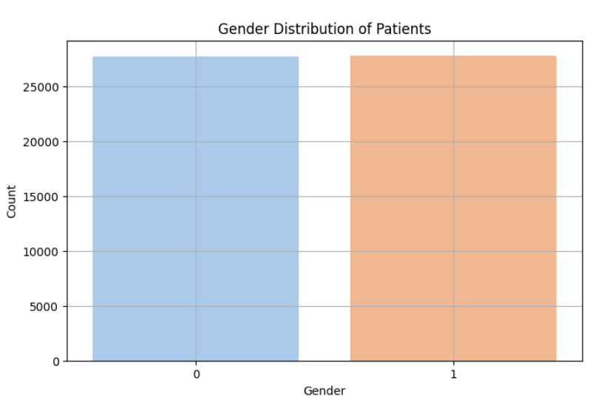
Key Findings of EDA
Billing Amount
Patients Demographics
Age Distribution: The dataset reveals a diverse age range among patients, with a notable concentration in middle-aged groups (30-60 years).
Gender Representation: The gender distribution is relatively balanced, with a slight majority of female patients.(where 0 represents Females and 1 represents Males)

Slide 11
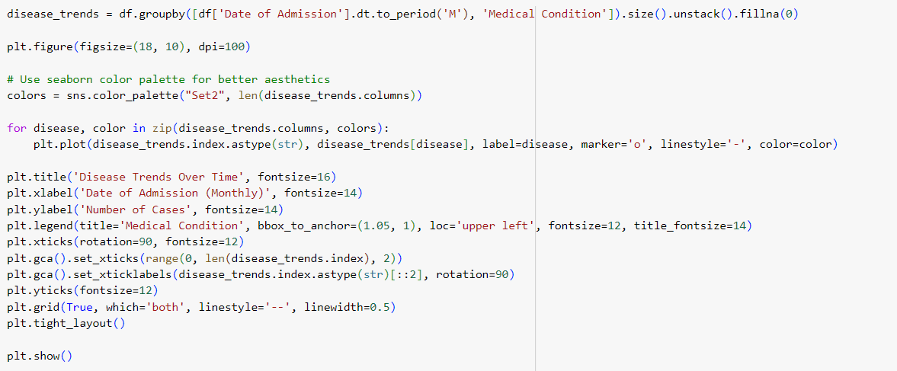
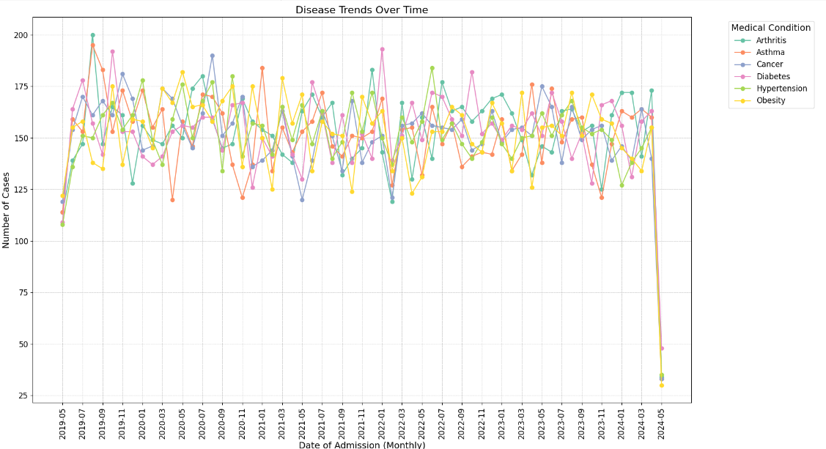
Disease Trends Over Time
The "Disease Trends Over Time" plot serves as a powerful tool for visualizing and analyzing the dynamics of various medical conditions within the healthcare dataset. By examining these trends, stakeholders can gain a deeper understanding of patient admissions, enabling them to make informed decisions that enhance patient care and optimize healthcare resources.
Trends Observed:
Seasonal Patterns : Some medical conditions may exhibit seasonal trends, where the number of cases rises or falls during specific months. For instance, conditions like asthma or respiratory issues may show increased cases during colder months.
Rising or Declining Trends : Certain conditions may show a consistent increase or decrease in cases over time. For example, if cancer cases are rising, this could indicate an increasing prevalence or improved detection methods.
Fluctuations : The number of cases for some conditions may fluctuate significantly from month to month, suggesting varying factors influencing admissions, such as public health initiatives, seasonal outbreaks, or changes in healthcare access.

Slide 12
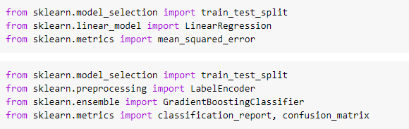
Model Building
To achieve the project objectives, several machine learning models were developed and evaluated on the healthcare dataset. The models aim to predict billing amounts, identify high-risk patients, and optimize treatment plans based on patient demographics, medical conditions, and treatment details.
Regression Models
Linear Regression: Used to predict billing amounts based on patient characteristics and medical conditions.
Ensemble Models
Gradient Boosting Regressor: Combines multiple weak regression models (e.g., decision trees) to create a strong predictive model for billing amount estimation.

Slide 13
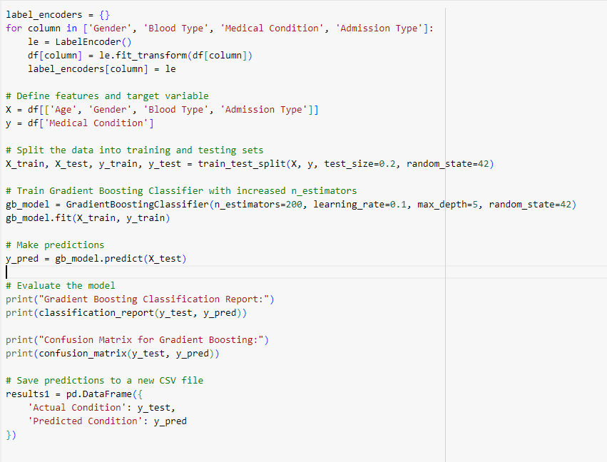
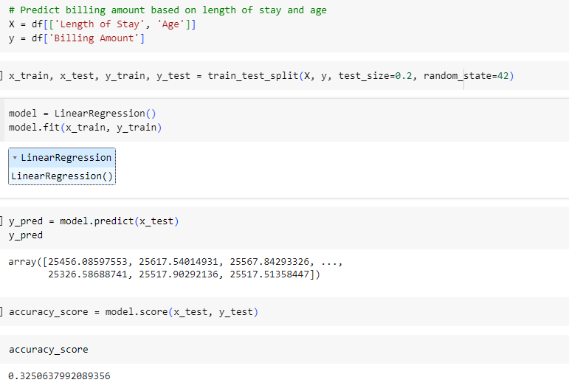
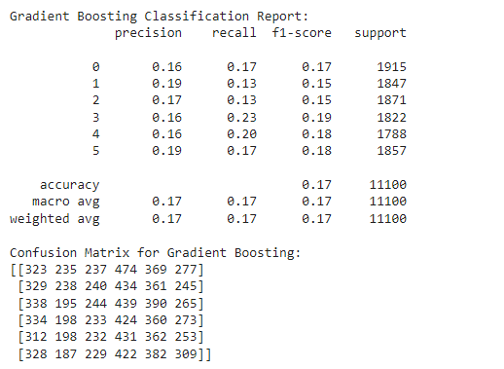
Linear Regression For Predicting Billing Amount
Gradient Boosting for Predicting Medical Condition

Slide 14
Thank you

