Slide 1
Dynamic Host Configuration Protocol
In large environments, manual address assignment can become an excessive administrative problem, especially for mobile devices that roam from one network to another many times each day. DHCP is a standardized network protocol for dynamically distributing IP addresses automatically, and setting other network configuration parameters, such as the subnet mask, default router, and DNS servers. With DHCP, computers request IP addresses and networking parameters automatically from a DHCP server, reducing the need for network administrators or users to manually configure these settings.
DHCP is implemented as an option of BOOTP and uses BOOTP as its transport protocol. UDP port number 67 is the destination port of a DHCP server, and UDP port number 68 is used by the DHCP client.
1

Slide 2
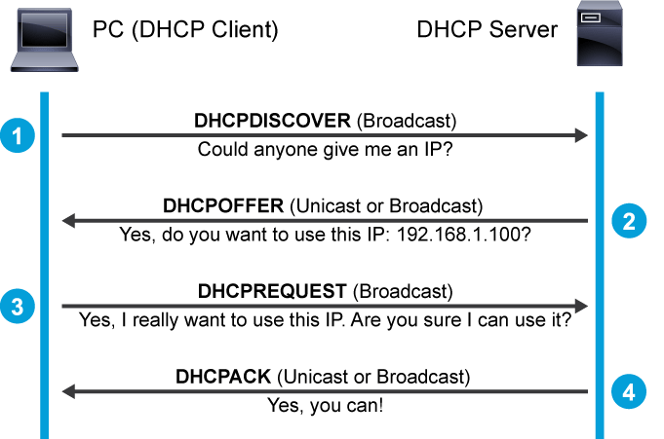
2

Slide 3
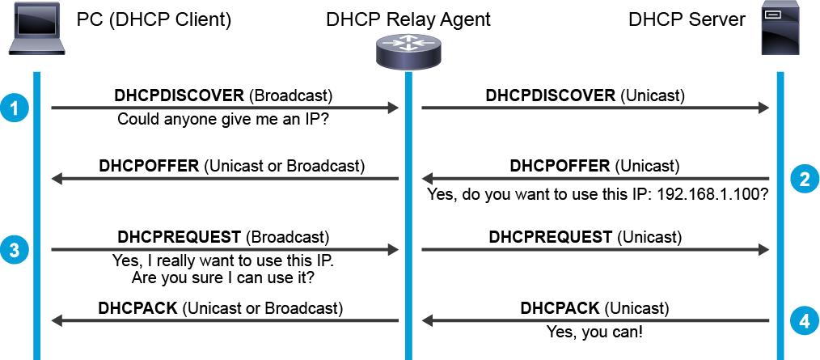
DHCP Relay Agent
The DHCP server does not have to reside directly on the same subnet.
The primary function of a DHCP relay agent is to forward DHCP messages from the local clients to the remote DHCP server. ( DHCP Capturing Örnekleri)
3

Slide 4
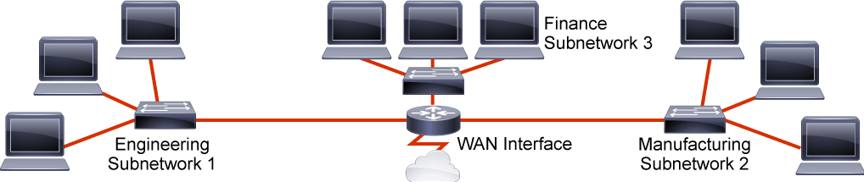
IP Subnetting
To increase scalability, network administrators often need to divide networks (especially large networks) into subnetworks, or subnets. A subnet segments the hosts within the network. With proper network segmentation, even when attackers get in, their access is limited to only a segment of the network.
4

Slide 5
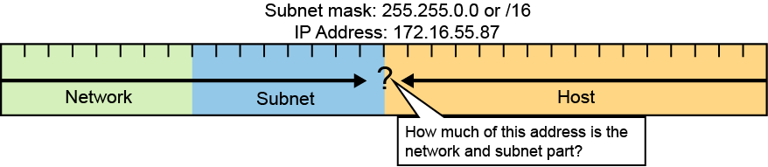
Subnet Masks
The IP addressing that is used in the flat network must be modified to accommodate the required segmentation. A subnet mask identifies the network-significant portion of an IP address.
5

Slide 6
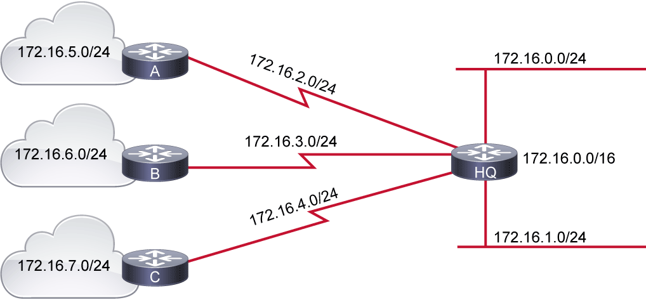
Variable-Length Subnet Masking
Fixed-Length Prefixes
6

Slide 7
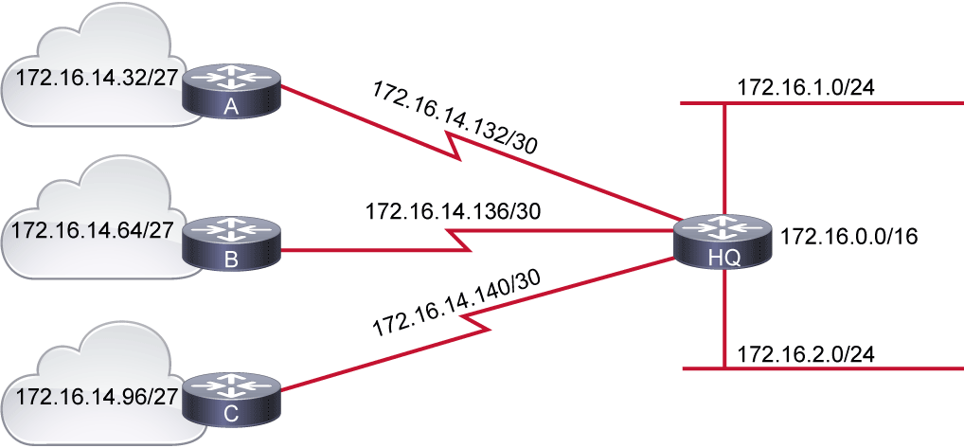
Variable-Length Subnet Masking
7

Slide 8
Hubs, Bridges and Layer 2 Switches
Network devices are used to communicate hosts with each other
Hub transmits signal out all ports on the hub, except for the original incoming port.
All ports of hub share single collision and single broadcast domain.
A collision domain is a section of a network that is connected by a shared medium where data packets sent from one device will be heard by all other devices on the segment.
A broadcast domain is a logical division of a computer network, in which all nodes can reach each other by broadcast at the data link layer.
8

Slide 9
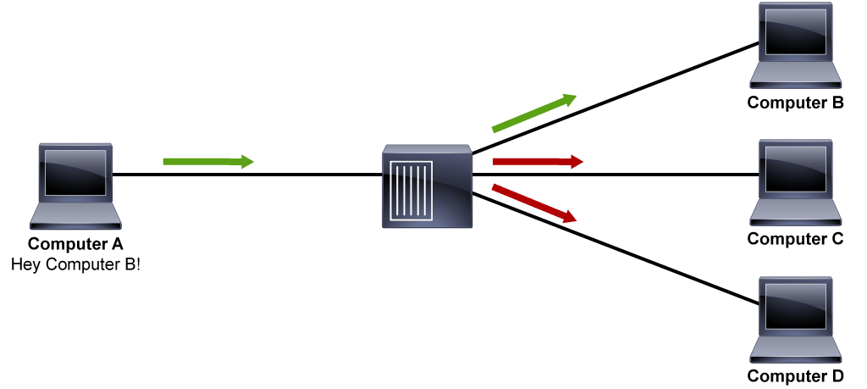
Communicating Host A and B with Hub
9

Slide 10
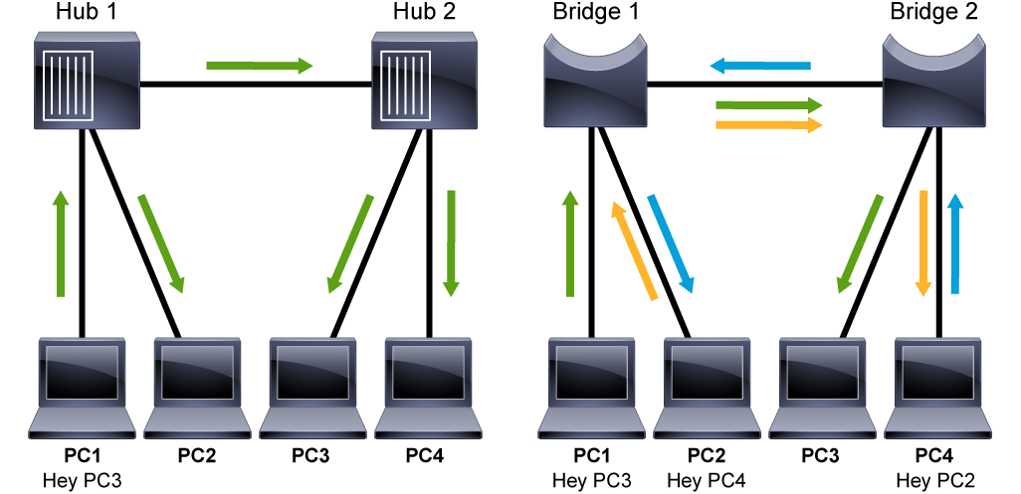
Traffic Flow: Hub vs. Bridge
Hub
PC 1 to PC 3
Bridge
PC 1 to PC 3
10

Slide 11
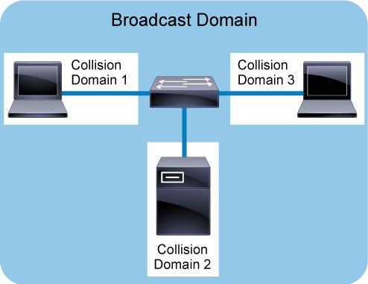
11

Slide 12
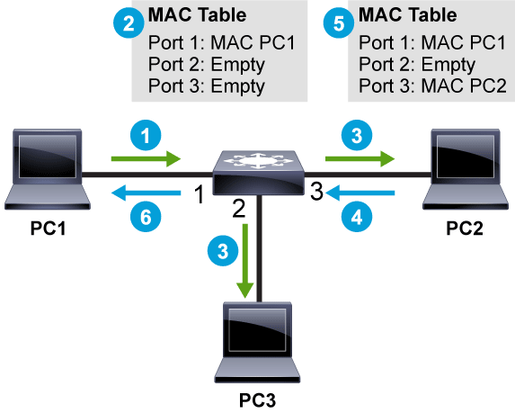
Switching Operations
12

Slide 13
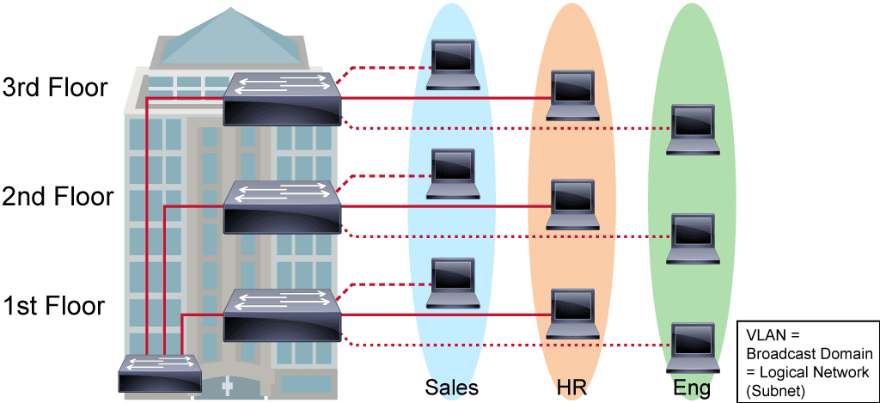
VLANs and Trunks
A VLAN is a logical broadcast domain that can span multiple physical LAN segments. A VLAN is a group of devices on one or more LANs that are configured to communicate as if they were attached to the same wire, when in fact they are located on several different LAN segments.
13

Slide 14
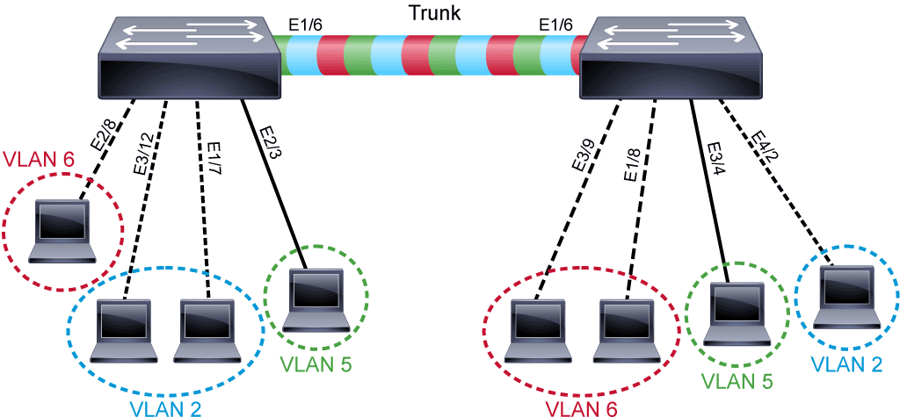
A trunk can carry traffic for multiple VLANs as shown in the following figure.
IEEE 802.1Q is a special Trunkin Protocol.
14

Slide 15
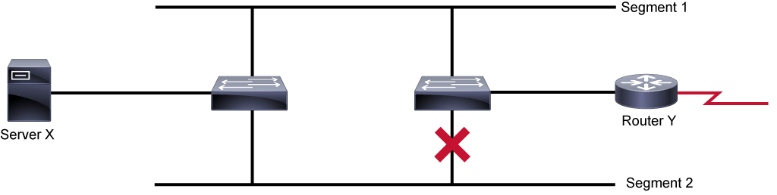
Spanning Tree Protocols
A topology with loops that imply the existence of multiple paths through internetwork and a network with multiple paths from source to destination can increase overall network fault tolerance can be harmful. STP was designed to eliminate loops.
15

Slide 16
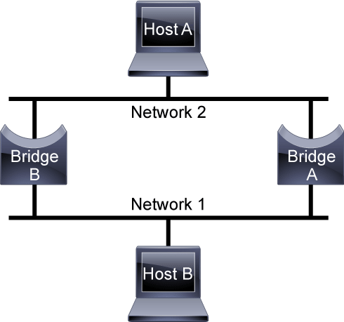
16

Slide 17
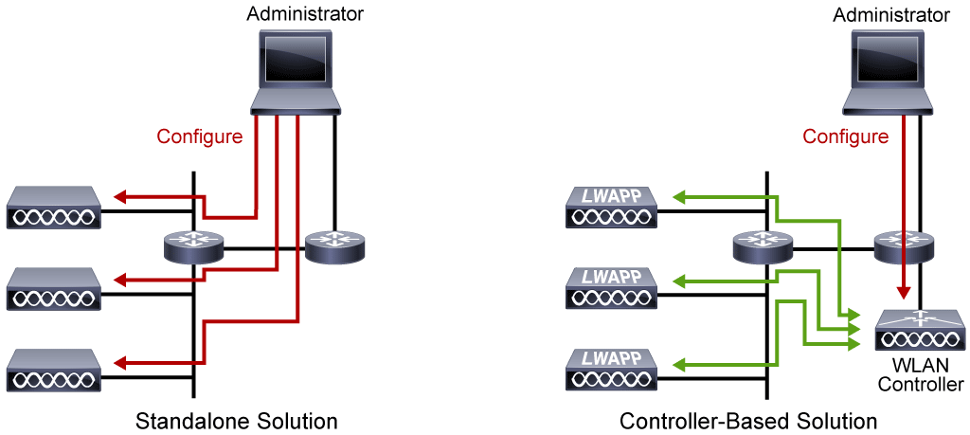
Standalone (Autonomous) and Lightweight Access Points
A wireless AP is a wireless LAN networking hardware device that allows a Wi-Fi compliant device with a wireless network adaptor to connect to a wired network. The AP converts the radio frequency communications into digital signals and vice versa. The AP usually connects to a router via a wired Ethernet connection as a standalone device.
Wireless AP Types
17

Slide 18
Standalone (Autonomous) APs
Standalone (autonomous) APs can be configured one-by-one and offer complete functionality by themselves; they are well-adapted for very small deployments. Standalone APs support standalone network configurations, where all configuration settings are maintained locally. Each standalone AP can load its starting configuration independently, and still operate in a cohesive fashion on the network.
Autonomous APs are self-contained, each offering one or more fully functional, standalone BSSs.
The AP advertises the wireless network with an SSID, which is a text string containing a logical name. Think of the BSSID as a machine-readable name tag that uniquely identifies the BSS ambassador (the AP).
The SSID as a non-unique, human-readable name tag that identifies the wireless service.
18

Slide 19
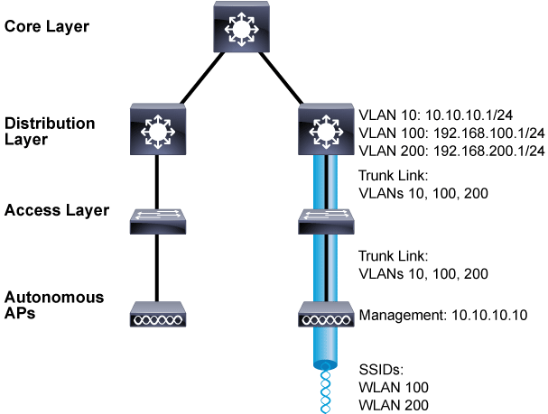
19

Slide 20
Lightweight APs
There are some disadvantages in using autonomous Aps:
Selecting and configuring the channel that is used by each autonomous Aps
Detecting and dealing with any rogue Aps
Manage some things like transmit power level, prevent overlap etc
Managing wireless network security and policies (no convenient place to monitor traffic)
LWAPs rely on central WLC(Wireless LAN Controller). LWAPs can be controlled and configured from a central WLC. Wireless LAN Administration work is done by the central WLC.
20

Slide 21
The two devices must use a tunneling protocol between them, to carry 802.11-related messages and also client data. Lightweight AP and WLC can be located on the same VLAN or IP subnet, but they do not have to be. Instead, they can be located on two entirely different IP subnets in two entirely different locations.
Once CAPWAP tunnels are built from a WLC to one or more lightweight APs, the WLC can begin offering various additional functions such as the following:
Dynamic channel assignment
Transmit power optimization
Self-healing wireless coverage
Flexible client roaming
Dynamic client load balancing
Security management
Wireless intrusion protection system
21

Slide 22
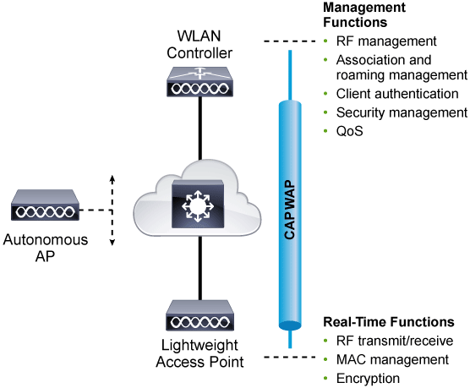
22

Slide 23
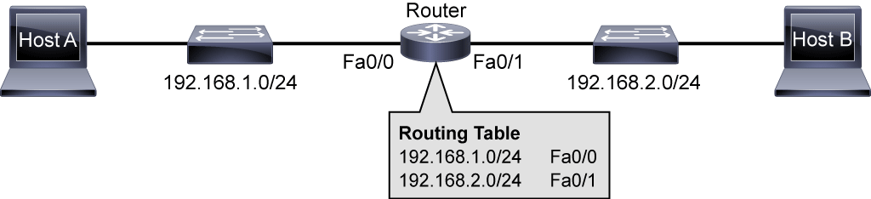
Routers
Routing is the process that routers, OSI Layer 3 devices, use to forward data packets between networks or subnetworks. The routing process uses network routing tables, protocols, and algorithms to determine the most efficient path for forwarding an IP packet.
23

Slide 24
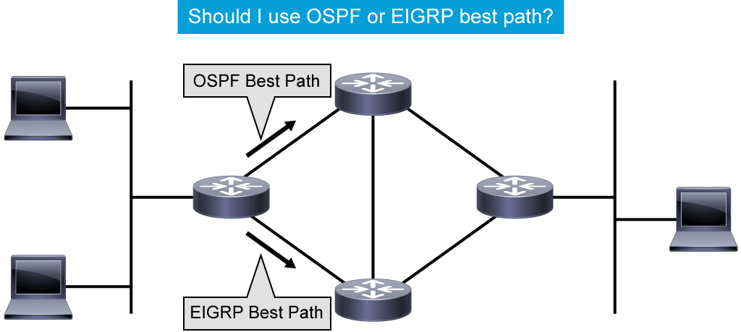
Routers have these two important functions:
Path determination: Routers must maintain their own routing tables and ensure that other routers know about changes in the network. Routers use a routing protocol to communicate network information to other routers.
Packet forwarding: Routers use the routing table to determine where to forward packets. Routers forward packets through a network interface toward the destination network. Each line of the routing table indicates which network interface is used to forward a packet.
24

Slide 25
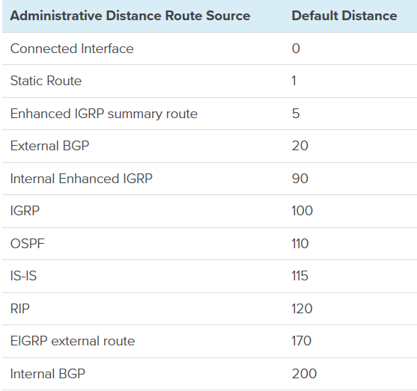
Administrative distance is the feature that routers use to select the best path when there are two or more routes to the same destination network from two routing protocols. Routing protocols use different metrics to measure the distance and desirability of a path to a destination network. The metric calculation is done by the routing protocol.
25

Slide 26
Types of Routes
Directly connected networks: This entry comes from having router interfaces that are directly attached to network segments.
Static routes: A system administrator manually enters static routes directly into the configuration of a router.
Dynamic routes: The router learns dynamic routes automatically when a routing protocol is configured and a neighbor relationship to other routers is established.
Default routes: A default route is an optional entry that is used when no explicit path to a destination is found in the routing table.
26

Slide 27
Routing Protocols
The different routing protocols can be grouped in several ways. One option is to group them based on whether protocols operate within or between Autonomous Systems.
An AS represents a collection of network devices under a common administrator. Typical examples of an AS are an internal network of an enterprise or a network infrastructure of an ISP.
Interior gateway protocols: IGPs are used within the organization, and exchange routes within an AS. They can support small, medium-sized, and large organizations, but their scalability has its limits.
Exterior gateway protocols: EGPs take care of exchanging routes between different ASs. BGP is the only EGP that is used today. The main capability of BGP is to exchange a huge number of routes between different ASs that are part of the Internet.
27

Slide 28
Routing protocols can also be grouped based on how they operate.
Distance Vector Protocols: The distance vector routing approach determines the direction (vector) and distance (such as link metric or number of hops) to any link in the network.
Link-state protocols: The link-state approach, which uses the SPF algorithm, creates an abstract of the exact topology of the entire network, or at least of the partition in which the router is situated.
Path vector protocols: The path vector routing approach exchanges not only information about the existence of destination networks but also the path on how to reach the destination.
28

Slide 29
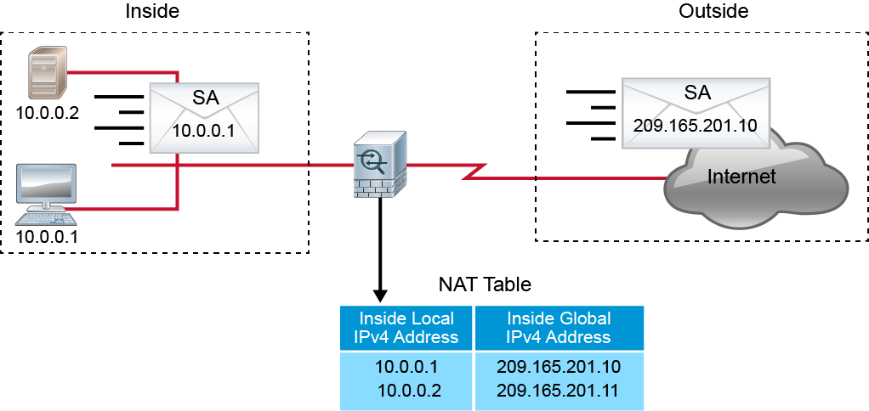
NAT (Network Address Translation)
NAT operates in Layer 3 forwarding devices to provide address simplification and conservation. The most common use of NAT is to connect networks using private RFC 1918 network addresses to the public Internet. NAT translates the private addresses that are used in the internal network into public addresses that can be routed across the Internet.
29

Slide 30
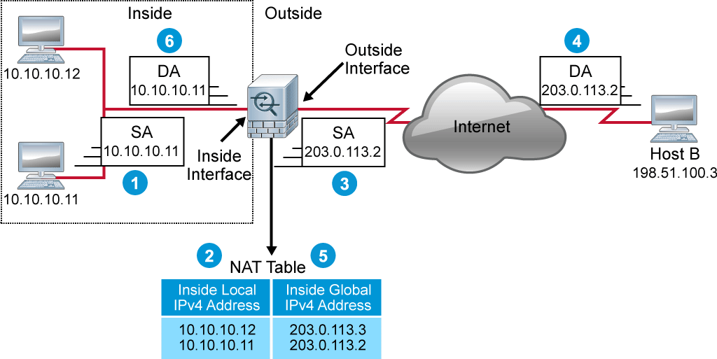
Yorumla. Trafik A → B
30

Slide 31
Types of NATs
Static NAT: One-to-one.
Dynamic NAT: Many-to-one.
Static PAT: Port Forwarding.
Dynamic PAT: Many-to-one, based on source port.
Policy PAT: Use extended criteria: source addresses, destination addresses and transport layer ports.
31

Slide 32
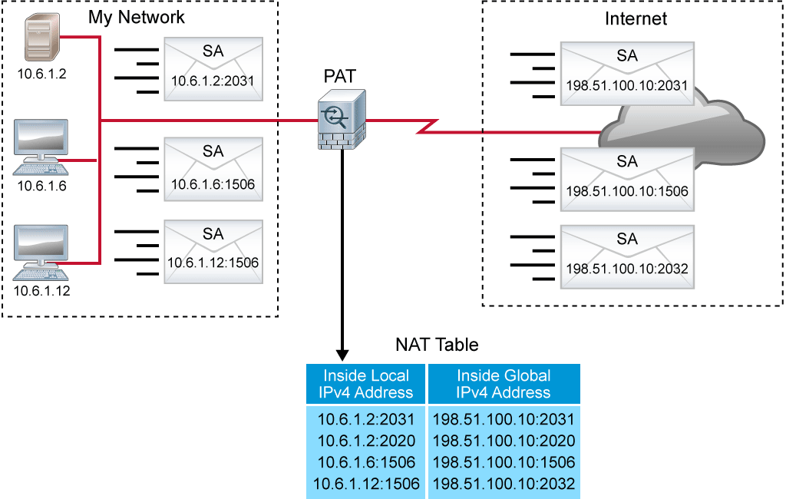
32

Slide 33
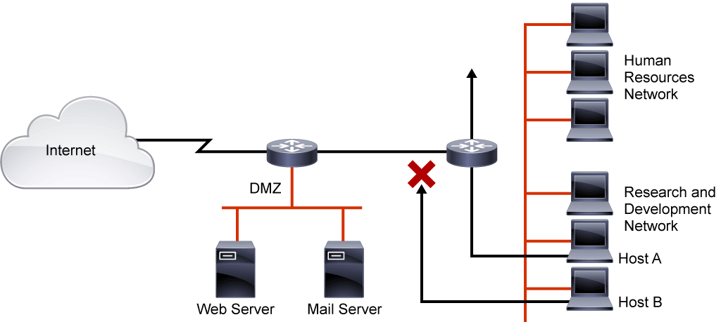
Access Control Lists
ACLs provide a basic level of security for network access. Without any ACLs configured on a router, all packets pass through the router and onto the network.
33

Slide 34
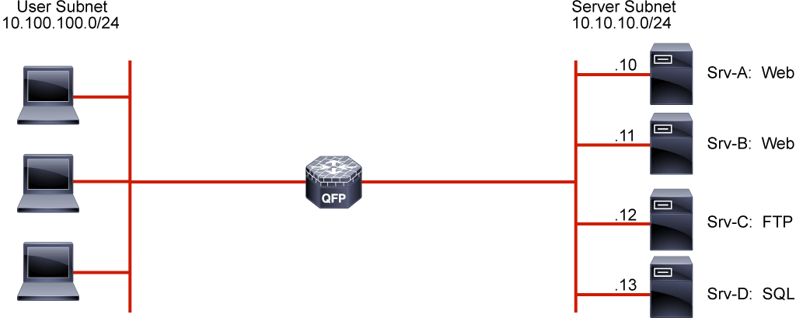
34

