Slide 1
1
1

Slide 2
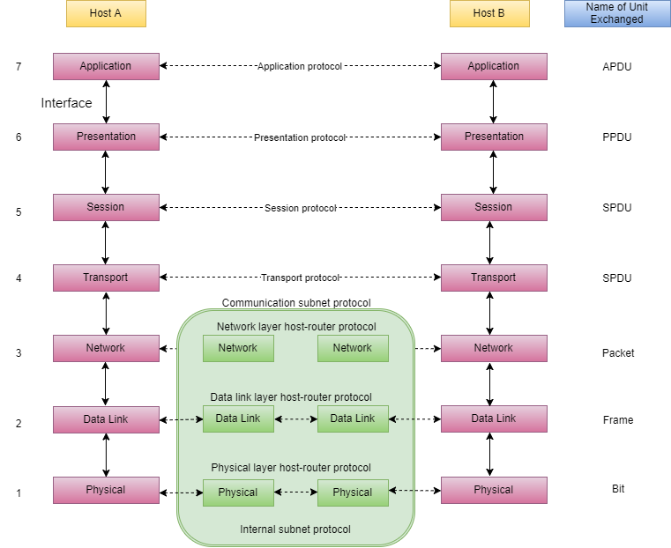
OSI Referans Modeli
OSI (Open Systems Interconnection) ISO tarafından geliştirilmiş iki bilgisayar arasındaki ilişkinin nasıl olacağını tanımlayan bir referans modelidir. OSI öncesindeki dönemde, yalnızca bilgisayar donanımı üreten kuruluşlara özgü ağlar vardı. Bu ağların özellikleri, çoğunlukla yalnızca o üreticinin donanımının bağlanmasına izin verecek biçimde tanımlanmıştı. OSI Modeli herhangi bir donanım ya da bilgisayar ağı tipine göre değişiklik göstermemektedir. OSI'nin amacı ağ mimarilerinin ve protokollerinin bir ağ ürünü bileşeni gibi kullanılmasını sağlamaktır. OSI modeli 7 katmana ayrılmıştır.
2
2

Slide 3
Layer 1, Physical: The physical layer defines the electrical, mechanical, procedural, and functional specifications for activating, maintaining, and deactivating the physical link between end systems. Characteristics such as voltage levels, timing of voltage changes, physical data rates, maximum transmission distances, physical connectors, and other similar attributes are defined by physical layer specifications. Examples of Layer 1 devices are transceivers, modems, and hubs.
Layer 2, Data Link: The data link layer defines how data is formatted for transmission and how data accesses the physical layer. This layer also typically includes error checking. Examples of Layer 2 devices are bridges and switches, which forward and flood traffic based on MAC addresses. Although MAC addresses are typically physical addresses, they operate at the data link layer of the OSI model.
Layer 3, Network: The network layer provides connectivity between two host systems that can be located on geographically separated networks. It provides logical addressing, selects the best path for data delivery, and routes data packets. An example of a Layer 3 device is a router.
3
3

Slide 4
Layer 4, Transport: The transport layer segments data from the system of the sending host and reassembles the data into a data stream on the system of the receiving host. For example, business users in large corporations often transfer large files from field locations to a corporate site. Reliable delivery of the files is important, so the transport layer breaks down large files into smaller pieces, which are known as segments, that are less likely to incur transmission problems.
The boundary between the transport layer and the session layer can be thought of as the boundary between application protocols and data-flow protocols. Whereas the application, presentation, and session layers are concerned with application issues, the lower four layers are concerned with data transport issues.
The transport layer shields the upper layers from transport implementation details. Specifically, issues such as reliability of transport between two hosts are assigned to the transport layer. In providing a communication service, the transport layer establishes, maintains, and properly terminates virtual circuits. Transport error detection, error recovery, and information flow control ensure reliable service.
4
4

Slide 5
Layer 5, Session: The session layer establishes, manages, and terminates sessions between two communicating hosts. The session layer also synchronizes dialog between the presentation layers of the two hosts and manages their data exchange. For example, web servers have many users, so there are many communication processes open at a given time. Therefore, it is important to keep track of which user communicates on which path.
Layer 6, Presentation: The presentation layer ensures that the information that is sent at the application layer of one system is readable by the application layer of another system. For example, a PC program communicates with another computer, with one computer using EBCDIC and the other using ASCII to represent the same characters. If necessary, the presentation layer translates between multiple data formats by using a common format.
Layer 7, Application: The application layer is the OSI layer that is closest to the user. This layer provides network services to the applications of the user, such as email, file transfer, and terminal emulation. The application layer differs from the other layers in that it does not provide services to any other OSI layer, but only to applications outside the OSI model. The application layer establishes the availability of intended communication partners and synchronizes and establishes agreement on procedures for error recovery and control of data integrity.
5
5

Slide 6
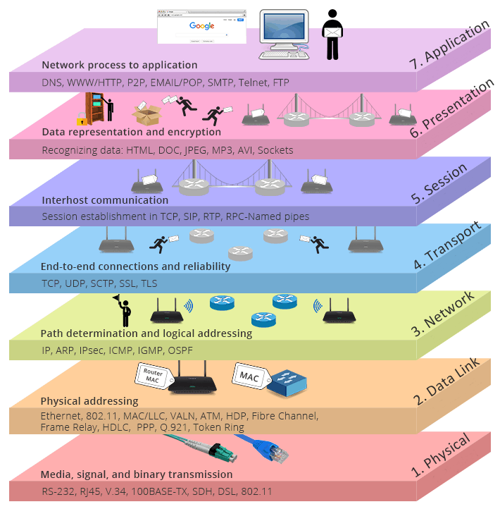
6
6

Slide 7
Data Encapsulation and Decapsulation
The user data is presented to the application layer.
The application layer adds the application layer header (Layer 7 header) to the user data. The Layer 7 header and the original user data become the data that is passed down to the presentation layer.
The presentation layer adds the presentation layer header (Layer 6 header) to the data. The combined data and header then become the data that is passed down to the session layer.
The session layer adds the session layer header (Layer 5 header) to the data. This combination then becomes the data that is passed down to the transport layer.
7
7

Slide 8
The transport layer adds the transport layer header (Layer 4 header) to the data. This combination, which is known as a segment, becomes the data that is passed down to the network layer.
The network layer adds the network layer header (Layer 3 header) to the data. This combination, which is known as a packet, becomes the data that is passed down to the data link layer.
The data link layer adds the data link layer header and trailer (Layer 2 header and trailer) to the data. A Layer 2 trailer is usually the FCS, which is used by the receiver to detect whether the data is in error. This combination, which is known as a frame, then becomes the data that is passed down to the physical layer.
The physical layer then transmits the bits onto the network media.
8
8

Slide 9
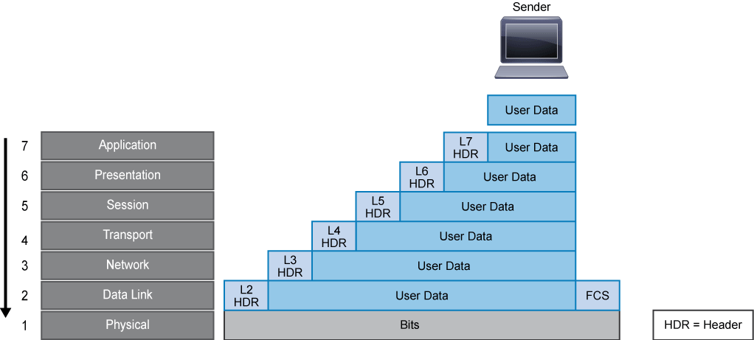
9
9

Slide 10
10
10

Slide 11
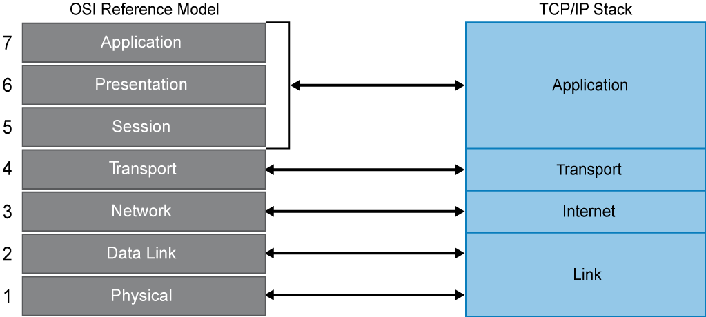
TCP/IP Modeli
11
11

Slide 12
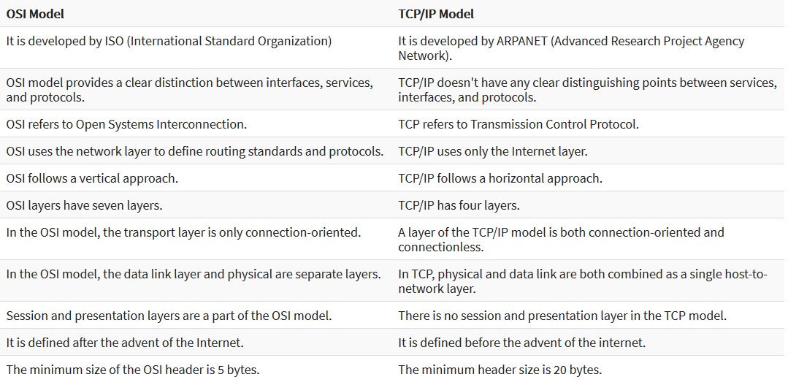
12
12

Slide 13
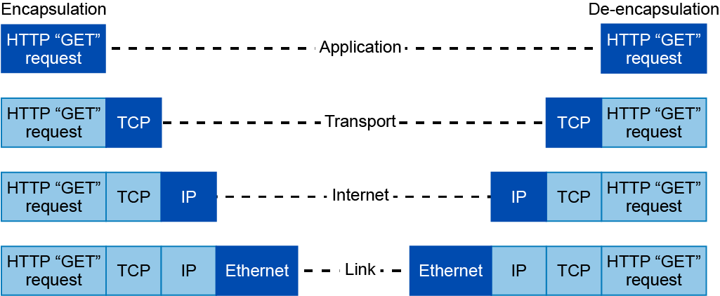
Encapsulation and Decapsulation of TCP/IP
13
13

Slide 14
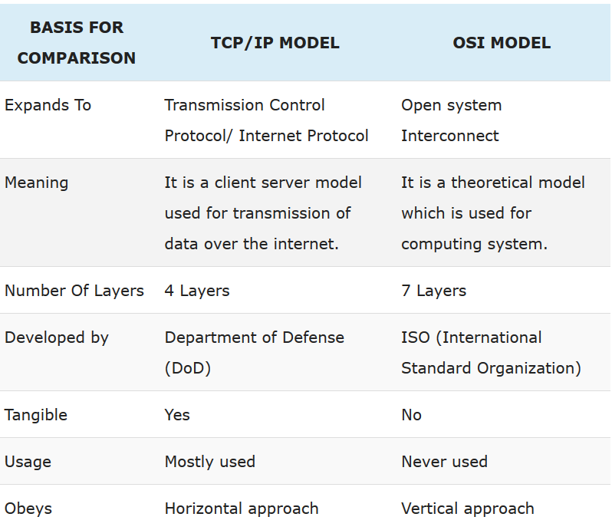
14
14

Slide 15
İnternet Protokolü (IP)
The Internet Protocol (IP) is a protocol for routing and addressing packets of data so that they can travel across networks and arrive at the correct destination. Data traversing the Internet is divided into smaller pieces, called packets. IP information is attached to each packet, and this information helps routers to send packets to the right place. Every device or domain that connects to the Internet is assigned an IP address, and as packets are directed to the IP address attached to them, data arrives where it is needed.
Once the packets arrive at their destination, they are handled differently depending on which transport protocol is used in combination with IP. The most common transport protocols are TCP and UDP.
15
15

Slide 16
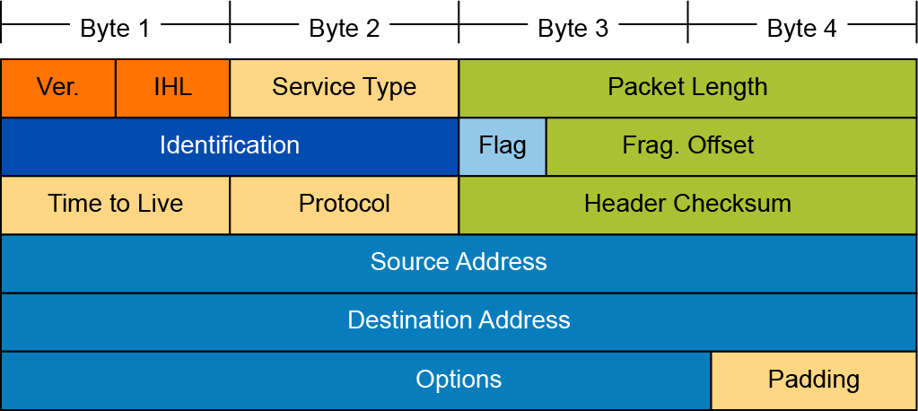
16
16

Slide 17
Version: A 4-bit field that identifies the IP version being used. The version is 4, indicating IPv4.
IP Header length: A 4-bit field containing the length of the IP header. The minimum length of an IP header is 20 bytes.
Total length: Specifies the length of the IP packet that includes the IP header and the user data. The length field is 2 bytes, so the maximum size of an IP packet is 65,535 bytes.
Identifier, flags, and fragment offset: As an IP packet moves through the Internet, it might need to cross a route that cannot handle the size of the packet. The packet will be divided, or fragmented, into smaller packets and reassembled later. These fields are used to fragment and reassemble packets.
Time to live: It is possible for an IP packet to roam aimlessly around the Internet. If there is a routing problem or a routing loop, then you don't want packets to be forwarded forever. A routing loop is when a packet is continually routed through the same routers over and over. The TTL field is initially set to a number and decremented by every router that is passed through. When TTL reaches 0, the packet is discarded.
17
17

Slide 18
Protocol: In the layered protocol model, the layer that determines which application the data is from or which application the data is for is indicated using the Protocol field. This field does not identify the application, but identifies a protocol that sits above the IP layer that is used for application identification. For example, protocol number 1 = ICMP, 6 = TCP, 17 = UDP.
Header checksum: A value that is calculated based on the contents of the IP header. Used to determine if any errors have been introduced during transmission.
Source IP address: 32-bit IP address of the sender.
Destination IP address: 32-bit IP address of the intended recipient.
Options and padding: A field that varies in length from 0 to a multiple of 32 bits. If the option values are not a multiple of 32 bits, 0s are added or padded to ensure that this field contains a multiple of 32 bits.
18
18

Slide 19
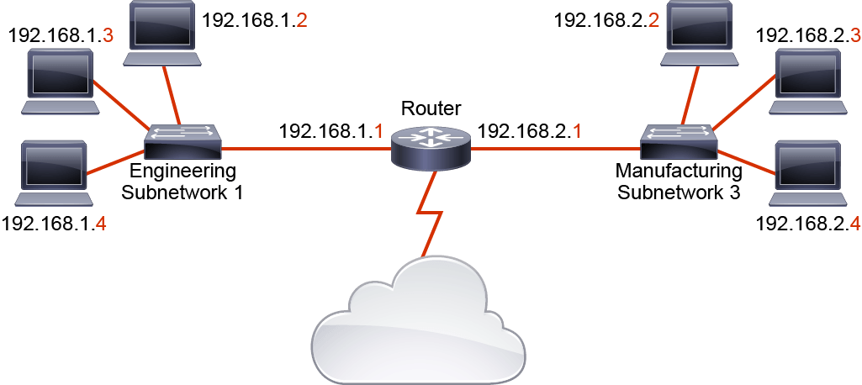
IP Adresleme
House Adress – Host Adress
Street Adress – Network adress
IP Adressing is a hierarchical structure that supplies
Host address uniquely identifies, network address commons for hosts in same network.
Packet Tracer Case
19
19

Slide 20
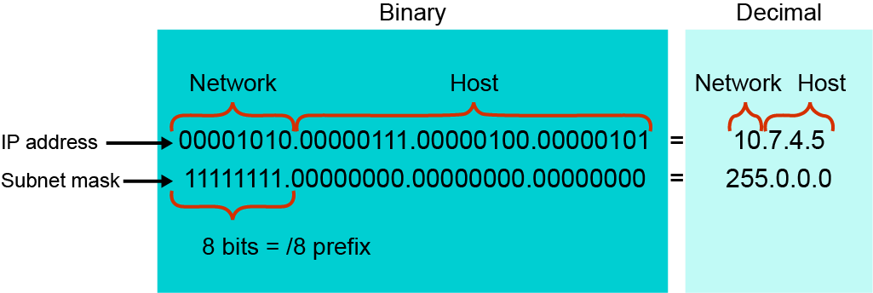
Subnet Mask
We use subnet mask to decide which part of IP address is network which one is host address.
20
20

Slide 21
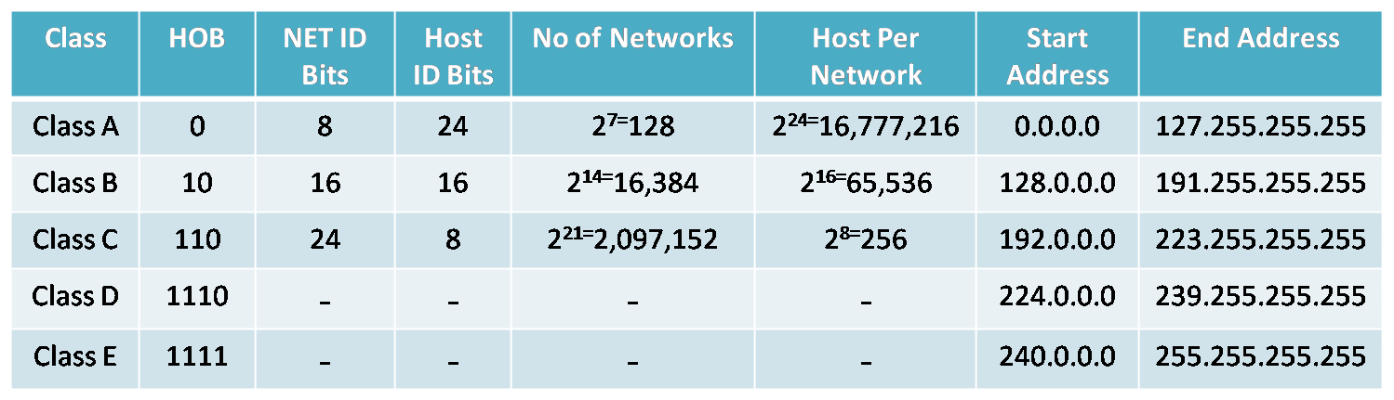
Classful IP Adressing vs VLSM
195.1.1.0 – Network and 25 Host needed. What is the IP address size?
21
21

Slide 22
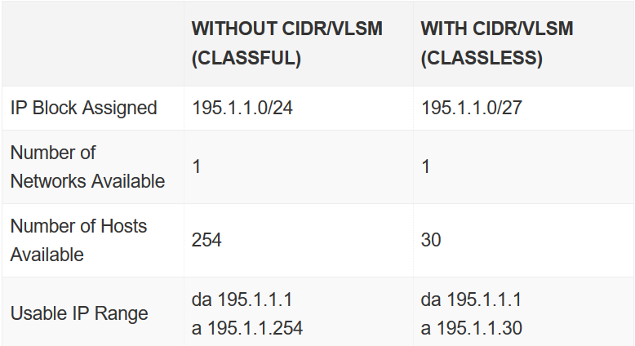
22
22

Slide 23
Public and Private IP Adresses
Class | Private Address Ranges
A | 10.0.0.0 to 10.255.255.255
B | 172.16.0.0 to 172.31.255.255
C | 192.168.0.0 to 192.168.255.255
Class | Public IP Ranges
A | 1.0.0.0 to 9.255.255.255 and 11.0.0.0 to 126.255.255.255
B | 128.0.0.0 to 172.15.255.255 and 172.32.0.0 to 191.255.255.255*
C | 192.0.0.0 to 192.167.255.255 and 192.169.0.0 to 223.255.255.255
D | 224.0.0.0 to 239.255.255.255 (for multicast groups)
Packet Tracer Implementation
23
23

Slide 24
IPv6 Addresses
IPv6 address format:
x:x:x:x:x:x:x:x, where each x is a 4-character (16-bit) hexadecimal field (case-insensitive for hexadecimal A, B, C, D, E, and F)
Leading zeros in a field are optional
Successive fields of zeros can be represented as :: only once per address
IPv6 address examples:
Unicast: 2001:0000:130F:0000:0000:09C0:876A:130B or 2001:0:130f::9c0:876a:130b
Multicast: FF01:0:0:0:0:0:0:1 or FF01::1
Loopback: 0:0:0:0:0:0:0:1 or ::1
Unspecified: 0:0:0:0:0:0:0:0 or ::
340,282,366,920,938,463,463,374,607,431,768,211,456 IPv6 addresses.
24
24

Slide 25
TCP – Transmission Control Protocol
TCP is a transport layer protocol that is used for sending data over an IP network. TCP provides a communication service at an intermediate level between an application program and the Internet Protocol. It is a connection-oriented protocol that provides data reliability between hosts, and it is the most widely used transport layer protocol.
Divide the packets into segments.It can be likened to envelop.
LA to NYC – postal service
25
25

Slide 26
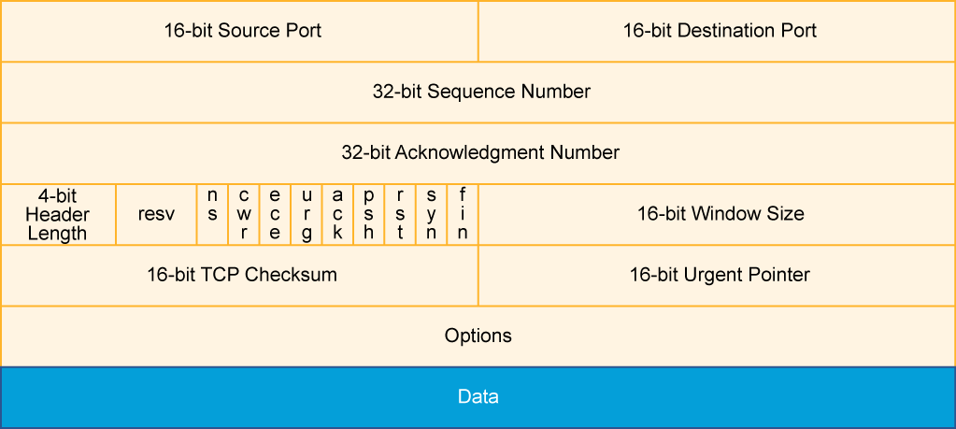
26
26

Slide 27
Source port: Number of the calling port (16 bits)
Destination port: Number of the called port (16 bits)
Sequence number: The sequence number of the first data octet in this segment, used to ensure correct sequencing of the arriving data (32 bits)
Acknowledgment number: Next expected TCP octet (32 bits). A TCP connection is a reliable connection. The sending and receiving computers use acknowledgment to ensure that the data is sent and received as specified and that it arrives without errors and in the right order.
Header length: Number of 32-bit words in the header (4 bits)
Reserved: Set to 0 (6 bits)
27
27

Slide 28
Control bits: Contains nine 1-bit field which is often referred to as a flag. Six of the flags are:
URG: Indicates that the Urgent pointer field is significant.
ACK: Indicates that the Acknowledgment field is significant. All packets, after the initial SYN packet, that are sent by the client should have this flag set.
PSH: Push function. Asks to push the buffered data to the receiving application.
RST: Reset the connection.
SYN: Initiates a connection. Only the first packet that is sent from each end should have this flag set.
FIN: No more data from sender.
Window: Number of octets that the device is willing to accept (16 bits). Windowing allows the sending computer to send out several packets without waiting to receive acknowledgment of those packets, which helps maintain the speed and reliability of the connection.
Checksum: Calculated checksum of the header and data fields (16 bits)
Data: Upper-layer protocol data (varies in size)
28
28

Slide 29
TCP delivers these applications, among others:
HTTP: HTTP is used by browsers to request web pages and by web servers to transmit the requested web page and web page components.
HTTPS: HTTPS is a variant of HTTP that uses SSL or TLS to add a layer of security to data in transit.
FTP: FTP is a full-featured application that is used for copying files by running a client application on one computer to contact the FTP server application on a remote computer. Files can be uploaded or downloaded using this application.
29
29

Slide 30
Telnet: Telnet allows for an emulated terminal session to a remote device, often a UNIX host, router, or other network device. With an emulated terminal session, you can manage a network device as if you had a directly connected serial terminal. Telnet is useful only with systems that use character mode command syntax. Telnet is also a concern when in a secure environment as it sends its message in unencrypted cleartext, instead most organizations now use SSH for remote communications.
SSH: SSH provides a secure way to access a remote computer. It provides secure encrypted data communications and strong authentication. SSH is widely used for managing systems and applications remotely.
SMTP: SMTP is used by e-mail servers to exchange e-mail messages and by e-mail clients to send messages to an e-mail server. It works with POP3 and IMAP4 to enable e-mail clients to retrieve and store e-mail messages.
30
30

Slide 31
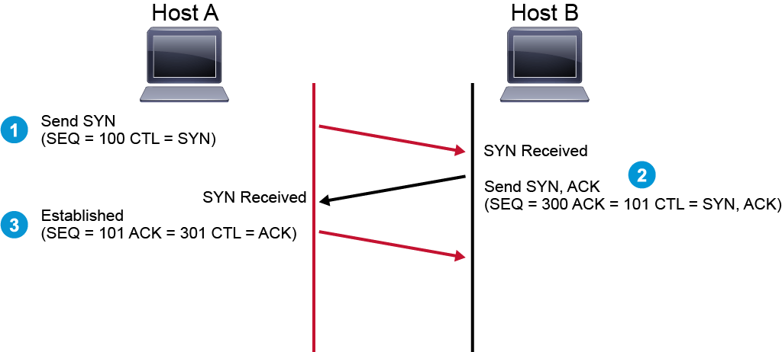
Three-Way Handshake
31
31

Slide 32
Step | Action | Notes
1 | The initiating device sends a TCP SYN (a TCP segment with the SYN bit set) to the receiving device, starting the handshake process by presenting its initial sequence number. | Host A is telling Host B: "Hey, I'd like to start a connection. My initial sequence number is 100."
2 | The receiving device responds with a TCP SYN/ACK (a TCP segment with the SYN and ACK bits set) acknowledging the peer's initial sequence number and presenting its own initial sequence number. | Host B is telling Host A: "I'm accepting your connection request. My initial sequence number is 300. I'm acknowledging your initial sequence number of 100. The next byte of data I expect to receive from you is byte number 101."
3 | The initiating device responds with a TCP ACK (TCP segment with the ACK bit set), acknowledging the initial sequence number of the receiving device. | Host A is telling Host B: "Great. I'm acknowledging your initial sequence number of 300. The next byte of data that I expect from you is byte number 301. The hosts are now ready for two-way data exchange."
32
32

Slide 33
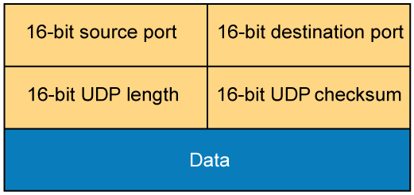
User Datagram Protocol
33
33

Slide 34
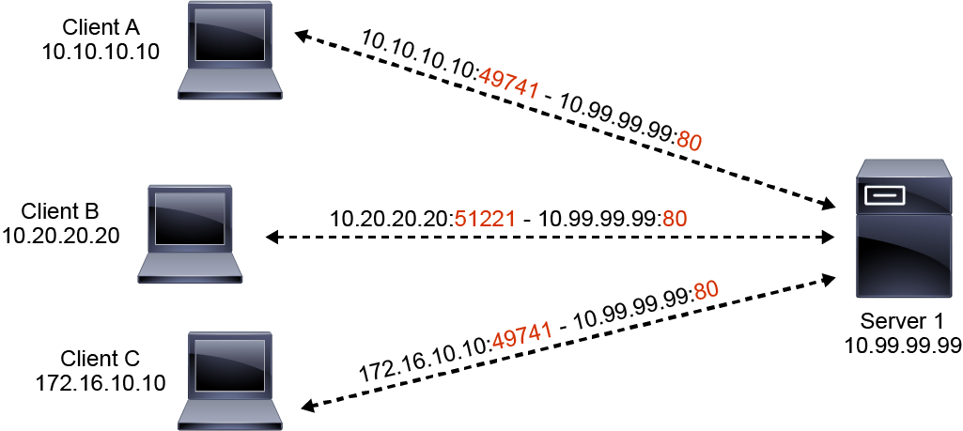
Source port: Number of the calling port (16 bits)
Destination port: Number of the called port (16 bits)
Length: Length of UDP header and UDP data (16 bits)
Checksum: Calculated checksum of the header and data fields (16 bits)
34
34

Slide 35
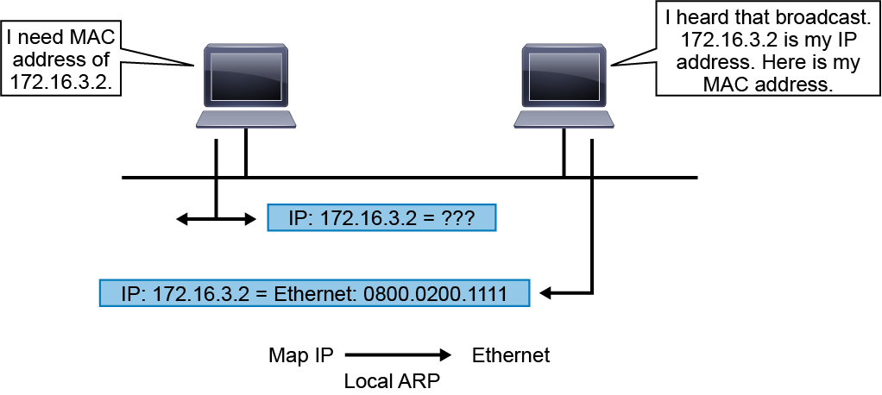
Address Resolution Protocol
The MAC address is the unique identifier of the device. It is usually embedded in the hardware during manufacturing. The MAC address is also referred to as the hardware address or the physical address. The address is 48 bits long and is usually represented using hexadecimal notation. Groups of digits are commonly separated with colons, dashes, or periods. The following three example notations are common and equivalent: 54:EE:75:B1:6F:22, 54-EE-75-B1-6F-22, and 54EE.75B1.6F22.
35
35

Slide 36
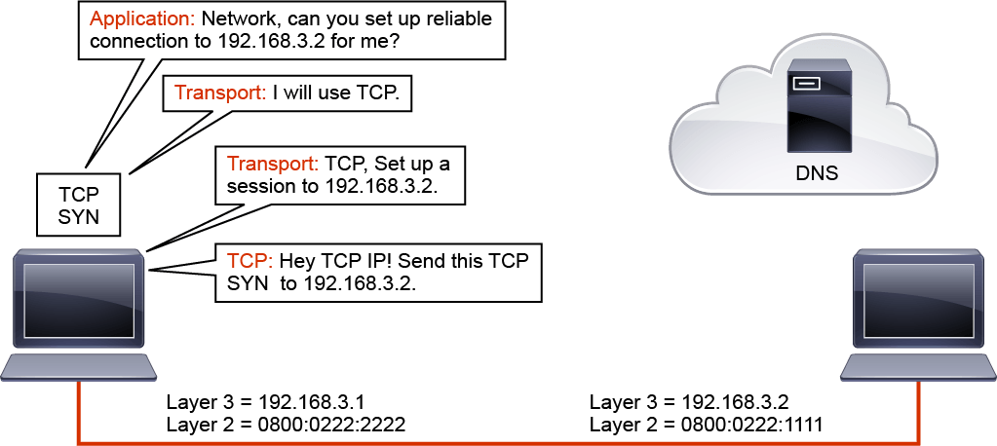
Host-to-Host Packet Delivery
36
36

Slide 37
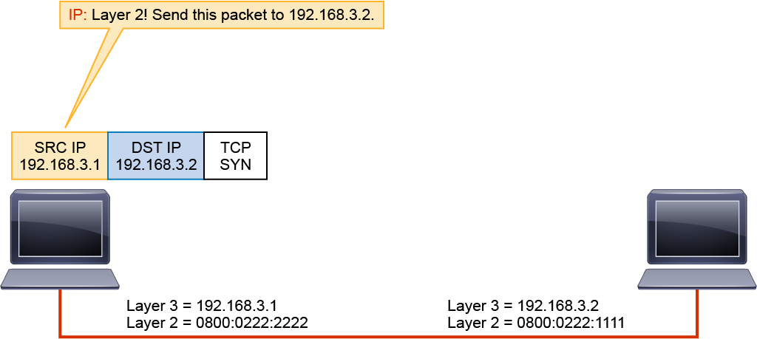
37
37

Slide 38
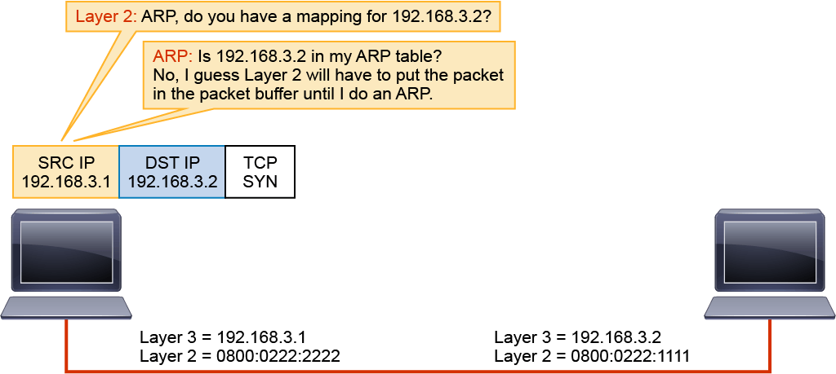
38
38

Slide 39
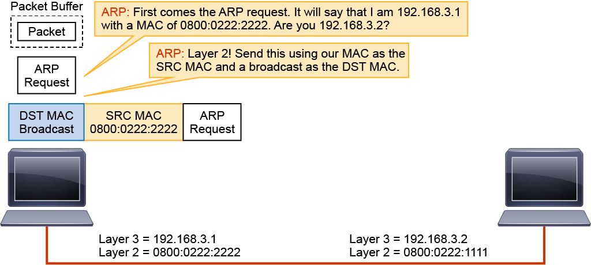
39
39

Slide 40
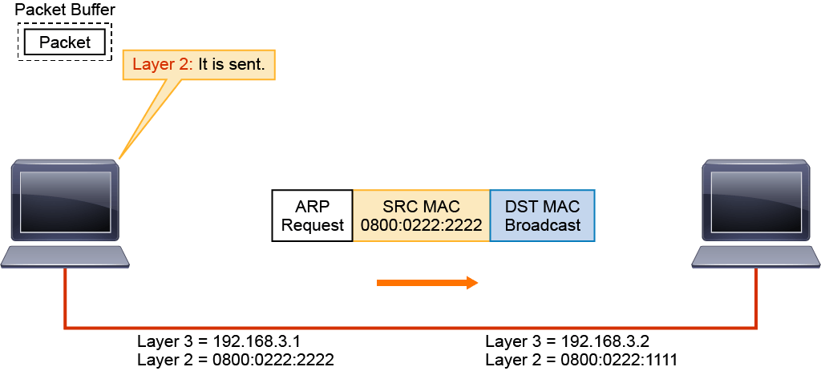
40
40

Slide 41
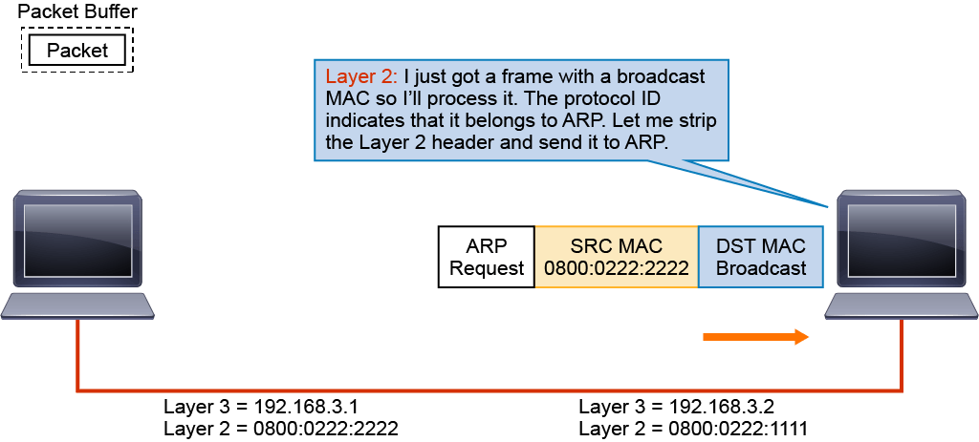
41
41

Slide 42
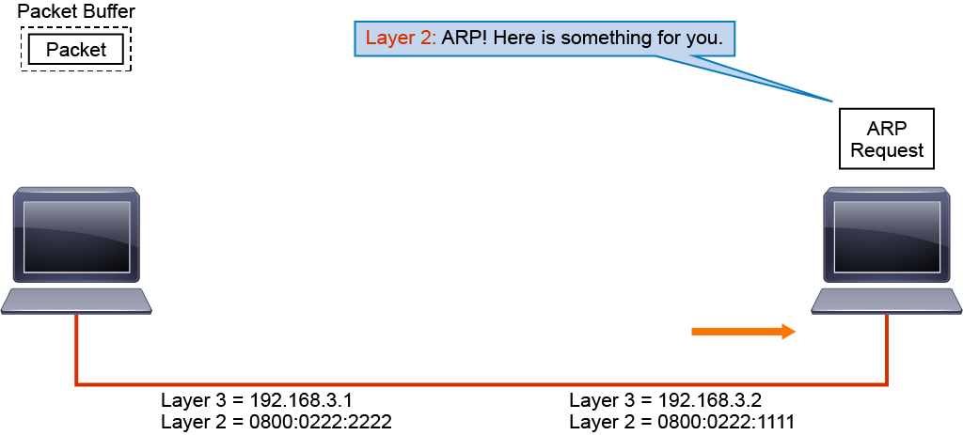
42
42

Slide 43
43
43

Slide 44
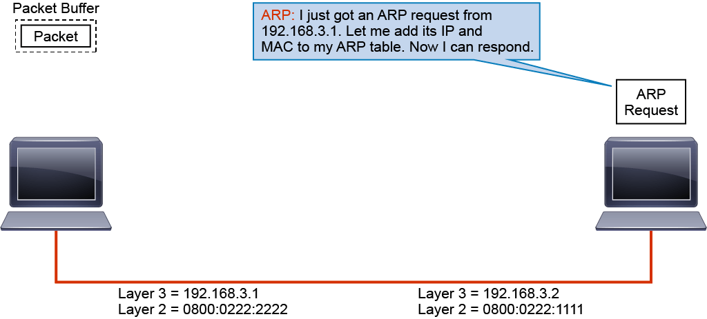
44
44

Slide 45
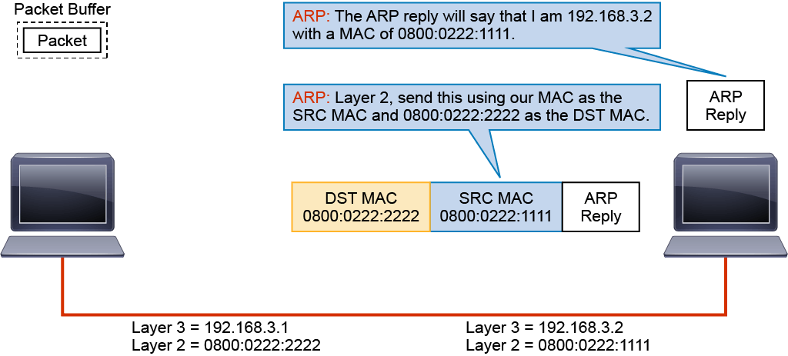
45
45

Slide 46
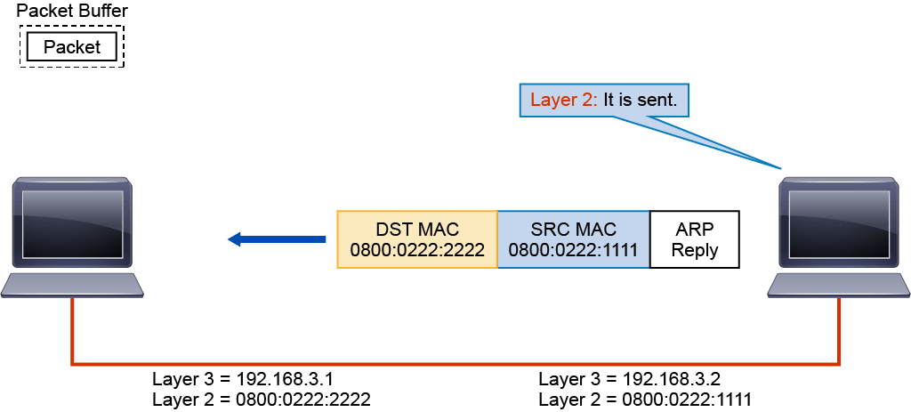
46
46

Slide 47
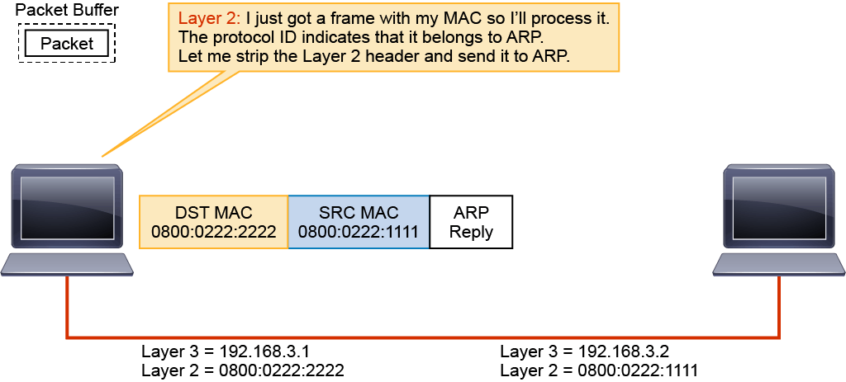
47
47

Slide 48
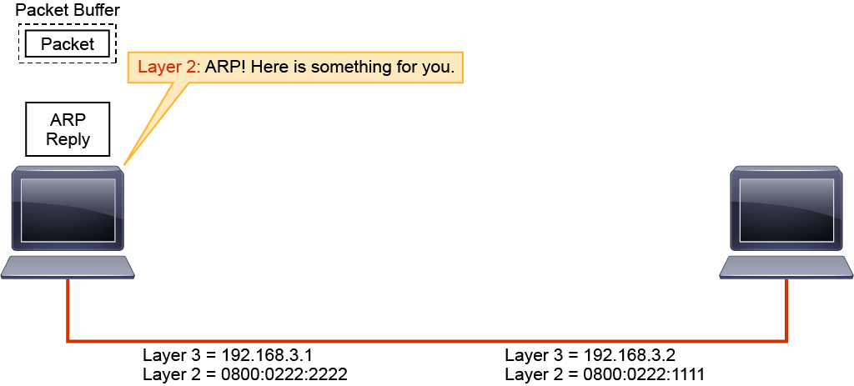
48
48

Slide 49
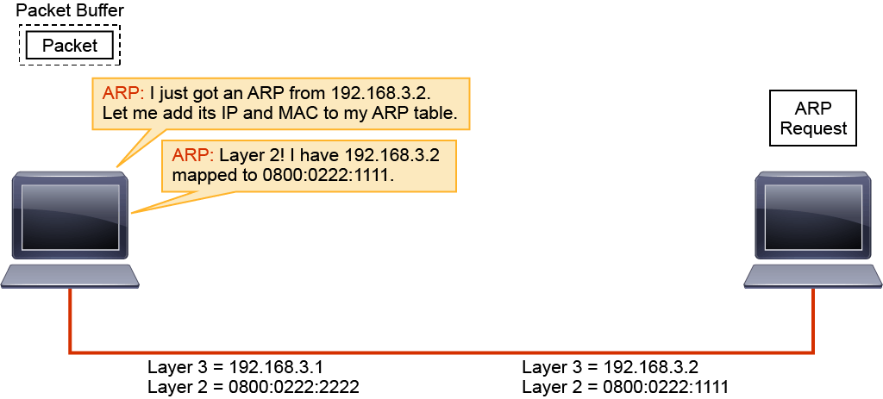
49
49

Slide 50
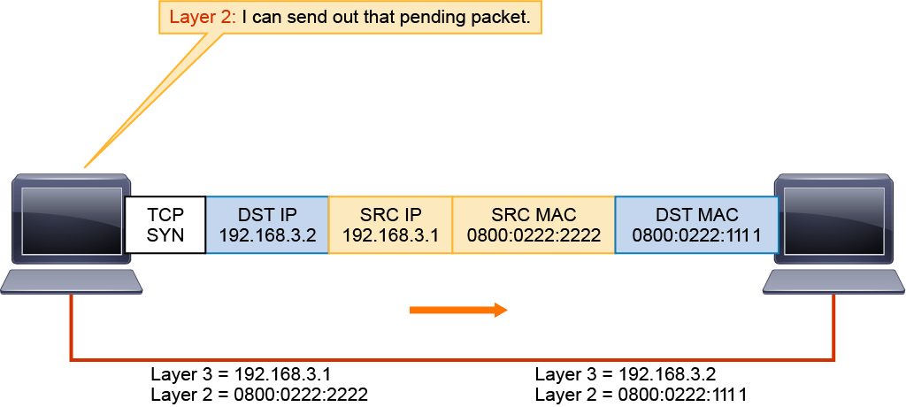
50
50

Slide 51
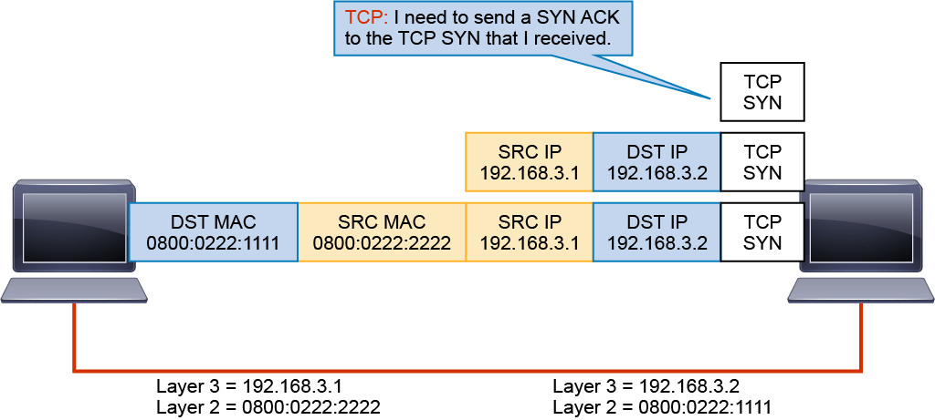
51
51

Slide 52
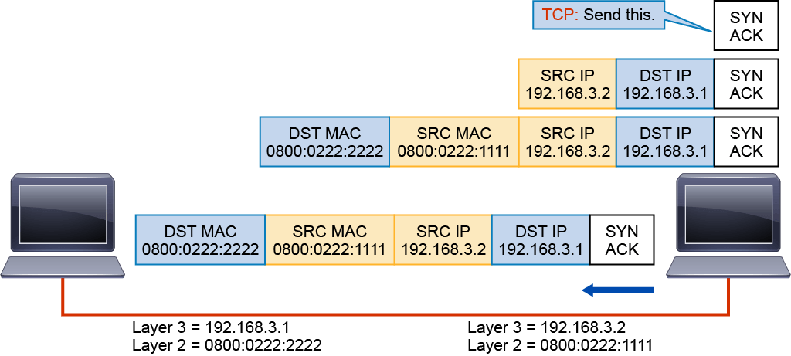
52
52

Slide 53
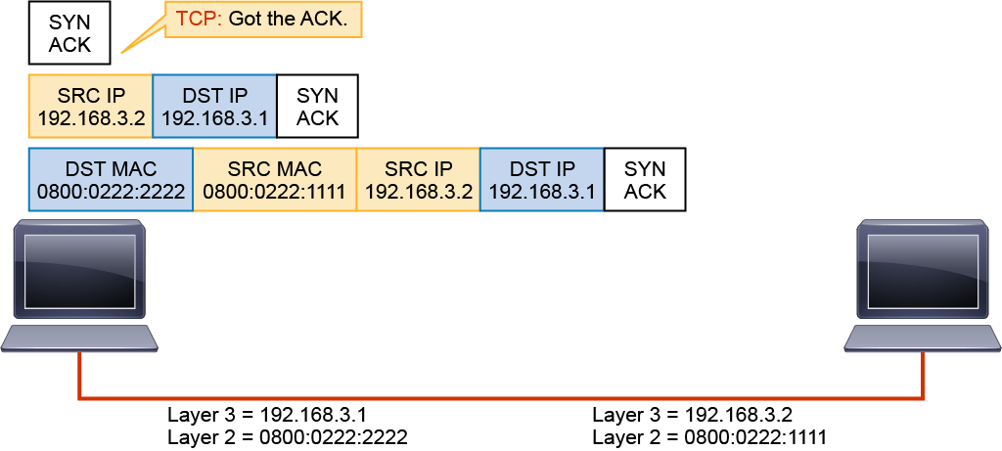
53
53

Slide 54
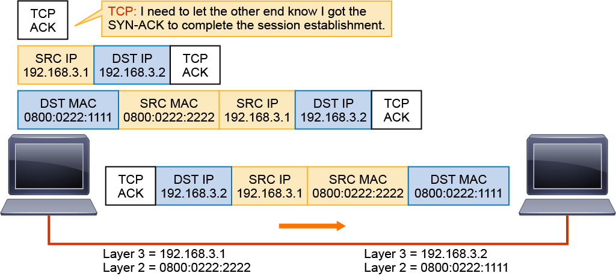
54
54

Slide 55
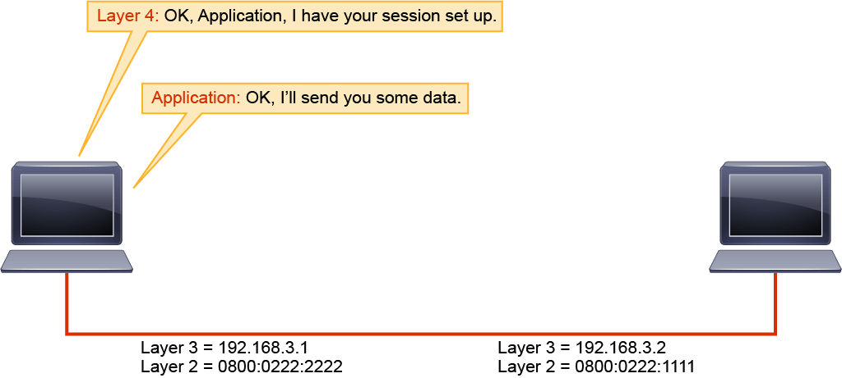
55
55

Slide 56
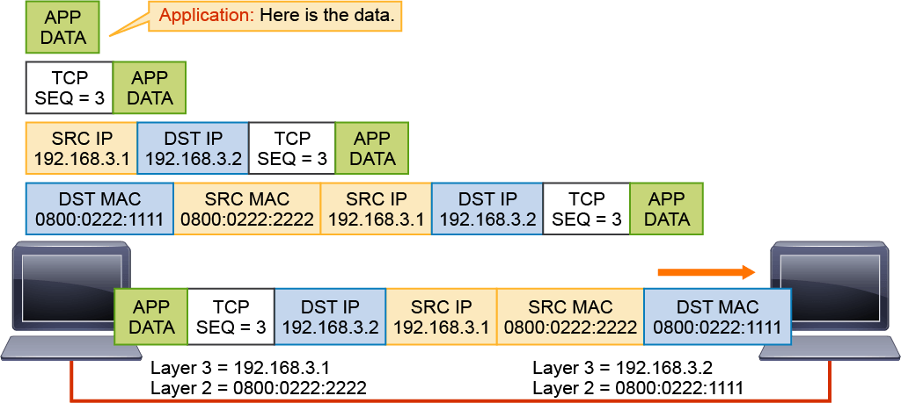
56
56

Slide 57
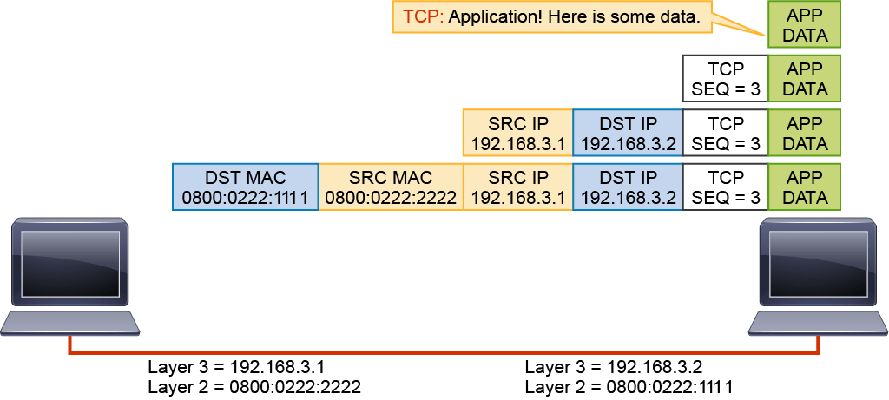
57
57

Slide 58
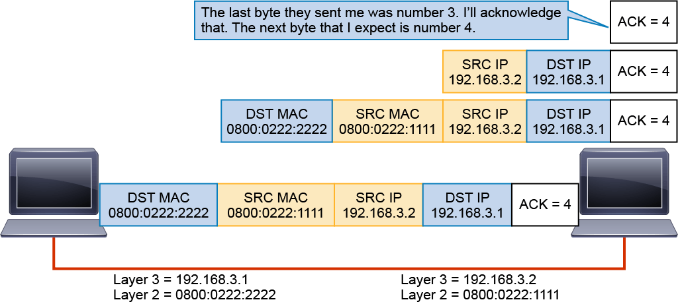
58
58

Slide 59
Dynamic Host Configuration Protocol
Four messages are exchanged during the process:
The client sends a DHCPDISCOVER message.
The server sends a DHCPOFFER message containing IP address and other IP configuration information.
The client sends a DHCPREQUEST, which is an acknowledgement of the server's offer.
The process ends with the server sending a DHCPACK, confirming the reservation for the client.
59
59

Slide 60
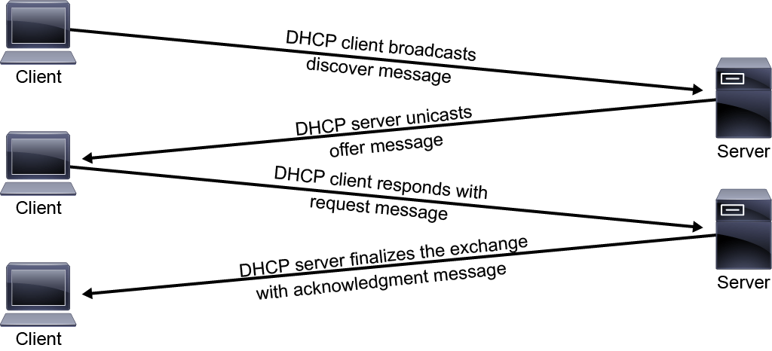
60
60

Slide 61
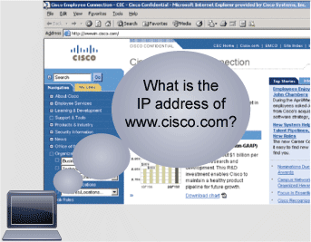
Domain Name System
DNS is a globally distributed dynamic database that is used to translate names to IP addresses. DNS frees the users of IP networks from the burden of needing to remember the IP addresses. Without this freedom, the World Wide Web would not be as popular or as usable as it has become.
61
61

Slide 62
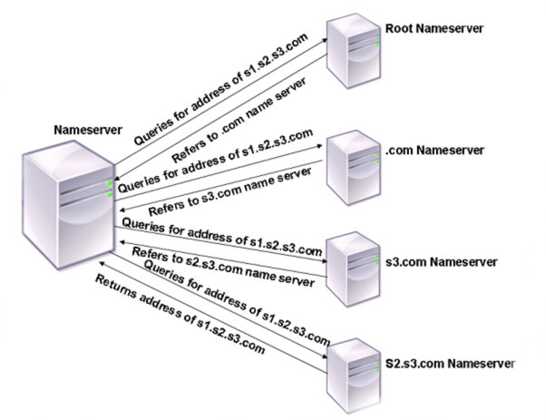
62
62

Slide 63
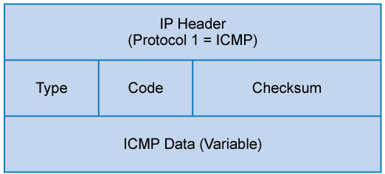
Internet Control Message Protocol
ICMP is used to report errors and other information regarding IP packet processing back to the source. ICMP, which is documented in RFC 792, is best known for its use by the "ping" and "traceroute" programs on IP-enabled hosts, or devices. The ping utility sends ICMP echo request packets out to a destination host to test the IP connectivity to that destination host. Receiving an ICMP echo reply message indicates that the host can be successfully reached.
63
63

Slide 64
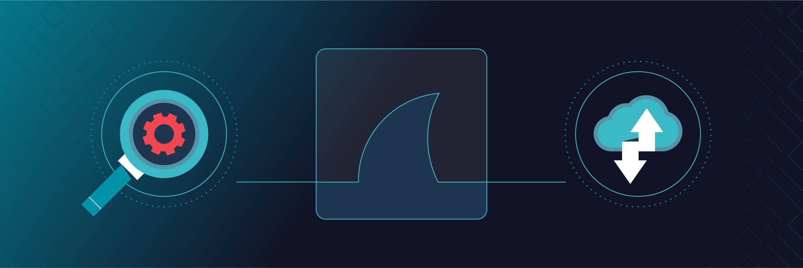

64
64

