Slide 1
PLINQ
.NET 4.0

Slide 2
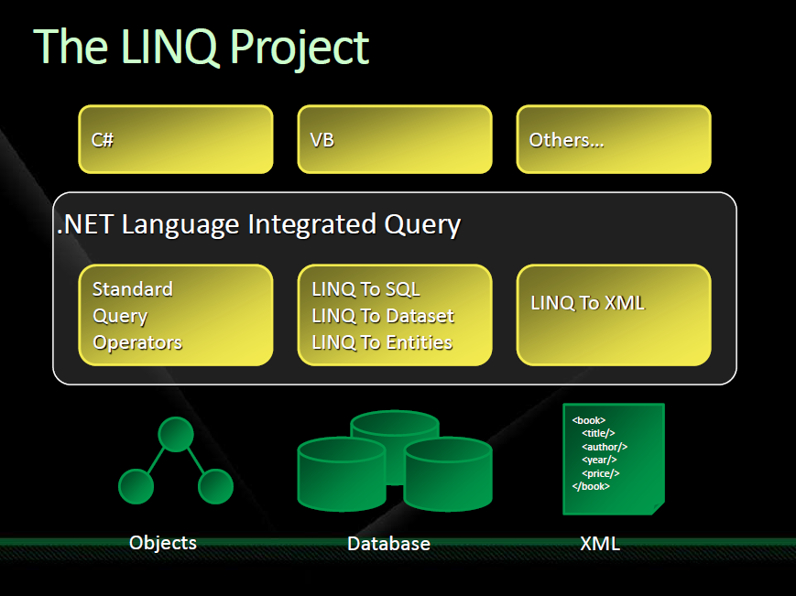

Slide 3
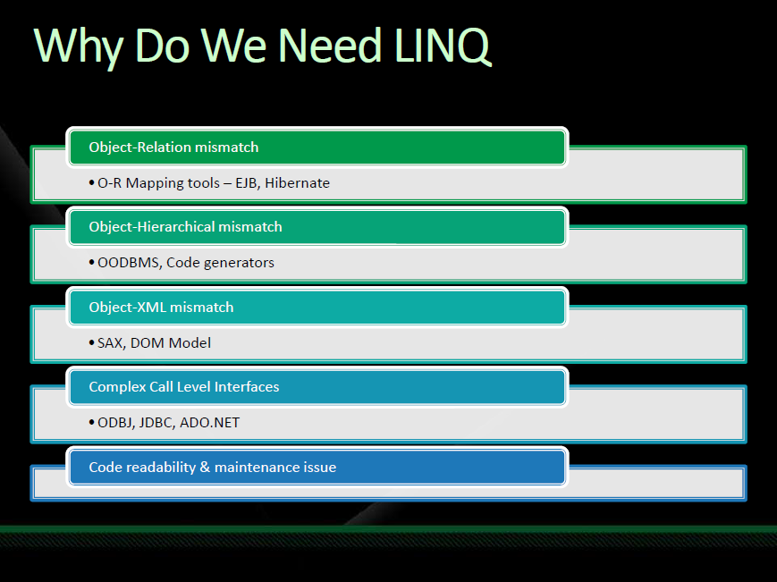

Slide 4
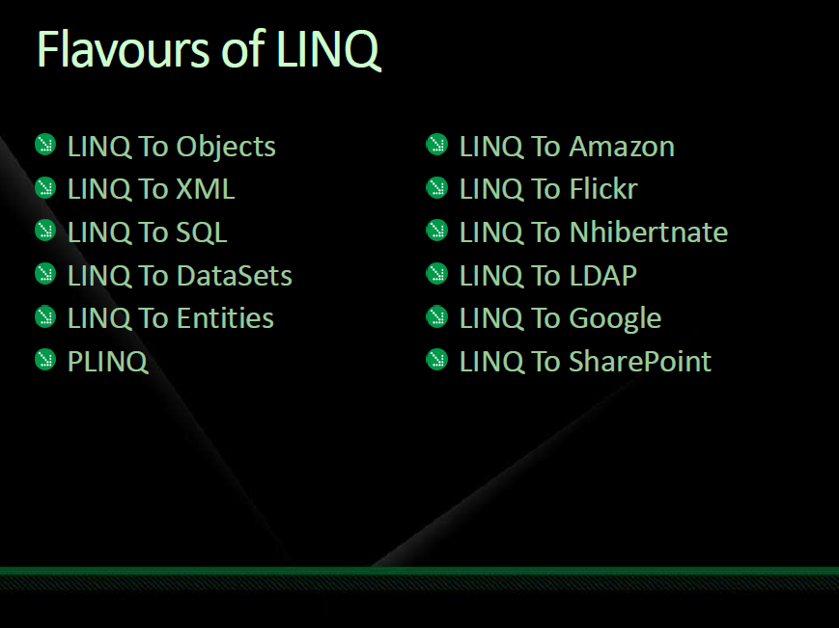

Slide 5
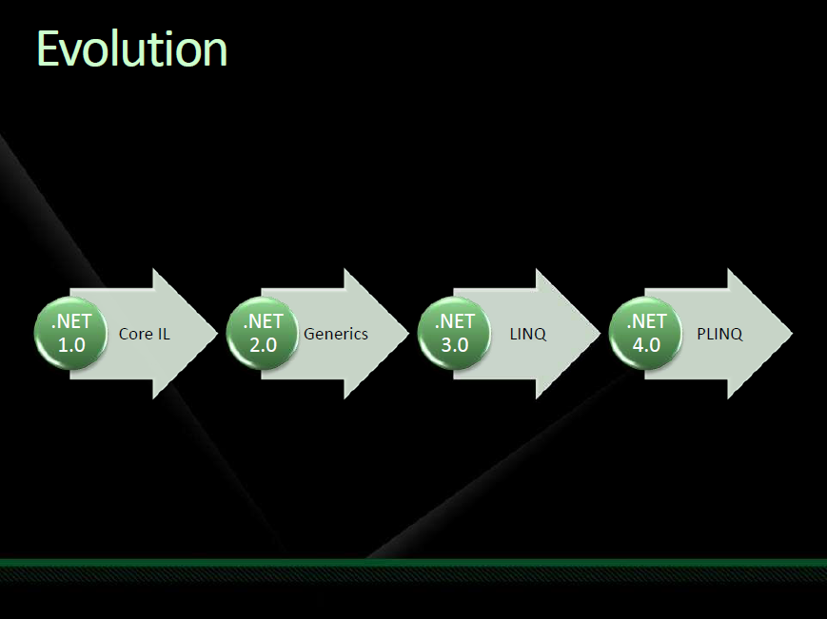

Slide 6
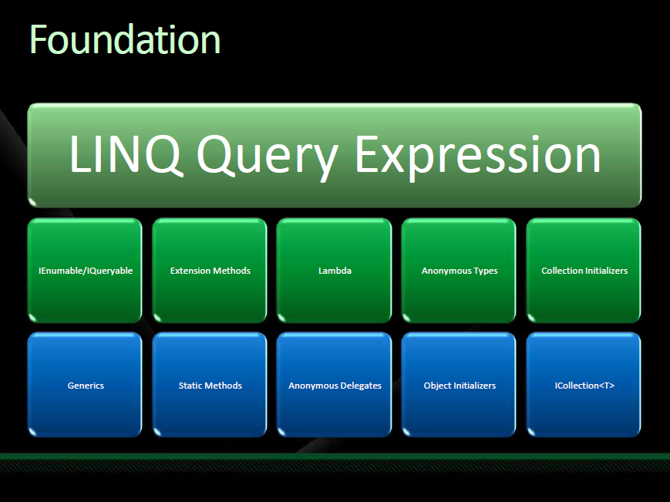

Slide 7
PLINQ
PLINQ is a technology that allows developers to easily leverage many core.
The great thing about PLINQ is that if using LINQ-to-objects, there is a very minimal impact to the code in order for it to use PLINQ.

Slide 8
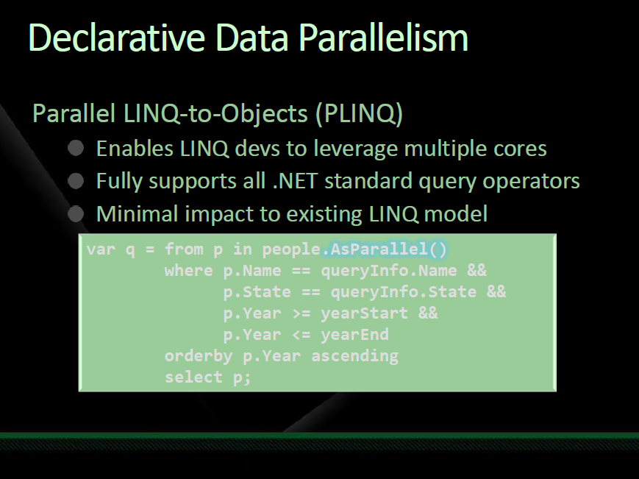

Slide 9
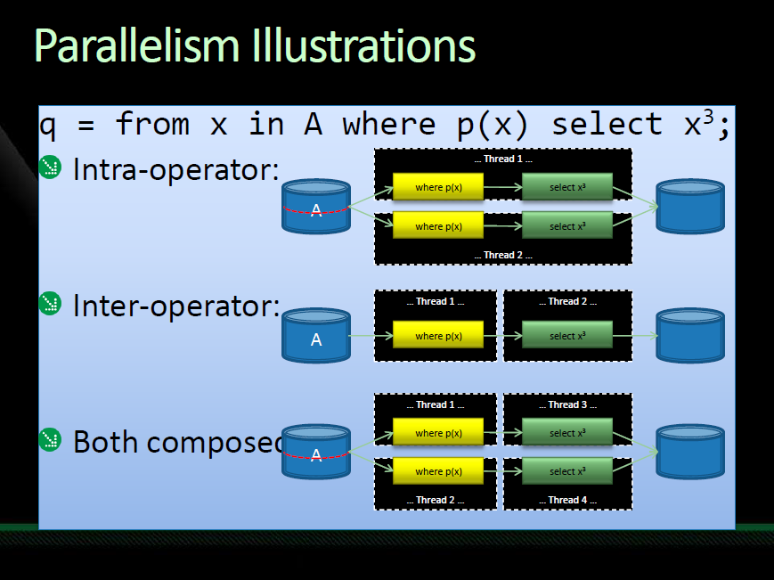

Slide 10
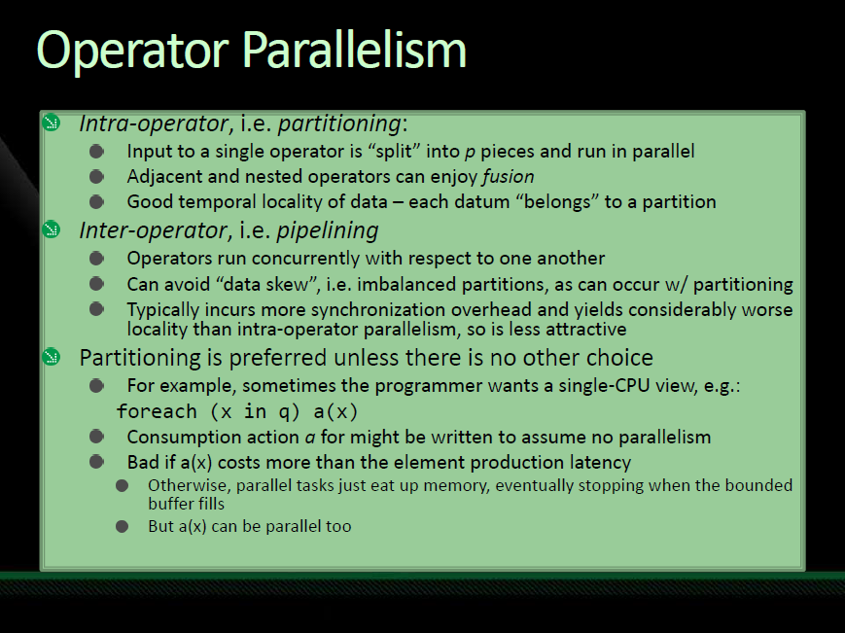

Slide 11
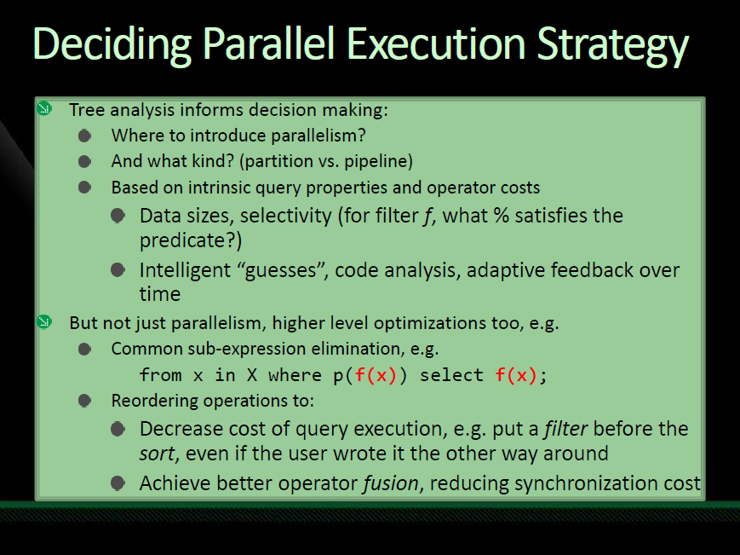

Slide 12
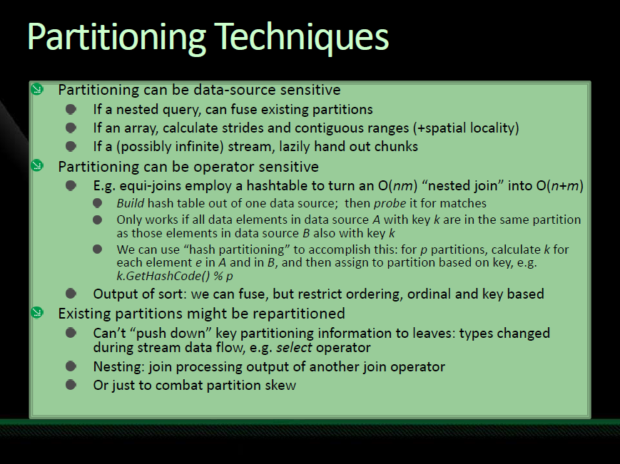

Slide 13
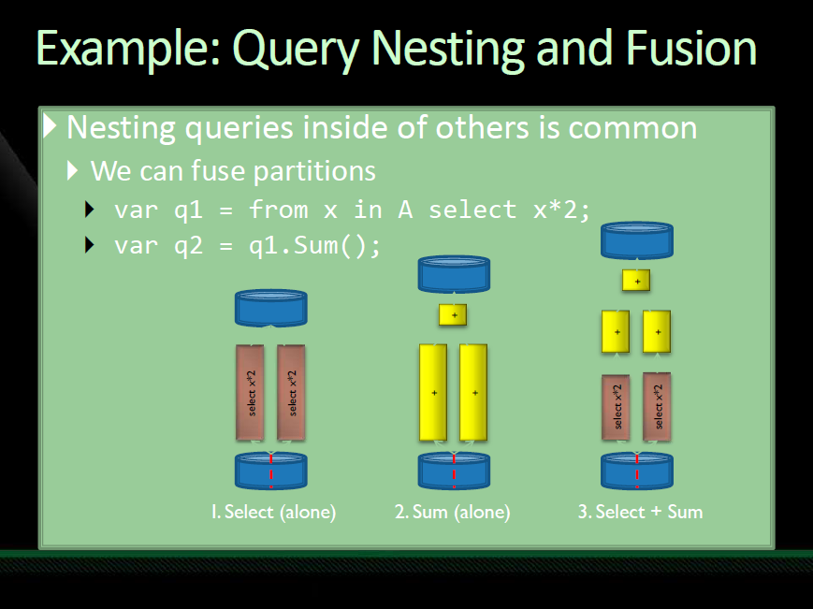

Slide 14
AsParallel()
All it takes to use PLINQ is adding “.AsParallel()” to the query.
This will turn the query into a PLINQ query and will use the PLINQ execution engine when executed.

Slide 15
AsParallel()
AsParallel() works by returning an IParallelEnumerable so every subsequent query operator works against the new IParallelEnumerable rather than the normal IEnumerable.

Slide 16
ASOrdered()
Enables treatment of a data source as if it was ordered, overriding the default of unordered.
AsOrdered may only be invoked on sequences returned by AsParallel(), ParallelEnumerable.Range(), and ParallelEnumerable.Repeat().

Slide 17
Thank You

