Slide 1
ASP.NET MVC

Slide 2
ASP.NET MVC Execution Process

Slide 3
ASP.NET Pipe Line
Request
HTTP Routing
Route
Route Handler
Http Handler
Controller
View Engine
View
Response

Slide 4
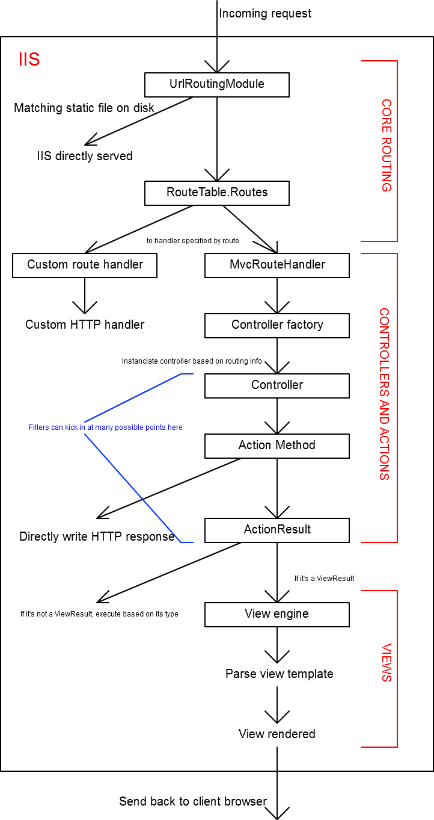
ASP.NET Pipe Line

Slide 5
UrlRoutingModule
Requests to an ASP.NET MVC-based Web application first pass through the UrlRoutingModule object, which is an HTTP module.
This module parses the request and performs route selection.

Slide 6
UrlRoutingModule
The UrlRoutingModule object selects the first route object that matches the current request. (A route object is a class that implements RouteBase, and is typically an instance of the Route class.)
If no routes match, the UrlRoutingModule object does nothing and lets the request fall back to the regular ASP.NET or IIS request processing.

Slide 7
MvcHandler
From the selected Route object, the UrlRoutingModule object obtains the IRouteHandler object that is associated with the Route object.- MvcRouteHandler
The IRouteHandler instance creates an IHttpHandler (MvcHandler ) object and passes it the IHttpContext object.
The MvcHandler object then selects the controller that will ultimately handle the request.

Slide 8
Note:
When an ASP.NET MVC Web application runs in IIS 7.0, no file name extension is required for MVC projects.
However, in IIS 6.0, the handler requires that you map the .mvc file name extension to the ASP.NET ISAPI DLL.

Slide 9
The module and handler are the entry points to the ASP.NET MVC framework. They perform the following actions:
Select the appropriate controller in an MVC Web application.
Obtain a specific controller instance.
Call the controller’s Execute method.

Slide 10
Stages of Execution
Stage | Details
Receive first request for the application | In the Global.asax file, Route objects are added to the RouteTable object.
Perform routing | The UrlRoutingModule module uses the first matching Route object in the RouteTable collection to create the RouteData object, which it then uses to create a RequestContext (IHttpContext) object.
Create MVC request handler | The MvcRouteHandler object creates an instance of the MvcHandler class and passes it the RequestContext instance.

Slide 11
Create controller | The MvcHandler object uses the RequestContext instance to identify the IControllerFactory object (typically an instance of the DefaultControllerFactory class) to create the controller instance with.
Execute controller | The MvcHandler instance calls the controller s Execute method.
Invoke action | Most controllers inherit from the Controller base class. For controllers that do so, the ControllerActionInvoker object that is associated with the controller determines which action method of the controller class to call, and then calls that method.

Slide 12
Execute result
A typical action method might receive user input, prepare the appropriate response data, and then execute the result by returning a result type. The built-in result types that can be executed include the following: ViewResult (which renders a view and is the most-often used result type), RedirectToRouteResult, RedirectResult, ContentResult, JsonResult, and EmptyResult.

