Slide 1

Writing an ASP.NET MVC View Engine
DEV345
Louis DeJardin
Principal SDE
Microsoft

Slide 2
This is a great extensibility point
You can implement a new HTML DSL
Existing libraries can become good view engines
Built-in and Custom ViewEngines can coexist
You can take control of rendering
Most ActionResults are View or PartialView
All Html.Partial calls pass through IViewEngine
You can expose APIs as views
@Html.Partial(“AdBlock”, new {Zone=“Banner”})

Slide 3
That said…
This is an advanced topic
Assumes familiarity with most MVC concepts
The nuts and bolts can be boring detailed
Several stable, production-ready options exist
This is rarely the simplest approach

Slide 4
Where does this fit in?
MVC
Controller builds Model
Model passed to View
The IViewEngine renders the View
Well known view engines
WebForms (.aspx, .ascx)
Razor (.cshtml, .vbhtml)
Third-party (Spark, NHaml, NVelocity, etc.)

Slide 5
The entire API: on one slide
ViewEngines.Engines
Add
IViewEngine
FindPartialView
FindView
ReleaseView
IView
Render

Slide 6
A “Claymore” View Engine
What’s the least you need to output html?
demo

Slide 7
Working well with others
Good news: it’s easy to do right
Returning searchedLocations is vital
The order of ViewEngine.Engines is significant
Pay attention to useCache!

Slide 8
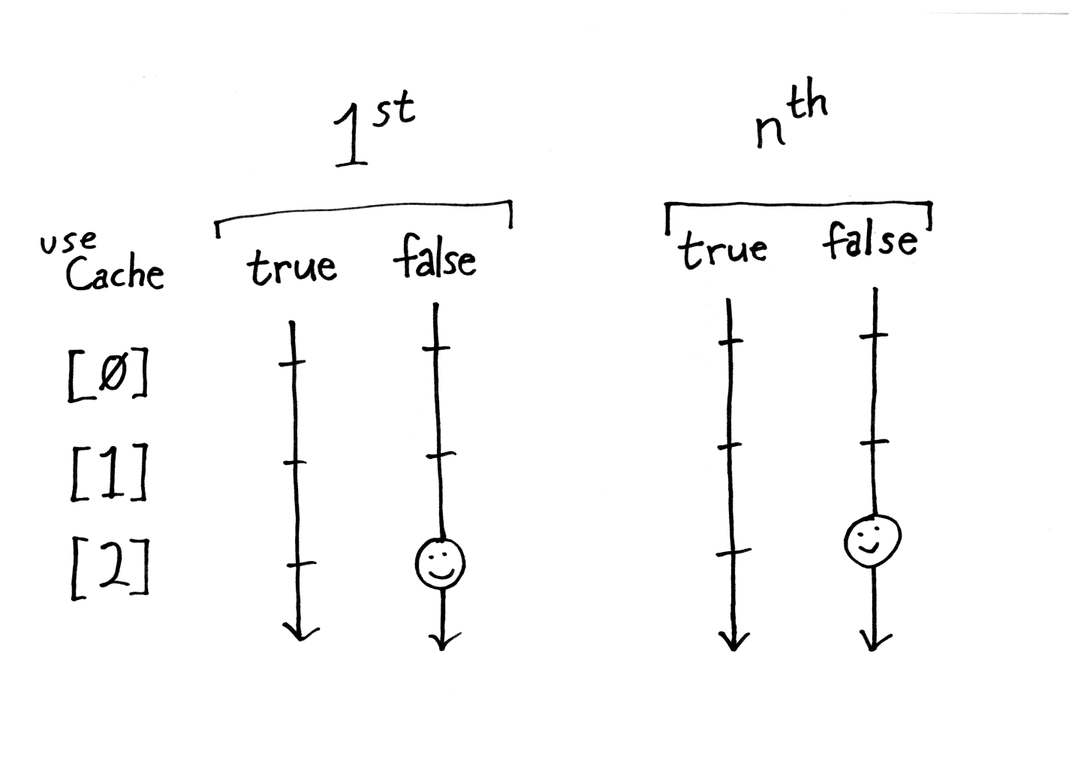
Return IView when useCache==false

Slide 9
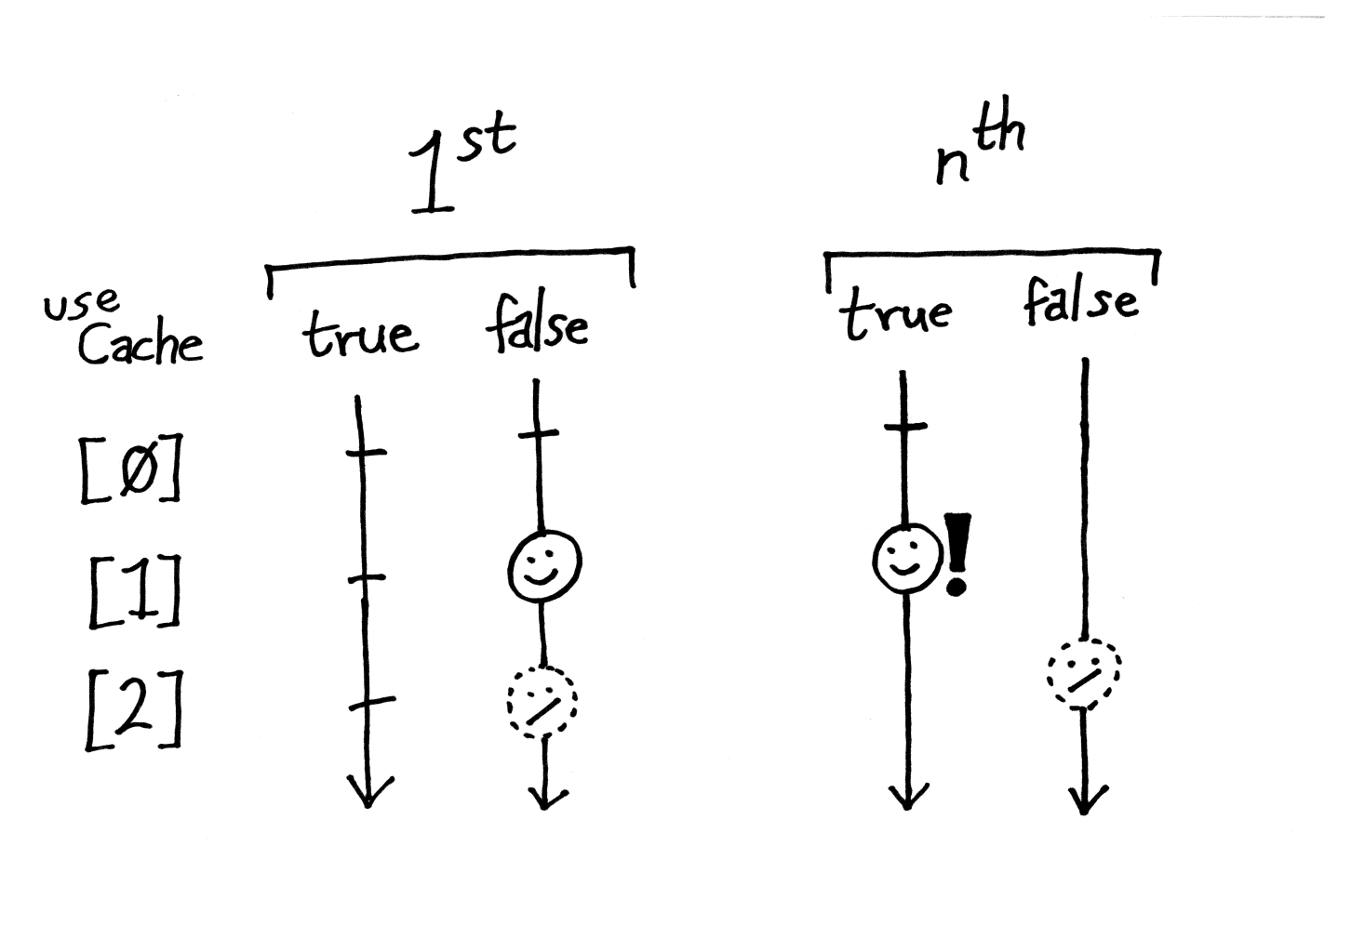
Hit useCache==true only on 2^{nd+} calls

Slide 10
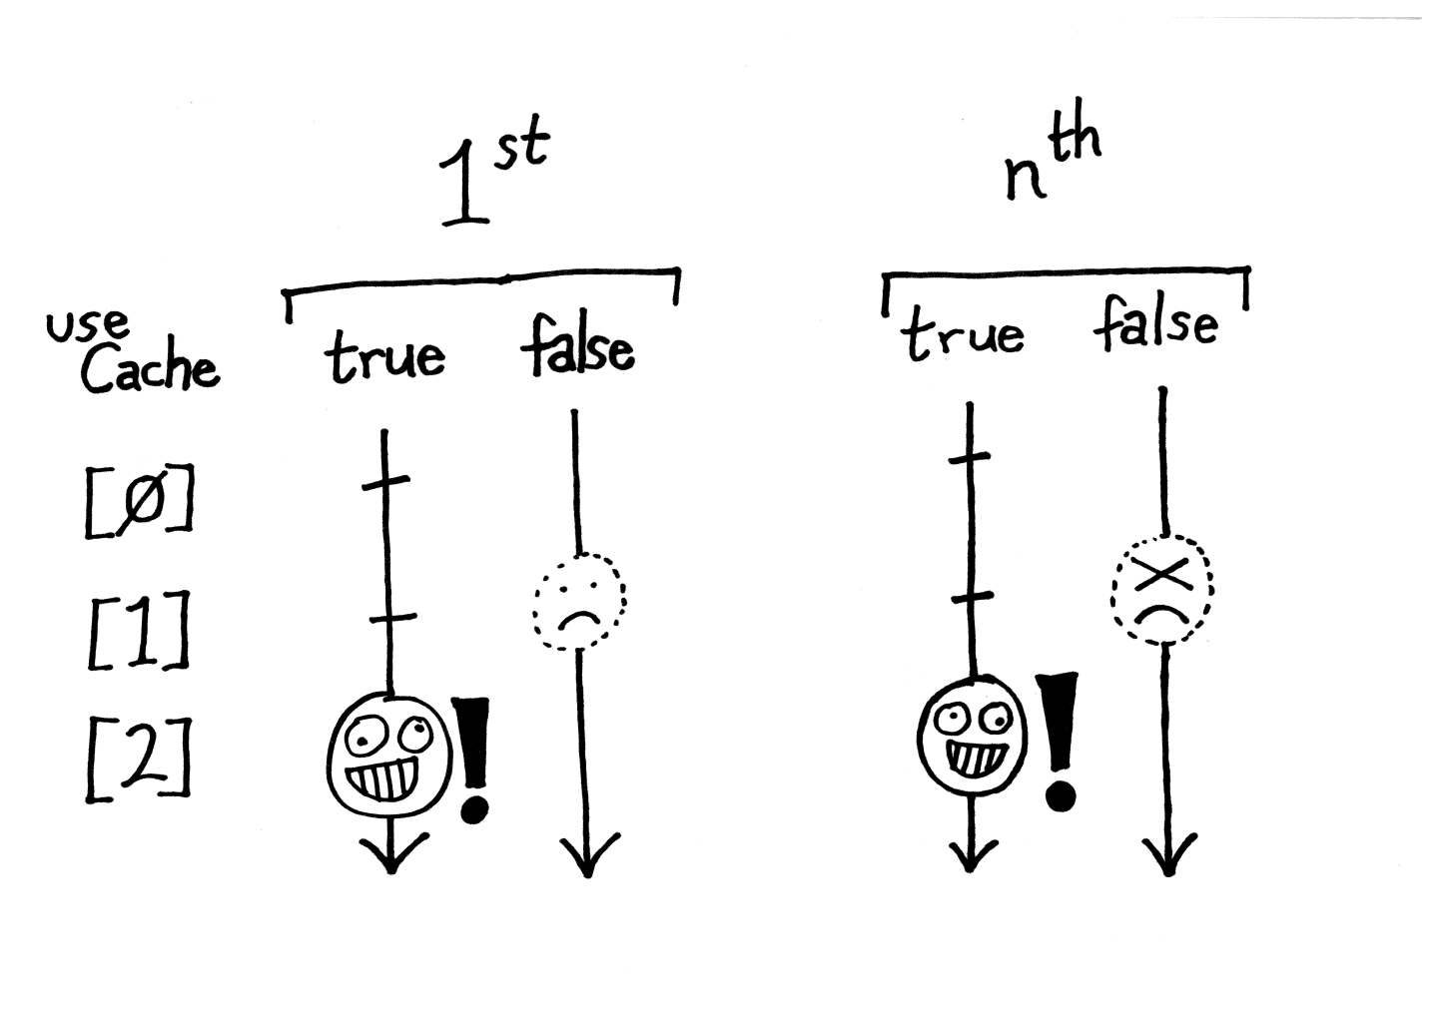
Never jump the gun

Slide 11
Following the rules
What do you need to follow the rules?
demo

Slide 12
What View Engines typically do
Typically based on template files
Most have a mix of literal HTML and code
Some have interpreted code
Others use actual C# compiler
Some have an inspired approach to “Literal HTML”

Slide 13
Getting views from files
Rendering markdown from .md files
demo

Slide 14
Things you’ll want on your IView base
Context and ViewData
ViewDataDictionary
ViewContext and friends
Support for Helpers is great
HtmlHelper Html
UrlHelper Url
AjaxHelper Ajax
Output methods
Write and WriteLiteral
Auto-Encoding is a Very Good Idea

Slide 15
Bulking out the base View class
demo

Slide 16
Code: bringing templates to life
Need something to control output
Output expressions
Conditional code, loops, etc.
Many different approaches are taken
CLR languages via CodeDom or BuildProvider
Other syntaxes, compiled or interpreted
This is often the key differentiator

Slide 17
Parsing, generating and compiling
demo

Slide 18
What have we done?
Create a new View Engine
Took care of searchedLocations and useCache
Avoiding common problems
Provided an factory _cache
Instantiated from templates from files
Turned an existing template library into a view engine
Parsed and compiled template files

Slide 19
Web Track Resources
http://www.asp.net/
http://www.silverlight.net/
http://www.microsoft.com/web/gallery/
http://www.iis.net/
http://weblogs.asp.net/Scottgu/
http://www.hanselman.com/blog/

Slide 20





Resources
Connect. Share. Discuss.
http://northamerica.msteched.com
Learning
Sessions On-Demand & Community
Microsoft Certification & Training Resources
www.microsoft.com/teched
www.microsoft.com/learning
Resources for IT Professionals
Resources for Developers
http://microsoft.com/technet
http://microsoft.com/msdn

Slide 21

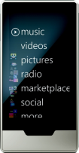
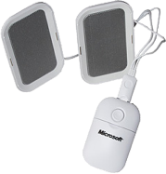


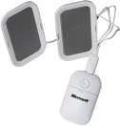






Complete an evaluation on CommNet and enter to win!

Slide 22


