Slide 1
GC
.Net

Slide 2
Garbage Collection
Garbage collection makes memory management easier for programmers by automatically reclaiming unused memory
The garbage collector in the CLR makes trade-offs to assure reasonable performance for a wide variety of situations.

Slide 3
Types Of Garbage Collections
C++ gc
Deterministic Collection
Dot Net / Java gc
Non Deterministic Collection

Slide 4
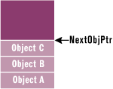
c1
b1
a1

Slide 5
MyClass A=new MyClass();
A.b1 = new Object();
MyClass C=new MyClass();
MyClass D=new MyClass();
MyClass E=new MyClass();
MyClass F=new MyClass();
MyClass G=new MyClass();
F.h1=new Object();
MyClass I=new MyClass();
MyClass J=new MyClass();
Heap
Next Obj Ptr
J
Object J
I
Object I
Object H
G
Object G
Object F
F
h1
E
Object E
D
Object D
Gen 0
C
Object C
Object B
A
Object A
b1

Slide 6
C = null;
D = null;
F = null;
I = null;
Heap
Next Obj Ptr
J
Object J
Object I
Object H
G
Object G
Object F
E
Object E
Object D
Gen 0
Object C
Object B
A
Object A

Slide 7
GC Algorithm
Create a Map of reachable Objects
Mark and Sweep
Compress and Re-reference

Slide 8
MyClass K = new MyClass();
Heap
Next Obj Ptr
J
Object J
Object I
Step1: Map the reachable Objects
Object H
G
Object G
root
Object F
E
Object E
Object D
Gen 0
A
E
G
J
Object C
Object B
B
A
Object A

Slide 9
Step2: Mark Orphans
Heap
Next Obj Ptr
J
Object J
Object I
Object H
root
G
Object G
Object F
E
Object E
A
E
G
J
Object D
Object C
B
Object B
A
Object A

Slide 10
Step3: Sweep the Orphans
Heap
Next Obj Ptr
J
Object J
G
Object G
E
Object E
Object B
A
Object A

Slide 11
Step4: Compress
Heap
J
G
Next Obj Ptr
E
Object J
Object G
Object E
Object B
A
Object A

Slide 12
Step5: Compress and Re reference
Heap
J
G
Next Obj Ptr
E
Object J
Object G
Object E
G1
Object B
A
Object A

Slide 13
After GC
Heap
Next Obj Ptr
Object O
O
N
Object N
M
Object M
G0
L
Object L
K
Object K
J
Object J
G
Object G
E
Object E
G1
Object B
A
Object A

Slide 14
Scenario 6
After Multiple GC’s
Heap
Next Obj Ptr
O
Object O
G0
Object N
M
Object M
Object L
Object K
G1
Object J
Object G
E
Object E
Object B
Object A

Slide 15
Scenario 6
After Gen 1 GC
Heap
G0
Next Obj Ptr
O
Object O
G1
M
Object M
G2
E
Object E

Slide 16
Heap
Next Obj Ptr
Gen 0
Object J
Gen 1
Object I
Object H
Object G
Object F
Object E
Object D
Gen 2
Object C
Object B
Object A

Slide 17
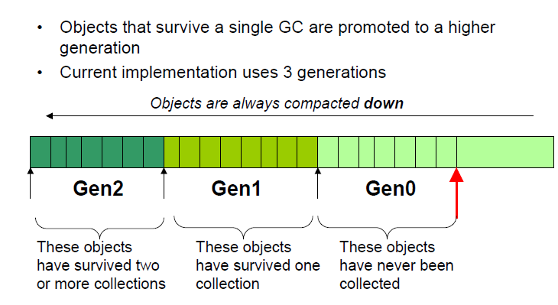
Generations

Slide 18
Finalization
Un Managed Mem
Heap
Next Obj Ptr
Object J
Object I
Object H
Object G
Object F
Object E
Object D
Object C
Object B
Gen 0
Object A

Slide 19
Finalization
Un Managed Mem
Heap
Next Obj Ptr
N3
Object J
Object I
Object H
Object G
N2
Object F
Object E
Object D
Object C
N1
Object B
Gen 0
Object A

Slide 20
Memory Leak
Un Managed Mem
Heap
Next Obj Ptr
N3
Object J
Object H
Object G
N2
Object F
Object D
N1
Object B
Gen 0
Object A

Slide 21
Finalizers
.Net

Slide 22
public class MyClass
{
Object obj;
NativeObject N1; // <<unmanaged object>>
public void DoSomeTask()
{
if(null== N1) { N1=LoadNative(); }
………
}
~MyClass ()
{
N1.Close();
N1=null;
}
}

Slide 23
Finalization
Finalizable Queue
Heap
Next Obj Ptr
Object J
Object I
_I
Object H
_E
Object G
_C
Object F
Object E
Object D
Object C
Gen 0
Object B
Object A

Slide 24
Finalization
Finalizable Queue
Heap
Next Obj Ptr
Object J
Object I
_I
Object H
_E
Object G
_C
Object F
Object E
Object D
Object C
Gen 0
Object B
Object A

Slide 25
Finalization
Finalizable Queue
Heap
Gen 0
_I
Next Obj Ptr
Object I
Free chable Queue
Object G
Object E
Object C
_E
Object B
_C
Object A

Slide 26
Finalization
Finalizable Queue
Heap
_I
Next Obj Ptr
Object I
Free chable Queue
Object G
Object E
Gen 0
Object C
Object B
Object A

Slide 27
Finalization
Finalizable Queue
Heap
Gen 0
_I
Free chable Queue
Object I
Next Obj Ptr
Object G
Object B
Object A

Slide 28
Dispose Pattern
IDispose interface

Slide 29
Finalize and Dispose Guidelines
Call Close or Dispose on classes that support it.
Use the using statement in C# and Try/Finally blocks in Visual Basic .NET to ensure Dispose is called.
Do not implement Finalize unless required.
Implement Finalize only if you hold unmanaged resources across client calls.
Move the Finalization burden to the leaves of object graphs.
If you implement Finalize, implement IDisposable.
If you implement Finalize and Dispose, use the Dispose pattern.
Suppress finalization in your Dispose method
Allow Dispose to be called multiple times.
Call Dispose on base classes and on IDisposable members.
Keep finalizer code simple to prevent blocking

Slide 30
GC Guidelines
Identify and analyze your application’s allocation profile.
Avoid calling GC.Collect.
Consider weak references with cached data.
Prevent the promotion of short-lived objects.
Set unneeded member variables to Null before making long-running calls.
Minimize hidden allocations.
Avoid or minimize complex object graphs.
Avoid preallocating and chunking memory.

