Slide 1
ASP.NET Core

Slide 2
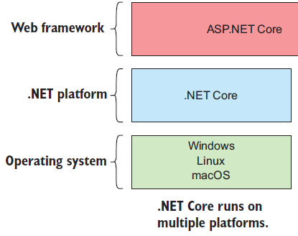

Slide 3
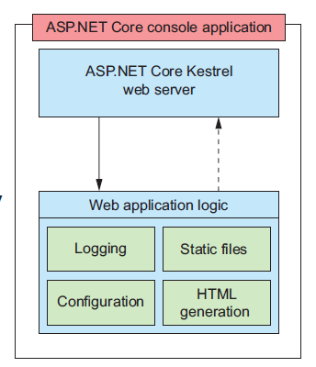

Slide 4
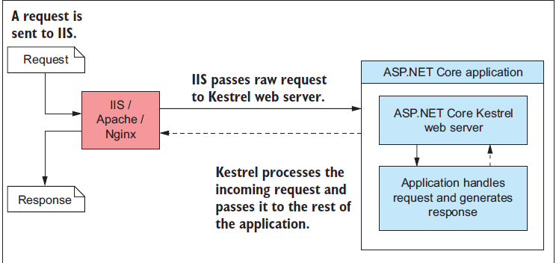

Slide 5
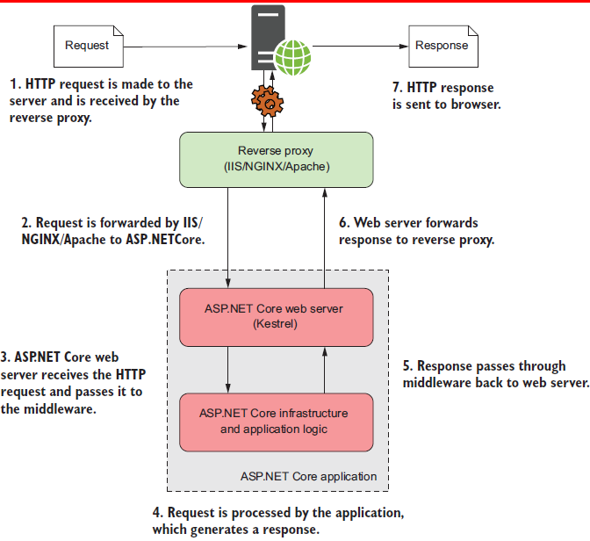

Slide 6
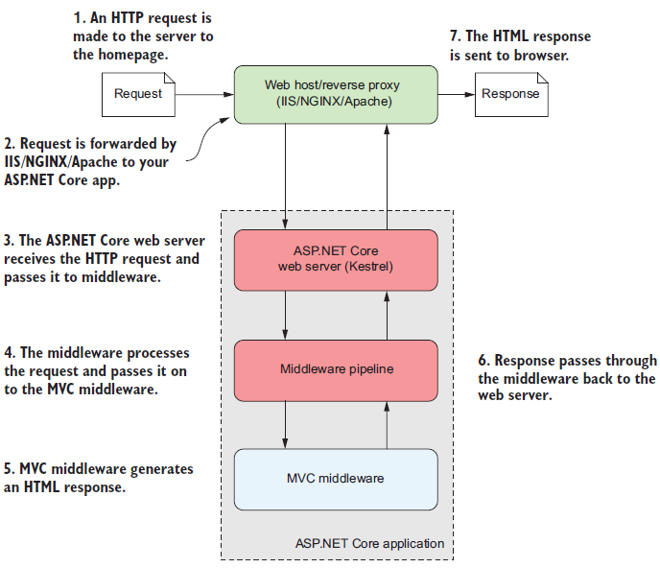

Slide 7
Creating A New Project
ASP.NET Core Empty
#> dotnet new web -o aspemptyapp
ASP.NET Core Web App-Web/MVC/Razor Pages
#> dotnet new webapp -o aspwebapp
ASP.NET Core Web App (MVC)
#> dotnet new mvc -o aspmvcapp
ASP.NET Core WebApi
#> dotnet new webapi -o asp_webapi_app

Slide 8
Build and Run
dotnet restore
Dotnet build
Dotnet run

Slide 9
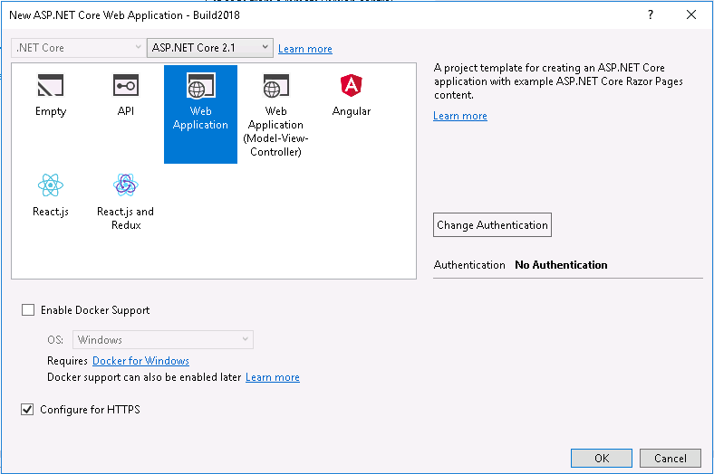
Creating A New Project

Slide 10
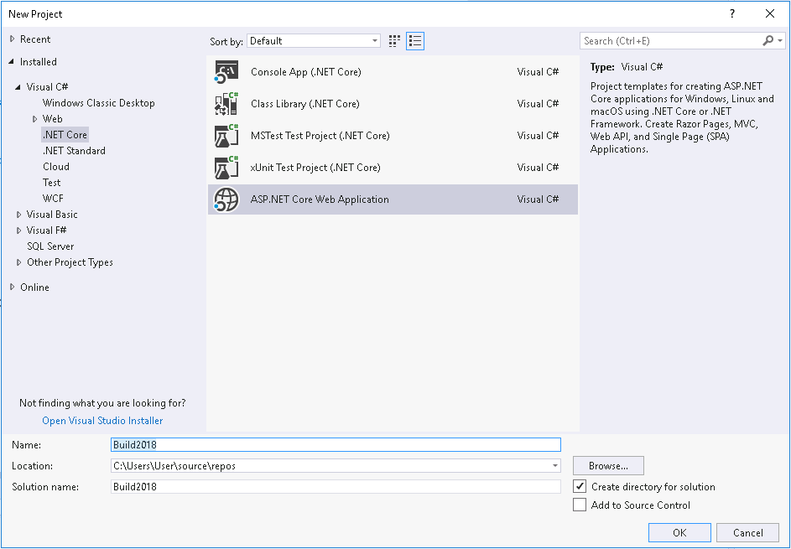

Slide 11
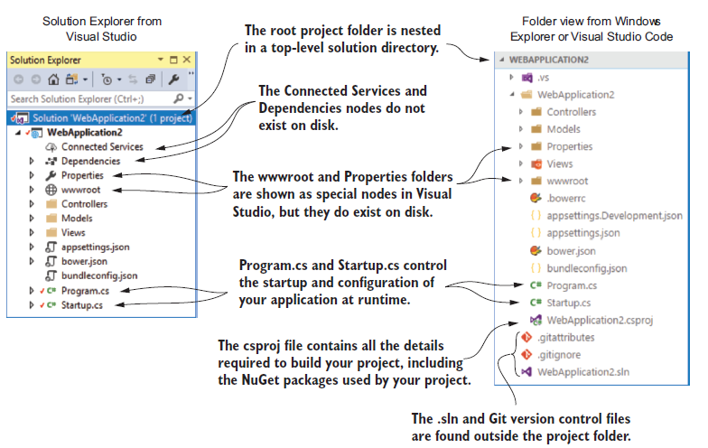
The project layout

Slide 12
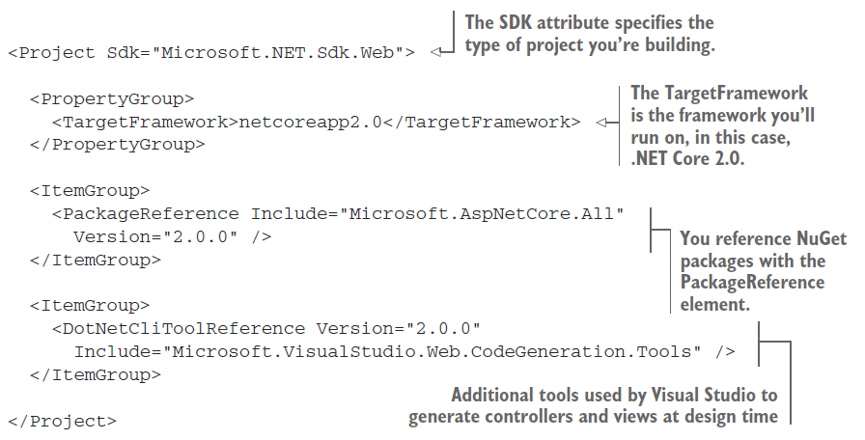
Defining your dependencies

Slide 13
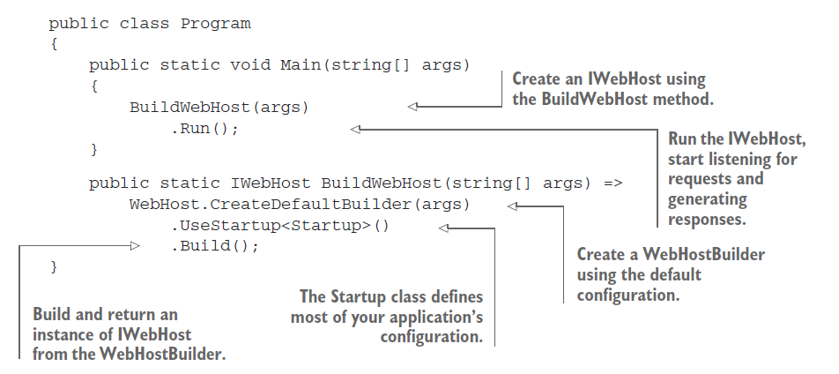
Building a web host

Slide 14


