Slide 1
LENDING CLUB CASE STUDY SUBMISSION
Name:
Venkata Krishna Rohith Dechiraju

Slide 2
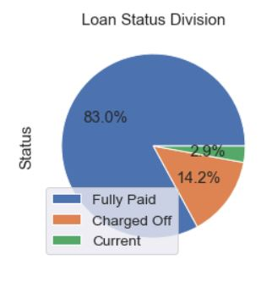
<Abstract>
Business objective:
To identify patterns which indicate if a person is likely to default.
Which may be used for taking actions such as:
Denying the loan
Reducing the amount of loan,
Lending (to risky applicants) at a higher interest rate, etc.
Source:
Complete loan data for all loans issued through the time period 2007 to 2011.
Constraints:
The dataset for defaulters i.e. ‘Charged Off’ status has only been analyzed as it was 14 % of total data.

Slide 3
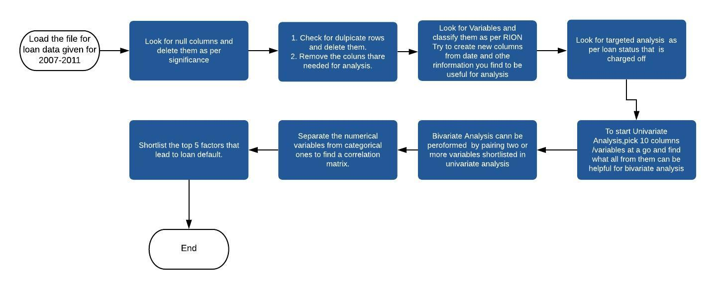
<Problem solving methodology>

Slide 4
<Analysis>
Type Of Variables in Data-Set Provided(RION)-
Ratio | Interval | Ordinal | Nominal
term | loan_amnt | grade | emp_title
emp_length | funded_amnt | sub_grade | home_ownership
annual_inc | funded_amnt_inv | loan_status | verification_status
dti | int_rate |  | pymnt_plan
inq_last_6mths | installment |  | url
delinq_2yrs | issue_d |  | desc
open_acc | earliest_cr_line |  | purpose
revol_bal | mths_since_last_delinq |  | title
revol_util | mths_since_last_record |  | zip_code
total_acc | pub_rec |  | addr_state
out_prncp | total_pymnt |  | initial_list_status
out_prncp_inv | total_pymnt_inv |  | policy_code
 | total_rec_prncp |  | application_type
 | total_rec_int |  | acc_now_delinq
 | total_rec_late_fee |  | chargeoff_within_12_mths
 | recoveries
 | collection_recovery_fee
 | last_pymnt_d
 | last_pymnt_amnt
 | next_pymnt_d
 | last_credit_pull_d
 | collections_12_mths_ex_med
 | delinq_amnt
 | pub_rec_bankruptcies
 | tax_liens

Slide 5
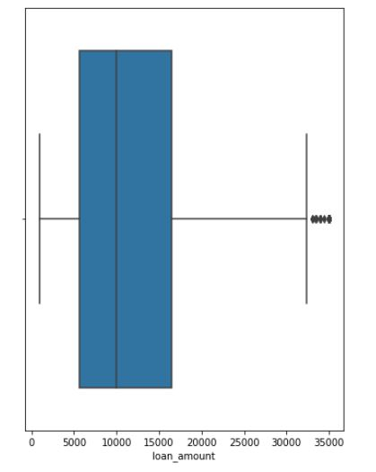
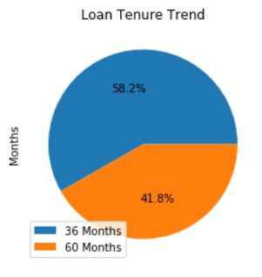
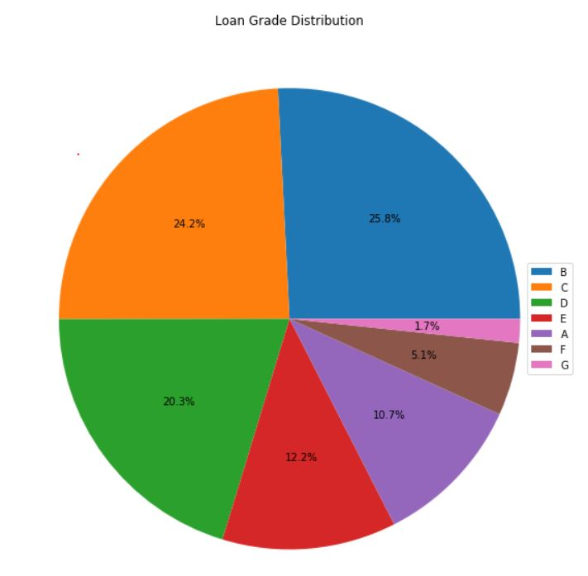
< Uni-Variate Analysis>
Loan Information and characteristics
As the no. of unique ids is same to no. of loans so no member has taken/been issued two loans.
Most of the loans given to defaulter are in range of 5500 to 16000.
More loans are taken for 3 years. So, the most popular option is 36 months for defaulters.
The average interest rate is of 13.5%. There are some people taking loan at at very high interest rate than average.
Most of the defaulted loans are in B-C-D category. That is considered to be medium risk category of loans. But B being highest. So, Club needs to revise its grading system.
The bank is giving loan to a 1967 unverified customers which is a high risk of defaulting.
The most loans are given in the year of 2011 and are given in the October-December Quarter
Loan Amount Range
Defaulted loan grades

Slide 6
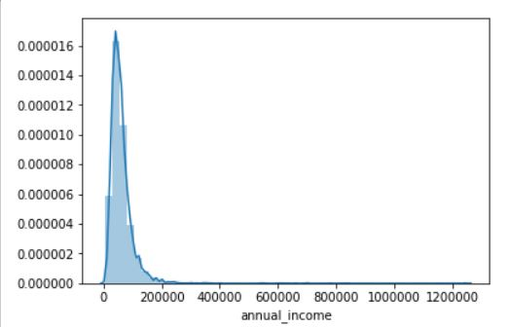
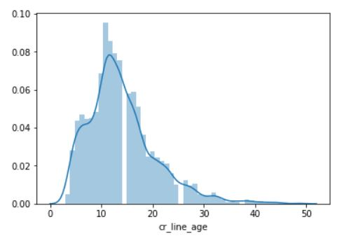
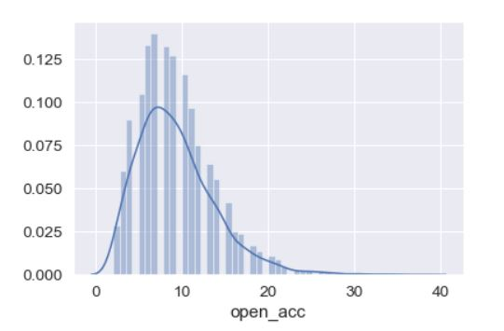
< Uni-Variate Analysis>
Customer Demographics
Customer Behaviour
Most of the people who are defaulting loans are employed for more than 10 years or just started the job.
Most people are taking loan for debt consolidation, personal reasons, small business and home improvement.
Average income of defaulters is 60,000.
Most no. of defaulted loans are being taken in the state of CA/West coast areas.
Average DTI for defaulters is 14.
A lot of customers who are associated with the club from 1997-2000 have defaulted. Majority are associated from 13-14 years.
The people who do not make much enquiries about loans are defaulting.
People who default have been missing payments at an average of 35 months.
A large no. of people defaulting have good reputation in public.
At an average people having more than 2 open credit lines are defaulting.
Revolving utilization should be less than 30%.Most defaulters fall above 30%.
Customers having 1 or more public bankruptcies need to be looked at and are potential to default.
Spread of Annual income
Customer association with club(years)
No. of Open credit lines

Slide 7
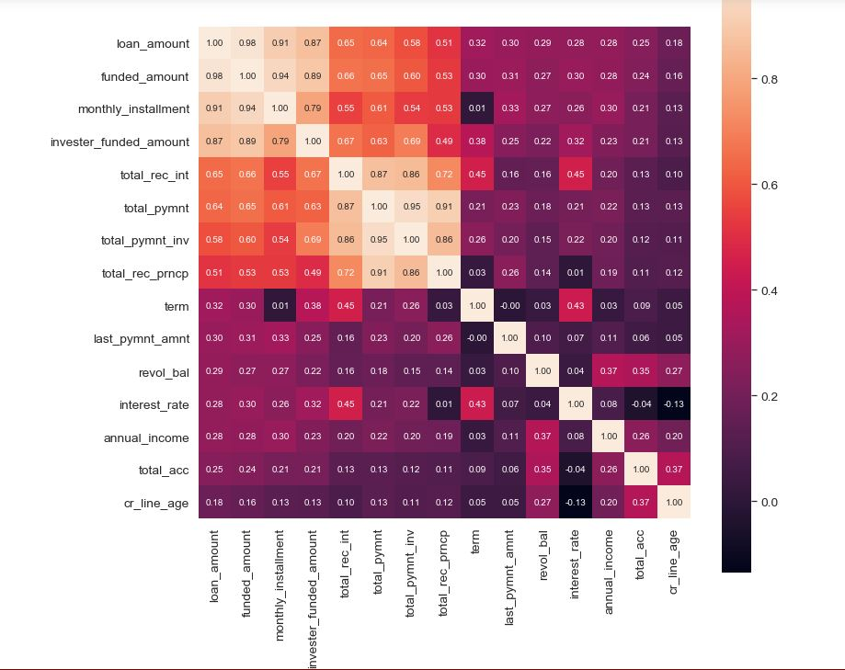
<Bi-Variate Analysis >
Heat Map for
Top 15 most correlated variables

Slide 8
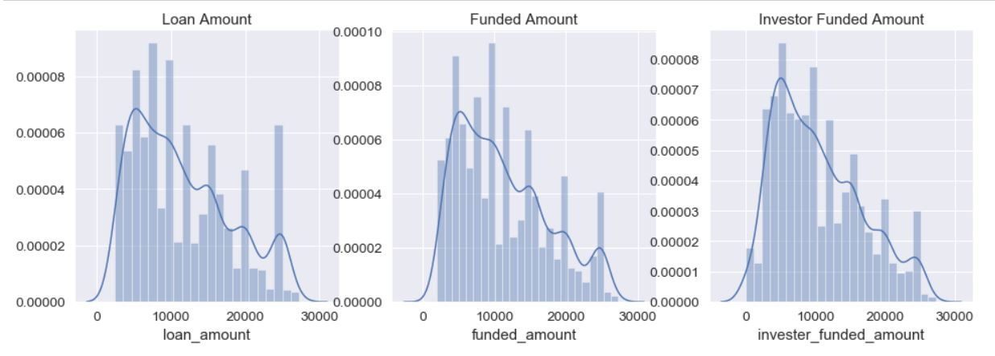
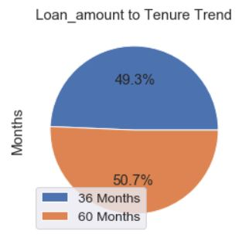
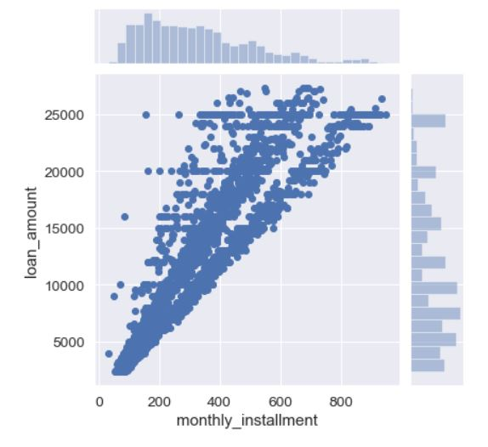
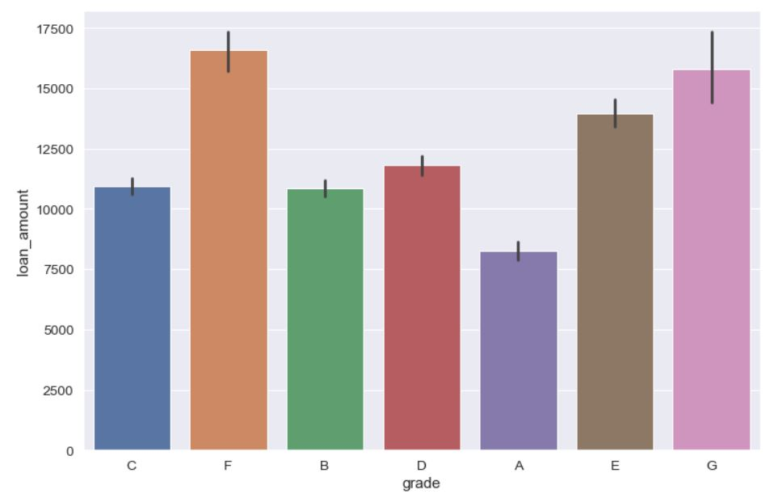
<Bi-variate Analysis>
There is not much difference in the distribution of loan amount requested, funded and provided. So, most people get the loan they ask for.
A large sum of lended money is given for 5 years.Though no. Of loans were huge for three years but looks like big defaulted loans are being taken for five years.
Borrower is shelling out more money for long duration loans. As average interest rate for longer duration is high.
Monthly installment and loan amount are almost following a straight line but the ones lying out of it seem to be exceptions because of the varied interest rates.
More loan amount is being given in lower grades of loan.
Loan amount
to grade

Slide 9
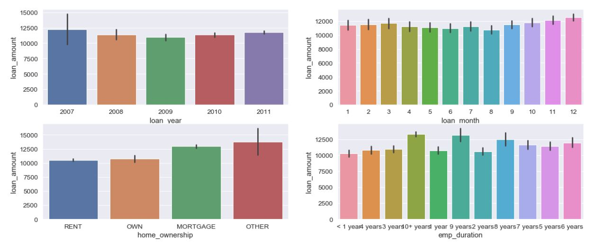
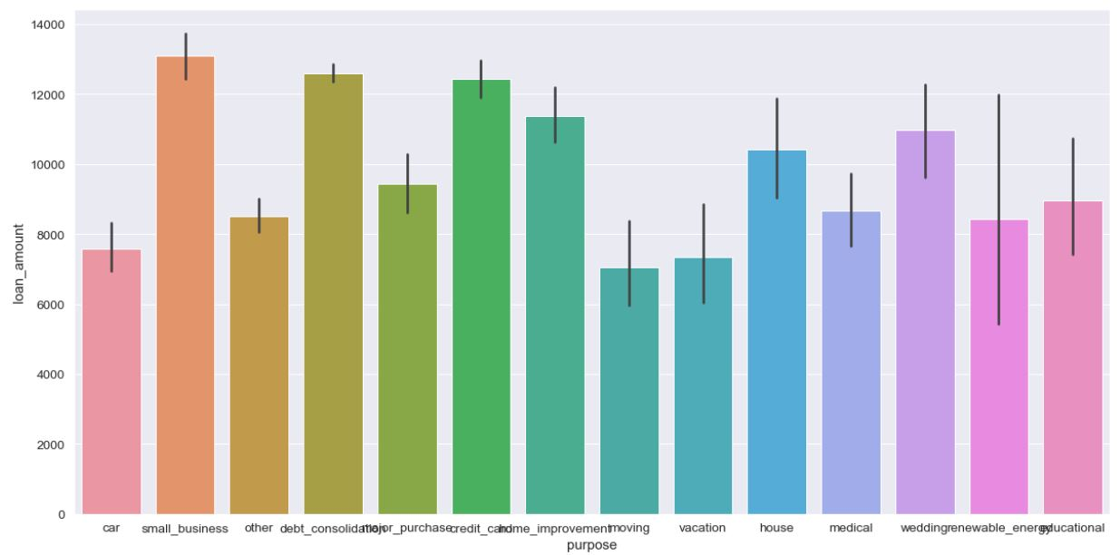
<Bi-Variate Analysis>
The following graph shows relationship of average loan amount to:
1.Loan Year:
The trend shows big loans were given in 2007 and then it decreased but again from 2010 the big loans were being given. The reason for trend might be economic slowdown was in 2008-2009 so lower amount loans were given.
2.Loan Month:
This shows previous trend as financial year starts.
3.Home_ownership:
The huge amount of loans are defaulted by people who are living in mortgaged house or other type.
4.Employment Duration:
People defaulting at higher amount of loans are from high work experience group.
5. Purpose:
When we compare purpose of a loan and average loan amount the top 5 purposes are small_business, debt_consolidation, credit card ,wedding and home_improvement.

Slide 10
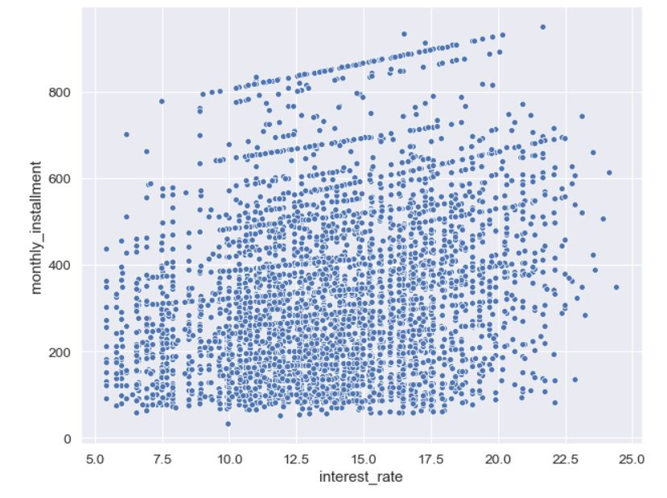
<Bi-Variate Analysis>
Customers with lower monthly installments are defaulting more when the interest rate is near to median.
Customers with higher monthly installments are defaulting more when the interest rate is higher.
Monthly Installment -Interest rate distribution

Slide 11
<Conclusion>
The important variables to look at for approving loans:
1. Purpose:
The people taking loan for small business, debt consolidation are to default more.
2.Employment Duration:
The highly experienced people take big loans and default more. Reason can be starting a small business.
3.Debt-Income Ratio:
The average is 14 for defaulters.
4.Revolving Utilization:
Revolving utilization should be less than 30%.Most defaulters fall above 30%.
5.Verification status of Customers:
The share of defaulting customers is more who are unverified or source verified.
6. Region:
Western coast regions like i.e. CA -1023, TX 270, NJ 258 people are more defaulting and reason can be supported by Small business. As, these are IT hubs. East coast regions like FL -460, NY- 455 people are defaulting next

Slide 12
THANK YOU

