Slide 1


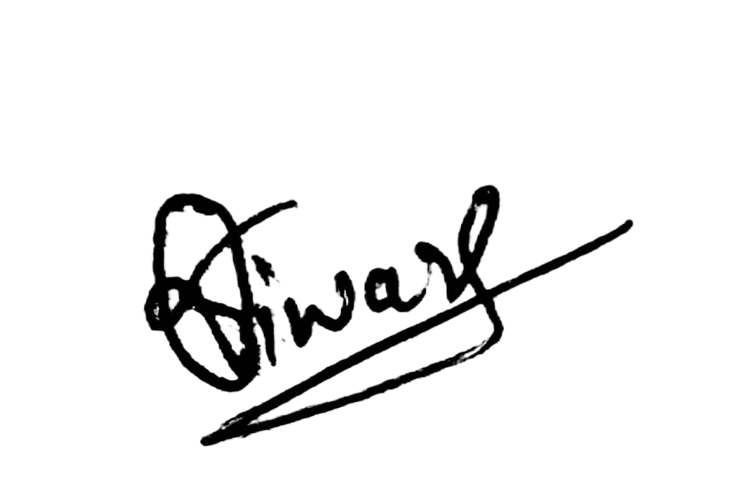

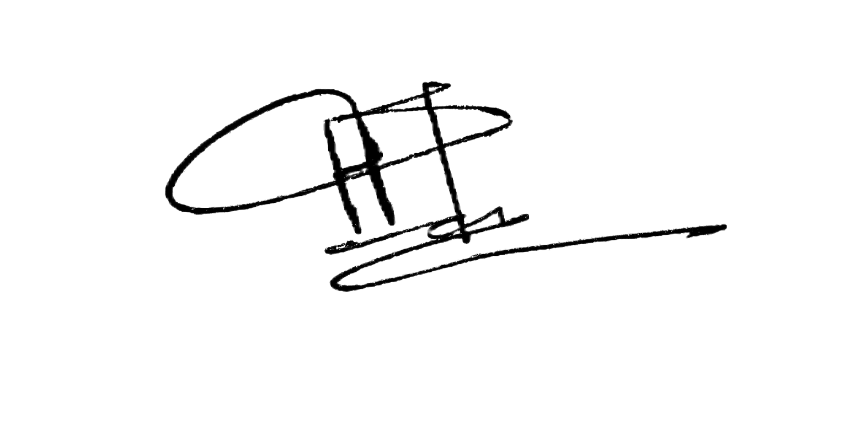
{{name}}
Engineer Astra
Certificate of appreciation
This is to certify that
has successfully completed the course {{course}} offered by Engineer Astra. This certificate is awarded in recognition of their dedication, learning, and achievement.
Date of Completion: {{date}}
Vishal Tiwari
Harsh Tiwari
Founder & Instructor, Engineer Astra
Head of Content, Engineer Astra
Certificate ID: {{certificate_id}}

