Slide 1
Learning teacher-student paradigm for Soft Gripper grasping tasks
Vo Khoi Thanh Son

Slide 2
Task description
Implementing teacher-student approach to autonomously learn a grasping task and can generalize to different types of objects and grippers
Teacher policy: is trained using reinforcement learning with privileged state information
2-stage training
Student policy: is trained to imitate the teacher using sensory inputs from the camera

Slide 3
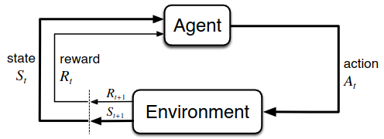
Teacher policy
The environment transitions to a new state, and the agent receives a reward.
A policy π is stochastic that maps from states to distribution over actions
Markov decision process (MDP)
(S; A; P; R; γ)
During each step, the agent receives an observation of the environment’s current state and takes action based on that observation.

Slide 4
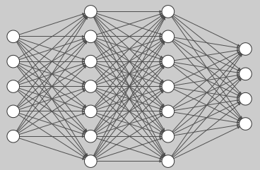
Policy Gradient Method
Action standard deviations
Policy
States
Action means
Gaussian distribution
Sampled actions
Policy network
The policy network is trained by maximizing the objective function:
$$J=E\left(π_{θ}{(a}_{t} | s_{t}\right)A_{t})$$

Slide 5
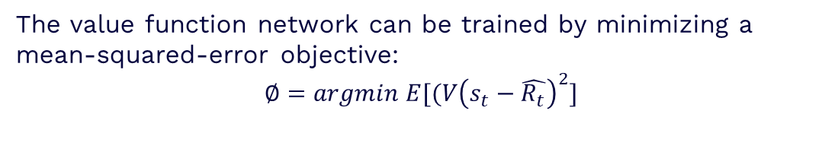
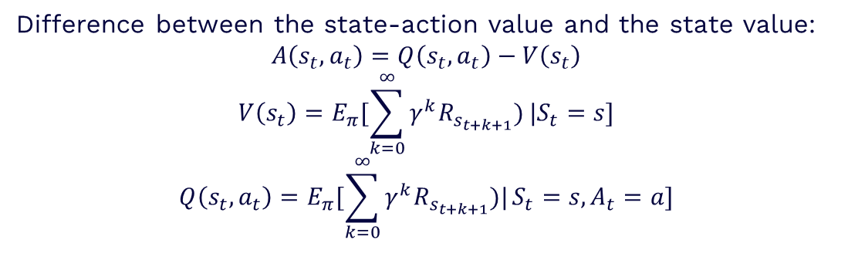
Policy Gradient Method
Advantage function
Difference between the state-action value and the state value:
$$A\left(s_{t}, a_{t}\right)=Q\left(s_{t},a_{t}\right)−V\left(s_{t}\right)$$
$$V\left(s_{t}\right)=E_{π}[\sum_{k=0}^{∞}{γ^{k}R_{s_{t+k+1}})}|S_{t}=s]$$
$$Q\left(s_{t},a_{t}\right)=E_{π}[\sum_{k=0}^{∞}{γ^{k}R_{s_{t+k+1}})|}S_{t}=s,A_{t}=a]$$
The value function network can be trained by minimizing a mean-squared-error objective:
$$∅=argmin E[(V{\left(s_{t}−\hat{R_{t}}\right)}^{2}]$$

Slide 6

Policy Gradient Method
Algorithm: PPO
Preventing divergence by the objective function:
$$L_{PPO}=min⁡(fA_{t}, clip\left(1−ε,1+ε,f\right)A_{t})$$
$f=\frac{π_{θ}(a_{t}|s_{t})}{π_{θ_{old}}(a_{t}|s_{t})}$
training two neural networks
Policy network:
states Gaussian distribution over actions
Value network:
states discounted sum of future rewards expected in a given state

Slide 7
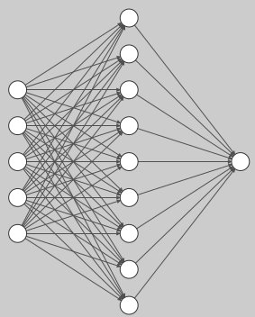
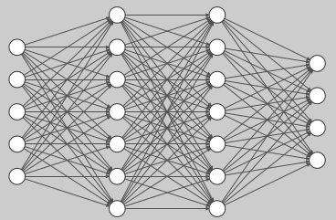
Implementation details
Network architectures
Both the policy and value networks are encoded by multi-layer perceptron (MLP)
Policy network
Value network

Slide 8
Implementation details
Learning environment
The proposed learning environment is developed by using Isaac Gym physics engine to simulate the physical system.
*) States:
Robot proprioception information: gripper's position and orientation, finger's position and velocities
Object information: object’s position, orientation, relative position vector of the object and grip site.
*) Actions:
Gripper's desired joint’s position and velocities

Slide 9
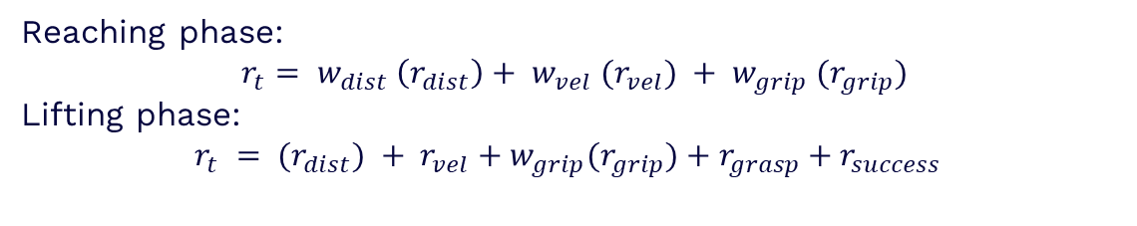
Implementation details
Reward shaping
Sparse reward:
The agent gets rewarded only if the grasping task is completed successfully
Dense reward:
Reaching phase:
$$r_{t}= w_{dist} \left(r_{dist}\right)+ w_{vel} (r_{vel}) + w_{grip} (r_{grip})$$
Lifting phase:
$$r_{t} = (r_{dist}) + r_{vel}+w_{grip}(r_{grip})+r_{grasp}+r_{success}$$
Learning Continuous Control Actions for Robotic Grasping with Reinforcement Learning

Slide 10
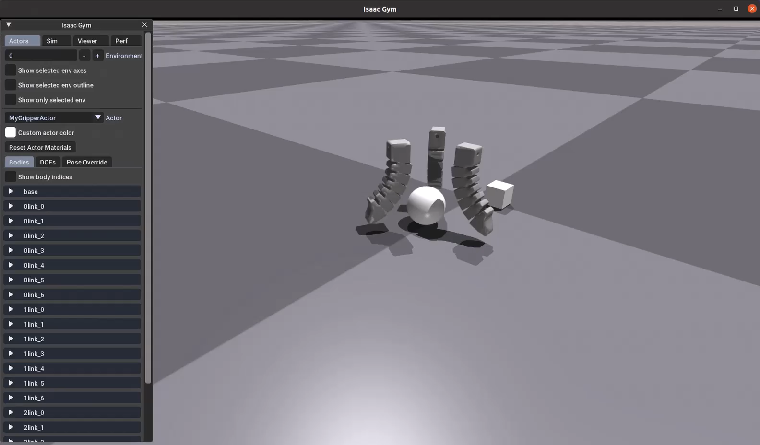
Future work
- Generate different types of grippers
- Implement the teacher policy in Gym environment

Slide 11
Thanks!

