Slide 1
Research Report
Vo Khoi Thanh Son
3-5-2024

Slide 2
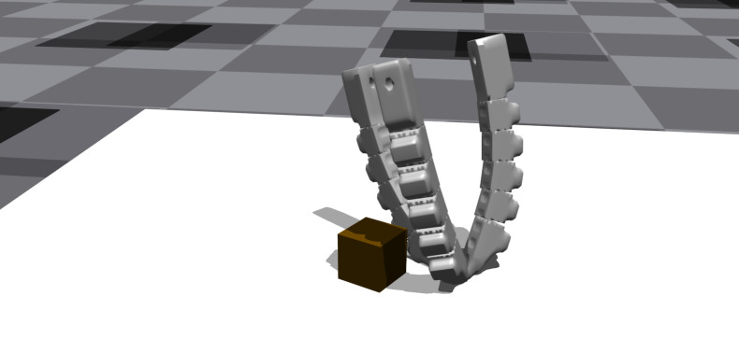
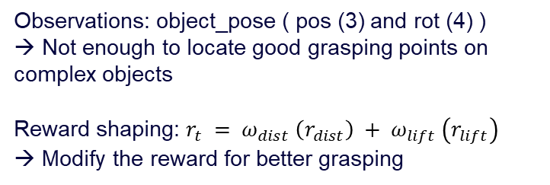
Previous work
Train the gripper to grasp different types of objects
→ High success rate on small objects
Switch to bigger objects → Fail to grasp
Observations: object_pose ( pos (3) and rot (4) )
→ Not enough to locate good grasping points on complex objects
Reward shaping: $r_{t} = ω_{dist} \left(r_{dist}\right) + ω_{lift} \left(r_{lift}\right)$
→ Modify the reward for better grasping

Slide 3
Object observations
Bounding box
Calculate and update the bounding box of object
Extract the oriented bounding box (OBB) from the object mesh
Initialize bounding box for the object
trimesh.bounds.oriented_bounds(mesh)
- OBB parameters:
+ Center.
+ Extents.
+ Position offset
+ Rotation offset
- During updates, compute:
+ Bbox Position
+ Bbox Rotation
+ OBB represents a 3D box that is oriented to tightly fit around the given mesh object
+ OBB can be oriented arbitrarily in 3D space based on the object's geometry.
→ self.object_bbox_pose = torch.cat([bbox_pos, bbox_rot], dim=1)
+ Bbox Corners
→ update Bbox Bounds

Slide 4
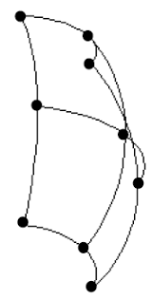
Object observations
Surface sampling
Calculate and update the surface samples of object
Extract points on the object surface from the object mesh
Initialize surface sample offset positions for objects
trimesh.sample.sample_surface(object_mesh, count=20)
+ Retrieves position of points sampled on the surface for the object identified
→ Append points to a list containing surface sample offset positions for all envs.
During updates, reshape:
+ object pos
+ object rot
+ Generate points on each surface that represent the object’s geometry
→ self.object_surface_samples = object_pos + quat_apply ( object_rot, self.object_surface_sample_offset_pos)

Slide 5
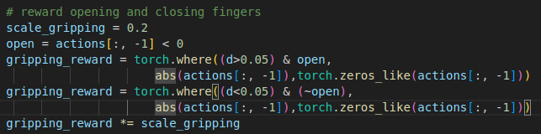

Reward shaping
+ Opened gripper when approaching the object:
$$r_{grip}= \left\{\begin{aligned}⁡(abs\left(action_{gripper}\right), if {action}_{gripper}<0 \\ 0, otherwise\end{aligned}\right.$$
+ When d is minimized, close the gripper:
$$r_{grip}= \left\{\begin{aligned}⁡(abs\left(action_{gripper}\right), if {action}_{gripper}>0 \\ 0, otherwise\end{aligned}\right.$$
Gripping reward
+ d: distance between gripper base and object

Slide 6
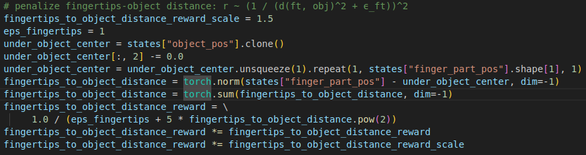
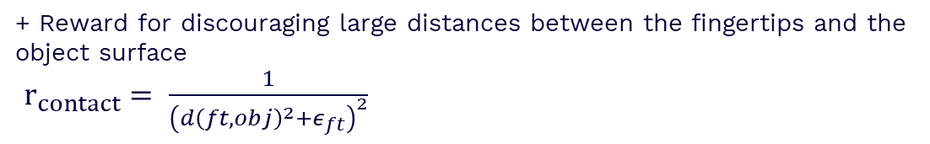
Reward shaping
Contact reward
+ Reward for discouraging large distances between the fingertips and the object surface
$r_{contact}= \frac{1}{{\left(d{\left(ft,obj\right)}^{2}+ε_{ft}\right)}^{2}}$

Slide 7
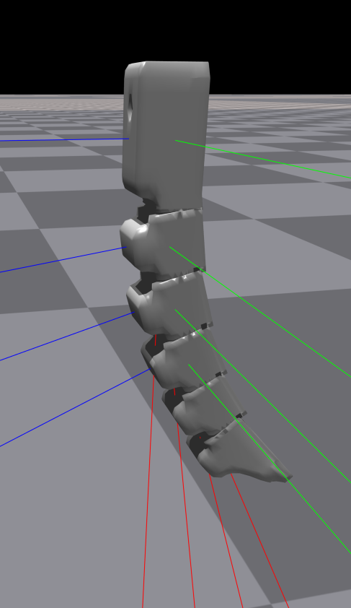
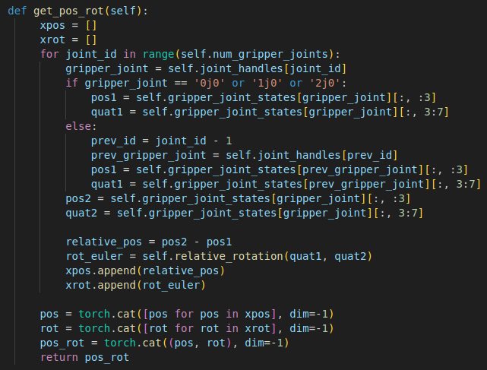





Gripper observations
Hardware conditioned policy
$π\left(a \right| \hat{s} ← s ⊕ v_{h}$)
Kinematic:
- Compute the relative pose between the joints
$$O_{i}$$
$$R_{i}^{i+1}$$
$$d_{i}$$
Pos: the fingers have difficulties holding the object
$$O_{i+1}$$

Slide 8
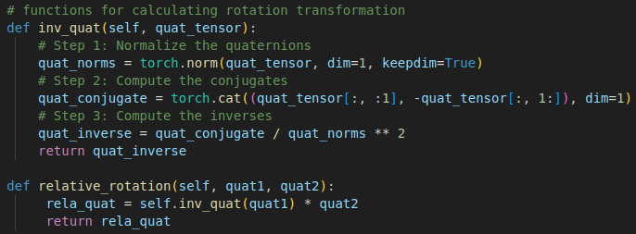
Gripper observations
Kinematic:
- Compute the relative orientation between the joints
+ Find inverse of quaternions of the joint
$$O_{i}$$
+ Find rotation transformation by multiplying quat inverse of joint 1 with joint 2 quat
$$R_{i}^{i+1}$$
$$d_{i}$$
$$O_{i+1}$$

Slide 9
Gripper observations
- Extract the dynamics properties of gripper dofs
- Construct the dynamics vector
$$O_{i}$$
$$R_{i}^{i+1}$$
$$d_{i}$$
stiffness | float32 | Drive stiffness.
damping | float32 | Drive damping.
friction | float32 | DOF friction.
armature | float32 | DOF armature.
$$O_{i+1}$$
self.gripper_dyn = torch.cat([self.gripper_stiffness, self.gripper_damping, self.gripper_friction, self.gripper_armature], dim=-1)

Slide 10
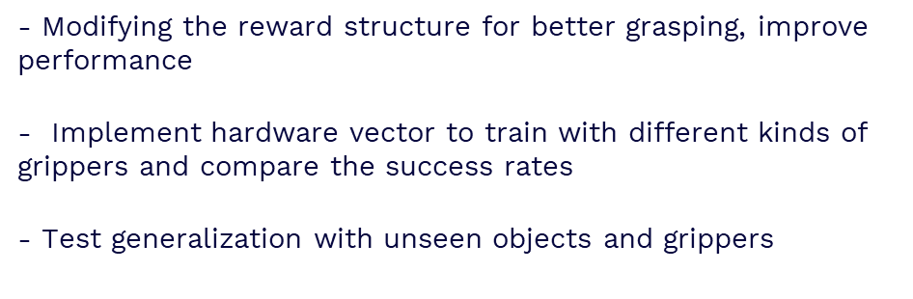
Future work
- Modifying the reward structure for better grasping, improve performance
- Implement hardware vector to train with different kinds of grippers and compare the success rates
- Test generalization with unseen objects and grippers

Slide 11
Thanks!

