Slide 1
Hardware Conditioned Policies for Multi-Robot Transfer Learning
Vo Khoi Thanh Son
5-4-2024

Slide 2

Hardware Conditioned Policies (HCP)
- Applied successfully in solving reacher and peg insertion tasks
- Manipulators with different DOFs and variants (different displacement of joints) → Different gripper variants
- Learn a policy conditioned on both the state and the hardware properties:
$π\left(a_{t} \right| s_{t} , v_{h}$)

Slide 3
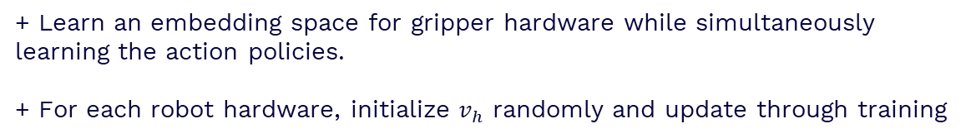
Implementation of HCP
2 encoding methods of hardware vector $v_{h}$
- Explicit encoding (HCP-E)
+ Directly use the kinematic structure as input to the policy function
+ Follow URDF convention and incorporate the least amount of information to fully define a multi-DOF gripper
- Implicit encoding (HCP-I)
+ Learn an embedding space for gripper hardware while simultaneously learning the action policies.
+ For each robot hardware, initialize $v_{h}$ randomly and update through training

Slide 4
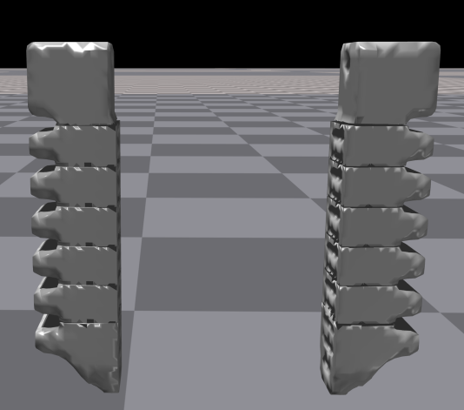
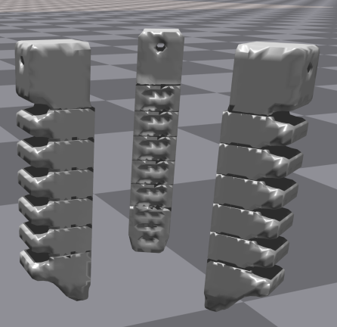
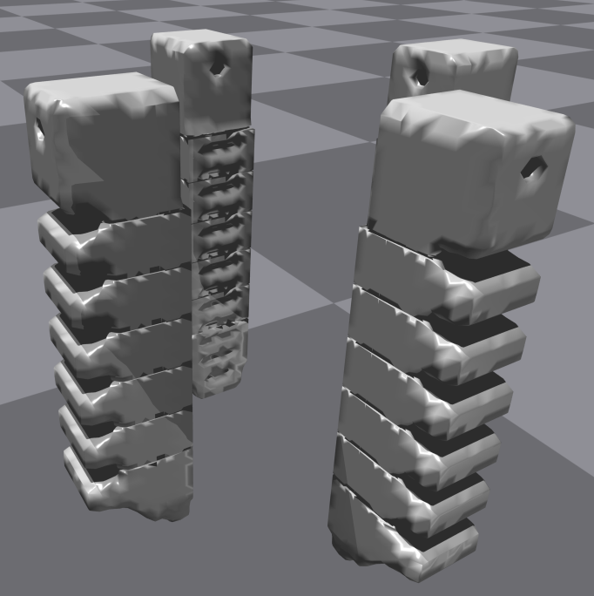
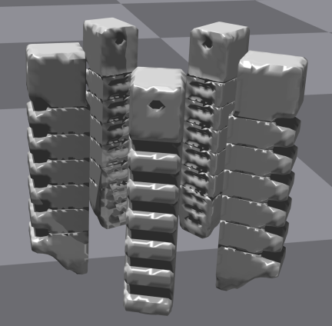
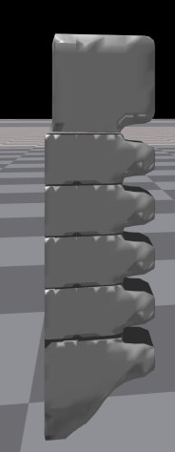
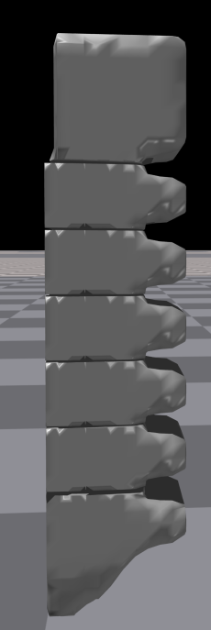
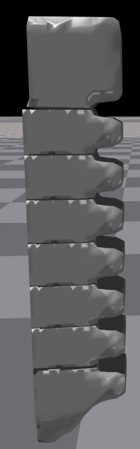
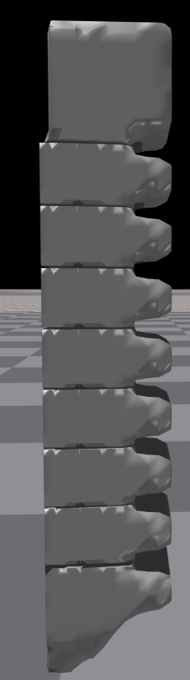
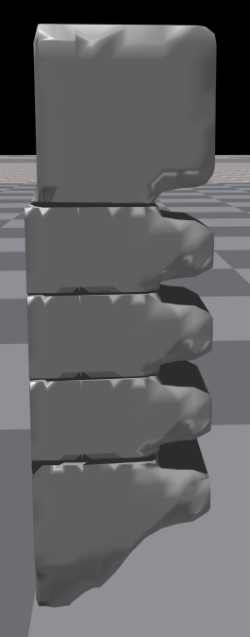
Robot Hardwares
- Create a set of different robot grippers based on a given 3-fingered gripper urdf file in Isaac Gym
Number of fingers:
range from 2 to 5
Number of mids for each finger: range from 3 to 7
finger’s mids

Slide 5
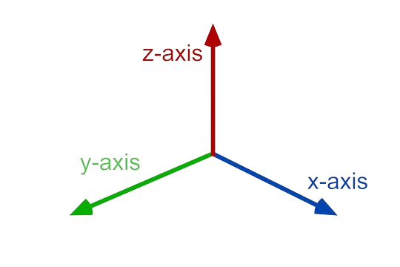
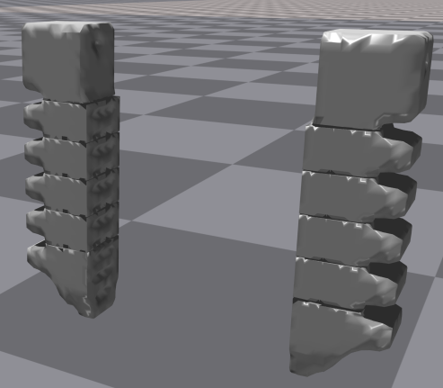

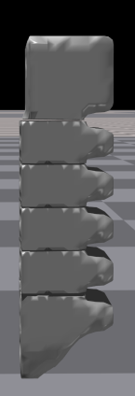
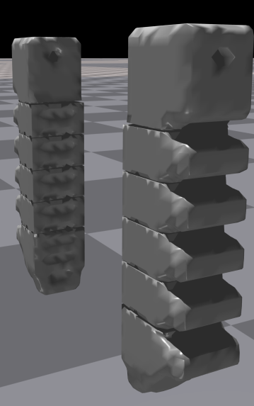
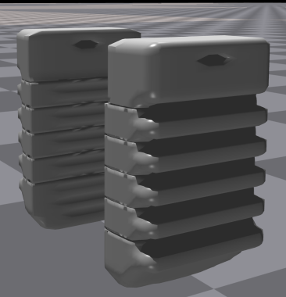
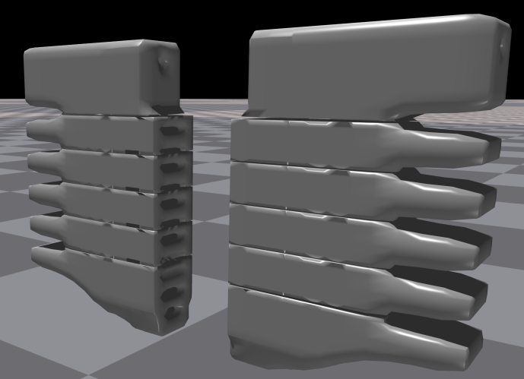
Robot Hardwares
Scale in 3 dimensions
Scale in z axis
Scale in y axis
Scale in x axis

Slide 6
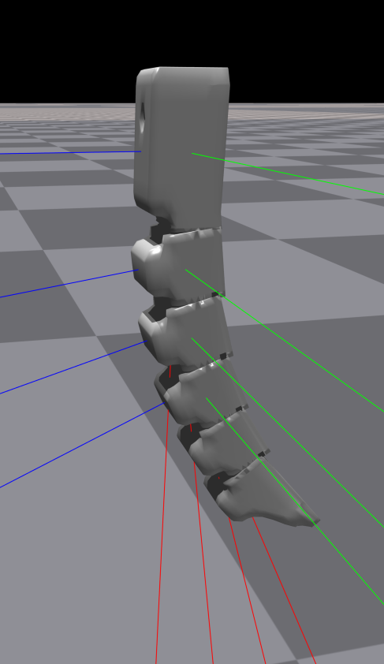



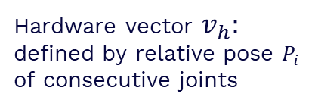



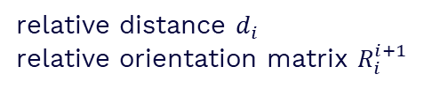

Implementation of HCP
Construction of the hardware vector representation $v_{h}$
Hardware vector $v_{h}:$ defined by relative pose $P_{i}$ of consecutive joints
relative distance $d_{i}$
relative orientation matrix $R_{i}^{i+1}$
$$O_{i}$$
$$R_{i}^{i+1}$$
$$d_{i}$$
$$O_{i+1}$$
$$v_{h}{=P}_{i}  P_{i+1} …$$
$π\left(a \right| \hat{s} ← s ⊕ v_{h}$)
object pos, rot, linear vel and angular vel
States s
finger position and orientation

Slide 7
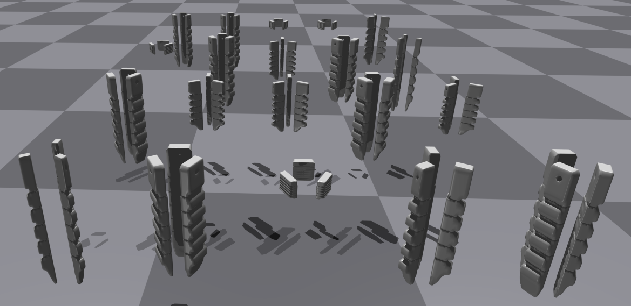
Future work
- Review the structure of grippers for proper grasping (size, distance between the fingers )
- Set up the environment for training, implement PPO or DDPG algorithm to train the policy
- Use object dataset from EGAD to train and evaluate the policy
Pool of 3-fingered gripper with different size

Slide 8
Thanks!

