Slide 1
Research Goal
Journal Review
Visual Dexterity: In-Hand Reorientation of Novel and Complex Object Shapes
A real-time controller that dynamically reorients complex and new objects by any amount using a single depth camera
reorient objects into any orientation
Real world reorientation system
generalize to new and complex objects
operate in real time using data from commodity sensors

Slide 2
Challenge
+ Real-world setup choices:
Placing multiple cameras around the workspace
Upwards facing hand configuration instead of downwards facing hand configuration

Slide 3
Challenge
+ Object reorientation problem:
High-dimensional control space
Measuring the state information the controller requires
Touch sensors?

Slide 4
Methods
Build a controller using deep reinforcement learning (RL)
How to train controllers with sensors available in the real world
sim-to-real transfer problem

Slide 5
Training RL controllers from visual inputs
Inferring the relevant state information
Determining the optimal action
Teacher policy
Two-stage teacher-student training paradigm
Student policy

Slide 6
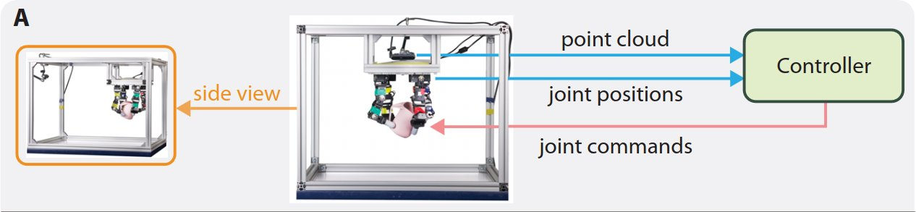
Training RL controllers from visual inputs
trained via RL with priviliged state information
Teacher policy
Synthetic point cloud
Student policy
slow speed of rendering
2-stage approach
Rendered point cloud

Slide 7
Overcoming the sim-to-real gap
- Achieving precise control in a system with fast-changing dynamics
- Using a downward-facing hand configuration
motor/object dynamics
- Differences in
perception noise
modeling approximations

Slide 8
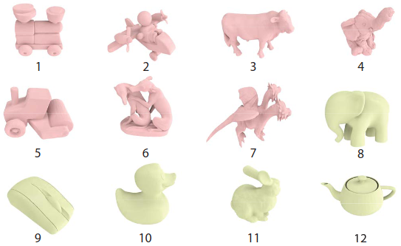
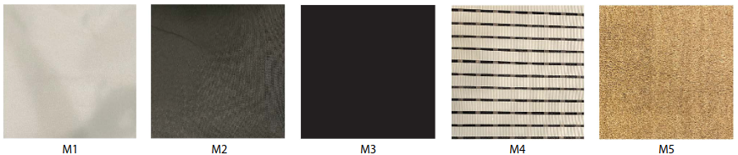
Experiment
Object datasets
- Big dataset: 150 objects from internet sources
- Small dataset:
+ 7 objects for the training dataset
+ 5 objects for the testing dataset
Three-fingered D’Claw manipulator and a modified four-fingered version with 9 and 12 degrees of freedom (DoFs)
5 table materials.

Slide 9
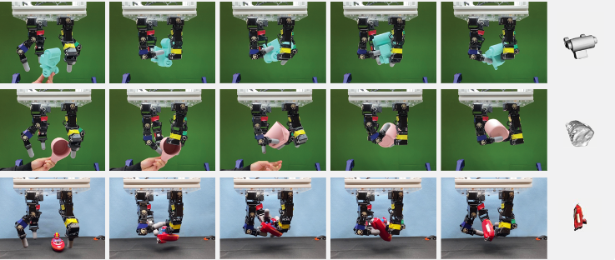
Experiment
Downward-facing hand configuration with 2 settings:
With and without a supporting table

Slide 10
Experiment
Training setup
Observation space for teacher policy:
+ joint positions and velocities
+ fingertip pose and velocities
+ object pose and velocity
+ target orientation expressed as a quaternion
+ rotation difference between current and target object orientation
Real-world observations:
+ The joint positions of each motor in the robotic hand
+ The depth image from the RealSense camera

Slide 11
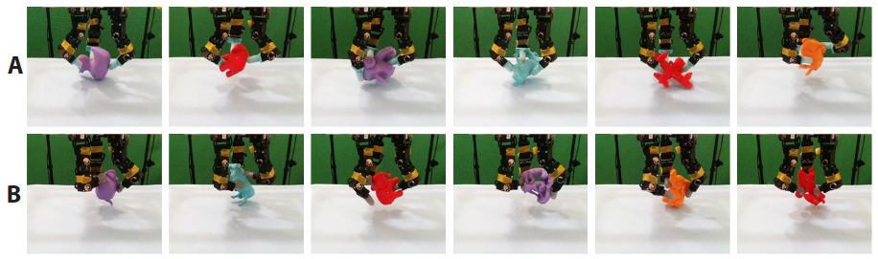
Results
Object reorientation with a supporting surface
Using a three-fingered manipulator with rigid and soft fingertips
+ rigid 3D-printed fingertips (row A)
+ soft elastomer fingertips (row B)

Slide 12
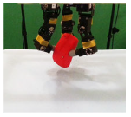
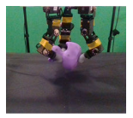
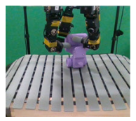
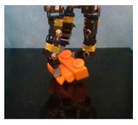
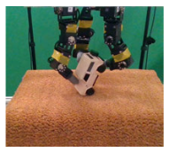
Results
Object reorientation with a supporting surface
Different supporting materials
+ Tablecloth, an uneven door mat, a slippery acrylic sheet, and a perforated bath mat

Slide 13
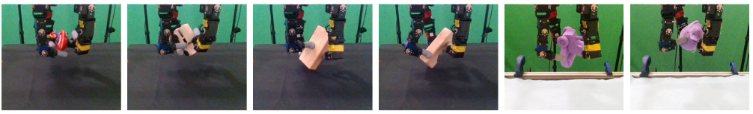
Results
Object reorientation in air
Four-fingered robot hand operating without the need for a supporting surface

Slide 14
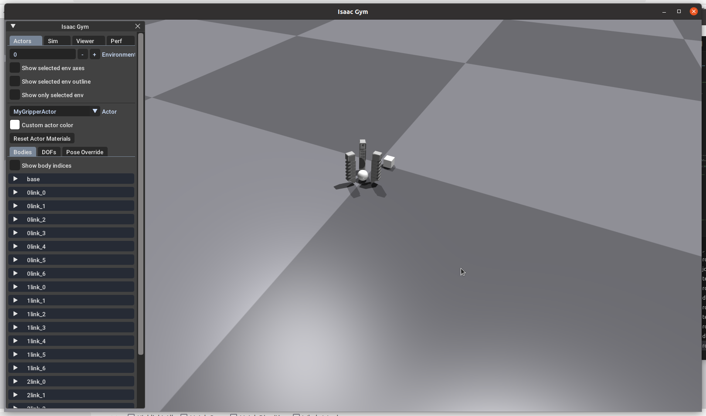
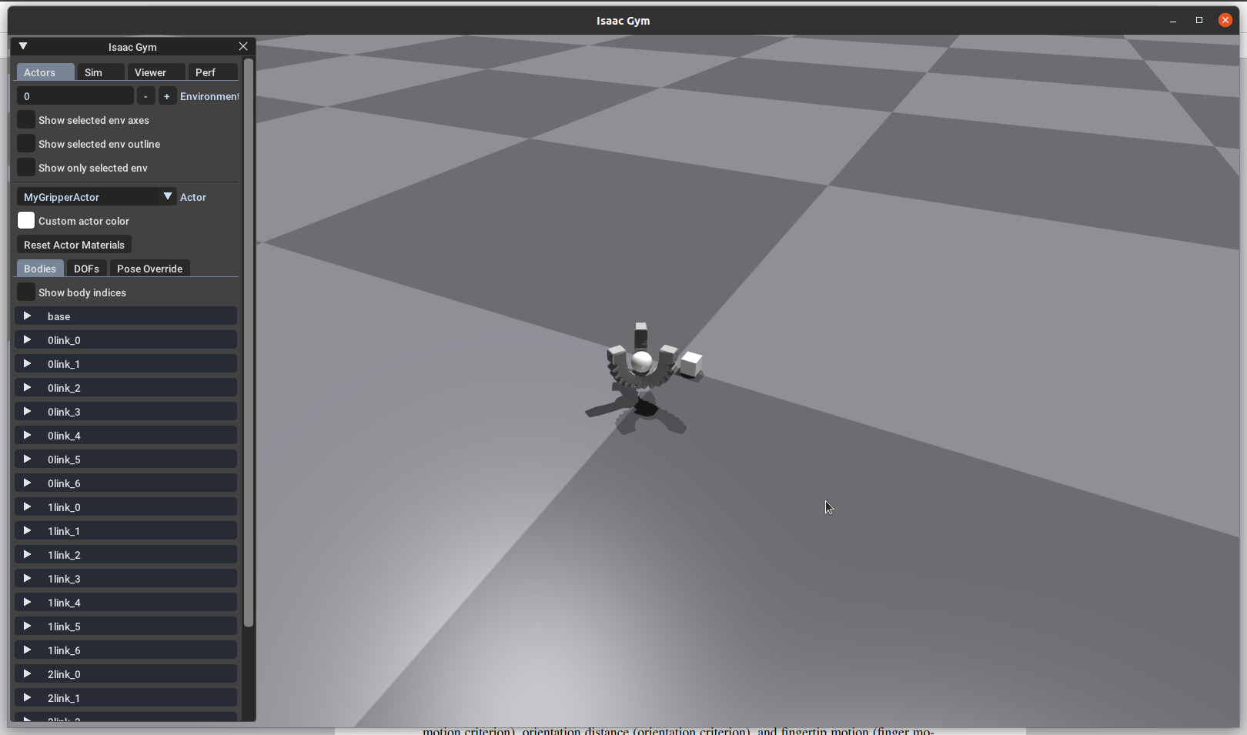
Practice
Simulating a 3-fingered gripper in Isaac Gym

