Slide 1
Hazardous Asteroids Prediction
Vidhya K V
PY DS MAY 24
Luminar Technolab

Slide 2
Table of Contents
Introduction
Objectives
Dataset Overview
Data Exploration
Data Preprocessing
Feature Engineering
Machine Learning Models
Model Evaluation
Results
Insights
Challenges Faced
Conclusion
Future Scope

Slide 3
Introduction
Context: Asteroids pose potential threats to Earth.
Problem Statement: Accurate prediction of hazardous asteroids is crucial for Earth's safety.
Solution Overview: Leveraging machine learning techniques for predictive modeling.

Slide 4
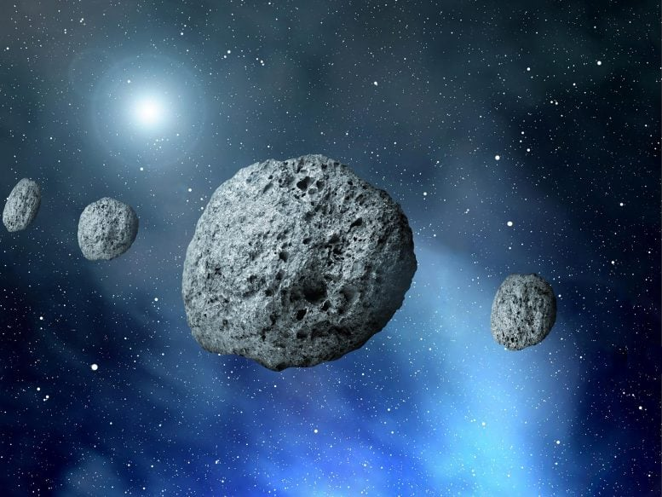
Asteroids

Slide 7
Steps
Data collection from Kaggle
Data exploration
Data preprocessing
Exploratory data analysis
Models creation
Models evaluation
Model selection
Hyper parameter tuning

Slide 8
Columns introduction
SPK-ID: Object primary SPK-ID
Object ID: Object internal database ID
Object fullname: Object full name/designation
pdes: Object primary designation
name: Object IAU name
NEO: Near-Earth Object (NEO) flag
PHA: Potentially Hazardous Asteroid (PHA) flag
H: Absolute magnitude parameter
Diameter: object diameter (from equivalent sphere) km Unit
Albedo: Geometric albedo
Diameter_sigma: 1-sigma uncertainty in object diameter km Unit
Orbit_id: Orbit solution ID
Epoch: Epoch of osculation in modified Julian day form
Equinox: Equinox of reference frame
e: Eccentricity
a: Semi-major axis au Unit
q: perihelion distance au Unit
i: inclination; angle with respect to x-y ecliptic plane
tp: Time of perihelion passage TDB Unit
moid_ld: Earth Minimum Orbit Intersection Distance au Unit
Class: class of object

Slide 9
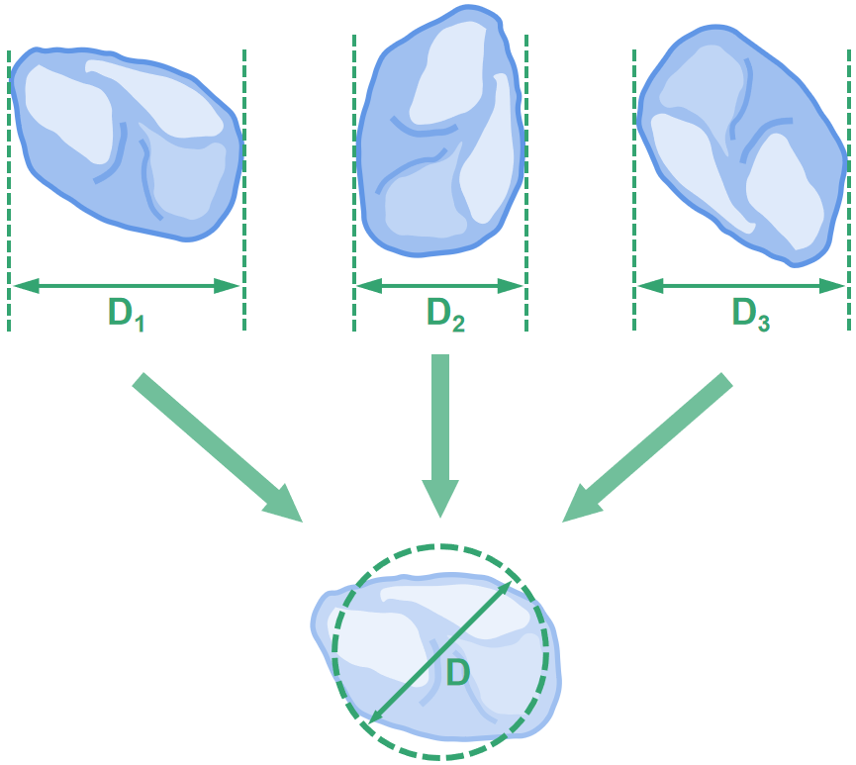
Diameter

Slide 10
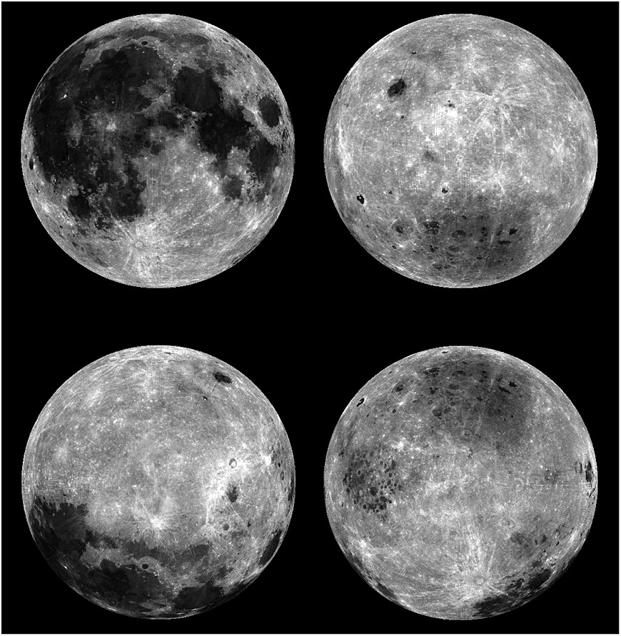
Geometric Albedo

Slide 11
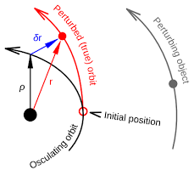
Epoch ID

Slide 12
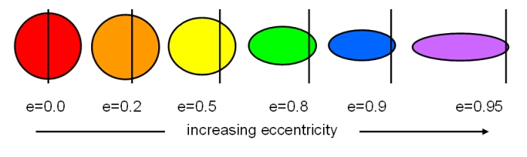
Eccentricity

Slide 13
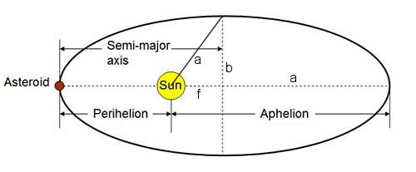
Semi major axis

Slide 14
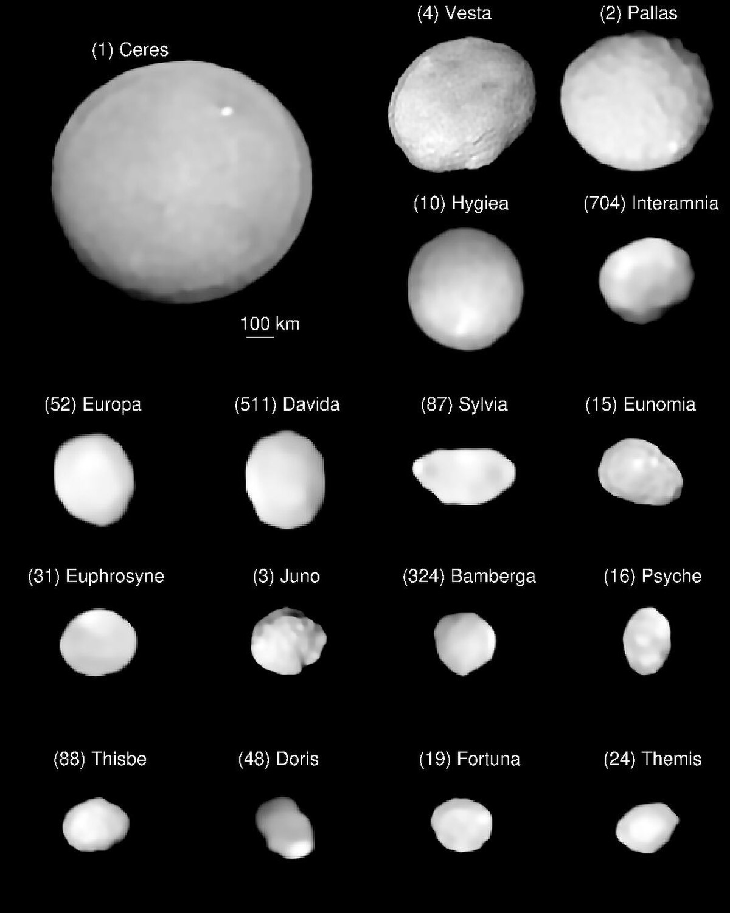

Slide 15
Data Preprocessing
- Data cleaning to handle missing and inconsistent values
- Outliers removal to ensure data quality
- Feature selection and engineering

Slide 16
Machine Learning Modeling
Techniques employed:
Algorithms tested: KNN, Decision tree, SVM, Logistic Regression, Random Forest
Train-test split: Ensured robust model evaluation
Hyperparameter tuning for optimization

Slide 17
Evaluation
Performance metrics:
- Accuracy, precision, recall, F1-score
- Confusion matrix to analyze classification results
- Comparison of model performance

Slide 18
Machine Learning Models
Algorithms Used:
- Logistic Regression
- Random Forest
- Support Vector Machine (SVM)
Steps:
- Train-test split (70%-30%).
- Hyperparameter tuning for optimization.

Slide 19
Model Evaluation
Metrics Evaluated:
- Accuracy, Precision, Recall, F1-score.
Visualization:
- Confusion Matrix for error analysis.
Best Model: Decision tree with superior performance metrics.

Slide 20
Results
Highlights:
- Accuracy: High predictive capability for non hazardous asteroids.
- Feature Importance: Insights into the most impactful parameters.
Visuals: Plots and tables results.

Slide 21
Challenges Faced
Technical Challenges:
- Imbalanced dataset: Fewer hazardous vs. non-hazardous samples.
- Computational limitations during model tuning.

Slide 22
Conclusion and Future Scope
Conclusion:
- Machine learning models can effectively predict hazardous asteroids.
Future Scope:
Incorporation of real-time asteroid tracking data.
Exploration of advanced deep learning models.

Slide 23
THANK YOU

