Slide 1
Crowdsourced Civic Issue Reporting and Resolution System
CSE7302 – University Project
Review-3
Batch Number: COM_15
Under the Supervision of,
Ms. Babitha S
School of Computer Science and Engineering
Presidency University
Roll Number | Student Name
20221COM0084 | VISHNU M
20221COM0096 | R AKASH
20221COM0099 | JAGADISH T S
Name of the Program: B.TECH CSE
Name of the HoD: Dr.Gopalkirshna Shyam
Name of the Program Project Coordinator: Ms.Sumita Guddin
Name of the School Project Coordinators: Dr.Samapth A K & Dr.Geetha Arjunan

Slide 2
Content
Problem Statement
Abstract
Literature Survey
Analysis of Problem Statement
Objectives
Existing Methods and Drawbacks
Proposed Method & Feasibility Study
Architecture Diagram
Modules
Software Details
Timeline (Gantt Chart)
References

Slide 3
Problem Statement Number : SIH25031
Problem Description:
Citizens frequently encounter civic issues such as potholes, garbage overflow,
water leakage, broken streetlights, and sanitation problems.
Existing complaint mechanisms are fragmented, manual, or lack transparency
and real-time tracking. This results in delayed resolution and poor accountability.
There is a need for a centralized, crowdsourced digital platform that allows citizens
to report civic issues and enables authorities to efficiently monitor and resolve them.

Slide 4
ABSTRACT
This project proposes a cloud-based, crowdsourced civic issue reporting and resolution system aimed at improving urban governance and public service delivery. The system enables citizens to report civic issues through a web interface by submitting descriptions and images. Authorities can monitor, manage, and resolve issues via a centralized dashboard with real-time updates. The proposed solution leverages serverless cloud architecture to ensure scalability, cost efficiency, transparency, and improved accountability in civic administration.

Slide 5
LITERATURE SURVEY
Literature Survey Summary :
1) Ilamaran et al. (2025) – Crowdsourced Civic Issue Reporting and Resolution System
(IJRPR – BASE PAPER)
Proposes a cloud-based, crowdsourced platform for reporting civic issues
Citizens upload images, descriptions, and geotagged locations
Uses machine learning for issue categorization, duplicate detection, and prioritization
Provides real-time tracking and a centralized dashboard for authorities
Limitation:
High system complexity
Heavy ML dependence increases computational cost
Not optimized for serverless / free-tier cloud deployment
2) Kurian et al. (2026) – SmartReporter: A Crowdsourced Complaint Resolution System
(IJERT)
Web-based civic issue reporting platform
Uses YOLOv8 / YOLOv9 deep learning models for image-based issue detection
Automatically classifies potholes, garbage, streetlight faults
Provides real-time dashboards and analytics
Limitation:
Requires GPU resources
High inference cost
Not feasible for student-level or free-cloud deployment

Slide 6
LITERATURE SURVEY
3) Walwadkar et al. (2022) – Smart Civic Issue Reporting System
(IJARSCT)
Android-based complaint reporting system
Uses CNN + RNN hybrid model
Applies NLP (SVM) to detect complaint severity
Uses GPS and camera for evidence collection
Limitation:
Over-engineered ML architecture
Requires large labeled datasets
Android-only; not web or cloud-native
4) Shukla et al. (2024) – Civic Complaint Registration Application for Urban/Rural Areas
(JETIR)
Android application for civic complaint registration
Uses image processing (Faster R-CNN) for issue categorization
Integrates Google Maps API for geolocation
Provides admin and user dashboards
Limitation:
Mobile-only system
High image-processing overhead
Limited scalability discussion

Slide 7
LITERATURE SURVEY
5) Meshram et al. (2025) – Smart Civic Issue Reporting, Resolution & Waste Recycle Reward System
(IJARESM)
Full-stack web-based civic issue platform
Adds AI-generated descriptions
Introduces waste recycling and reward-based gamification
Encourages citizen participation using points and leaderboards
Limitation:
Very broad scope
Increased system complexity
Reward focus diverts attention from core resolution workflow
6) Walwadkar et al. (2022) – Smart Civic Issue Reporting using CNN–RNN & NLP
(IJARSCT – Extended ML Focus)
Uses CNN–RNN hybrid for image-based issue analysis
Applies SVM-based NLP for severity detection
Automatically routes complaints to departments
Limitation:
High training and maintenance cost
Not suitable for low-resource environments
Difficult to deploy on free cloud platforms

Slide 8
LITERATURE SURVEY
7) Mohanty et al. (2025) – Crowdsourced Complaint Resolution using Geotagging
(IRJMETS)
Flutter-based mobile application
Citizens report civic issues with GPS tagging
Uses community upvoting for complaint validation
Ticket-based escalation mechanism
Limitation:
Limited civic categories (mostly road issues)
No intelligent automation
Mobile-app dependency

Slide 9
Objectives
To develop a centralized web-based platform for reporting civic issues.
To enable citizens to submit complaints with descriptions and images.
To allow authorities to track, manage, and resolve issues efficiently.
To improve transparency and accountability in civic governance.
To encourage citizen participation through crowdsourced reporting.

Slide 10
EXISTING METHODS & DRAWBACKS
Existing Methods :
Municipal grievance portals
Mobile complaint apps
Manual complaint registers
Email-based reporting systems
Drawbacks :
Lack of real-time tracking
Poor user engagement
No centralized dashboard
Limited transparency
Delayed issue resolution
Poor scalability

Slide 11
PROPOSED METHOD
Proposed Solution :
Fully cloud-based, serverless web application
Citizens submit civic issues with images and descriptions
Authorities access centralized dashboards
Real-time status updates
Role-based access (Citizen / Authority / Admin)
Innovation :
Crowdsourced reporting
Real-time cloud synchronization
Zero infrastructure cost (free-tier cloud)
Scalable and transparent system

Slide 12
FEASIBILITY STUDY
Technical Feasibility
Uses proven cloud platforms
No hardware dependency
Serverless architecture
Economic Feasibility
100% free-tier cloud services
No maintenance or server cost
Operational Feasibility
Simple UI
Minimal training required
Accessible via browser
Scalability Feasibility
Auto-scaling cloud infrastructure

Slide 13
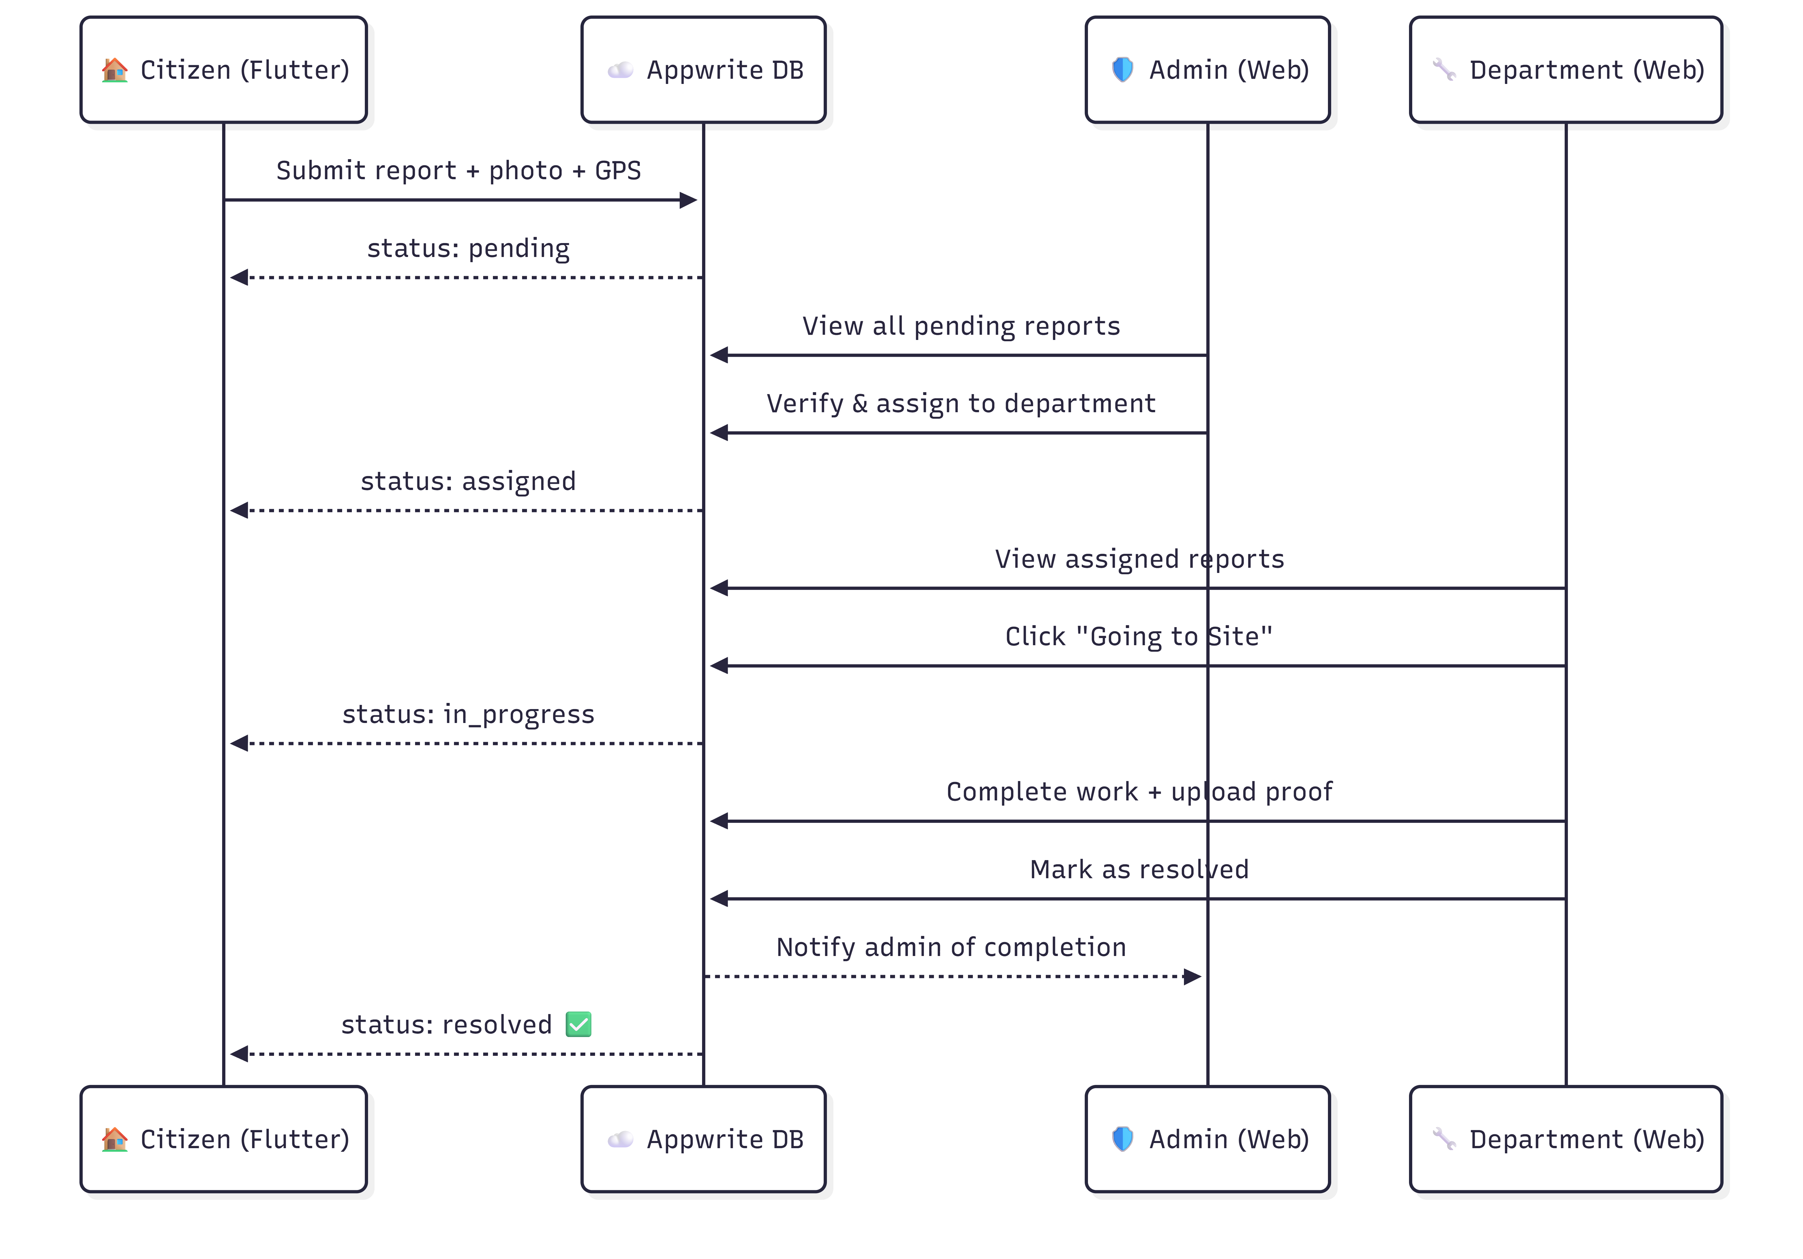
SYSTEM ARCHITECTURE DIAGRAM

Slide 14
MODULES
System Modules
User Authentication Module
Citizen Issue Reporting Module
Issue Management Module
Authority Dashboard Module
Admin & Analytics Module
Notification & Status Update Module

Slide 15
SOFTWARE DETAILS
Software Stack :
Frontend: React.js, HTML, CSS, JavaScript
Backend: Appwrite Cloud (Serverless Functions — Node.js)
Database: Appwrite Database (Cloud NoSQL)
Storage: Appwrite Storage (Cloud Object Storage)
Authentication: Appwrite Auth (Cloud-based Authentication)
Version Control: GitHub (Public Repository) — github.com/vkv211/civic-frontend

Slide 16
TIMELINE (GANTT CHART)
Activity | Jan | Feb | Mar | Apr
Problem Identification | ████
Review-1 (CA-01) | ███
Literature Survey & Design | ████
Review-2 (CA-02) | █
Frontend Development |  | ████
Review-3 (CA-03) |  | █
Backend & Integration |  |  | ████
Review-4 (CA-04) |  |  |  | █
Testing & Documentation |  |  |  | ███
Final Viva (CA-05) |  |  |  | █

Slide 17
References (IEEE Paper format)
[1] R. Ilamaran, M. Kavin Rajan, and S. Hareeswar, “Crowdsourced Civic Issue Reporting and Resolution System,” International Journal of Research Publication and Reviews (IJRPR), vol. 6, no. 11, pp. 8907–8910, Nov. 2025.
[2] K. Binu, K. Vinay, R. Midhun, V. P. Athul, and T. Shereena, “SmartReporter: A Crowdsourced Complaint Resolution System,” International Journal of Engineering Research & Technology (IJERT), vol. 15, no. 1, Jan. 2026.
[3] D. Walwadkar, J. Patil, M. Hussain, and S. Yadav, “Smart Civic Issue Reporting System,” International Journal of Advanced Research in Science, Communication and Technology (IJARSCT), vol. 2, no. 1, pp. 248–254, Mar. 2022, doi: 10.48175/IJARSCT-2659.
[4] S. G. Shukla, T. A. Bhandare, R. V. Bava, and I. S. Ahirrao, “Civic Complaint Registration Application for Citizens of Urban/Rural Areas,” Journal of Emerging Technologies and Innovative Research (JETIR), vol. 11, no. 5, May 2024.
[5] D. D. Meshram, R. R. Sahu, S. V. Pathak, K. P. Fukte, A. P. Darodkar, and G. S. Ramtekkar, “Smart Civic Issue Reporting, Resolution & Waste Recycle Reward System,” International Journal of All Research Education and Scientific Methods (IJARESM), vol. 13, no. 11, pp. 1377–1380, Nov. 2025.
[6] D. Walwadkar et al., “Civic Complaint Reporting Using Image Processing and NLP Techniques,” International Journal of Advanced Research in Science, Communication and Technology (IJARSCT), vol. 2, no. 1, Mar. 2022.
[7] A. Mohanty, P. Das, and S. Rout, “Crowdsourced Complaint Resolution System Using Geotagging,” International Research Journal of Modernization in Engineering Technology and Science (IRJMETS), vol. 7, no. 4, Apr. 2025.

Slide 18


