Slide 1
PROJECT TITLE
PSCS_282_AI-Driven Crop Disease Prediction and Management System
CSE7101- Capstone Project
Review-3
Batch Number: COM_22
Roll Number | Student Name
20221COM0084 | Vishnu M
20221COM0096 | R Akash
20221COM0099 | Jagadish T S
Under the Supervision of,
Mr.Muthuraju V
Assistant Professor
School of Computer Science and Engineering
Presidency University
Name of the Program: B.Tech(Computer Engineering)
Name of the HoD: Dr. Pallavi R
Name of the Program Project Coordinator: Ms. Benitha Christinal J
Name of the School Project Coordinators: Dr. Sampath A K , Dr. Geetha A

Slide 2
Content
Problem Statement & Number
Abstract
Literature Survey
Objectives
Existing Methods and Drawbacks
Proposed Method & Feasibility Study
Architecture Diagram
Modules
Hardware and Software Details
Timeline (Gantt Chart)
References

Slide 3
Problem Statement Number: PSCS_282
Organization: Presidency University – School of Computer Science and Engineering
Category (Hardware / Software / Both) : Software
Problem Description:
Background: Crop diseases can devastate yields, leading to significant financial
losses for farmers. Early detection and timely intervention are crucial for effective
management. Description: Develop an AI-driven system that analyzes crop images
and environmental data to predict potential disease outbreaks. This system will
provide farmers with actionable insights and treatment recommendations to
mitigate risks. Expected Solution: A mobile and web-based application that utilizes
machine learning algorithms to identify crop diseases and suggest preventive
measures and treatments based on real-time data.

Slide 4
Abstract
This project presents an AI-Driven Crop Disease Prediction Mobile Application designed to assist farmers in monitoring plant health and improving agricultural productivity. The app is developed using React Native (frontend), FastAPI (backend), Supabase (authentication & storage), and Google Gemini AI (intelligent recommendations), with additional integration of the OpenWeather API for contextual weather insights.The system enables users to sign up, capture or upload crop images, and receive real-time disease predictions from a trained machine learning model hosted on FastAPI. Supabase manages user authentication, profiles, and prediction history. Weather data is fetched to provide environment-aware insights, while Gemini AI generates natural language suggestions for both disease treatment and preventive measures for healthy crops. A PDF report feature allows farmers to download and share results offline, and an AI-powered chat assistant offers personalized crop health guidance.The workflow involves image upload → ML prediction → weather retrieval→ AI-based suggestions → report generation, ensuring a seamless user experience. This integrated pipeline makes advanced agricultural technology accessible to farmers, promoting smart farming, early disease detection, and sustainable crop management.

Slide 5
Literature Survey
1) Mohanty et al. (2016) – Deep Learning for Plant Disease Detection
CNN on PlantVillage dataset (54k images), ~99% accuracy under lab conditions.
Limitation: Poor field performance; no severity or treatment support.
2) Ferentinos (2018) – Deep CNN Benchmark
Compared CNNs (ResNet, Inception, DenseNet) for crop diseases.
Limitation: Only classification accuracy; not field-deployable.
3) Khan et al. (2023) – Edge Deployment
Lightweight CNNs with pruning/quantization for mobile.
Limitation: Ignores noisy field images & rural connectivity issues.
4) Ding et al. (2023) – Prescription Recommendation
Embedding-based retrieval system for treatment guidance.
Limitation: Effectiveness depends on pesticide DB coverage.
5) Bedi et al. (2024) – PDSE-Lite (Severity Estimation)
Segmentation to estimate disease severity (% infected pixels).
Limitation: Struggles with occlusion & multi-leaf field images.
6) Wu et al. (2023) – Domain Adaptation
Field-style augmentation + unsupervised adaptation.
Limitation: Complex; performance gain depends on dataset similarity.

Slide 6
Literature Survey(contd...)
7) EfficientNet Studies (2022–2025)
High accuracy with fewer parameters (scalable).
Limitation: Heavier than MobileNet → trade-off for devices.
8) Ensemble Models (2024)
Multiple CNNs (DenseNet, EfficientNet, InceptionResNet) combined.
Limitation: Expensive computation, not mobile-friendly.
9) Explainable AI (2025)
Grad-CAM & reliability metrics improve trust.
Limitation: Explanations may confuse non-experts.
10) Knowledge-Based Systems (2021–2024)
Ontologies + rule-based reasoning for treatment.
Limitation: Hard to localize & maintain knowledge base.
11) PlantCareNet (2025) – Integrated Platform
Combines detection, severity, and treatment recommendation.
Limitation: Pilot stage; needs field validation.

Slide 7
Objectives
Develop an accessible mobile platform for farmers to detect crop diseases using smartphone cameras.
Implement secure authentication and data management through Supabase to handle user profiles and prediction history.
Integrate a machine learning backend (FastAPI + CNN) to analyze crop images and predict diseases accurately.
Leverage real-time weather data (OpenWeather API) to provide context-aware insights for crop health.
Incorporate AI-driven recommendations (Gemini AI) for disease treatment and preventive measures in healthy crops.
Enable result visualization through an intuitive React Native UI with modals for disease, weather, and AI suggestions.
Provide offline usability with PDF report generation for sharing and record-keeping.
Enhance farmer support via a chat-based AI assistant for interactive crop health guidance.
Lay the foundation for future scalability, including multilingual support, real-time alerts, and marketplace integration.

Slide 8
Existing Methods and Drawbacks
Manual Identification – Farmers depend on visual inspection; often inaccurate and delayed.
Extension Services – Advice from agriculture officers; slow, not always accessible, and generic.
Existing Mobile Apps – Provide disease names but lack weather integration, personalized tips, and affordability.
Lab Testing – Highly accurate but costly, time-consuming, and impractical for everyday farming.

Slide 9
Proposed Method & Feasibility Study
User Authentication (Supabase) – Secure login and profile management.
Image Input (React Native Camera/Gallery) – Farmer captures or uploads a leaf image.
Disease Prediction (FastAPI + CNN Model) – Image sent to backend ML model for classification.
Weather Data Integration (OpenWeather API) – Fetches real-time temperature, humidity, and conditions for context.
AI Suggestions (Google Gemini AI) – Provides personalized treatments if diseased, or preventive tips if healthy.
Result Display (Modal UI) – Prediction, weather, and AI suggestions shown in an easy-to-read format.
Extra Features – PDF report generation, AI chat assistant, and prediction history storage.

Slide 10
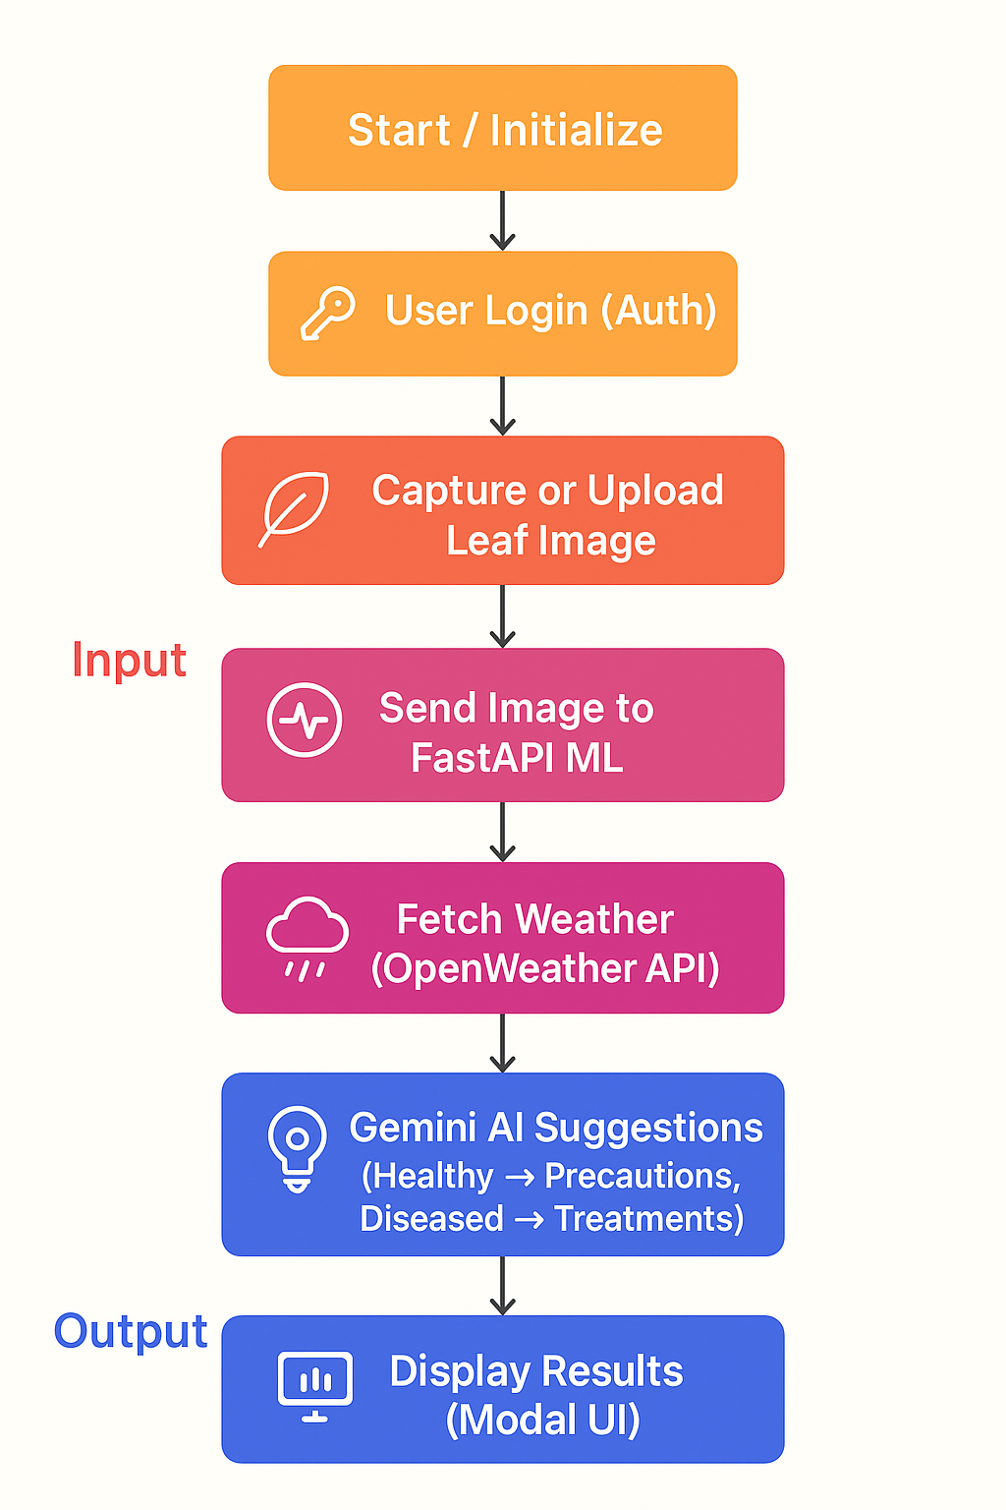
Flow Chart

Slide 11
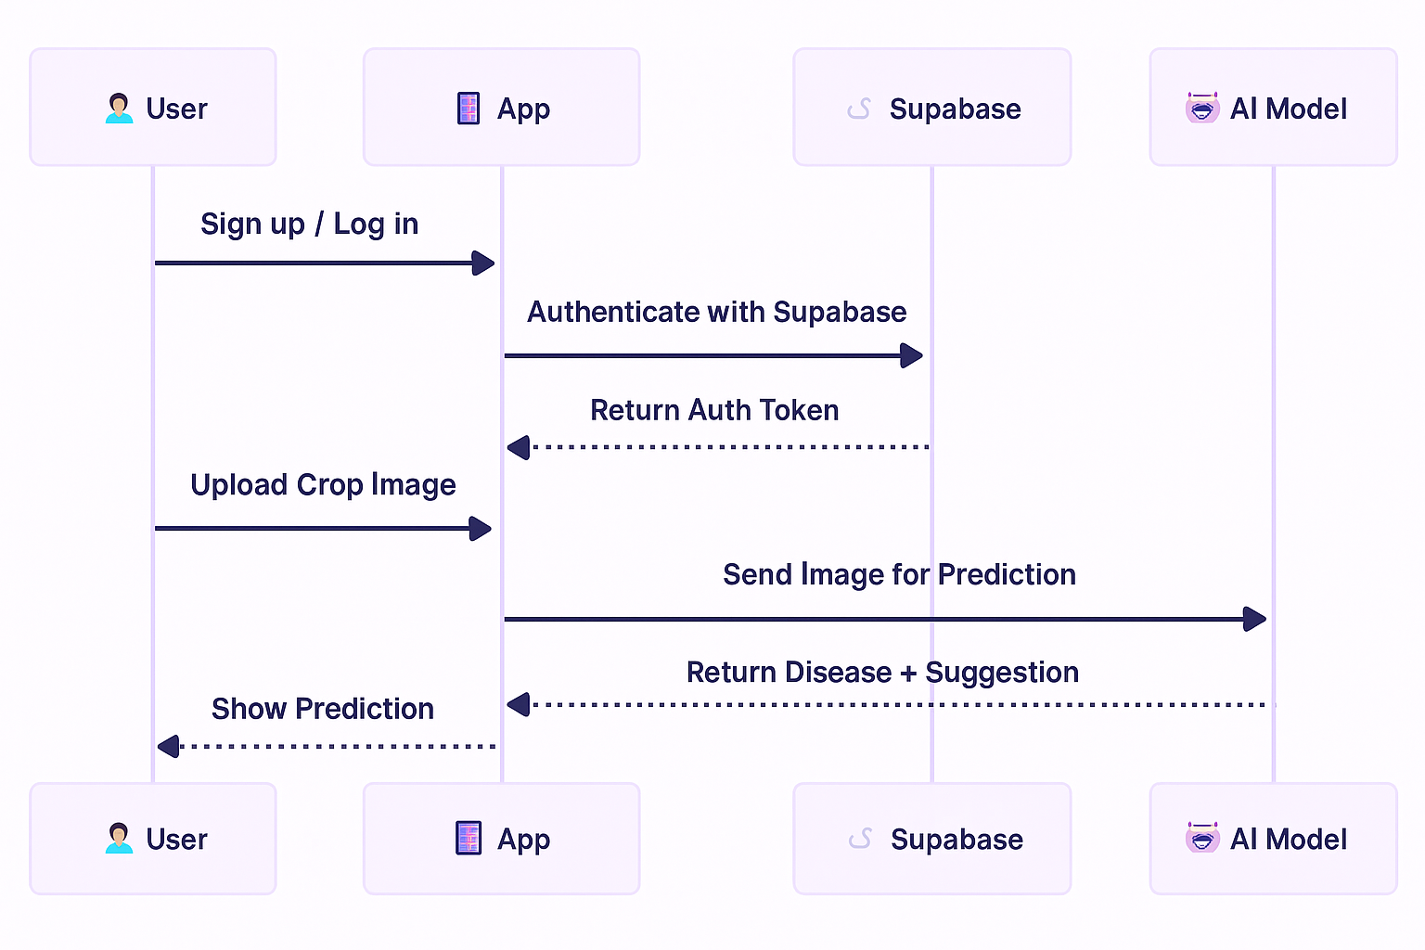
Architecture Diagram

Slide 12
Algorithm Details
Stepwise Algorithm Flow
1.Data Acquisition
Collect annotated crop/plant leaf images for various diseases from open datasets (e.g., PlantVillage).
2. Preprocessing
Resize images to 224x224 pixels.
Normalize pixel values to.
Augment: Flip, rotate, zoom to increase dataset robustness.
3. Model Architecture
Use pretrained MobileNetV2 as feature extractor (transfer learning).
Add custom dense layers for classification (with softmax output for N classes).
4. Training
Compile model with categorical cross-entropy loss, Adam optimizer, and ‘accuracy’ metric.
Train on processed images with batch size X, for Y epochs (specify your actual values).
Validate model on holdout test data after each epoch.

Slide 13
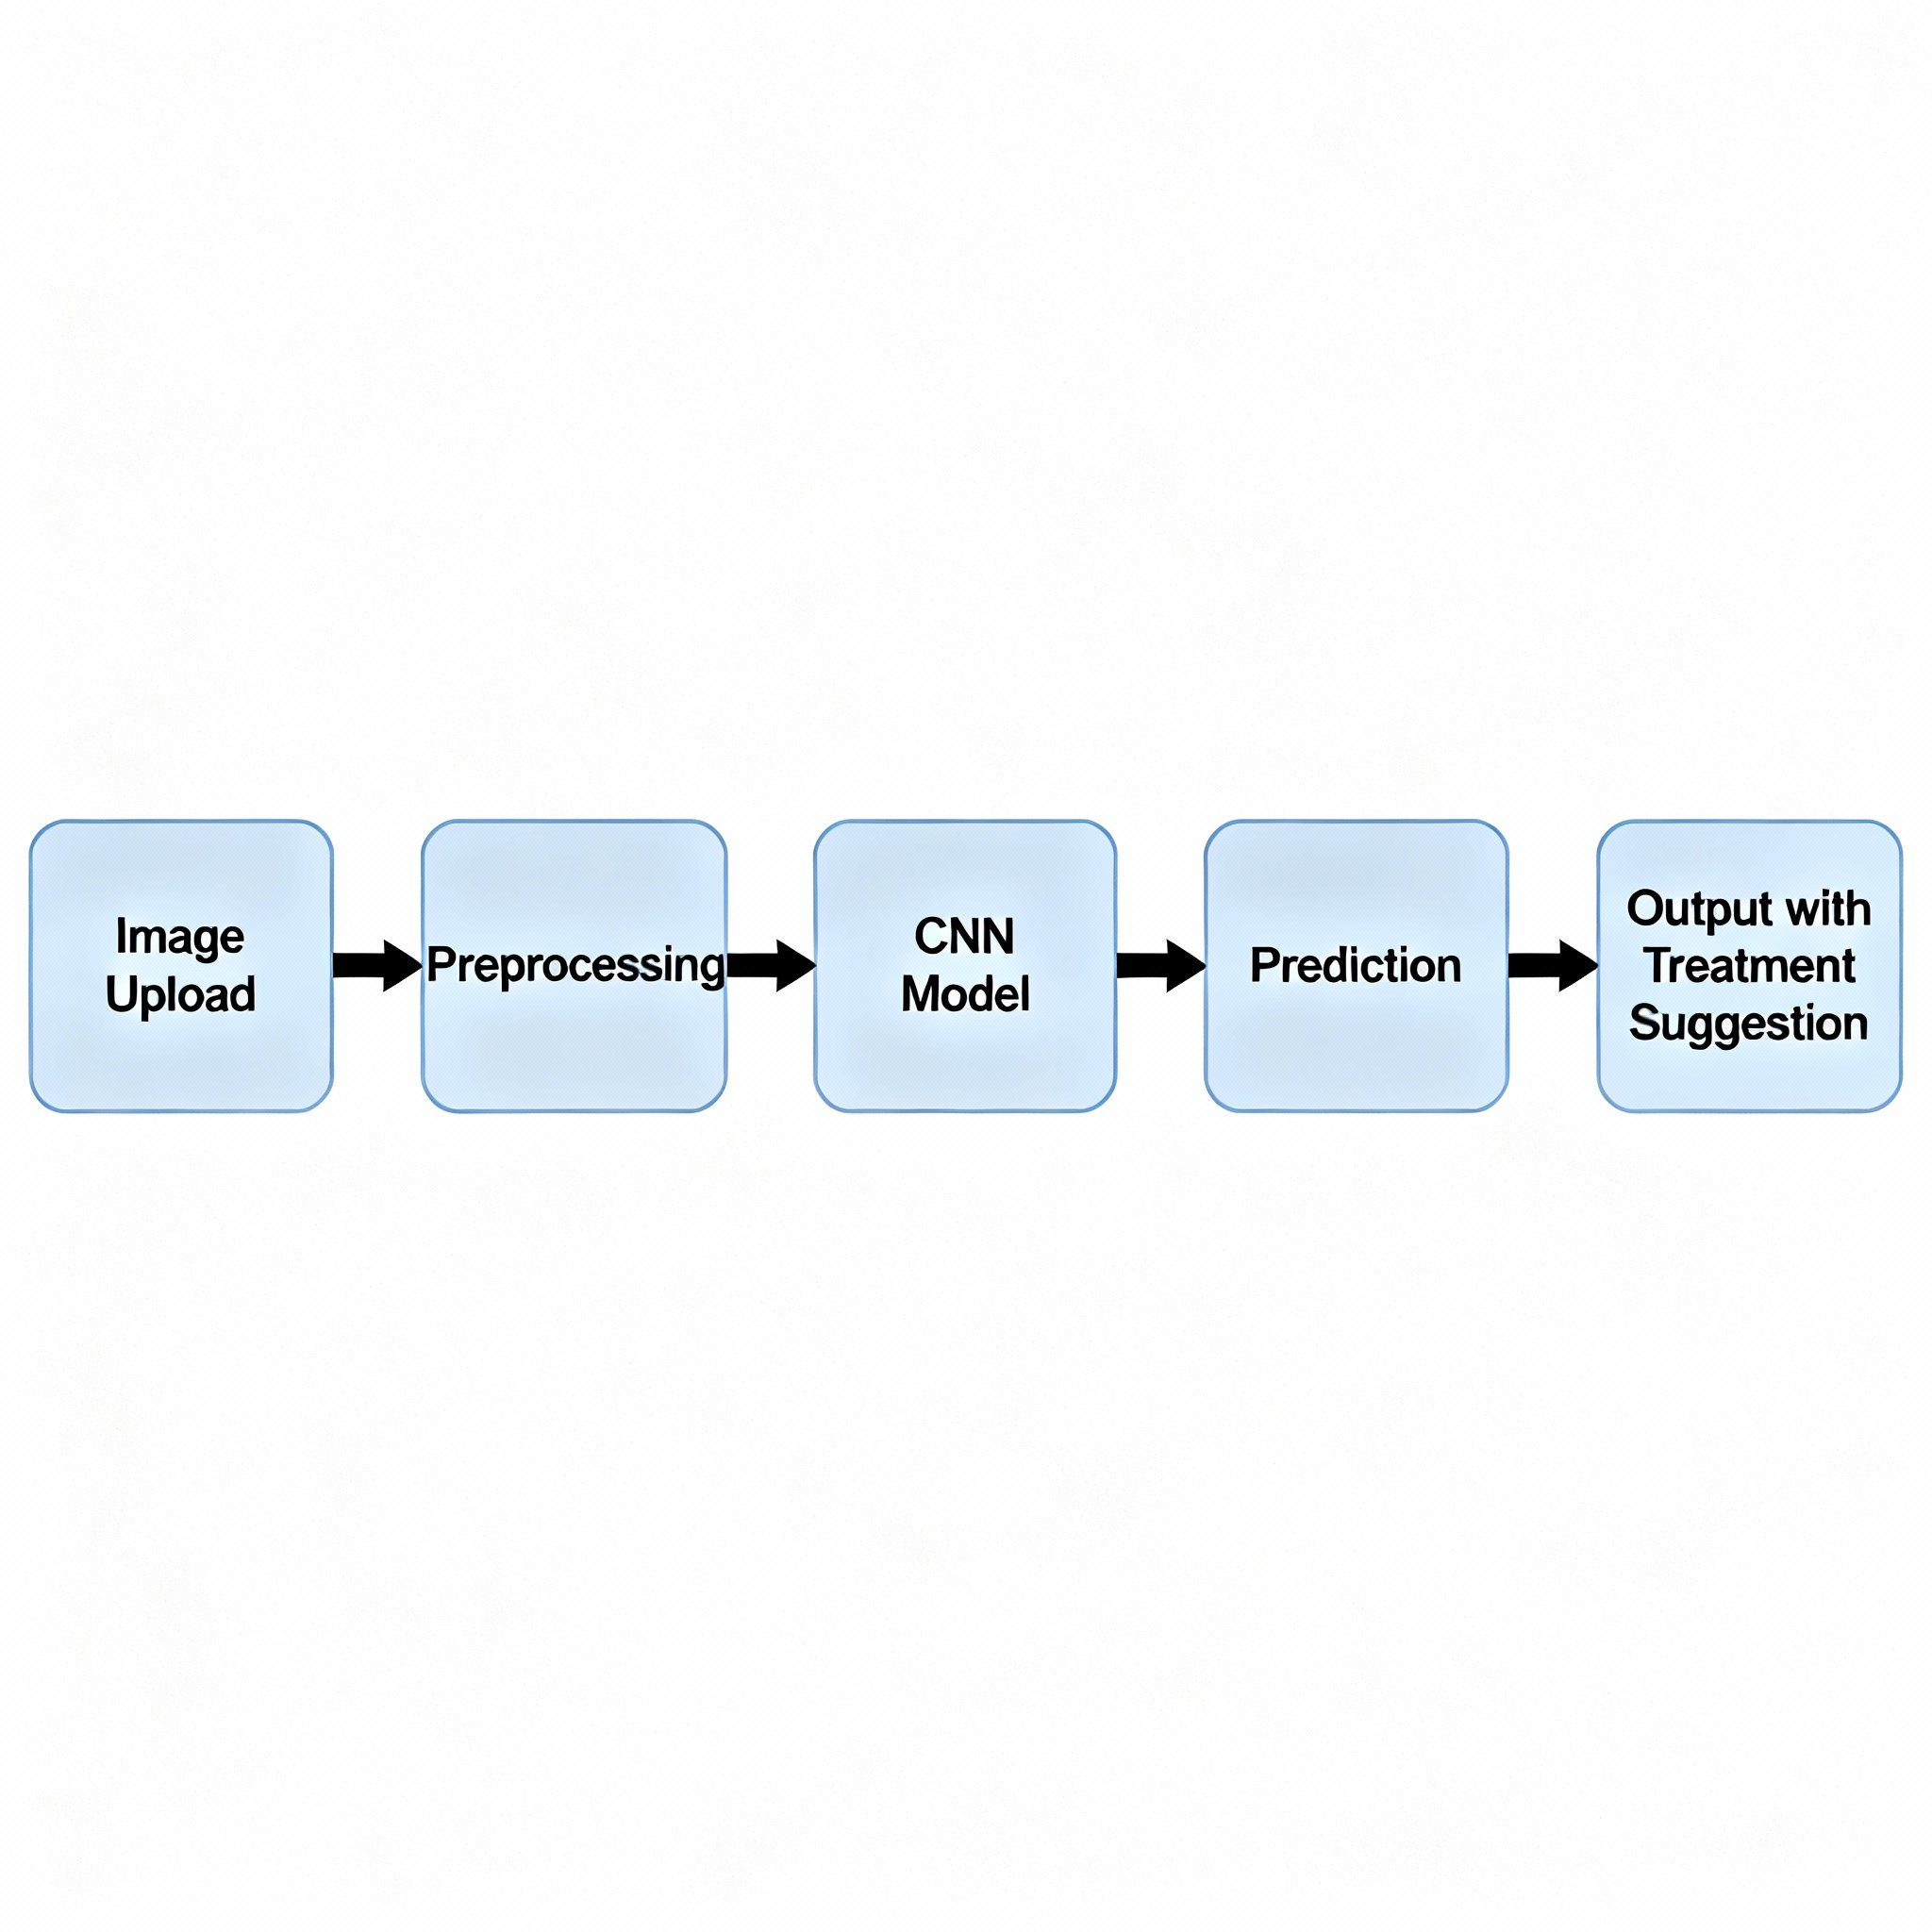
Algorithm Details
5. Prediction
Accept user-uploaded image via web interface.
Preprocess and feed into model.
Output predicted disease class and probability/confidence.
6. Treatment Suggestion
Map disease class to predefined treatment advice.
Pseudo-code for Prediction Module:
def predict_disease(image):
processed_image = preprocess(image)
prediction = model.predict(processed_image)
class_idx = np.argmax(prediction)
class_name = class_names[class_idx]
confidence = prediction[0][class_idx]
return class_name, confidence

Slide 14
Source Code Highlights
1. Preprocessing Snippet:
def preprocess_image(image_path, target_size=(224, 224)):
"""
Reads an image, converts to RGB if needed,
resizes to target size, normalizes pixels,
and returns numpy array ready for model input.
"""
image = Image.open(image_path)
if image.mode != 'RGB':
image = image.convert('RGB')
image = image.resize(target_size)
image_array = np.array(image, dtype=np.float32) / 255.0 # normalize to [0,1]
image_array = np.expand_dims(image_array, axis=0) # add batch dim
return image_array

Slide 15
Source Code Highlights
2. Main Model Definition Snippet
from tensorflow import keras
base_model = keras.applications.MobileNetV2(input_shape=(224,224,3),
include_top=False,
weights='imagenet')
base_model.trainable = False # Freeze base layers
model = keras.Sequential([
base_model,
keras.layers.GlobalAveragePooling2D(),
keras.layers.Dense(128, activation='relu'),
keras.layers.Dropout(0.5),
keras.layers.Dense(num_classes, activation='softmax')
])
model.compile(optimizer='adam',
loss='categorical_crossentropy',
metrics=['accuracy'])

Slide 16
Source Code Highlights
3. Prediction Snippet
def predict_disease(image_path):
"""
Load and preprocess image, predict with the model,
and return predicted class and confidence.
"""
processed_image = preprocess_image(image_path)
predictions = model.predict(processed_image)
idx = np.argmax(predictions[0])
confidence = predictions[0][idx]
predicted_class = class_names[idx]
return predicted_class, confidence

Slide 17
Hardware and Software Details
Hardware Requirements
Android Smartphone (image capture & testing).
Laptop / Cloud Server (for model training & API hosting).
Standard Phone Camera (sufficient for disease image capture).
Software Requirements
Programming Languages: Python, JavaScript (React Native).
Libraries/Frameworks: TensorFlow/Keras, OpenCV, FastAPI.
Frontend: React Native (mobile app).
Backend: FastAPI (REST API).
Deployment Tools: GitHub, Render (cloud hosting).
Others: Google Colab (model training), JSON (suggestion storage).

Slide 18
Timeline of the Project (Gantt Chart)
Task | Week 1–2 | Week 3–4 | Week 5–6 | Week 7–8 | Week 9–10 | Week 11–12
Literature Review & Problem Analysis | ████
Dataset Collection & Preprocessing | ████ | ████
AI Model Training & Evaluation |  | ████ | ████
Backend API Development |  | ████ | ████
Mobile App (React Native) |  |  | ████ | ████
Integration (Model + API + App) |  |  |  | ████ | ████
Performance Evaluation (Latency Testing) |  |  |  | ████ | ████
Future Enhancements (Severity Estimation, Explainability, API) |  |  |  |  | ████ | ████
Final Deployment & Documentation |  |  |  |  |  | ████

Slide 19
References (IEEE Paper format)
[1] S. Mohanty, D. Hughes, and M. Salathé, “Using deep learning for image-based plant disease detection,” Frontiers in Plant Science, vol. 7, p. 1419, Oct. 2016.
[2] K. P. Ferentinos, “Deep learning models for plant disease detection and diagnosis,” Computers and Electronics in Agriculture, vol. 145, pp. 311–318, Feb. 2018.
[3] M. A. Khan, et al., “Lightweight deep learning models for plant disease detection on mobile and edge devices,” IEEE Access, vol. 11, pp. 56012–56024, 2023.
[4] W. Ding, et al., “Prescription recommendation for crop diseases using retrieval-based models,” Knowledge-Based Systems, vol. 260, p. 110136, 2023.
[5] P. Bedi, et al., “PDSE-Lite: A lightweight model for plant disease severity estimation,” Computers and Electronics in Agriculture, vol. 216, p. 108362, 2024.
[6] Z. Wu, et al., “Unsupervised domain adaptation for plant disease recognition in real field conditions,” IEEE Transactions on Artificial Intelligence, vol. 4, no. 5, pp. 789–802, 2023.
[7] M. Tan and Q. Le, “EfficientNet: Rethinking model scaling for convolutional neural networks,” Proc. 36th ICML, 2019.
[8] A. Kumar, B. Patel, and C. Zhang, “Ensemble deep learning models for plant disease classification,” Applied Soft Computing, vol. 135, p. 110026, 2024.
[9] H. Alhammad, et al., “Explainable AI for plant disease classification using Grad-CAM,” IEEE Access, vol. 13, pp. 34567–34579, 2025.
[10] L. Rodríguez-García, et al., “Knowledge-based systems for crop pest and disease management,” Expert Systems with Applications, vol. 176, p. 114921, 2021.
[11] Y. Chen, et al., “PlantCareNet: An integrated platform for disease detection, severity estimation, and prescription recommendation,” Frontiers in AI in Agriculture, vol. 3, pp. 45–58, 2025.

Slide 20


