Slide 1

VNG NEXT GEN 2026
A CHAIN TO HEAVEN

Slide 2
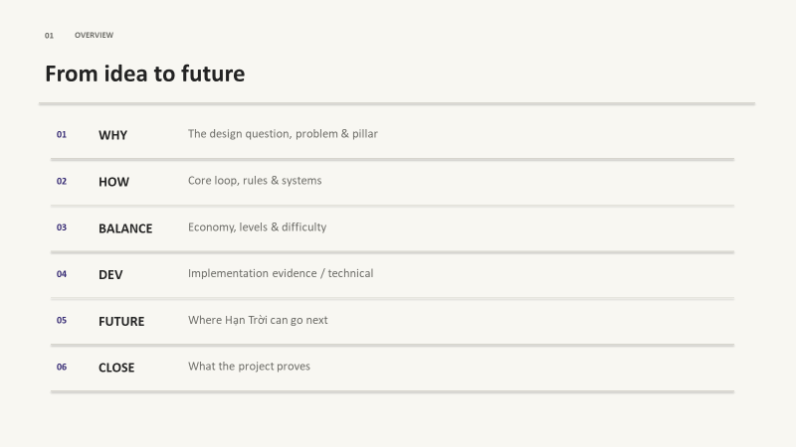

Slide 3


HISTORICAL ROOTS AND DIVERSITY IN VIETNAMESE SOCIETY
WHY HẠN TRỜI
HISTORICAL HERITAGE
BEAUTIFUL AND RICH
ETHNIC DIVERSITY
MORE ROOM TO DEVELOP
VIET NAM FOLKLORE
RELATABLE

Slide 4
A CHAIN TO HEAVEN
ONE LINER

Slide 5
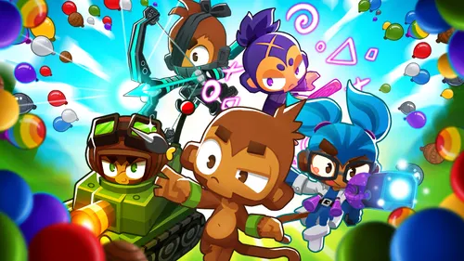
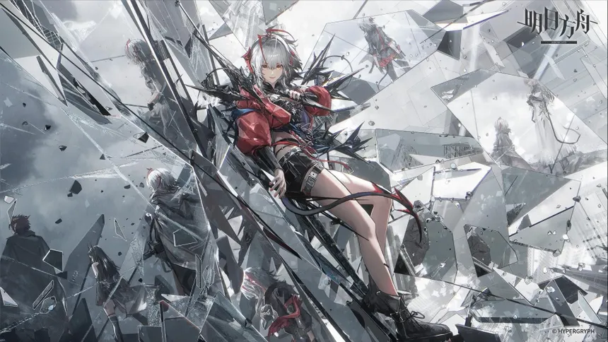
TRADITION TOWER DEFENSE
BEHAVIOUR
WHICH ENEMIES DO I TARGET ?
DAMG COME FROM PLACING TURRET

Slide 6
HẠN TRỜI DESIGN DECISION
WHERE DO I PUT DAMAGE ?
DAMG COME FROM PERFECT PLACEMENT AND CHAIN

Slide 7
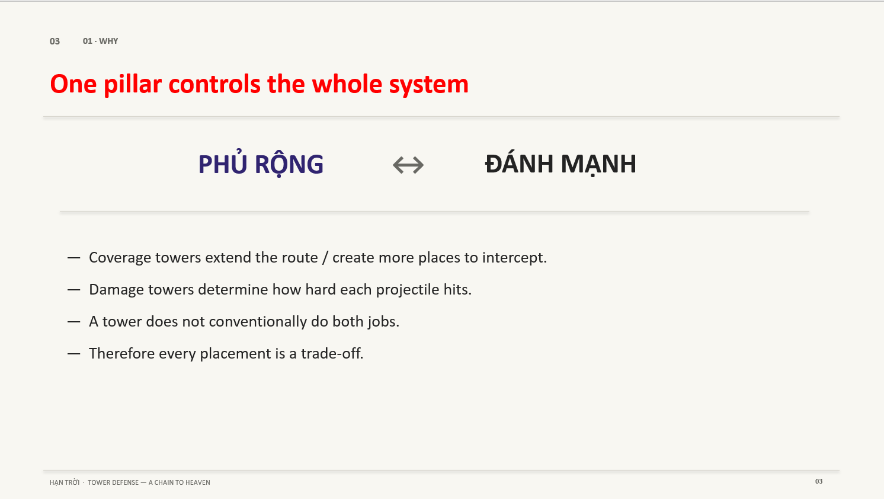

Slide 8

CORELOOP
WHAT’S THE GAME ABOUT
READ BUILD CONNECT RUN SETTLE
WAVE TOWER WIRE WAVE GOLD/HP

Slide 9
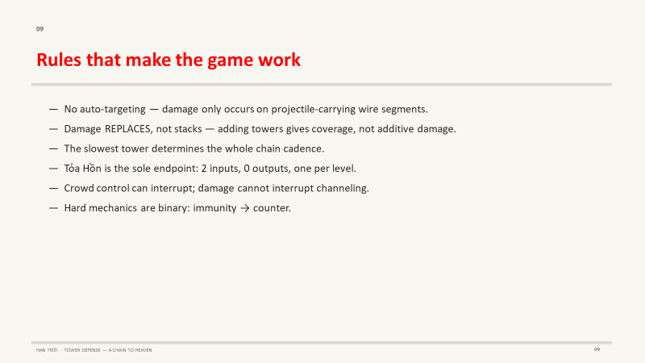

Slide 10

TURRETS
NGŨ HÀNH

Slide 11
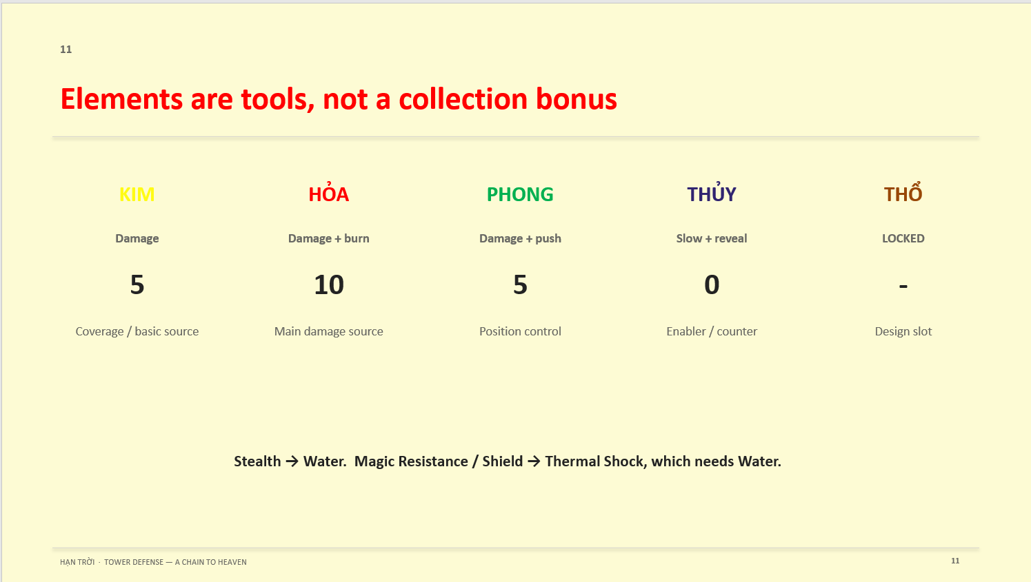

Slide 12
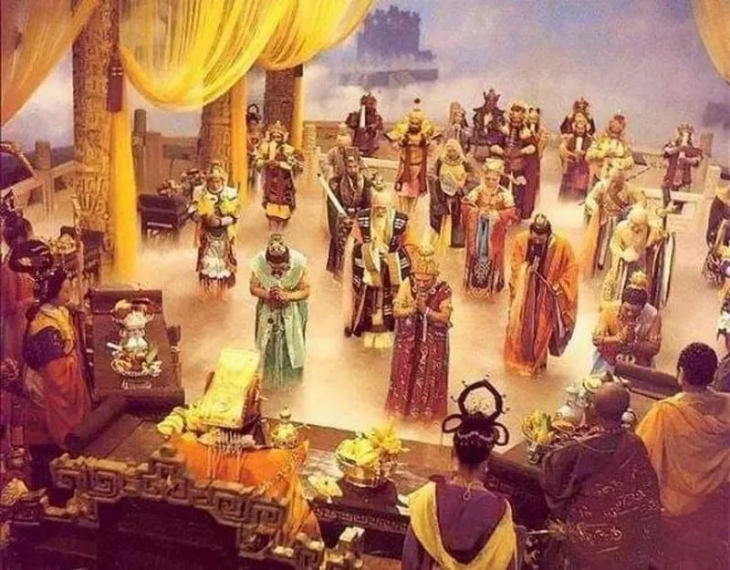
INSPIRATION
EXPLORING THE VIBRANT OF VIETNAM CELESTIAL COURT
DỰA THEO FOLKORE
ENEMIES

Slide 13
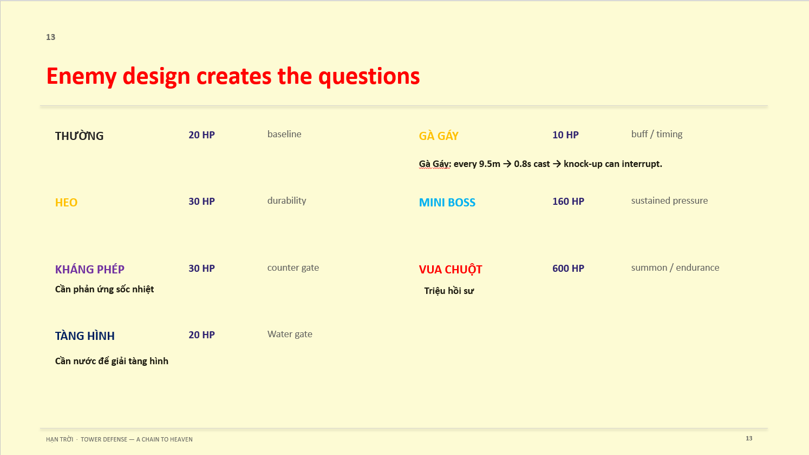
INSPIRATION
ENEMIES
EXPLORING THE VIBRANT OF VIETNAM CELESTIAL COURT
DỰA THEO FOLKORE

Slide 14

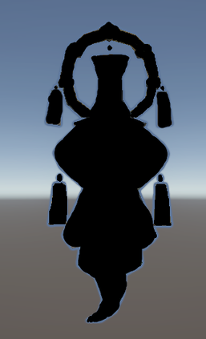
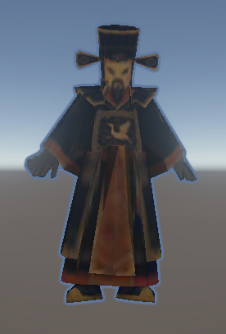
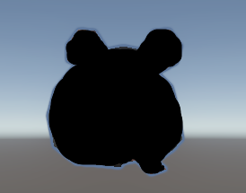
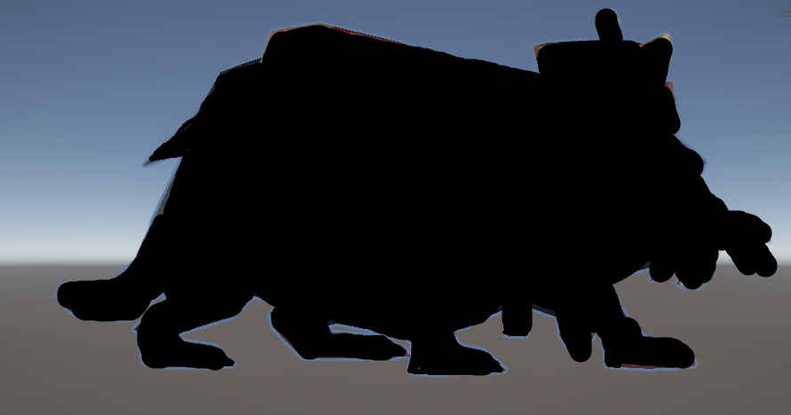
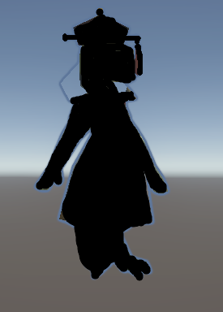
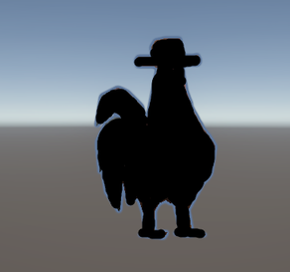
INSPIRATION
ENEMIES
EXPLORING THE VIBRANT OF VIETNAM CELESTIAL COURT
DỰA THEO FOLKORE

Slide 15
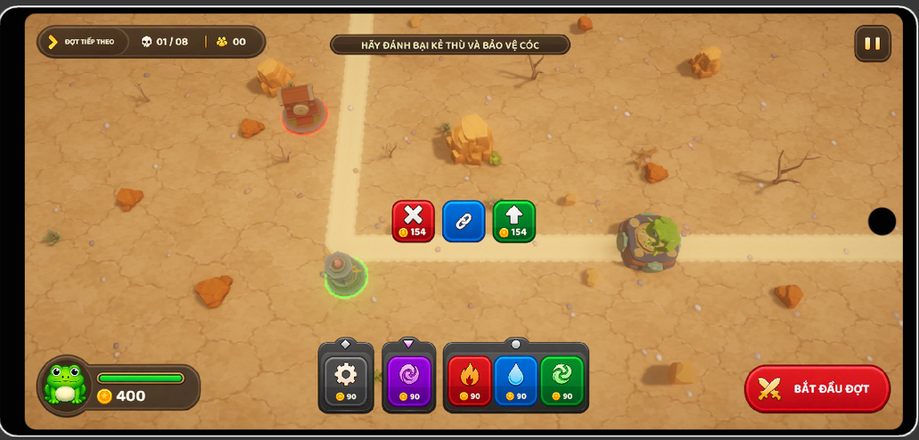
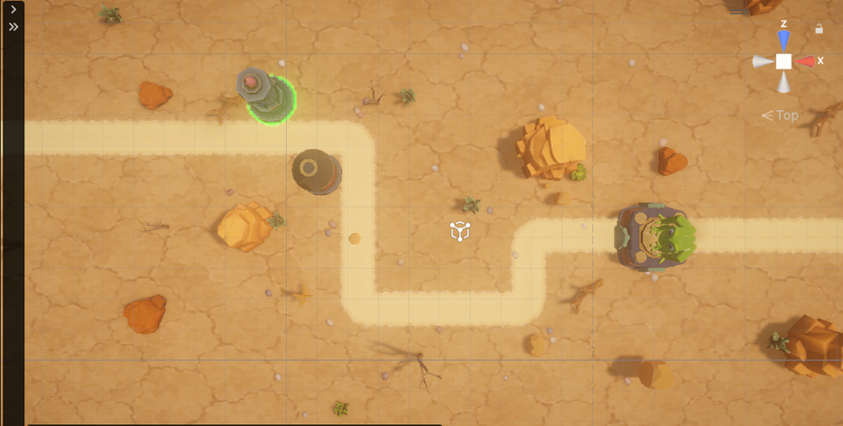
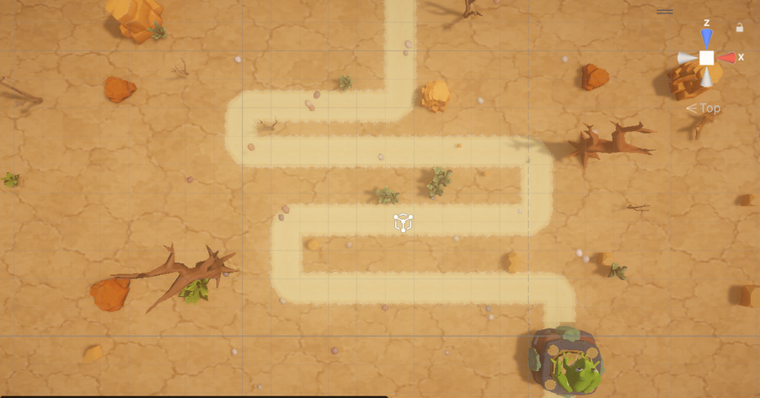
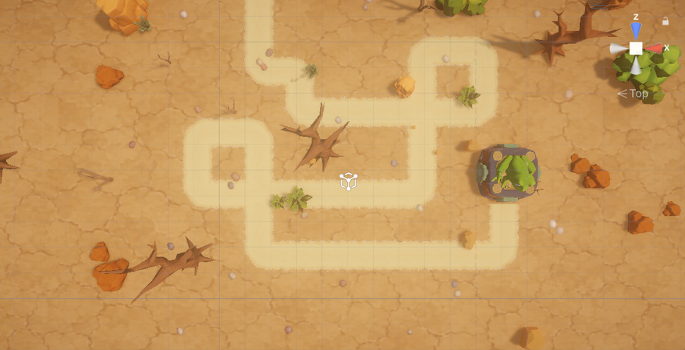
MAP LAYOUT
1
2
3
4

Slide 16
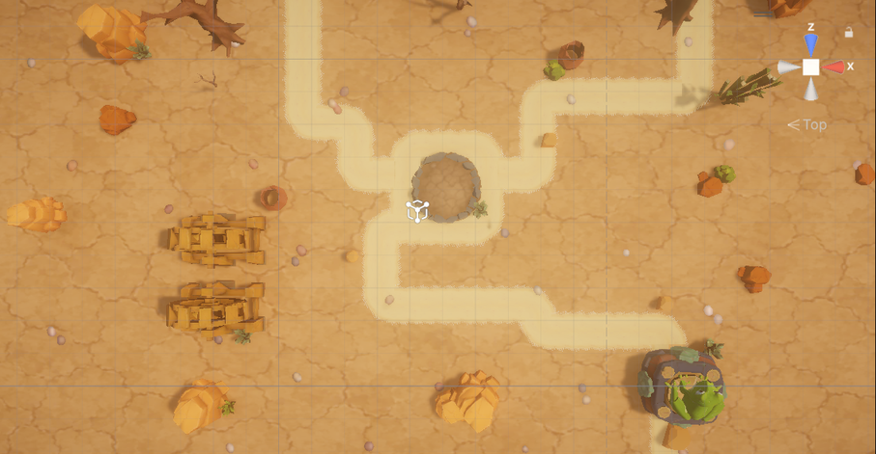
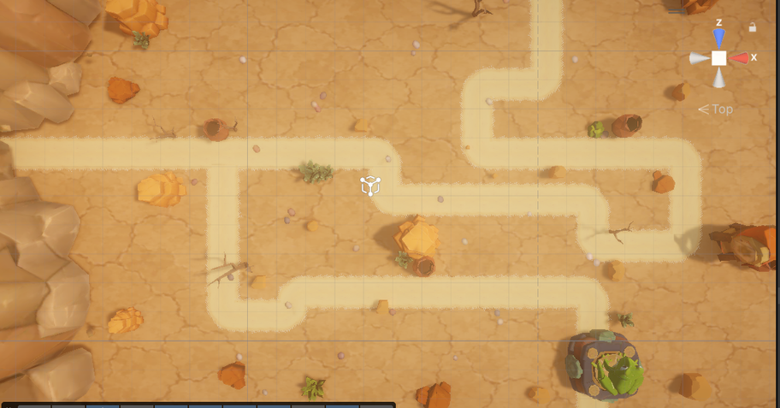
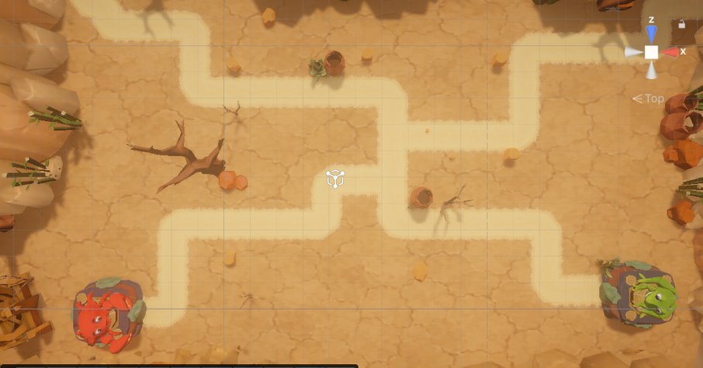
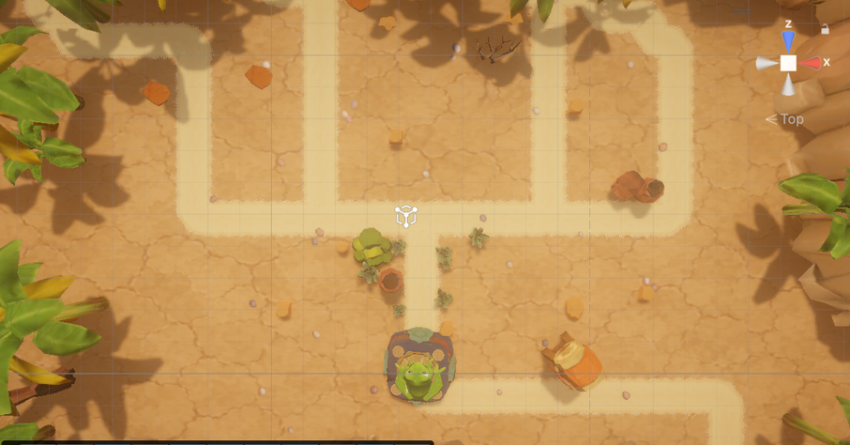
MAP LAYOUT
5
6
7
8

Slide 17
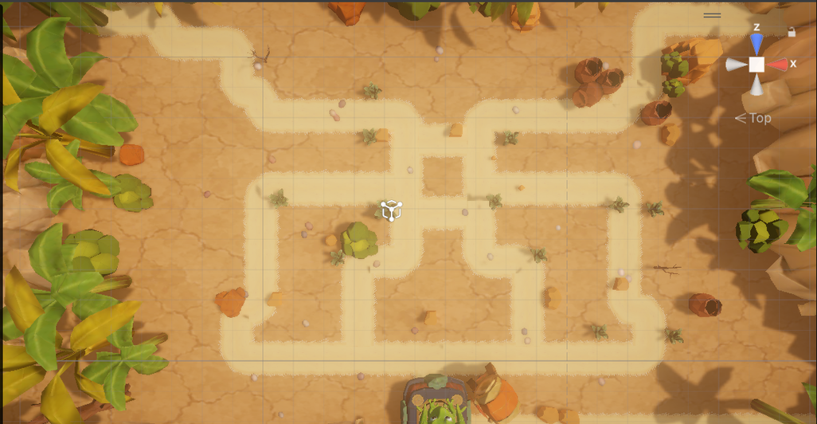
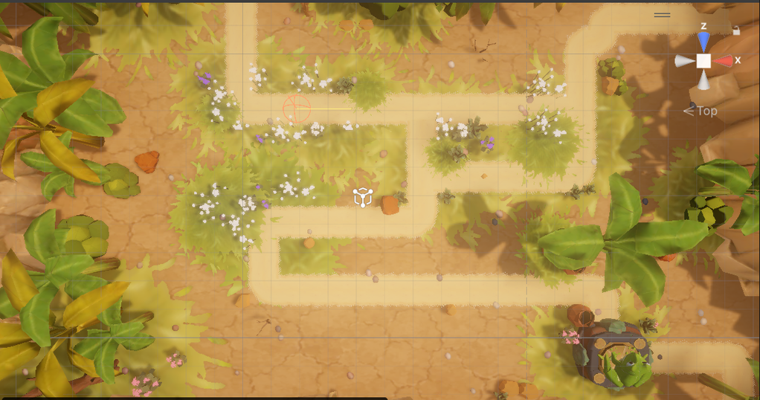
MAP LAYOUT
9
10

Slide 18
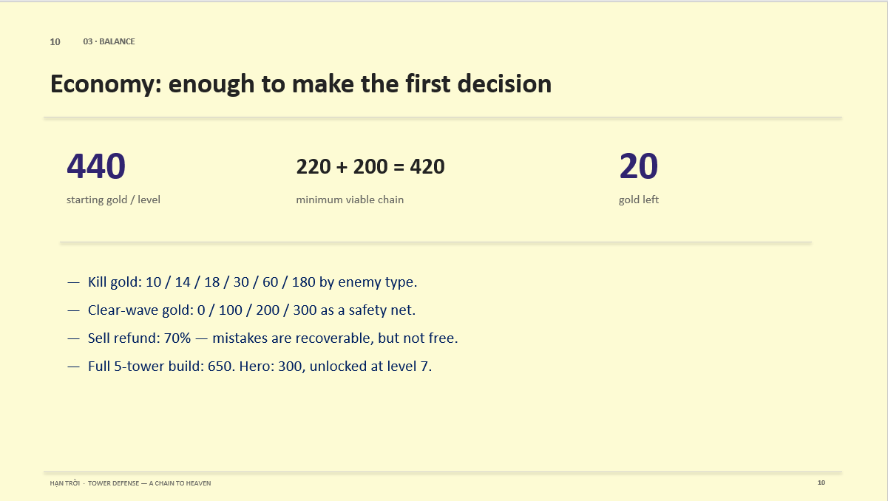
SOURCE
SINK
--- TOWER UPGRADE

Slide 19
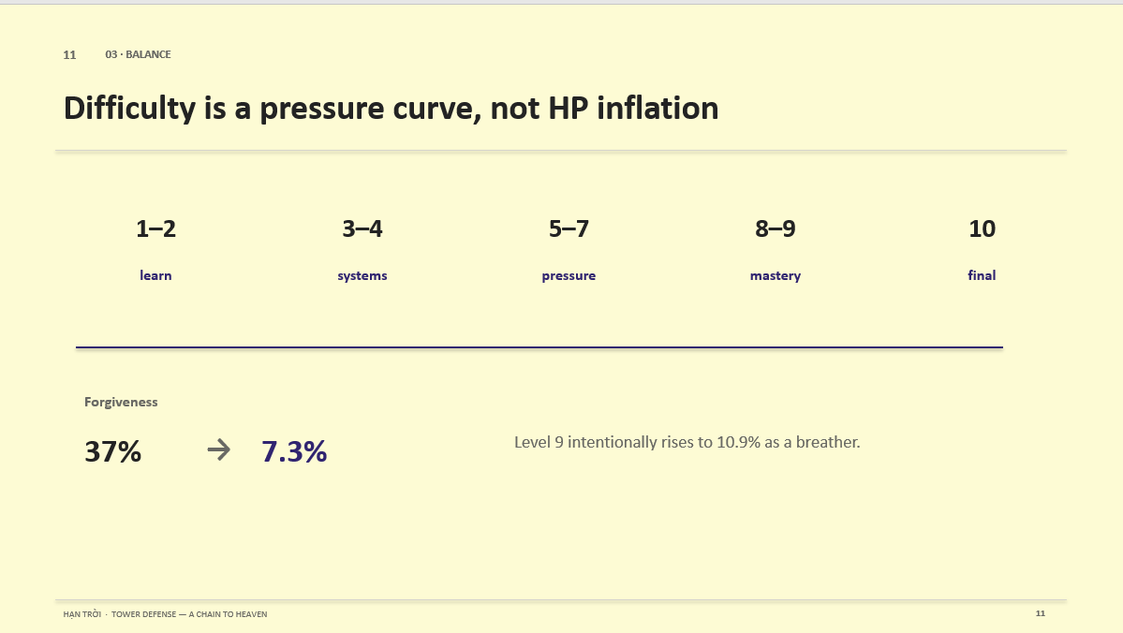

Slide 20
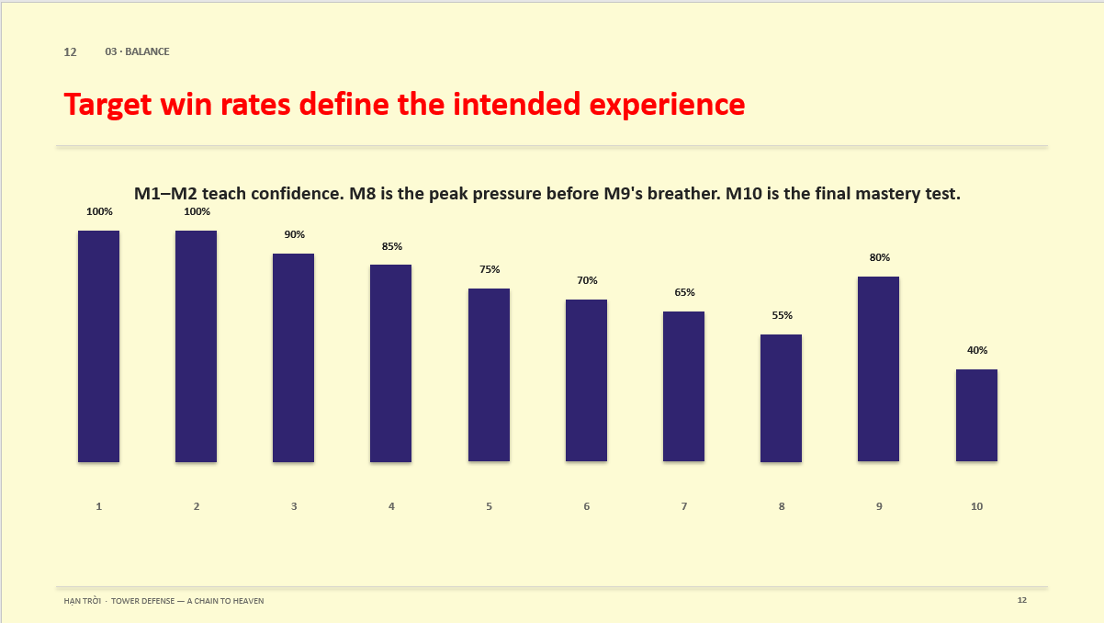

Slide 21
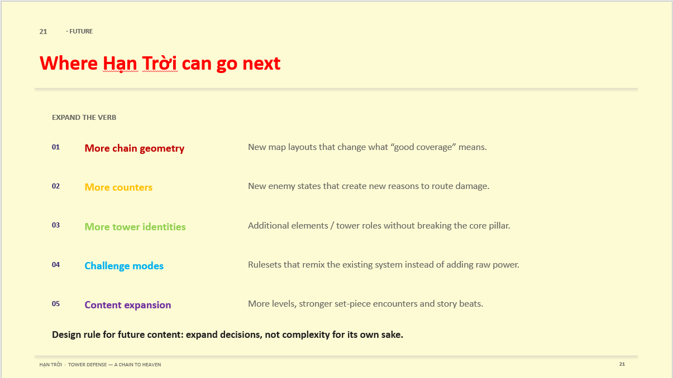

Slide 22
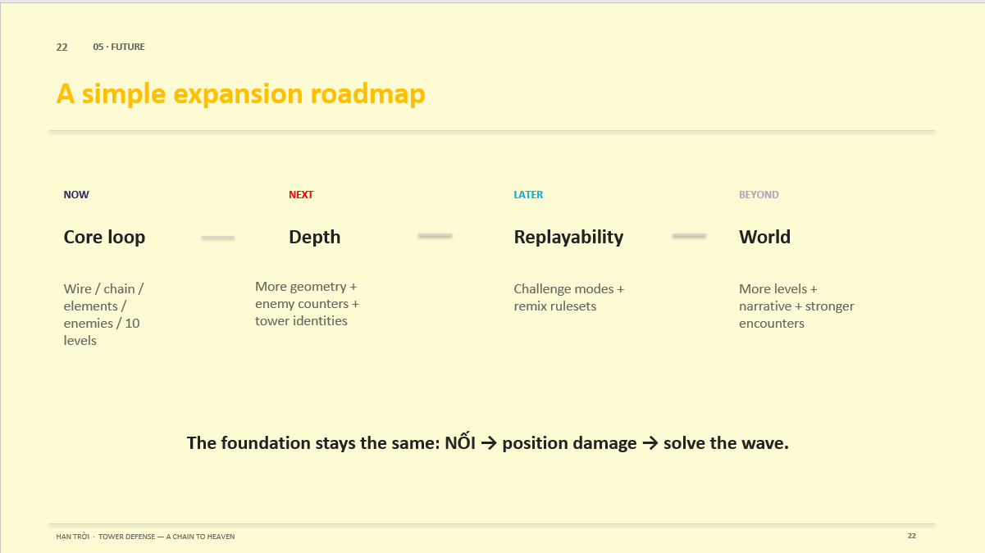

Slide 23
LIVE DEMO

Slide 24
TECHNICAL SPEC
DEV

Slide 25
  Architecture
  Techniques
  Data
  Graphic
  AI Workflow

Slide 26
ARCHITECTURE
Layered Architecture
BENEFIT
APPLICATION
  Tests can run in edit mode
  Swappable UI
  Readability
COMPONENTS
SYSTEM

Slide 27
ARCHITECTURE
BENEFIT
  Execution Orders
  Reduce Update() cost
Single Entry Point
INIT SYSTEM,
REGISTER COMPONENTS
Monobehavior
SYSTEM A
APPLICATION LIFE TIME SCOPE
SINGLE ENTRY POINT
SYSTEM B
Bootscene
RUN UNITY LIFE CYCLE (ITickable/ILateTickable)
SYSTEM C

Slide 28
ARCHITECTURE
VContainer - Dependency Injection
BENEFIT
DISADVANTAGE
  Nested scopes match the game's real lifetimes
  Level scope disposed → 33 systems die together, no leaks
  Dependencies visible in the constructor signature
  1 Fail whole game Fail
  Hard to debug

Slide 29
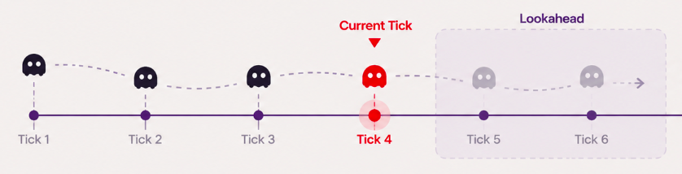
TECHNIQUES
Tick System
=> NO MID-WAVE INTERACTION
  Precomputed
  Frame-rate independent
  Zero raycasts, colliders or collision callbacks during combat
  Lookahead — can query events before they happen (For Tutorial)
  Speed control is one multiplication
  Testable without a scene

Slide 30
TECHNIQUES
Object Pooling, Particle Emitter, VFX Prewarm, Audio Pool
  Reduce instantiate cost
  Reduce Draw call of Particle System, disadvantage: not for moving particle system
  Build shader pipelines at boot to avoid first-use frame spikes.
  Fixed 6 audio voices, steal by priority; cooldown blocks sound spam

Slide 31
DATA
ScriptableObject, JSON Save System
  13 ScriptableObject types — designer balances numbers without touching code
  Every asset self-validates at load, not mid-game
  Save: write temp → validate → atomic File.Replace, never a half-written file
  Primary + backup copy; stale schemaVersion rejected

Slide 32
GRAPHIC
Bloom
  DownScale: Mặc định Half → Quarter
  DownSample: Mặc định 6 → 4
  High Quality Filtering: Mặc định Bật → tắt
LightBaking
Batching & GPU Instancing
  Rule: a type repeated 6+ times in a level drops Batching Static and falls back to GPU Instancing - static batching duplicates transformed vertices per repeat, instancing stores the mesh once
  008 BananaTree ×12, SmallBush ×8, SunstoneCliff ×7, BananaTree2 ×7, BananaTree3 ×6
  006 Rock_04 ×10, BigRock ×8, SmallBush ×8, VerticalTwig ×7, SmallRock ×6
  009 SmallBush ×13, BananaTree ×13, MediumBush ×9, SunstoneCliff ×7, BananaTree2 ×7, BananaTree3 ×6
  010 BananaTree ×14, SmallBush ×12, MediumBush ×9, SM_Env_Flowers_01 ×8, SunstoneCliff ×7, BananaTree2 ×7, Rock_03 ×6

Slide 33
GRAPHIC
Material Properties Block
  Enemies and towers are tinted per object (damage flash, stealth, element) - only a Material Property Block can do that without cloning the material
  But SRP Batcher needs every property inside CBUFFER UnityPerMaterial, so one shader cannot serve both paths
  TheVayuputra/ToonShader, CBUFFER UnityPerMaterial - scenery, props, environment | SRP Batcher
  TheVayuputra/ToonShaderInstanced, UNITY_INSTANCING_BUFFER - enemies, towers, frog | GPU Instancing

Slide 34
GRAPHIC
Sprite Atlas
  3 atlases split by screen: Gameplay 35 sprites, Menu 7, Shared 11
  An atlas is one texture, fully resident while any sprite in it is on screen
  Merged into one, Menu sprites would sit in RAM through a whole level
  Shared holds what both screens use, so nothing is duplicated
  ETC2_RGBA8 on Android, max size 2048
Raycast Target

Slide 35
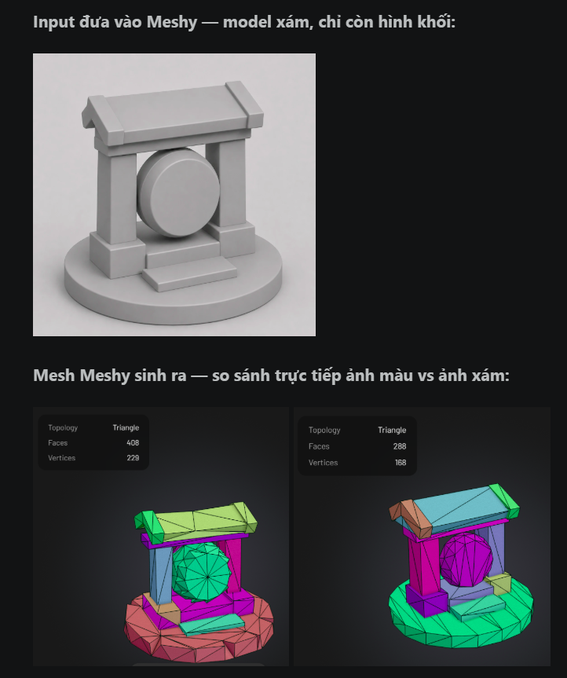
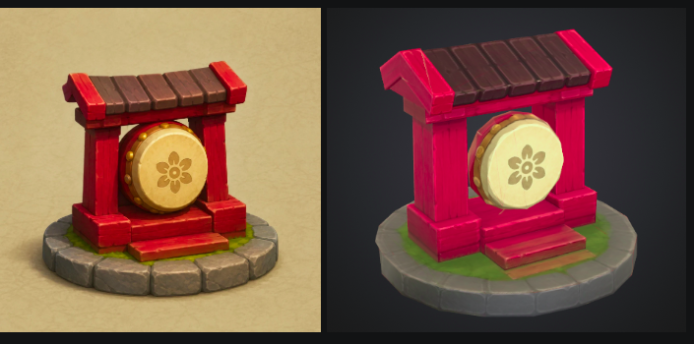
AI WORKFLOW
Model optimization

Slide 36
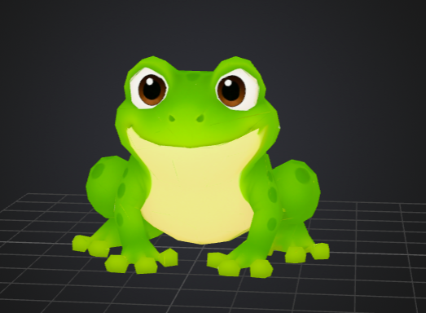
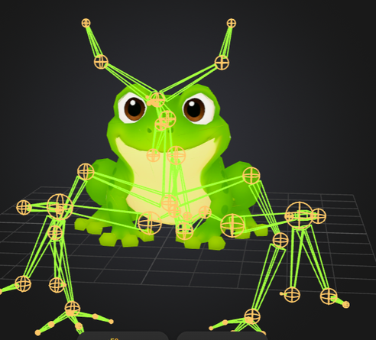
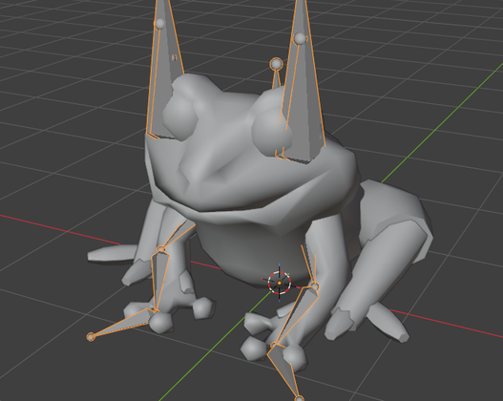
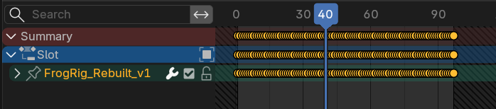
AI WORKFLOW
Animation
BONES & WEIGHT REFINE USING BLENDER MCP

Slide 37
AI WORKFLOW
CODEGRAPH FOR CODING
Coding
READ
COCOINDEX FOR DOCUMENTS
AGENTS
BETTER CONTEXT FOR FILES NAVIAGATION
WRITE
SERENA
TASK
BEADS

Slide 38
THIS IS THE END OF
HẠN TRỜI
GAME SHOWCASE
THANK YOU FOR YOUR ATTENTION.
ANY QUESTION ?

