Slide 1
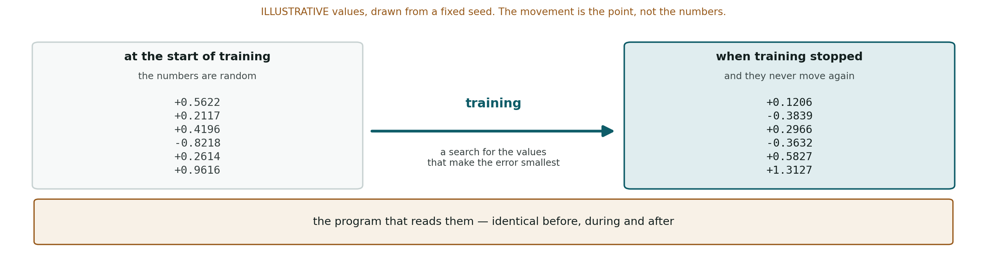
Neural network and learning are borrowed names for a search over numbers

Slide 2
Neural network
layers of multiply-and-add, named after a biological analogy
Learning
a search for values that lower the error
The brain comparison
correlational; the appendix carries what it establishes
Source: Schrimpf, M., Blank, I. A., Tuckute, G., et al., 2021. PNAS 118(45):e2105646118 Hadidi, N., Feghhi, E., Song, B. H., Blank, I. A. Kao, J. C., 2026. Nature Communications 17(1):5769

Slide 3
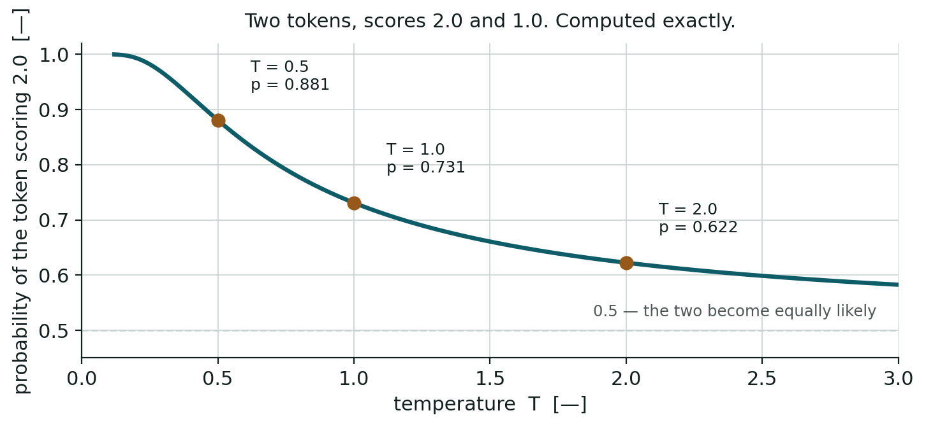
Softmax converts the scores into probabilities that add up to one
pi = exp​ziscore for token i/T⏟temperaturej​exp(zj/T)⏟sum over every token, so the result adds to 1

Slide 4
Worked case — two tokens, scores 2.0 and 1.0, at $T=1$
$$p_{1}=\frac{e^{2.0}}{e^{2.0}+e^{1.0}}=\frac{7.389}{7.389+2.718}=0.731$$
All quantities dimensionless. $z$ and $T$ carry no units, and $p$ is a probability.
Source: No source. The equation is standard and the arithmetic is checked in .

