Slide 1
Naïve Bayes classifier text mining application
Petr Paščenko
2. 9. 2021

Slide 2
Outline
Naïve Bayes
Text Mining
Tasks

Slide 3
Key Question
Should I bother to visit school at all?
How does my studying affect my exam results?
Based on data
Suppose you have records of 100 students last year results

Slide 4
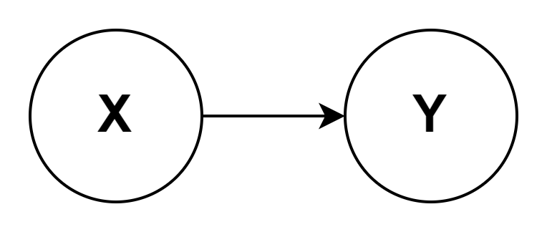
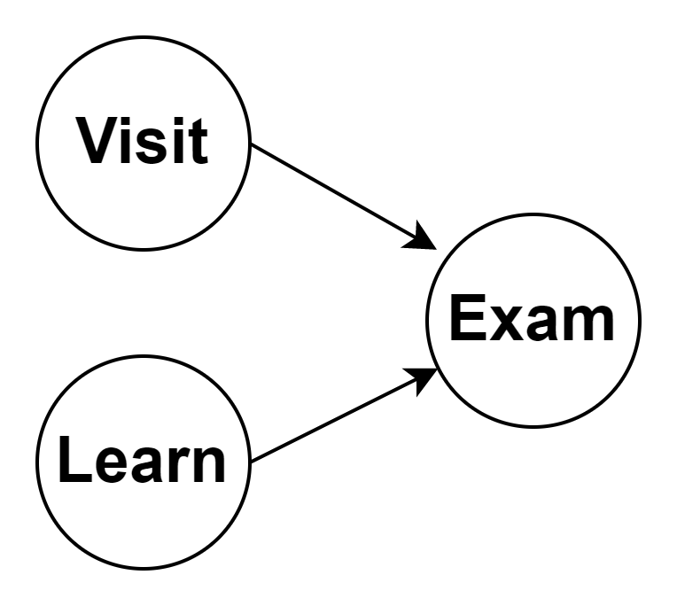


Causal diagrams
cause
(hypothesis)
(feature)
effect
(evidence)
(target)
Causal diagrams
Probability of passing the exam ($E$)
based on student visited lectures ($V$)
based on student learned for exam ($L$)
Bayes theorem
$$P\left(Y | X\right)=\frac{P\left(X | Y\right)∗P(Y)}{P(X)}$$
Multiple causes situation
(aka Bayesian
evidence iteration)

Slide 5



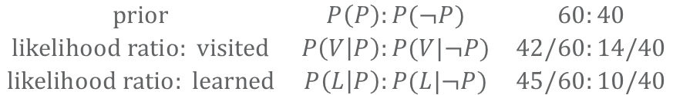

Calculating the conditionals from data
passed
(60)
Data:
id
features
other
failed
25
target
9
student | visited | learned | passed
John | 1 | 1 | 1
Julia | 0 | 1 | 1
Jinny | 1 | 1 | 1
Josh | 1 | 0 | 0
…
counting the students
N=100
6
9
36
5
9
1
visited
(50)
learned
(55)
counts
$$\begin{matrix}prior & P\left(P\right):P(¬P) & 60:40 \\ likelihood ratio: visited & P\left(V | P\right):P(V|¬P) & 42/60:14/40 \\ likelihood ratio: learned & P\left(L | P\right):P(L|¬P) & 45/60:10/40\end{matrix}$$
$$\begin{matrix}3:2 \\ 2:1 \\ 3:1\end{matrix}$$
$$reality:$$
$$36:9=4:1$$
$$80\%$$
$$\begin{matrix}passed given visited and learned & P\left(P | V,L\right):P(¬P|V,L) & 9:1\end{matrix}$$
$$90\%$$

Slide 6
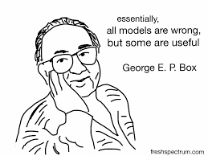
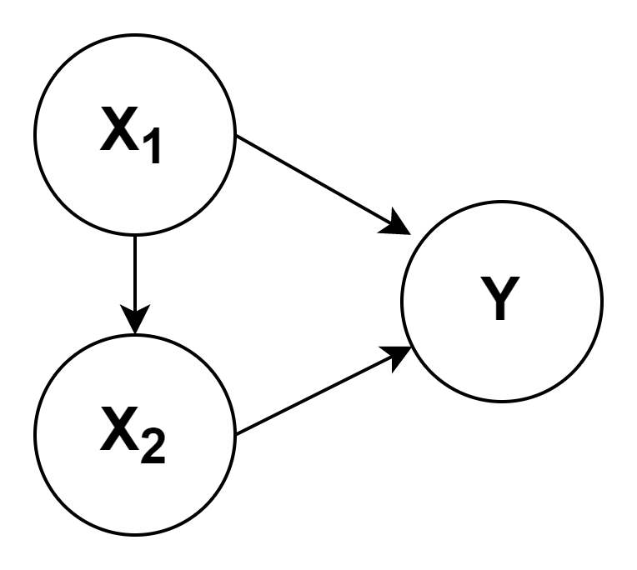
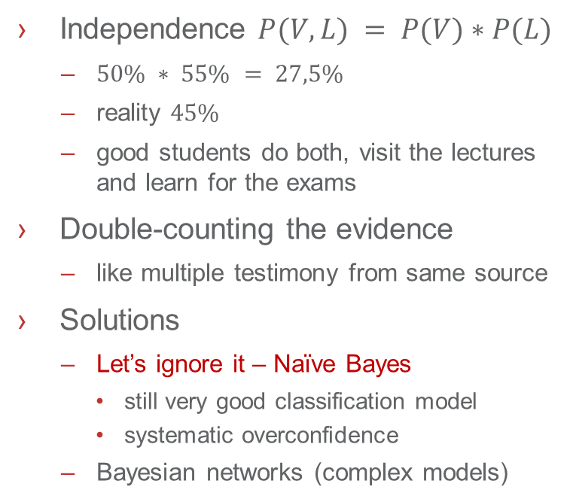
Where is the problem?
passed
(60)
Independence $P(V,L) = P(V)∗P(L)$
$50\% ∗ 55\% = 27,5\%$
reality $45\%$
good students do both, visit the lectures and learn for the exams
Double-counting the evidence
like multiple testimony from same source
Solutions
Let’s ignore it – Naïve Bayes
still very good classification model
systematic overconfidence
Bayesian networks (complex models)
other
failed
25
9
6
9
36
5
9
1
visited
(50)
learned
(55)

Slide 7
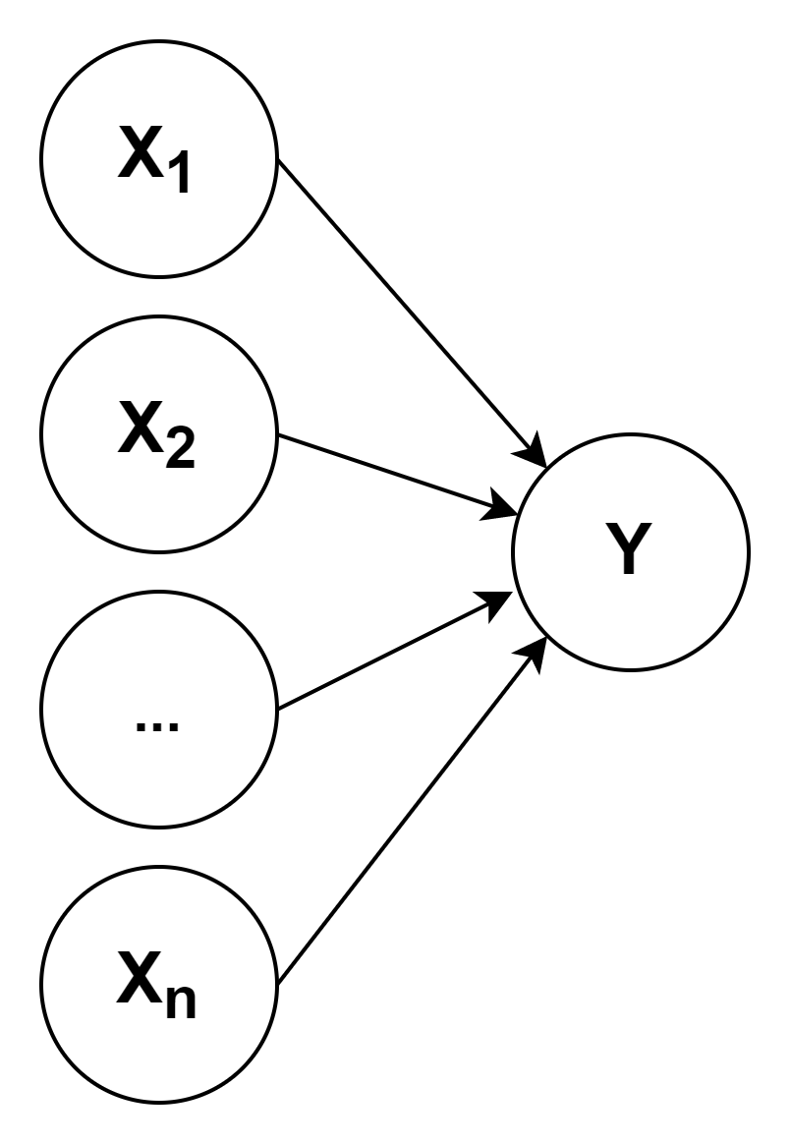
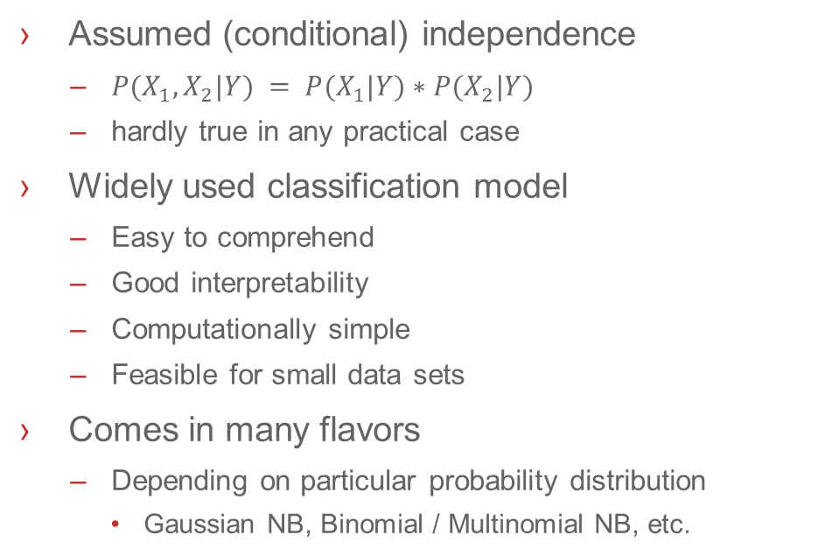
Naïve Bayes Classifier
Assumed (conditional) independence
$P(X_{1},X_{2}|Y) = P(X_{1}|Y)∗P(X_{2}|Y)$
hardly true in any practical case
Widely used classification model
Easy to comprehend
Good interpretability
Computationally simple
Feasible for small data sets
Comes in many flavors
Depending on particular probability distribution
Gaussian NB, Binomial / Multinomial NB, etc.

Slide 8
Text mining
input
features
output
plain text
preprocess
words, n-grams
model
class, decision, (probability)
I am nigerian prince.
Buy my VIAGRA to
enlarge your p e n i s.
nigerian viagra …
spam: 99,99%
vi, ag, ra, nig, pr …
Text mining is a large field with hundreds of sophisticated methods
Sometimes simple approaches work
keywords, n-grams (shingles) tf-idf statistics, cosine similarity, etc.
why n-grams? robust to declinations, spell errors, etc.

Slide 9
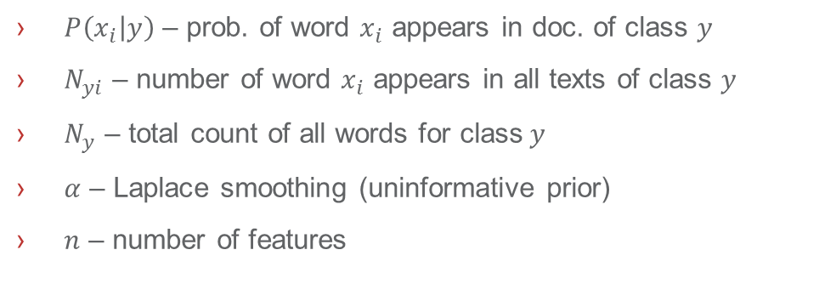
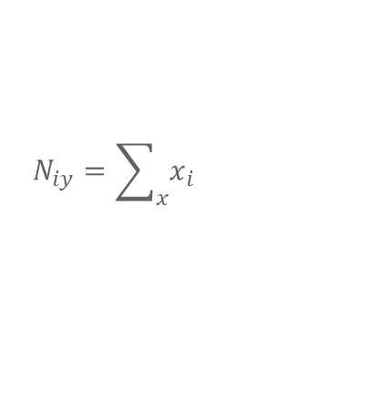
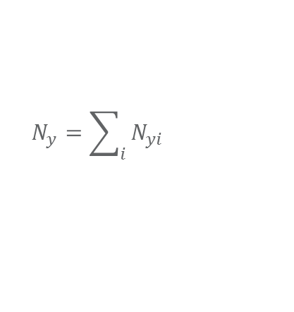

Multinomial Naïve Bayes Classifier
$P\left(y | x_{i}..x_{j}\right)=\frac{P\left(x_{i} | y\right)…P\left(x_{j} | y\right)∙P(y)}{P\left(x_{i}\right)…P\left(x_{j}\right)}∝$ $P\left(x_{i} | y\right)…P\left(x_{j} | y\right)∙P(y)$
normalization
likelihoods
prior
$$P\left(x_{i} | y\right)=\frac{N_{yi}+α}{N_{y}+αn}$$
$$N_{y}=\sum_{i}{N_{yi}}$$
$$N_{iy}=\sum_{x}{x_{i}}$$
$P\left(x_{i} | y\right)$ – prob. of word $x_{i}$ appears in doc. of class $y$
$N_{yi}$ – number of word $x_{i}$ appears in all texts of class $y$
$N_{y}$ – total count of all words for class$y$
$α$ – Laplace smoothing (uninformative prior)
$n$ – number of features

Slide 10
Tasks
pull the repository from
github.com/profinit/MFF-DS
open the directory
practice/week_8_nbayes
follow the instructions in the notebook
naive_bayes.ipynb
the correct answers can be found in
naive_bayes_results_1.ipynb
naive_bayes_results_2.ipynb
naive_bayes_results.ipynb

Slide 11
Diskuze

