Slide 1

Unit Testing
Building Rock-Solid Software
SoftUni Team
Technical Trainers
Software University
https://softuni.bg

Slide 2
Table of Contents
What is Testing?
What is Unit Testing?
Unit Testing Basics
3A Pattern
Good Practices
Unit Testing Framework – unittest
Mocking
2
Notes:
2

Slide 3
Questions
sli.do #python-advanced

Slide 4

Testing
What is Testing

Slide 5
What is Testing? (1)
The first level of software testing
The smallest testable parts of a software are tested
Validates that each unit of the software performs as designed
Types of testing:
unit testing
integration testing
system testing

Slide 6
What is Testing? (2)
Testing changes the convention of writing code:
Less abstract
Тest specific cases
Triple A pattern:
Arrange
Act
Assert

Slide 7
Drawbacks from Manual Testing
Not structured
Not repeatable
Less accuracy
Not as easy as it should be
Requires more time and resources

Slide 8
Moving Away from Manual Testing
We need a structured approach that:
Allows refactoring
Reduces the cost of change
Decreases the number of defects in the code
Bonus:
Improves design

Slide 9

What is Unit Testing?

Slide 10
What is Unit Testing?
Unit Testing is a type of software testing where individual units or components of a software are tested
The purpose is to validate that each unit of the software code performs as expected
Unit Testing is done during the development (coding phase) of an application by the developers

Slide 11
Automated Testing
Done through an automation tool
Higher accuracy
Better reporting capabilities
Increased coverage
Improved bug detection
Increased reusability
Stability

Slide 12

Unit Testing Framework

Slide 13
Unit Testing Framework
Individual units or components are being tested
Validate each unit to perform as expected
A unit may be an individual:
function
method
procedure
modules
object

Slide 14
Concepts Behind unittest (1)
test fixture
A baseline for running tests to ensure there is a fixed environment in which tests are run so that results are repeatable
test case
A set of conditions used to determine if a system works correctly
test suite
A collection of testcases used to test a software if it has some specified set of behaviors

Slide 15
Concepts Behind unittest (2)
test runner
A component which sets up the execution of tests and provides the outcome to the user
import unittest
class SimpleTest(unittest.TestCase): def test_upper(self): expected_value = 'FOO' self.assertEqual('foo'.upper(), expected_value)
if __name__ == '__main__':
unittest.main()

Slide 16
Running the Tests (1)
Run by the following block of code
Results printed on the console
if __name__ == '__main__':
unittest.main()
----------------------
Ran 1 test in 0.00s
OK
Test outcome

Slide 17
Running the Tests (2)
The possible outcomes are
OK – all tests passed
FAIL – one or many tests failed and an AssertionError exception is raised
ERROR – the tests raised an exception other than AssertionError

Slide 18
Basic Unittest Terms (1)
unittest.TestCase – create test cases by subclassing it
assertEqual() – checks if the result obtained is equal to the expected result
assertTrue() / assertFalse() – verifies if a given statement is True or False

Slide 19
Basic Unittest Terms (2)
assertRaises() – raises a specific exception
unittest.main() – provides a command-line interface to the test script
setUp() – prepares the test fixture
The method is called immediately before the test method

Slide 20
Test Example (1)
import unittesting
from test import Person
class PersonTests(unittest.TestCase):
def setUp(self):
self.person = Person("John", "Doe", 35)
def test_init(self):
self.assertEqual(self.person.first_name, "John") self.assertEqual(self.person.last_name, "Doe") self.assertEqual(self.person.age, 35)

Slide 21
Test Example (2)
def test_get_full_name(self): result = self.person.get_full_name() expected_result = "John Doe" self.assertEqual(result, expected_result) def test_get_info(self): result = self.person.get_info() expected_result = "John Doe is 35 years old" self.assertEqual(result, expected_result) if __name__ == "__main__": unittest.main()

Slide 22

Mocking

Slide 23
What is Mocking?
In simple English, Mocking is make a replica or imitation of something
In programming an object that you want to test may have dependencies on other complex objects
Used to:
simulate the behavior of the real objects
isolate the behavior of an object
Based on the 'action -> assertion' pattern
Designed for use with unittest

Slide 24
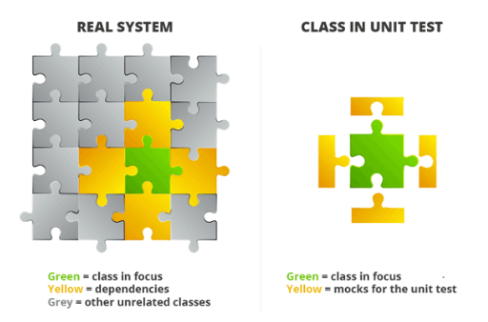
Mocking Example
In unit testing we want to test methods of one class in isolation, but classes are not isolated
They are using services and methods from other classes
We mock the services and methods from other classes and simulate the real behavior

Slide 25
Mocking in Python
In python we use a package called unittest.mock
For example, to test an abstract class, we can use mocking
from abc import ABC,abstractmethod
class Animal(ABC):
@abstractmethod
def move(self):
pass
import unittest
from unittest import mock
class TestAnimal(unittest.TestCase):
@mock.patch.multiple(Animal,
__abstractmethods__=set())
def setUp (self):
self.animal = Animal() # Ha!

Slide 26

How to Write Good Tests
Unit Testing Best Practices

Slide 27
Assertion Messages
Assertions can show messages
Helps with diagnostics
Assertion message
def test_get_info(self):
result = self.person.get_info()
expected_result = "John Doe is 35 years old"
self.assertEqual(result, expected_result)

Slide 28
DRY: Don't Repeat Yourself
class DogTests(unittest.TestCase):
def setUp(self):
self.dog = Dog("Pug", 4)
def test_init(self):
self.assertEqual(self.dog.species, "Pug")
self.assertEqual(self.dog.age, 4)
def test_get_full_info(self):
result = self.dog.get_full_info()
expected_result = "Dog: Pug, 4 years old")
self.assertEqual(result, expected_result)
Executes before each test

Slide 29


Naming Tests
Test names
Should use business domain terminology
Should be descriptive and readable
test_increment_Number(self): …
test_Test1(self): …
testTransfer(self): …
test_deposit_Xleva_should_increase_balance_with_Xleva(self): …
test_deposit_negativeLeva__should_not_increase_balance(self): …

Slide 30

Seven Testing Principles

Slide 31
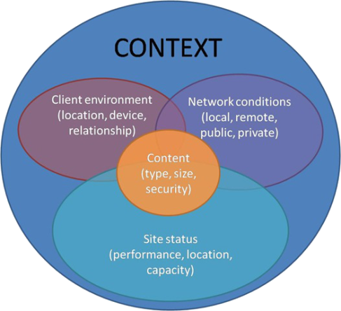
Seven Testing Principles (1)
Testing is context dependent
Testing is done differently in different contexts
Example:
Safety-critical software is tested differently from an e-commerce site

Slide 32
Seven Testing Principles (2)
Exhaustive testing is impossible
All combinations of inputs and preconditions are usually almost infinite number
Testing everything is not feasible
Except for trivial cases
Risk analysis and priorities should be used to focus testing efforts

Slide 33
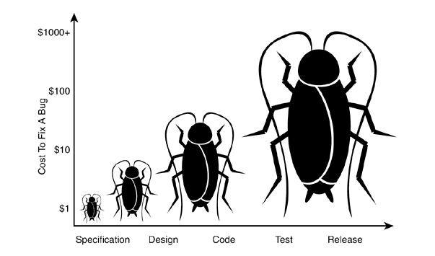
Seven Testing Principles (3)
Early testing is always preferred
Testing activities shall be started as early as possible
And shall be focused on defined objectives
The later a bug is found – the more it costs!

Slide 34
Seven Testing Principles (4)
Defect clustering
Testing effort shall be focused proportionally
To the expected and later observed defect density of modules
A small number of modules usually contains most of the defects discovered
Responsible for most of the operational failures
Notes:
In your opinion which operation is most likely to cause your Operation system to fail?
- Opening Microsoft Word
- Open IE
- Opening 10 different application all at the same time

Slide 35
Seven Testing Principles (5)
Pesticide paradox
Same tests repeated over and over again tend to lose their effectiveness
Previously undetected defects remain undiscovered
New and modified test cases should be developed

Slide 36
Seven Testing Principles (6)
Testing shows presence of defects
Testing can show that defects are present
Cannot prove that there are no defects
Appropriate testing reduces the probability for defects

Slide 37
Seven Testing Principles (7)
Absence-of-errors fallacy
Finding and fixing defects itself does not help in these cases:
The system built is unusable
Does not fulfill the user needs and expectations

Slide 38

Summary
…
…
…
Unit Testing helps us build solid code
Structure your unit tests – 3A Pattern
Use different assertions depending on the situation
Concepts behind the unittest framework

Slide 39
Questions?
Notes:
39

Slide 40












SoftUni Diamond Partners

Slide 41




SoftUni Organizational Partners

Slide 42
Trainings @ Software University (SoftUni)
Software University – High-Quality Education, Profession and Job for Software Developers
softuni.bg, softuni.org
Software University Foundation
softuni.foundation
Software University @ Facebook
facebook.com/SoftwareUniversity
Software University Forums
forum.softuni.bg
Notes:
42

Slide 43

License
This course (slides, examples, demos, exercises, homework, documents, videos and other assets) is copyrighted content
Unauthorized copy, reproduction or use is illegal
© SoftUni – https://softuni.org
© Software University – https://softuni.bg
Notes:
43

