Slide 1

URL's and Templates
SoftUni Team
Technical Trainers
Software University
https://softuni.bg

Slide 2
Table of Contents
What is URL
The views.py file
The urls.py file
Templates
2

Slide 3
Have a Question?
sli.do
#python-web

Slide 4

What is URL

Slide 5
What are URL's
A Uniform Resource Locator (URL) is a reference to a web resource that specifies its location on a network and a mechanism for retrieving it
A URL is a specific type of URI (Uniform Resource Identifier) although many people use the two terms interchangeably

Slide 6
URL Structure
protocol
root domain
subdirectory
https://www.example.com/blog/page-name
sub domain
top level domain
file name

Slide 7
URL's in Django
In Django we use the path function from django.urls
After creating your project, in the urls.py there are already some URL configurations
from django.contrib import admin
from django.urls import path
urlpatterns = [
path('admin/', admin.site.urls)
]
action (function that needs to be executed)
url

Slide 8

The views.py file

Slide 9
What the views.py file does
In the views.py file of our application we implement the logic that needs to happen when a given URL is reached
The names of the functions are usually related to the URL that is being reached

Slide 10
Simple Example
views.py (in the app)
urls.py(in the project)
from django.shortcuts import render
from django.http import HttpResponse
# Create your views here.
def index(req):
return HttpResponse("It Works!")
from django.contrib import admin
from django.urls import path
from {app_name} import views
urlpatterns = [
path('admin/', admin.site.urls),
path('app/', views.index)
]

Slide 11
The urls.py file
Creating urls.py file for each app

Slide 12
What the urls.py file does
In the urls.py file you configure what function or logic should be executed when accessing a given URL in your apps
Usually every app you have in your project has it's own urls.py file
That file can then be imported in your project urls.py file using the include function

Slide 13
Simple Example
Using the previous example, we can refactor the code to use include
urls.py (in the app)
urls.py(in the project)
from django.urls import path
from {app_name} import views
urlpatterns = [
path('', views.index)
]
from django.contrib import admin
from django.urls import path, include
urlpatterns = [
path('admin/', admin.site.urls),
path('app/', include('{app_name}.urls'))
]

Slide 14

Templates
Generate HTML Dynamically

Slide 15
What is a Template
Being a web framework, Django needs a convenient way to generate HTML dynamically
The most common approach relies on templates
A template contains the static parts of the desired HTML output as well as some special syntax describing how dynamic content will be inserted

Slide 16
Creating a Template Folder
In order to use templates, we need a special folder where we create them
After the folder is created, you have to add some configurations in the settings.py file
For the purpose we define a TEMPLATES_DIR variable which stores the path to the templates folder

Slide 17
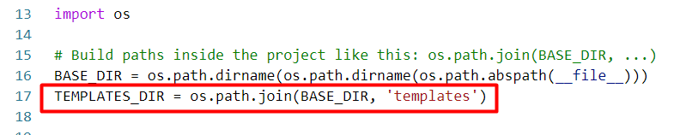
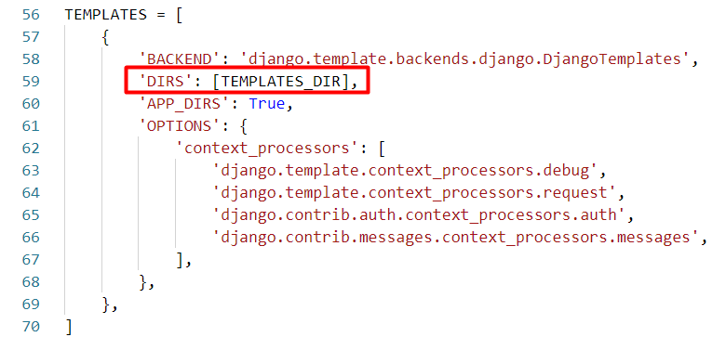
Configuring the Templates Directory
The name of the templates folder

Slide 18
Creating a Template
Now you can create .html files that will be the templates
index.html
<html lang="en">
<head>
<meta charset="UTF-8">
<title>Django App</title>
</head>
<body>
<h1>The App works!</h1>
</body>
</html>

Slide 19
Rendering a Template
Now that we created a template, we want to refactor the views.py file in the app
Instead of using HttpResponse, we can now use the render function that will show the template we created
from django.shortcuts import render
# Create your views here.
def index(req):
return render(req, 'index.html')

Slide 20
Adding Context
The render function can receive a context which is a dictionary passed to the template
We can then use this dictionary to display data dynamically in the template
We use {{}} as a syntax for dynamically rendering data in the templates

Slide 21
Context Example
views.py (in the app)
index.html
from django.shortcuts import render
# Create your views here.
def index(req):
context = { 'app_name': 'my_first_app'
}
return render(req, 'index.html', context=context)
<html lang="en">
<head>
<meta charset="UTF-8">
<title>Django App</title>
</head>
<body>
<h1>The {{ app_name }} works!</h1>
</body>
</html>

Slide 22
Basic Template Logic
As in our python code, in the templates we can also have programming logic
Using programming logic in the templates allows us to render different html based on some conditions
On the next slides you will see examples of for loops and if statements in templates

Slide 23
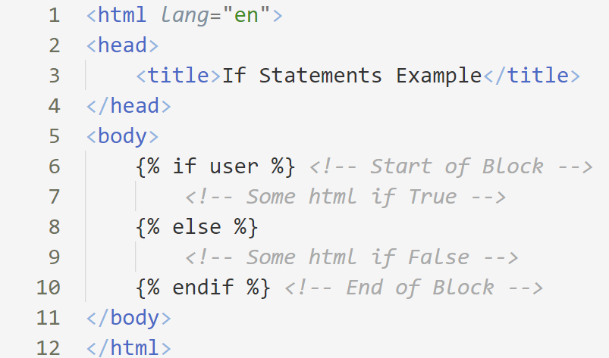
Example: If Statement
Assuming we pass as context: {"user": "Peter"}
If "user" was passed as context and is evaluated to True

Slide 24
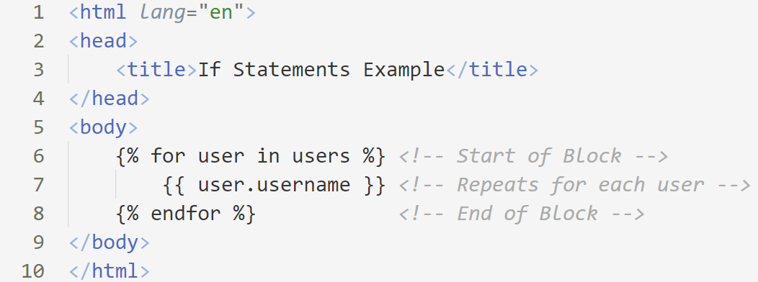
Example: For Loop
Assuming we pass as context: {"users": [{"username": "Peter"}, {"username": "George"}]}

Slide 25

Summary
URL is a reference to a web resource
The views.py file contains the logic for when a given URL is reached
The urls.py file uses the views.py file to configure the URL's
Templates are used to generate HTML dynamically

Slide 26
Questions?
Notes:
26

Slide 27












SoftUni Diamond Partners

Slide 28




SoftUni Organizational Partners

Slide 29

License
This course (slides, examples, demos, exercises, homework, documents, videos and other assets) is copyrighted content
Unauthorized copy, reproduction or use is illegal
© SoftUni – https://softuni.org
© Software University – https://softuni.bg
Notes:
29

Slide 30
Trainings @ Software University (SoftUni)
Software University – High-Quality Education, Profession and Job for Software Developers
softuni.bg, softuni.org
Software University Foundation
softuni.foundation
Software University @ Facebook
facebook.com/SoftwareUniversity
Software University Forums
forum.softuni.bg
30
Notes:
30

