Slide 1

Forms
SoftUni Team
Technical Trainers
Software University
https://softuni.bg

Slide 2
Table of Contents
Forms
Django Forms
Built-in widgets
Forms with views
CRTF token
Bots and bot catchers
Custom validation functions
Django Validators
2

Slide 3
Have a Question?
sli.do
#python-web

Slide 4

Forms

Slide 5
What is a HTML form?
Document which stores information of a user on a web server using interactive controls
Contains different kind of information: username, password, etc.
The elements used in an HTML form are check box, input box, radio buttons, submit buttons etc
5

Slide 6
Bound and Unbound
A Form instance is either bound to a set of data, or unbound.
unbound:
Cannot do Validation
bound to a set of data:
Capable of validating that data and rendering the form as HTML with the data displayed in the HTML
6

Slide 7
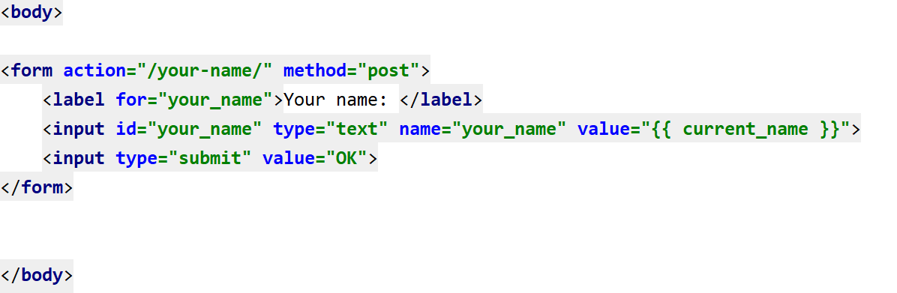
Example
7

Slide 8
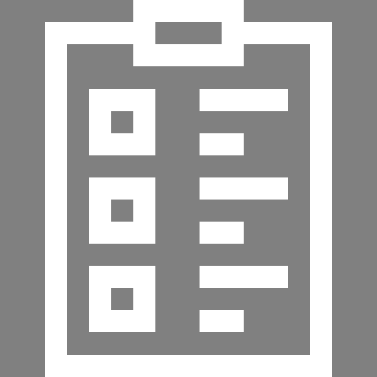
Django Forms

Slide 9
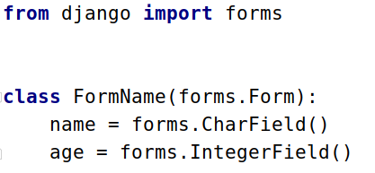
Django Forms Advantages
Quickly generate HTML form widgets
Validate data and process it into a Python data structure
Create form versions of our Models
Quickly update models from Forms
9

Slide 10
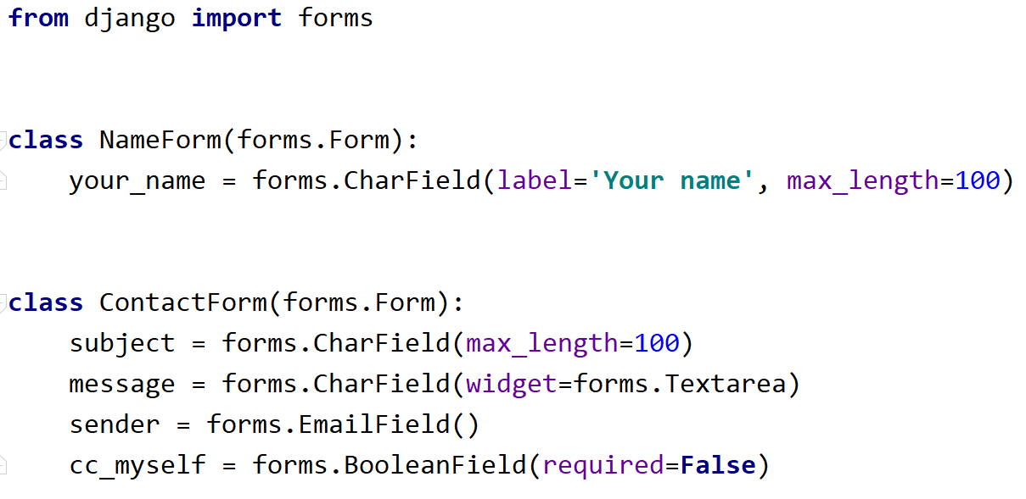
Example
10

Slide 11
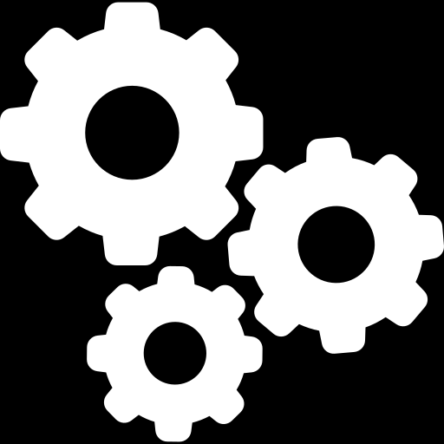
Built-in Widgets

Slide 12
Widgets
Django's representation of an HTML input element
Widgets documentation
Types of widgets:
Textarea
PasswordInput
It handles:
the rendering of the HTML
the extraction of data from GET/POST dictionary
12

Slide 13
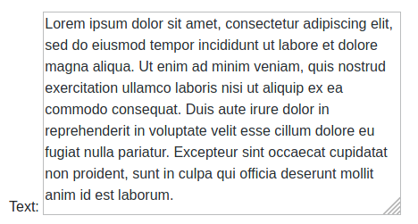

Widget: Textarea
Used to larger text
Able to be expanded
13

Slide 14



Widget: PasswordInput
Converts the text into password
14

Slide 15
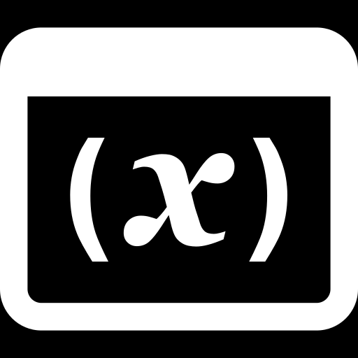
Forms with Views

Slide 16

Bootstrap
CSS Framework
Developing Responsive
Mobile-first websitesa
Booststrap 4 website
16

Slide 17
CRTF token
Cross-site Request Forgery protection
Cross-site request forgeries:
type of malicious exploit
unauthorized commands are performed on behalf of an authenticated users
More about Cross-site Request Forgery
17

Slide 18

Custom Form Validators

Slide 19
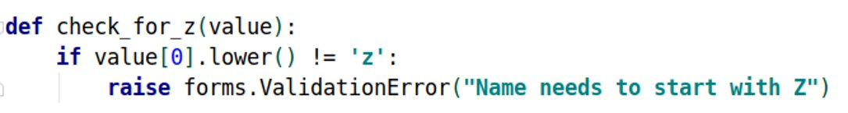
Validation
Form validation happens when the data is cleaned
Validators are functions
Takes a single argument and raises ValidationError on invalid input
19

Slide 20
Built-in Validators
Collection of callable validators
Form validation happens when the data is cleaned
Validators are functions
Takes a single argument and raises ValidationError on invalid input
Validators can be used for reusing validation logic between different types of fields
20

Slide 21
Example: Django Validators
EmailValidator
URLValidator
MinValueValidator / MaxValueValidator
MinLengthValidator / MaxLengthValidator
RegexValidator
21

Slide 22

Bots and Bot Catchers

Slide 23
What are bots?
Also called "web crawlers"
Bots are software application that run automated scripts
Perform simple and structurally repetitive tasks
Indexing a search engine
Gathering information much faster
23

Slide 24
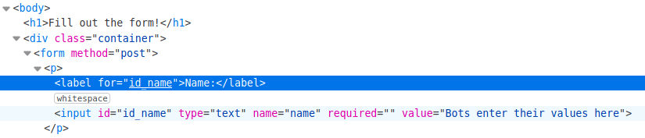

What are bots? (2)
24

Slide 25
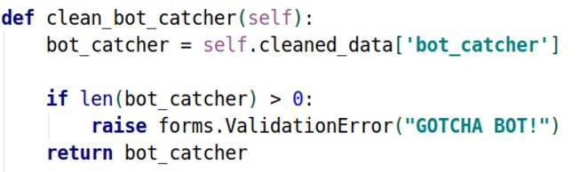
Bot catchers
User created forms
Used to catch malicious bots on our website
25

Slide 26
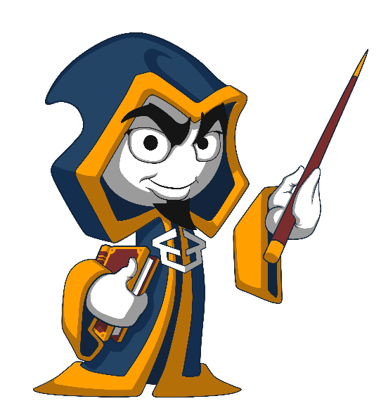
Summary
…
…
…
Forms
Widgets
CRTF
Bots
Botcatchers
Validating data
Django Validators

Slide 27
Questions?
Notes:
27

Slide 28












SoftUni Diamond Partners

Slide 29



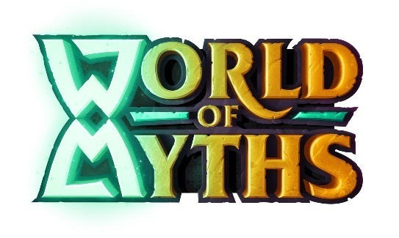
SoftUni Organizational Partners

Slide 30

License
This course (slides, examples, demos, exercises, homework, documents, videos and other assets) is copyrighted content
Unauthorized copy, reproduction or use is illegal
© SoftUni – https://softuni.org
© Software University – https://softuni.bg
Notes:
30

Slide 31
Trainings @ Software University (SoftUni)
Software University – High-Quality Education, Profession and Job for Software Developers
softuni.bg, softuni.org
Software University Foundation
softuni.foundation
Software University @ Facebook
facebook.com/SoftwareUniversity
Software University Forums
forum.softuni.bg
31
Notes:
31

