Slide 1

Model Forms
Binding forms with models
SoftUni Team
Technical Trainers
Software University
https://softuni.org

Slide 2
Table of Contents
The ModelForm Class
Using Model Forms
Validation on Model Forms
2
Notes:
2

Slide 3
Have a Question?
sli.do
#python-web
Notes:
3

Slide 4

The ModelForm Class

Slide 5
The ModelForm Class
In most cases when we have a database-driven app, the forms we create overlap with our models
In this case, we might want to skip defining the field types of our forms, because we already defined them in the model
For this reason, we use the ModelForm helper class

Slide 6
Example: ModelForm
from django.forms import ModelForm
from my_app.models import Book
class BookForm(ModelForm):
class Meta:
model = Book
fields = ['title', 'pages', 'author']

Slide 7

Using Model Forms

Slide 8
Create a Book Model
First, we create a simple model called Book
from django.db import models
class Book(models.Model):
title = models.CharField(max_length=20)
pages = models.IntegerField(default=0)
description = models.CharField(max_length=100, default="")
author = models.CharField(max_length=20)

Slide 9
Creating the Model Form
After that, we create the model form
from django import forms
from app.models import Book
class BookForm(forms.ModelForm):
class Meta:
model = Book
fields = '__all__'
widgets = {
'title': forms.TextInput(attrs={'class': 'form-control'}),
'pages': forms.NumberInput(attrs={'class': 'form-control'}),
'author': forms.TextInput(attrs={'class': 'form-control'}),
'description': forms.Textarea(attrs={'class': 'form-control'})
}
Include all fields from the model
Add styling using bootstrap

Slide 10
Create View
def create(req):
if req.method == "GET":
form = BookForm()
return render(req, 'create.html', {'form': form})
else:
form = BookForm(req.POST)
if form.is_valid():
book = form.save()
book.save()
return redirect('index')

Slide 11
Edit View
def edit(req, id):
book = Book.objects.get(pk=id)
if req.method == "GET":
form = BookForm(instance=book)
return render(req, 'edit.html', {'form': form})
else:
form = BookForm(req.POST, instance=book)
if form.is_valid():
book = form.save()
book.save()
return redirect('index')

Slide 12
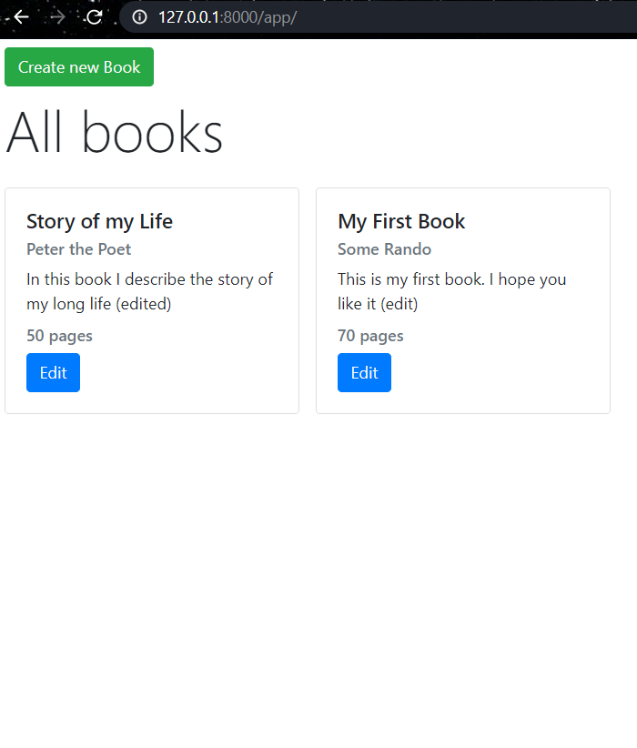
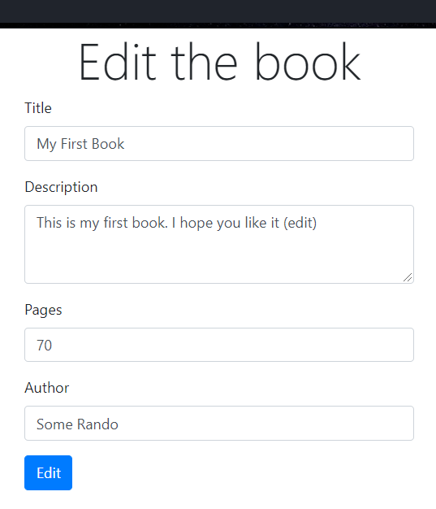
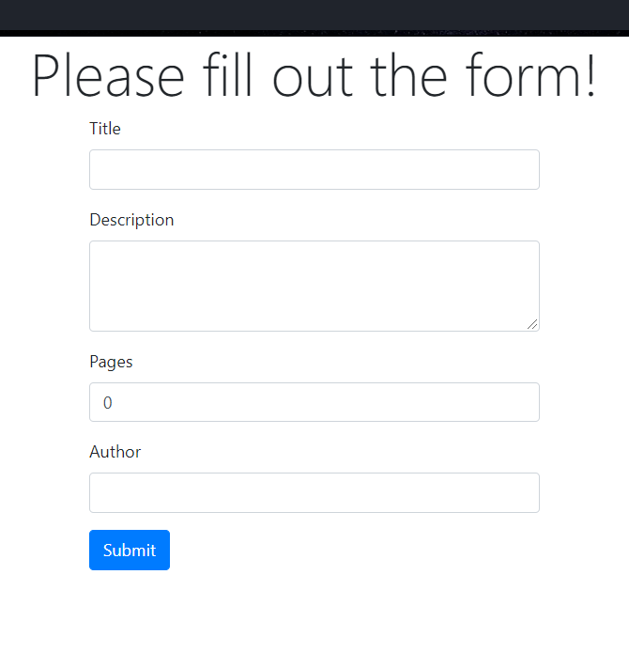
The Result

Slide 13

Live Demo
Using Model Forms

Slide 14

Validating Model Forms

Slide 15
Validating Model Forms
There are two ways to make form validation in ModelForm
Validation in the Model
Validation in the Form
To validate a form, we can override the clean() method
To validate the model, we can create custom field validators

Slide 16
Validating the Form
To make form validations, we can override the clean() method
def clean(self):
if not isinstance(self.cleaned_data['pages'], int):
raise ValidationError('Pages must be a number')
if self.cleaned_data['pages'] <= 0:
raise ValidationError ('Pages cannot be zero or negative')
return self.cleaned_data

Slide 17
Validating the Model (1)
We can make a validators.py file that will contain our validation functions
from django.core.exceptions import ValidationError
def pages_validator(value):
if value <= 0:
raise ValidationError ('Pages cannot be zero or negative')

Slide 18
Validating the Model (2)
After that, we can add the validator in our model
from django.db import models
from app.validators import pages_validator
class Book(models.Model):
title = models.CharField(max_length=20)
pages = models.IntegerField(default=0, validators=[pages_validator])
description = models.CharField(max_length=100, default="")
author = models.CharField(max_length=20)

Slide 19
Live Demo
Validating Model Forms

Slide 20

Summary
Most of the times we might want to skip defining the field types of our forms
For this reason, we use the ModelForm helper class
To validate a form, we can override the clean() method
To validate the model, we can create custom field validators
Notes:
20

Slide 21
Questions?
Notes:
21

Slide 22












SoftUni Diamond Partners
Notes:
22

Slide 23




SoftUni Organizational Partners
Notes:
23

Slide 24

License
This course (slides, examples, demos, exercises, homework, documents, videos and other assets) is copyrighted content
Unauthorized copy, reproduction or use is illegal
© SoftUni – https://softuni.org
© Software University – https://softuni.bg
Notes:
24

Slide 25
Trainings @ Software University (SoftUni)
Software University – High-Quality Education, Profession and Job for Software Developers
softuni.bg, softuni.org
Software University Foundation
softuni.foundation
Software University @ Facebook
facebook.com/SoftwareUniversity
Software University Forums
forum.softuni.bg
Notes:
25

