Slide 1


Unit and Integration Testing
SoftUni Team
Technical Trainers
Software University
https://softuni.bg

Slide 2
Table of Contents
Unit vs. Integration Testing
Best Practices
Structure
Packages and Setup
Testing in Django
2

Slide 3
Have a Question?
sli.do
#python-web

Slide 4

Unit vs. Integration Testing

Slide 5
Difference
Unit Testing - isolated tests that test one specific function
Integration Testing - larger tests that focus on user behavior and testing entire applications
Concentrate a lot on unit tests
They are easier to write and the more you have of them, the less integration tests you will need

Slide 6

Best Practices

Slide 7
Best Practices
If a piece of code can break, you must test it
Each test should cover only one function
Keep it simple
Arrange, Act, Assert

Slide 8

Structure

Slide 9
Structure
There are several ways to write tests
Putting everything in the tests.py file and grouping tests by what they test (models, views, forms, etc.)
Or creating a folder test with the different test files for the different functionality that they test (test_forms.py, test_models.py, test_views.py)

Slide 10
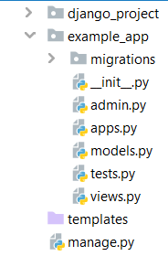
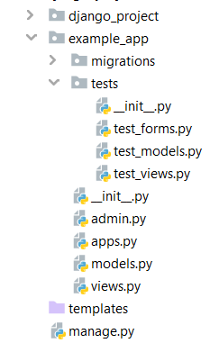
Example
All tests in the tests.py file
All tests in a tests folder
Create tests folder and separate the code
Use tests.py file for each app

Slide 11

Packages and Setup

Slide 12
Packages to Use
django-webtest - makes it much easier to write functional tests and assertions that match the end user's experience
coverage - used for measuring the effectiveness of tests, showing the percentage of your codebase covered by tests
selenium - tests with webdriver. All browsers have to develop webdriver which allows to write a script which will automate interaction between browser and script

Slide 13
Coverage Installation and Setup
Installing coverage
Add coverage to INSTALLED_APPS
Run your tests
Open report html
pip install coverage
coverage run manage.py test
coverage html

Slide 14
Set Up Selenium
Install selenium using "pip install selenium"
In order to use selenium, we need drivers for the browser we want to use
Download chromedriver for Chrome or geckodriver for Firefox
https://github.com/mozilla/geckodriver/releases # geckodriver
https://chromedriver.chromium.org/downloads # chromedriver

Slide 15

Testing in Django
Code Examples

Slide 16
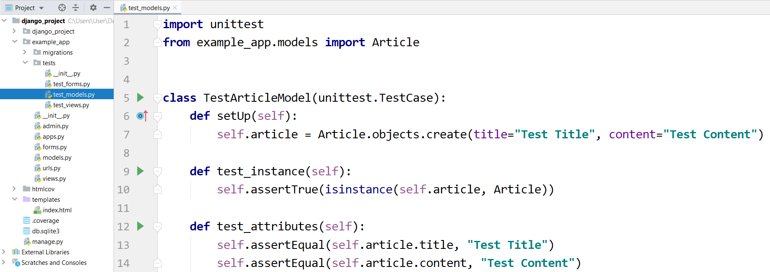
Example: Testing Models

Slide 17
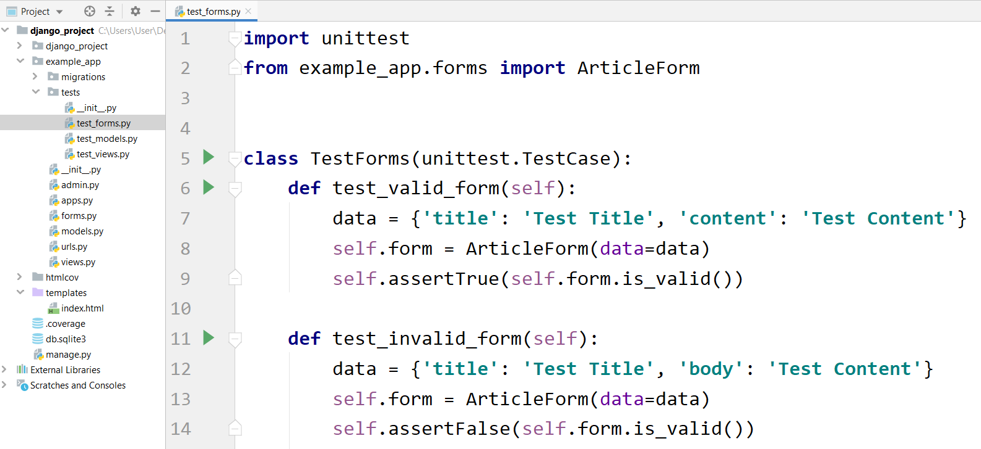
Example: Testing Forms

Slide 18
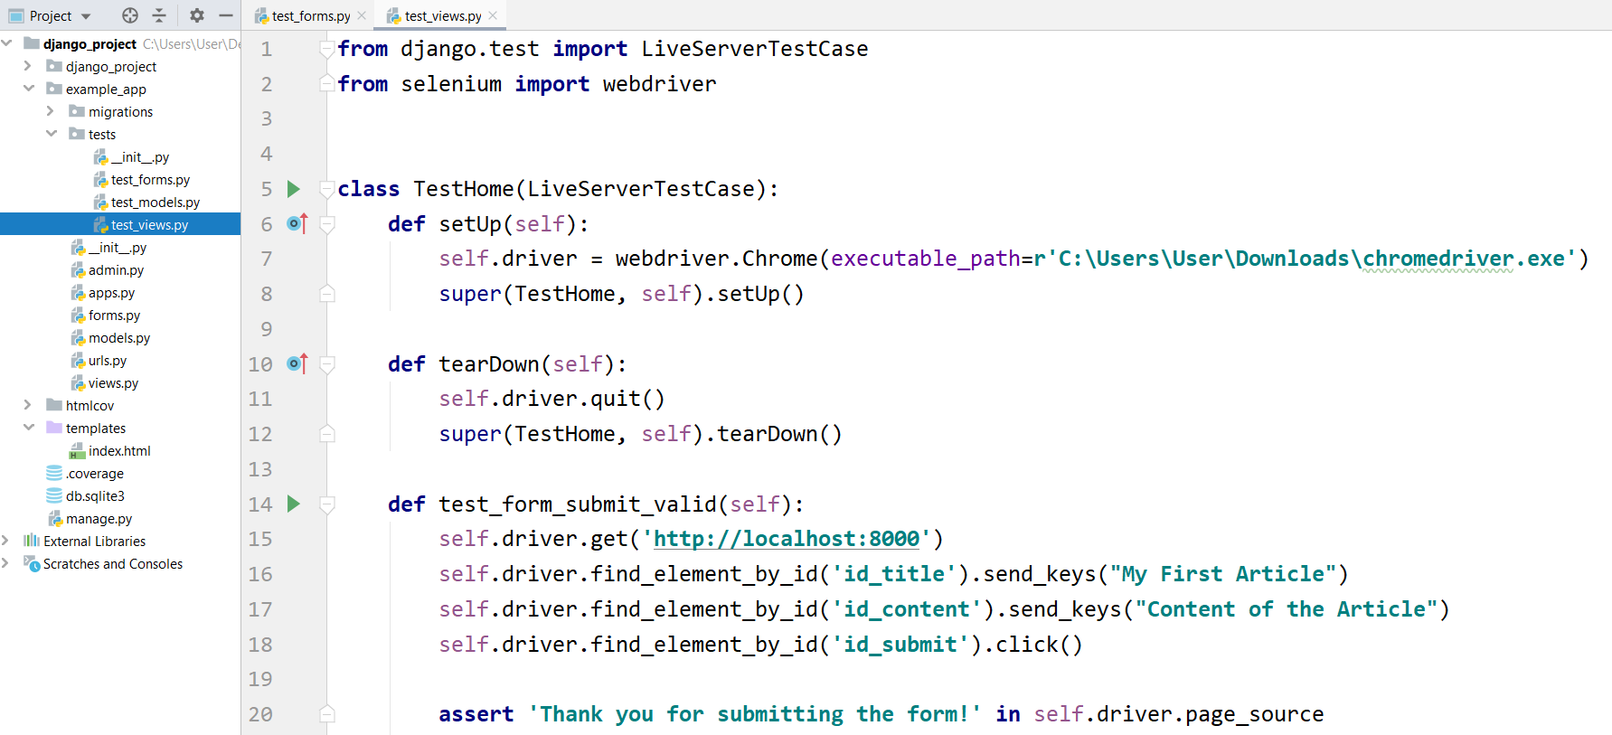
Example: Testing Views
Set up driver

Slide 19

Live Demo
Creating Unit Tests

Slide 20

Summary
Unit Testing - isolated tests that test one specific function
Integration Testing - larger tests that focus on user behavior and testing entire applications
We can use coverage and selenium to help us create tests

Slide 21
Questions?
Notes:
21

Slide 22












SoftUni Diamond Partners

Slide 23




SoftUni Organizational Partners

Slide 24

License
This course (slides, examples, demos, exercises, homework, documents, videos and other assets) is copyrighted content
Unauthorized copy, reproduction or use is illegal
© SoftUni – https://softuni.org
© Software University – https://softuni.bg
Notes:
24

Slide 25
Trainings @ Software University (SoftUni)
Software University – High-Quality Education, Profession and Job for Software Developers
softuni.bg, softuni.org
Software University Foundation
softuni.foundation
Software University @ Facebook
facebook.com/SoftwareUniversity
Software University Forums
forum.softuni.bg
25
Notes:
25

