Slide 1

PostgreSQL
SoftUni Team
Technical Trainers
Software University
https://softuni.bg

Slide 2
Table of Contents
What is PostgreSQL?
Query Basics
Retrieving Data
Writing Data in Tables
Modifying Existing Records
Table Relation
Writing SQL in pgAdmin 4

Slide 3
Questions
sli.do #python-web

Slide 4
PostgreSQL

Slide 5
What is PostgreSQL?
ORDBMS
Open-source descendant of the original Berkeley code
Cross platform
Companies using PostgreSQL:
Netflix
Spotify
Instagram
Reddit

Slide 6
What makes PostgreSQL stand out?
First DBMS that implements multi-version concurrency control feature
Able to add custom functions
Designed to be extensible
Defining custom data types, plugins, ext.
Very active community

Slide 7

Retrieving Data
Using SQL SELECT

Slide 8
Capabilities of SQL SELECT
Projection
Take a subset of the columns
Selection
Take a subset of the rows
Join
Combine tables by
some column
Table 1
Table 2
Notes:
Capabilities of SQL SELECT Statements
A SELECT statement retrieves information from the database. Using a SELECT statement, you can do the following:
Projection: You can use the projection capability in SQL to choose the columns in a table that you want returned by your query. You can choose as few or as many columns of the table as you require.
Selection: You can use the selection capability in SQL to choose the rows in a table that you want returned by a query. You can use various criteria to restrict the rows that you see.
Joining: You can use the join capability in SQL to bring together data that is stored in different tables by creating a link between them. You learn more about joins in a later lesson.

Slide 9
SELECT – Examples
Selecting all columns from the "employees" table
id | first_name | last_name | job_title | department_id | salary
1 | John | Smith | Therapist | 1 | 900
2 | John | Johnson | Acupuncturist | 1 | 880
3 | Smith | Johnson | Technician | 2 | 1100
… | … | … | … | … | …
SELECT * FROM employees;
List of columns
(* for all)
Table name

Slide 10
Concatenation
You can concatenate column names or strings using the concat() function
concat() - returns the string that results from concatenating the
arguments.
String literals are enclosed in ['](single quotes)
Table and column names containing special symbols use [`] (backtick)
SELECT concat(`first_name`,' ',`last_name`) AS 'full_name', `job_title` as 'Job Title',
`id` AS 'No.'
FROM `employees`;
Notes:
Concatenation Operator
You can link columns to other columns, arithmetic expressions, or constant values to create a character expression by using the concatenation operator (+). Columns on either side of the operator are combined to make a single output column.
In the example, FirstName and LastName are concatenated, and they are given the alias FullName. Notice that the employee first name and last name are combined to make a single output column.
The AS keyword before the alias name makes the SELECT clause easier to read.

Slide 11
Concatenation(2)
Another function of concatenation is concat_ws() - stands for
concatenate with separator and is a special form of CONCAT().
Skip any NULL values after the separator argument.
Separator
Arguments
SELECT concat_ws(' ', `first_name`, `last_name`, `job_title`)
AS 'full_name',
`job_title` AS 'Job Title',
`id` AS 'No.'
FROM `employees`;

Slide 12
Filtering the Selected Rows
Use DISTINCT to eliminate duplicate results
You can filter rows by specific conditions using the WHERE clause
Other logical operators can be used for better control
SELECT DISTINCT `department_id`
FROM `employees`;
SELECT `last_name`, `department_id`
FROM `employees`
WHERE `department_id` = 1;
SELECT `last_name`, `salary`
FROM `employees`
WHERE `salary` <= 20000;
Notes:
In the example, the SELECT statement retrieves the name and department number of all employees whose department is 1.
Character strings and dates in the WHERE clause must be enclosed in single quotation marks (''). Number constants, however, should not be enclosed in single quotation marks.

Slide 13
Other Comparison Conditions
Conditions can be combined using NOT, OR, AND and brackets
Using BETWEEN operator to specify a range:
Using IN / NOT IN to specify a set of values:
SELECT `last_name` FROM `employees`
WHERE NOT (`manager_id` = 3 OR `manager_id` = 4);
SELECT `last_name`, `salary` FROM `employees`
WHERE `salary` BETWEEN 20000 AND 22000;
SELECT `first_name`, `last_name`, `manager_id`
FROM `employees`
WHERE `manager_id` IN (109, 3, 16);
Notes:
The BETWEEN Condition
You can display rows based on a range of values using the BETWEEN range condition. The range that you specify contains a lower limit and an upper limit.
The SELECT statement on the slide returns rows from the Employees table for any employee whose base rate is between 40 and 50.
Values specified with the BETWEEN condition are inclusive. You must specify the lower limit first.
The IN Condition
To test for values in a specified set of values, use the IN condition. The IN condition is also known as the membership condition.
The LIKE Condition
You may not always know the exact value to search for. You can select rows that match a character pattern by using the LIKE condition. The character pattern-matching operation is referred to as a wildcard search. Two symbols can be used to construct the search string.
Search conditions can contain either literal characters or numbers:
% denotes zero or many characters.
_ denotes one character.

Slide 14
Comparing with NULL
NULL is a special value that means missing value
Not the same as 0 or a blank space
Checking for NULL values
SELECT `last_name`, `manager_id`
FROM `employees`
WHERE `manager_id` = NULL;
This is always false!
SELECT `last_name`, `manager_id`
FROM `employees`
WHERE `manager_id` IS NULL;
SELECT `last_name`, `manager_id`
FROM `employees`
WHERE `manager_id` IS NOT NULL;
Notes:
Null Values
If a row lacks the data value for a particular column, that value is said to be null, or to contain a null.
A null is a value that is unavailable, unassigned, unknown, or inapplicable. A null is not the same as zero or a space. Zero is a number, and a space is a character.
Columns of any data type can contain nulls. However, some constraints, NOT NULL and PRIMARY KEY, prevent nulls from being used in the column.
In the ManagerID column in the Employees table, notice that managers (like Sanchez) have no ManagerID.
If any column value in an arithmetic expression is null, the result is null. For example, if you attempt to perform division with zero, you get an error. However, if you divide a number by null, the result is a null or unknown.

Slide 15
Sorting with ORDER BY
Sort rows with the ORDER BY clause
ASC: ascending order, default
DESC: descending order
LastName | HireDate
Gilbert | 1998-07-31
Brown | 1999-02-26
Tamburello | 1999-12-12
… | …
SELECT `last_name`, `hire_date`
FROM `employees`
ORDER BY `hire_date`;
LastName | HireDate
Valdez | 2005-07-01
Tsoflias | 2005-07-01
Abbas | 2005-04-15
… | …
SELECT `last_name`, `hire_date`
FROM `employees`
ORDER BY `hire_date` DESC;
Notes:
The ORDER BY Clause
The order of rows returned in a query result is undefined. The ORDER BY clause can be used to sort the rows. If you use the ORDER BY clause, it must be the last clause of the SQL statement. You can specify an expression, or an alias, or column position as the sort condition.

Slide 16
Views – Example
Get employee names and salaries, by department
CREATE VIEW `v_hr_result_set` AS SELECT
CONCAT(`first_name`,' ',`last_name`) AS 'Full Name', `salary`
FROM `employees` ORDER BY `department_id`;
SELECT * FROM `v_hr_result_set`;

Slide 17

Writing Data in Tables
Using SQL INSERT

Slide 18
Inserting Data
Values for
all columns
The SQL INSERT command
Bulk data can be recorded in a single query, separated by comma
INSERT INTO `towns` VALUES (33, 'Paris');
Specify
columns
INSERT INTO projects(`name`, `start_date`)
VALUES ('Reflective Jacket', NOW())
INSERT INTO `employees_projects`
VALUES (229, 1),
(229, 2),
(229, 3), …

Slide 19
Inserting Data (2)
You can use existing records to create a new table
Or into an existing table
New table name
CREATE TABLE `customer_contacts`
AS SELECT `customer_id`, `first_name`, `email`, `phone`
FROM `customers`;
Existing source
List of columns
INSERT INTO projects(name, start_date)
SELECT CONCAT(name,' ', ' Restructuring'), NOW()
FROM departments;

Slide 20

Modifying Existing Records
Using SQL UPDATE and DELETE

Slide 21
Updating Data
The SQL UPDATE command
Note: Don’t forget the WHERE clause!
New values
UPDATE `employees`
SET `last_name` = 'Brown'
WHERE `employee_id` = 1;
UPDATE `employees`
SET `salary` = `salary` * 1.10,
`job_title` = CONCAT('Senior',' ', `job_title`)
WHERE `department_id` = 3;

Slide 22
Deleting Data
Deleting specific rows from a table
Note: Don’t forget the WHERE clause!
Delete all rows from a table (TRUNCATE works faster than DELETE)
Condition
DELETE FROM `employees`
WHERE `employee_id` = 1;
TRUNCATE TABLE users;

Slide 23
Retrieving Related Data
Table 1
Table 2

Slide 24
Joins
Table relations are useful when combined with JOINS
With JOINS we can get data from two tables simultaneously
JOINS require at least two tables and a "join condition"
Example:
Select from Tables
SELECT * FROM table_a JOIN table_b ON table_b.common_column = table_a.common_column
Join Condition

Slide 25
Writing SQL in pgAdmin 4
Demo

Slide 26
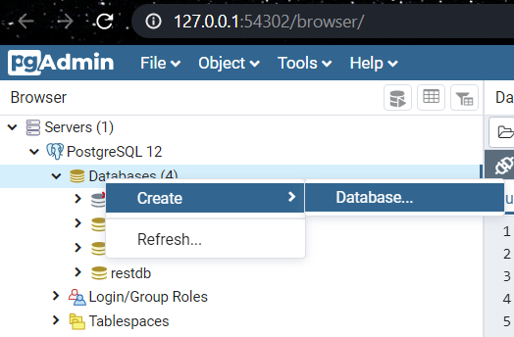
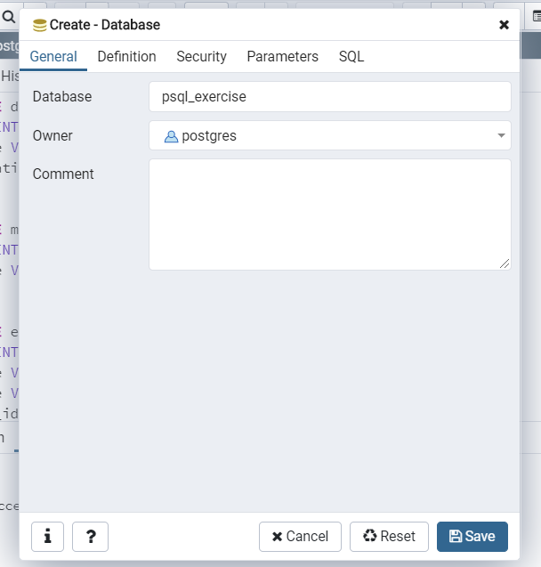
Create Database using pgAdmin 4

Slide 27
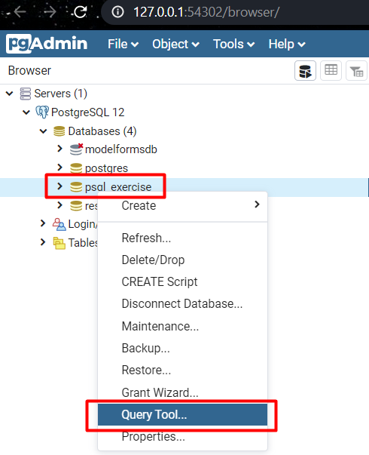
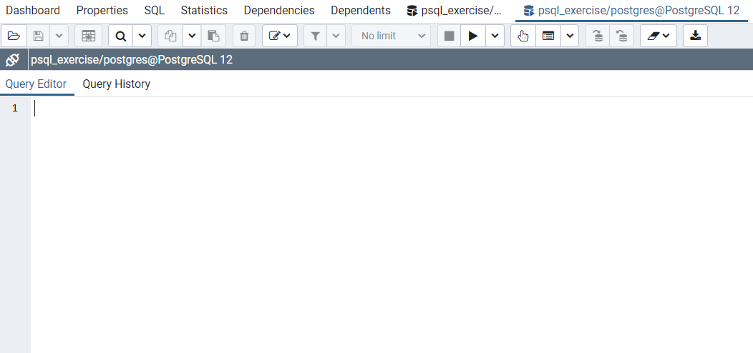
Open the Query Tool
Write SQL here

Slide 28
Example (1)
CREATE TABLE department (
dep_id INTEGER NOT NULL PRIMARY KEY,
dep_name VARCHAR (20),
dep_location VARCHAR (15)
);
CREATE TABLE manager (
man_id INTEGER NOT NULL PRIMARY KEY,
man_name VARCHAR(15)
);

Slide 29
Example (2)
CREATE TABLE employees (
emp_id INTEGER NOT NULL PRIMARY KEY,
emp_name VARCHAR(15),
job_name VARCHAR(10),
manager_id INTEGER,
hire_date DATE,
salary DECIMAL(10, 2),
commission DECIMAL(7, 2),
dep_id INTEGER,
FOREIGN KEY (manager_id) REFERENCES manager(man_id),
FOREIGN KEY (dep_id) REFERENCES department(dep_id)
);

Slide 30
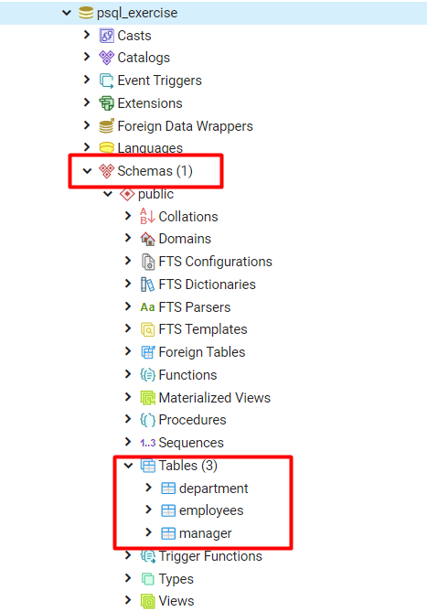
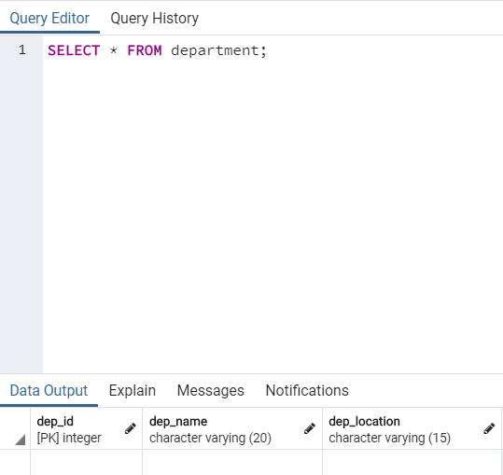
Result

Slide 31

Lab
Live Exercise in Class

Slide 32

Summary
…
…
…
We design databases by specification entities and their characteristics
Types of relations:
One-to-one
One-to-many
Many-to-many
We visualize relations via E/R diagrams

Slide 33
Questions?
Notes:
33

Slide 34












SoftUni Diamond Partners

Slide 35




SoftUni Organizational Partners

Slide 36
Trainings @ Software University (SoftUni)
Software University – High-Quality Education, Profession and Job for Software Developers
softuni.bg, softuni.org
Software University Foundation
softuni.foundation
Software University @ Facebook
facebook.com/SoftwareUniversity
Software University Forums
forum.softuni.bg
Notes:
36

Slide 37

License
This course (slides, examples, demos, exercises, homework, documents, videos and other assets) is copyrighted content
Unauthorized copy, reproduction or use is illegal
© SoftUni – https://softuni.org
© Software University – https://softuni.bg
Notes:
37

